Slide 1
Tips and Tricks: Effectively Manage Your SharePoint Farm with BI
DBI306
Kevin Donovan
Program Manager
Microsoft Corporation

Slide 2
Session Takeaway
The problem: How do I find and monitor environmental data about my SharePoint farm?
Finding data doesn’t have to be hard.
Monitoring farm data doesn’t have to be hard.
Microsoft’s BI tools can help you get there quickly.

Slide 3

Peaceful farm.
http://commons.wikimedia.org/

Slide 4

Alligator farm.
http://commons.wikimedia.org/

Slide 5
Roadmap (It’s all about the data!)
A bit about BI
Data the hard way
This is where we want to go!
1
3
Is 18M rows too much?
Too much data!
SCOM Data
2
4

Slide 6
Quickly put Perfmon data on a PerformancePoint dashboard
demo

Slide 7



BI Areas, Tools and Matchup
Personal BI
Team BI
Organizational BI
“My Context”
BI solution created by user. Context is only for user & exists as document.
“Our Context”
BI Solution created by power user. Context: small team & managed on a server.
“The Org’s Context”
BI Solution created by IT, Established corporate context & is reusable, scalable and backed up.
Visio & Visio Services
Excel & PowerPivot
Excel Services
PerformancePoint Services
Report Builder
Reporting Services
SQL Reporting Services – SQL Integration Services – SQL Analysis Services

Slide 8
An Ounce of Prevention
Too much data!
2

Slide 9

Reducing the Noise
PerformancePoint Capacity
    PerformancePoint can use a lot of app server memory
Poorly Tuned Data Sources
    MS Access under a desk scenario
Memory, Disk, Network use

Slide 10
Gotchas
Temp files on the SQL backend
  Good TempDB size calc:
    [((max db size in kb)(.25)) / (# of cores)] = data file size
Multiple Content databases
  New-SPContentDatabase -Name <ContentDbName> -WebApplication <WebApplicationName>
Fine line between too much caching and not enough
  Depends on the data source

Slide 11
Data the Hard Way
Data the Hard Way
3

Slide 12
Data the Hard Way (example)
2008 white paper on “cubifying” SP health data and SCOM data
  Basic knowledge of T-SQL
  Basic knowledge of SQL Server 2005 Integration Services
  Basic understanding of data warehousing and OLAP concepts including star schemas, facts and dimensions
  Intermediate knowledge of SQL Server 2005 Analysis Services
  Intermediate knowledge of Operations Manager. Understanding of terminology used with Operations Manager is assumed in this document.
  Familiarity with the Manager data warehouse
  Basic knowledge of Office PerformancePoint Server 2007 Monitoring and Analytics
  Basic knowledge of Office SharePoint Server 2007 or Windows® SharePoint Services

Slide 13
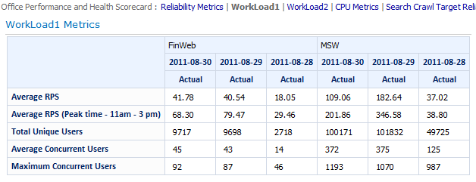
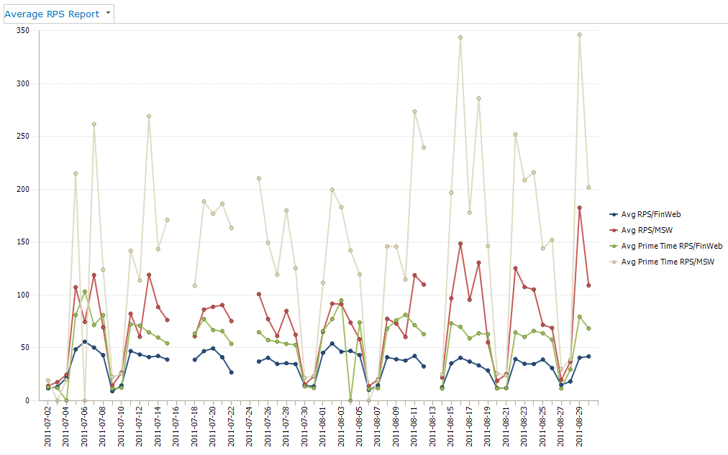
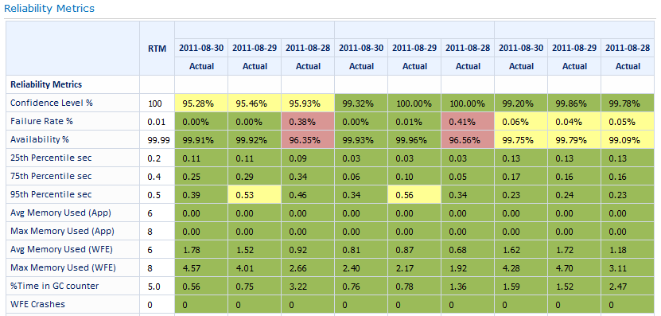
SPHealth Experience (example)

Slide 14
System Center Operations Manager
SCOM
3
SCOM
4
Exploring the data

Slide 15
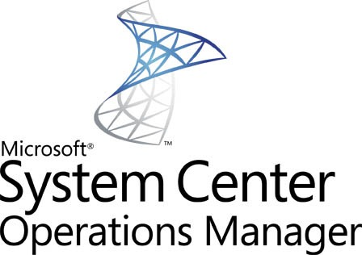
System Center Operations Manager
Enterprise-class Monitoring infrastructure
Ensures predictable performance and availability
For data centers and public/private cloud
What’s new? . . .
Network Monitoring, Web Console, PowerShell, enhanced UNIX and Linux support, Dashboard views

Slide 16
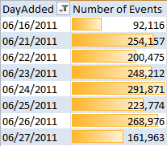
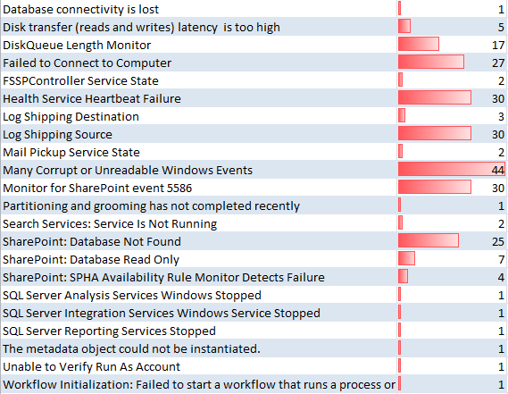
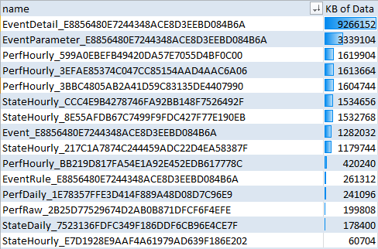
System Center Operations Manager
I can even see data about the data.
Events
Most Common Alerts
Database useage

Slide 17
Let’s build a tabular model in PowerPivot
Reporting with BI Tools:
PowerPivot
Power View
PerformancePoint Services

Slide 18
PowerPivot + SCOM Summary
Understanding vPerfHourly (or vPerfDaliy) pointed us to vManagedEntity, vPerformanceRule, and vPerformanceRuleInstance
Derived a table of dates without the time element
Created a PowerPivot model
Used that model to create interactive reports and visualizations

Slide 19


Related Content
Business Intelligence and Data Visualization: Microsoft SQL Server 2012 (DBI206)
Building Self-Service BI Applications Using PowerPivot (DBI301)
Enriching Your BI Semantic Tabular Models with DAX (DBI323)
Killer Real-World PowerPivot Examples (DBI330)
Find me anytime at kdonovan@microsoft.com

Slide 20

kdonovan@microsoft.com
PerformancePoint Blog
Kevin
Donovan
@kp_donovan
Program Manager, Microsoft Business Intelligence

Slide 21


Track Resources
SQL Server 2012 Eval Copy
Hands-On Labs
@sqlserver
@TechEd_NA
#msTechEd
Get Certified!
mva
Microsoft Virtual Academy

Slide 22
Track Resources
DAX Overview (http://technet.microsoft.com/en-us/library/gg399181.aspx)
Capacity Planning (http://technet.microsoft.com/en-us/library/ff758645.aspx)
SCOM 2012 (http://www.microsoft.com/en-us/server-cloud/system-center/datacenter-management-capabilities.aspx)
Microsoft.com/bi

Slide 23



Resources
Learning
  Connect. Share. Discuss.
  Microsoft Certification & Training Resources
http://northamerica.msteched.com
www.microsoft.com/learning
TechNet
  Resources for IT Professionals
  Resources for Developers
http://microsoft.com/technet
http://microsoft.com/msdn

Slide 24







Required Slide
Complete an evaluation on CommNet and enter to win!

Slide 25


MS Tag
Scan the Tag
to evaluate this
session now on
myTechEd Mobile

Slide 26
© 2012 Microsoft Corporation. All rights reserved. Microsoft, Windows, Windows Vista and other product names are or may be registered trademarks and/or trademarks in the U.S. and/or other countries.
The information herein is for informational purposes only and represents the current view of Microsoft Corporation as of the date of this presentation. Because Microsoft must respond to changing market conditions, it should not be interpreted to be a commitment on the
part of Microsoft, and Microsoft cannot guarantee the accuracy of any information provided after the date of this presentation. MICROSOFT MAKES NO WARRANTIES, EXPRESS, IMPLIED OR STATUTORY, AS TO THE INFORMATION IN THIS PRESENTATION.

