Slide 1
Delivering KPIs with Microsoft SQL Server Analysis Services
DBI320
Peter Myers

Slide 2
Abstract
Key Performance Indicators (KPIs) are important measurements that influence behavior and allow an organization to evaluate whether they are meeting target for specific objectives. This session begins by introducing how KPIs are defined in Analysis Services, in both multidimensional and tabular BI Semantic Models, and then made available for consistent reporting using Microsoft Excel, Excel Services, SQL Server Reporting Services and PerformancePoint Services. Next, consideration is given to where the KPI sources its target data from. The session explores additional capabilities of the multidimensional BI Semantic Model to collect planning data, specifically by using cube write-back, and Data Mining to seed planning values. Finally, the session introduces how the Excel 2010 What-If Analysis feature can be used to support the collection of planning data from users.
NEXT: <next slide title>

Slide 3




Presenter Introduction
pmyers@solidq.com
Peter
Myers

Slide 4
Session Outline
Defining KPIs
KPI Data Requirements
Introducing Analysis Services 2012
Defining Analysis Services KPIs
Delivering Analysis Services KPIs
  Excel 2010
  Reporting Services 2012
  PerformancePoint Services 2010

Slide 5
Defining KPIs
KPI = Key Performance Indicator
Quantifiable measurements comparing business performance to goals
Aligned with corporate strategy and objectives
Designed to drive desired behavior
Presents a measure of overall organizational health when combined into a collection for a business scorecard

Slide 6
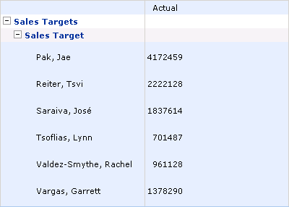
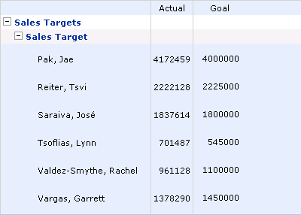
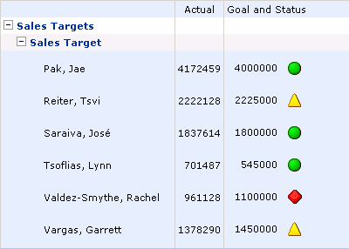
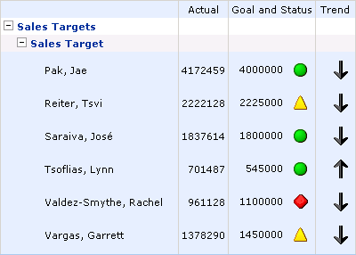
Defining KPIs
Example

Slide 7
KPI Data Requirements
A KPI at minimum requires an actual value and a
target value
Ideally corporate data systems will deliver both values
Actuals are typically retrieved from operational databases
Targets can be retrieved from formal planning systems
The absence of planning systems may involve:
  Maintaining target values in supplementary data stores
  Defining KPIs with fixed target values

Slide 8

Introducing Analysis Services 2012
BI Semantic Model (BISM)
  Developed using tabular or multidimensional development approaches
  Delivers intuitive browsing and high performance query results
  Performs calculations difficult to perform using relational queries
  Supports advanced Business Intelligence, including KPIs
Data mining
  Discovers patterns in data
  Patterns can be used to surface knowledge about data, and may be used for predictive analytics

Slide 9

demo
Introducing the Frosty Ice Cream company
Preparing the cube to store target values
Seeding target values based on historic actual
values using:
  Simple factor
  Data Mining (Time Series)
Contributing target values using Excel 2010

Slide 10
Defining Analysis Services KPIs
Analysis Services KPIs can be developed in multidimensional and tabular BI Semantic Models
  Multidimensional project cube
  Tabular model (including PowerPivot)

Slide 11
Defining Analysis Services KPIs
Multidimensional Development
KPIs are defined as part of the cube definition
KPI properties:
  Value
  Goal
  Status
  Trend
Status and Trend expressions should return a normalized value between -1 and 1
StatusGraphic
TrendGraphic
ParentKpiID
Weight
AssociatedMeasureGroupID
CurrentTimeMember
MDX expressions

Slide 12
Defining Analysis Services KPIs
Tabular Development
KPIs are defined as part of the model definition
The Actual metric is based on an existing measure
The Target metric is either:
  An existing measure
  Absolute value (i.e. based on the value of the Actual metric)
The Status metric is defined by setting thresholds, using:
  (Actual / Target) * 100 (where a Target measure is defined)
  Actual (where absolute value is defined)

Slide 13
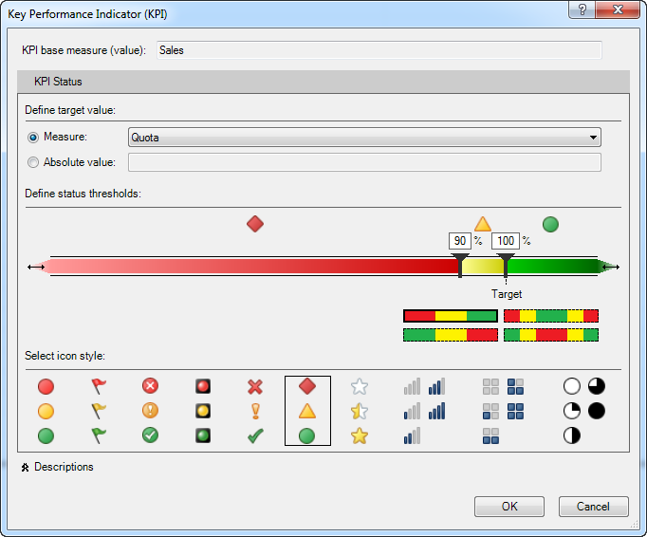
Defining Analysis Services KPIs
Tabular Development (Continued)
Optionally, descriptions can be defined for the KPI and its metrics
Note:
  Unlike multidimensional KPIs, the Trend metric cannot be defined
  Icon styles are fixed
  KPIs will not surface in
  Power View

Slide 14
demo
Defining an Analysis Services cube KPI

Slide 15
Delivering Analysis Services KPIs
Excel
Add KPIs to PivotTables
Use the CUBEKPIMEMBER function to retrieve specific KPI properties:
  kpi_property:
  1=Value, 2=Goal, 3=Status, 4=Trend, 5=Weight, 6=CurrentTimeMember
Share workbooks using SharePoint Excel Services
=CUBEKPIMEMBER(connection, kpi_name, kpi_property, [caption])

Slide 16

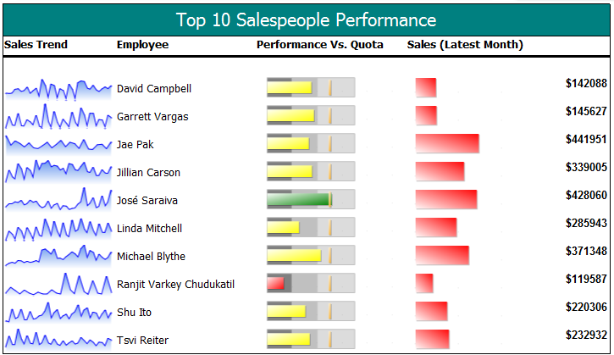
Delivering Analysis Services KPIs
Reporting Services 2012
Retrieve KPI data using the Analysis Services data provider
Present KPI values and supplement with Gauges and Indicators

Slide 17
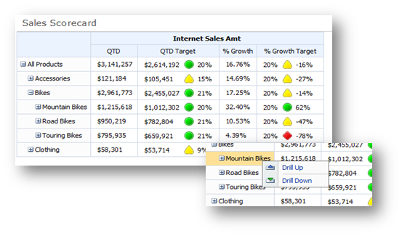
Delivering Analysis Services KPIs
PerformancePoint Services 2010
Import KPIs
Add KPIs to scorecards
Embed scorecards into dashboards and enrich with analytic reports

Slide 18
demo
Delivering the Analysis Services KPI with:
  Excel 2010 and Excel Services 2010
  Reporting Services 2012
  PerformancePoint Services 2010

Slide 19


Related Content
Breakout Sessions (session codes and titles)
DBI305: Developing and Managing a BI Semantic Model in Microsoft SQL Server 2012 Analysis Services
DBI323: Enriching Your BI Semantic Tabular Models with DAX
DBI61-HOL: Developing a Microsoft SQL Server 2012 Tabular BISM Using SSDT
DBI63-HOL: Creating a Microsoft SQL Server Reporting Services Report Based on a Tabular BISM
DBI64-HOL: Creating a PerformancePoint Services Dashboard Based on a Microsoft SQL Server 2012 BISM
DBI65-HOL: Creating Microsoft Excel 2010 Reports Based on a Microsoft SQL Server 2012 Tabular BISM
Hands-on Labs (session codes and titles)

Slide 20


Track Resources
SQL Server 2012 Eval Copy
Hands-On Labs
@sqlserver
@ms_teched
Get Certified!
mva
Microsoft Virtual Academy

Slide 21



Resources
Learning
  Connect. Share. Discuss.
  Microsoft Certification & Training Resources
http://northamerica.msteched.com
www.microsoft.com/learning
TechNet
  Resources for IT Professionals
  Resources for Developers
http://microsoft.com/technet
http://microsoft.com/msdn

Slide 22







Required Slide
Complete an evaluation on CommNet and enter to win!

Slide 23


MS Tag
Scan the Tag
to evaluate this
session now on
myTechEd Mobile
Notes:
TechEd is working with Microsoft Tag (http://tag.microsoft.com/overview.aspx) to create a unique Tag for every session at the event. Your session Tag will appear on both the room signage and at the end of your presentation. With your session Tag, attendees will be able to scan as they enter the room to retrieve session details, view speaker bios, and engage in discussions; or scan at the end of the presentation to evaluate your session and download materials.

Slide 24
© 2012 Microsoft Corporation. All rights reserved. Microsoft, Windows, Windows Vista and other product names are or may be registered trademarks and/or trademarks in the U.S. and/or other countries.
The information herein is for informational purposes only and represents the current view of Microsoft Corporation as of the date of this presentation. Because Microsoft must respond to changing market conditions, it should not be interpreted to be a commitment on the
part of Microsoft, and Microsoft cannot guarantee the accuracy of any information provided after the date of this presentation. MICROSOFT MAKES NO WARRANTIES, EXPRESS, IMPLIED OR STATUTORY, AS TO THE INFORMATION IN THIS PRESENTATION.

