Slide 1
Upgrading SSIS Packages to SQL Server 2012
DBI329
Sven Aelterman
Lecturer in Information Systems & Web/Technology Specialist
Troy University, Sorrell College of Business

Slide 2
Scenario for This Session
Using SQL Server 2005/2008 Integration Services?
Excited about SQL Server 2012 improvements?
Decided to upgrade?
This session is for you…

Slide 3
Benefits of Upgrading
Developer
DBA / ETL Admin
Designer enhancements
Package XML changes
New tasks/components
  CDC
  DQS
With project deployment model
  Project Reference with Execute Package Task
With project deployment model
  Configuration management
  Logging
  Monitoring

Slide 4
Upgrade ≠ Upgrade
Running packages in SSIS 2012: Upgrade and forget
  dtexec: upgrades package, does not save upgraded version
  Consider performance impact of upgrade phase
Editing packages in SSDT: Upgrade and save
  Open dtproj file in SQL Server Data Tools (SSDT)
  Add existing package to SSDT project
  Open existing package (temporary if not saved)

Slide 5

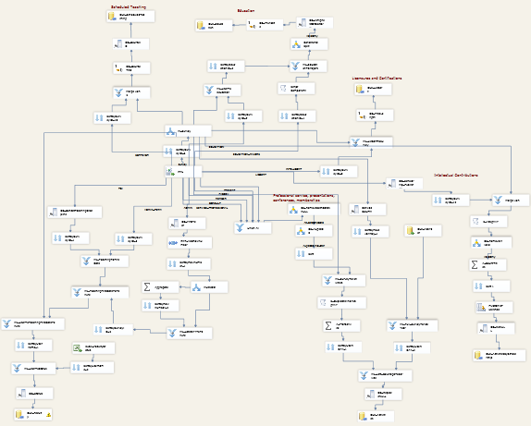


Examining My Real-World Packages
What makes them real-world?
.dtsConfig

Slide 6




Upgrade Process
Step-by-Step
Visual Studio project/solution upgrade
Upgrade SSIS Packages with
SSIS Package Upgrade Wizard
  One wizard execution per project
  Wizard upgrades all packages in project
Fix up connection strings in
config files, data source files, expressions
If desired (to take advantage of new functionality)
Convert to project deployment model
Convert appropriate connections to project scope
Replace custom components with 2012 versions

Slide 7
Upgrading Projects and Packages
demo 1
Steps 1-2-3

Slide 8
Upgrade Results
Solution and projects convert
Packages upgraded
  Format version 3 to version 6
Connection managers may require manual upgrade
Custom components convert if
  devenv.exe.config contains assembly redirect
  2012 component version is available
Take advantage of UI and usability improvements
See additional resources later for specifics

Slide 9
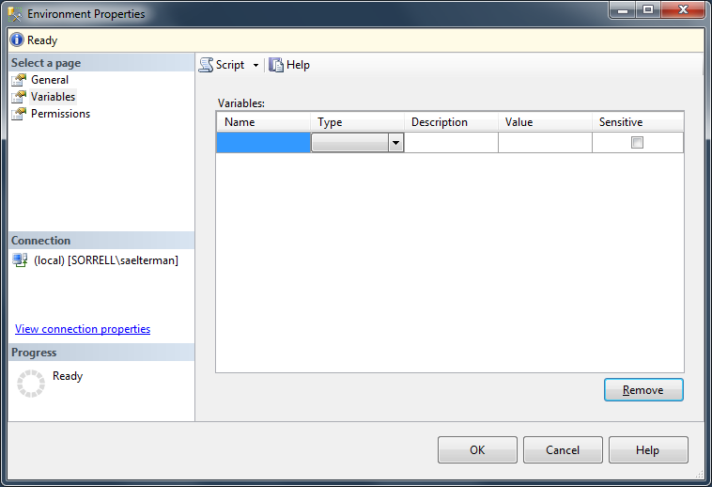
Project Deployment Model
Project
Environment
Variable X
Package A
Package
Parameter
Variable Y
Package B
Package A
Connection Manager
Project
Parameter
DBA

Slide 10
Upgrade Process Revisited
Step-by-Step
Visual Studio project/solution upgrade
Upgrade SSIS Packages with
SSIS Package Upgrade Wizard
  One wizard execution per project
  Wizard upgrades all packages in project
Fix up connection strings in
config files, data source files, expressions
If desired (to take advantage of new functionality)
Convert to project deployment model
Convert appropriate connections to project scope

Slide 11
Convert Projects to
Project Deployment Model
demo 2
Steps 4-5

Slide 12
Package vs. Project Parameter Scope
Decide on scope when creating parameter
Scope: where parameter value is available
  Project: any package in the project
  Package: only the package where the parameter is defined
Configure connection managers
  Parameter scope ≈ Connection manager scope
Configure tasks or components
  Is value useful across packages?

Slide 13
About the SSIS Catalog
Central store for
  SSIS projects
  Configuration settings
  Logs
UI Provides
  Configuration ability, optionally using environments
  Logging at different levels
  Monitoring
  Security

Slide 14
Deploy Projects to SSIS 2012
demo 3

Slide 15
Wrap-Up
Complexity of upgrade varies by package
Complexity increases when using
  Third-party components
  Package configurations
  Scripts calling custom assemblies
Online resources
  http://svenaelterman.wordpress.com/upgrading-to-ssis-2012-resources/

Slide 16



Related Content
Required Slide
*delete this box when your slide is finalized
Speakers, please list the Breakout Sessions, Labs, Demo Stations and Certification Exams that relate to your session. Also indicate when they can find you staffing in the TLC.
Breakout Sessions
DBI310: Enterprise Information Management (IEM): Bringing Together SSIS, …
DBI322: Incremental ETL Using CDC for SQL and Oracle with SSIS 2012
Hands-on Labs
DBI24-HOL: Exploring Microsoft SQL Server Integration Services
Product Demo Station: DBI-6: Credible, consistent data
Certification Exam Cram: Exam 70-463: Implementing a Data Warehouse…
Find Me Later At
  Technical Learning Center
  Community Night: Tuesday, 6:15 PM

Slide 17


Track Resources
SQL Server 2012 Eval Copy
Hands-On Labs
@sqlserver
@ms_teched
Get Certified!
mva
Microsoft Virtual Academy

Slide 18



Resources
Learning
  Connect. Share. Discuss.
  Microsoft Certification & Training Resources
http://northamerica.msteched.com
www.microsoft.com/learning
TechNet
  Resources for IT Professionals
  Resources for Developers
http://microsoft.com/technet
http://microsoft.com/msdn

Slide 19

Thank You!
sven@adduxis.com
http://bit.ly/saelterman
Sven
Aelterman
@svenaelterman

Slide 20







Required Slide
Complete an evaluation on CommNet and enter to win!

Slide 21


MS Tag
Scan the Tag
to evaluate this
session now on
myTechEd Mobile

Slide 22
© 2012 Microsoft Corporation. All rights reserved. Microsoft, Windows, Windows Vista and other product names are or may be registered trademarks and/or trademarks in the U.S. and/or other countries.
The information herein is for informational purposes only and represents the current view of Microsoft Corporation as of the date of this presentation. Because Microsoft must respond to changing market conditions, it should not be interpreted to be a commitment on the
part of Microsoft, and Microsoft cannot guarantee the accuracy of any information provided after the date of this presentation. MICROSOFT MAKES NO WARRANTIES, EXPRESS, IMPLIED OR STATUTORY, AS TO THE INFORMATION IN THIS PRESENTATION.

