Slide 1
SQL Database Federations
Tips and Tricks
DBI408
Cihan Biyikoglu
Program Manager
Windows Azure SQL Database

Slide 2
Agenda
Overview
Tips and Tricks
  Design and Development
    Picking Federation Model & Key
    Picking Reference Tables
    Generating Unique Keys without bottlenecks
    Coding Fan-out Queries
Tips and Tricks Cont.
  Administration
    Configuring Federation Layout
    DMVs for Where and When to Split?
    Deploying & Upgrading Schema
    Monitoring Federation Members
vNext – What’s Next
  Recent Improvements
  Coming in the next quarter
  Coming in the next few quarters

Slide 3
Overview

Slide 4
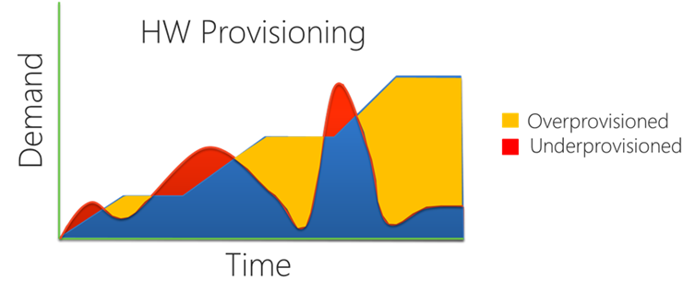
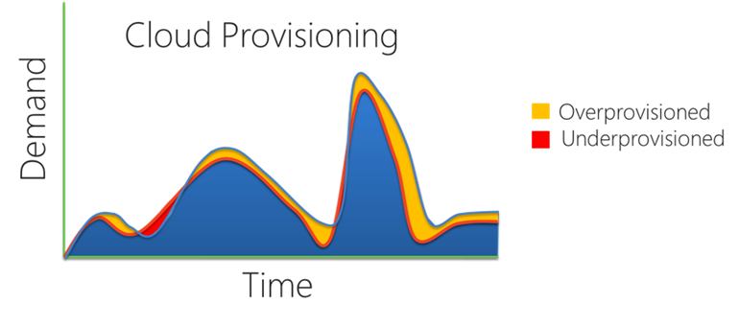
Scalability Model for the Cloud
Cloud Apps Require Scale Beyond Scale-Up
  Massive aggregate capacity: 100s of nodes available for use
Cloud Apps Demand the Best Economics
  Best Price/Performance :
    Many commodity nodes for the economics
  Elasticity + Pay-as-you-go
    Reduce overcapacity: take advantage of cloud provisioning model!
On Prem Provisioning Model
Cloud Provisioning Model

Slide 5
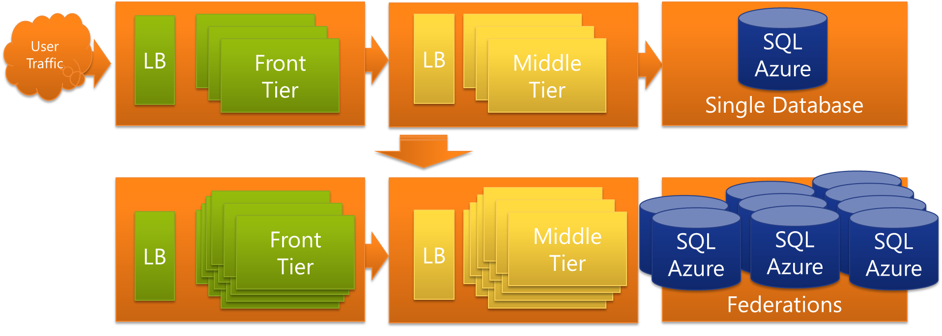
Introducing Federations in SQL Azure
Canonical 3 tier app scales by adding and removing nodes
Federations extend the model to the DB Tier.
  Add and Remove SQL Azure nodes with federations.
  Scale on demand to your traffic without any downtime!
Larger User Traffic
Front
Tier
SQL Azure
Front
Tier
Front
Tier
Front
Tier
Front
Tier
Front
Tier
Middle
Tier
Front
Tier

Slide 6
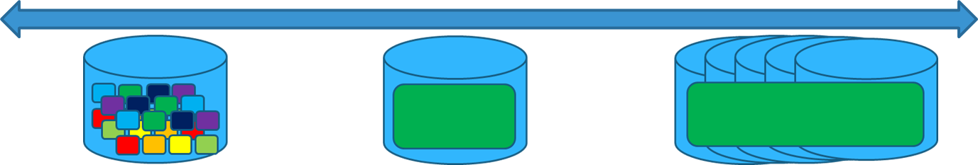

Why use Federations? cont.
Go Beyond Single DB to Practically Unlimited Scale:
  Harness 100s of SQL Azure nodes
Best Economics
  Elastic database tier that can repartition with your applications workload. No downtime required!
Simplified Multi-tenancy:
  Efficient management of tenant placement and re-placement
Simplified Development and Administration:
  Robust programming & connectivity model with native tooling
Single tenant per database
Multiple-tenants per database Multiple databases per tenant

Slide 7
Architecture
Federations in SQL Azure

Slide 8
Overview - Concepts
CREATE FEDERATION fed_name(fed_key_label fed_key_type distribution_type)
Federations
Range Partitioning
member: Range [1000, 2000)
SalesDB
Orders_federation
AU
PK=5
AU
PK=25
AU
PK=35
Orders_federation
fed_name
AU
PK=5
AU
PK=25
AU
PK=35
AU
PK=1005
AU
PK=1025
AU
PK=1035
Federation Root
Atomic Units
Federation Members

Slide 9
Overview – Architecture cont.
Repartitioning Operations without Downtime!
  SPLIT members to spread workloads over to more nodes
  DROP members to shrink back to fewer nodes
ALTER FEDERATION Orders_Fed SPLIT AT (tenant_id=7500)
SalesDB
Orders_federation
Orders_federation
Orders_Fed
[5000, 7500) & [7500, 10000)
[5000, 10000)

Slide 10
Overview – Architecture cont.
Built-in Data-Dependent Routing
  DDR ensure app can discover where the data is just-in-time
    Apps no longer has to cache ‘shard map’
    No cache coherency issues even with repartitioning
  Prevents connection pool fragmentation issues
USE FEDERATION Orders_Fed(tenant_id=7500)
SalesDB
Orders_federation
Orders_federation
Orders_Fed

Slide 11
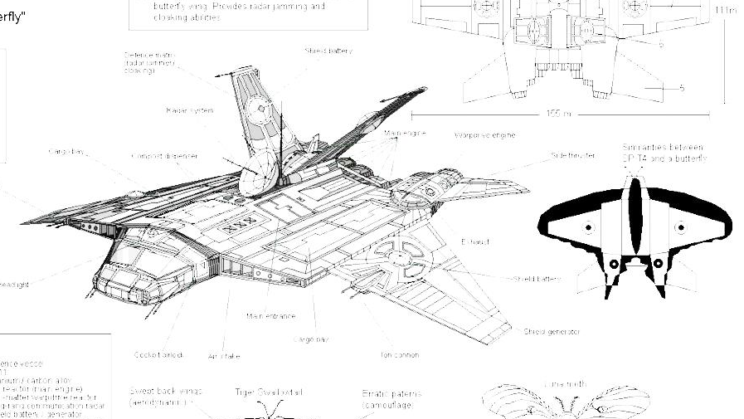
Tip and Tricks
SQL Scale-out
Tips and Tricks

Slide 12

Design and Development
Tips and Tricks

Slide 13
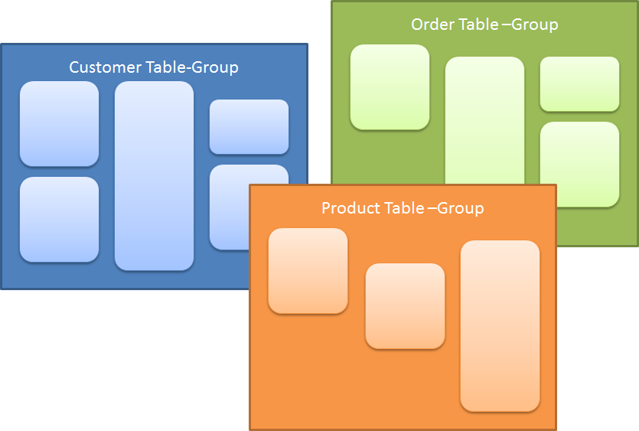
Picking Federations
Normalize your data model all the way and then…
Apply the Scale-First db design principles
Pick Federations – “Table Groups” that need Scale-out
  “Table Groups” are properties of the same entity - tied with fk relationships or access patterns
  “Table Groups” may need scale out if they have high storage needs or computational capacity needs.
Table Groups
Orders_federation
Orders_federation
fed_name

Slide 14
Picking Federation Keys
Pick Federation Keys and Define the Atomic Units (AU)
  AU instance is the target of in all (or most) latency and scale sensitive queries
  AU Instance is target of all (or most) transaction boundaries
  AUs distribute the app workload equally to all members
  Largest AU instance fits in the scale-up limit of SQL Database
Federation Columns
Orders_federation
Orders_federation
fed_name

Slide 15
Picking Reference Tables
What are Reference Tables?
  Look up tables that are cloned to all members
  Provide easier programmability
    Easier queries & transactions
    Lowered latencies with local joins
How to pick ref tables?
  Set of tables use for lookups in in latency & scale sensitive workload of the app
  Tables that don’t need strict consistency – (o.k with eventual consistency)

Slide 16

Generating Unique Keys
How to generate unique keys without identity property
  Identity Property is not allowed on Federated Tables
Identity Generation can be expensive for large scale apps
  Provides linearly increasing values
  Provides no gaps id generation guarantees
  Can only be generated at the db tier
Benefits of Uniqueidentifier (GUID)
  Does not require centralized id generation
    Allows gaps and is not linearly increasing
  Can be generate at any tier of the app

Slide 17
Writing Fan-out Queries
What is a Fan-out Query?
  Queries that can process data across fed members.
Fan-out Benefits
  Reporting Queries
    Union or Aggregate Data Across Members
  Unaligned Queries
    Query customer_name on fed with key customer_id
Types of Fan-out Queries:
  Union All: Simple
  Aligned vs Unaligned Fan-out Queries
    Additive vs None-additive Aggregations

Slide 18
Writing Fan-out Queries Cont.
Breaking It Down
  Member Query: the part you send to each member
  Summary Query: the post processing query for member query results
Fan-out Pseudo-Code
  //MEMBER QUERY
  //start from the first member – min value
  USE FED f(id=min)
  WHILE (nextvalue != NULL)
  //get results into dataset
  DataAdapter.Fill(ds);
  //get the value to navigate to the next member
  nextvalue = SELECT range_high FROM sys.federation_member_distributions
  //SUMMARY QUERY
  LINQ2DataSet(ds)

Slide 19
Demo
Fan-out Queries
Submitting Fan-out Queries with Sample Fan-out Query Utility

Slide 20
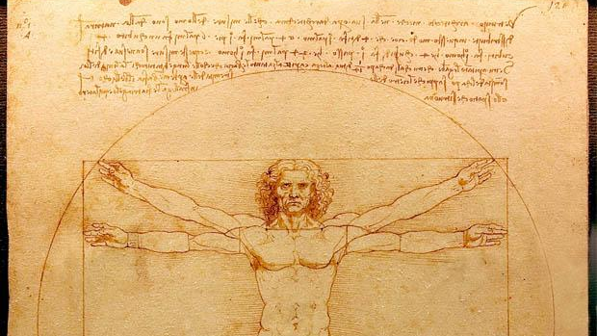
Administration
Tips and Tricks

Slide 21
Deploying and Upgrading Schema
With Federations Root and Each Member owns its own schema
  Great for online upgrades – partial upgrade & rollbacks
  Great if you want to differentiate schema
  Not so great if you need to manually run schema updates
Schema Deployment with Sample Fan-out Utility
  Ensure to write idempotent scripts
    Idempotency: multiple runs produce the same outcome - pattern: if (not exists) then do
    Benefits: avoids long transactions, idempotent scripts are retry-able
  Script upgrade and rollback
    Upgrade applies the changes & Rollback reverses the changes

Slide 22
Monitoring and Tshooting with Federations
Monitoring and TShooting Federation Operations
  Use federation DMVs sys.dm_federation_operations*
  All federation command come with retry logic
    CREATE|ALTER|DROP FEDERATION
    USE FEDERATION
Monitoring and Tshooting with Sample Fan-out Utility
  Federations is not different from a collection of dbs
    Figuring the hottest member?
    Apply the same concepts of tshooting as single db
      Figure out the resource contention
      Optimize the resource usage for better throughput
      And Repeat for the next resource concatenation…

Slide 23
Configuring Federation Layout - First Time?
Deciding You Initial Layout
  How many members? Which split-points?
Cold Start
  Scale characteristics in the cloud vs on premise are very different
    Test your load: Load you expect the first week, months and year?
  Favor smaller and more members
    Take advantage of better throughput
      Better Tx/sec
      Faster split times for rebalancing and redistributing the load
    Take advantage of pay as you go
      10GB/month = $45.95
      2x5GB/month = 25.97*2 = $51.94

Slide 24
DMVs for Where & When to Split?
Online elasticity is great but today you still need to manage repartitioning
    When you need to repartition a member?
    What the best split point?
When to SPLIT?
  Decide Threshold for ‘good’ vs ‘bad’ behaving app
  Identify early indicators of resource contention for the member
    #user connections, large blocking, #concurrent requests, throttling events
Where to SPLIT?
  Decide the KPI that will give you the equal redistribution of load
    Typically this is the median AU in the member…

Slide 25
Demo
SPLIT with GUIDs
Walkthrough when and where to split with Uniqueidentifier as the Federation Key

Slide 26

Recent Changes Available Today
Changes Coming in the Next Quarter
Roadmap Federations

Slide 27
Recent Changes Available Today
#Users
Performance Improvements
  Latency of USE FEDERATION Improved
    Improved Caching at the Gateway
      Connection pooling at the gateway
      Federation map pooling at the gateway
  USE FED for curing Connection Pool Fragmentation
  #ConcurrentUsers per Server = CU (ex:10)
  #AppServer = N (ex:50)
  #Databases = M (ex:50)
  Sharding Total App Connections = CU*N*M – (ex:25K)
  Federations Total App Connections = CU*N – (ex:500)
App Server
App Server
App Server
App Server
Gateway Nodes
DB Nodes

Slide 28
Coming in the Next Quarter
Identity and Timestamp:
  Supported on Reference Tables
  Still restricted on Federated Tables
Data Sync Service
  Manual Setup with Data Sync
    Reference Data Replication Between Members
    Sync on-prem databases with federated databases
    Sync between federated databases in the cloud

Slide 29
Coming in the Next Few Quarters
Local DR
  SQL Azure Provides built in HA with 99.9% SLA
  How about?
    App upgrades and rollbacks,
    Admin and User errors – dropped tables or rows
Geo-DR
  How about?
    Protect against planned or unplanned Data-Center failures
    Backing up DBs to another Data-center
    Take an on-prem snapshot of your data in the cloud
DR simplified with Federations

Slide 30
Federation DR Enhanced
Partially Present Federations and Member Switch Operation
  Switch members in and out of federations
  *ALTER FEDERATION fed_name SWITCH IN|OUT AT (HIGH id=100) WITH db1
  (*preview – final syntax may look different)
db1
Federations
SalesDB
Orders_federation
Orders_federation
Orders_Fed
Federation Root
Unavailable Federation Members

Slide 31

Federations DR Enhanced!
Scenarios:
  Copy Databases for easy application rollout and rollback
    Rollback upgrade on member db with snapshots
  Point in Time Restore for easy “oops” recovery:
    Restore the member db for customerID “55” at “5/28/2012 12:00:00”
DBCopy
member2 @ now
PITR
member2 @ 6/11/2012 12:00:00
Federations
SalesDB
Orders_federation
Orders_federation
Orders_Fed

Slide 32
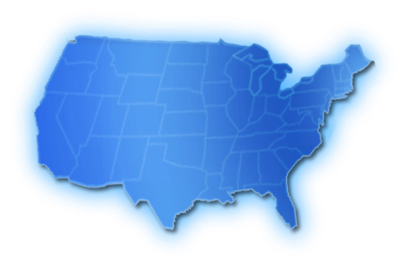
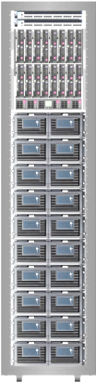

Federations DR Enhanced!
Scenarios:
  Geo DR for Failover for each Geo Availability
    Initially at the member level
    Eventually for the federated db
P’
S’
P
S
S’
S

Slide 33
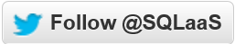
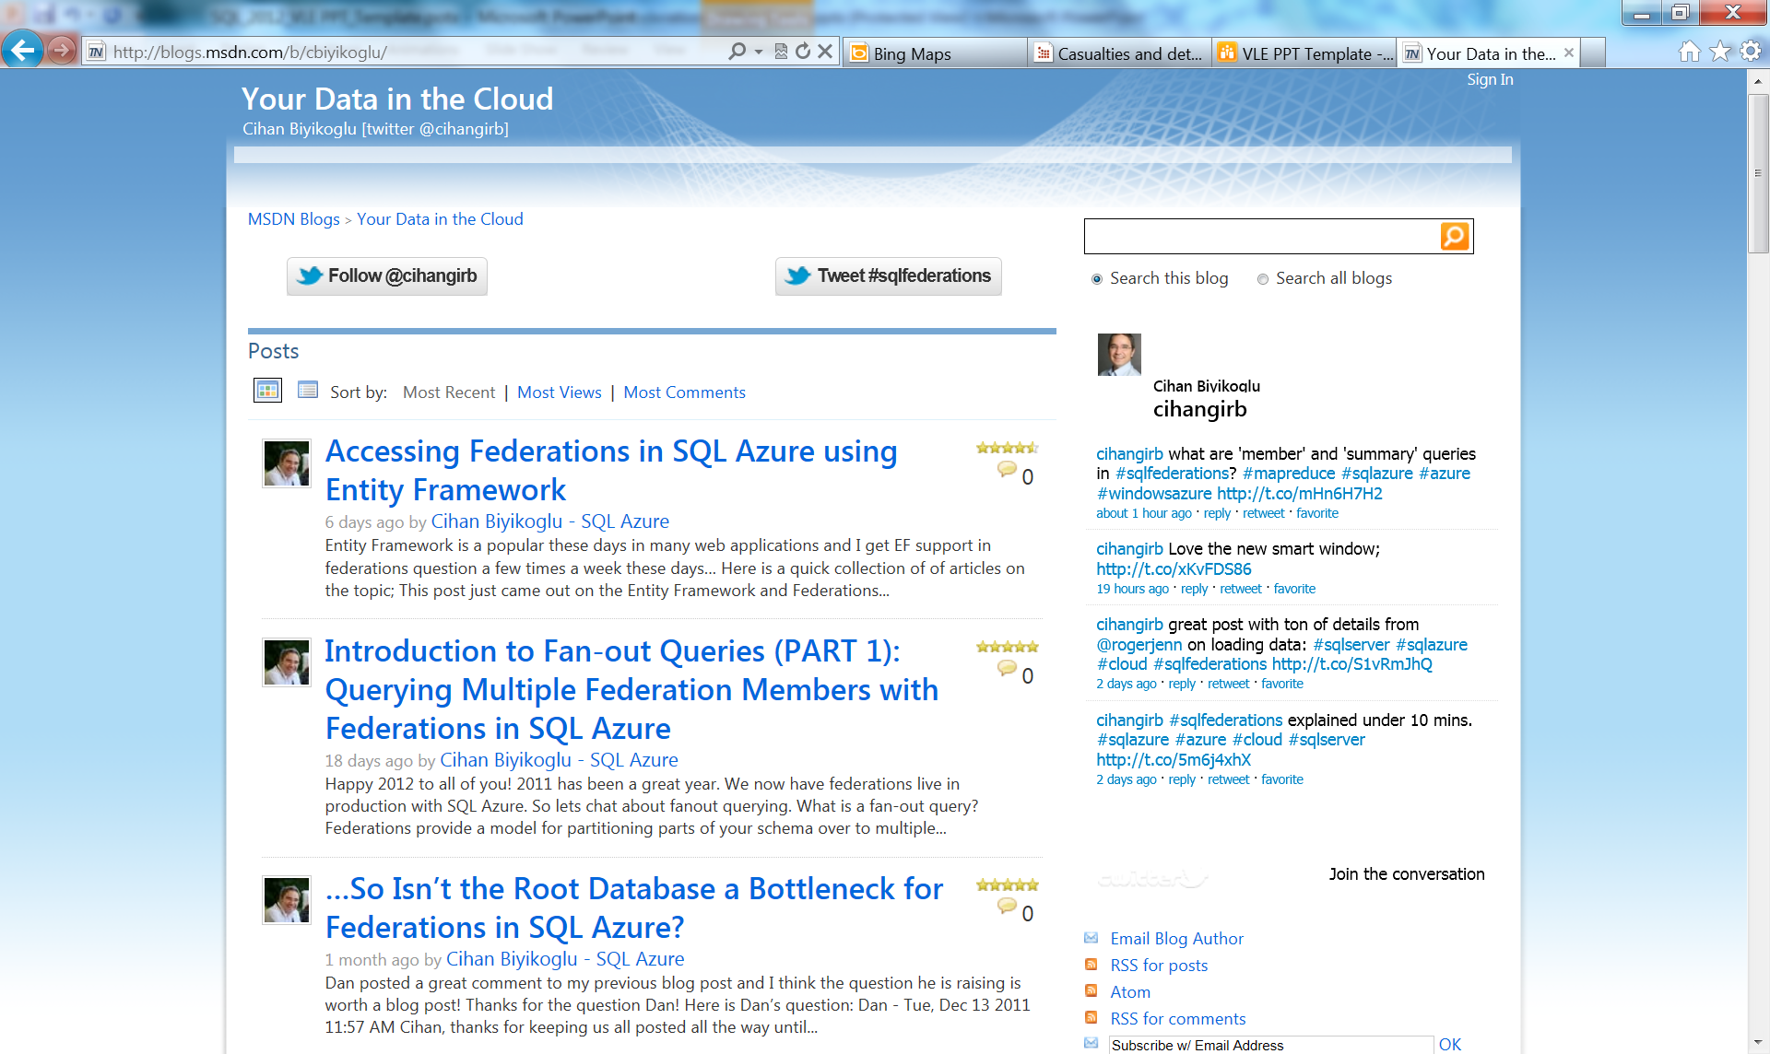
Further Information
SQL Azure Online Documentation
  http://msdn.microsoft.com/en-us/library/windowsazure/ee336279.aspx
My Blog – “You Data in the Cloud”
  Fan-out Utility and other Tips
  http://blogs.msdn.com/b/cbiyikoglu/
Up to date information on twitter

Slide 34
Q&A

Slide 35



Related Content
SQL Azure Administration
Windows Azure Hands-on-Labs
Cloud on your terms Demo Station at the Windows Azure Booth
Find Me Later At… cihangib@microsoft.com

Slide 36


Track Resources
SQL Server 2012 Eval Copy
Hands-On Labs
@sqlserver
@ms_teched
Get Certified!
mva
Microsoft Virtual Academy

Slide 37



Resources
Learning
  Connect. Share. Discuss.
  Microsoft Certification & Training Resources
http://northamerica.msteched.com
www.microsoft.com/learning
TechNet
  Resources for IT Professionals
  Resources for Developers
http://microsoft.com/technet
http://microsoft.com/msdn

Slide 38







Complete an evaluation on CommNet and enter to win!

Slide 39


MS Tag
Scan the Tag
to evaluate this
session now on
myTechEd Mobile

Slide 40
© 2012 Microsoft Corporation. All rights reserved. Microsoft, Windows, Windows Vista and other product names are or may be registered trademarks and/or trademarks in the U.S. and/or other countries.
The information herein is for informational purposes only and represents the current view of Microsoft Corporation as of the date of this presentation. Because Microsoft must respond to changing market conditions, it should not be interpreted to be a commitment on the
part of Microsoft, and Microsoft cannot guarantee the accuracy of any information provided after the date of this presentation. MICROSOFT MAKES NO WARRANTIES, EXPRESS, IMPLIED OR STATUTORY, AS TO THE INFORMATION IN THIS PRESENTATION.

