Slide 1
Optimizing Your BI Semantic Model for Performance and Scale
DBI414
Allan Folting, Ashvini Sharma
Program Managers
SQL Server Business Intelligence
Microsoft

Slide 2
Session Objectives
You will understand:
architecture of Analysis Services in tabular mode
optimizing processing performance
query processing architecture

Slide 3
Takeaway
Factors to think through for capacity planning

Slide 4
BI Semantic Model: Architecture
Third-party
applications
Reporting
Services
SharePoint
Insights
Excel
PowerPivot
BI Semantic Model
Data model
Multi-
dimensional
Tabular
Business logic
and queries
MDX
DAX
Data access
ROLAP
MOLAP
VertiPaq
Direct
Query
Databases
LOB Applications
Files
OData Feeds
Cloud Services

Slide 5
VertiPaq Design Principles
Performance, Performance, Performance
Query Performance > Processing Performance
Accommodate changes without forcing reload, if possible

Slide 6
VertiPaq Storage
T1
(C1,C2,C3)
T2
(C1,C2)
CC1
CC1
1
2
3
Partition 1
Partition 1
5
4
Partition 2
6
P2
Dictionary
Col. Segment
Hierarchy
Relationship
1
Table data stored in segments & dictionaries per column
5
Partitions are a group of segments and intended for data management
2
Calculated columns are stored like regular columns
6
Any table can have partitions, defined independently of other tables. Partitions are only for segment data
3
Hierarchies can provide quicker access for querying
4
Relationship structures are created to accelerate lookups across tables, remove hard coupling between tables

Slide 7
Processing Architecture & Optimizations
title

Slide 8
Processing Phases
Segment N
Segment N +1
Read & Encode Data
Segment N
Read & Encode Data
Segment N + 1
Build calc cols, hier, relationships
t
Compress
Segment N
Compress
Segment N+1

Slide 9
Special case of 3rd segment
First segment can “stretch” to be twice as large
Optimizes for smaller lookup tables
Segment 1 + 2
Segment 3
Read & Encode Data
Segment (until 2*segment_size)
Split
Read & Encode Data
Segment 3
t
Compress
Segment 1
Compress
Segment 3
Compress
Segment 2

Slide 10
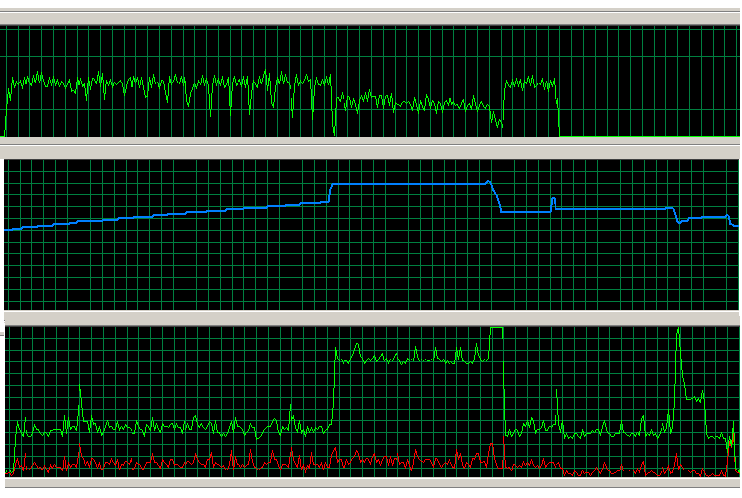
Processing - Memory & CPU usage
Network
Split
Segment 1 + 2
Segment 3
Memory
Read & Encode Data
Segment (until 2*segment_size)
Read & Encode Data
Segment 3
Compress Segment 1
Compress
Segment 3
Calc cols, hier, rels.
Compress Segment 2
CPU

Slide 11
Controlling Segment Size and Compression
DefaultSegmentRowCount – # of rows in the segment
0 – default: 8M for Analysis Services, 1M for PowerPivot
Value must be power of 2, should be at least 1M
Larger => generally better compression, faster queries with lower overhead
Smaller => smaller working set during processing
ProcessingTimeboxSecPerMRow
0 – default: 10 sec
Smaller => greedy algorithm gives most gains in the beginning
Larger => almost always better compression, higher query performance
Increase for large number of columns (~>200)
Reported in profiler & DISCOVER_STORAGE_TABLE_COLUMN_SEGMENTS

Slide 12
Processing options
Data
T1
Data
CC1
Recalc
Full: Data and Recalc
Default: Data and Recalc if needed
Defrag: defragment dictionaries for a table
Clear: remove data
Add: creates new partition and merges
Hierarchies
Relationships

Slide 13
Incremental Processing
Typical
Create new partitions for new data
ProcessData on new partition or to reload into existing tables
Process Recalc to rebuild calc columns, hierarchies, relationships
Avoid
Multiple ProcessFull – each causes a Recalc, unless in a single transactional batch

Slide 14
Advanced Processing
Parallel processing
Use single transaction batch for processing tables in parallel
Parallel processing of a table’s partitions not supported in Denali
Use ProcessDefrag periodically
Deleting partitions may leave outdated values in dictionaries
Merge partitions for reducing metadata overhead
Error handling
RI violations assigned a blank value, no error during processing

Slide 15
Server Memory Map
Server memory
DB1
DB2
DB1~
New, not committed part of the database
FE
VertiPaq caches
VertiPaqMemoryLimit – 60 %
TotalMemoryLimit – 80 %
VertiPaqPagingMode enables use of system paging
Dictionaries need to remain in memory

Slide 16
Discover memory used per Database
demo

Slide 17
Query Processing
title

Slide 18
Querying
Queries
Two formula engines: MDX, DAX
FE calls into VertiPaq to retrieve data
Query logic pushed to VertiPaq where possible
A VertiPaq query executes in parallel, one core per segment
Optimized for execution on compressed format
VertiPaq-level caching for chatty FE/VertiPaq communication
Events in profiler
MDX
DAX
VertiPaq

Slide 19
VertiPaq Query Performance
Scans @ 5B+ rows/s
1B+ rows of data
Scans @ 20B+ rows/s
10B+ rows of data

Slide 20
Rich & Fast
DAX
VertiPaq Query
Rich
Single threaded per query
Designed for expressivity
Simple
One core per segment
Optimized for speed
More pushed down over time

Slide 21
Inspecting Query Evaluation
demo

Slide 22
Best Practices for Tabular Models
Workspace DB for data-driven design experience
BI Dev Studio
Analysis Services
Deploy project
DB
Analysis Services
Workspace DB
Process Tables/Partitions

Slide 23
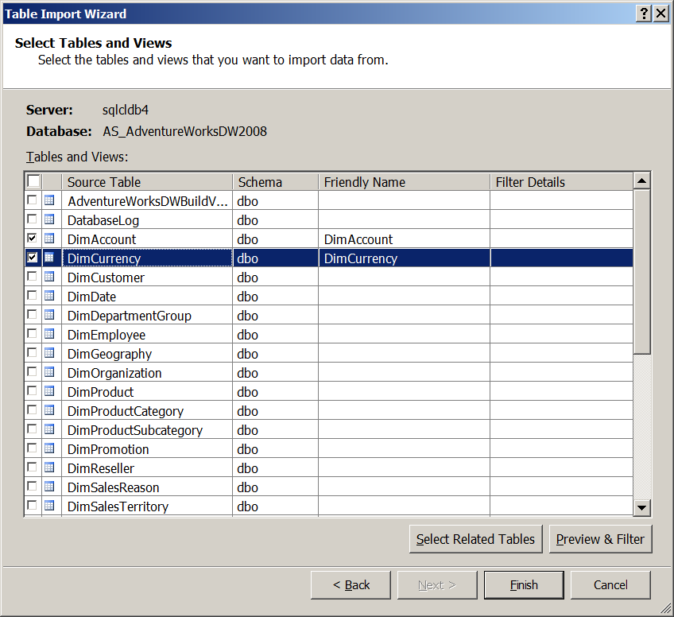
Options for working with large datasets
Point to smaller/empty DB
Filter large tables to reduce rows

Slide 24
Session Objectives and Takeaways
Session Objectives:
Understand the architecture of Analysis Services in tabular mode
Understand and optimize processing performance
Understand query processing architecture
Takeaways:
Factors to think through for capacity planning

Slide 25
Related Content
DBI305: Developing and Managing a BISM
DBI61-HOL: Developing a Tabular BISM Using SQL Server Data Tools
Microsoft SQL Server: Breakthrough Insights - Credible, Consistent Data

Slide 26
Ashvini.Sharma @microsoft.com
@ashvinis
Ashvini Sharma

Slide 27
afolting
@microsoft.com
Allan
Folting

Slide 28
Track Resources
SQL Server 2012 Eval Copy
Hands-On Labs
@sqlserver
@TechEd_NA
#msTechEd
Get Certified!
mva
Microsoft Virtual Academy

Slide 29
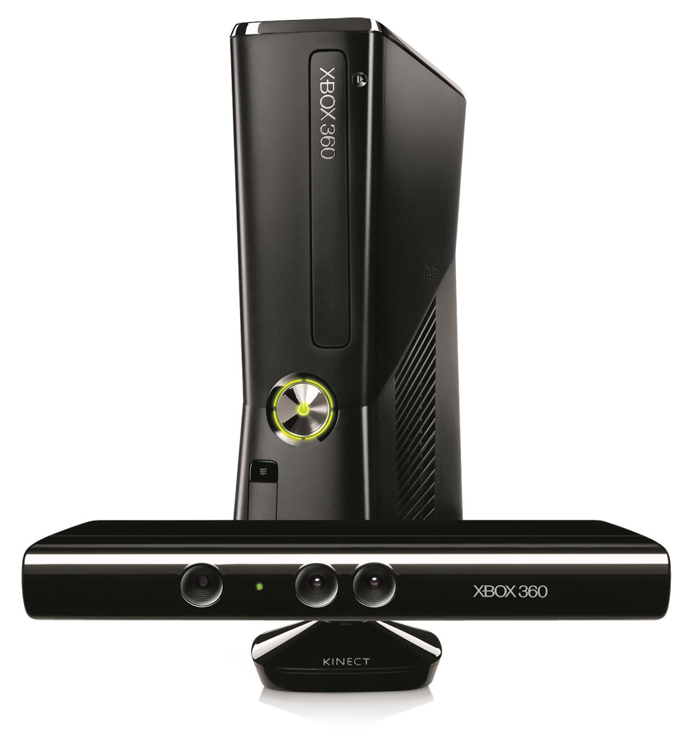
Required Slide
Complete an evaluation on CommNet and enter to win!

Slide 30
MS Tag
Scan the Tag
to evaluate this
session now on
myTechEd Mobile

Slide 31
© 2012 Microsoft Corporation. All rights reserved. Microsoft, Windows, Windows Vista and other product names are or may be registered trademarks and/or trademarks in the U.S. and/or other countries.
The information herein is for informational purposes only and represents the current view of Microsoft Corporation as of the date of this presentation. Because Microsoft must respond to changing market conditions, it should not be interpreted to be a commitment on the part of Microsoft, and Microsoft cannot guarantee the accuracy of any information provided after the date of this presentation. MICROSOFT MAKES NO WARRANTIES, EXPRESS, IMPLIED OR STATUTORY, AS TO THE INFORMATION IN THIS PRESENTATION.

