Slide 1
ASP.NET Loves HTML5
DEV303
Damian Edwards
Senior Program Manager
Microsoft Corporation

Slide 2
HTML5
FOR
ASP.NET
4 & 4.5

Slide 3
WHY

Slide 4
Standard
A NEW
Web

Slide 5
footer
article
time
video
websockets
boxshadow
audio
section
validation
keyframes
hgroup
aside
storage
header
canvas
nav
progress

Slide 6
s
maller
s
impler
s
emantic

Slide 7
<style>
.rounded {
padding: 10px;
position: relative;
}
.rounded-top-left,
.rounded-top-right,
.rounded-bottom-left,
.rounded-bottom-right {
height: 10px;
position: absolute;
width: 10px;
}
.rounded-top-left {
background-image: url(../images/topleft.gif);
left: 0;
top: 0;
}
.rounded-top-right {
background-image: url(../images/topright.gif);
right: 0;
top: 0;
}
.rounded-bottom-left {
background-image: url(../images/bottomleft.gif);
bottom: 0;
left: 0;
}
.rounded-bottom-left {
background-image: url(../images/bottomright.gif);
bottom: 0;
left: 0;
}
</style>
<div>
<div class="rounded-top-left"></div>
<div class="rounded-top-right"></div>
<p>Rounded Corners</p>
<div class="rounded-bottom-left"></div>
<div class="rounded-bottom-right"></div>
</div>
37 lines
8 lines
<style>
.rounded {
border-radius: 10px;
}
</style>
<p class="rounded">
Rounded corners
</p>

Slide 8
5 paths
<script>
$(function () {
$("input[type=text]").each(function () {
$(this).val(this.title);
$(this).addClass("placeholder");
});
$("input[type=text]").focus(function () {
if ($(this).val() === this.title) {
$(this).val = "";
$(this).removeClass("placeholder");
}
});
$("input[type=text]").blur(function () {
if ($(this).val() === "") {
$(this).val(this.title);
$(this).addClass("placeholder");
}
});
});
</script>
<form action="/stuff" method="post">
<input type="text" name="value" title="Value" />
<input type="submit" value="Submit" />
</form>
1 path
<form action="/stuff" method="post">
<input type="text" name="value" placeholder="Value" />
<input type="submit" value="Submit" />
</form>

Slide 9
mixed
<div class="header">
<div id="nav">
<ul>
<li><a href="#">Link</a></li>
<li><a href="#">Link</a></li>
<li><a href="#">Link</a></li>
</ul>
</div>
</div>
<div class="page-body">
<div class="post">
<p>Some Content</p>
</div>
<div id="ads">Ad</div>
</div>
<div id="footer">
&copy;
</div>
self contained
not related

Slide 10
fixed
<header>
<nav>
<ul>
<li><a href="#">Link</a></li>
<li><a href="#">Link</a></li>
<li><a href="#">Link</a></li>
</ul>
</nav>
</header>
<section>
<article>
<p>Some Content</p>
</article>
<aside>Ad</aside>
</section>
<footer>
&copy;
</footer>
portable
separated

Slide 11
DEMO

Slide 12
damianedwards
.com
slides by osbornm
twitter
github
codeplex

Slide 13



Related Content
DEV308: JavaScript: The Developer Experience
DEV302: What’s new in Visual Studio 2012 for Web Developers
DEV304: ASP.NET for Mobile and Tablet Development
Find me later at the TLC, Tue & Wed 10:30 AM – 1:00 PM

Slide 14



Resources
Learning
  Connect. Share. Discuss.
  Microsoft Certification & Training Resources
http://northamerica.msteched.com
www.microsoft.com/learning
TechNet
  Resources for IT Professionals
  Resources for Developers
http://microsoft.com/technet
http://microsoft.com/msdn

Slide 15


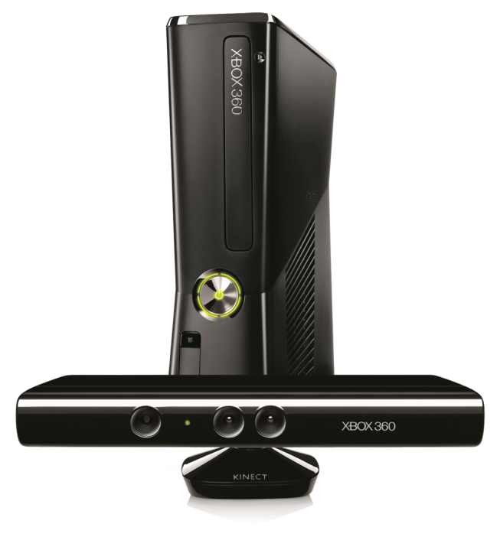


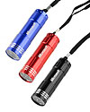

Required Slide
Complete an evaluation on CommNet and enter to win!

Slide 16


MS Tag
Scan the Tag
to evaluate this
session now on
myTechEd Mobile

Slide 17
© 2012 Microsoft Corporation. All rights reserved. Microsoft, Windows, Windows Vista and other product names are or may be registered trademarks and/or trademarks in the U.S. and/or other countries.
The information herein is for informational purposes only and represents the current view of Microsoft Corporation as of the date of this presentation. Because Microsoft must respond to changing market conditions, it should not be interpreted to be a commitment on the
part of Microsoft, and Microsoft cannot guarantee the accuracy of any information provided after the date of this presentation. MICROSOFT MAKES NO WARRANTIES, EXPRESS, IMPLIED OR STATUTORY, AS TO THE INFORMATION IN THIS PRESENTATION.

