Slide 1
Creating Robust, Maintainable Coded UI Tests with Visual Studio 2012
DEV312
Eric Maino
Senior Developer
Microsoft Corporation

Slide 2


Upcoming Sessions
DEV214 Testing Un-testable Code with Fakes in Visual Studio 11
DEV412 Identify and Fix Performance Problems with Visual Studio 11 Ultimate
DEV16-HOL Learn How Microsoft Test Manager 11 Will Embrace and Exploratory Testing Approach
DEV17-HOL Explore the New Unit Testing and Code Clone Capabilities of Visual Studio 11

Slide 3
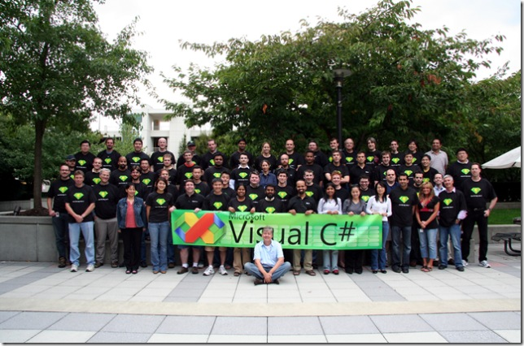
Photo Credit: Terry Adams, C# Team

Slide 4

Photo Credit: http://www.clker.com/clipart-toolbox.html

Slide 5
Agenda
Coded UI Test Overview
Building Reliable UI Automation
Investigating UI Automation Failures
Q+A

Slide 6
Coded UI Test Fundamentals
Recorder
  Application Inspection
  Search Generation
  Code Generation (primitives and asserts)
UI Map
Playback
  Find
  Inspect
  Execute Primitives

Slide 7
Why use Coded UI Test?
Testing was an after thought
Accessibility
Localization
Usability Validation

Slide 8
CUIT Playback Architecture
UI Controls
HtmlControl
WpfControl
WinControl
UITestControl
Managed Wrapper
RPF
Core Engine
Win32
MSAA
UIA
Web

Slide 9
Playback Settings

Slide 10

Search Settings
// Default search is breadth first, unlimited depth with smart match
// Value is in milliseconds. Default search timeout is 2 minutes.
// The search engine will continue making passes until the timeout has expired
// or the window has been found.
settings.SearchTimeout = 10000;
// Default search will make 3 attempts.
// If true the default 3 attempts is applied. If false then only one attempt should take place.
settings.ShouldSearchFailFast = true;
// Default wait for ready timeout is 60 seconds. Level is UIThreadOnly
// Suggested setting when building tests is 1 second to help uncover performance issues
settings.WaitForReadyTimeout = 1000;
settings.WaitForReadyLevel = WaitForReadyLevel.UIThreadOnly;

Slide 11
Match Settings
// Default both Top Level & Control
// Ensures target class name matches if set as part of search
// Assumes window format is A - B
// Splits on the first '-' delimiter
// Assuming target window is in the format of C - D
// Attempts to match A&C, B&C, A&D, B&D
// Scores each matching window and returns the one with the
settings.SmartMatchOptions = SmartMatchOptions.TopLevelWindow;
// Ensures control hierarchy is corectly defined
// Given the query ;TopLevel;A;B;C, if false A;B may be ignored
settings.MatchExactHierarchy = false;

Slide 12
Remote Debugging

Slide 13
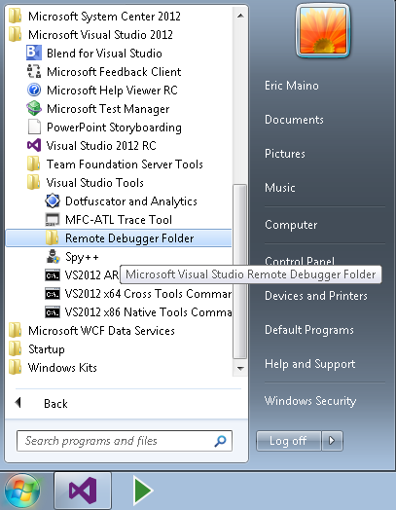
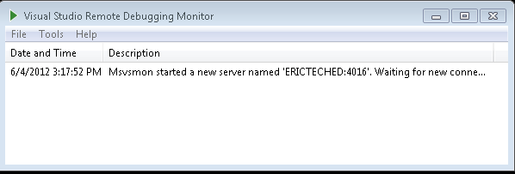
Enable Remote Debugger

Slide 14
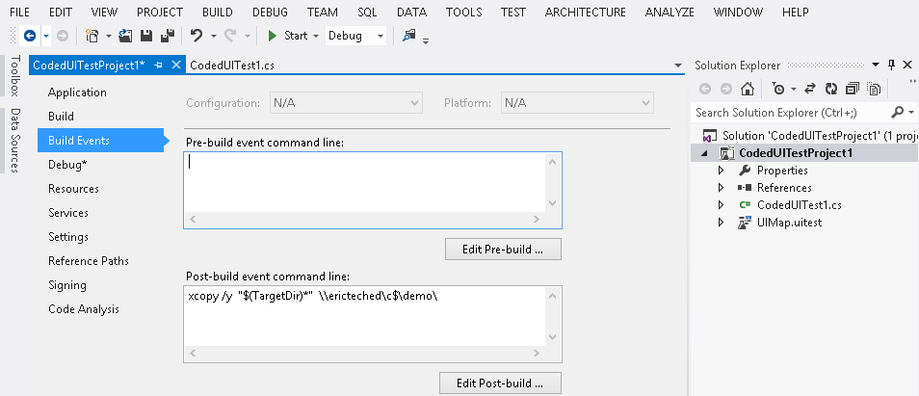
Configure Build Deployment

Slide 15
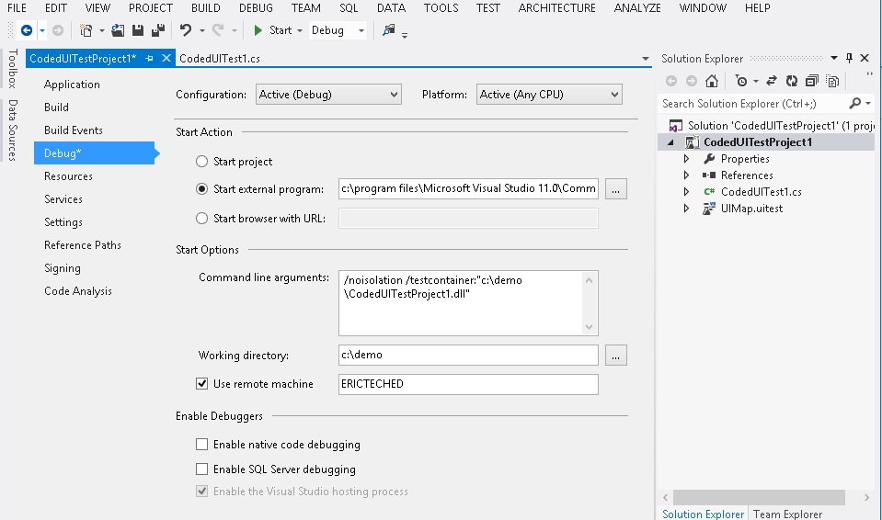
Configure Remote Debugging

Slide 16
Smart Waiters

Slide 17
Ensure Your Applications Are Testable
Use a testable application stack
Ensure controls have unique ids or names
Use naming conventions and stick with them
Use standard automation patterns
Ensure custom controls have patterns

Slide 18
DEV Track Resources
Visual Studio Home Page :: http://www.microsoft.com/visualstudio/en-us
Somasegar’s Blog :: http://blogs.msdn.com/b/somasegar/
Jason Zander’s Blog :: http://blogs.msdn.com/b/jasonz/
Facebook :: http://www.facebook.com/visualstudio
Twitter :: http://twitter.com/#!/visualstudio

Slide 19



Resources
Learning
  Connect. Share. Discuss.
  Microsoft Certification & Training Resources
http://northamerica.msteched.com
www.microsoft.com/learning
TechNet
  Resources for IT Professionals
  Resources for Developers
http://microsoft.com/technet
http://microsoft.com/msdn

Slide 20







Required Slide
Complete an evaluation on CommNet and enter to win!

Slide 21


MS Tag
Scan the Tag
to evaluate this
session now on
myTechEd Mobile

Slide 22
© 2012 Microsoft Corporation. All rights reserved. Microsoft, Windows, Windows Vista and other product names are or may be registered trademarks and/or trademarks in the U.S. and/or other countries.
The information herein is for informational purposes only and represents the current view of Microsoft Corporation as of the date of this presentation. Because Microsoft must respond to changing market conditions, it should not be interpreted to be a commitment on the
part of Microsoft, and Microsoft cannot guarantee the accuracy of any information provided after the date of this presentation. MICROSOFT MAKES NO WARRANTIES, EXPRESS, IMPLIED OR STATUTORY, AS TO THE INFORMATION IN THIS PRESENTATION.

