Slide 1
Working on an Agile Team with Visual Studio 2012 and Team Foundation Server 2012
DEV318
Peter Provost
Sr. Program Manager Lead
Microsoft Corporation

Slide 2
Agenda
PRIORITIZE
PLAN
EXECUTE
RESPOND
1
2
3
4

Slide 3

The Agile Manifesto
Individuals and
interactions
-over-
Processes and
tools
Working
software
-over-
Comprehensive
documentation
Created in 2001, it defines four values and twelve principles.
Customer
collaboration
-over-
Contract
negotiation
Responding to
change
-over-
Following a
plan
While there is value in the items below,
we value the items above more.

Slide 4
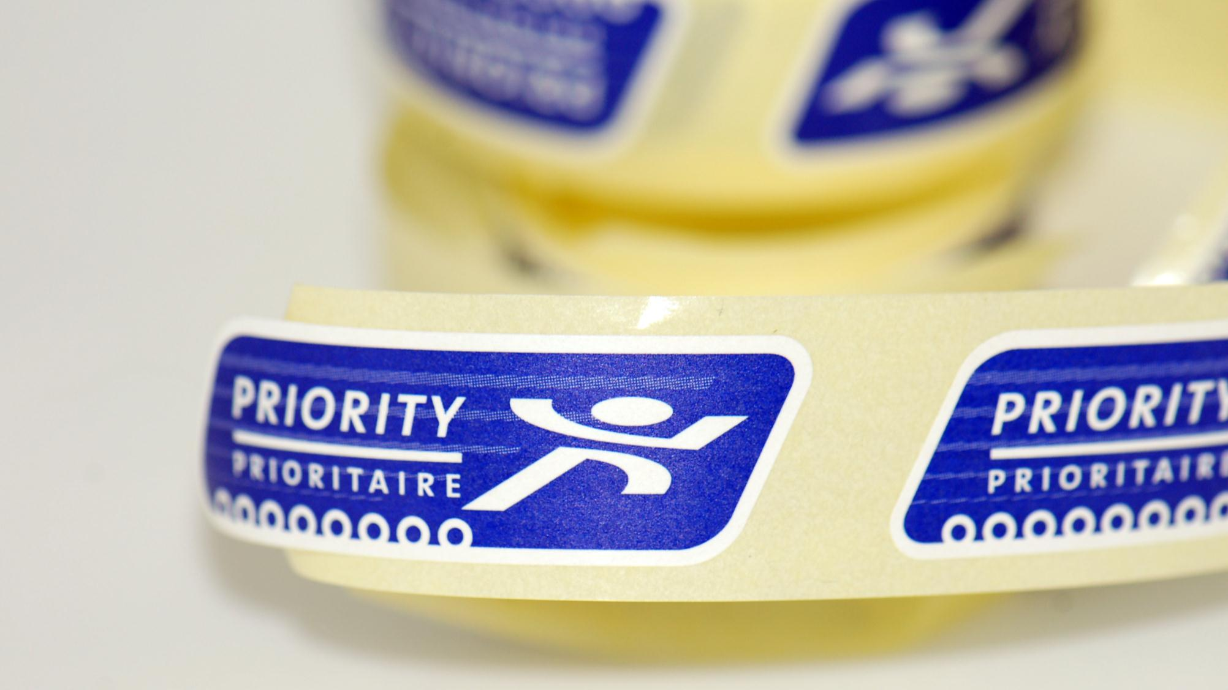
Prioritizing the work

Slide 5
PRIORITIZE
PLAN
EXECUTE
RESPOND

Slide 6
Grooming the Backlog
Product Backlog
3
8
5
Priority
3
8
1
5

Slide 7
Grooming the Backlog
Product Backlog
3
8
5
3
5
5
8
1

Slide 8
Acceptance Criteria
Product Backlog
Acceptance Criteria
I can search for ….
I can pay with a ….
I can view and edit …

Slide 9
Prioritizing
Demo
Agile backlog management with Scrum and
Team Foundation Server 2012

Slide 10

Planning the work

Slide 11
PRIORITIZE
PLAN
EXECUTE
RESPOND

Slide 12
Planning
Product Backlog
Sprint Backlog
3
5
8
5

Slide 13
Planning
Product Backlog
Sprint Backlog
5
8
5

Slide 14
Planning
Product Backlog
Sprint Backlog

Slide 15
Planning
Product Backlog
Sprint Backlog
TOO BIG!

Slide 16
Planning
Product Backlog
Sprint Backlog

Slide 17
Planning
Product Backlog
Sprint Backlog
COMMIT!

Slide 18
Planning
Demo
Scrum sprint planning with Team Foundation Server 2012

Slide 19

Executing on the plan

Slide 20
PRIORITIZE
PLAN
EXECUTE
RESPOND

Slide 21
Executing
Product Backlog
Sprint Backlog

Slide 22
Red, Green, Refactor
Tests
Code

Slide 23
Red, Green, Refactor
Tests
Code

Slide 24
Red, Green, Refactor
Tests
Code

Slide 25
Red, Green, Refactor
Tests
Code
Refactor!

Slide 26
Red, Green, Refactor
Tests
Code

Slide 27
Executing
Demo
A day in the life of an agile developer using
Visual Studio 2012 and Team Foundation Server 2012

Slide 28
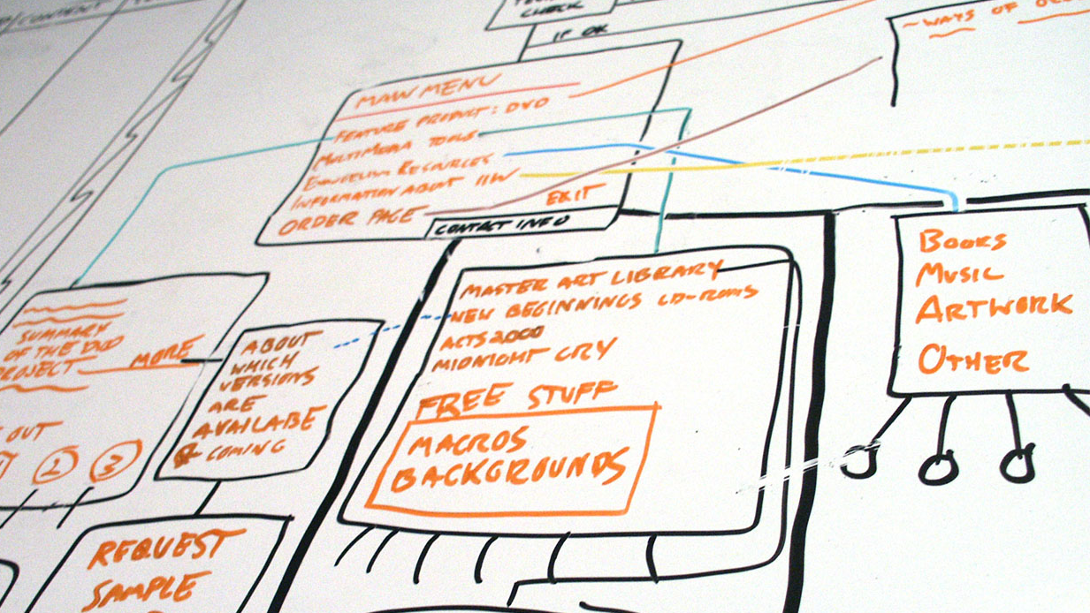
Responding to change

Slide 29
PRIORITIZE
PLAN
EXECUTE
RESPOND

Slide 30

Planning
Product Backlog
Sprint Backlog

Slide 31
Velocity
Product Backlog
Velocity
Sprint 1:
13
Sprint 2:
15
Sprint 3:
12
Sprint 4:
18

Slide 32
Grooming the Backlog
Product Backlog
Priority

Slide 33
Respond to Change
Product Backlog
Priority

Slide 34

Takeaways
Lessons from the trenches

Slide 35
10 Things to Take Away
Define done
Fail fast
Understand your team’s velocity
Finish what you start
Bugs are real work
Write unit tests – always
Autonomy, mastery, purpose
Do the right thing… at the right time
Plan until you need to learn
Quality is not a variable

Slide 36
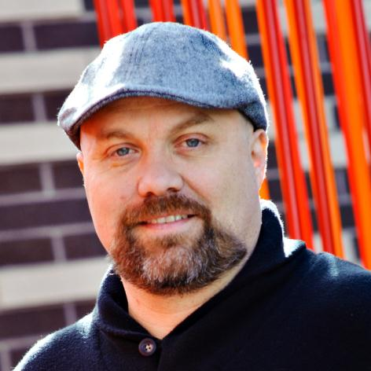

Thank you!
Have questions now?
  Please use the mics
  I will stick around outside after
Think of a question later?
  peter.provost@microsoft.com
  www.peterprovost.org
  @pprovost
Peter Provost
Find Me Later At DEV01-TLC: Application Lifecycle Management (ALM)

Slide 37

Related Content
Breakout Sessions
DEV214 Introducing the New Visual Studio 11 Unit Testing Experience
AAP401 Real World Developer Testing with Visual Studio 2012
DEV411 Testing Un-testable Code with Fakes in Visual Studio 2012
AAP330 Compile & Execute Requirements in .NET
Hands on Labs
DEV17-HOL Explore the New Unit Testing and Code Clone Capabilities of
Visual Studio 2012
Product Demo Stations
DEV01-TLC Application Lifecycle Management (ALM)

Slide 38
DEV Track Resources
Visual Studio Home Page :: http://www.microsoft.com/visualstudio/en-us
Somasegar’s Blog :: http://blogs.msdn.com/b/somasegar/
Jason Zander’s Blog :: http://blogs.msdn.com/b/jasonz/
Facebook :: http://www.facebook.com/visualstudio
Twitter :: http://twitter.com/#!/visualstudio

Slide 39



Resources
Learning
  Connect. Share. Discuss.
  Microsoft Certification & Training Resources
http://northamerica.msteched.com
www.microsoft.com/learning
TechNet
  Resources for IT Professionals
  Resources for Developers
http://microsoft.com/technet
http://microsoft.com/msdn

Slide 40







Complete an evaluation on CommNet and enter to win!

Slide 41


MS Tag
Required Slide
*delete this box when your slide is finalized
Your MS Tag will be inserted here during the final scrub.
Scan the Tag
to evaluate this
session now on
myTechEd Mobile

Slide 42
© 2012 Microsoft Corporation. All rights reserved. Microsoft, Windows, Windows Vista and other product names are or may be registered trademarks and/or trademarks in the U.S. and/or other countries.
The information herein is for informational purposes only and represents the current view of Microsoft Corporation as of the date of this presentation. Because Microsoft must respond to changing market conditions, it should not be interpreted to be a commitment on the
part of Microsoft, and Microsoft cannot guarantee the accuracy of any information provided after the date of this presentation. MICROSOFT MAKES NO WARRANTIES, EXPRESS, IMPLIED OR STATUTORY, AS TO THE INFORMATION IN THIS PRESENTATION.

