Slide 1
Continuous Feedback in Agile Teams
DEV321
Justin Marks
Senior Program Manager
Microsoft Corporation
Sebastian Holst
Chief Marketing Officer
PreEmptive Solutions

Slide 2
Delivering Continuous
Value
OPERATIONAL EXCELLENCE
TIMELY INNOVATION

Slide 3
Impediments to Delivering Value
DEFINE
Value definition and ideation
OPERATE
Deployment to
Continuous Improvement
Misunderstood requirements
Long value delivery cycle times
Misalignment with PMO
Excessive prioritization chum
Incident root cause analysis
Tooling silos
No repros -> delays in MTTR
Long process for production deploy
PRODUCT BACKLOG
DELIVER
Idea to working software
No built-in quality
Late detection of defects
Siloed dev/test tooling
Poor build and test
environments management
Inability to overcome
technical debt
Unmet user expectations
Sprint
Monitor
OPS BACKLOG
CYCLE TIME
MEAN TIME TO REPAIR

Slide 4
Enabling Continuous Value Delivery
DEFINE
Value definition and ideation
OPERATE
Deployment to
Continuous Improvement
Backlog and sprint management
Visual task boards
Storyboarding tools
PRODUCT BACKLOG
DELIVER
Idea to working software
Sprint
Monitor
OPS BACKLOG
CYCLE TIME
MEAN TIME TO REPAIR

Slide 5

A picture is worth a 1000 words

Slide 6
PowerPoint Storyboarding
demo

Slide 7
Enabling Continuous Value Delivery
DEFINE
Value definition and ideation
OPERATE
Deployment to
Continuous Improvement
Backlog and sprint management
Visual task boards
Storyboarding tools
PRODUCT BACKLOG
DELIVER
Idea to working software
Architecture modeling and validation
Best in class developer productivity
Test driven development
  Unit testing frameworks
  QoS testing tools
    Load testing
    Performance testing
Build and test lab management
Team build
Built in continuous integration
Exploratory testing
Feedback collection and integration
Sprint
Monitor
OPS BACKLOG
CYCLE TIME
MEAN TIME TO REPAIR

Slide 8
Stakeholder Feedback
demo

Slide 9
Enabling Continuous Value Delivery
DEFINE
Value definition and ideation
OPERATE
Deployment to
Continuous Improvement
Backlog and sprint management
Visual task boards
Storyboarding tools
Production debugging: IntelliTrace
Integrated incident management
(System Center -> TFS integration)
PreEmptive Analytics
PRODUCT BACKLOG
DELIVER
Idea to working software
Sprint
Monitor
Architecture modeling and validation
Best in class developer productivity
Test driven development
  Unit testing frameworks
  QoS testing tools
    Load testing
    Performance testing
Build and test lab management
Team build
Built in continuous integration
Exploratory testing
Feedback collection and integration
OPS BACKLOG
CYCLE TIME
MEAN TIME TO REPAIR

Slide 10
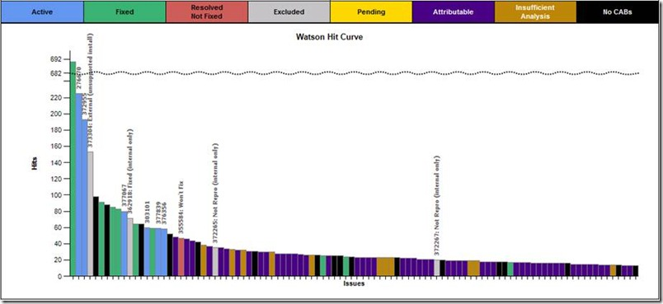

20% of errors cause 80% of user issues

Slide 11
Runtime Intelligence & PreEmptive Analytics for TFS
partner

Slide 12

PreEmptive Analytics
Clarify requirements
FEEDBACK
Actionable application and user feedback
Support priorities
PRODUCT BACKLOG
Validate test plans against user patterns and preferences
Prevent and detect tampering
Sprint
Monitor
INSTRUMENTATION
OPS BACKLOG
Post-compile instrumentation beyond the data center and across app layers
Near real-time alerts
CYCLE TIME
MEAN TIME TO REPAIR
HARDENING
IP protection, privacy & opt-in policy enforcement, and tamper defense

Slide 13
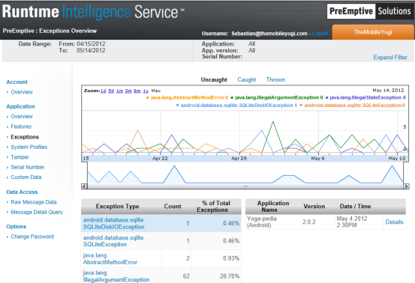
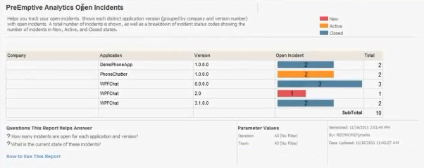
PreEmptive Analytics
Instrumentation
Injection: .NET & Java
API: Native, JavaScript, Java …
Surface & Platform
Server, thick client, mobile, cloud, web (ASP.net, HTML5, …)
Repository
SaaS and On-Premises
Runtime Intelligence
Custom data, opt-in enforcement, offline caching, user behavior…
PreEmptive Analytics for TFS
Rule-driven intelligent work item creation connecting development and operations through near real-time alerts and encoding of business priorities.

Slide 14
A sprint through Runtime Intelligence
demo

Slide 15
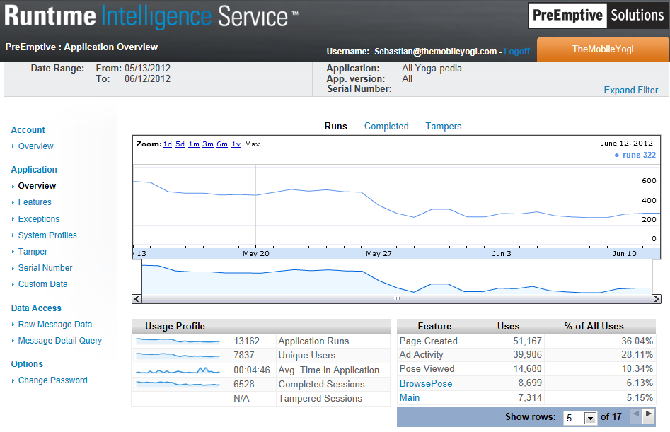

Slide 16
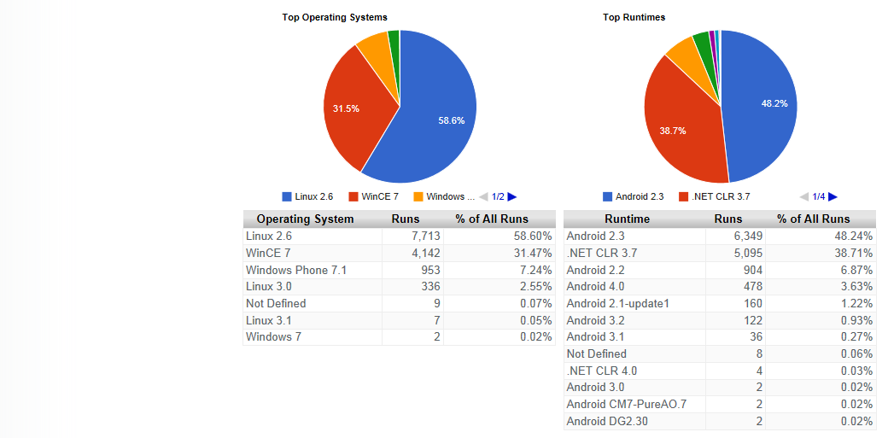

Slide 17
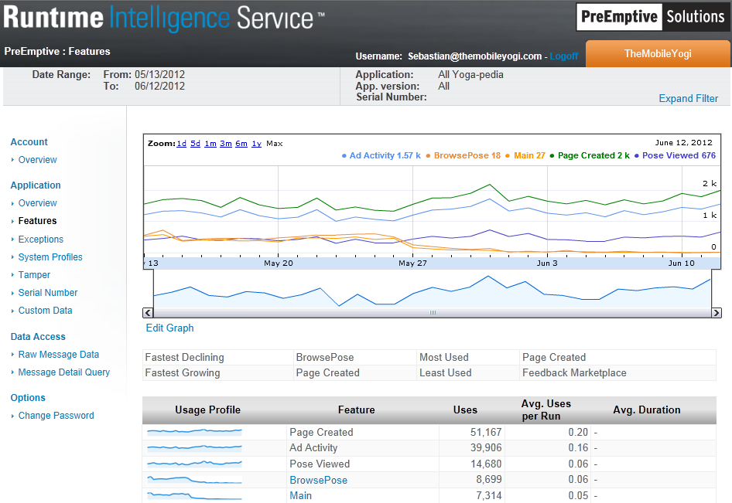

Slide 18
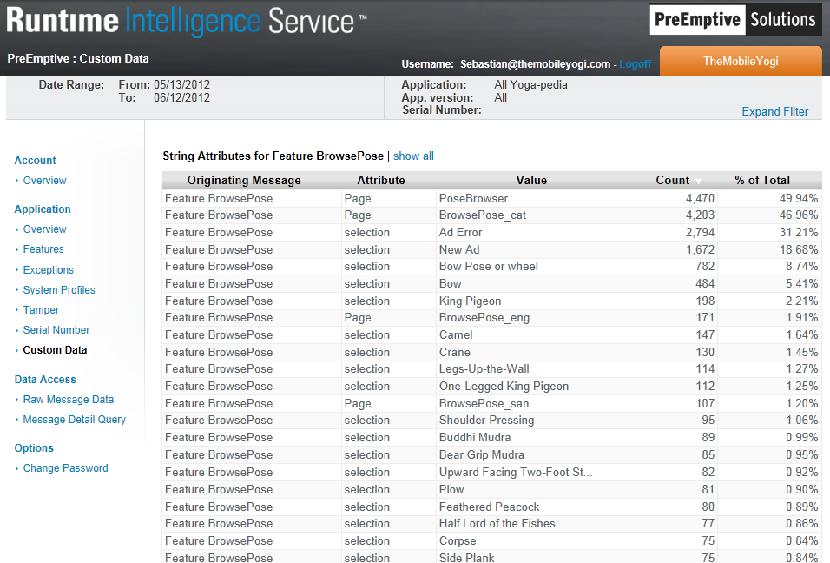

Slide 19
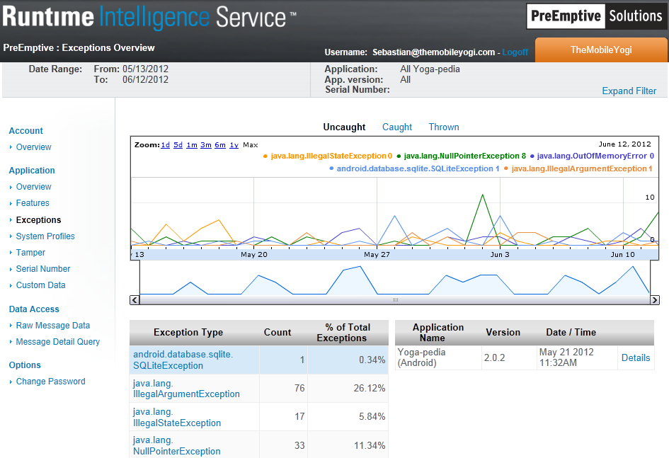

Slide 20
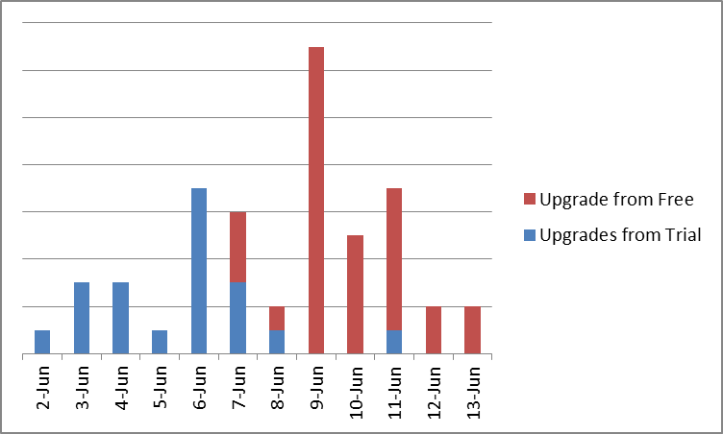
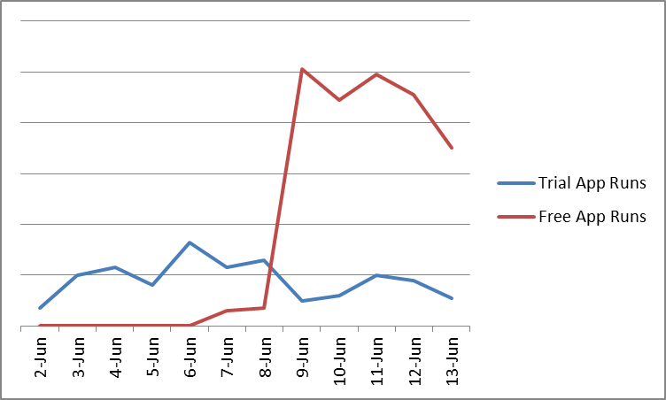
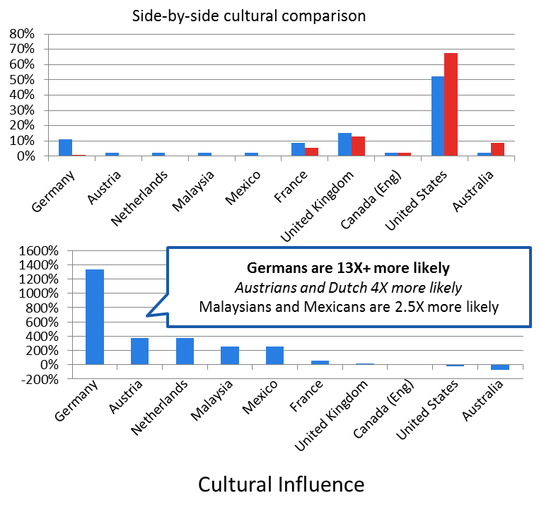
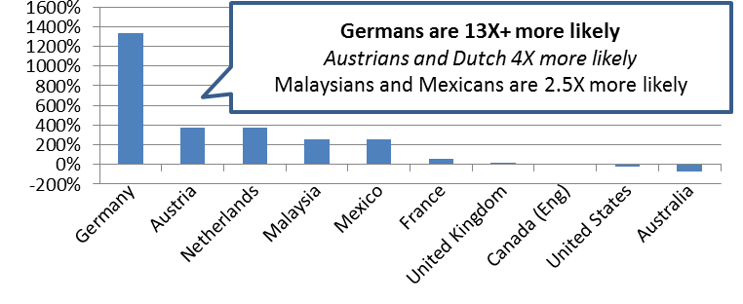
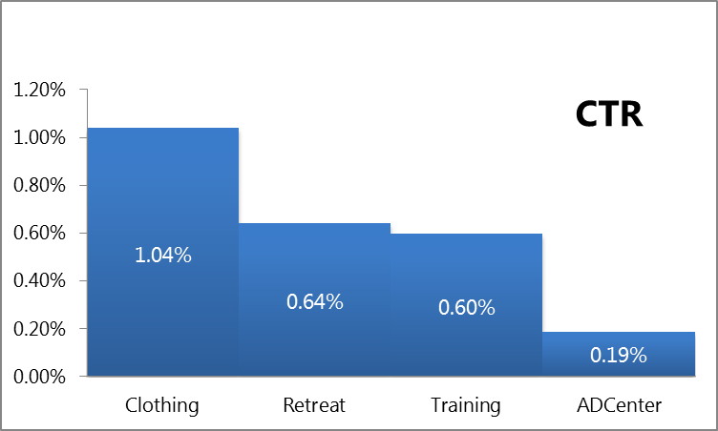
Maximizing revenue within Yoga-pedia
Try – Buy - Freemium
Know thy user: A/B/n testing
Culture drives user experience and software quality

Slide 21
PreEmptive Analytics for TFS
demo

Slide 22

Enabling Continuous Value Delivery
DEFINE
Value definition and ideation
OPERATE
Deployment to
Continuous Improvement
Backlog and sprint management
Visual task boards
Storyboarding tools
Production debugging: IntelliTrace
Integrated incident management
(System Center -> TFS integration)
PreEmptive Analytics
PRODUCT BACKLOG
DELIVER
Idea to working software
Sprint
Monitor
Architecture modeling and validation
Best in class developer productivity
Test driven development
  Unit testing frameworks
  QoS testing tools
    Load testing
    Performance testing
Build and test lab management
Team build
Built in continuous integration
Exploratory testing
Feedback collection and integration
OPS BACKLOG
CYCLE TIME
MEAN TIME TO REPAIR

Slide 23
Developer Tools, Languages & Frameworks
ALM Sessions
  June 13
Title | Primary Speaker | Start (US) | Finish (US)
Working on an Agile Team with Visual Studio 2012 and Team Foundation Server 2012 | Gregg Boer; Peter Provost | 5:00PM | 6:15PM
  June 14
Title | Primary Speaker | Start (US) | Finish (US)
Metrics That Matter: Improving Lean and Agile, Kanban and Scrum | Steven Borg | 8:30AM | 9:45AM
Introduction to Kanban | Steven Borg | 1:00PM | 2:15PM

Slide 24
Developer Tools, Languages & Frameworks
Hands On Labs
Code | Title
DEV11-HOL | Agile Project Management in Team Foundation Server 2012
DEV12-HOL | Build the Right Software and Collaborate Effectively Using Storyboarding and Feedback Tools in Visual Studio 2012
DEV13-HOL | Using IntelliTrace with Production Systems to Quickly Diagnose and Fix Issues
DEV16-HOL | Learn How Microsoft Test Manager 2012 Will Embrace an Exploratory Testing Approach
DEV17-HOL | Explore the New Unit Testing and Code Clone Capabilities of Visual Studio 2012
DEV19-HOL | Discover How the New Features of Team Foundation Server 2012 Can Improve Collaboration in Your Development Team
Try out the VS11 ALM Hands On Labs at home
http://aka.ms/vs11almvm

Slide 25

DEV Track Resources
Visual Studio Home Page :: http://www.microsoft.com/visualstudio/en-us
Somasegar’s Blog :: http://blogs.msdn.com/b/somasegar/
Jason Zander’s Blog :: http://blogs.msdn.com/b/jasonz/
Facebook :: http://www.facebook.com/visualstudio
Twitter :: http://twitter.com/#!/visualstudio

Slide 26



Resources
Learning
  Connect. Share. Discuss.
  Microsoft Certification & Training Resources
http://northamerica.msteched.com
www.microsoft.com/learning
TechNet
  Resources for IT Professionals
  Resources for Developers
http://microsoft.com/technet
http://microsoft.com/msdn

Slide 27







Required Slide
Complete an evaluation on CommNet and enter to win!

Slide 28


MS Tag
Scan the Tag
to evaluate this
session now on
myTechEd Mobile

Slide 29
© 2012 Microsoft Corporation. All rights reserved. Microsoft, Windows, Windows Vista and other product names are or may be registered trademarks and/or trademarks in the U.S. and/or other countries.
The information herein is for informational purposes only and represents the current view of Microsoft Corporation as of the date of this presentation. Because Microsoft must respond to changing market conditions, it should not be interpreted to be a commitment on the
part of Microsoft, and Microsoft cannot guarantee the accuracy of any information provided after the date of this presentation. MICROSOFT MAKES NO WARRANTIES, EXPRESS, IMPLIED OR STATUTORY, AS TO THE INFORMATION IN THIS PRESENTATION.

Slide 30

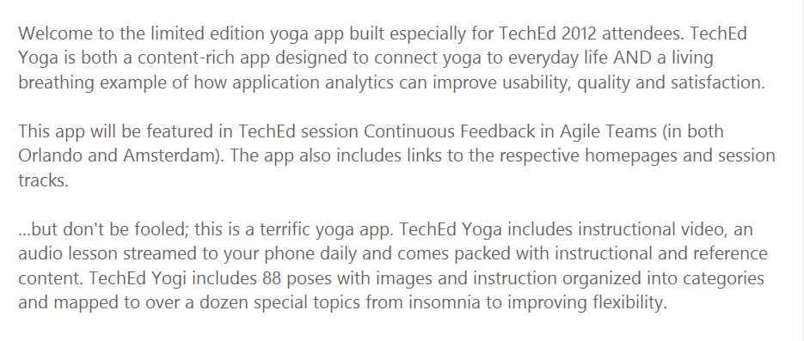
Have a Windows Phone?
Download our companion app: TechEd Yoga

