Slide 1
What’s New in WF4.5
DEV329
Dave Cliffe
Program Manager
Microsoft Corporation

Slide 2

GUESS WHO?
WF in
.NET
PULSE
WF4.*
WF4.5

Slide 3
Agenda
Why Workflow?
WF in .NET 4.5 & VS 2012
  A Lap Around WF 4.5
  Demos
  Details about the features!
Q & A – throughout, if we don’t blab too much

Slide 4
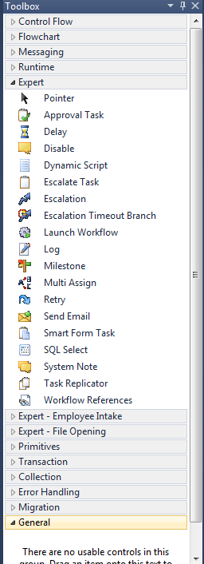
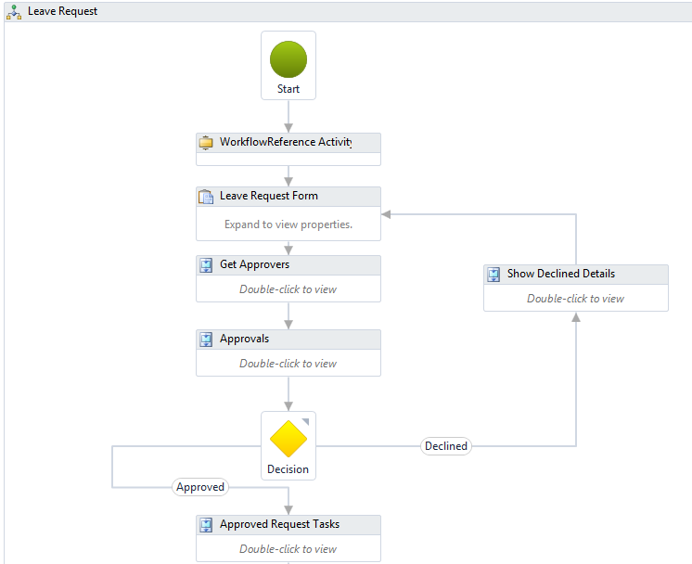
Recap - Why Workflow?
Customizable business processes
Coordination of long-running work
Transparency
(*) screenshot from Aderant Expert

Slide 5


Key Investments
WF 4.5
w
This session is focused on WF4.5 in VS 2012
AZR321 Building, Running, and Managing Workflows in Windows Azure
By: Jurgen Willis
Thursday 6/14/2012 13:00 - 14:15

Slide 6
A Lap Around WF 4.5
Key new features
Ask | Feature
Expressions in the language of the project | C# expressions
Create workflow services based on an existing contract | Contract-First
Better experience with Flowchart / State Machine designer | Auto-connect, auto-insert, pan
Add comments to activities in the designer surface | Annotations (designer)
Search integration in the workflow designer | Search (designer)
Create state machine workflows | State Machine
Workflow activities are shown in a tree-style outline view | Outline View
D
D
D
Authoring Improvements
D
D
D
Basic building blocks for a versioning story | WorkflowIdentity
Host several versions of a service side by side | WFSH versioning support
Update running instances to a new definition | Dynamic Update
D
Versioning
D
D
Runtime Enhancements
Run my workflows in Partial Trust | Partial Trust
Be able to plug my own expressions story | Expressions Extensibility
Better runtime performance | VB expressions performance

Slide 7
Authoring Improvements
DEMO
pan, search, outline, annotations, auto-connect, auto-insert, auto-surround with sequence, C# expressions

Slide 8


Contract-First Authoring
In WF 4 …
  Contracts are inferred from the messaging activities in the workflow

Slide 9
Contract-First Authoring
In WF 4.5 …
  Implement your workflow from an existing contract
  Validate that the contract is implemented correctly/completely

Slide 10
Contract-First Authoring
DEMO

Slide 11
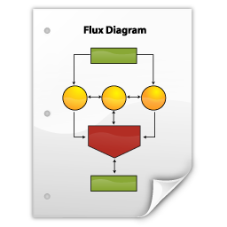


Recap - WF 3.5 Persistence
Workflow Definition
(XOML)
Workflow Definition
(XOML)
Instance Data
Instance Data
Instance Store

Slide 12
WF 4 Persistence
Workflow Definition
(XAML)
Instance Data
Instance Data
Instance Store

Slide 13


WF 4 Persistence
Exception (?)
Workflow Definition
(XAML)
Workflow (v2)
Instance Data (v?)
Instance Data
Instance Store

Slide 14

WorkflowIdentity … to the rescue!
WorkflowIdentity
Version Mismatch
Side-by-Side
Dynamic Update
Associates an instance with its definition
Represented by a Name + Version
Persisted and queryable as part of the instance state
Enables customizable load behavior

Slide 15
WF 4.5 Persistence
“My Workflow”
1.0.0.0
Instance Data for
“My Workflow”
1.0.0.0
Instance Data (1.0.0.0)
Instance Store

Slide 16
Version Mismatch
Exception
(Version Mismatch)
“My Workflow”
1.0.0.0
“My Workflow”
2.0.0.0
Instance Data for
“My Workflow”
1.0.0.0
Instance Data (1.0.0.0)
Instance Store

Slide 17
Side-by-Side Versioning Scenarios
PHASED-IN BUSINESS PROCESS CHANGE
Applications Started Before 12/31/2011
Applications Started After 1/1/2012
Client
Mortgage
Application Process
Receive
Application
Mortgage Application Process
Side-by-Side Execution
Receive
Application
Verify
Income
Approve
Application
Approve
Application
Issue
Loan
Issue
Loan

Slide 18
Side-by-Side
“My Workflow”
2.0.0.0
“My Workflow”
1.0.0.0
Instance Data for
“My Workflow”
1.0.0.0
Instance Data (1.0.0.0)
Instance Data for
“My Workflow”
2.0.0.0
Instance Data (2.0.0.0)
Instance Store

Slide 19
WorkflowServiceHost
Side-by-Side Versioning
DEMO

Slide 20

Dynamic Update Scenarios
REQUIRED PROCESS CHANGE
BUG FIX
Mortgage Application Process
Receive
Application
Approve
Application
Issue
Loan
Mortgage
Application Process
Receive
Application
Verify
Income
Approve
Application
Issue
Loan

Slide 21

Dynamic Update
Create Update map
“My Workflow”
1.0.0.0
“My Workflow”
2.0.0.0

Slide 22
Dynamic Update
APPLY UPDATE MAP
Instance Data for
“My Workflow”
1.0.0.0
Instance Data for
“My Workflow”
2.0.0.0

Slide 23
Dynamic Update
DEMO

Slide 24
Summary
WF4.5 addresses top customer painpoints!
  Large workflow navigation
  Designer productivity++
  Contract-first authoring
  Versioning, Versioning, Versioning
Workflow is a great platform for …
  Customizable business processes
  Coordinating long-running work
  Authoring/managing transparent programs

Slide 25


Related Content
Breakout Sessions
AZR321 Building, Running, and Managing Workflows in Windows Azure
By: Jurgen Willis
Thursday 6/14/2012 13:00 - 14:15
Other Great Resources
Samples: http://code.msdn.microsoft.com (keyword: WF 4.5)
UserVoice: http://bit.ly/wfuservoice
WF blog: http://blogs.msdn.com/workflowteam
WF Dev Center: http://msdn.microsoft.com/wf
Codeplex: http://wf.codeplex.com/
Find Me Later At… The Attendee Party!

Slide 26
DEV Track Resources
Visual Studio Home Page :: http://www.microsoft.com/visualstudio/en-us
Somasegar’s Blog :: http://blogs.msdn.com/b/somasegar/
Jason Zander’s Blog :: http://blogs.msdn.com/b/jasonz/
Facebook :: http://www.facebook.com/visualstudio
Twitter :: http://twitter.com/#!/visualstudio

Slide 27



Resources
Learning
  Connect. Share. Discuss.
  Microsoft Certification & Training Resources
http://northamerica.msteched.com
www.microsoft.com/learning
TechNet
  Resources for IT Professionals
  Resources for Developers
http://microsoft.com/technet
http://microsoft.com/msdn

Slide 28







Complete an evaluation on CommNet and enter to win!

Slide 29





Please Complete an Evaluation
Your feedback is important!
Be eligible
to win great daily prizes and the grand prize of a $5,000 Travel Voucher!
Multiple
ways to Evaluate Sessions
Scan the Tag
to evaluate this
session now
on myTechEd Mobile

Slide 30
© 2012 Microsoft Corporation. All rights reserved. Microsoft, Windows, Windows Vista and other product names are or may be registered trademarks and/or trademarks in the U.S. and/or other countries.
The information herein is for informational purposes only and represents the current view of Microsoft Corporation as of the date of this presentation. Because Microsoft must respond to changing market conditions, it should not be interpreted to be a commitment on the
part of Microsoft, and Microsoft cannot guarantee the accuracy of any information provided after the date of this presentation. MICROSOFT MAKES NO WARRANTIES, EXPRESS, IMPLIED OR STATUTORY, AS TO THE INFORMATION IN THIS PRESENTATION.

