Slide 1
Building Business Applications in LightSwitch
DEV348
Jay Schmelzer
Director of Program Management – Visual Studio
Microsoft Corporation

Slide 2
What is LightSwitch for Visual Studio 2012?
Rapid Application Development (RAD) environment in Visual Studio for building data-based business applications
Plumbing is all handled for you, the only code you write is the business logic
LightSwitch provides a roadmap for the application as its needs and user base grows
  Flexible deployment model requires no code changes
  Easy publish to Azure cloud

Slide 3
Hello LightSwitch
demo

Slide 4
The LightSwitch Development Experience
Start
Describe your data
Create screens for common tasks
Refine
Author business logic
Customize screen layouts
Define custom queries
Extend
Explore ecosystem components
Create custom controls
Integrate with custom data sources

Slide 5
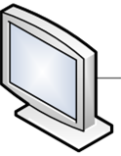


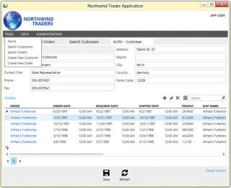
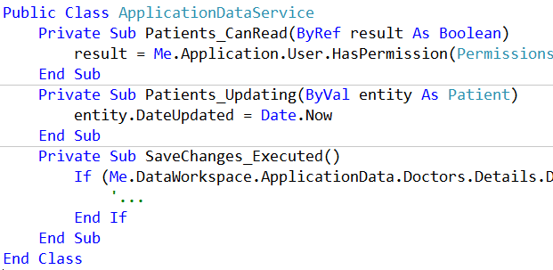
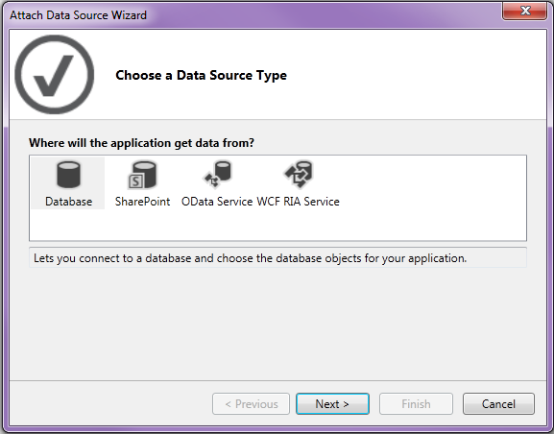
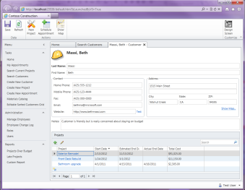
LightSwitch Architecture
Client Tier
Middle Tier
Data Access
Screens
Methods
Controls
Submit Pipeline
Queries
Data Workspace
Data Workspace
WCF Data Service
WCF Data Service
SQL Server
Azure
SharePoint
OData Services
Silverlight
ASP.NET
Other…
Browser Host
Desktop Host
IIS

Slide 6
LightSwitch for Visual Studio 2012 Design Goals
Open up services for interoperability with other systems
Make it easier to work with legacy databases
Modernize the client’s look-and-feel
Make deployment easier and predictable
Address customer feedback

Slide 7
LightSwitch for Visual Studio 2012 Enhancements
Middle-tier Services
  WCF Data Services now provides open data (OData) endpoints
  Opening up the middle-tier enables other clients
Data
  Consume OData services
  “Conceptual” foreign keys in database data sources (a.k.a virtual relationships in same container)
  Row-level entity set filtering
  New Business Types: Web Address, Percentage
  SQL Server LocalDB support

Slide 8
Building and Consuming OData Services w/LightSwitch
demo

Slide 9
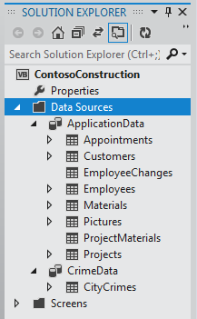
LightSwitch OData Service Mapping
Access the service endpoints by data source name
Use standard OData URI conventions for CRUD operations
http://mysite.../ApplicationData.svc
.../ApplicationData.svc/Appointments
.../ApplicationData.svc/Customers
…
http://mysite.../CrimeData.svc
.../CrimeData.svc/CityCrimes

Slide 10

LightSwitch OData Service Architecture
Each data source exposed as a service endpoint
Business rules & user permissions run no matter what client is talking to the services
LightSwitch Middle-tier (rules pipeline)
LightSwitch Client
Intrinsic Data
ApplicationData.svc
Other OData Clients
External Data Source
MyDataSource.svc

Slide 11
LightSwitch for Visual Studio 2012 Enhancements (cont.)
Security
  Active Directory security group support
UI design improvements
  New Cosmopolitan Shell (default for new projects)
  Static images/text, group box, formatting
  Logo on Login screen
Deployment Enhancements
  Simpler Publishing Experience to Azure & IIS

Slide 12
UI Design Improvements
demo

Slide 13
Deployment Improvements
demo

Slide 14
LightSwitch for Visual Studio 2012
The simplest way to create modern line of
business applications for the enterprise.

Slide 15

Join the Growing Community!
LightSwitch Team Blog: blogs.msdn.com/LightSwitch
Developer Center: msdn.com/LightSwitch
Forums: bit.ly/LightSwitchForums
Facebook: www.facebook.com/VSLightSwitch
Twitter: @vslightswitch

Slide 16


DEV Track Resources
Visual Studio Home Page :: http://www.microsoft.com/visualstudio/en-us
Somasegar’s Blog :: http://blogs.msdn.com/b/somasegar/
Jason Zander’s Blog :: http://blogs.msdn.com/b/jasonz/
Facebook :: http://www.facebook.com/visualstudio
Twitter :: http://twitter.com/#!/visualstudio

Slide 17



Resources
Learning
  Connect. Share. Discuss.
  Microsoft Certification & Training Resources
http://northamerica.msteched.com
www.microsoft.com/learning
TechNet
  Resources for IT Professionals
  Resources for Developers
http://microsoft.com/technet
http://microsoft.com/msdn

Slide 18







Required Slide
Complete an evaluation on CommNet and enter to win!

Slide 19

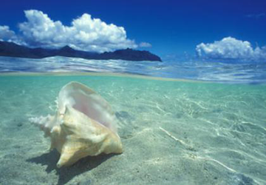
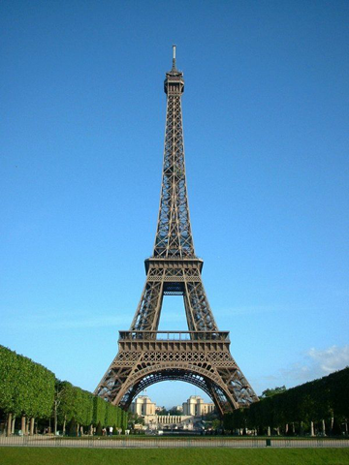


Please Complete an Evaluation
Your feedback is important!
Be eligible
to win great daily prizes and the grand prize of a $5,000 Travel Voucher!
Multiple
ways to Evaluate Sessions
Scan the Tag
to evaluate this
session now
on myTechEd Mobile

Slide 20
© 2012 Microsoft Corporation. All rights reserved. Microsoft, Windows, Windows Vista and other product names are or may be registered trademarks and/or trademarks in the U.S. and/or other countries.
The information herein is for informational purposes only and represents the current view of Microsoft Corporation as of the date of this presentation. Because Microsoft must respond to changing market conditions, it should not be interpreted to be a commitment on the
part of Microsoft, and Microsoft cannot guarantee the accuracy of any information provided after the date of this presentation. MICROSOFT MAKES NO WARRANTIES, EXPRESS, IMPLIED OR STATUTORY, AS TO THE INFORMATION IN THIS PRESENTATION.

