Slide 1
Using Windows Runtime and SDK to build Metro style apps
DEV350
John Lam
Principal Program Manager Lead
jlam@microsoft.com @john_lam
Microsoft Corporation

Slide 2

Beer
http://www.flickr.com/photos/kellbailey/1763951722/

Slide 3

Donuts
http://www.flickr.com/photos/msvg/5200730922/

Slide 4

Coffee
http://www.flickr.com/photos/visualpanic/334916864/

Slide 5

C#
http://en.wikipedia.org/wiki/File:Anders_Hejlsberg.jpg

Slide 6

Visual Basic
http://en.wikipedia.org/wiki/File:AlanCooper.jpg

Slide 7
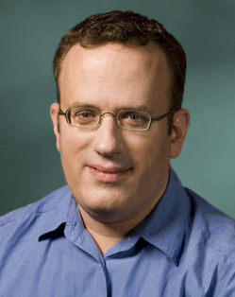
JavaScript
http://en.wikipedia.org/wiki/File:BEich.jpg

Slide 8
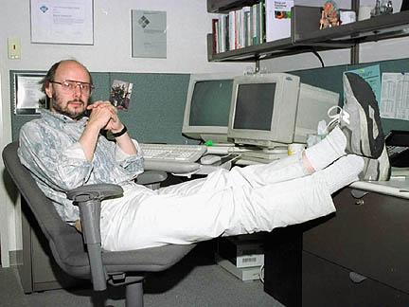
C++
http://en.wikipedia.org/wiki/File:BjarneStroustrup.jpg

Slide 9
Runtime Experience Team
JavaScript [Chakra]
C#/VB & CLR
C++ & Windows SDK

Slide 10
No Programmer Left Behind

Slide 11
WinRT and the Metro style SDK
Easily create apps
Rich apps that use all of Windows
High quality apps
WinRT and the Metro style SDK

Slide 12
WinRT and the Metro style SDK
HTML/CSS/JavaScript
Use what you know
C#/VB/C++/XAML
Easily create apps
C++/DirectX
3rd party existing code
Use what you have
Your existing code

Slide 13
WinRT and the Metro style SDK
Contracts
Samples
Rich apps that use all of Windows
Capabilities
APIs

Slide 14
WinRT and the Metro style SDK
Async everywhere
Debugging
High quality apps
Onboarding to Store
Trustworthy

Slide 15
Let’s code!
demo

Slide 16
WinRT and the Metro style SDK
Easily create apps
Rich apps that use all of Windows
High quality apps
WinRT and the Metro style SDK

Slide 17


Related Content
Breakout Sessions
  DEV352: What Web Developers Need to Know When Building Metro style Apps
  DEV353: Building Metro style Apps with XAML
  DEV354: Building Windows 8 Metro style UIs
  DEV366: Building Metro style Apps with HTML and JavaScript

Slide 18
DEV Track Resources
Visual Studio Home Page :: http://www.microsoft.com/visualstudio/en-us
Somasegar’s Blog :: http://blogs.msdn.com/b/somasegar/
Jason Zander’s Blog :: http://blogs.msdn.com/b/jasonz/
Facebook :: http://www.facebook.com/visualstudio
Twitter :: http://twitter.com/#!/visualstudio

Slide 19



Resources
Learning
  Connect. Share. Discuss.
  Microsoft Certification & Training Resources
http://northamerica.msteched.com
www.microsoft.com/learning
TechNet
  Resources for IT Professionals
  Resources for Developers
http://microsoft.com/technet
http://microsoft.com/msdn

Slide 20







Required Slide
Complete an evaluation on CommNet and enter to win!

Slide 21


MS Tag
Scan the Tag
to evaluate this
session now on
myTechEd Mobile

Slide 22
© 2012 Microsoft Corporation. All rights reserved. Microsoft, Windows, Windows Vista and other product names are or may be registered trademarks and/or trademarks in the U.S. and/or other countries.
The information herein is for informational purposes only and represents the current view of Microsoft Corporation as of the date of this presentation. Because Microsoft must respond to changing market conditions, it should not be interpreted to be a commitment on the
part of Microsoft, and Microsoft cannot guarantee the accuracy of any information provided after the date of this presentation. MICROSOFT MAKES NO WARRANTIES, EXPRESS, IMPLIED OR STATUTORY, AS TO THE INFORMATION IN THIS PRESENTATION.

