Slide 1
Advanced IntelliTrace in Production
DEV365
Larry Guger
Program Manager
Microsoft Corporation

Slide 2


Questions?
Ever had a problem in production where you had to dive into the code?
Text me: 503.841.1893
503.841.1893

Slide 3
Standalone Collector - Where can you use it?
Desktop
Web Server
Production (or not)
503.841.1893

Slide 4
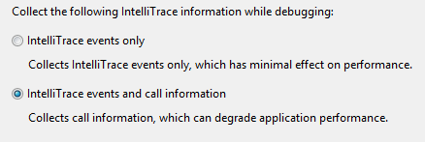
What data is collected?
503.841.1893

Slide 5

public class Employee
{
public int ID { get; set; }
[DisplayName("First Name")]
public string FirstName { get; set; }
[DisplayName("Last Name")]
public string LastName { get; set; }
public Address Address { get; set; }
public IEnumerable<Phone> Phone { get; set; }
public string Identity { get; set; }
[DisplayName("Service Areas")]
public string ServiceAreas { get; set; }
[DisplayName("Full Name")]
public string FullName
{
get { return string.Format("{0} {1}", this.FirstName, this.LastName); }
}
}

Slide 6

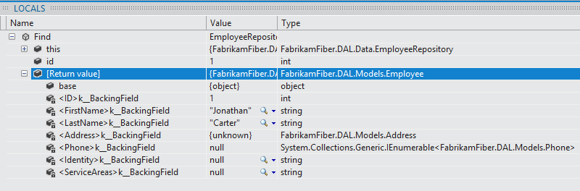
Address
string Street
string City
string State
string Zip
Employee
int ID
string FirstName
string LastName
string Identity
string ServiceAreas
IEnumerable<Phone>
IEnumerator <T>
Data that is collected

Slide 7
IntelliTrace
demo
503.841.1893

Slide 8
The Ask
Try it!
Tell me about it!
larrygug@microsoft.com
503.841.1893

Slide 9

Related Content
Breakout Sessions (DEV317, DEV363)
Hands-on Labs (DEV13-HOL IntelliTrace with Production)
Product Demo Stations (Visual Studio ALM Booth)
Related Certification Exam - NA
Find Me Later At The Visual Studio ALM Booth

Slide 10
DEV Track Resources
Visual Studio Home Page :: http://www.microsoft.com/visualstudio/en-us
Somasegar’s Blog :: http://blogs.msdn.com/b/somasegar/
Jason Zander’s Blog :: http://blogs.msdn.com/b/jasonz/
Facebook :: http://www.facebook.com/visualstudio
Twitter :: http://twitter.com/#!/visualstudio

Slide 11



Resources
Learning
  Connect. Share. Discuss.
  Microsoft Certification & Training Resources
http://northamerica.msteched.com
www.microsoft.com/learning
TechNet
  Resources for IT Professionals
  Resources for Developers
http://microsoft.com/technet
http://microsoft.com/msdn

Slide 12







Required Slide
Complete an evaluation on CommNet and enter to win!

Slide 13


MS Tag
Scan the Tag
to evaluate this
session now on
myTechEd Mobile

Slide 14
© 2012 Microsoft Corporation. All rights reserved. Microsoft, Windows, Windows Vista and other product names are or may be registered trademarks and/or trademarks in the U.S. and/or other countries.
The information herein is for informational purposes only and represents the current view of Microsoft Corporation as of the date of this presentation. Because Microsoft must respond to changing market conditions, it should not be interpreted to be a commitment on the
part of Microsoft, and Microsoft cannot guarantee the accuracy of any information provided after the date of this presentation. MICROSOFT MAKES NO WARRANTIES, EXPRESS, IMPLIED OR STATUTORY, AS TO THE INFORMATION IN THIS PRESENTATION.

