Slide 1
Microsoft Exchange Server 2010 SP2 Tips & Tricks
EXL305_R
Scott Schnoll
Principal Technical Writer
Microsoft Corporation

Slide 2
Agenda
Announcements
Exchange Server 2010 SP2 – The Basics
Top Ten Tools for Exchange Administrators
Random Tips

Slide 3
The One Pager
announcing
All Microsoft Products, Rolled into One

Slide 4
The One Pager
Want to see all of Microsoft’s products at-a-glance?
The One Pagers (Enterprise and All-Up) are available now!
  The One Pager uses Zoom.it, a free service from Microsoft for viewing and sharing high-resolution imagery using Deep Zoom, which is part of Silverlight
Latest version: 2.6
Updated on a quarterly basis (next update 6/29/12)

Slide 5
Exchange Server 2010 SP2
Tips & Tricks
The Basics

Slide 6
Exchange Server 2010 Service Pack 2
Exchange 2010 SP2 update / full release bits
  Released December 4, 2011
  Download from http://aka.ms/E14SP2
  Build number 14.2.247.5
  Details on updates at http://aka.ms/E14SP2New
Latest update: Update Rollup 3 for Exchange 2010 SP2
  Released May 29, 2012
  Download from http://aka.ms/E14SP2UR3
  Build number 14.2.309.2
  List of updates and fixes at http://aka.ms/KB2685289

Slide 7
Exchange Server 2010 SP2 Server Editions
Standard
  Available via Retail and Volume Channels
  Supports up to 5 databases per server
Enterprise
  Available via Volume Channel
  Supports up to 100 databases per server
Hybrid
  Designed to be gateway between Exchange on-premises and Exchange Online

Slide 8
Exchange Server 2010 SP2 Hybrid Edition
Download Exchange 2010 SP2 from Download Center
Install Exchange and use Hybrid Edition product key
  Obtained from Office 365 Support
  Not available for Office 365 trial customers; don’t use key
Can be used only for connecting on-premises environment with Office 365
  If you move a mailbox to it, or leverage any features outside the scope of a hybrid deployment, you must purchase regular license and CALs
Multiple Hybrid Edition servers can be deployed, if needed

Slide 9
Double Schema Upgrades in SP2
Active Directory schema upgrades
  3 new classes (and class object IDs)
  59 new attributes (and attribute object IDs)
  29 new MAPI IDs
  46 new indexed attributes
  36 new global catalog attributes
  List of updates at http://aka.ms/E14SP2Schema
Database schema upgrades
  Upgraders for from RTM -> SP1 -> SP2
  Can take a while to upgrade from RTM (20-30 min)
  Affects *overs while DAG upgrade is in transition

Slide 10
Top Ten Tools
Tips & Tricks
Excluding JetStress and LoadGen ☺

Slide 11
Top Ten Tools for Exchange Administrators
Calendar Checking Tool for Outlook (CalCheck) - checks Outlook Calendar for problems / potential problems
  Version 1.2 (Released 5/30/12) - http://aka.ms/CalCheck
Exchange Client Network Bandwidth Calculator - helps you predict network bandwidth requirements for a specific set of clients
  Version .43/Beta 2 (Released 3/9/12) - http://aka.ms/ExClientCalc
Mailbox Server Role Requirements Calculator - helps you properly design Mailbox servers for your environment
  Version 18.9 (Released 4/13/12) - http://aka.ms/ExMailboxCalc

Slide 12
Top Ten Tools for Exchange Administrators
Exchange Remote Connectivity Analyzer (ExRCA) - provides a test system for administrators to use to validate external connectivity to Exchange
  Version 1.3 - https://www.TestExchangeConnectivity.com
Microsoft Outlook Configuration Analyzer Tool (OCAT) - provides a quick and easy method to analyze Outlook profiles for common configurations that cause problems
  Version 1.0 (Released 4/9/12) - http://aka.ms/OCAT
Microsoft Exchange PST Capture - discover and import PST files into Exchange Server or Exchange Online
  Version 14.3.16.4 (Released 1/29/12) - http://aka.ms/PSTCapture

Slide 13
Top Ten Tools for Exchange Administrators
Exchange Server Deployment Assistant (ExDeploy) - generates custom instructions for moving your organization to Exchange 2010 or Office 365
  Version 2.2.0.0 - http://aka.ms/ExDeploy
MFCMAPI - provides access to MAPI stores through a GUI to facilitate investigation of Exchange and Outlook issues and to provide developers with a canonical sample for MAPI development
  April 2012 (Released 4/23/12) - http://aka.ms/MFCMAPI

Slide 14
Top Ten Tools for Exchange Administrators
Microsoft Active Directory Topology Mapper - reads Active Directory configuration using LDAP, and automatically generates a Visio diagram of your Active Directory and/or Exchange topology
  Version 2.2.4146 (Released 6/6/11) - http://aka.ms/ADTD
Microsoft Exchange 2010 Visio Stencil - contains a Microsoft Office Visio stencil with shapes for Microsoft Exchange Server 2010 and later
  November 20 (Released 11/5/10) - http://aka.ms/ExVisio

Slide 15
Random Tips
Tips & Tricks
Tips used to solve recent customer problems

Slide 16
Messages in Outbox with Outlook Anywhere
Newer network devices have more aggressive timeouts
These timeouts can manifest as problems when using Outlook Anywhere; specifically, messages stuck in the Outbox
To resolve this issue, change the timeout for the RPC Proxy component to 120 second (two minutes)
  HKLM\Software\Policies\Microsoft\Windows NT\Rpc\MinimumConnectionTimeout
http://msdn.microsoft.com/en-us/library/windows/desktop/aa373592(v=vs.85).aspx

Slide 17
Split Permissions and SCOM Management Pack
When operating in the Split Permission model you cannot create the synthetic transaction accounts necessary to do certain operations with the Management Pack for Exchange 2010

Slide 18
Split Permissions and SCOM Management Pack
Add Exchange Trusted Subsystem to Exchange Windows Permissions security group
Create an OU to contain your synthetic transaction mailboxes
Grant Exchange Windows Permissions the necessary permissions on the OU by running the script in the Note section: perms.ps1 “ou=<ou name>,dc=<domain name>” where <ou name> and <domain name> are replaced with the appropriate values. Repeat for each domain in the environment that contains Exchange 2010 servers

Slide 19
Split Permissions and SCOM Management Pack
Execute the following command:
New-RoleGroup -Name "SCOM SynTran Mailbox Creators" -Roles "Mail Recipient Creation" -RecipientOrganizationalUnitScope "<domain fqdn>/<ou name>"
Add members to the SCOM SynTran Mailbox Creators security group
Allow for Active Directory replication to complete
Log off and back on to reset the security token if currently logged user was added to the group
Execute new-TestCasConnectivityUser with –OU parameter

Slide 20
Enable Logging for RPC Client Access Throttling
By default, no RPC Client Access throttling activity is logged
  PerfMon counters must be used to see how often throttling is occurring
Enable logging by modifying the Microsoft.Exchange.RpcClientAccess.Service.exe.config file in \Program Files\Microsoft\Exchange Server\V14\Bin
Add Throttling to the LoggingTag comma separated string, then restart the RPC Client Access service
  <add key="LoggingTag" value="ConnectDisconnect, Logon, Failures, ApplicationData, Warnings, Throttling " />

Slide 21
Wiped Device Can Access Mailbox
Similar to when you disable a user account and they can still access their mailbox with Outlook for up to 2 hours
If you wipe a mobile device that has a partnership, that device may able to re-establish partnership and access mailbox for up to 24 hours (same with OWA/EAS)
Solution:
  Disable the Mailbox
  Set a Send Prohibit Quota of 0
  Move the Mailbox (on-premises) / Disable protocols at CASMailbox level (Office 365)

Slide 22
Disable Mailbox Auto-Mapping in Outlook
Outlook 2007/2010 can map to any mailbox to which a user has Full Access and, through Autodiscover, automatically loads all mailboxes to which the user has Full Access
If the user has Full Access to a large number of mailboxes, performance suffers when starting Outlook
SP2 enables admin to disable this behavior by setting new Automapping parameter for Add-MailboxPermission to False
See http://aka.ms/gxxxk1 for steps

Slide 23
Sync Active Directory and the Information Store
In large environments, you may need to periodically scan Active Directory for disconnected mailboxes that aren't yet marked as disconnected in the Information Store and update the status of those mailboxes in the Store
You can use Clean-MailboxDatabase to do this, but that requires mailbox database GUIDs
    To get the GUID:
    Get-MailboxDatabase | fl Identity, Guid
    Or simply run
    Get-MailboxDatabase | Clean-MailboxDatabase

Slide 24
Get All Email Addresses for a Domain
  Get-Recipient | where {$_.emailaddresses
  -match “contoso.com”} | fl name,emailaddresses >>emailaddresses.txt

Slide 25
Free Script Repository for Exchange 2010
http://aka.ms/Ex2010Scripts
Over 50 scripts for Exchange 2010 created by internal and external community contributors
Each contribution is licensed to you under a License Agreement by its owner, not Microsoft
Microsoft does not guarantee the contribution or purport to grant rights to it

Slide 26
Delegate ActiveSync Device Approval
Create mail-enabled security group used for quarantine notifications
Enable EAS quarantine and configure notification message
Copy management role containing Set-CASMailbox
–ActiveSyncAllowedDeviceIDs cmdlet/parameter
Remove all other management role entries from custom role
Create new role group containing security group
Add user to new role group and Recipient Management role

Slide 27
Known Issues
Tips & Tricks
We know…we’re working on it

Slide 28
Exchange ActiveSync and BYOD
Be aware of the following issues
  2711053 – High CPU usage when you synchronize a mobile device to an Exchange Server CAS
  2711181 – Duplicate contacts are created when you synchronize a mobile device by using Exchange ActiveSync
  2714118 – Calendar items that are copied are missing in Exchange Server 2007 (yes, I know ☺)

Slide 29
Witness Server and Numeric Domains
When creating a DAG and specifying the Witness Server, you get an error if you use an FQDN with a suffix that only contains numbers
contoso.123.com
corp.fabrikam.456.net
Workaround: Use another server, rename witness server
Expected to be fixed in future update rollup for Exchange

Slide 30



Related Content
EXL302 - Exchange Simple Migration Gets a Makeover
EXL301 - Archiving in the Cloud with Exchange Online Archiving (EOA)
EXL306 - Best Practices for Virtualizing Microsoft Exchange Server 2010
EXL401 - Microsoft Exchange Server 2010 High Availability Deep Dive
Find Me Later Tomorrow at the Exchange Booth from 12:30 to 1:30

Slide 31
Track Resources
Exchange Team Blog: http://blogs.technet.com/b/exchange/
Exchange TechNet Tech Center: http://technet.microsoft.com/exchange
Geek Out with Perry Blog: http://blogs.technet.com/b/perryclarke/
MEC Website and Registration: http://www.mecisback.com/

Slide 32
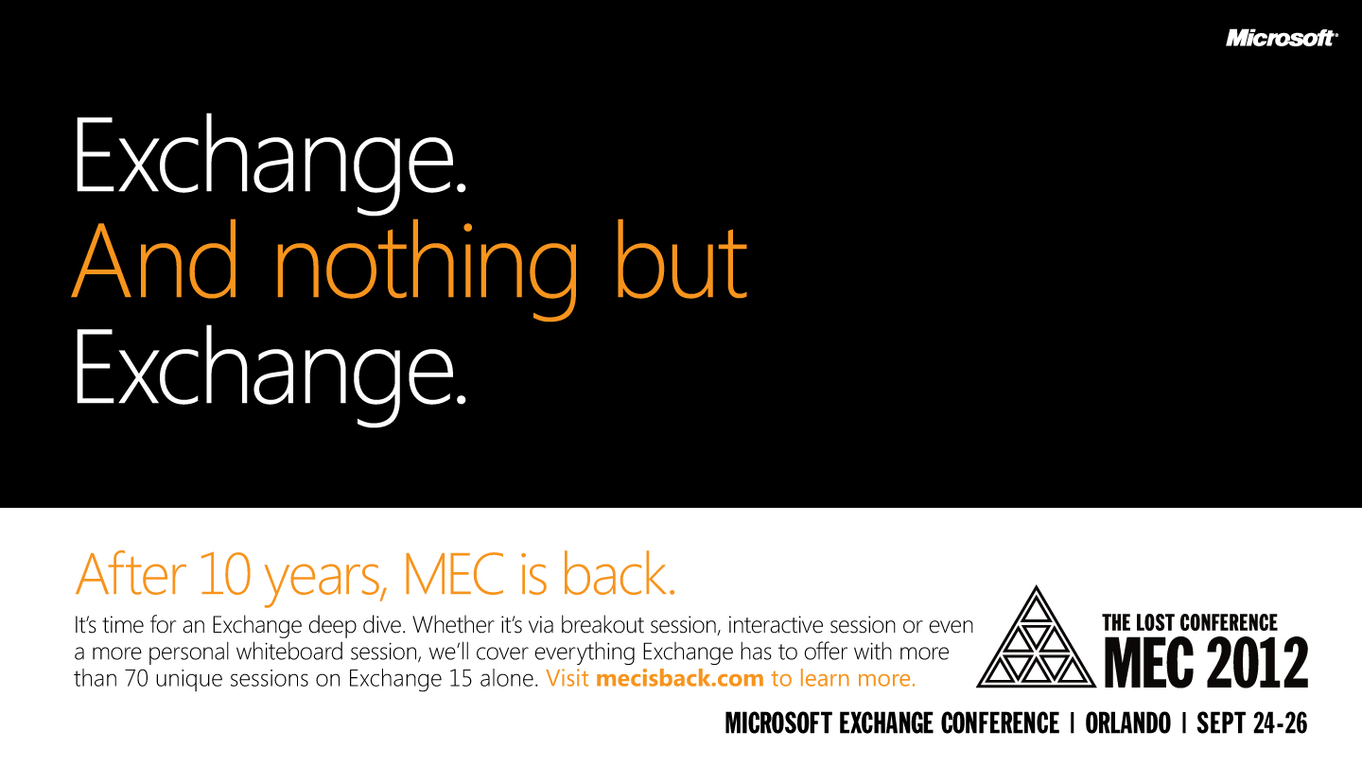

Slide 33



Resources
Learning
  Connect. Share. Discuss.
  Microsoft Certification & Training Resources
http://northamerica.msteched.com
www.microsoft.com/learning
TechNet
  Resources for IT Professionals
  Resources for Developers
http://microsoft.com/technet
http://microsoft.com/msdn

Slide 34







Required Slide
Complete an evaluation on CommNet and enter to win!

Slide 35


MS Tag
Scan the Tag
to evaluate this
session now on
myTechEd Mobile

Slide 36
© 2012 Microsoft Corporation. All rights reserved. Microsoft, Windows, Windows Vista and other product names are or may be registered trademarks and/or trademarks in the U.S. and/or other countries.
The information herein is for informational purposes only and represents the current view of Microsoft Corporation as of the date of this presentation. Because Microsoft must respond to changing market conditions, it should not be interpreted to be a commitment on the
part of Microsoft, and Microsoft cannot guarantee the accuracy of any information provided after the date of this presentation. MICROSOFT MAKES NO WARRANTIES, EXPRESS, IMPLIED OR STATUTORY, AS TO THE INFORMATION IN THIS PRESENTATION.

