Slide 1
Best Practices for Virtualizing Microsoft Exchange Server 2010
EXL306
Jeff Mealiffe
Sr. Program Manager
Microsoft Corporation

Slide 2
Agenda
Quick Supportability Review
Big Problems
  The Memory Mess (Dynamic Memory/Memory Overcommit)
  Time Traveling (Snapshots)
  Too Much Work, Too Little Time (CPU Oversubscription)
Best Practices
  Capacity, Sizing and Performance
  Coexistence With Other Workloads
  High Availability & VM Migration
Tools & Resources

Slide 3
Quick Supportability Review

Slide 4
Quick Supportability Review
Be sure you are running Exchange 2010 SP1 or later
  Virtualized Unified Messaging
  Exchange HA + Hypervisor Clustering/Migration
  and many other unrelated improvements!
We support Hyper-V
We also support any hypervisor participating in the Server Virtualization Validation Program (SVVP)

Slide 5
Quick (Un?)Supportability Review
What’s not supported?
  Hypervisor snapshots
  Differencing/delta disks
  Processor oversubscription in a ratio greater than 2:1
  Applications running on the root partition
  VSS backup of VMs from root (using passthrough disks or iSCSI w/guest initiator)
  NAS storage of VHD/VMDK files

Slide 6
The Latest On Jetstress
Historically, we’ve seen some very strange results with Jetstress in guest VMs, hence the lack of support
Based on your feedback, we ran some new tests on current hypervisors
As of April 2, we support using Jetstress in guest VMs on the following hypervisors
  Microsoft Windows Server 2008 R2 (or newer)
  Microsoft Hyper-V Server 2008 R2 (or newer)
  VMware ESX 4.1 (or newer)
ESRP program guidelines updated as well
Interested in more?
http://bit.ly/HP8G0f

Slide 7
Big Problems

Slide 8
The Memory Mess
Dynamic memory technologies are fantastic for lab environments
For production Exchange servers, just don’t do it!
Exchange code doesn’t deal well with disappearing memory
  It also doesn’t deal well with new memory suddenly appearing
End result for the mailbox role is cache served from the page file or very small DB cache
  Dramatic performance impact

Slide 9
Dynamic Memory At Work

Slide 10
Dynamic Memory At Work

Slide 11
Dynamic Memory At Work

Slide 12
Dynamic Memory At Work

Slide 13
Time Traveling
Hypervisor snapshots make lab testing much easier
Resist the temptation to use hypervisor snapshots in production – they aren’t supported!
Aspects of the Exchange system do not handle time travel well, particularly DAG replication and public folder replication
Even in a lab environment, extreme caution must be applied to make sure that all related systems are rolled back to the right spot simultaneously

Slide 14
Too Much Work, Too Little Time
Hypervisors are pretty cool… but they don’t make CPU appear out of thin air
While oversubscription can help with hardware consolidation, it doesn’t help provide reliable high-performance Exchange services
Proper Exchange sizing ensures that resources are available on-demand, so don’t allow hypervisors to yank those resources away
CPU constrained Exchange servers will experience reduced throughput in some form
  Delivery throughput reduction = queue growth
  Content indexing throughput reduction = increased IOPS
  Store ROP processing throughput reduction = RPC latency & end-user pain

Slide 15
Best Practices

Slide 16
General Deployment Reminders
Exchange isn’t “virtualization aware”
Virtualization isn’t free
  Hypervisor adds CPU overhead: ~12% in our Exchange 2010 tests
Virtualization doesn’t provide resources where they don’t truly exist
  Size for required physical resources for each VM
  Make sure you can deliver those resources

Slide 17
Scale up or scale out?
Exchange architected for scale out
  Large mailboxes, low cost, DAS, redundant inexpensive servers, etc.
Virtualization typically implies scale up (root hardware)
Avoid “all eggs in one basket”:
  Where possible, scale out Exchange servers across many root servers

Slide 18
Sizing Process Overview
Start with the physical server sizing process
  Calculator & TechNet guidance
Account for virtualization overhead
Determine VM placement
  Account for VM migration if planned
Size root servers, storage, and network infrastructure

Slide 19
Guest Sizing Recommendations
Size Mailbox role first
  CPU ratios for other roles based on Mailbox role sizing
  Mailbox role performance is key to user experience
  High availability design significantly impacts sizing
Once again: Don’t oversubscribe resources
  Size based on anticipated peak workload, don’t under provision physical resources

Slide 20
Guest Sizing for Unified Messaging
Requires Exchange 2010 SP1 (or greater)
Role is susceptible to poor voice quality and/or latency if undersized
Requires min. 4 virtual processors
UM must be able to utilize physical processors on demand
Consider network requirements (low latency, sufficient bandwidth) to meet UM needs
Tests show that 4VP/16GB VM can handle 40 concurrent calls with VM Preview and 65 calls without

Slide 21
Storage Decisions
Exchange storage should be on spindles separate from guest OS VHD physical storage
Exchange storage must be fixed VHD (VMDK), SCSI passthrough (RDM) or iSCSI
  Preference is to use SCSI passthrough (RDM) to host queues, DBs, and logfile streams
  Hyper-V Live Migration suggests Cluster Shared Volumes with fixed VHD (faster “black-out” period)

Slide 22
Storage Decisions
Internet SCSI (iSCSI)
  Standard best practices for iSCSI connected storage apply (dedicated NIC, jumbo frames, offload, etc…)
  iSCSI initiator in the guest is supported but may need to account for reduced performance
Exchange storage must be block-level
  Network attached storage (NAS) volumes not supported
  No NFS, SMB, or any other NAS technology

Slide 23
Virtual Processors
Scale up CPU on VMs as much as possible
  Don’t deploy 4 x 1 vCPU machines vs. 1 x 4 vCPU machine: take advantage of Exchange scalability
Don’t oversubscribe CPUs unless consolidating with P2V, or similar scenario
  Have we mentioned not oversubscribing yet?
Generally assume 1 physical CPU core == 1 virtual CPU core, don’t assume that a hyperthreaded (SMT) CPU core counts

Slide 24
Private Cloud Considerations
Given fixed resource requirements, isolate Exchange within private cloud as much as possible to avoid “bad” resource sharing
  Balance this with high availability requirements!
Be prepared to apply different resource management policies to Exchange VMs vs. other workloads which may be less mission critical
Use private cloud as infrastructure/resources for Exchange, not necessarily “dynamic”
  Based on deployment sizing, understand overall resource requirements and allocate accordingly from pool of cloud resources

Slide 25
Host Based Failover Clustering
Host Based Failover Clustering “High Availability”
  Using Host Based Failover Clustering and automatically failing VMs to an alternate cluster node in the event of a critical hardware issue
What you need to be aware of:
  Not an Exchange Aware Solution
  Only protects against server hardware/network failure
  No HA in the event of storage failure / data corruption
  Requires a shared storage deployment
If you are going to deploy this, combine with DAG when possible

Slide 26





Host Based Failover Clustering
Virtual machine guests failover from one node to another
Hosts are clustered
SAN
Hyper-V uses Windows Server 2008 Clustering for HA
VHDs reside on shared disk
Notes:
6/13/2012 6:04 PM
26
© 2006 Microsoft Corporation. All rights reserved. Microsoft, Windows, Windows Vista and other product names are or may be registered trademarks and/or trademarks in the U.S. and/or other countries.
The information herein is for informational purposes only and represents the current view of Microsoft Corporation as of the date of this presentation. Because Microsoft must respond to changing market conditions, it should not be interpreted to be a commitment on the part of Microsoft, and Microsoft cannot guarantee the accuracy of any information provided after the date of this presentation.
MICROSOFT MAKES NO WARRANTIES, EXPRESS, IMPLIED OR STATUTORY, AS TO THE INFORMATION IN THIS PRESENTATION.

Slide 27
Host Based Failover Clustering
Shared storage
(SAN)
Hyper-V host 1
Hyper-V host 2
Hyper-V host 3
Mailbox server 1
Mailbox server 2
Mailbox server 1
DB1
DB1
DB1
DB1
DB1
DB2
DB2
DB2
DB3
DB3
DB3
DB4
DB4
DB4
DB4
DB4
DB5
DB5
DB5
CAS/HUB server 1
CAS/HUB server 2
CAS/HUB server 1

Slide 28
VM Migration and Exchange 2010: Why?
Physical Computer Maintenance
  Operating System/Application Updates
  Hardware Maintenance
Rebalancing Workloads
  Dynamic redistribution of VM’s to optimize workload on physical hardware
Green IT
  ‘Off Peak’ Virtual Machine Consolidation
Everybody else is doing it…

Slide 29
Live Migration of DAG Member Server
Shared storage
(SAN)
Mailbox server 1
Mailbox server 2
Hyper-V host 1
DB1
Hyper-V host 2
DB1
Hyper-V host 3
DB2
DB2
DB3
DB3
DB4
DB4
DB5
DB5
CAS/HUB server 1
CAS/HUB server 2

Slide 30
VM Cluster & Migration Considerations
Minimize “outage” during migration operations
  Consider CSV rather than pass-through LUNs for all Mailbox VM storage
Disable migration technologies that save state and migrate: always migrate live or completely shut down
Consider relaxing cluster heartbeat timeouts
  Cluster nodes considered down after 5 seconds by default
  Adjustments made via PowerShell:
  import-module FailoverClusters
  (get-cluster).SameSubnetDelay=x
  (get-cluster).SameSubnetThreshold=y
  get-cluster | fl Same*
Be aware of additional network interface requirements for VM migration technologies – size network appropriately

Slide 31
Locating Virtual Machines
VM placement is important for high availability
  Take advantage of as many physical hosts as possible
Don’t co-locate DAG database copies on physical hosts
Exchange unaware of VM location relative to other VMs
  No path correction in transport to avoid data loss
Ensure peak workload can run in standard VM locations
  OK to move temporarily for maintenance assuming high availability requirements are met and current workload can be serviced

Slide 32
Tools & Resources

Slide 33
Server Virtualization Validation Program
List of validated 3rd party virtualization solutions
Matrix includes:
  Vendor
  Product & version
  OS architecture
  Processor architecture
  Max supported processors & memory
  http://www.windowsservercatalog.com/svvp/

Slide 34




Exchange 2010 Solutions (on Hyper-V)
Exchange Tested Solutions Program
Configurations
HP BladeSystem Matrix and Microsoft Exchange Server 2010: http://bit.ly/jE2yPn
Exchange Server 2010: HP LeftHand P4000 SAN for 5,000 users: http://bit.ly/m7z7B4
Exchange Server 2010: StorageWorks EVA8400 using CA-EVA and CLX-EVA for 20,000 users: http://bit.ly/mNAsDO
Configurations
Dell servers running in single site for 500 users: http://bit.ly/loEl9r
Dell M610 servers with Dell Equalogic storage for 9,000 users: http://bit.ly/krUecS
Dell R910 servers with EMC CLARiion storage for 20,000 users: http://bit.ly/kWthfD
Configurations
Unisys ES7000 servers for 15,000 users: http://bit.ly/kOBSuo
Configurations
EMC unified storage and Cisco unified computing system for 32,000 users: http://bit.ly/9DBfoB

Slide 35
Support Guidelines
TechNet is the single source for Exchange support guidelines:
http://technet.microsoft.com/en-us/library/jj126252.aspx
SVVP Support Policy Wizard is a great tool:
http://www.windowsservercatalog.com/svvp.aspx?svvppage=svvpwizard.htm
  Always confirm SPW results with our TechNet article
Check back for updates
  Clarifications published frequently

Slide 36


Related Content
Breakout Sessions:
EXL311 – Microsoft Lync 2010: Server and Client Virtualization (Thursday @ 10:15am)
VIR308 – What’s New in Windows Server 2012 Hyper-V, Part 1 (Monday @ 3pm)
VIR309 – What’s New in Windows Server 2012 Hyper-V, Part 2 (Monday @ 4:45pm)

Slide 37

Track Resources
Exchange Team Blog: http://blogs.technet.com/b/exchange/
Exchange TechNet Tech Center: http://technet.microsoft.com/exchange
Geek Out with Perry Blog: http://blogs.technet.com/b/perryclarke/
MEC Website and Registration: http://www.mecisback.com/

Slide 38



Resources
Learning
  Connect. Share. Discuss.
  Microsoft Certification & Training Resources
http://northamerica.msteched.com
www.microsoft.com/learning
TechNet
  Resources for IT Professionals
  Resources for Developers
http://microsoft.com/technet
http://microsoft.com/msdn

Slide 39
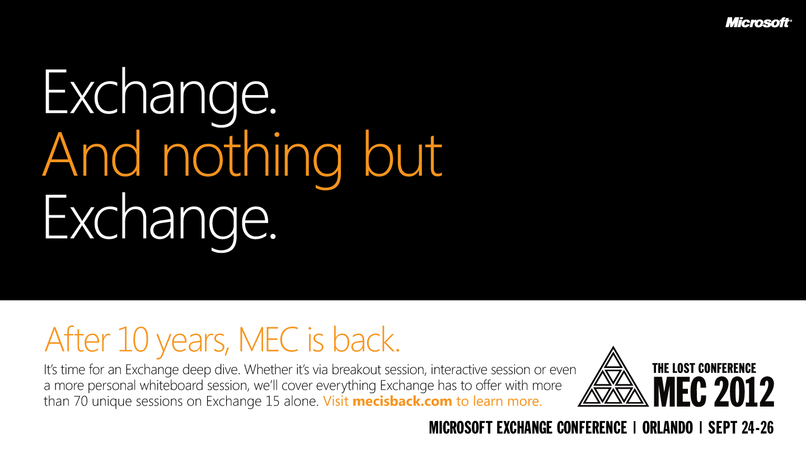

Slide 40







Required Slide
Complete an evaluation on CommNet and enter to win!

Slide 41


MS Tag
Scan the Tag
to evaluate this
session now on
myTechEd Mobile

Slide 42
© 2012 Microsoft Corporation. All rights reserved. Microsoft, Windows, Windows Vista and other product names are or may be registered trademarks and/or trademarks in the U.S. and/or other countries.
The information herein is for informational purposes only and represents the current view of Microsoft Corporation as of the date of this presentation. Because Microsoft must respond to changing market conditions, it should not be interpreted to be a commitment on the
part of Microsoft, and Microsoft cannot guarantee the accuracy of any information provided after the date of this presentation. MICROSOFT MAKES NO WARRANTIES, EXPRESS, IMPLIED OR STATUTORY, AS TO THE INFORMATION IN THIS PRESENTATION.

