Slide 1
Lync 2010:Planning Voice Features
EXL319
Subbu Chandrasekaran
Senior Program Manager
Lync Business Voice

Slide 2







Agenda
A Survey of Voice Features of Microsoft Lync
Policy and management capability around Lync Voice
Phones & devices integration & interworking with Lync
Enterprise use cases & scenarios for advanced call management
Lync to Lync calling
Lync to Phone calling
Enterprise Calling Features
On Site Networking

Slide 3
Lync Voice and PBX
Eliminate the need for a separate PBX system
Full set of critical IP-PBX features
Broad choice of cost effective 3rd party phones
Designed for high availability
Leverages Active Directory, Exchange and other existing infrastructure

Slide 4

Lync to Lync calling
Lync to Lync calling
Easy to use Features
Anywhere access without a VPN
Camp-on / Tagging with Presence
Fast Redial & Recent Conversations
Music On Hold
Connecting Everywhere
Federated Calls between Lync deployments
Video Calling to Windows Live Messenger
Superior Audio and Video Experience
USB Device Switching & Optimization
Optimized Media – Wideband Audio & HD Video
Call quality application & real-time quality indicator
Network Health indicator

Slide 5
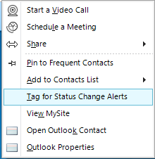
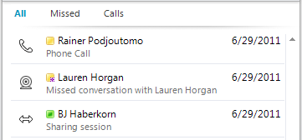
Lync to Lync calling
Lync to Lync calling
Easy to use Features
Anywhere access without a VPN
Camp-on / Tagging with Presence
Fast Redial & Recent Conversations
Music On Hold

Slide 6
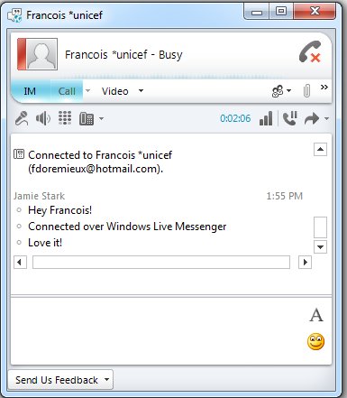
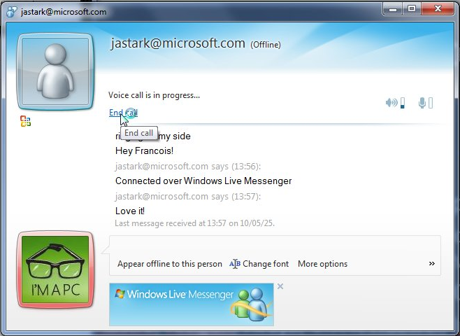
Lync to Lync calling
Lync to Lync calling
Connecting Everywhere
Federated Calls between Lync deployments
HD Video Calling with Windows Live Messenger

Slide 7
Federation Capability
Lync to Lync calling
 | Collaboration | Audio & Video | IM & Presence
Lync Deployment | Yes | Yes | Yes
Office 365 | Yes | Yes | Yes
Windows Live |  | Yes | Yes
AOL & Yahoo |  |  | Yes
XMPP |  |  | Yes

Slide 8
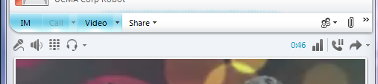
Lync to Lync calling
Lync to Lync calling
Superior Audio and Video Experience
USB Device Switching & Optimization
Optimized Media – Wideband Audio & HD Video
Call quality application & real-time quality indicator
Network Health indicator
Activity Indicator
Network Health
Fast in-call Device Switching

Slide 9
Headsets, Handsets, USB Phones
Lync to Lync calling
Integrated UX, centralized management and security
End User Experience
  Plug and play with awesome first run experience
  Superior audio quality embedded in the device.
Administrator Experience
  Common support infrastructure with TSANet
  Firmware and fixes remote software update
  Contractual SLA for hardware updates
Portfolio
  Joint development to enable more scenarios
  Mobile pairing, hoteling and hot-desking

Slide 11
Lync to Phone calling
Lync to Phone calling
Completely integrated PSTN dialing
Dial by name and by number
Integrated Dial pad
Contact list PSTN numbers
Dial from Internet Explorer
Simple Call Management
Call Forwarding
Simultaneous Ringing
Personal Call Handling w/Exchange UM
Emergency & Location Awareness
Location-based Number Translation
Emergency Dialing with Location
Malicious Call Tracing

Slide 12
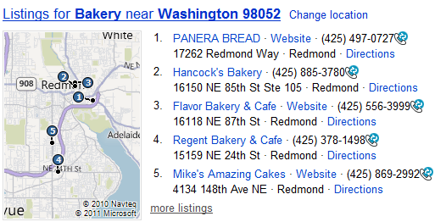
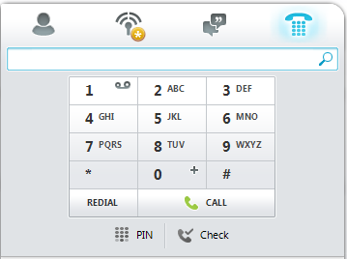
Lync to Phone calling
Lync to Phone calling
Completely integrated PSTN dialing
Dial by name and by number
Integrated Dial pad
Contact list PSTN numbers
Dial from Internet Explorer

Slide 13
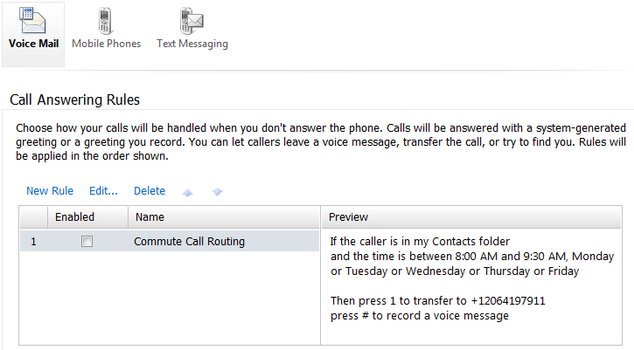
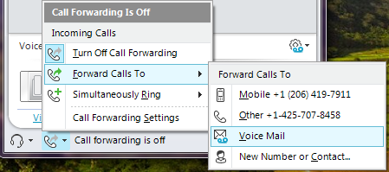
Lync to Phone calling
Lync to Phone calling
Simple Call Management
Call Forwarding
Simultaneous Ringing
Personal Call Handling w/Exchange UM

Slide 14
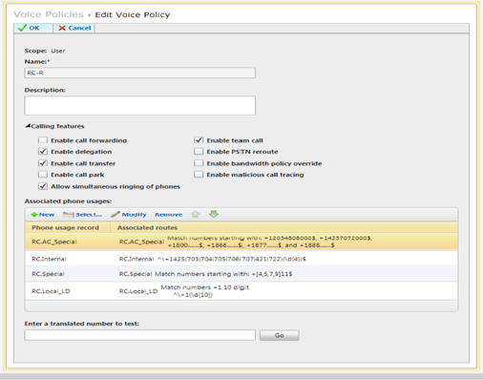

Voice Policy
Lync to Phone calling
Flexibility to control user voice entitlements
    Call Forwarding
    Delegation
    Call Transfer
    Call Park
    Simultaneous Ringing
    Team Call
    PSTN Rerouting
    BW Policy Override
    Malicious Call Tracing
Useful to address Common Area Device requirements

Slide 15
Common Area IP Phone Settings
Lync to Phone calling
Policy | Setting | Usage
DeviceType (AD) | urn:device: commonareaphone | Specifies if device is a common area phone
ClientPolicy | EnableHotdesking HotdeskingTimeout | Enables user to log on to common area device Specifies timeout value
VoicePolicy | EnableCallTransfer EnableCallPark AllowCallForwarding | Enables UI for call transfer Enables UI for call park Enables UI for call forwarding
MeetingPolicy | AllowIPAudio | Enables UI for conference escalation
ExternalAccess Policy | EnableOutsideAccess | Enables external access

Slide 16








Lync to Phone calling
Lync to Phone calling
Emergency & Location Awareness
Emergency Dialing with Location
Malicious Call Tracing
Location-based Number Translation
Customer Site
Switch: 157.56.64.2
Port: 6/29
3910 163rd Ave NE #3222
Redmond WA 98052
425-706-1442
0016E3A558CA
172.24.33.132
3
1
5
2
Chicago
911 Router
4
MSAG
Seattle
Lync Pool with LIS
E911 Service Provider

Slide 17
Emergency Dialing and Locations
Lync to Phone calling
Each network region can define a location
Unique emergency dial strings & dial mask
defined in the location policy for that network region
Policy contains PSTN Usage, directing emergency calls to the PSTN Gateway in that site & out to the local emergency services.
If that same user was in Spain, the different network would apply a different location policy & PSTN usage, directing emergency calls to the local Spain gateway.
Core capability exists independent of location-based E911

Slide 18
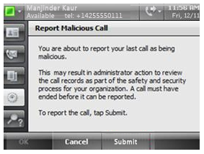
Malicious Call Trace
Lync provides the end-user
the capability of tagging the
prior call as a malicious call.
Available in Lync,
Lync Phone Edition &
Attendant Console.
Tagging is reflected in the backend CDR database, enabling
the Lync Server administrator to take action on the call.

Slide 19
Enterprise Calling Features
Enterprise Calling Features
Advanced Call Handling
Call Parking
Delegation & Private Line
Shared Lines & Team Call
Enterprise Calendar Call Routing
Essential Features for IW
Integrated Calendar, Voice Mail & UM with Exchange
Low-cost IP phones (with Aastra, Polycom & SNOM)
PIN-based IP phone authentication
Automated Call Distribution
Unassigned Number Handling
Attendant Console for high-volume applications
Call Treatment, Queuing, Routing & Agent support

Slide 20
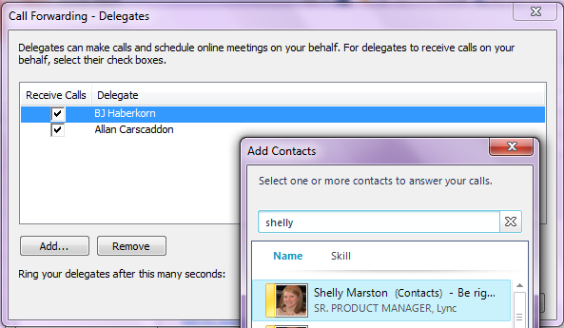
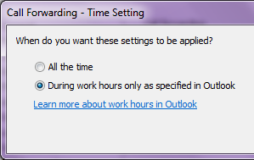
Enterprise Calling Features
Enterprise Calling Features
Advanced Call Handling
Call Parking
Delegation & Private Line
Shared Lines & Team Call
Enterprise Calendar Call Routing

Slide 21
Call Park
Enterprise Calling Features
  Parking clients: Lync, Attendant, Phone Edition
  Retrieving clients: Above plus OCS 2007 R2
  Clients, Common Area Phones, PBX Phones, etc.
Orbit Range
    Call Park uses orbits for parking calls - internal numbers not assigned to users
    Orbits are scoped at the pool level by assigning the range to the Call Park Service running
    Have enough orbits so that any one orbit is not reused too quickly
Comparison/Caveats
    No assigning DID numbers as orbit numbers
    No need to define an orbit range for every pool but must disable call park service on pools without defined ranges
    No pickup possible from any ringing extension

Slide 22
Private Line
Enterprise Calling Features
Single SIP URI, single Exchange mailbox,
single presence source
  Receipt of inbound calls on private DID to same SIP URI
Private lines carry many of the same features
  Call pickup & park work as expected
  Simultaneous ringing & call deflection on primary line carry to private line
Private lines are different:
  Available for inbound calls only
  Overrides delegation, call forwarding, do-not-disturb and other routing options – private calls are always going to go through
  Calls to a private line have a distinctive ring & “toast” pop-up

Slide 23
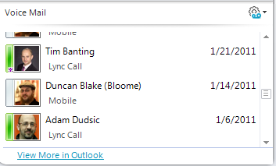
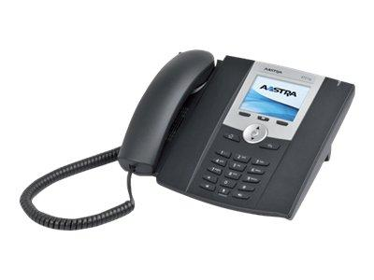
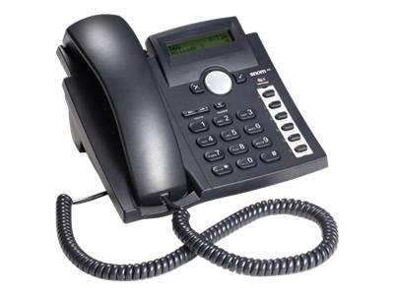
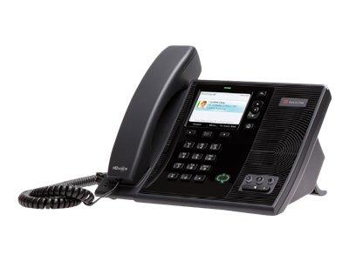
Enterprise Calling Features
Enterprise Calling Features
Essential Features for IW
Integrated Calendar, Voice Mail & UM with Exchange
Low-cost IP phones with Aastra, Polycom & SNOM
PIN-based IP phone authentication

Slide 24
IP Phones “Optimized for Lync”
Enterprise Calling Features
Runs Microsoft® Lync™ Phone Edition
  Equivalent media stack as Lync Client
Great for Information Workers who want a
very feature rich instrument
  Rich conferencing with click to join, roster and leader controls
  Provision the phone with domain creds for Exchange calendar,
  View Outlook, MSN, and federated contacts
  Control the call from the PC or phone
  Share desktop, add video, whiteboard while on a call or conference

Slide 25
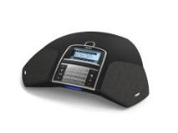
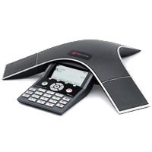
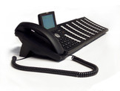
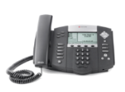


IP Phones “Tested with Lync”
Enterprise Calling Features
Runs qualified firmware from phone vendor
  Typically supports standard “G dot” codecs
  Offers great Lync experience with remote users, etc.
  Large variety of features, functionality and price points
Polycom
SoundPoint
SoundStation
IP5000
Snom MeetingPoint
Polycom
Spectralink
snom Expansion Module

Slide 26
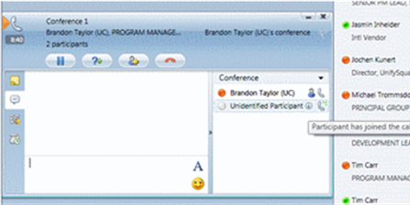
Enterprise Calling Features
Enterprise Calling Features
Automated Call Distribution
Unassigned Number Handling
Attendant Console for high-volume applications
Call Treatment, Queuing, Routing & Agent support
26 Supported Languages for RGS
Catalan | French - France
Chinese - China | German
Chinese - Hong Kong | Italian
Chinese - Taiwan | Japanese
Danish | Korean
Dutch | Norwegian
English - Australia | Polish
English - Canada | Portuguese - Brazilian
English - Great Britain | Portuguese - Portugal
English - US | Russian
English - India | Spanish - Mexico
Finnish | Spanish - Spain
French - Canada | Swedish

Slide 27
Response Groups
Enterprise Calling Features
Media service allowing for automated call
management for small hunt groups, basic call
treatment, presence-enabled routing and queueing support
Not a replacement for robust contact-center offerings.
  By default, no supervisor function, multi-media routing, etc.
Client Support
  Lync rich client with Headset – best experience & lowest cost.
  Tested IP Phones – optimized for fast transfer timing
  Lync Phone Edition clients – slower call connection time (4-6 seconds) best suited for casual agents.

Slide 28
On-site Networking
On Site Networking
Resilient
Data Center Failover
Branch Office Survivability
Call Admission Control & DSCP Marking
Design for Interoperability
Built-in Interoperability & Integration
Complete Virtualization Support
Centralized Deployment
Complete Administration
PowerShell-based management
Role-based Admin Access Control
Advanced Quality Monitoring

Slide 29
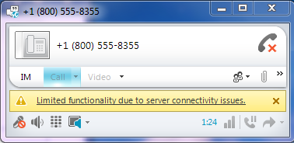
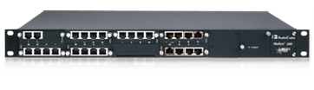
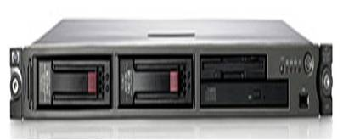
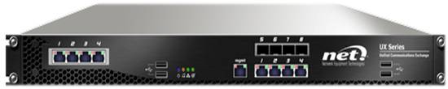
On-site Networking
On Site Networking
Resilient
Data Center Failover
Branch Office Survivability
Call Admission Control & DSCP Marking

Slide 30
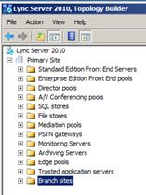


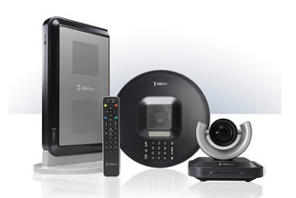

On-site Networking
On Site Networking
Design for Interoperability
Built-in Interoperability & Integration
Complete Virtualization Support
Centralized Deployment
IP-PBX
Lync
Lync
Endpoint
G.711
PBX
Endpoint

Slide 31
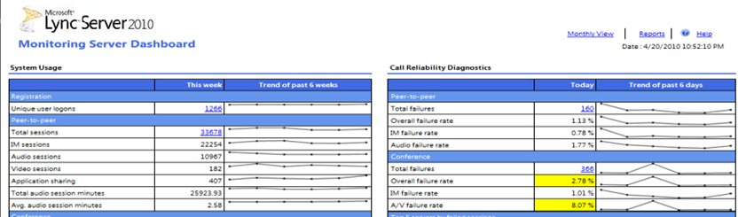
On-site Networking
On Site Networking
Complete Administration
PowerShell-based management
Role-based Admin Access Control
Advanced Quality Monitoring

Slide 32
Lync Telephony Deployment
Replace the PBX
“We’re sold – our goal is Enterprise Wide UC as soon as practical”
Connect with the PBX
“We love Lync, but I can’t replace everything yet….”
Retain the PBX
“Lync is our presence platform, but all telephony will remain on the PBX”

Slide 33
Lync Telephony Deployment
What
How
Implications
Replace the PBX
SIP Trunking
Lync Everywhere
Gateway to PSTN
Connect with the PBX
Direct SIP to IP-PBX
Using Lync Voice where practical for the business
Gateway to TDM PBX
Retain the PBX
Separate Servers & Vendors for UC
More Costly with Suboptimal UEX

Slide 34
Retain the PBX
Remote Call Control
PBX plugins to Lync
Remote call control
  Lync controls the PBX endpoint & provides binary presence status
  Loses media capabilities of Lync
  Requires licensing of PCAL
PBX plugins to Lync
  Lync client becomes the host to headless PBX client
  Call control still remains on PBX
  Does not require PCAL
These options are not recommended; only if PBX must be retained

Slide 35
Replace the PBX
SIP Trunking
Gateway to PSTN
PBX becomes obviated
  Intra-company calls route through PSTN
  Sensible for right combination of internal politics, Δ over time.
DIDs & Numbering
  Move the numbers: Lots of carrier hassle
  Get new numbers;
SIP Trunking
  Fastest way to future proof solution
  Regional availability may be an issue
Gateway
  Is scale & quantity of Mediation a concern with SIP Trunking.
  Consider deploying behind PBX’s Gateway

Slide 36
Connect with the PBX
Direct SIP to IP-PBX
Gateway to TDM PBX
Who moves?
  Locations: Main site first, may make numbering easier.
  Job functions: Those that can best prove out the ROI
  Depreciation: Old equipment / stations go first, new ones later.
PBX stays resident
  Does it make sense to reconfigure or replace the shop floor? Emergency campus phones? Garage phones?
Direct SIP
  Available for most older IP-PBX releases
  Blocking interop to aid in compete against Lync.

Slide 37

Lync Voice & PBX
Eliminate the need for separate PBX systems
Full set of critical IP-PBX features
Broad choice of cost effective 3rd party phones
Designed for high availability
Leverages Active Directory, Exchange,
and other existing infrastructure
Anywhere Access
VoIP
PSTN Calling
Departmental Features
E-911
Least Cost Routing
PBX & Network Interoperability
Lync to Lync calling
Lync to Phone calling
Enterprise Calling Features
On Site Networking

Slide 38
Related Sessions – all in S330A
On Site Networking
EXL314 – Lync Deep Dive: Dial Plans
Monday, June 11 at 1:15 PM - 2:30 PM
EXL412 – Lync Deep Dive: Edge Media Connectivity
Monday, June 11 at 3:00 PM - 4:15 PM
EXL317 – Lync and the Enterprise Network
Tuesday, June 12 at 1:30 PM - 2:45 PM
EXL316 – Lync Availability, Recovery, Resiliency
Thursday, June 14 at 1:00 PM - 2:15 PM
EXL 410 – Lync 2010 – Planning Voice Deployments
Thursday, June 14 at 2:45 PM - 4:00 PM

Slide 39


Track Resources
Lync Team Blog: http://blogs.technet.com/b/uc/
Lync Facebook: http://www.facebook.com/MicrosoftOfficeCommunicator
Lync Server Blog: http://blogs.technet.com/b/nexthop/
Lync Website: http://lync.microsoft.com/en-us/Pages/unified-communications.aspx

Slide 40



Resources
Learning
  Connect. Share. Discuss.
  Microsoft Certification & Training Resources
http://northamerica.msteched.com
www.microsoft.com/learning
TechNet
  Resources for IT Professionals
  Resources for Developers
http://microsoft.com/technet
http://microsoft.com/msdn

Slide 41







Required Slide
Complete an evaluation on CommNet and enter to win!

Slide 42


MS Tag
Scan the Tag
to evaluate this
session now on
myTechEd Mobile

Slide 43
© 2012 Microsoft Corporation. All rights reserved. Microsoft, Windows, Windows Vista and other product names are or may be registered trademarks and/or trademarks in the U.S. and/or other countries.
The information herein is for informational purposes only and represents the current view of Microsoft Corporation as of the date of this presentation. Because Microsoft must respond to changing market conditions, it should not be interpreted to be a commitment on the
part of Microsoft, and Microsoft cannot guarantee the accuracy of any information provided after the date of this presentation. MICROSOFT MAKES NO WARRANTIES, EXPRESS, IMPLIED OR STATUTORY, AS TO THE INFORMATION IN THIS PRESENTATION.

