Slide 1
Lync Server 2010 Security
EXL411
Rui Maximo
Principal Engineer

Slide 2

Agenda
Examine security protection Lync Server provides
Identify potential security gaps
Examine external user authentication
Best practice recommendation

Slide 3

How Much Security is Enough?
It depends on...
What is important to you?
What is it that you need protected?
How much are you willing to spend to protect it?

Slide 4

Security is as Strong as its Weakest Link
Where is your weakest link?

Slide 5
Protecting Internal Communications
Lync Security

Slide 6

Internal Access
Business Requirement
Technical Solution
Is server to server communication strongly authenticated and encrypted?
Required by default.
Deploy private Certificate Server if one is not already available.
Configure Lync Servers with certificates:
  Server authentication
  Encrypted communication channel

Slide 7
Internal Access
Business Requirement
Technical Solution
Is server to server communication strongly authenticated and encrypted?
Is user authentication configurable?
SIP traffic user authentication:
  Kerberos
  TLS-DSK
  NTLM
HTTPS traffic user authentication:
  TLS-DSK
  NTLM
  Basic Authentication

Slide 8
Internal Access
Business Requirement
Technical Solution
Is server to server communication strongly authenticated and encrypted?
Is user authentication configurable?
Do you use a media gateway that does not support SIP/TLS 5061?
Configure Mediation Server with 2 NICs.
Place Mediation Server and media gateway in a separate subnet.

Slide 9
Internal Access
Business Requirement
Technical Solution
Is server to server communication strongly authenticated and encrypted?
Is user authentication configurable?
Do you use a media gateway that does not support SIP/TLS 5061?
Do you have internal firewalls?
Refer to Product Documentation.
Refer to Lync Server Protocol Poster⁺.
Leverage Lync Firewall app* to define firewall rules.
⁺Download from http://www.microsoft.com/en-us/download/details.aspx?id=6797
*Follow @rui_maximo, @DrRez for general availability

Slide 10
Lync Server 2010 Protocol Poster
announcing
Version 12 update now available on TechNet Download Center

Slide 12
Lync Server 2010 Topology
Active Directory
Branch office
Reverse proxy
A/V Conferencing Server
Directors
Edge Servers
Front End Pool
Front End Pool
SBA
Exchange Server
XMPP gateway
Persistent Chat Server
Monitoring Server
Archiving Server
Mediation Server

Slide 13
Lync Server 2010 Topology
Branch office

Slide 14

Lync Server 2010 Topology
Branch office

Slide 15
Lync Firewall App
demo
Rui Maximo
Developer

Slide 16
Protecting External Communications
Lync Security

Slide 17

Afraid your Firewall will end up looking like this?

Slide 18
External Access
Business Requirement
Technical Solution
Does your organization need to communicate with other trusted organization?
If yes, deploy Edge pool.
Configure Federation type:
  Closed Federation
  DNS Federation
  Open Federation
Configure public certificates.
Configure external DNS.
All communications are encrypted by default.

Slide 19
External Access
Business Requirement
Technical Solution
Does your organization need to communicate with other trusted organization?
Do your users need external access to Lync?
If yes, deploy Edge pool.
Determine which workloads are needed:
  IM
  Conferencing
  Enterprise Voice
Deploy reverse proxy.
Deploy XMPP gateway if interop with XMPP networks (gmail) is needed.
Configure public certificates:
  Server authentication
  Encrypted communication channel
Configure external DNS.

Slide 20
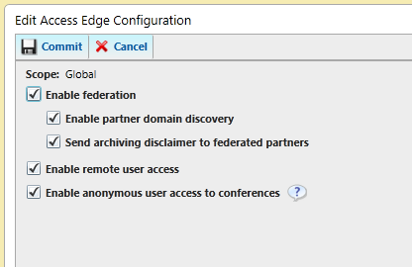
External Access
Business Requirement
Technical Solution
Does your organization need to communicate with other trusted organization?
Do your users need external access to Lync?
Do your users need to invite external participants to web conference?
If not, block Anonymous Access.

Slide 21
External Access
Business Requirement
Technical Solution
Does your organization need to communicate with other trusted organization?
Do your users need external access to Lync?
Do your users need to invite external participants to web conference?
Is defending against DoS attacks and password brute force attacks a priority?
Install Security Filter on Edge pool*.
Install Security Web Filter on Forefront TMG*.
Download trial from http://LyncSecurityFilter.com

Slide 22
Security Filter in action
video
By Fabian Kunz (Connectis)

Slide 23

Security Filter
demo
Rui Maximo
Developer

Slide 24
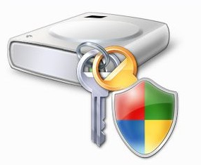
External Access
Business Requirement
Technical Solution
Does your organization need to communicate with other trusted organization?
Do your users need external access to Lync?
Do your users need to invite external participants to web conference?
Is defending against DoS attacks and password brute force attacks a priority?
Do you need to restrict remote access to corporate issued devices?
Enforce BitLocker on corporate issued laptops
Install Security Filter on Edge pool to block NTLM authentication

Slide 25

Security Web Filter
demo
Rui Maximo
Developer

Slide 26
External Access
Business Requirement:
Technical Solution
Does your organization need to communicate with other trusted organization?
Do your users need external access to Lync?
Do your users need to invite external participants to web conference?
Is defending against DoS attacks and password brute force attacks a priority?
Do you need to restrict remote access to corporate issued devices?
Do you need to restrict clickable links?
Enable IIMFilter* on Edge pool
*Documentation:
http://technet.microsoft.com/en-us/library/gg520952.aspx

Slide 27
Client Authentication
Lync Security

Slide 28
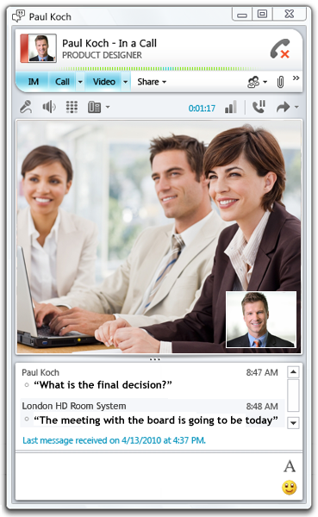
External Client Authentication
Process
Lync Client
Lync authenticates user using NTLM over SIP (via Edge Server)
Lync authenticates user using NTLM over HTTPS (via reverse proxy)
Lync requests self-signed certificate from Lync Server over HTTPS (via reverse proxy)
Lync stores certificate in user’s Personal store and credentials in Credential Manager.

Slide 29
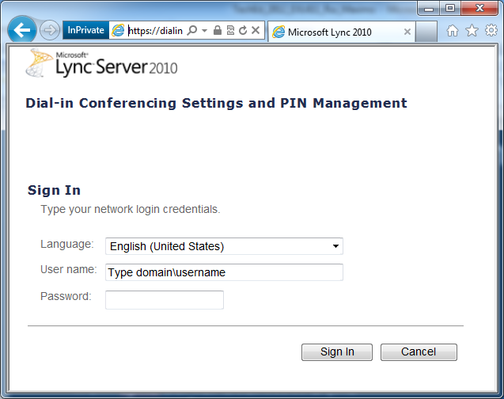
External Client Authentication
Process
Browser Client
Browser authenticates user using Basic Auth over HTTPS (via reverse proxy)
Lync stores user’s credentials in Credential Manager.

Slide 30
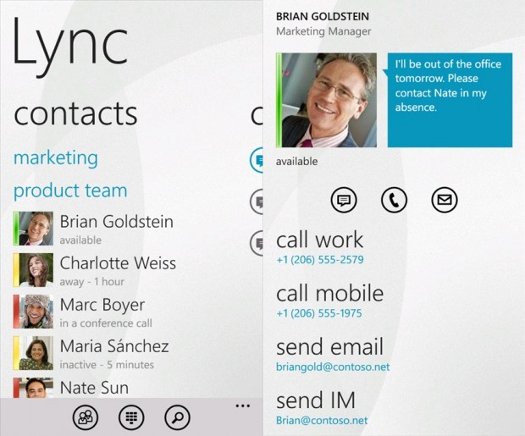
External Client Authentication
Process
Lync Mobile Client
Lync authenticates user using NTLM over HTTPS (via reverse proxy)

Slide 31
Best Practices
Keep your security patches up to date
Know your ports and protocols
Configure your firewall rules properly
Configure additional protection at the Edge
Tighten external access to your corporate network
@DrRez
http://nexthop.info
@rui_maximo
rui@maximo.ws
http://about.me/rmaximo

Slide 32


Track Resources
Lync Team Blog: http://blogs.technet.com/b/uc/
Lync Facebook: http://www.facebook.com/MicrosoftOfficeCommunicator
Lync Server Blog: http://blogs.technet.com/b/nexthop/
Lync Website: http://lync.microsoft.com/en-us/Pages/unified-communications.aspx

Slide 33



Resources
Learning
  Connect. Share. Discuss.
  Microsoft Certification & Training Resources
http://northamerica.msteched.com
www.microsoft.com/learning
TechNet
  Resources for IT Professionals
  Resources for Developers
http://microsoft.com/technet
http://microsoft.com/msdn

Slide 34







Required Slide
Complete an evaluation on CommNet and enter to win!

Slide 35

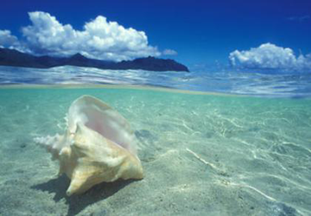



Please Complete an Evaluation
Your feedback is important!
Be eligible
to win great daily prizes and the grand prize of a $5,000 Travel Voucher!
Multiple
ways to Evaluate Sessions
Scan the Tag
to evaluate this
session now
on myTechEd Mobile

Slide 36
© 2012 Microsoft Corporation. All rights reserved. Microsoft, Windows, Windows Vista and other product names are or may be registered trademarks and/or trademarks in the U.S. and/or other countries.
The information herein is for informational purposes only and represents the current view of Microsoft Corporation as of the date of this presentation. Because Microsoft must respond to changing market conditions, it should not be interpreted to be a commitment on the
part of Microsoft, and Microsoft cannot guarantee the accuracy of any information provided after the date of this presentation. MICROSOFT MAKES NO WARRANTIES, EXPRESS, IMPLIED OR STATUTORY, AS TO THE INFORMATION IN THIS PRESENTATION.

