Slide 1
OPERATIONS MANAGER 2012: OVERVIEW OF WHAT'S NEW
MGT301
MGT301
Åke Pettersson, Daniele Muscetta
Program Managers
Microsoft Corporation

Slide 2

System Center 2012 Operations Manager – History
MOM 2005
OpsMgr 2007
OpsMgr 2007 R2
SC 2012 OpsMgr
2004
2005
2007
2008
2009
2012
MOM 2005
RTM
MOM 2005
SP1
OpsMgr 2007
RTM
OpsMgr 2007
SP1
OpsMgr 2007
R2
System Center 2012
Operations Manager
MOM 2005
Workload Discovery State Monitoring
OpsMgr 2007
Revolutionary release Service modeling Health modeling
OpsMgr 2007 R2
Heterogeneous support SLA monitoring
SC 2012 OpsMgr
360º monitoring Network App Insight Dashboards Reduced TCO

Slide 3











SYSTEM CENTER 2012 CAPABILITIES AND COMPONENTS
Application Management
Service Delivery and Automation
Infrastructure Management
App Controller
Orchestrator
Virtual Machine
Manager
Virtual Machine
Manager
Service Manager
Operations
Manager
Operations
Manager
Configuration
Manager
Data Protection
Manager
Notes:
3

Slide 4



AGENDA – A JOURNEY THROUGH 360^{O} MONITORING
360 provides perspectives and visibility to the underlying application environment(s) or infrastructure
Consistent UX
(Console, Web, SharePoint)
End User Experience
(First to Last Mile)
3
2
CIO
Application Monitoring
(Transactions, Components & Dependencies)
2
Service Owner
Infrastructure Monitoring
(Network, Servers, OS & Workloads)
1
Infra Owner

Slide 5
INFRASTRUCTURE MONITORING

Slide 6
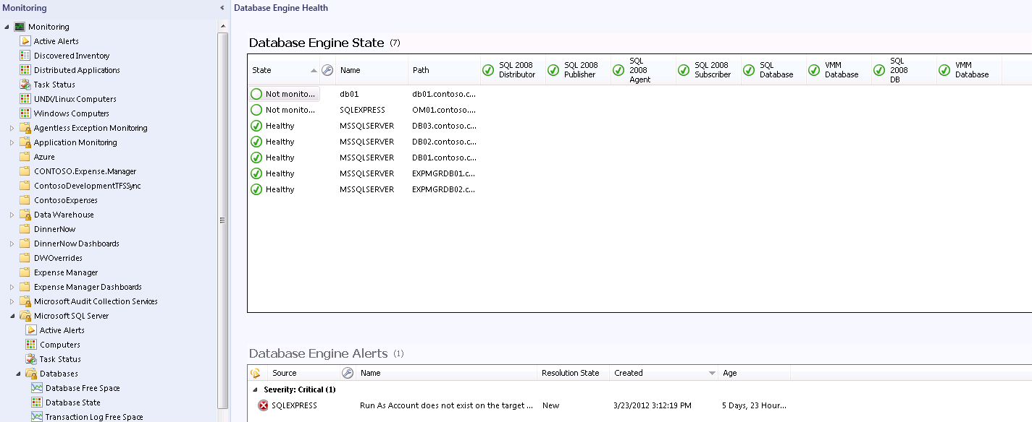
PRESERVING EXISTING INVESTMENTS
What we deliver
Best in class Server, OS and Workload monitoring
Existing Management Packs
Audit Collection Services (ACS)
Agentless Exception Monitoring (AEM)
Distributed Application Designer (DAD)
Reporting & Data Warehouse
Synthetic Transactions & Templates
Gateway Servers
PowerShell
Service Level Tracking (SLA/SLO)
Active Directory Integration
Notifications & Subscriptions

Slide 7
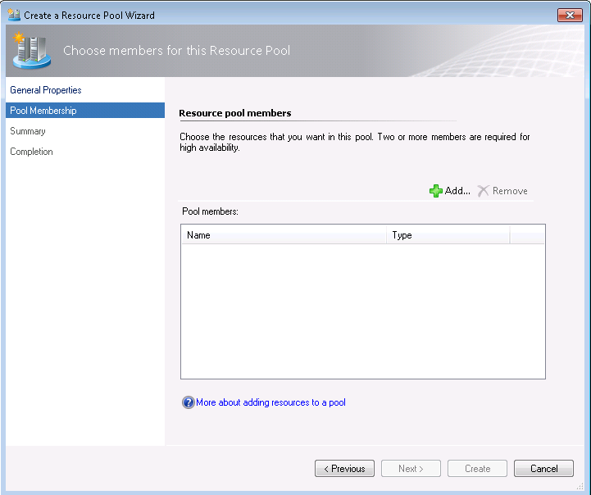
TOPOLOGY SIMPLIFICATION
What we deliver
RMS Removal and federation of configuration service
Add or remove management servers easily with Resource Pools
RMS emulator role to ensure backwards compatibility
Full support for the Operations Manager 2007 MPs

Slide 8
TOPOLOGY SIMPLIFICATION
Challenges Addressed:
Out of the box HA
Easy to scale out
Operational Database
Data Warehouse
Dependency Monitors
Availability
Notification
Group Calculation
X

Slide 9
SERVER POOL
Operational Database
Data Warehouse
X
Managed by Pool
Managed by a single HS

Slide 10
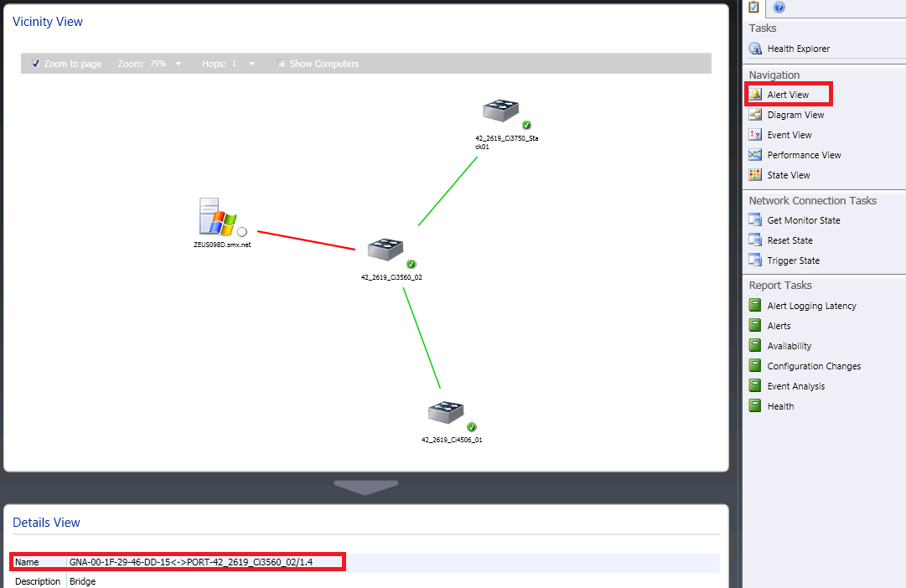
NETWORK DEVICE MONITORING
What we deliver
Out of the box discovery, monitoring, and dashboards/reporting
Memory utilization, processor utilization, port traffic volume, port error analysis & port packet analysis
Server to network dependency discovery
Multi protocol support
  SNMP v1/v2c/v3
  IPv4 and IPv6
Extensibility

Slide 11
NETWORK MONITORING
DEMO
Åke Pettersson

Slide 12
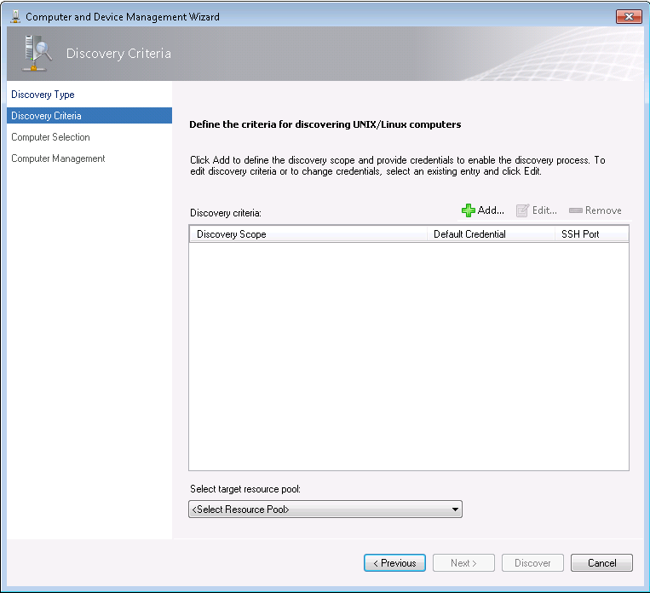
UNIX AND LINUX SUPPORT
What we deliver
Support for SSH keys and Sudo elevation
Monitoring using resource pools
Support for RHEL 6.0 and AIX 7.1
Additional Linux distributions supported later this year
New shell command templates

Slide 13
UNIX/LINUX
DEMO
Daniele Muscetta

Slide 14
APPLICATION MONITORING
Åke Pettersson

Slide 15
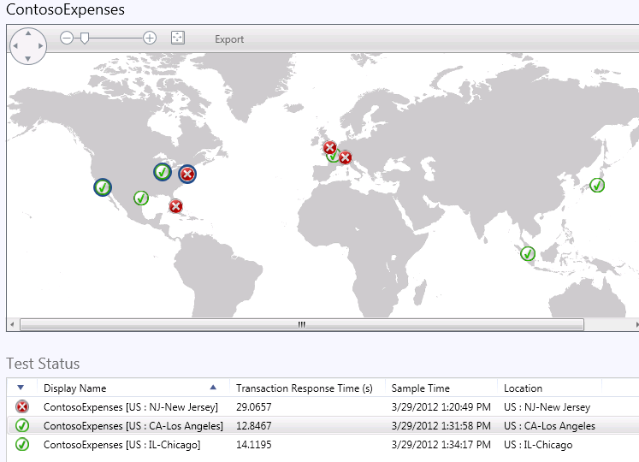
APPLICATION MONITORING
What we deliver
Availability monitoring using rich
synthetic transactions
Last mile monitoring
Performance & reliability monitoring of the application through the .NET framework
Rich diagnostics to pinpoint the root cause of application failures
No new agents to deploy, no management packs to author
Dashboards that can be viewed in the web or in SharePoint
Integration with TFS to reduce mean time to fix

Slide 16
APPLICATION MONITORING
DEMO

Slide 17
JEE SUPPORT
What we deliver in OM12
Tomcat
JBoss
WebSphere
WebLogic
RHEL
✓
✓
✓
✓
SLES
✓
✓
✓
✓
Solaris
✓
AIX
✓
Windows
✓
✓
✓
✓

Slide 18
APPLICATION MONITORING PERSPECTIVES
Your Application: SCOM .Net Application & Java Performance Monitoring
Mid-mile: Global Service Monitor
https://connect.microsoft.com/site1286/Survey/NominationSurvey.aspx?SurveyID=14053&ProgramID=7588
Last mile: SCOM client-side monitoring
First mile: SCOM internal synthetic transactions

Slide 19
MONITORING VISUALIZATION
Åke Pettersson

Slide 20
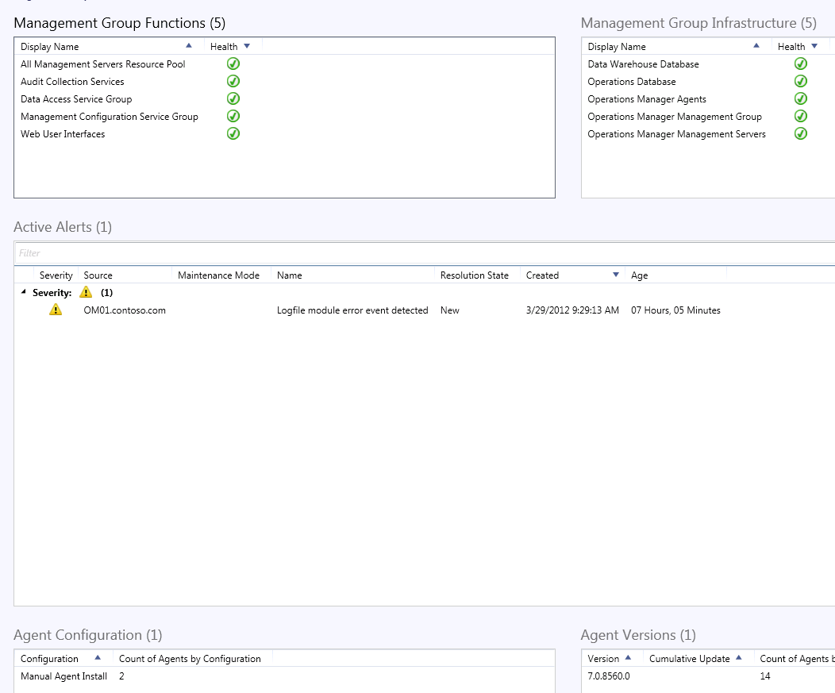
VISUALIZATION
What we deliver
Management Group health dashboard for agent and infrastructure health
Service Level Dashboards
Map Dashboards
SharePoint and Visio integration
Wizard-based Dashboard creation using Widgets

Slide 21
DASHBOARDS
DEMO
Åke Pettersson

Slide 22



Related Content
MGT302 - Application Monitoring with Microsoft System Center Operations Manager 2012
MGT306 - Tips & Tricks for Creating Custom Management Packs for Microsoft System Center Operations Manager
MGT307 - How to Have Microsoft System Center 2012 Operations Manager Work for You: Lessons Learned, Beyond the Install
MGT308 - Massively Multi-Instance: Building and Deploying Microsoft System Center Operations Manager Management Packs in the Enterprise
MGT31-HOL - Microsoft System Center 2012 Operations Manager: A Look at What’s New
MGT52-HOL - Microsoft System Center 2012 Application Performance Monitoring
MGT32-HOL - Microsoft System Center 2012 Operations Manager Java Monitoring
MGT33-HOL - Microsoft System Center 2012 Operations Manager Linux Monitoring
Product Demo Station: Application Management
Exam 70-400 | Microsoft System Center Operations Manager 2007, Configuring
Find Me Later At Application Management 6/14 9AM-11AM

Slide 23
Track Resources
Required Slide
*delete this box when your slide is finalized
Track PMs will supply the content for this slide, which will be inserted during the final scrub.
Resource 1
Resource 2
Resource 3
Resource 4

Slide 24


MS Tag
Required Slide
*delete this box when your slide is finalized
Your MS Tag will be inserted here during the final scrub.
Scan the Tag
to evaluate this
session now on
myTechEd Mobile

Slide 25

© 2012 Microsoft Corporation. All rights reserved. Microsoft, Windows, Windows Vista and other product names are or may be registered trademarks and/or trademarks in the U.S. and/or other countries.
The information herein is for informational purposes only and represents the current view of Microsoft Corporation as of the date of this presentation. Because Microsoft must respond to changing market conditions, it should not be interpreted to be a commitment on the
part of Microsoft, and Microsoft cannot guarantee the accuracy of any information provided after the date of this presentation. MICROSOFT MAKES NO WARRANTIES, EXPRESS, IMPLIED OR STATUTORY, AS TO THE INFORMATION IN THIS PRESENTATION.

Slide 26
NETWORK MONITORING
DEMO

Slide 27
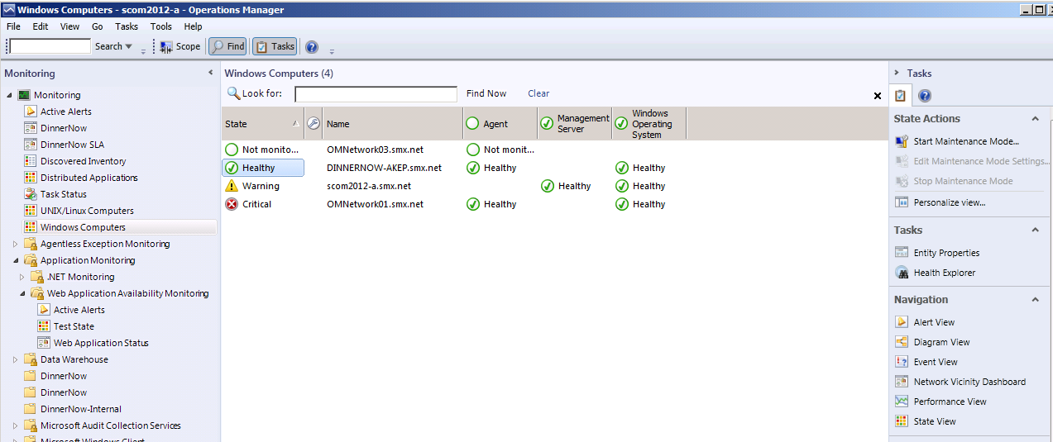

Slide 28
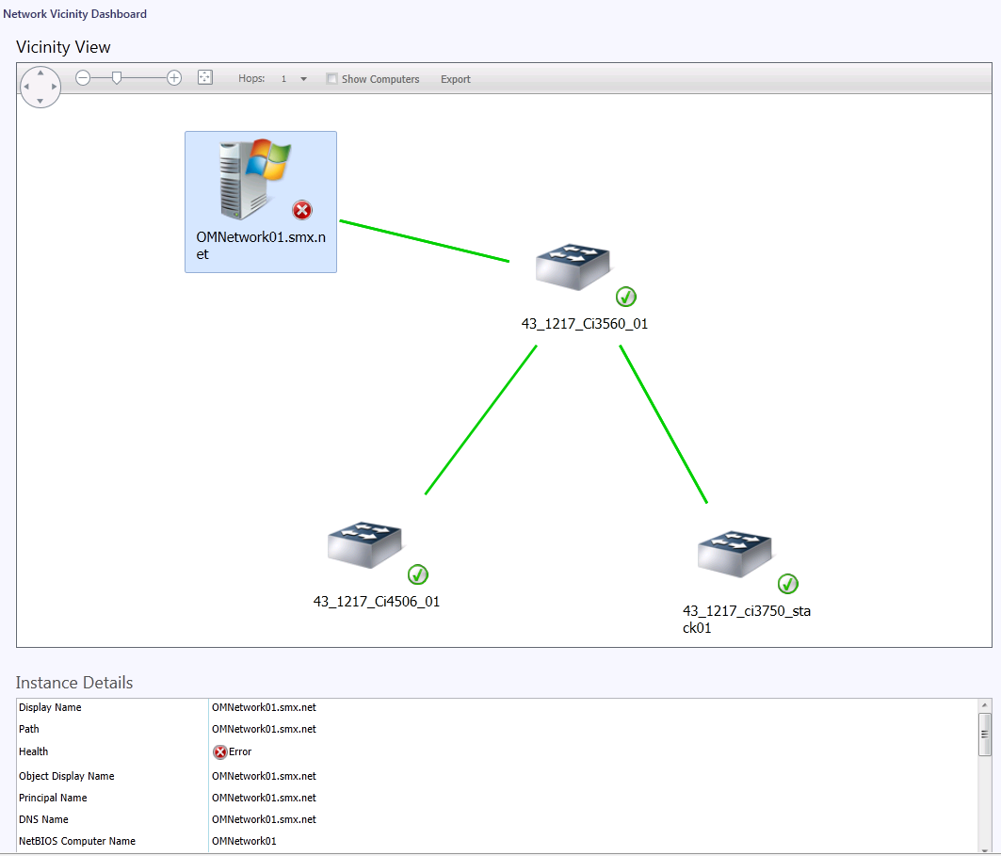

Slide 29
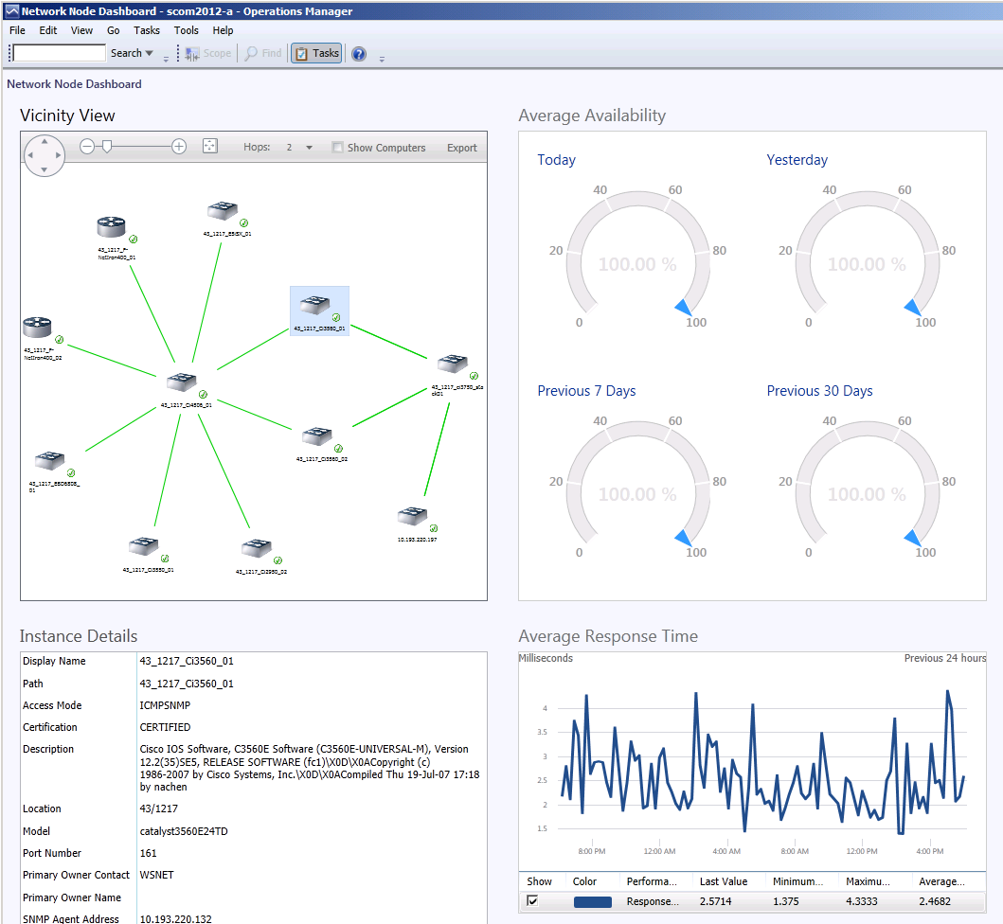

Slide 30
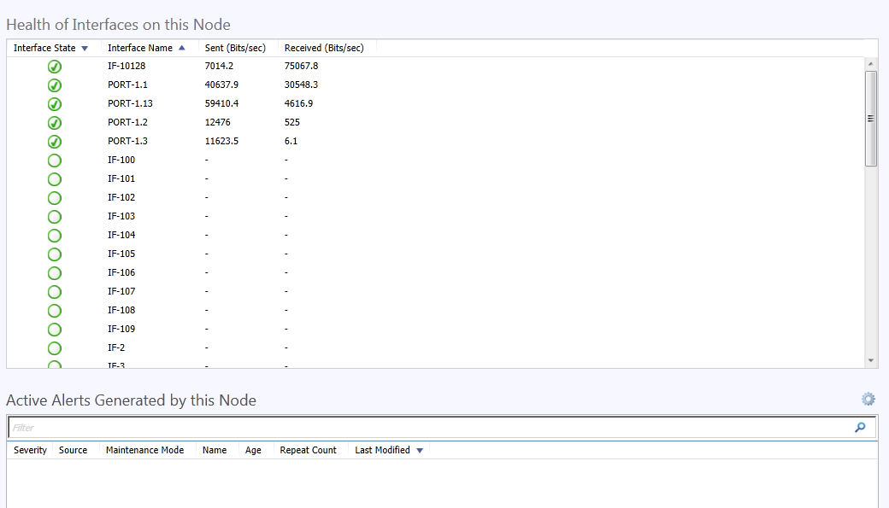

Slide 31
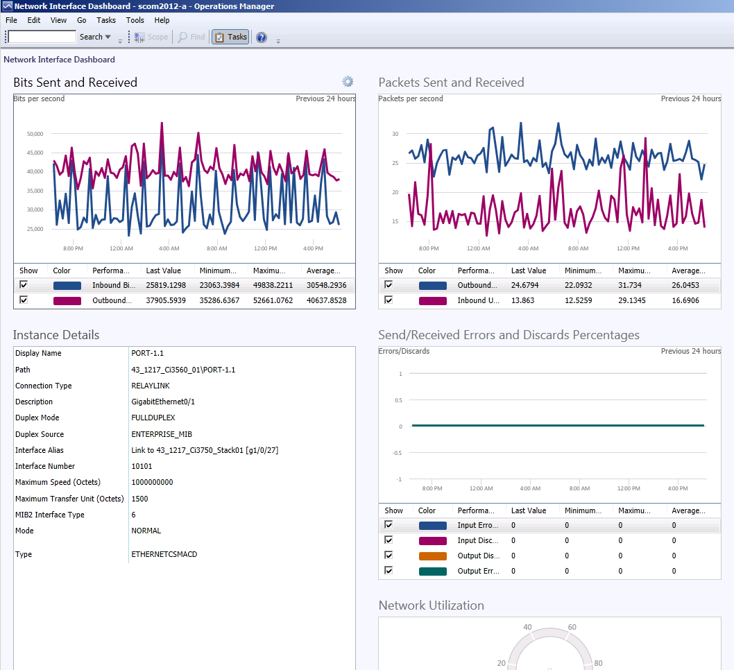

Slide 32
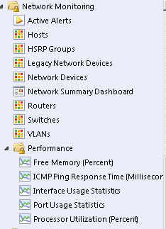
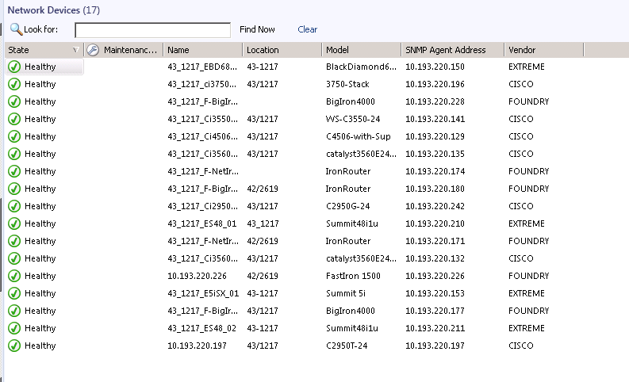

Slide 33
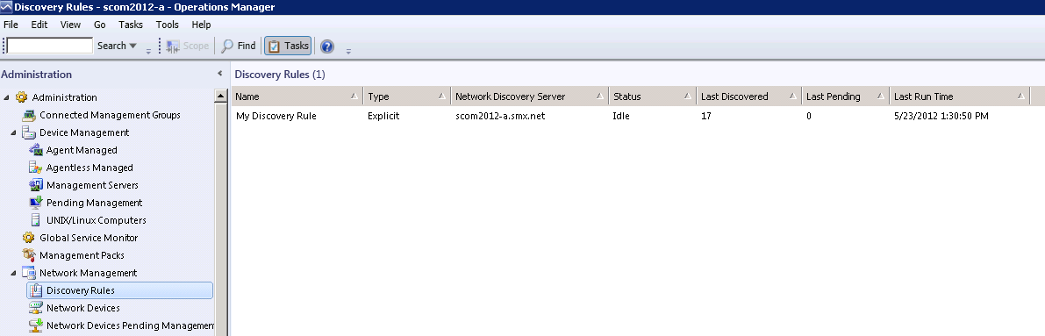

Slide 34
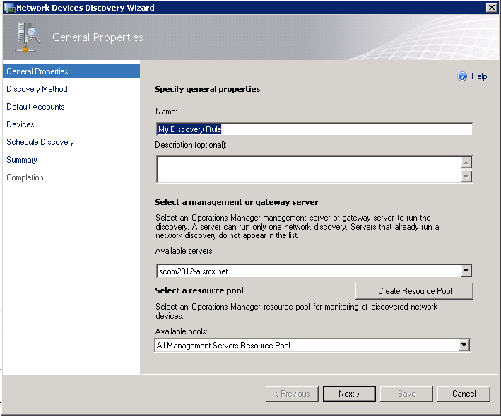

Slide 35
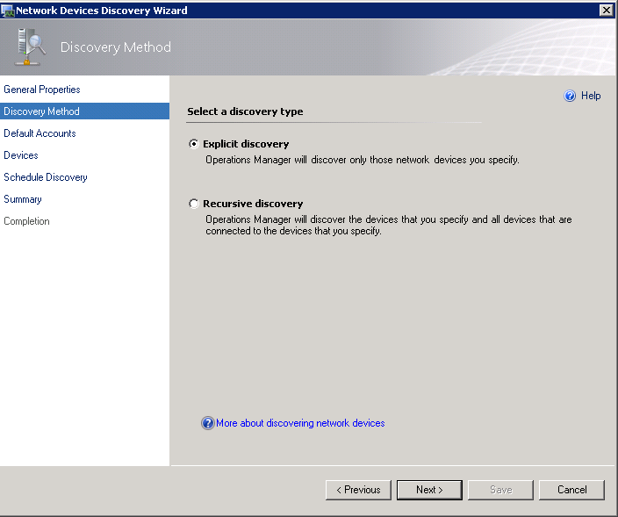

Slide 36
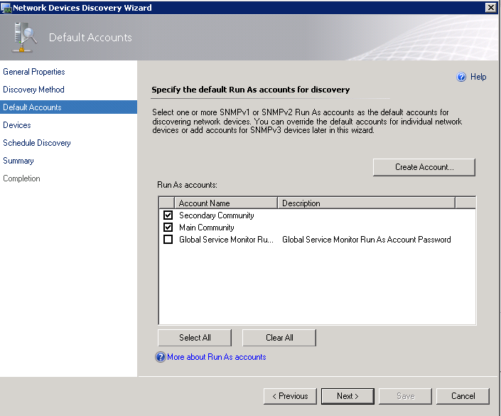

Slide 37
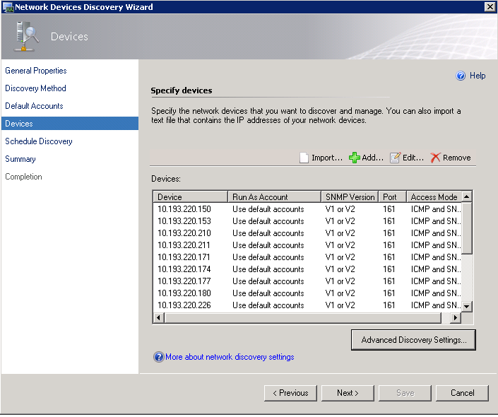

Slide 40
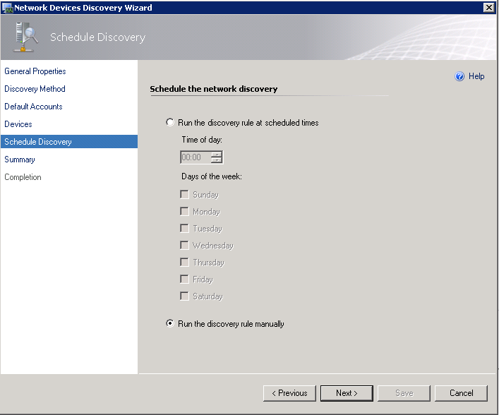

Slide 41
UNIX/LINUX
DEMO

Slide 42
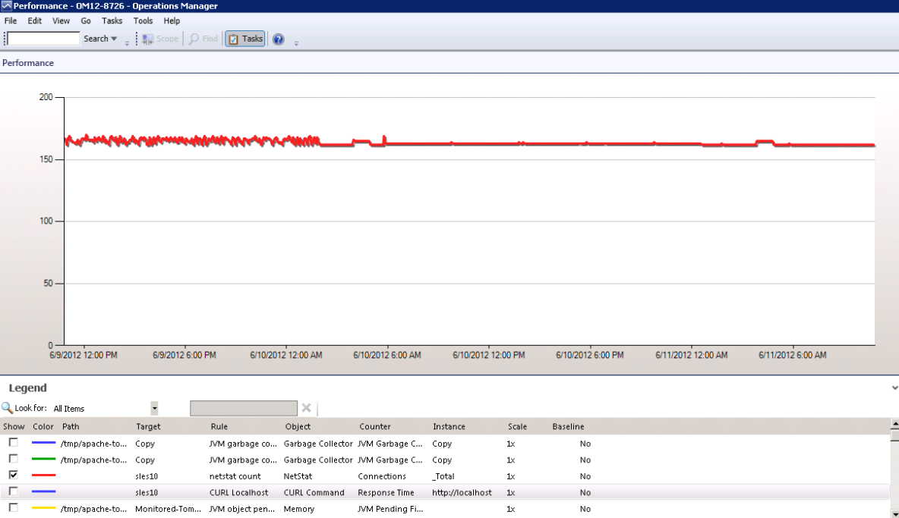

Slide 43
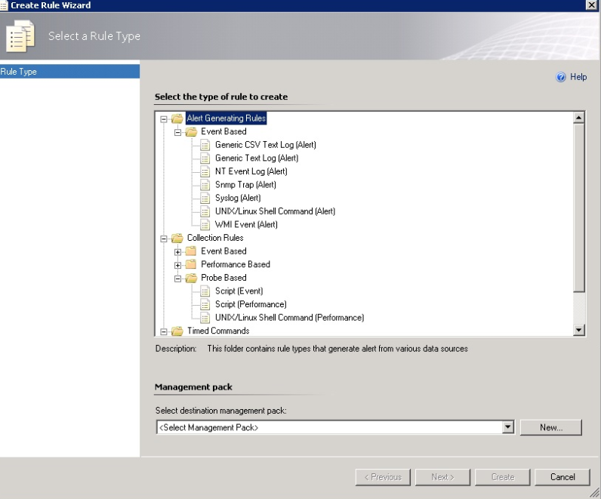

Slide 44
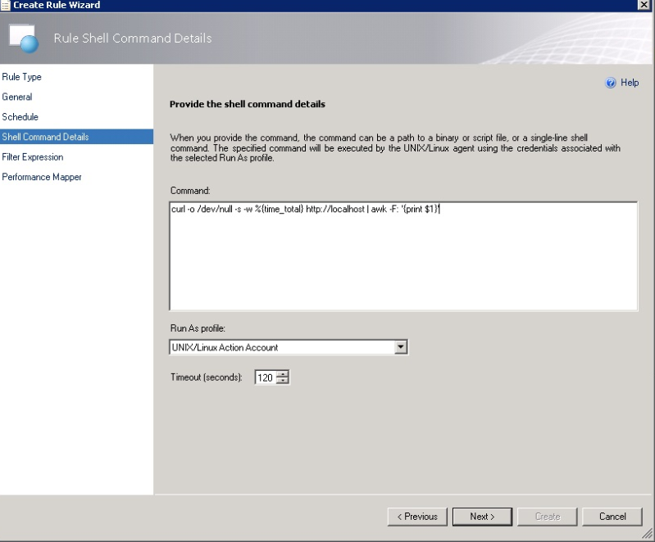

Slide 45
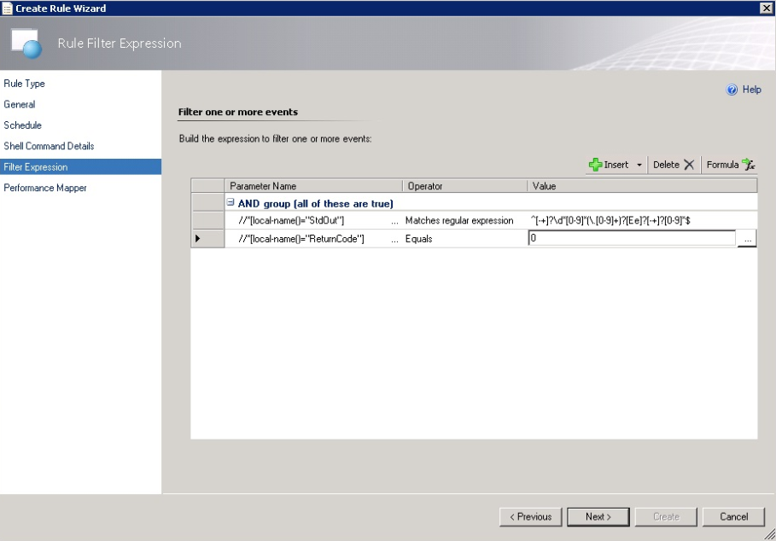

Slide 46
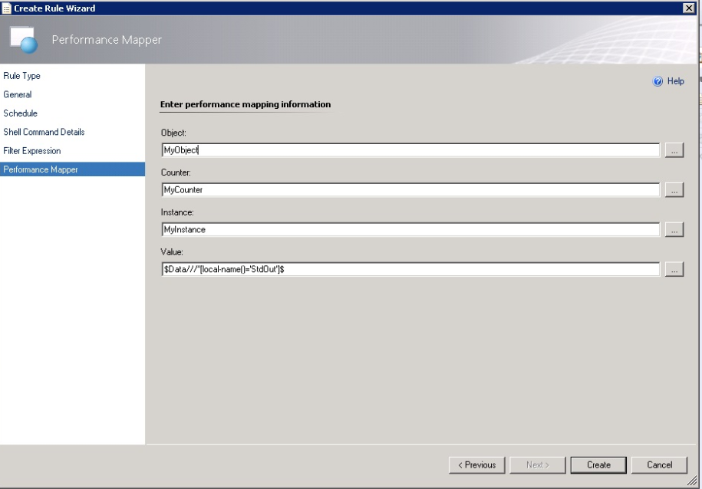

Slide 47
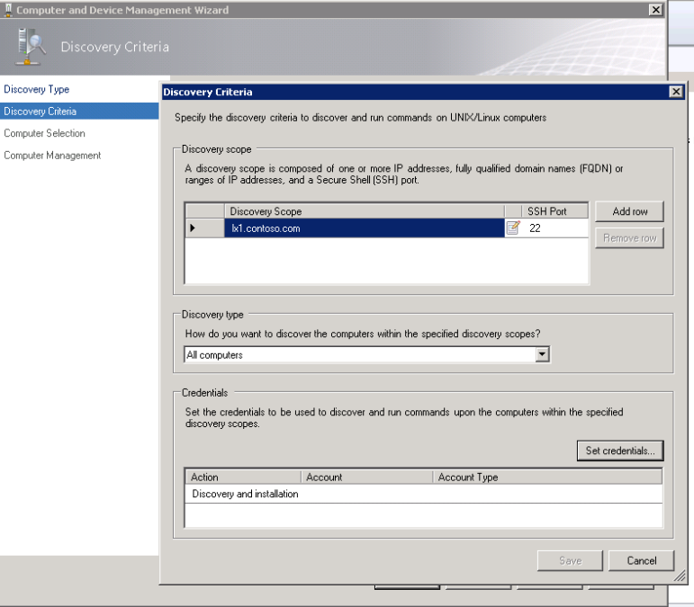

Slide 48
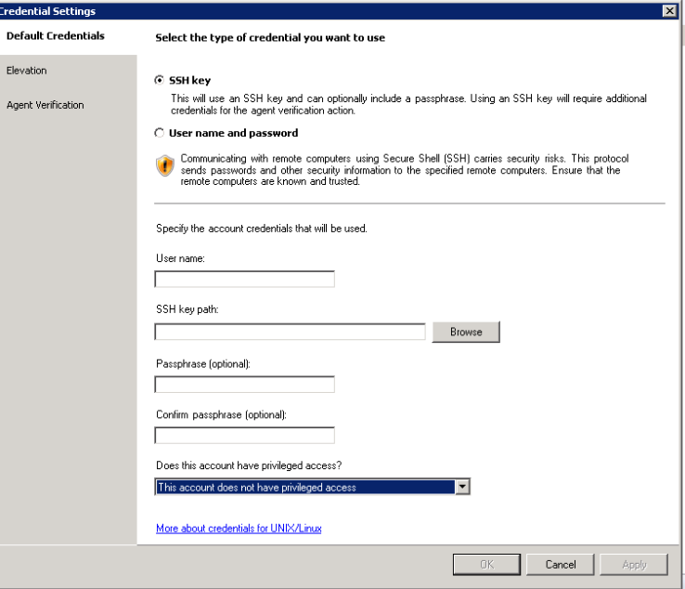

Slide 49
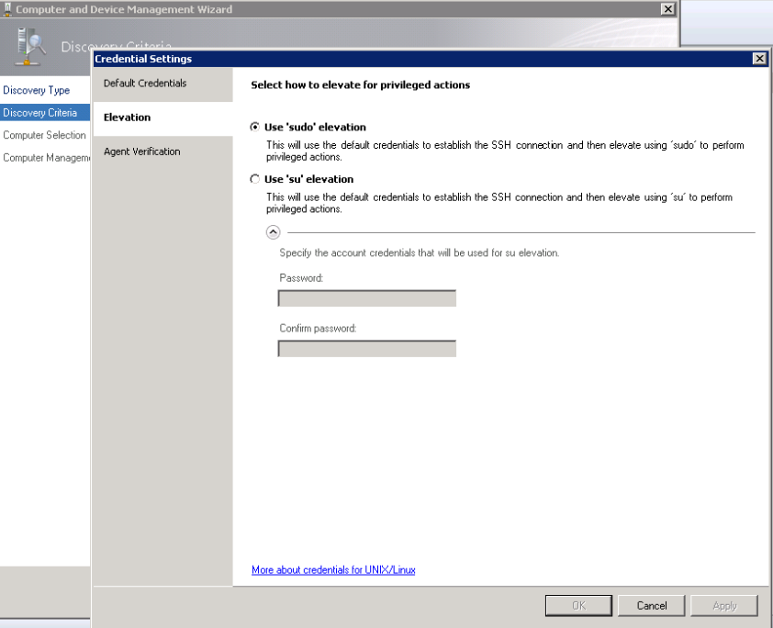

Slide 50
APPLICATION MONITORING
DEMO

Slide 51
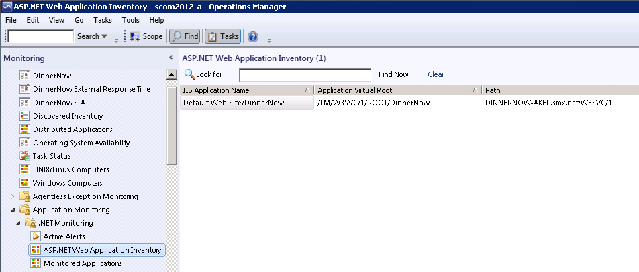

Slide 52
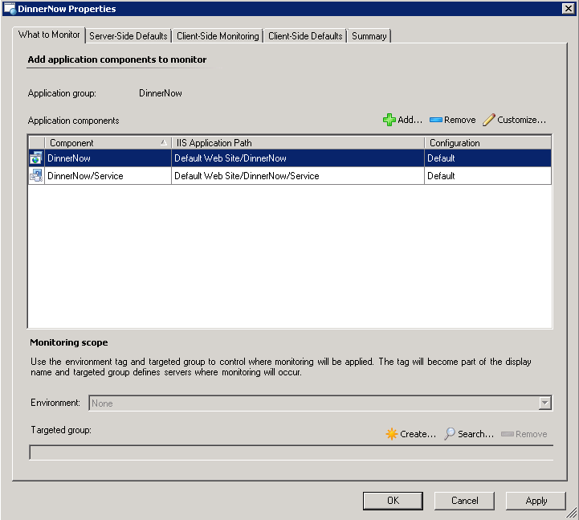

Slide 53
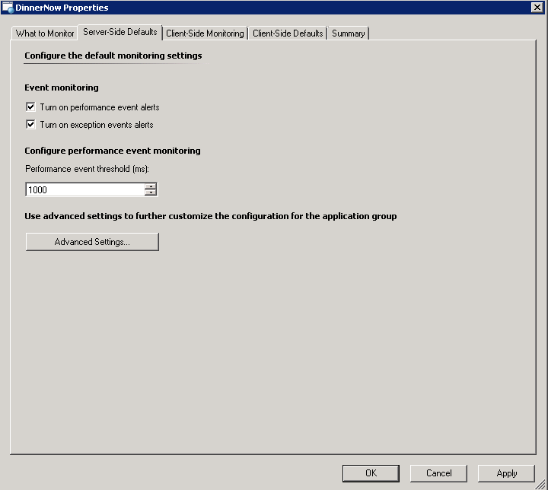

Slide 54
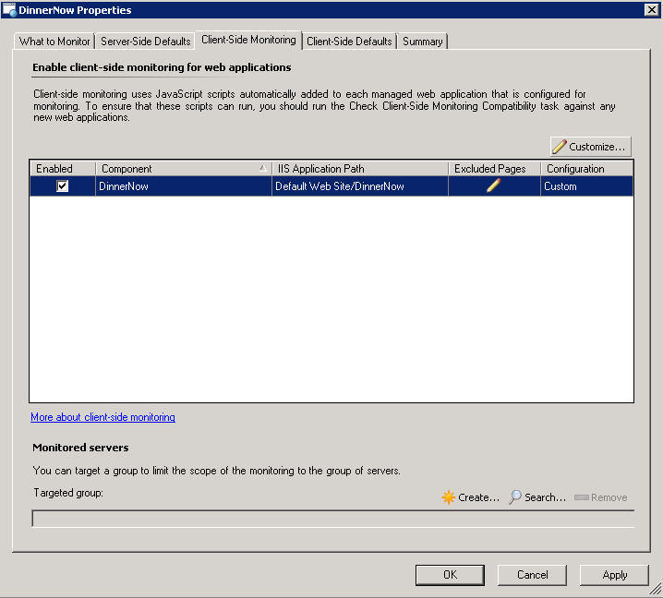

Slide 55
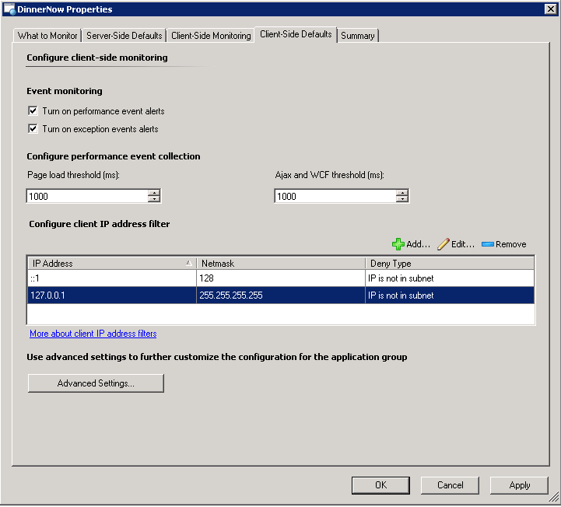

Slide 56
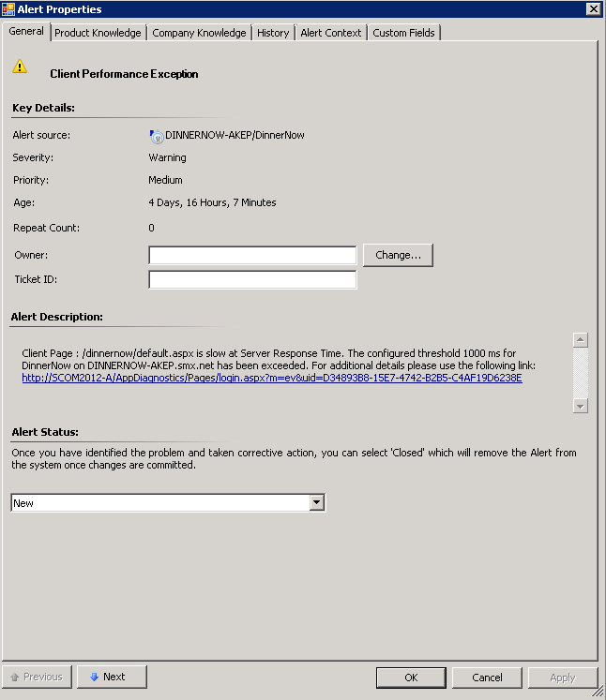
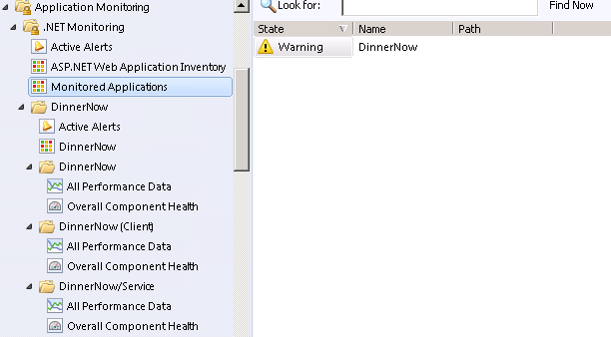

Slide 57
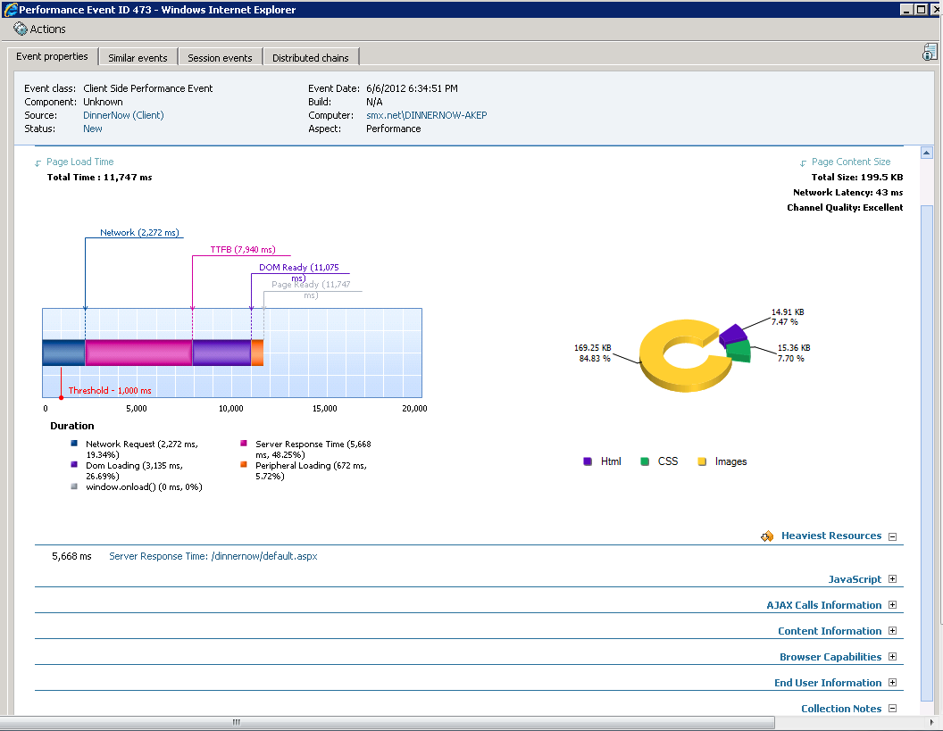

Slide 58
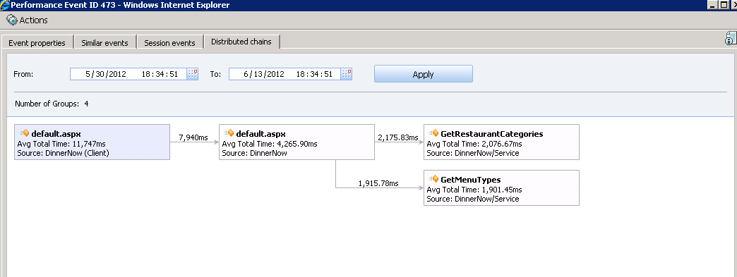

Slide 59
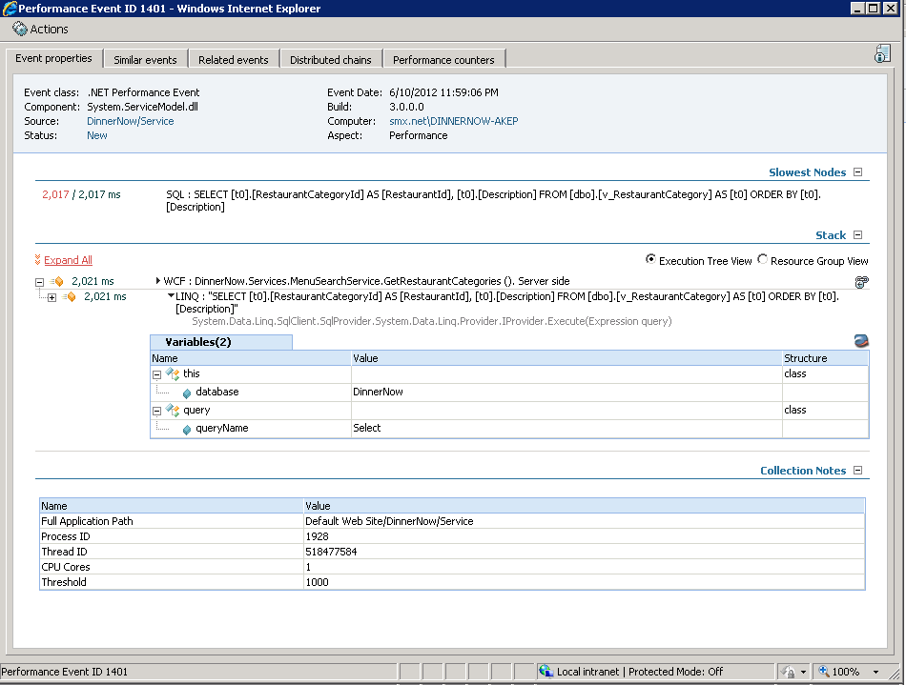

Slide 60
DASHBOARDS
DEMO

Slide 61
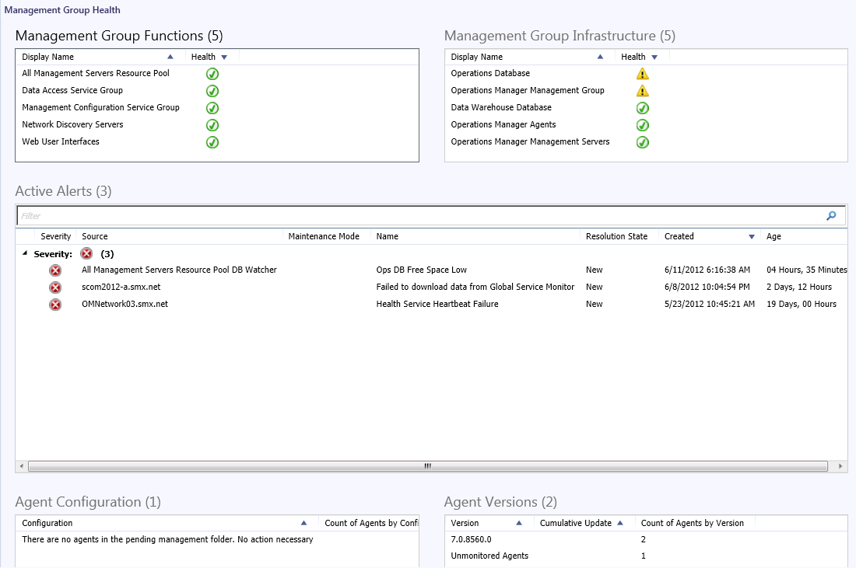

Slide 62
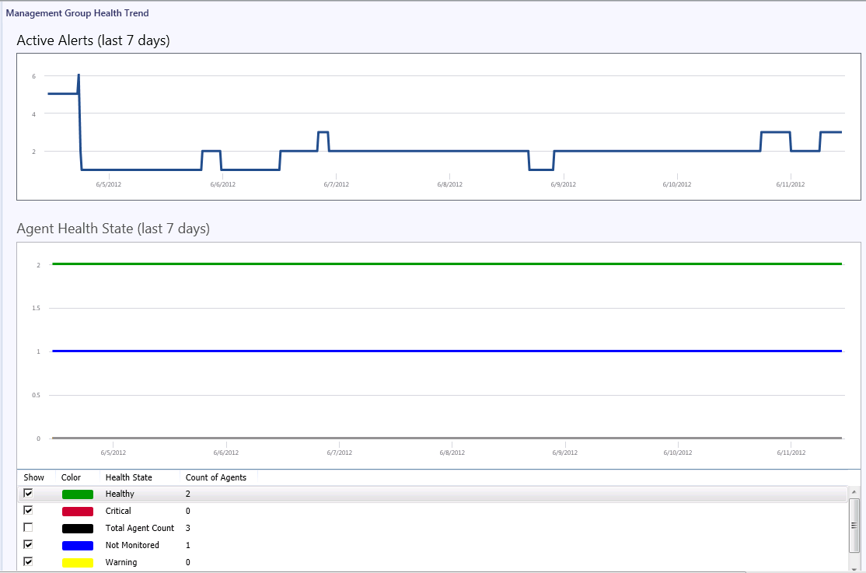

Slide 63
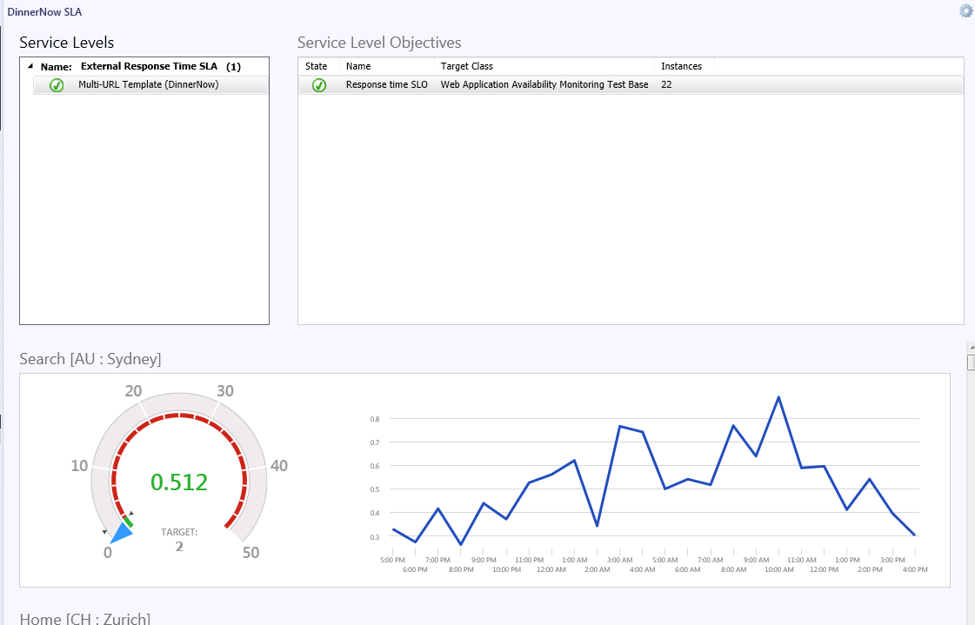

Slide 64
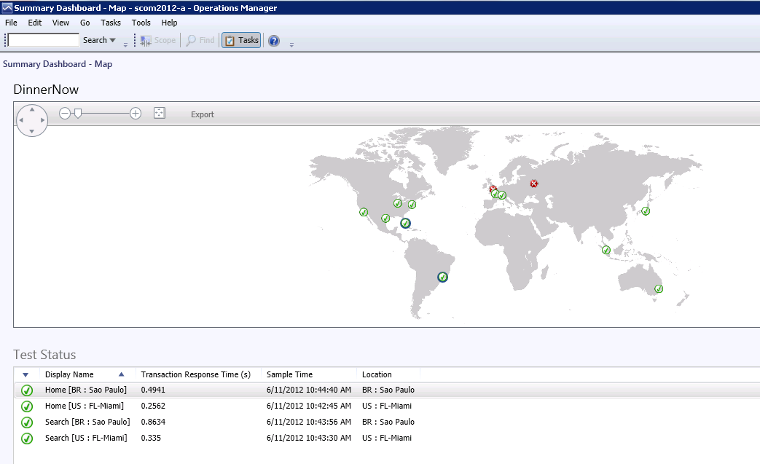

Slide 65
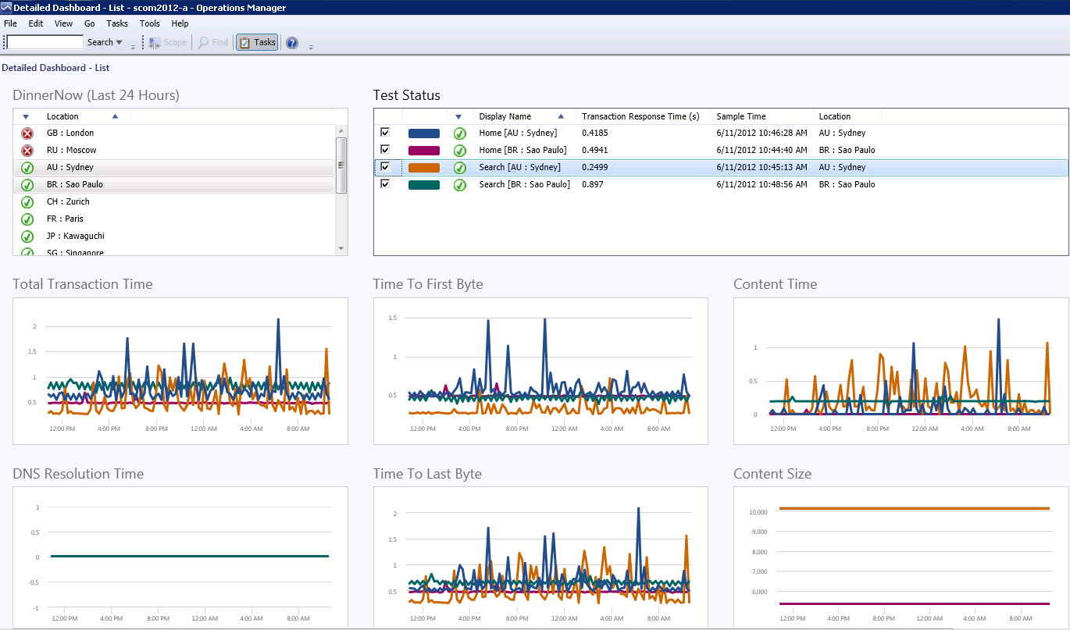

Slide 66
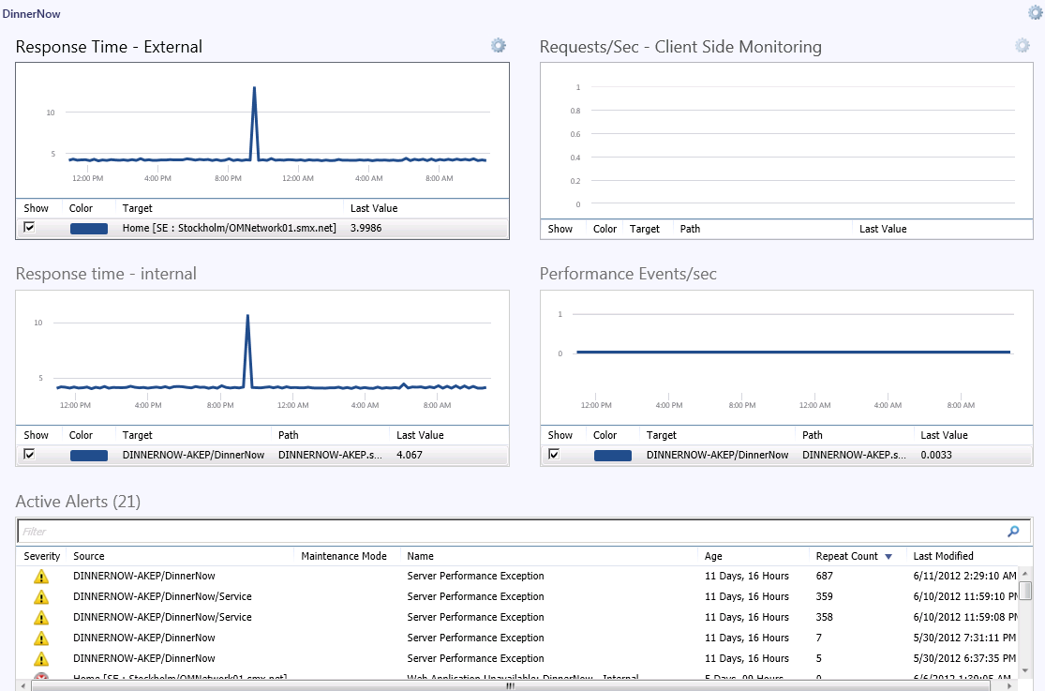

Slide 67
