Slide 1
Cloud? It's All about the App!
MGT304
Maarten Goet
System Center Cloud & Datacenter Management MVP

Slide 2

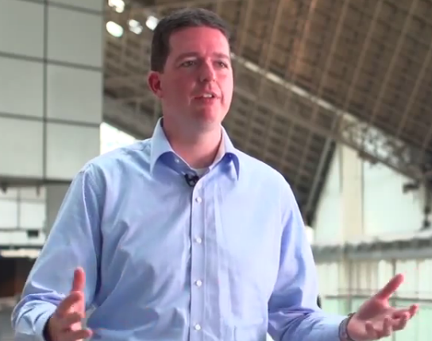

MVP

Slide 3

Traditional
Virtualized
Private Cloud
Public Cloud
Future distribution of computing models
Distribution of models used today
The Evolution of Datacenter Computing

Slide 4





System Center 2012 Cloud & Datacenter Management
PRODUCTIVE
INFRASTRUCTURE
PREDICTABLE APPLICATIONS
YOUR CLOUD
Deliver flexible and cost effective infrastructure with what you
already know and own
Apps power your business
Deliver predictable application service levels with deep application insight
Private and public cloud computing
on your terms managed with
a common toolset
Flexibility with delegation
and control
Applications self-service across clouds
Physical, virtual, and cloud management
Heterogeneous support
Process automation
Self-service infrastructure
Deep application monitoring
and diagnosis
Comprehensive application manageability
Service-centric approach
Flexibility with delegation
and control
Applications self-service across clouds
Physical, virtual, and cloud management
Deep application monitoring
and diagnosis
Comprehensive application manageability
Service-centric approach

Slide 5














System Center Helps Deliver IT as a Service
Configure
App Controller
Orchestrator
Deploy
Public Cloud
Self Service
Service Delivery & Automation
Virtual Machine Manager
Service Model
Operations Manager
Configuration Manager
Private Cloud
Data Protection Manager
App
Owner
DC Admin
Service Manager
Service Manager
Virtual
Monitor
Operate
Physical
Application Management
Service Delivery & Automation
Infrastructure Management

Slide 6
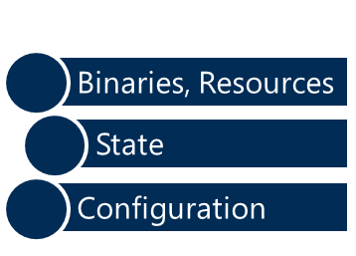
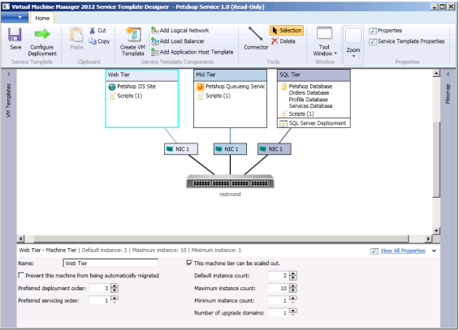
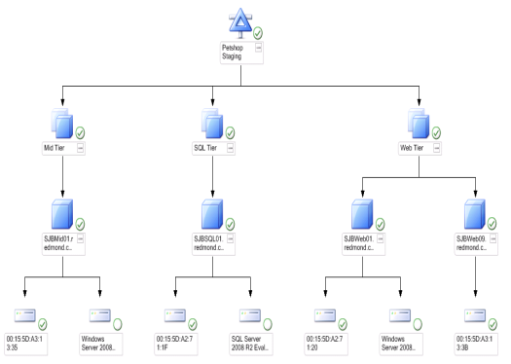
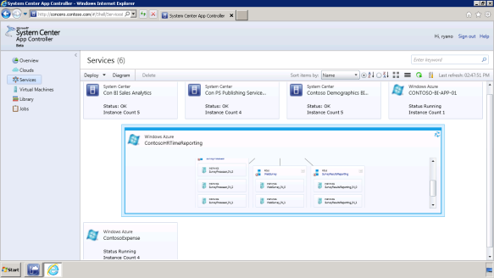
Scalable, Standardized, and Predictable Applications
ABSTRACTION
CONSISTENCY
INSIGHT
CONTROL
  Server App-V abstracts the application from the OS, encapsulated in a consistent format and dynamically configured at deployment
  Service Templates provide standardized specifications for deploying applications, defining how they are configured and scaled
  Application Performance Monitoring provides the structure to define desired performance levels based on end user experiences
  App Controller provides visibility of quota utilization across applications running in both on-premise and public-cloud contexts with a single role-based identity

Slide 7





Standardized application provisioning
Service Template (Multi-Tier .NET App)
Web Tier
App Tier
Data Tier
Scale- out & health policy
Scale- out & health policy
Scale- out & health policy
IIS
App Server
SQL
HW profile
OS profile
App profile
HW profile
OS profile
App profile
HW profile
OS profile
SQL profile
W2K8R2.VHD
OS
settings
Configuration
App-V
MSDeploy
package
Configuration
SQL DAC
Configuration
Service Template Library

Slide 8




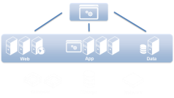



Application delivery lifecycle
Application Specification
Update Template and Apply to Service
Create Service Template
Deploy Service
Customize Deployment

Slide 9




Application profiles for consistent and predictable apps
Compatibility
Definition
Execution
  Define which OS versions and editions the application will run on
  Windows 2003/2008 (x86, x64)
  Windows Server 2008 R2 (x64)
  Capture the OS configuration and the SQL connection information
  Timezone, Product key, admin password, Domain join, dacpacs
  Run pre-scripts, post-scripts, and executables as part of the application deployment
  Any commands and actions outside of the application

Slide 10

SQL profiles for automated SQL deployment
Deployment
Configuration
Consistent configurations
Named instances
Product key injection for individualized installations
Media sources
Administrators and Security mode
Network configuration
SQL configuration file support
Service Accounts
Connections
Define accounts per profile
SQL Service, Agent, and Reporting Services accounts
Define via Run As Accounts
Data-Tier Application Packages capture connections
Instance definition
Authentication mode
Upgrade and Migration behavior

Slide 11


Delivering consistent applications with Server App-V
SEQUENCE
DEPLOY
UPDATE
AVAILABLE
  Create application packages from installers or installation procedures using Server App-V
  Deploy and configure applications in a reliable and repeatable way through application profiles and Service Templates
  Easily update applications that have previously been deployed through self-service application management
  Update the underlying operating system without losing deployed application state through application abstraction

Slide 12
Virtualizing applications with Server App-V
HOSTS
RESOURCES
COMPONENTS
Virtualized Windows Services are registered with the Service Control Manager
Web applications that run on top of IIS 6, 7, 7.5
All types of user accounts are supported (LocalSystem, Network Service, Domain Accounts)
Application binaries
COM+ and DCOM
Text-based configurations
WMI providers
SSRS
Local users and groups
Registry settings
COM
Java apps
.NET components
State-persisted information stored on the local disk

Slide 13
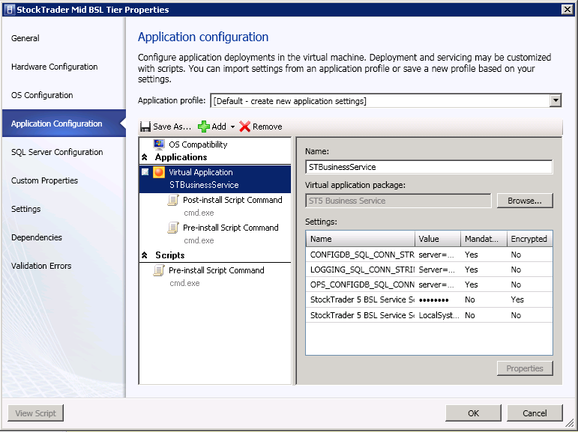
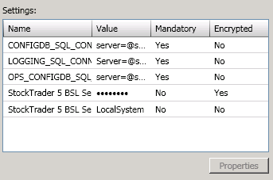
Deploying consistent and flexible applications
  Deploy at runtime or with Service Template
  Configure service templates to deploy any application dependencies
  Capture configuration into an application profile for consistent deployments
Application Profile A
Server App-V Package Binaries, Resources and State Configuration
Application Profile B
Runtime configuration applied on deployment

Slide 14
Deploying consistent and flexible applications
demo
Maarten Goet
System Center Cloud & Datacenter Management MVP

Slide 15



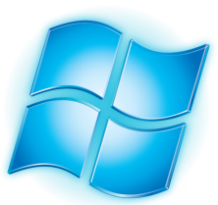


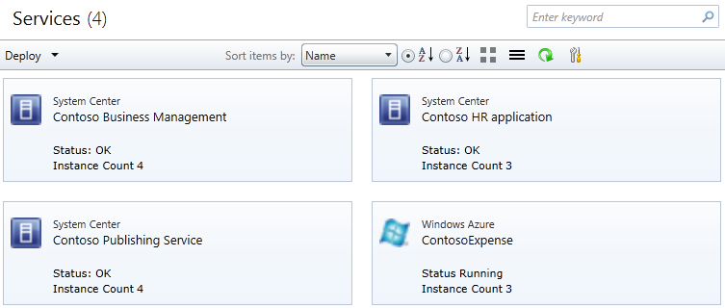
Managing applications across multiple clouds
Deploy
Monitor
Service Templates
Package and Configuration
Hyper-V
VMware
Xen
Windows Azure
Private Cloud
Manage
Application management across private and public

Slide 16




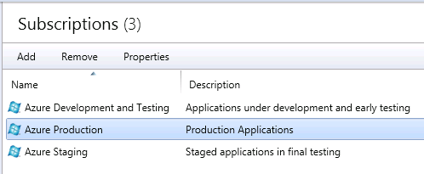
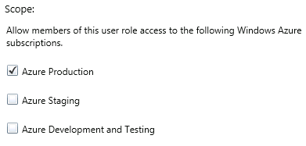
Managing Windows Azure subscriptions
Public Key
App Controller
Windows Azure
Production
API Authentication
Windows Azure
Service API
Private keys stored in
App Controller database
Public Key
Windows Azure
Staging
On-Premise
Windows Azure
Single view of multiple Windows Azure subscriptions
Granular delegation of access to subscriptions

Slide 17


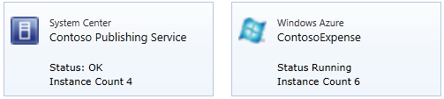
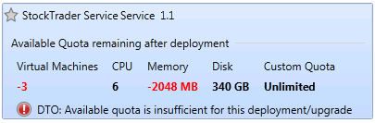
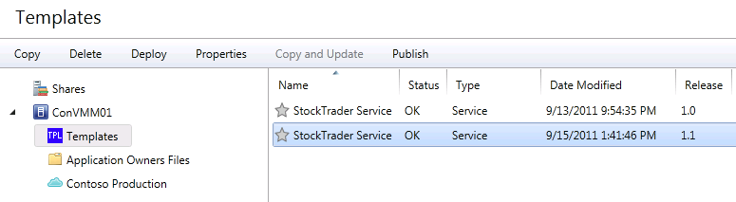
Enabling application self service
DELEGATION WITH CONTROL
EMPOWERING APPLICATION OWNERS
SINGLE MANAGEMENT POINT
Take advantage of standardized templates
Quota enforcement with clear guidance on utilization
Role-based access to content
Create, manage, and
move resources between repositories
Private and public cloud services plus virtual machines
Job auditing and task progress
Change history

Slide 18
Managing applications across multiple clouds
demo
Maarten Goet
System Center Cloud & Datacenter Management MVP

Slide 19



The complete application monitoring solution
Server-Side
Client-Side
Synthetic
Monitoring the actual code that is executed and delivered by the application
End-user experiences related to page load times, server and network latency, and client-side scripting exceptions
Pre-recorded testing paths through the application that highlight availability, response times, and unexpected responses
Use the same tools to monitor with visibility across infrastructure and applications
Infrastructure Monitoring

Slide 20

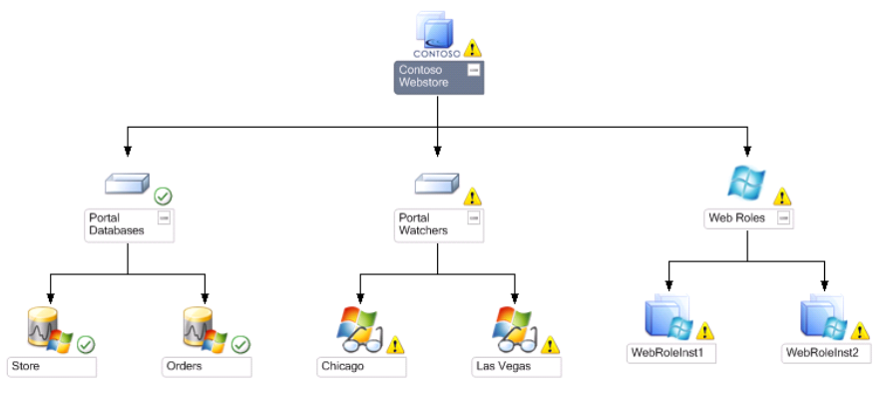
Monitoring Windows Azure applications
Read app roles
and structure
Windows Azure
Service API
Worker Role
Performance data,
events, logs
Web Role
Performance data,
events, logs
Read operational
data and grooming
Table storage
On-Premise Operations Manager
Windows Azure Application
On-premise
Windows Azure
Operations Manager Console Diagram View

Slide 21
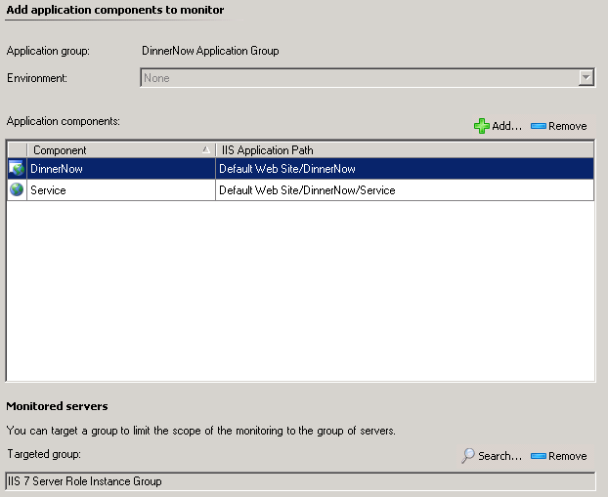
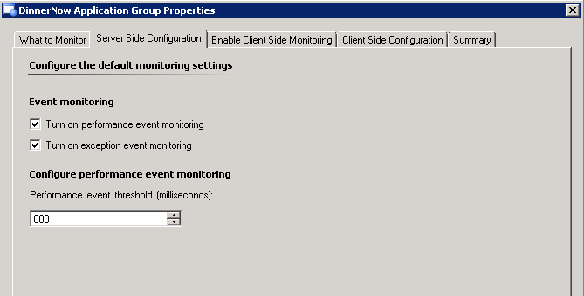
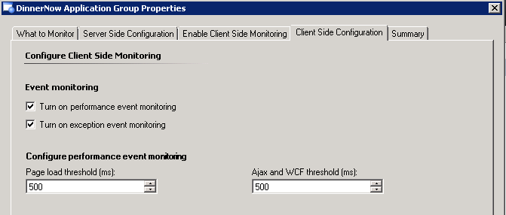
Configuring application performance monitoring
Set server-side performance thresholds
Define the application to monitor
Applications are discovered through MPs
Default thresholds are provided, you tune!
Set client-side performance thresholds for page load times and Ajax/WCF execution

Slide 22
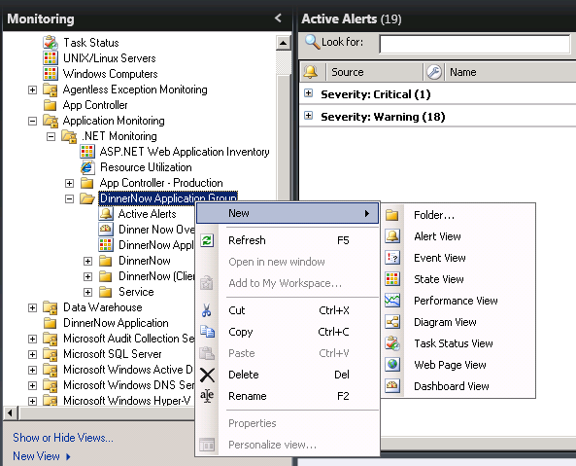
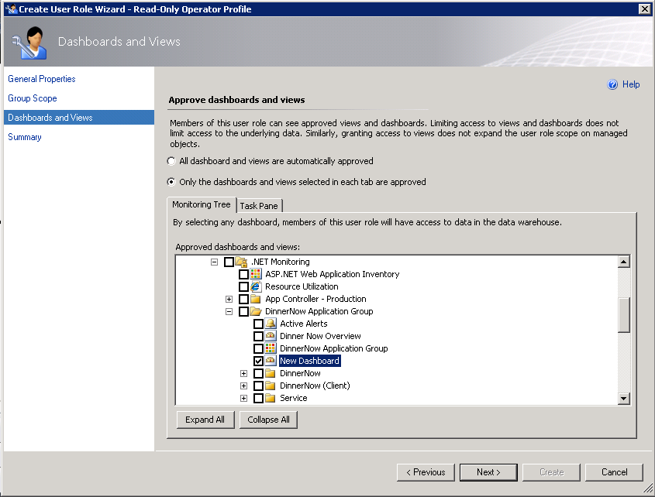
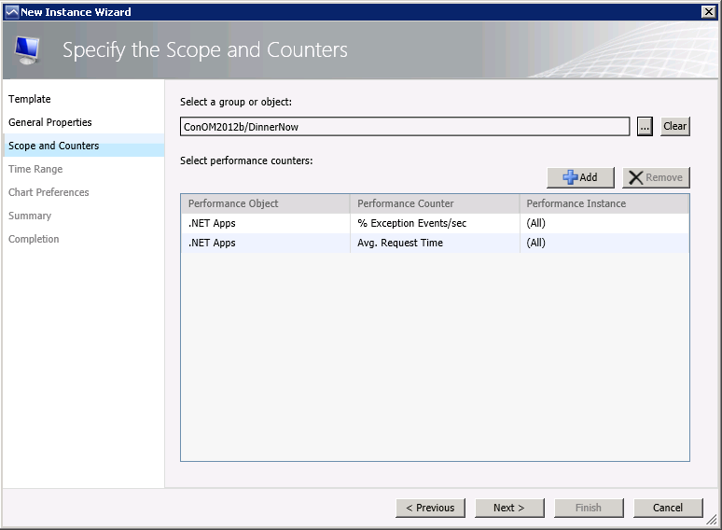
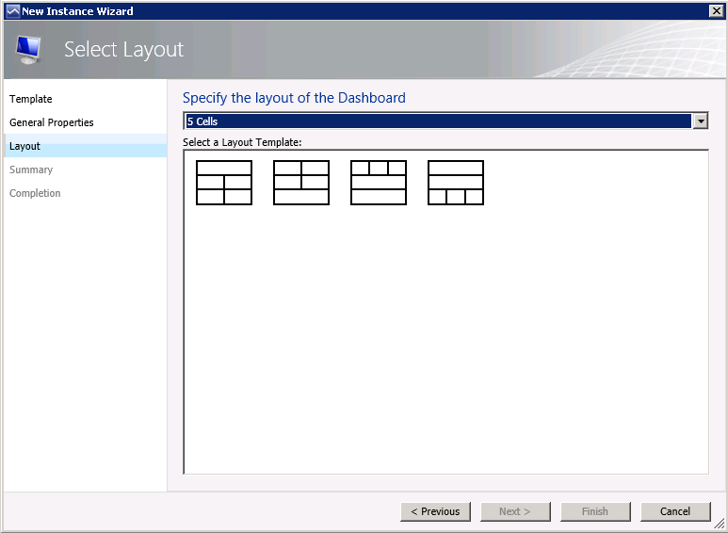



Create an application dashboard in four steps!
Select
Define
Configure
Share
Select a folder to show the dashboard
Choose a template and layout for the dashboard
Add widgets and configure with your desired display
Share the visualizations through the web console or SharePoint
Delegate and publish at a very granular level

Slide 23
The complete application monitoring solution
demo
Maarten Goet
System Center Cloud & Datacenter Management MVP

Slide 24
Application delivery lifecycle - Revisited
Application Specification
  Define the resources and performance requirements for the application
Update the application and version control
Provision application resources to the VMM library
  Deliver of on-going maintenance of the application and new version upgrades
Update Template and Apply to Service
Create Service Template
  Create a new Service Template in the VMM library based on the application requirements
Move the application to production, add into maintenance routines, and configure APM
Publish Service Template, delegate authority and quota
Deploy Service
Customize Deployment
  Start the deployment of the application, either by IT or by an App Owner through App Controller
  Choose most appropriate cloud of server instances for the application

Slide 25

Summary
Cloud is a journey
Private, public, hybrid
Built for the future, ready now

Slide 26




Resources
Learning
  Connect. Share. Discuss.
  Microsoft Certification & Training Resources
http://northamerica.msteched.com
www.microsoft.com/learning
TechNet
  Resources for IT Professionals
  Resources for Developers
http://microsoft.com/technet
http://microsoft.com/msdn

Slide 27






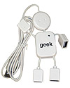
Required Slide
Complete an evaluation on CommNet and enter to win!

Slide 28


MS Tag
Scan the Tag
to evaluate this
session now on
myTechEd Mobile

Slide 29
© 2012 Microsoft Corporation. All rights reserved. Microsoft, Windows, Windows Vista and other product names are or may be registered trademarks and/or trademarks in the U.S. and/or other countries.
The information herein is for informational purposes only and represents the current view of Microsoft Corporation as of the date of this presentation. Because Microsoft must respond to changing market conditions, it should not be interpreted to be a commitment on the
part of Microsoft, and Microsoft cannot guarantee the accuracy of any information provided after the date of this presentation. MICROSOFT MAKES NO WARRANTIES, EXPRESS, IMPLIED OR STATUTORY, AS TO THE INFORMATION IN THIS PRESENTATION.

