Slide 1
Microsoft System Center Configuration Manager 2012 Deployment and Infrastructure Technical Overview
MGT311
Bryan Keller
Lead Program Manager
Microsoft Corporation
Wally Mead
Senior Program Manager
Microsoft Corporation

Slide 2
Session Agenda
Infrastructure Simplification and Hierarchy Design Considerations
Forest Discovery and Boundary Groups
SQL Replication
Client Agent Settings
Role-Based Administration
What’s Coming in SP1

Slide 3




System Center 2012 Configuration Manager
Empower Users
Unify Infrastructure
Simplify Administration
Empower people to be more productive from almost anywhere on almost any device.
Reduce costs by unifying
IT management
infrastructure.
Improve IT effectiveness
and efficiency.

Slide 4
Infrastructure Promises
Modernizing Architecture
  Minimizing infrastructure for remote offices
    Improvements to Distribution Points
  Consolidating infrastructure for primary sites
    Role-Based Administration and Logical Data Segmentation
    Language Neutral Support at Primaries
    Collection-based Client Agent Settings
  Scalability and Data Latency Improvements
    SQL Replication

Slide 5
Infrastructure Decisions – When Do I Need the Following:
Central Administration Site
Primary Sites
Secondary Sites
Distribution Points

Slide 6

Central Administration Site
Unify
Central Administration Site
Central Administration
Site
Centralized Reporting and Administration, simplifies management
More than 100K clients in hierarchy. So essentially you need a central to add multiple primaries and to scale out beyond 100K clients
Any other time you might need more than one primary site in hierarchy
Primary Site
Primary Site
Secondary Site
Secondary Site
Distribution Point

Slide 7
Primary Sites
Unify
Primary Sites
Central Administration
Site
Manage Clients - Clients never report directly to a CAS
Scale (100K clients per primary)
Reduce impact of primary site failure
Political Reasons
Content Regulation
Local point of administrative connectivity
You don’t need a Primary Site for:
  Decentralized administration
  Logical data segmentation
  Client settings
  Language
  Content routing for deep hierarchies
Primary Site
Primary Site
Secondary Site
Secondary Site
Distribution Point

Slide 8
Secondary Sites
Unify
Secondary Sites
Central Administration
Site
No local administrator for secondary
Manage upward flow of WAN traffic
Tiered content routing for deep network topologies
Primary Site
Primary Site
Secondary Site
Secondary Site
Distribution Point

Slide 9
Distribution Points
Unify
Distribution Points
Central Administration
Site
BITS not enough control for WAN traffic
Throttling & Scheduling
BracheCache is not available
PXE & Multicast for Operating System Deployment
App-V Streaming
Primary Site
Primary Site
Secondary Site
Secondary Site
Distribution Point

Slide 10
Minimizing Infrastructure at Remote Offices
One Distribution Point covers it
  No Branch DPs - DPs can be installed on clients and servers now
  Multicast option
  Throttling and scheduling of content to that location
  Pre-stage of content and specify specific drives for storage
Improved Distribution Point Groups
  Manage content distribution to individual Distribution Points or Groups
  Content automatically added or removed from Distribution Points based on Group membership
  Associate Distribution Point Groups with a collections to automate content staging for software targeted to the collection

Slide 11
Content Prestaging
One feature that can preload on a site server or a distribution point
  All package types supported
  Content Library and Package Share
  Registers package availability with site server
  Prestaged content file is compressed
  Single action to load Multiple prestaged content files
    < ExtractContent.exe> used for prestaging the prestaged content file
  Conflict detection to ensure latest package version

Slide 12
Forest Discovery – New
Discovers site server’s forest + any trusted forests
Manually add forests that are not trusted
  Example: Forests for a perimeter network
  Supports both publishing and discovery
Discovery returns the following information
  Domains, IP Subnets, AD Sites
Supports boundary creation
  Can even be automatic!
  On-Demand selection of specific boundaries
  Converts all AD subnet types including “supernets” into ranges

Slide 13

Forest and Boundary Process Flow
Domains | Subnets | Sites
Contoso | 10.10.10.x | North America
engineering | 10.10.11.x | Hawaii
 | 10.10.12.x
Contoso.com
Engineering.contoso.com
Discovery
Runs
Boundaries | Boundary Group | Boundary Group Purpose
NorthAmerica | NA_Site_QQQ | Site Assignment
Hawaii | HI_Site_HAW | Site Assignment, Content
10.10.10.x | Chicago_DP | Content
10.10.11.x | Chicago_DP | Content
10.10.12.x | St_Louis_DP1 | Content

Slide 14
Boundaries
Retained same boundary types as Configuration Manager 2007
Boundary management has been simplified
  Automatically create boundaries as part of forest discovery
    Enable Active Directory forest discovery
  Separated client assignment and content lookup
  Added boundary groups to keep boundaries organized in logical containers
  Boundary groups are the primary object for client assignment and content lookup (not the boundary)
Automatically create a boundary group and associated boundaries from Configuration Manager 2007 site during migration
Active Directory Site | IPv4 subnet
IP address range | IPv6 prefix

Slide 15
Forest Discovery &
Boundary Groups
DEMO

Slide 16
SQL Replication in Configuration Manager 2012
SQL Replication is the new mode for data moving throughout a ConfigMgr hierarchy
  Interactions with SQL DBA are consistent with Configuration Manager 2007
  Configuration Manager admin can monitor and troubleshoot new replication approach independently
DRS (Data Replication Service)
  Configuration Manager built solution
    SQL Service Broker
    SQL Change Tracking
  Data is encrypted
  One-way and bi-directional
  Runs under SMSEXEC using rcmctrl component

Slide 17
Replication Data Types
Data type | Examples | Replication type | Where is data found?
Global data Created by admin | Collection rules, package metadata, software update metadata, Deployments | SQL | Central administration site, all primary sites, secondary sites*
Site data Created by system | Collection members, HINV, alert messages | SQL | Central administration site, originating primary site
Content | Software package installation bits, software updates, boot images | File-based | Primary sites, secondary sites, distribution points
*Global_Proxy is a subset of global data only

Slide 18
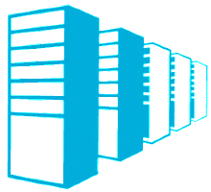
Replication Data Types, cont.
Global Data
Global Data
Site Data
Content
Available at: Central Administration Site and all Primary Sites
Examples include Collection rules, Package metadata, Deployments, Security Scopes
A subset of global data also goes to and from Secondary sites (Package metadata and status, Program metadata)
CENTRAL
ADMINISTRATION
SITE
PRIMARY SITE
PRIMARY SITE
Site Data
Available at: Central Administration Site, Replicating Primary
Examples include HINV, Status, Collection Membership Results
SECONDARY SITE
W/DISTRIBUTION POINT
DISTRIBUTION POINT
Content
DISTRIBUTION POINT
– CLIENT OS
Available where content has been distributed to a Distribution Point

Slide 19
Maintenance Modes
Site Maintenance Mode (SMM)
  On Primary site & Secondary site
  All SMSEXEC components except those required for replication are shutdown
Replication Maintenance Mode (RMM)
  On Central Administration Site
  Some part of replication is not initialized
SMM implies RMM but not the other way

Slide 20
Maintenance Modes
CAS while primary is attaching is in RMM
  Site is usable, but reporting data may be missing
Primary while attaching to CAS is in SMM
  Primary is not usable during SMM
  Primary is usable once global data replication is complete
Secondary while attaching to a primary is in SMM
  Secondary is not usable during this time
CAS with no primary or standalone primary (without secondary sites) does not replicate data; no replication detail in UI

Slide 21
Replication Monitoring and Troubleshooting
UI – status gives an idea where to look
Status Messages for RCM and Hman
Rcmctrl.log – errors in prereqs, etc.
  Registry options for more information
spDiagDrs
vLogs – BCP and SQL errors
Replication Link Analyzer

Slide 22
Monitoring from the Admin Console
Things to look for
  Are site states active for each link?
    If not we have an initialization issue
    Look at the link states to determine which one
  Are the link states active?
    If not investigate the link directions one at a time
    Check the last sync time, is it recent?
    If status is unknown, make sure smsexec/rcm is running (via log)
Replication Link Analyzer
  Provides analysis and remediation for common link issues

Slide 23
Replication Link Analyzer
Admin should use RLA when there is a failure on one of the replication links
Admin can use RLA any time they believe there might be issues with replication
The administrator experience is imilar to Windows 7 Network Troubleshooting Tool
  Available as an action from monitoring / database replication node
  There is also a command line option for running the tool

Slide 24
Site Replication Monitoring
DEMO

Slide 25
Client Settings
Easiest Step to Infrastructure Reduction: Stop using primary
sites for different Client Settings
Default Client Settings are for the entire hierarchy
Custom Client Settings are assigned to collections
Priority-based conflict resolution
  Custom settings always override default settings
Resultant settings can be an aggregation of both default and one or more custom settings
PolicySpy tool updated to view enforced settings

Slide 26

Client Settings and Collection Assignment
Collections Are Global Data
Configuration Manager 2007 |  | Configuration Manager 2012
Collection are site specific |  | Collections are global
 | Created at a primary site Only affects resources at or below this site Site centric administration |  | Created at CAS or primary site Evaluated at all primary sites Clients from any site can be members and receive targeted deployments Client centric administration
Remember
  Global data: collection rules & count
  Site data: collection members

Slide 27
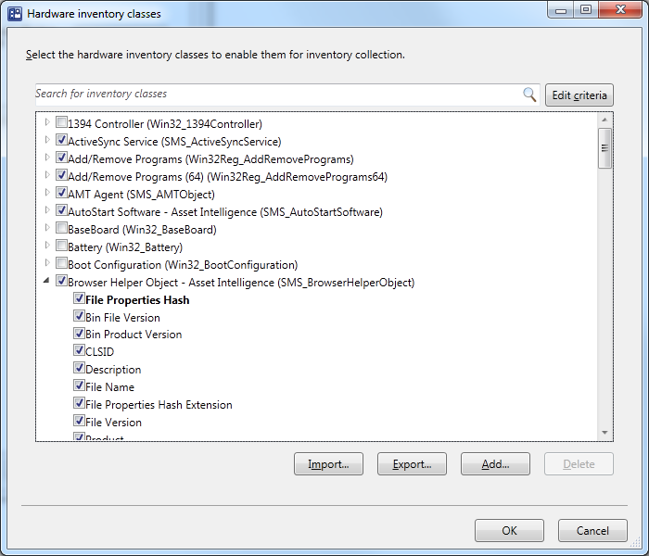
Hardware Inventory
Simplified experience
  Forget about SMS_DEF.MOF!
  Browse WMI namespace to select the classes you need
Backward compatible
  Import existing .mof files

Slide 28


Hardware Inventory
Use Client Setting to configure inventory classes
Server Setting
 | Services
 | NT_Event Log File
Laptop Setting
 | Battery
 | PCMCTA Controller
Default Setting
 | Computer System
 | Device Memory
 | Processor
 | User Profile
Default Setting
 | Computer System
 | Device Memory
 | Processor
 | User Profile

Slide 29
Client Settings and
Hardware Inventory
DEMO

Slide 30
Role-Based Administration
Role-Based Administration allows:
Mapping organizational roles of administrators to security roles
Hierarchy-wide security management from a single console
  RBA is global data
  Don’t think about sites!
Removing clutter from the console
  “Show me what’s relevant to me”!

Slide 31
Administrative Segmentation
Security Roles
  What types of objects can I see and what can I do to them?
  Example: the “Software Update Manager” role gives rights to read and deploy software updates to specific collections
Security Scopes
  Which instances can I see and interact with?
Collections
  Which resources can I interact with?

Slide 32



Data Segmentation of the Past
Configuration Manager 2007
Meg wishes to distribute a package to all of her EMEA users in the West region
France Primary Site
Louis
“French Admin”
French collections
Create advertisement for French collections
England Primary Site
Meg Collins
“Central Admin”
Create and distribute package
Anthony
“English Admin”
English collections
Create advertisement for English collections

Slide 33
Segmentation Using Role Based Administration Configuration Manager 2012
Meg wishes to distribute an application to all of her EMEA users in the West region
Central Admin Site
Meg Collins
“Central Admin”
Anthony
“English Admin”
Louis
“French Admin”
French collection(s)
Create deployment for French collection(s)
English collection(s)
Create deployment for English collection(s)
Create and distribute application

Slide 34
Collection Limiting
Meg gives Louis permissions to “French Systems”
All Systems
Louis
can read French Systems and all collections limited to French Systems
cannot see All Systems and English Systems
can modify and delete French Desktops
can create new collections limited to French Systems or French Desktops
French Systems
English Systems
French Desktops
French Servers

Slide 35
Collection Limiting
Every collection is limited by another
Assigning a collection to an administrator automatically assigns all limited collections
Ship with two read-only root collections
  All Systems
  All Users and User Groups

Slide 36
Role Based
Administration
DEMO

Slide 37
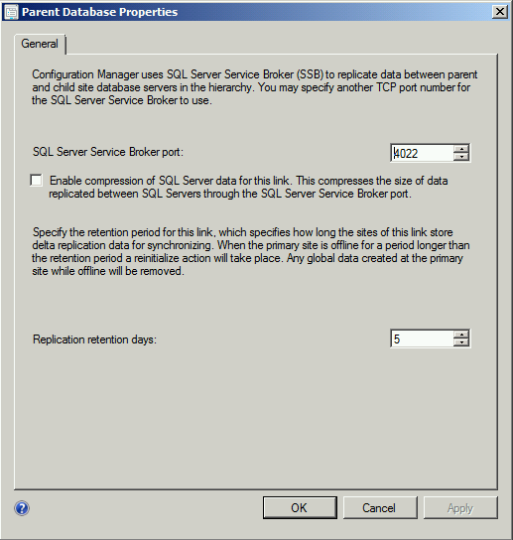
SQL Compression
Coming in SP1!
Ability to turn compression on/off for replication traffic across sites
Can be turned on or off on a per link basis
Early testing indicates significant improvement in network traffic usage while replicating data, specifically in network I/O to the CAS)
Does incur a slight increase in CPU utilization

Slide 38
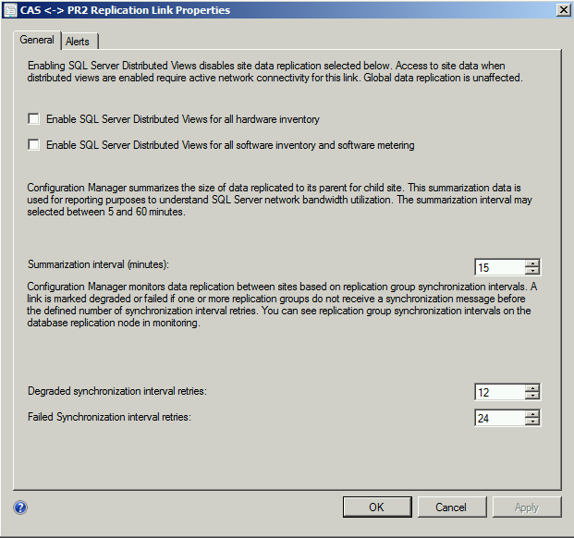
SQL Distributed Views
Coming in SP1!
Allows a view of data from one site to another using a query that retrieves data on-demand, replication is turned off
When enabled, no site data (hinv, sinv, and metering data) is replicated or stored at the CAS
Saves on data storage and link traffic
Requires a good, reliable connection between SQL Servers for sites where distributed views are enabled

Slide 39

Hierarchy Expansion
Coming in SP1!
Allows a growing organization to expand to a hierarchy when scale requires it
Gives customers the freedom to use a standalone primary as long as they need
There will be some before and after steps to make it work right
  For example, admin may have to remove and re-deploy some roles
Central Administration Site
Primary Site
Global Data initialized
Primary Site

Slide 40
Configuration Manager 2007 Versus
Configuration Manager 2012
Delivering on the Promise
Promise | Configuration Manager 2007 | Configuration Manager 2012
Scalability and data latency improvements | Central primary reprocesses all data from child sites | Central administration site – no data processing
Consolidating infrastructure for primary sites | Separate primary | Collection-based settings Role-based administration/admin segmentation
Minimizing infrastructure for remote offices | Secondary Site | Secondary site Distribution points with throttling and scheduling
 | Standard distribution points and branch distribution points | Distribution points BranchCache™

Slide 41
Minimum System Requirements
Component | Minimum Requirement
Site Server and Site Roles | Windows Server 2008 (64-bit ) Windows Server 2008 R2 (64-bit)
Database | SQL Server 2008 SP2 CU9 SQL Server 2008 SP3 CU4 SQL Server 2008 R2 SP1 CU6 (64-bit) *SQL Server 2008 Std. on CAS with max 50k clients, otherwise SQL Server 2008 Ent. on CAS
Distribution Point | Windows Server 2003 (including 32-bit) with limited functionality Windows Vista SP2 and later (including 32-bit)
Client | Windows XP SP2 (64-bit) & SP3 (32-bit) Windows 2003 Server SP2 (32-bit & 64-bit) Vista SP2 (32-bit & 64-bit) Windows 7 RTM (32-bit & 64-bit) Windows 2008 SP2 (32-bit & 64-bit) Windows 2008 R2 RTM (64-bit)

Slide 42
Prepare For Configuration Manager 2012
Flatten hierarchy where possible
Plan for Windows Server 2008, SQL 2008, and 64-bit
Start implementing BranchCache™ with Configuration Manager 2007 SP2
Move from web reporting to SQL Reporting Services
Avoid mixing user & devices in collection definitions
Use UNC (\\server\myapp\myapp.msi) in package source path instead of local path (d:\myapp)

Slide 43
Things You Can Do Next
Follow our blog, How-to-Videos and website
Download the VHDs - here
Work through the TechNet Virtual Labs - here
Join the Conversation on Twitter (#sysctr)

Slide 44

Related Content
Breakout Sessions
  MGT309 | Microsoft System Center 2012 Configuration Manager Overview
  MGT310 | Microsoft System Center 2012 Endpoint Protection Overview
  MGT312 | Deep Application Management with Microsoft System Center 2012 Configuration Manager
  MGT313 | Microsoft System Center 2012 Configuration Manager: Plan, Deploy, and Migrate from Configuration Manager 2007 to 2012
  MGT318 | Patch and Settings Management in Microsoft System Center 2012 Configuration Manager
  WCL388 | Client Management Scenarios in the Windows 8 Timeframe

Slide 45

Related Content
Hands-on Labs:
  MGT23-HOL | Deploying Windows 7 to Bare Metal Systems with Microsoft System Center 2012 Configuration Manager
  MGT24-HOL | Implementing Endpoint Protection 2012 in Microsoft System Center 2012 Configuration Manager
  MGT12-HOL | Compliance and Settings Management in Microsoft System Center 2012 Configuration Manager
  MGT25-HOL | Deep Dive: Microsoft System Center 2012 Configuration Manager SQL Replication Labs
  MGT21-HOL | Basic Software Distribution in Microsoft System Center 2012 Configuration Manager
  MGT16-HOL | Migrating from Microsoft System Center Configuration Manager 2007 to System Center 2012 Configuration Manager
  MGT14-HOL | Implementing Role Based Administration in Microsoft System Center 2012 Configuration Manager
  MGT15-HOL | Deploying a Microsoft System Center 2012 Configuration Manager Hierarchy
  MGT11-HOL | Introduction to Microsoft System Center 2012 Configuration Manager

Slide 46



Resources
Learning
  Connect. Share. Discuss.
  Microsoft Certification & Training Resources
http://northamerica.msteched.com
www.microsoft.com/learning
TechNet
  Resources for IT Professionals
  Resources for Developers
http://microsoft.com/technet
http://microsoft.com/msdn

Slide 47







Required Slide
Complete an evaluation on CommNet and enter to win!

Slide 48


MS Tag
Scan the Tag
to evaluate this
session now on
myTechEd Mobile

Slide 49
© 2012 Microsoft Corporation. All rights reserved. Microsoft, Windows, Windows Vista and other product names are or may be registered trademarks and/or trademarks in the U.S. and/or other countries.
The information herein is for informational purposes only and represents the current view of Microsoft Corporation as of the date of this presentation. Because Microsoft must respond to changing market conditions, it should not be interpreted to be a commitment on the
part of Microsoft, and Microsoft cannot guarantee the accuracy of any information provided after the date of this presentation. MICROSOFT MAKES NO WARRANTIES, EXPRESS, IMPLIED OR STATUTORY, AS TO THE INFORMATION IN THIS PRESENTATION.

Slide 50
Sample slides from other presentations

Slide 51

Internet-based Client Management
Unify
Reduced Complexity
Single Primary site can manage both Intranet clients (over HTTP) and Internet clients (over HTTPS)
Flexibility
Primary sites can be configured to either support only HTTPS roles or both HTTP and HTTPS site roles
Reliability
Intelligent client behavior enables client to communicate using the most secure option available
Tighter security enforcement by only allowing clients with Enterprise-issued certificates to communicate with the ConfigMgr roles
Intranet
Internet
PR1
MP
MP
DP
DP
Non PKI enabled site system
PKI enabled site system

Slide 52



Unified Management of Virtual Clients
Unify
User-centric application delivery through App-V or Citrix XenApp.
CONNECTION BROKER
Single admin experience for managing physical and virtual desktops. Integrates with RDS and XenDesktop.
Recognizes pooled and personal virtual desktops
Randomizes tasks
APP-V
SEQUENCER
CONFIGMGR
DP/MP
HYPER-V

Slide 53
Operating System Deployment
Simplify
Multiple Deployment Method Support
CAS
PXE initiated deployment allows client computers to request deployment over the network
Multi-cast deployment to conserve
network bandwidth
Stand-alone media deployment for no network connectivity or low bandwidth
Pre-staged media deployment allows you to deploy an operating system to a computer that
is not fully provisioned
USMT 4.0 UI integration makes it easier transfer files and user settings from one machine to another
Image
Task Sequence
Report
WDS PXE Server
Primary Site
DP Role
Primary Site
MP Role

Slide 54
Reduced Infrastructure Requirements
Unify
Central Administration Site
Primary Sites
Secondary Sites
Central primary site administration
Reporting
Client management and settings
Delegated administration
Content routing
Distributions points
Central Administration
Site
Primary Site
Primary Site
Secondary Site
Secondary Site
Secondary Site
Secondary Site
Secondary Site
Secondary Site

Slide 55
Internet-based Client Management
Unify
Reduced Complexity
Single Primary site can manage both Intranet clients (over HTTP) and Internet clients (over HTTPS)
Flexibility
Primary sites can be configured to either support only HTTPS roles or both HTTP and HTTPS site roles
Reliability
Intelligent client behavior enables client to communicate using the most secure option available
Tighter security enforcement by only allowing clients with Enterprise-issued certificates to communicate with the ConfigMgr roles
Intranet
Internet
PR1
MP
MP
DP
DP
Non PKI enabled site system
PKI enabled site system

Slide 56
Unified Management of Virtual Clients
Unify
User-centric application delivery through App-V or Citrix XenApp.
CONNECTION BROKER
Single admin experience for managing physical and virtual desktops. Integrates with RDS and XenDesktop.
Recognizes pooled and personal virtual desktops
Randomizes tasks
APP-V
SEQUENCER
CONFIGMGR
DP/MP
HYPER-V

Slide 57
Operating System Deployment
Simplify
Multiple Deployment Method Support
CAS
PXE initiated deployment allows client computers to request deployment over the network
Multi-cast deployment to conserve
network bandwidth
Stand-alone media deployment for no network connectivity or low bandwidth
Pre-staged media deployment allows you to deploy an operating system to a computer that
is not fully provisioned
USMT 4.0 UI integration makes it easier transfer files and user settings from one machine to another
Image
Task Sequence
Report
WDS PXE Server
Primary Site
DP Role
Primary Site
MP Role

