Slide 1
Patch and Settings Management in Microsoft System Center Configuration Manager 2012
MGT318
Mark Florida
Principal Program Manager Lead
Microsoft Corporation
Wally Mead
Senior Program Manager
Microsoft Corporation

Slide 2
Agenda
Overview of the security features in
Configuration Manager 2012
Software update management overview and demo
Settings management overview and demo

Slide 3


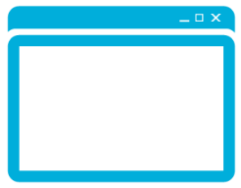

System Center 2012 Configuration Manager
Empower Users
Unify Infrastructure
Simplify Administration
Empower people to be more productive from almost anywhere on almost any device.
Reduce costs by unifying
IT management
infrastructure.
Improve IT effectiveness
and efficiency.

Slide 4
Building Your Compliance Management Solution With Configuration Manager 2012
Plan and Configure
Assessing Compliance
Remediating Non-compliance
Software Updates
Planning and setup
Targeting and Delegation
Maximizing productivity
Software Updates
Scanning for compliance
Measuring compliance
Software updates
Deploying monthly updates
Monitoring ongoing compliance
Settings Management
Define standards
Create baselines and CIs
Settings Management
Deploy compliance baselines to collections of users or systems
Settings Management
Monitor drift from desired state
Remediate issues impacting setting of desired state
Endpoint Protection
Enable the product
Define standards for protection (AM Policy, Definitions, Alerts)
Endpoint Protection
Enable and deploy EP client
Actively monitor for malware based on AM policy
Endpoint Protection
Clients remediate malware and rapidly report state
Admin intervenes where required

Slide 5
Building Your Compliance Management Solution
With Configuration Manager 2012
Plan and Configure
Software Updates
Planning and setup
Targeting and Delegation
Maximizing productivity

Slide 6
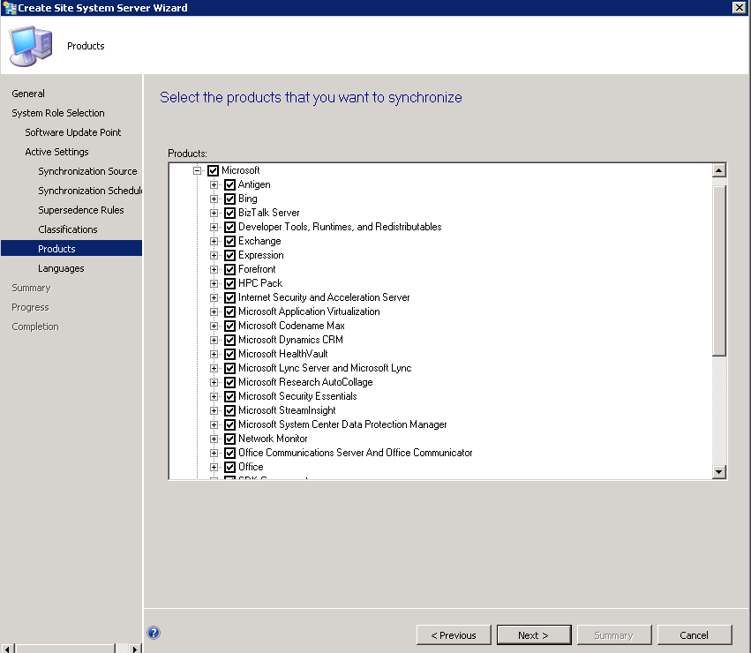

Plan and Configure: Setup
Administrator Console
Hierarchy
MICROSOFT
UPDATE
2
Installs SUP role and configures WSUS through Admin SDK
PRIMARY SITE
3
Synch catalog of selected products and classifications
Catalog metadata synched into ConfigMgr database
4
MANAGEMENT
POINT
SUP
(WSUS)
DISTRIBUTION
POINT
1
Add SUP role and select products and classifications
Client
5
Add 3rd party updates through SCUP Tool

Slide 7

Plan and Configure: 3rd Party Updates
Catalogs downloaded from web
Import Updates
Create Updates
Publish Updates
Sync Updates
Scan Updates
Deploy Updates
ADMIN
UPDATES PUBLISHER CONSOLE
WSUS
SERVER
CONFIGMGR SERVER / SUP
Updates Publisher users can either download already existing catalogs or create their own. Once approved, updates can be published into WSUS which will be synchronized into a Configuration Manager environment. The updates are now in Configuration Manager and can be scanned and deployed on client machines with the same process as Microsoft Updates.
CONFIGMGR CLIENTS

Slide 8
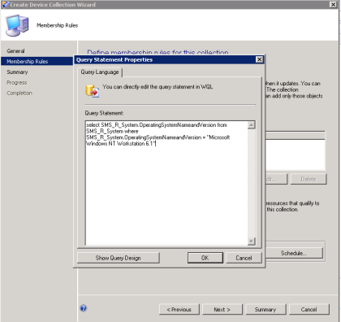
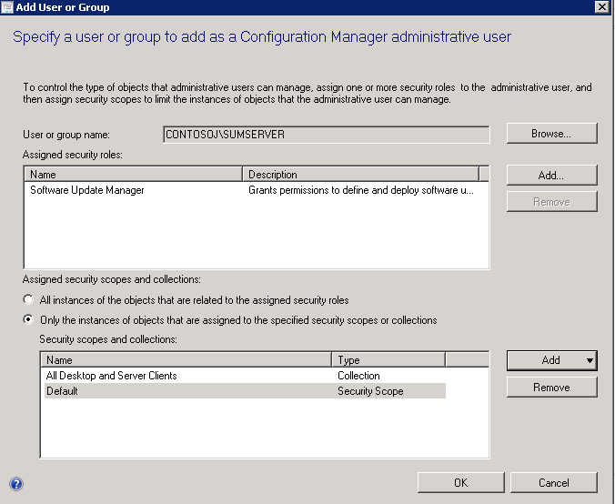
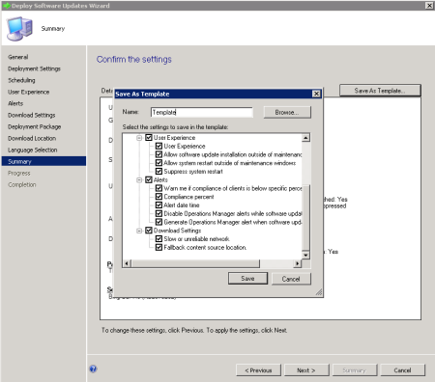
Plan and Configure: Administration
Collections
Role-based Access
Create Templates
Build collections through dynamic queries
Create SUM administrators and assign to collections for which they need to manage updates
SUM Admin goes through the distribute software updates wizard and saves his default settings for deployments
All Windows 7 Desktops in North America
Template
Collection
Deployment
Schedule
User Experience
Alerts
Download settings
Note: for multiple SUM admins you can also use scopes to further secure console objects

Slide 9
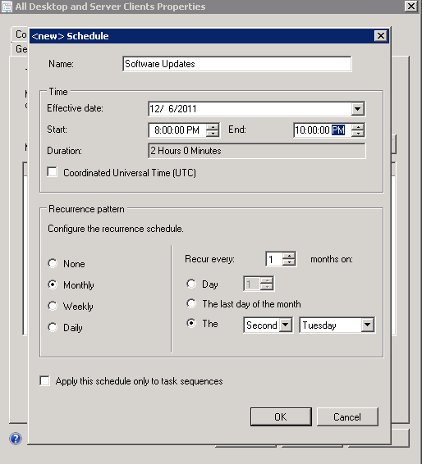
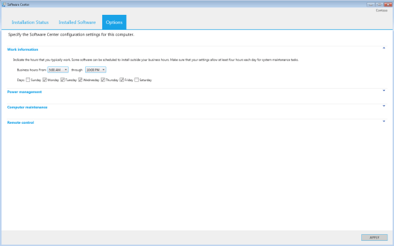
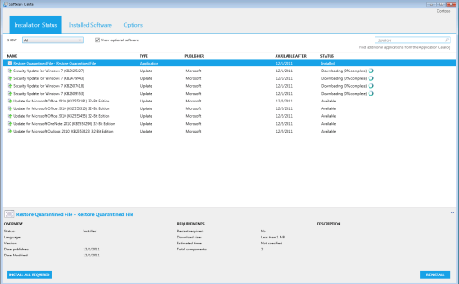
Plan and Configure: End-user Impact
Maintenance Windows
Non-business Hours
Software Center
Apply maintenance windows to collections to manage when updates can occur
Melissa sets her own business hours in Software Center
Melissa gets notifications that software updates are required
All Windows 7 Desktops
“Software updates and reboots can only occur from 8:00 – 10:00 PM on the 2nd Tuesday of every month”
Melissa’s Computer
Software can be installed from 6:00 PM to 7:00 AM
Suspend Software Center activities when in presentation mode
Options
Postpone
Install now
Install after business hours
View updates

Slide 10

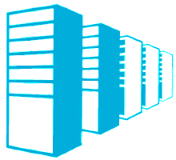
Plan and Configure: Infrastructure Impact
Using Distribution Points
Using Branchcache
Internet-based Users
Deploy distribution points
to branch locations
Configure BranchCache on your clients and appropriate ConfigMgr servers
Configure internet facing SUPs and MPs
Clients get their content from those distribution points
Windows 7 clients get their software updates from peers, and they don’t have to go over the network, nor do you have to put a distribution point at that location
Client updates are managed on internet-roaming clients, and they get their content from Windows Update / Microsoft Update

Slide 11
Building Your Compliance Management Solution
With Configuration Manager 2012
Plan and Configure
Assessing Compliance
Software Updates
Planning and setup
Targeting and Delegation
Maximizing productivity
Software Updates
Scanning for compliance
Measuring compliance

Slide 12
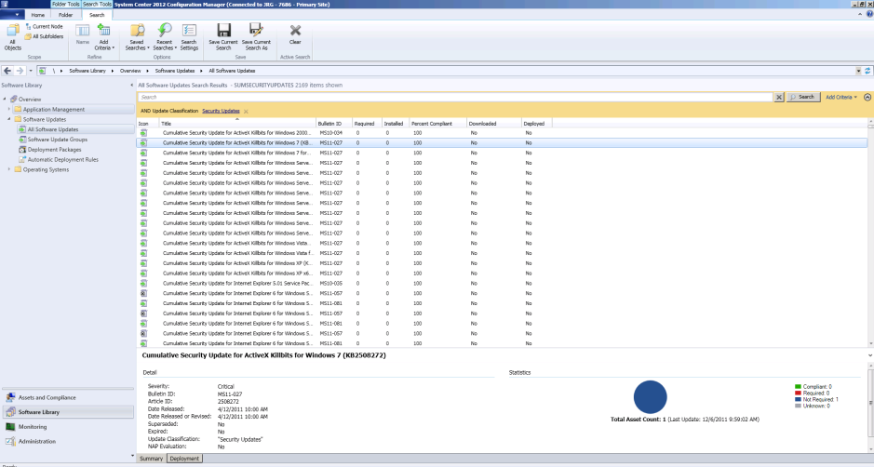
Scanning and Measuring
Administrator Console
Hierarchy
MICROSOFT
UPDATE
PRIMARY SITE
5
Admin sees compliance for all updates in console and in reports
MANAGEMENT
POINT
SUP
(WSUS)
DISTRIBUTION
POINT
Client
Client gets SUM policy and is assigned a SUP/WSUS server
1
2
Windows Update Agent scans against WSUS catalog
Compliance state messages sent to MP and DB
4
3
Scan results are written to WMI on the client

Slide 13
Building Your Compliance Management Solution
With Configuration Manager 2012
Plan and Configure
Assessing Compliance
Remediating Non-compliance
Software updates
Planning and setup
Targeting and Delegation
Maximizing productivity
Software updates
Scanning for compliance
Measuring compliance
Software updates
Deploying monthly updates
Monitoring ongoing compliance

Slide 14
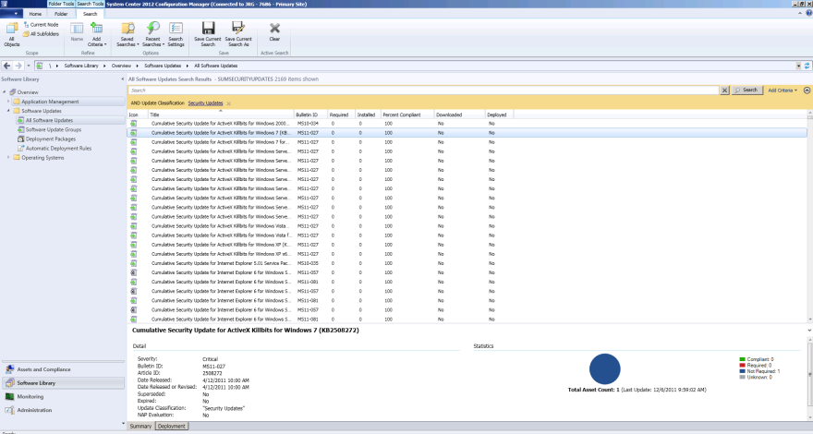
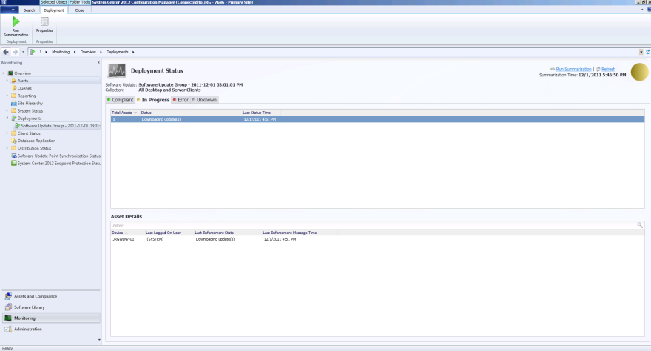
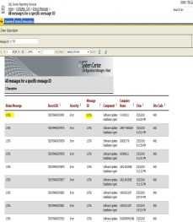
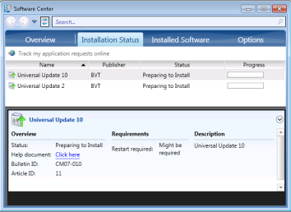
Remediating Non-Compliance
Administrator Console
Hierarchy
2
Binaries are downloaded
from Microsoft Update
MICROSOFT
UPDATE
PRIMARY SITE
3
Updates are placed in deployment package and sent to Distribution Point
1
ADR or Admin deploys applicable updates
MANAGEMENT
POINT
SUP
(WSUS)
DISTRIBUTION
POINT
Client
Client gets deployment policy
4
5
Client gets update binaries from distribution point and caches them locally
Enforcement state messages sent to MP and DB
7
6
Updates are installed on a schedule or by the end user
8
Admin views deployment status
in-console or from reports

Slide 15
The Software Updates Workflow
DEMO

Slide 16

Software Updates: Bringing It All Together
Administrator Console
Setup & Synch
2
Installs SUP role and configures WSUS through Admin SDK
MICROSOFT
UPDATE
PRIMARY SITE
3
Synch catalog of selected products and classifications
Catalog metadata synched into ConfigMgr database
4
1
Add SUP role and select products
and classifications
SUP (WSUS)
Scan & Report
Client gets SUM policy and is assigned a SUP/WSUS server
5
6
Windows Update Agent scans against WSUS catalog
9
Admin sees compliance for all updates in console and in reports
Compliance state messages sent to MP and DB
8
7
Scan results are written to WMI on the client
MANAGEMENT
POINT
10
Add 3rd party updates through SCUP Tool

Slide 17
Best Practices Recap
Create update groups of all required, released updates (do not exceed 1000)
Use migration (from CM07) or create new update groups for required, released updates
Delegated admins can create deployments of any approved update group
Update groups can be used to measure overall compliance, and not deployed
Create new update groups for each Patch Tuesday, manually or through rules
Add monthly updates to the compliance update group each month for overall compliance
Client optimized to evaluate multiple update deployments with applicable updates
Cleanup expired updates across your groups through search

Slide 18
Building Your Compliance Management Solution
With Configuration Manager 2012
Plan and Configure
Assessing Compliance
Remediating Non-compliance
Software updates
Planning and setup
Targeting and Delegation
Maximizing productivity
Software updates
Scanning for compliance
Measuring compliance
Remediation strategy
Software updates
Deploying monthly updates
Monitoring ongoing compliance
Settings Management
Define standards
Create baselines and CIs

Slide 19
Plan And Configure: Setting Management
ConfigMgr MP
Baseline
ConfigMgr Agent
Deploy baselines to collections
Baseline drift
Auto Remediate
OR
Create Alert
!
Baseline Configuration Items
Active
Directory
Script
WMI
XML
SQL
File
Software
Updates
Registry
MSI
IIS
Improved functionality
Copy settings
Trigger console alerts
Richer reporting
Enhanced versioning and audit tracking
Ability to specify versions to be used in baselines
Audit tracking includes who changed what
Pre-built industry standard baseline templates
through IT GRC Solution Accelerator

Slide 20
BUILDING YOUR COMPLIANCE MANAGEMENT SOLUTION
WITH CONFIGURATION MANAGER 2012
Plan and Configure
Assessing Compliance
Remediating Non-compliance
Software updates
Planning and setup
Targeting and Delegation
Maximizing productivity
Software updates
Scanning for compliance
Measuring compliance
Remediation strategy
Software updates
Deploying monthly updates
Monitoring ongoing compliance
Settings Management
Define standards
Create baselines and CIs
Settings Management
Deploy compliance baselines to collections of users or systems

Slide 21
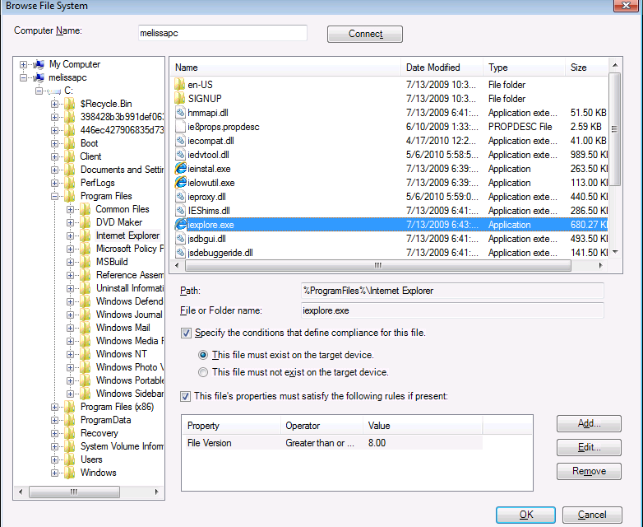
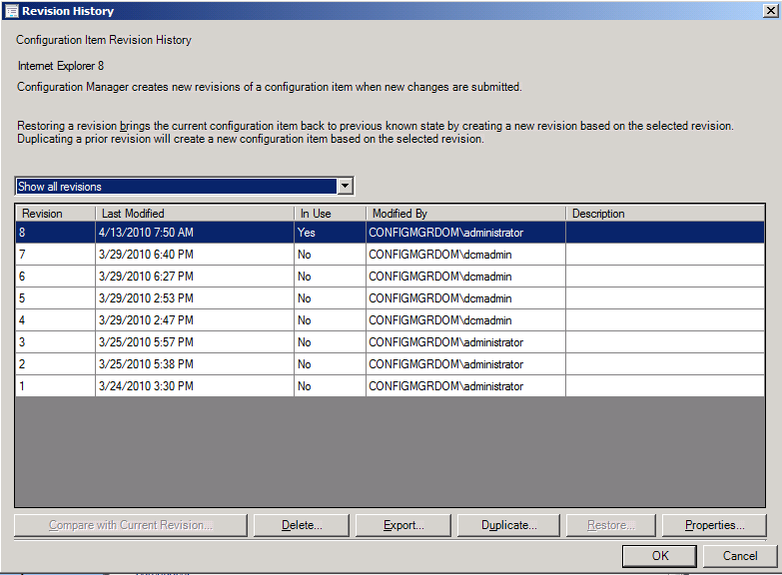
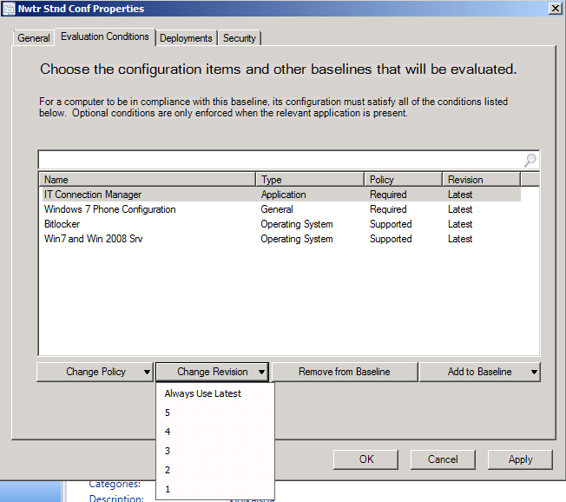
Accessing Compliance:
Configuration Items Creation
Browse to Gold Systems
Browse local / remote machine
Registry and File System only
Configuration Item re-visioning
Ability to see revisions of configuration item, view who changed what and chose to use specific or latest revision of CIs in Baselines.
Re-use of settings across CI boundary

Slide 22
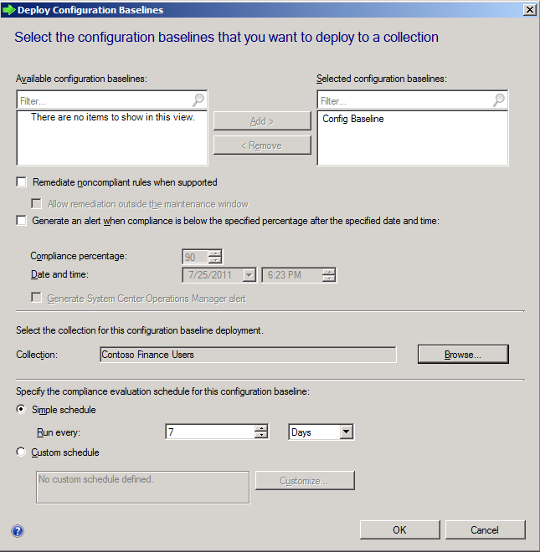
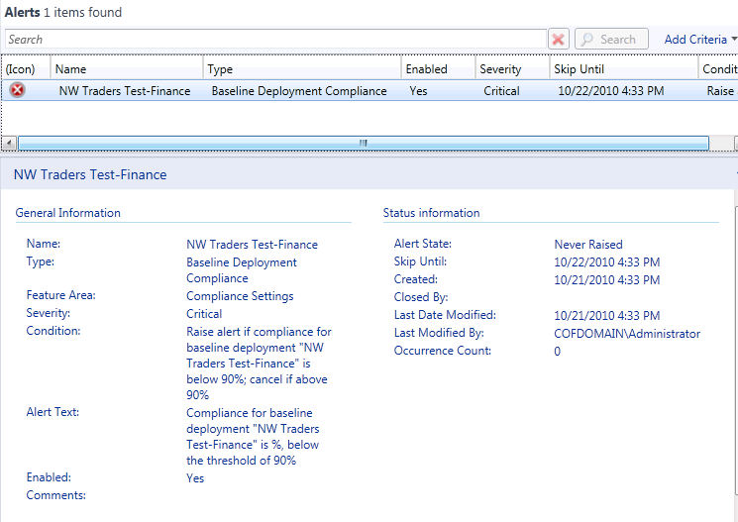
Accessing Compliance: Deploy Baseline
Target It to User or Device
User targeting
Registry settings stored under HKCU
CIs with user settings will be evaluated when user logs on
Evaluate Baseline on all devices user logs on
Evaluate Baseline on only user’s primary machines
Device targeting
Evaluate Baselines to devices
Compliance results summarized for devices
Role Based Management
Assign Settings Management admins to appropriate baselines and collections
CI revision history
Control CI versions to be used in baselines
Audit tracking: who changed what
Compare/restore/duplicate previous revisions

Slide 23
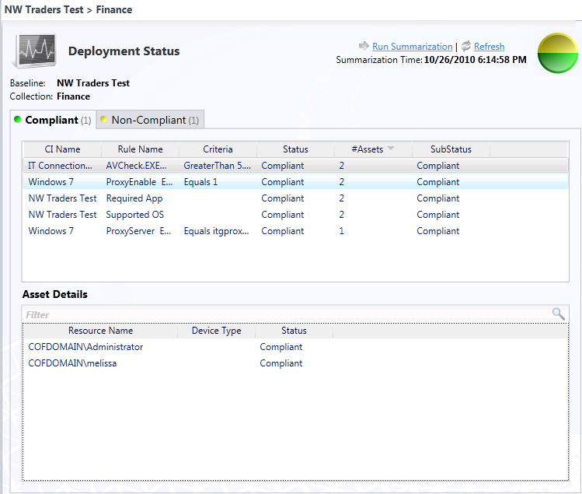
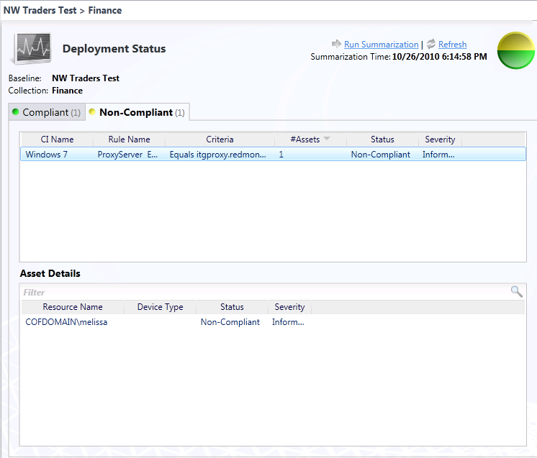
Assessing Compliance: Settings Management
Compliance Monitoring
Separate tabs to drill down assets Complaint, Non Complaint, Error and Unknown
common Noncompliant/Errors sorted based on # of devices/users impacted
User/device collection sorted by user or device appropriately

Slide 24
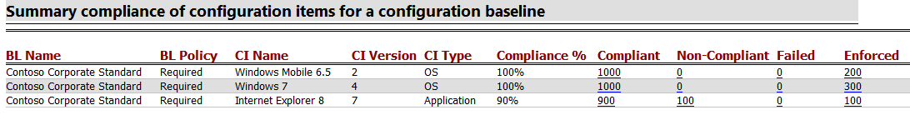
Assessing Compliance: Settings Management
Reports
Reports are also available and now includes remediation, conflict and error reporting
Lets admin see compliance at a glance
Multiple drill downs Drill-down to see details
View Troubleshooting, remediation and conflict info

Slide 25
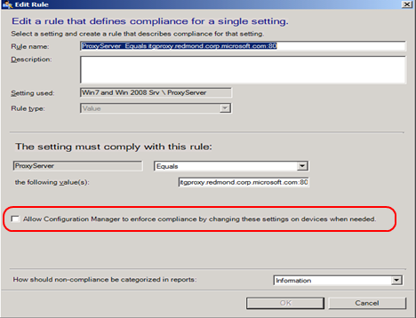
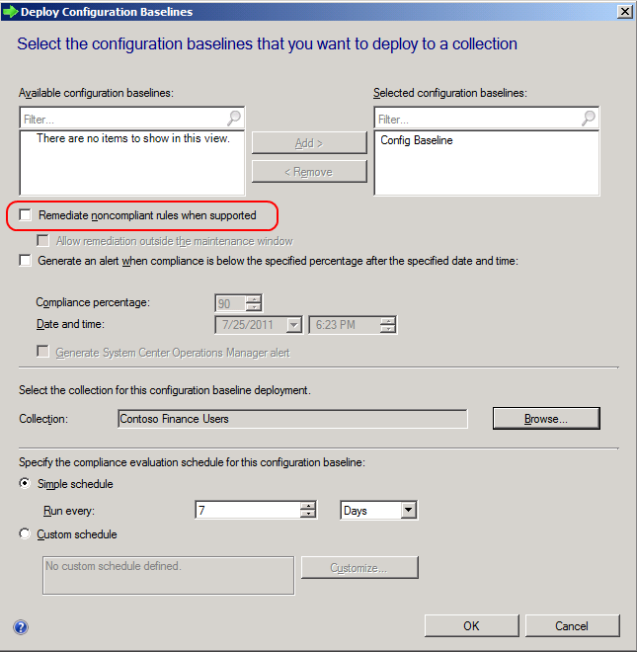
Remediation: Setting Management
Automatic Remediation: supported for Registry-, wmi- and script-based settings an
Create setting if not exist
Set value if not compliant
Run remediation script
Remediate phone settings

Slide 26
Settings Modified By Malware
DEMO

Slide 27
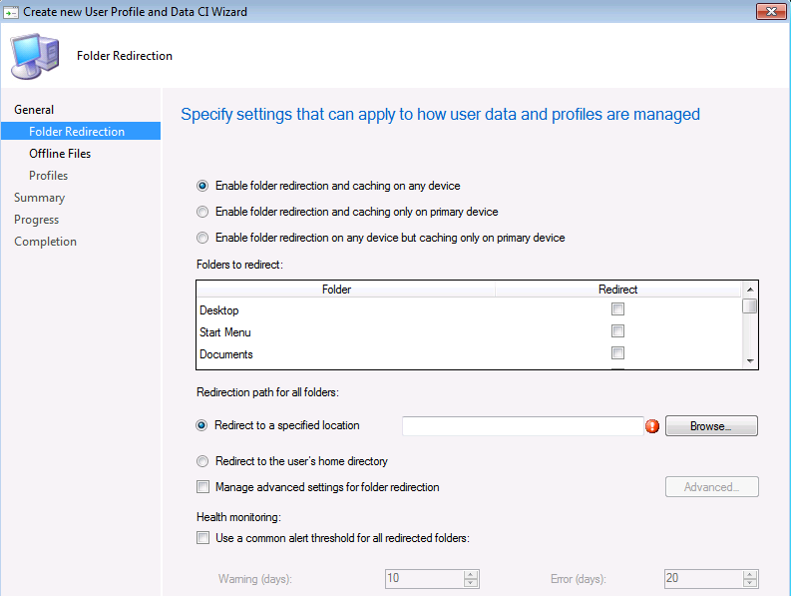
User Profile and Data Management
What’s new in SP1
New feature to manage:
  Client Side Caching
  Roaming User Profiles
  Folder Redirection
ConfigMgr client modified so that user policies are applied at user logon

Slide 28
Summary
Plan and Configure
Assessing Compliance
Remediating Non-compliance
Software Updates
Planning and setup
Targeting and Delegation
Maximizing productivity
Software Updates
Scanning for compliance
Measuring compliance
Software updates
Deploying monthly updates
Monitoring ongoing compliance
Settings Management
Define standards
Create baselines and CIs
Settings Management
Deploy compliance baselines to collections of users or systems
Settings Management
Monitor drift from desired state
Remediate issues impacting setting of desired state
Endpoint Protection
Enable the product
Define standards for protection (AM Policy, Definitions, Alerts)
Endpoint Protection
Enable and deploy EP client
Actively monitor for malware based on AM policy
Endpoint Protection
Clients remediate malware and rapidly report state
Admin intervenes where required

Slide 29
Online Resources
Launching a Windows Defender Offline Scan with Configuration Manager 2012 OSD
Operating System Deployment and Endpoint Protection Client Installation
Software Update Content Cleanup in System Center 2012 Configuration Manager
Building Custom Endpoint Protection Reports in System Center 2012 Configuration Manager
Managing Software Updates in Configuration Manager 2012
How-to-Videos
Product Documentation
Security and Compliance Manager – Configuration Packs

Slide 30


Related Content
Breakout Sessions
  MGT309 | Microsoft System Center 2012 Configuration Manager Overview
  MGT310 | Microsoft System Center 2012 Endpoint Protection Overview
  MGT311 | Microsoft System Center 2012 Configuration Manager Deployment and Infrastructure Technical Overview
  MGT312 | Deep Application Management with Microsoft System Center 2012 Configuration Manager
  MGT313 | Microsoft System Center 2012 Configuration Manager: Plan, Deploy, and Migrate from Configuration Manager 2007 to 2012
  WCL388 | Client Management Scenarios in the Windows 8 Timeframe

Slide 31

Related Content
Hands-on Labs:
  MGT23-HOL | Deploying Windows 7 to Bare Metal Systems with Microsoft System Center 2012 Configuration Manager
  MGT24-HOL | Implementing Endpoint Protection 2012 in Microsoft System Center 2012 Configuration Manager
  MGT12-HOL | Compliance and Settings Management in Microsoft System Center 2012 Configuration Manager
  MGT25-HOL | Deep Dive: Microsoft System Center 2012 Configuration Manager SQL Replication Labs
  MGT21-HOL | Basic Software Distribution in Microsoft System Center 2012 Configuration Manager
  MGT16-HOL | Migrating from Microsoft System Center Configuration Manager 2007 to System Center 2012 Configuration Manager
  MGT14-HOL | Implementing Role Based Administration in Microsoft System Center 2012 Configuration Manager
  MGT15-HOL | Deploying a Microsoft System Center 2012 Configuration Manager Hierarchy
  MGT11-HOL | Introduction to Microsoft System Center 2012 Configuration Manager

Slide 32



Resources
Learning
  Connect. Share. Discuss.
  Microsoft Certification & Training Resources
http://northamerica.msteched.com
www.microsoft.com/learning
TechNet
  Resources for IT Professionals
  Resources for Developers
http://microsoft.com/technet
http://microsoft.com/msdn

Slide 33






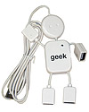
Required Slide
Complete an evaluation on CommNet and enter to win!

Slide 34


MS Tag
Scan the Tag
to evaluate this
session now on
myTechEd Mobile

Slide 35
© 2012 Microsoft Corporation. All rights reserved. Microsoft, Windows, Windows Vista and other product names are or may be registered trademarks and/or trademarks in the U.S. and/or other countries.
The information herein is for informational purposes only and represents the current view of Microsoft Corporation as of the date of this presentation. Because Microsoft must respond to changing market conditions, it should not be interpreted to be a commitment on the
part of Microsoft, and Microsoft cannot guarantee the accuracy of any information provided after the date of this presentation. MICROSOFT MAKES NO WARRANTIES, EXPRESS, IMPLIED OR STATUTORY, AS TO THE INFORMATION IN THIS PRESENTATION.

