Slide 1
Microsoft System Center Virtual Machine Manager 2012: Zero to Cluster to Cloud
MGT320
Greg Cusanza
Senior Program Manager
Microsoft Corporation

Slide 2
SESSION OBJECTIVES AND TAKEAWAYS
Demonstrate creating private clouds from raw resources
Demonstrate resource abstraction, allocation and subsequent usage
Understand how to configure resources that enable creating private clouds
Share tips and tricks

Slide 3













ZERO TO CLOUD WORKFLOW
Standardized Services
Delegated Capacity
Development
Production
Cloud Abstraction
Assign dedicated and shared resources
Logical & Standardized
Diverse Infrastructure
Production
Development

Slide 4
DEPLOYING COMPUTE
RESOURCES BARE-METAL
HYPER-V DEPLOYMENT
DEMO
Greg Cusanza
Senior Program Manager
Microsoft Corporation

Slide 5
DEMO STEPS
Kick off – Bare-Metal Deployment…
Post-Deployment GCE Scripts
Assign Storage
Create Cluster
After demo
  Pre-Deployment WinPE Customization
  Running GCE Scripts During Bare-Metal Deployment

Slide 6

BARE-METAL HYPER-V DEPLOYMENT CONFIGURATION SETUP
Initial VMM WinPE Customization
WDS server
2
  WDS role on Windows Server 2008 R2 or R2 SP1
  (initial configuration complete, no images needs to be added)
7
  WinPE image is published to the WDS server
    * Publishing is where VMM injects VMM WinPE agent and certificate to the WinPE image
6
  “DCMgr” folder gets created under D:\RemoteInstall (or where ever WDS is configured to keep images)
3
5
  VMM installs VMM agent to WDS server
DHCP server
4
User adds the WDS server to the VMM server using Add Resources -> PXE Server wizard
1
VMM requires WAIK, which contains ‘vanilla’ WinPE image
VMM server

Slide 7
Script Example: WinPE Customization 1/2
#1 Get tags for matching drivers in the VMM library
# For this example
# Master WIM = c:\Program Files\Windows AIK\Tools\PETools\amd64\winpe.wim
# Driver tag = winpe
$wim = read-host "Master WIM"
$tags = read-host "Driver tag"
#2 Prepare directories
$winpesrcdir = $wim
$workingdir = $workingdir = $env:temp + "\" + [System.Guid]::NewGuid().toString()
$mountdir = $workingdir + "\mount"
$wimfile = $workingdir + "\winpe.wim"
mkdir $workingdir
mkdir $mountdir
#3 Copy default WIM file and mount it using DISM
copy $winpesrcdir $workingdir
dism /mount-wim /wimfile:$wimfile /index:1 /mountdir:$mountdir
…..Continues on the next page

Slide 8
Script Example: WinPE Customization 2/2
#4 Find the path of each driver that matches the tag and insert it into mounted wim using DISM
$drivers = get-scdriverpackage | where { $_.tags -match $tags }
foreach ($driver in $drivers)
{
$path = $driver.sharepath
dism /image:$mountdir /add-driver /driver:$path
}
#5 Commit the changes
Dism /Unmount-Wim /MountDir:$mountdir /Commit
#6 Republish the wim file to every PXE server managed by VMM
publish-scwindowspe -Path $wimfile
#7 Clean up
del $wimfile
rmdir $mountdir
rmdir $workingdir

Slide 9






BARE-METAL HYPER-V DEPLOYMENT IN ACTION
Download VMM customized WinPE
Boot from PXE
Run GCE (Generic Command Execution) scripts and configure partitions
4
2
WDS server
Host Group
Customize and domain join
Authorize
PXE boot
3
DHCP server
OOB reboot
8
contoso
5
Host Group
Host Group
1
Install VMM Agent
Enable Hyper-V
VMM server
Hyper-V server
Download VHD
Hyper-V server
Hyper-V server
Inject drivers
Bare-metal
server
9
Hyper-V server
VHD
10
Hyper-V server
Hyper-V server
6
Run scripts post installation
7
Drivers
Library server
Host profile

Slide 10
RUNNING GCE SCRIPTS DURING BARE-METAL DEPLOYMENT
Purpose
  Firmware updates and/or prepping the local storage RAID configuration before OS installation
Steps (e.g. RAID)
  Find/download the command line RAID configuration program for your vendor
  Find the exact command to run to erase current RAID configuration and create a new one
  Update the VMM host profile with this information
  Start the bare-metal deployment

Slide 11
Script Example: Running GCE Scripts During Bare-Metal Deployment – Using Local Resource
#1 Get the VMM host profile to be used
$HostProfile = Get-SCVMHostProfile -Name "Host GCE Profile“
#2 Provide the script command settings
$scriptSetting = New-SCScriptCommandSetting -WorkingDirectory "" -PersistStandardOutputPath "" -PersistStandardErrorPath "" -MatchStandardOutput "" -MatchStandardError "" -MatchExitCode "" -AlwaysReboot $false -MatchRebootExitCode "" -RestartScriptOnExitCodeReboot $false -WarnAndContinueOnMatch -commandmayreboot
#3 Add script command to the host profile to delete existing virtual disk and the RAID configuration
Add-SCScriptCommand -VMHostProfile $HostProfile -Executable "x:\dell\toolkit\tools\raidcfg.exe" -ScriptCommandSetting $scriptSetting -CommandParameters "-vd -ac=dvd -c=0" -TimeoutSeconds 120
#4 Add script command to the host profile to create RAID 1 configuration with the two existing drives
Add-SCScriptCommand -VMHostProfile $HostProfile -Executable "x:\dell\toolkit\tools\raidcfg.exe" -ScriptCommandSetting $scriptSetting -CommandParameters "-ctrl -ac=cvd -c=0 -ad=0:0:1,0:1:1 -r=1" -TimeoutSeconds 12000

Slide 12
Script Example: Running GCE Scripts During Bare-Metal Deployment – Using Custom Resource
#1 Get resource folder location (for raidcfg.exe) in the VMM library
$Resource = Get-SCCustomResource | where { $_.SharePath -eq "\\FC213.dcmanager.lab\MSSCVMMLibrary\ConfigUtil.cr" }
#2 Get the host profile to be used
$HostProfile = Get-SCVMHostProfile -Name "Host GCE Profile"
#3 Provide the script command settings
$scriptSetting = New-SCScriptCommandSetting -WorkingDirectory "" -PersistStandardOutputPath "" -PersistStandardErrorPath "" -MatchStandardOutput "" -MatchStandardError "" -MatchExitCode "" -AlwaysReboot $false -MatchRebootExitCode "" -RestartScriptOnExitCodeReboot $false -WarnAndContinueOnMatch -CommandMayReboot
#4 Add script command to the host profile to delete existing virtual disk and the RAID configuration
Add-SCScriptCommand -VMHostProfile $HostProfile -Executable "raidcfg.exe" -ScriptCommandSetting $scriptSetting -CommandParameters "-vd -ac=dvd -c=0" -TimeoutSeconds 120 -LibraryResource $Resource
#5 Add script command to the host profile to create RAID 1 configuration with the two existing drives
Add-SCScriptCommand -VMHostProfile $HostProfile -Executable "raidcfg.exe" -ScriptCommandSetting $scriptSetting -CommandParameters "-ctrl -ac=cvd -c=0 -ad=0:0:1,0:1:1 -r=0" -TimeoutSeconds 120 -LibraryResource $Resource

Slide 13
POST-DEPLOYMENT GCE SCRIPTS
Purpose
  NIC teaming
  iSCSI configuration
  Any other remote command execution
Steps (for misc. command execution)
  Find out the exact command to run
  Use VMM commandlet “Invoke-SCScriptCommand” and pass your command

Slide 14
Script Example: Post Deployment GCE Example
#Get the host server and credentials that will run this command
$VMHost = Get-SCVMHost -ComputerName “HVServer1“
$RAA = get-SCRunAsAccount -name DomainCreds
#Example1: Run ‘PROSetCL.exe’ command to team four Intel PRO/1000 NICs on your host
Invoke-SCScriptCommand -VMHost $VMHost -Executable "C:\Program Files\Intel\DMIX\CL\PROSetCL.exe" -CommandParameters "team_create 2,3,4,5 TECHREADY14 ALB" -TimeoutSeconds 60
#Example2: Run the netsh command to set the NIC called “Demo” to static IP address 10.10.1.15
with subnet mask 255.255.255.0 default gateway 10.10.1.1
Invoke-SCScriptCommand -VMHost $VMHost -Executable "cmd.exe" -CommandParameters "/K netsh interface ip set address Demo static 10.10.1.15 255.255.255.0 10.10.1.1" -TimeoutSeconds 60
$Resource

Slide 15
POST-DEPLOYMENT GCE SCRIPTS
Purpose
  NIC teaming
  iSCSI configuration
  Any other remote command execution
Steps (for misc. command execution)
  Find out the exact command to run
  Use VMM commandlet “Invoke-SCScriptCommand” and pass your command

Slide 16
ZERO TO CLOUD WORKFLOW
Standardized Services
Delegated Capacity
Development
Production
Cloud Abstraction
Logical & Standardized
Diverse Infrastructure
Production
Development

Slide 17
CREATING RESOURCES
FOR CLOUD CONSUMPTION
DEMO
Greg Cusanza
Senior Program Manager
Microsoft Corporation

Slide 18
DEMO STEPS
Create clouds
Create user roles
Attach virtual/logical networks
Allocate capacity
Assign service template
Assign Self-Service User (SSU)
Deploy Service

Slide 19


Related Content
Breakout Sessions
MGT314 - What's New in System Center 2012 SP1 - Virtual Machine Manager
MGT315 - Network Management in Microsoft System Center 2012 SP1 – Virtual Machine Manager
MGT316 - Overview of Microsoft System Center 2012 SP1 - Storage Management
MGT317 - Overview of Microsoft System Center 2012 SP1 - Virtual Machine Manager Services
MGT319 - Infrastructure Management: Configure and Deploy
MGT320 - Microsoft System Center Virtual Machine Manager 2012: Zero to Cluster to Cloud
MGT321 - Service Template Creation from the Ground Up
MGT326 - Building a Hosted Cloud Using Microsoft System Center 2012 and Windows Server 2012
VIR312 - Compete to Win, Part 2: Comparing Private Cloud Capabilities
Other Sessions
MGT41-HOL- Microsoft System Center 2012 Virtual Machine Manager Infrastructure Components Management
MGT42-HOL - Microsoft System Center 2012 Virtual Machine Manager and App Controller Creating, Deploying, and Managing Service Templates
MGT53-HOL - Microsoft System Center 2012 Application Self-Service and Managing Applications across Clouds
PRC03 - Pre-Conference Seminar - Private Cloud Immersion

Slide 20




Resources
Learning
  Connect. Share. Discuss.
  Microsoft Certification & Training Resources
http://northamerica.msteched.com
www.microsoft.com/learning
TechNet
  Resources for IT Professionals
  Resources for Developers
http://microsoft.com/technet
http://microsoft.com/msdn

Slide 21







Required Slide
Complete an evaluation on CommNet and enter to win!

Slide 22


MS Tag
Scan the Tag
to evaluate this
session now on
myTechEd Mobile

Slide 23
© 2012 Microsoft Corporation. All rights reserved. Microsoft, Windows, Windows Vista and other product names are or may be registered trademarks and/or trademarks in the U.S. and/or other countries.
The information herein is for informational purposes only and represents the current view of Microsoft Corporation as of the date of this presentation. Because Microsoft must respond to changing market conditions, it should not be interpreted to be a commitment on the
part of Microsoft, and Microsoft cannot guarantee the accuracy of any information provided after the date of this presentation. MICROSOFT MAKES NO WARRANTIES, EXPRESS, IMPLIED OR STATUTORY, AS TO THE INFORMATION IN THIS PRESENTATION.

Slide 24
APPENDIX

Slide 25
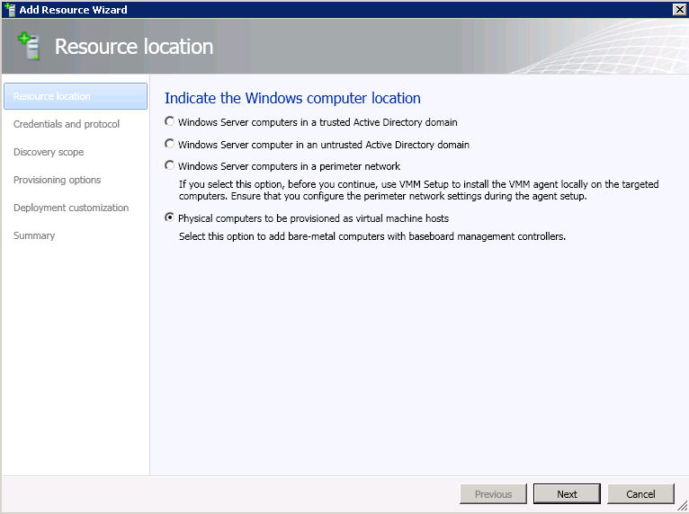

Slide 26
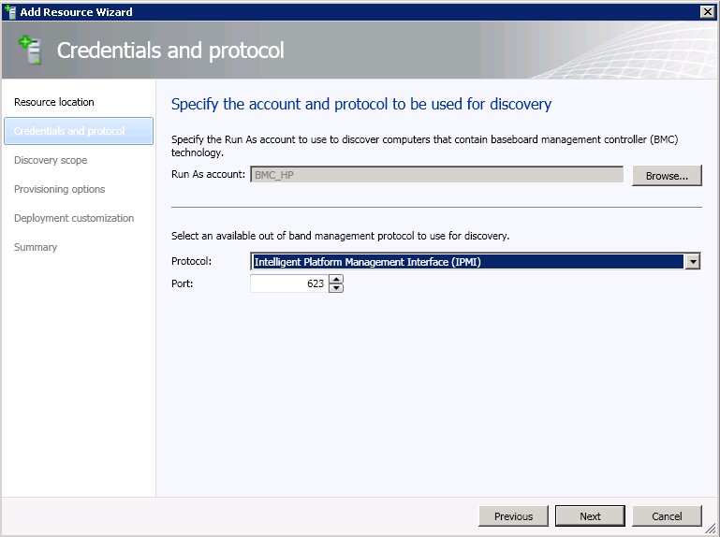

Slide 27
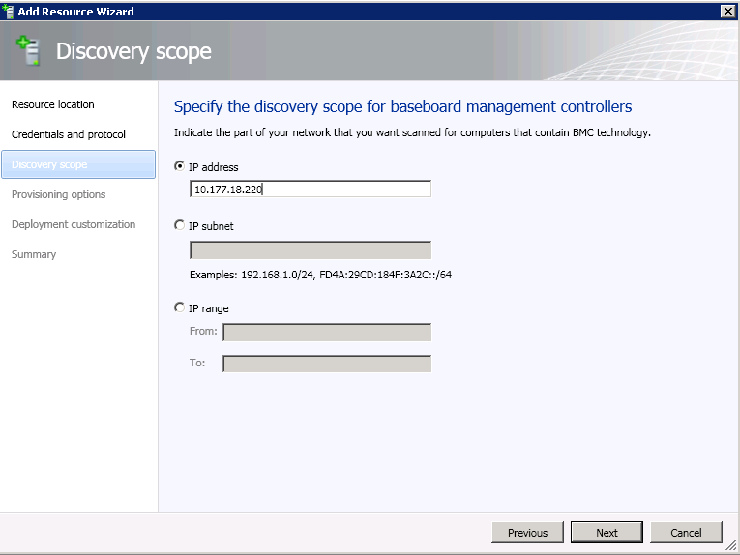

Slide 28
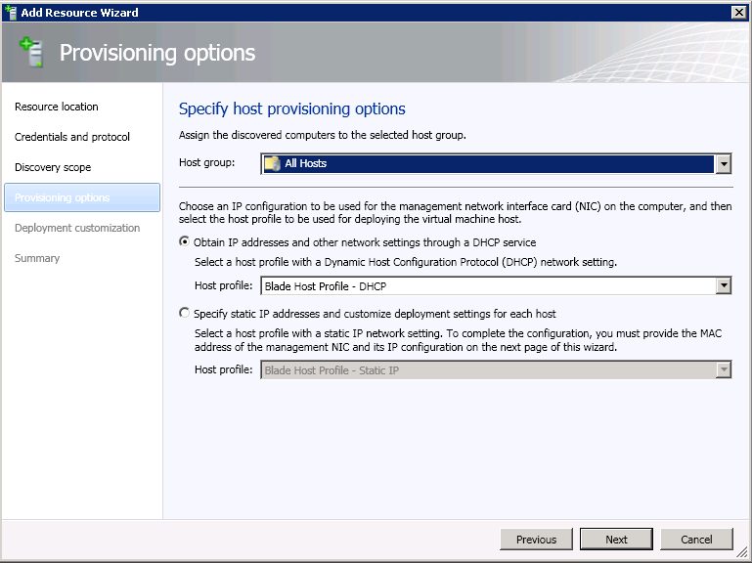

Slide 29
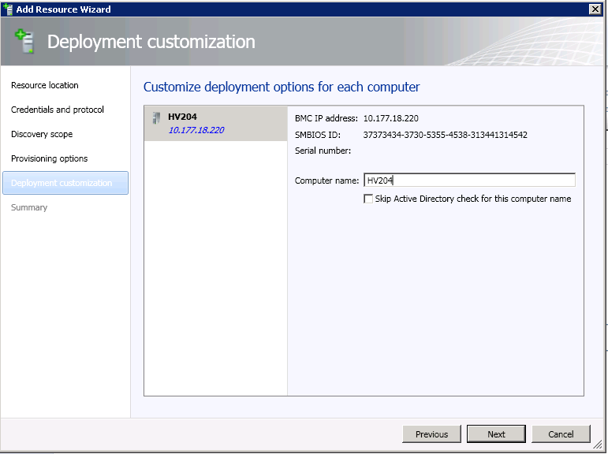

Slide 30
Network Management
LOGICAL NETWORKS
ADDRESS POOLS
LOAD BALANCERS
Classify network for VMs to access
Map to network topology
Allocate to hosts and clouds
Allocate a static IP address to VMs from a preconfigured pool
Create IP pool as a managed range of IP address assignments
Create MAC address pool as a managed range of MAC address assignments
Apply settings for load balancer capability in service deployment
Control load balancer through vendor provider based on PowerShell
Create virtual IP templates consisting of load balancer configuration settings
Notes:
30

Slide 31

Service Placement
FRONTEND
New York
BACKEND
Host1
FRONTEND
Frontend Tier
VMs
BACKEND
Host2
FRONTEND
FRONTEND
Middle Tier
VMs
BACKEND
Host3
CORP
Host4
DB Tier
VMs
BACKEND
CORP
BACKEND
Host5
CORP
BACKEND
Host6

Slide 32
Placement
Pick VLAN that has least number of VMs on it for load balancing traffic
10.1.1.0/24 VLAN5
5 VMs
FRONTEND
12.1.1.0/24 VLAN7
6 VMs
BACKEND
New York
Host1
FRONTEND
12.1.1.0/24 VLAN7
6 VMs
BACKEND
Host2
Checks IP pools associated with subnet has available IPs
FRONTEND
10.1.1.0/24 VLAN5
5 VMs
BACKEND
Host3
Place VMs within a service that connect to same logical network on same subnet to avoid layer 3 traversal
CORP
BACKEND
Host5
CORP
BACKEND
Host6

Slide 33
OS unattend file to configure static IP allocated from IP Pool
Find v-switch that’s connected to the required NIC
FRONTEND
New York
Host1
Frontend Tier
VMs
v-switch
BACKEND
FRONTEND
Host3
Middle Tier
VMs
v-switch
BACKEND
v-switch
CORP
Host6
DB Tier
VMs
v-switch
BACKEND

Slide 34
Configure and Deploy Fabric
Storage

Slide 35
Storage Management
CAPACITY MANAGEMENT
END-TO-END MAPPING
RAPID PROVISIONING
Add storage to a host or cluster through masking operations, initialization, partitioning, formatting, and CSV cluster resource creation
Add storage capacity during new cluster creation
Create associations between storage and VM through reconciling data from Hyper-V and storage arrays
Identify storage consumed by VM, host, and cluster
Create new VMs leveraging the SAN to copy the VHD
Utilize SMI-S copy services and replication profiles
Deploy to host or cluster at scale
Notes:
35

Slide 36




Storage Allocation Process
Discover storage through SMI-S provider
Virtual Machine Manager
Host Group
Create storage classification pools and associate with storage
SMI-S Provider
Allocate storage to specific host groups
Assign existing LUNs to hosts and clusters
Create new LUNs from pool and assign to hosts and clusters
Gold
Silver
Notes:
36

