Slide 1
Enabling Hosted IaaS Clouds for Service Providers Using Microsoft System Center 2012 SP1 with Windows Server 2012
MGT326
Marc Umeno, Eric Winner
Microsoft Corporation

Slide 2


Overview: System Center 2012 VMM
Service Templates
Application Deployment
Custom Command Execution
Image-based Servicing
Clouds
Services
Application Owner Usage
Capacity and Capability
Delegation and Quota
Server Lifecycle Management
Multiple Hypervisors
Network Management
Storage Management
Dynamic Optimization
Infrastructure
Fabric
HA VMM Server
PowerShell
Upgrade
Custom Properties

Slide 3



Themes: System Center 2012 SP1 VMM
Multi-tenancy
Perf and Scale
Partner Enablement
Windows Server 2012
Tenant Administrator
VM Network Isolation
Service Deployment
UI Add-ins
Service Templates
Server Hardware Providers
Load Balancer Providers
Storage automation
Large VMs
Live Migration Enhancements
Network Virtualization
Storage Management
Increase Scale
Increase Performance
Decrease Latency

Slide 4
Private Cloud Usage Scenario
Configure the fabric (servers, network, storage)
Delegate the cloud to a Self Service User
Self Service User creates VMs and Services in the cloud
Create a cloud from the fabric

Slide 5
Private Clouds
Cloud Consumer View
Capacity
Capabilities
Libraries
Hosts
Clusters
Library Servers
Logical Networks
Load Balancers
IP Address Pools
MAC Address Pools
Storage Classifications
Storage Capacity
Storage Pools
Storage Providers
Storage Arrays

Slide 6

Cloud Capacity
Cloud can expose
  Limited set of underlying resources
  “Overstated” set of underlying resources
  Actual aggregate capacity of underlying resources (vCPU, Memory, Storage)
Dimensions of Capacity
  vCPUs
  Memory
  Storage
  Number of deployed VMs (VMs in Library are not counted)
  Custom Quota (to support quota points from VMM 2008 R2)

Slide 7

Cloud Capabilities
Cloud can
  Host highly available VMs
  Allow VMs to use dynamic disks or differencing disks
  Enable network optimizations
VM “shape” limits
  Processor Range (i.e. 1 - 4)
  Memory Range (i.e. 16MB – 32 GB)
  Number of disks (0 – 7)
  Number of NICs (0 – 7)
  …
Built-in set representing underlying limits for Hyper-V, Xen, VMware

Slide 8
VMM 2012 User Role Profiles
Delegated Admin
Configure fabric (hosts, networking and storage)
Tenant Administrator
Application Owner
Scope: Clouds only
Fabric Administrator
Scope: Host groups and clouds
Author templates
Deploy/manage VMs and Services
Share resources
Quota as a shared and per-user limit
VMM Admin
Fabric Administrator
Scope: Entire system
Can take any action
Create cloud on fabric
Assign cloud
Revocable actions
Self-Service User
Tenant
Scope: Clouds only
Author VM Networks
Assign cloud
All other SSU settings →
Read-only Administrator
Help Desk
Scope: Host groups and clouds, No actions

Slide 9
Fabric Admin
App Admin
Templates
Service
Virtual Machine
Virtual Machine
Service
Jobs
Quota
Cloud
Library Paths
Library Servers
Shares
Capacity
Logical Networks
Network Sites
Subnet / VLAN
IP Pools
Storage Classifications
Pools
Luns
Arrays
Host groups
Clusters
Hosts
Nodes
SC 2012 VMM

Slide 10
Fabric Admin
Tenant Admin
App Admin
UserRole
VM Networks creation
Jobs
App Admin
Templates
Service
Virtual Machine
Virtual Machine
Service
VM Networks usage
Quota
Cloud
Library Paths
Library Servers
Shares
Capacity
Logical Networks
Network Sites
Subnet / VLAN
IP Pools
Storage Classifications
Pools
Luns
Arrays
Host groups
Clusters
Hosts
Nodes
SC 2012 SP1 VMM

Slide 11


Controlling Usage by Self-Service Users
Permitted actions – fine-grained action control
  Author, VM Control, Read-only
Quota – 2 Types of Quota
  Shared – total usage of all members of the user role
  Per-user – usage of each member of the user role
Dimensions of Quota
  vCPUs
  Memory
  Storage
  Number of deployed VMs (VMs in Library are not counted)
  Custom Quota (to support quota points from VMM 2008 R2)

Slide 12
Sharing among application owners
An application owner authors the service template and then shares that template with his team to deploy the application.
Shareable Objects
  Resource group – group of on-disk library objects which user considers interchangeable
  Profiles (Hardware, Guest OS, Application, SQL)
  Templates (VM, Service)
  Virtual machine
  Service

Slide 13
Proxying Identity - OnBehalfOf
Powershell interface to multiplex TA and SSU operations on a single connection (requires Full Admin)
Open connection in OnBehalfOf mode
Object filtering operates against OnBehalfOf context
Quota and Action restrictions are verified against the OnBehalfOf userrole and user.
Pass OnBehalfOf userrole and OnBehalfOfUser to each subsequent commandlet
Audit trail will keep job owner (OnBehalfOf user) and job session owner (Full Admin identity)

Slide 14
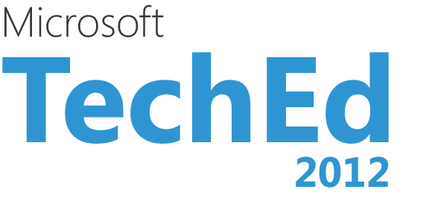
Example of OnBehalfOf syntax
get-scvmmserver localhost -UserRoleName Administrator –ForOnBehalfOf
$blueSSU = get-scuserrole -Name Blue_SSU
$bluevm = Get-SCVirtualMachine -Name BlueVM -OnBehalfOfUser user1@bluecola
-OnBehalfOfUserRole $blueSSU
Stop-scVirtualMachine –VM $bluevm -OnBehalfOfUser user1@bluecola
-OnBehalfOfUserRole $blueSSU

Slide 15
Tenant Administration and OnBehalfOf
demo
Eric Winner
Microsoft

Slide 16




Feedback from Service Providers
Let me use my existing customer-facing UI
Web APIs to enable Hosted IaaS Portals
Add Multi-tenancy to System Center
Manage across multiple instances of System Center
Customize and extend offerings to differentiate
Remove need for me to manage tenant networks
Value-add services such as monitoring or backup

Slide 17
Enabling Service Providers to Offer IaaS
Hoster Portal
Tenant 1
http
Provider’s Other Systems
Tenant Admins
Tenant’s
Apps, Scripts, Tools
Service Provider Foundation
Self-service Users
REST OData API
Aggregation
Automation
https
Tenant 2
Tenant Admins
Tenant’s
Apps, Scripts, Tools
Fabric Stamps
Self-service Users

Slide 18
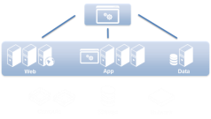





SPF Enables Hosted IaaS
Virtual Machines
Virtual Machine Manager
Cloud Services
Virtual Machine Manager
VM Networks
Virtual Machine Manager
VM Monitoring Operations Manager
Automation
Orchestrator
  2012

Slide 19
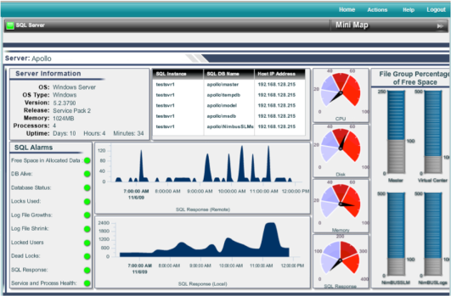
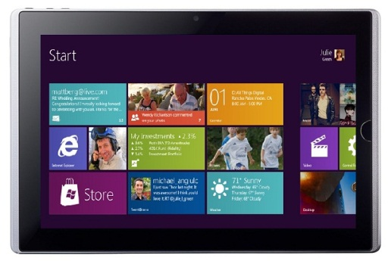
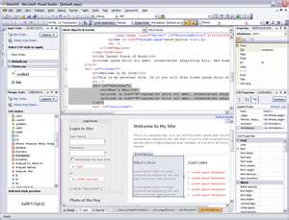
Why introduce a REST OData API to System Center?
Leverage existing UI or Apps from any platform
OData client libraries (.NET, PHP, Javascript, Ruby)
Enables access from mobile devices such tablets or smartphones

Slide 20
SPF Architecture
Hoster Portal Client
App Controller
REST API - OData
Powershell Web Service
Stamps
Mgmt Servers
Tenants
User Roles
Claims-based AuthN and AuthZ
Aggregation
PS Scripts
SCO Runbooks
Management Stamps

Slide 21
DEMO – REST OData API for VMM
http://<spfserver>:8090/SC2012/VMM/Microsoft.Management.oData.svc/Clouds?$filter=VMMServer eq ‘<vmmserver>’
Hoster
Web Browser
http requests
REST API - OData
Powershell Web Service
SPF
Resources (MOF)
PS Scripts
VMM 2012 Client
WCF
Stamp
VMM 2012

Slide 22
REST OData API for VMM
demo

Slide 23



Multi-tenancy and Aggregation
Tenant A
Tenant B
SPF Endpoint can access multiple stamps
Tenant user roles tracked in the SPF DB and synced to stamps
Tenant admin manages SSU users and hosted cloud resources
Configure Tenants to access specific stamps and clouds
Aggregate results across stamps
Tenant Admin User Role
Tenant Admin User Role
IT Ops
Dev
Test
Dev
Test
Europe
IT Ops
Tenant A
Prod User Role
Tenant A
Dev User Role
Tenant A
Test User Role
Tenant B Dev User Role
Tenant B
Test User Role
Tenant B Prod User Role
SPF API
Gold
Silver1
Bronze
Silver2
Silver3
Europe3
Synced User Roles
Synced User Roles
Synced User Roles
VMM Server 1
VMM Server 2
VMM Server 3

Slide 24
Role-based Tenant Auth – AD not Required
Tenant
Provider
Tenant Admin creates Self-service User Role
SPF Validates Token matching Tenant and User Role in SPF DB
Claim Token
User, User Role and Tenant ID are passed in http header
Self-service User accesses Portal
User Role and Tenant ID mapped to VMM Self-service User Role
Portal creates SAML Claim Token
SPF accesses VMM on behalf of User and User Role

Slide 25


Service Provider Foundation
Client
Application
SPF
Interface
User
Authentication
Resource
Model
Action
Mapping
Task
Execution
User
Action
Defined extension points (runbooks)
Upgrade safe
Supported Areas
For SPF Extensions
Create new resource
Provide new action mapping (PS script or runbook)
Create new task execution logic

Slide 26




Demo - App Controller Brings Enterprise Access to Hosted IaaS
1. Acquire | Enterprise customer (Central IT) acquires capacity from IaaS Service Provider via Service Provider portal
2. Register | Acquired capacity is registered with App Controller on-premise
3. Delegate | Central IT delegates access to acquired capacity
4. Deploy and Operate | Self-Service users deploy VM’s onto hoster acquired capacity and private cloud from same tool
On-Premise
Private Clouds
VMM
Service
Provider
Cloud
Hybrid Cloud
Self-Service Portal
(App Controller)
3
1
2
4
Service Provider Portal
Enterprise Tenant
Admin
Enterprise App
Owner

Slide 27
App Controller Accessing Hosted IaaS Cloud
demo

Slide 28
Service Provider Foundation Features
Feature | Description
VM Management | Create, update, & operate VM’s
Service management | Deploy, update, and operate VMM services; scale-out within service tiers
Self-service VM networks | Create, update, and use self-service VM networks
Multi-tenancy / Multi-stamp | Isolated, role-based access for tenants Manage tenants at large scale across multiple VMM stamps
Self-service Tenant Administration | Tenant admin manages access to hosted IaaS cloud Tenant admin configures and manages self-service user roles
Enterprise identity for SPF | Tenants can authenticate and authorize using corporate identity
Extensibility for hosted cloud API | Extensible REST OData API surface Use runbooks to customize processes driven through SPF API
Expose VM usage data | IaaS monitoring based on Operations Manager

Slide 29
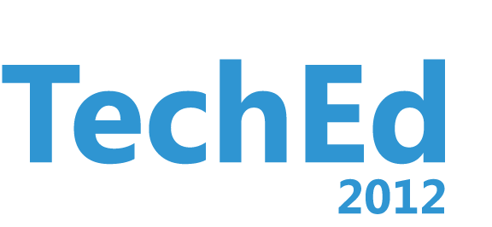


Related Content
Breakout Sessions
MGT314 - What's New in System Center 2012 SP1 - Virtual Machine Manager
MGT316 - Overview of Microsoft System Center 2012 SP1 - Storage Management
MGT317 - Overview of Microsoft System Center 2012 SP1 - Virtual Machine Manager Services
MGT319 - Infrastructure Management: Configure and Deploy
MGT320 - Microsoft System Center Virtual Machine Manager 2012: Zero to Cluster to Cloud
MGT321 - Service Template Creation from the Ground Up
MGT326 - Building a Hosted Cloud Using Microsoft System Center 2012 and Windows Server 2012
VIR312 - Compete to Win, Part 2: Comparing Private Cloud Capabilities
Other Sessions
MGT41-HOL- Microsoft System Center 2012 Virtual Machine Manager Infrastructure Components Management
MGT42-HOL - Microsoft System Center 2012 Virtual Machine Manager and App Controller Creating, Deploying, and Managing Service Templates
MGT53-HOL - Microsoft System Center 2012 Application Self-Service and Managing Applications across Clouds
PRC03 - Pre-Conference Seminar - Private Cloud Immersion

Slide 30



Resources
Learning
  Connect. Share. Discuss.
  Microsoft Certification & Training Resources
http://northamerica.msteched.com
www.microsoft.com/learning
TechNet
  Resources for IT Professionals
  Resources for Developers
http://microsoft.com/technet
http://microsoft.com/msdn

Slide 31



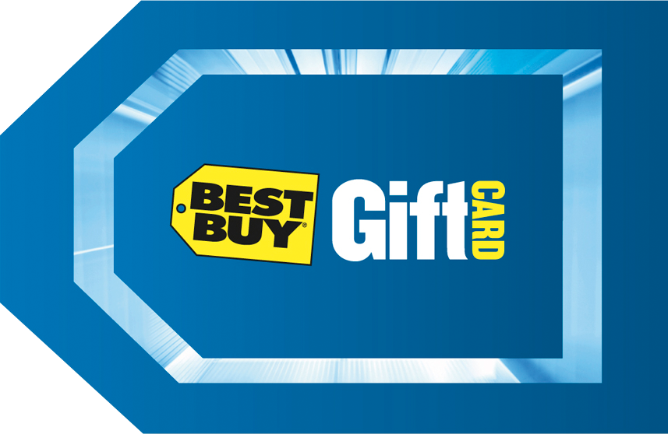
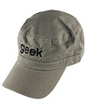

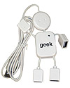
Required Slide
Complete an evaluation on CommNet and enter to win!

Slide 32


MS Tag
Scan the Tag
to evaluate this
session now on
myTechEd Mobile

Slide 33
© 2012 Microsoft Corporation. All rights reserved. Microsoft, Windows, Windows Vista and other product names are or may be registered trademarks and/or trademarks in the U.S. and/or other countries.
The information herein is for informational purposes only and represents the current view of Microsoft Corporation as of the date of this presentation. Because Microsoft must respond to changing market conditions, it should not be interpreted to be a commitment on the
part of Microsoft, and Microsoft cannot guarantee the accuracy of any information provided after the date of this presentation. MICROSOFT MAKES NO WARRANTIES, EXPRESS, IMPLIED OR STATUTORY, AS TO THE INFORMATION IN THIS PRESENTATION.

