Slide 1
Developing and Managing SharePoint Solutions with Visual Studio 2012
OSP231
Jay Schmelzer
Director of Program Management – Visual Studio
Microsoft Corporation

Slide 2
Agenda
SharePoint development with Visual Studio 2012
Visual Studio 2012 ALM enhancements for SharePoint developers
LightSwitch for Visual Studio 2012 and SharePoint
Lots of demos!

Slide 3
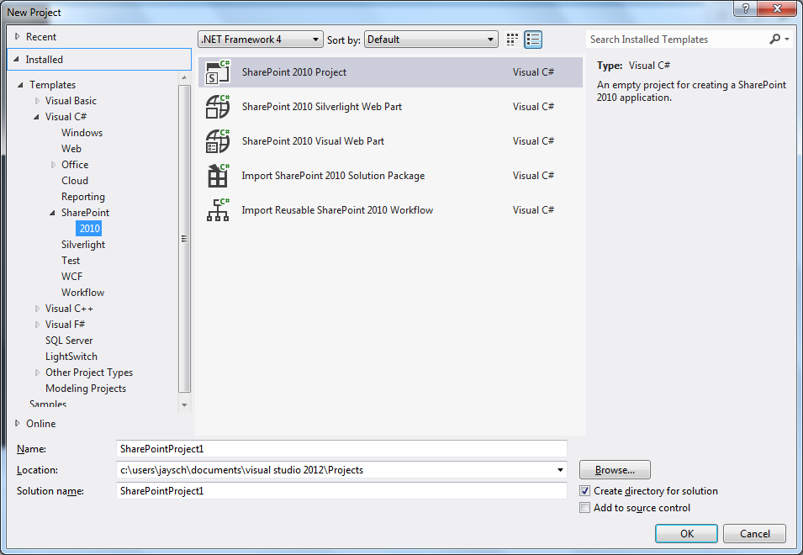
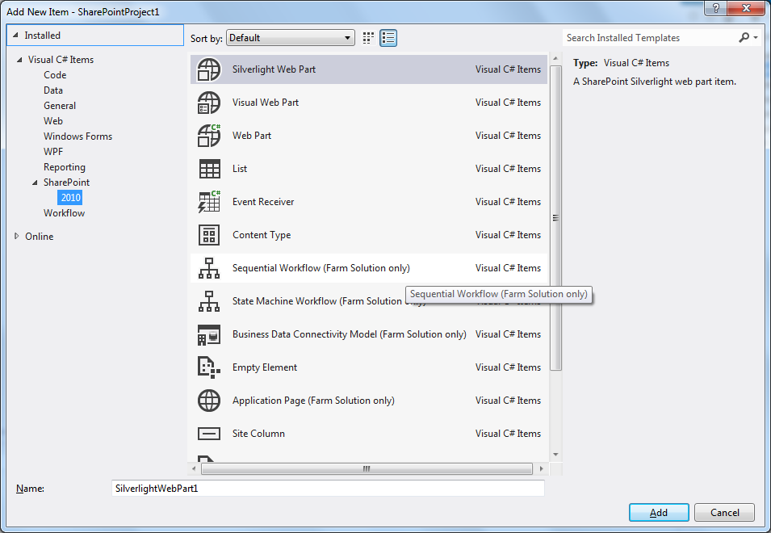
SharePoint development with Visual Studio
Familiar Visual Studio experience
  Build, debug, deploy SharePoint projects
  Designers for Web parts, BDC & workflows
  View SharePoint sites in Server Explorer
  Team Foundation Server integration
  Application lifecycle management
Broad SharePoint support
  Supports SharePoint Foundation and Server
  Sandboxed and farm solutions
  Business Connectivity Services
  Expanded workflow support
SP Designer → Visual Studio continuum

Slide 4
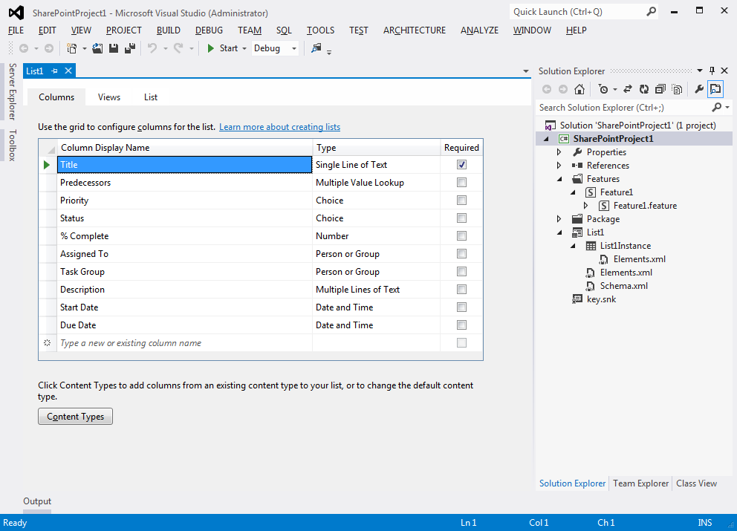
Visual Studio 2012 SharePoint enhancements
List and Content Type designer
Silverlight Web Part development
Remote publish to Office 365/on-premise SharePoint server
Enhanced JavaScript IntelliSense
Integration with Visual Studio Ultimate Profiling

Slide 5
SharePoint Development with Visual Studio 2012

Slide 6





Application Lifecycle
Developer Machine
Fix Bugs (repeat as necessary)
Team Foundation Server
Check In
Development
F5 Deploy
Nightly
Build
or
Continuous
Integration
Testing
Staging
TFS Build Server
Open/Close Bugs
SharePoint Projects
Warm-Blooded User Testing
Build
SP2010 DLL’s
WSP
Automated Testing
Deploy Using PowerShell
Run Tests?

Slide 7
Visual Studio 2012 ALM Updates
Visual Studio Profiler support
  Identify performance issues in your SharePoint solutions
Unit Testing
  Create and execute unit tests in Visual Studio using Microsoft Fakes framework

Slide 8
Visual Studio 2012 ALM

Slide 9
LightSwitch and SharePoint

Slide 10

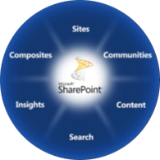

The Business Collaboration Platform
for the Enterprise and the Internet
The Business Collaboration Platform for the Enterprise & the Internet
Deliver the Best Productivity Experience
Cut Costs with a Unified Infrastructure
Rapidly Respond to Business Needs
The capabilities of SharePoint 2010 provide a powerful business
collaboration platform

Slide 11
Project and SharePoint
Better Together
Manage Resources
Improve efficiency and save money by better managing work and allocation of resources
Maximize Portfolio Returns
Make informed investment decisions and effectively communicate results across a portfolio of projects
Keep Teams Productive
Save time and improve project results by centralizing team collaboration on deliverables and tasks
Improve SharePoint ROI
Effectively manage requests to maximize the ROI of your SharePoint environment
www.sharepoint.microsoft.com
www.microsoft.com/project

Slide 12




Resources
Learning
  Connect. Share. Discuss.
  Microsoft Certification & Training Resources
http://northamerica.msteched.com
www.microsoft.com/learning
TechNet
  Resources for IT Professionals
  Resources for Developers
http://microsoft.com/technet
http://microsoft.com/msdn

Slide 13







Required Slide
Complete an evaluation on CommNet and enter to win!

Slide 14


MS Tag
Scan the Tag
to evaluate this
session now on
myTechEd Mobile

Slide 15
© 2012 Microsoft Corporation. All rights reserved. Microsoft, Windows, Windows Vista and other product names are or may be registered trademarks and/or trademarks in the U.S. and/or other countries.
The information herein is for informational purposes only and represents the current view of Microsoft Corporation as of the date of this presentation. Because Microsoft must respond to changing market conditions, it should not be interpreted to be a commitment on the
part of Microsoft, and Microsoft cannot guarantee the accuracy of any information provided after the date of this presentation. MICROSOFT MAKES NO WARRANTIES, EXPRESS, IMPLIED OR STATUTORY, AS TO THE INFORMATION IN THIS PRESENTATION.

