Slide 1
Managing the SharePoint Disruption with End-to-End SharePoint Governance
OSP233
Dan Holme
Chief SharePoint Evangelist
AvePoint

Slide 2
GOVERNANCE

Slide 3
Why do we need governance

Slide 4
We don’t know what’s “out there”

Slide 5
User adoption isn’t what we want it to be… they don’t understand…

Slide 6
Our developers
don’t understand…

Slide 7
IT doesn’t understand…

Slide 8
My boss doesn’t understand…

Slide 9
Nobody can make a decision

Slide 10
We can’t get anything delivered because they keep adding requirements

Slide 11
We can’t keep up with business demand

Slide 12
We can’t support new workloads

Slide 13
We can’t get enough funding

Slide 14
It has become chaos

Slide 15
SharePoint shines a spotlight on everything that’s wrong with us

Slide 16

#OSP233
#MSTechEd
#SharePoint
@danholme

Slide 18
Managing the SharePoint Disruption with End-to-End SharePoint Governance
OSP233
Dan Holme
Chief SharePoint Evangelist
AvePoint

Slide 19






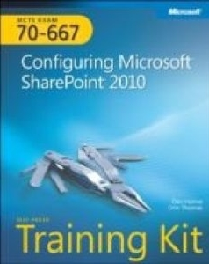


Dan Holme
Dan Holme
MAUI, HAWAII
Consultant
AvePoint
AvePoint
Author
danholme http://tiny.cc/danholmepresentations dan.holme@avepoint.com

Slide 20
GOVERNANCE

Slide 21


GOVERNANCE

Slide 22




Slide 23
Four Forces and Twelve Steps
Change
Project
Strategic
Operations
Admit You Have a Problem
Align SharePoint with Strategy
Master the Politics
Identify Business Need
Manage the Project
Architect the Solution
Define Roles & Responsibilities
Deploy the Solutions
Focus on the User
Improve Operations
Manage the Portfolio
Commit to Evolve

Slide 24
What is governance

Slide 25
According to the Interweb
Governance defines the processes, people, policies and technologies
that deliver a service

Slide 26
According to the Etymologists
ˈgʌvərnəns
Origin:
Greek kybernân to steer (a ship)
Latin gubernāre
Medieval Latin gubernantia
Old French gouverner
Middle English governaunce

Slide 27
According to Dan*
Governance defines how
BUSINESS NEEDS
are
DELIVERED AND MANAGED

Slide 28



BUSINESS
GOVERNANCE
Sites
Composites
Communities
Insights
Content
Search

Slide 29
BUSINESS
GOVERNANCE
Sites
Composites
Communities
Insights
Content
Business
Needs
Governance
Processes
Management
Policies
Technical Specifications
Search

Slide 30
GOVERNANCE
Set expectations
  Deliverable functionality
  Roadmap
  Service levels
Manage change: business requirements → service
Define roles and assign responsibilities
Identify risks vs. rewards; costs vs. benefits
Verify performance

Slide 31
BUSINESS
GOVERNANCE
MANAGEMENT
SERVICE
Sites
Composites
Communities
Insights
Content
Business
Needs
Governance
Processes
Management
Policies
Technical Specifications
Search

Slide 32
How do we establish governance

Slide 33
Four Forces
Change
Project
Strategic
Operations

Slide 34
Twelve Steps
Change
Project
Strategic
Operations
Admit You Have a Problem
Align SharePoint with Strategy
Master the Politics
Identify Business Need
Manage the Project
Architect the Solution
Define Roles & Responsibilities
Deploy the Solutions
Focus on the User
Improve Operations
Manage the Portfolio
Commit to Evolve

Slide 35
Governance Twelve Step Program
Project
Strategic
Operations
Change

Slide 36
1. Admit You Have a Problem*
*or will have

Slide 37
Admit that you have a problem
If you’re not feeling the pain yet, you will
Governance is critical
(and always has been)
SharePoint is not like other services

Slide 38
2. Align SharePoint with Strategy

Slide 39
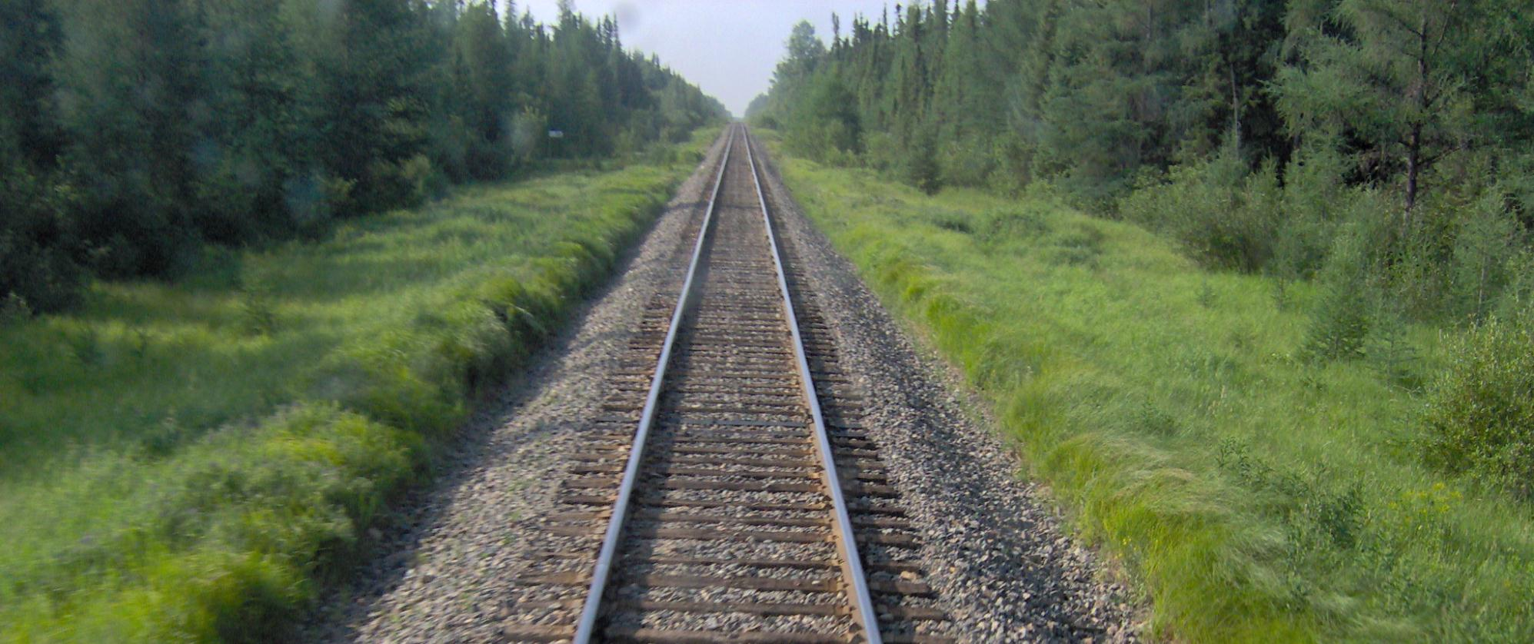
Vision

Slide 40

Governance is (much) bigger than SharePoint
Business Governance
IT Governance
Service Governance

Slide 41
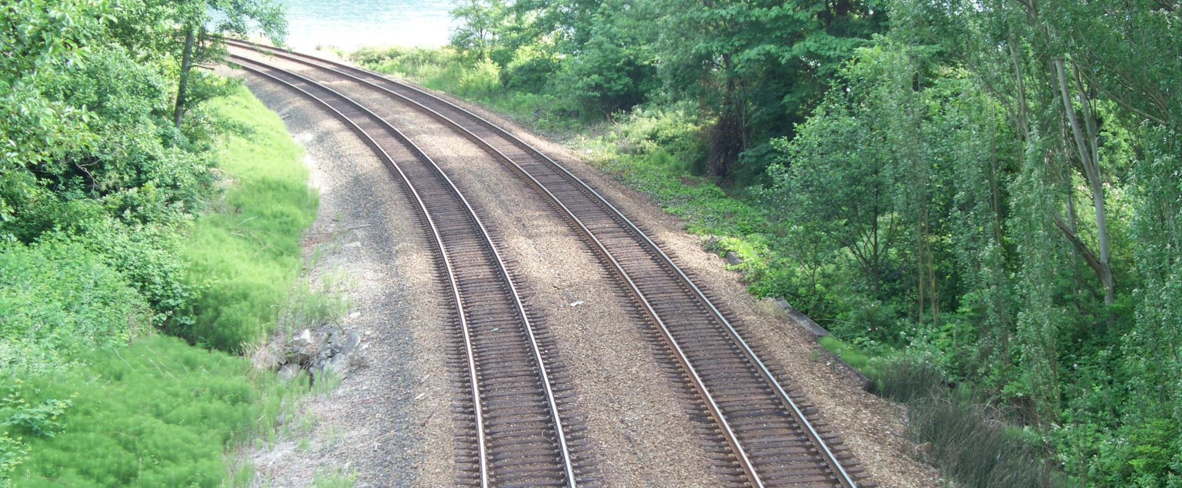
Alignment

Slide 42
Many Projects to One Platform Mapping
SharePoint
Business Automation
Records Mgt
Findability
Search
Multi platform
Comms
Compliance
Globalization
People Search
Mobility
Intranet
Publishing
iPads
Contract Mgt

Slide 43
Align SharePoint with Strategy
SharePoint is rarely chosen to deliver a single, point solution
Define how SharePoint delivers the first solution and supports the strategic direction of the enterprise
Communicate ROI and ROI*
*Risk of Inaction

Slide 44
3. Master the Politics

Slide 45
Who Is Involved?
Identify your constituencies
  Business user
  IT
  Developer
  Security
  Finance
  HR
  Executive
  Legal
  Project manager

Slide 46
Master the Politics
Who drives SharePoint and why?
Who is impacted by SharePoint?
Understand the dynamics of and between each of these groups
Establish teams and communications channels based on political realities

Slide 47
Governance Twelve Step Program
Change
Project
Strategic
Operations
Admit You Have a Problem
Align SharePoint with Strategy
Master the Politics

Slide 48
Governance Twelve Step Program
Change
Project
Strategic
Operations

Slide 49
4. Identify Business Need

Slide 50
Identify Business Need
Question | Identifies

Slide 51
Identify Business Need
Question | Identifies
What are we trying to achieve? | Outcomes

Slide 52
Identify Business Need
Question | Identifies
What are we trying to achieve? | Outcomes
Why does it matter? | Business Value

Slide 53
Identify Business Need
Question | Identifies
What are we trying to achieve? | Outcomes
Why does it matter? | Business Value
To whom does it matter? | Politics

Slide 54
Identify Business Need
Question | Identifies
What are we trying to achieve? | Outcomes
Why does it matter? | Business Value
To whom does it matter? | Politics
How do we know it worked? | Metrics

Slide 55
5. Manage the Project

Slide 56
A Discipline of D’s
Define
Define the solution
  Outcomes
  Business value
  Politics
  Metrics

Slide 57
A Discipline of D’s
Define
Design
Develop
Deploy
Delegate
Define the solution
  Outcomes & metrics
Design the solution
  Each decision based on
  requirements
Develop the solution
  Build in iterations
  Validation
Deploy the solution
Delegate to operations

Slide 58
A Discipline of D’s and R’s
Define
Design
Develop
Deploy
Delegate
Define the solution
Design the solution
Develop the solution
  Release
  Refine requirements
  Revisit design
  Revise solution
  Repeat
Deploy the solution
Delegate to operations
Refine
Revisit
Revise
Release

Slide 59
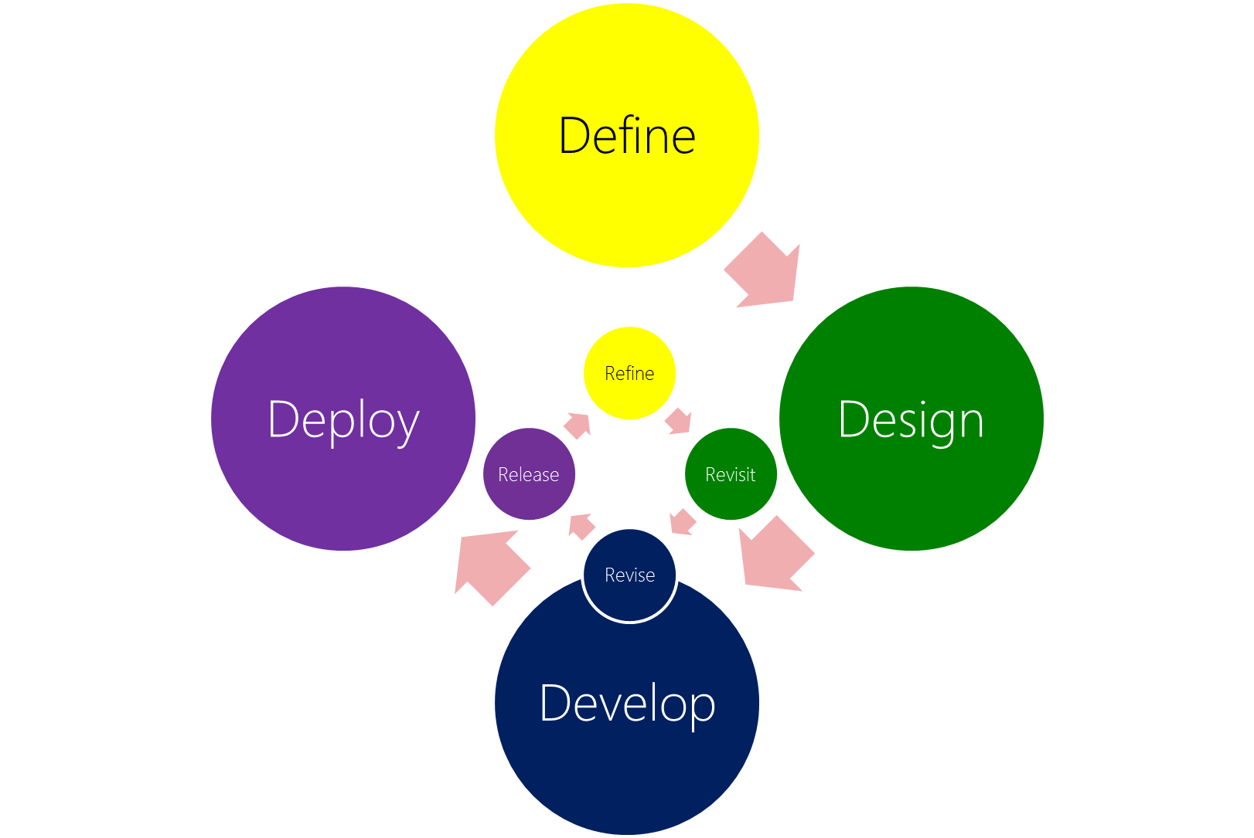
A Discipline of D’s and R’s
Project Lifecycle
Define the solution
Design the solution
Develop the solution
  Release
  Refine requirements
  Revisit design
  Revise solution
  Repeat
Deploy the solution
Delegate to operations
Delegate
Development Lifecycle

Slide 60
6. Architect the Solution

Slide 61
Crazy Architecture?

Slide 62
We run SharePoint on a single server with SQL on the same box

Slide 63
We have over 200 farms

Slide 64
We allow self-service site creation

Slide 65
Crazy Architecture?
not if it meets the REQUIREMENTS

Slide 66
Definition to Design
Define
Deploy
Design
Develop

Slide 67
Definition to Design

Slide 68

Definition to Design
Information Architecture
Describe content
  Metadata
  Content types
Content findability
  Site map
  Search optimization
Facilitate information management

Slide 69
Definition to Design
Information Management
POLICIES
Security (Permissions)
Compliance (Records)
Lifecycle Management
  Capture
  Store
  Deliver
  Preserve
  Delete
  http://www.avepoint.com/assets/pdf/solution_briefs/
  Enterprise_Content_Management.pdf

Slide 70
Definition to Design
Service Management
POLICIES
Uptime (availability)
Data protection (integrity)
  Content recovery
Business continuity
  Disaster recovery
Performance
Storage
Interoperability

Slide 71
Definition to Design
Architecture Design Specifications

Slide 72
Architecture
Farm
TEAMS
PEOPLE
INTRANET
Content DB
Content DB
Content DB
Site collection
Site collection
Site collection
HR
Marketing
Intranet Home
Finance
Marketing
HR

Slide 73
Definition to Design
Architecture Design Specifications

Slide 74
Definition to Design

Slide 75
Definition to Design
Process
Specifications
Decision track-back
  The input
  Who drove it
  Why it matters
  How it will be measured
It’s a system
Solicited
Der
ived

Slide 76
Definition to Design
Critical!
SharePoint expertise required

Slide 77

“Best Practice” Architecture*
Extranet Farm
Biz Crit Farm
Content
Farm
Apps
Farm
LOB
Farm
EXTRANET
TEAMS*
TEAMS
PEOPLE
INTRANET
APPS
<LOB>
Content DB
Content DB
Content DB
Content DB
Site collection
Site collection
Site collection
Site collection
Finance
Engineering
Marketing
Intranet Home
Finance
Marketing
HR
SEARCH
PROFILE
METADATA
BCS
Service
Farm
* tongue in cheek

Slide 78
Architecture
Extranet Farm
Farm
EXTRANET
TEAMS
PEOPLE
INTRANET
Content DB
Content DB
Content DB
Site collection
Site collection
Site collection
HR
Marketing
Intranet Home
Finance
Marketing
HR

Slide 79
Architecture
Extranet Farm
Content
Farm
EXTRANET
TEAMS
PEOPLE
INTRANET
Content DB
Content DB
Content DB
Site collection
Site collection
Site collection
HR
Marketing
Intranet Home
Finance
Marketing
HR
SEARCH
PROFILE
METADATA
BCS
Service
Farm

Slide 80
Architecture
Extranet Farm
Biz Crit Farm
Content
Farm
Apps
Farm
LOB
Farm
EXTRANET
TEAMS*
TEAMS
PEOPLE
INTRANET
APPS
<LOB>
Content DB
Content DB
Content DB
Content DB
Site collection
Site collection
Site collection
Site collection
Finance
HR
Marketing
Intranet Home
Finance
Marketing
HR
SEARCH
PROFILE
METADATA
BCS
Service
Farm

Slide 81
“Best Practice” Architecture*
Extranet Farm
Biz Crit Farm
Content
Farm
Apps
Farm
LOB
Farm
EXTRANET
TEAMS*
TEAMS
PEOPLE
INTRANET
APPS
<LOB>
Content DB
Content DB
Content DB
Content DB
Site collection
Site collection
Site collection
Site collection
Finance
Engineering
Marketing
Intranet Home
Finance
Marketing
HR
SEARCH
PROFILE
METADATA
BCS
Service
Farm
* tongue in cheek

Slide 82
Definition to Design
Critical!
SharePoint expertise required
SharePoint Governance, Part I: Architecting SharePoint for Scalability and Enforceable Governance
http://technet.microsoft.com/en-us/video/tdbe12-sharepoint-governance-part1-scalability-governance.aspx

Slide 83
7. Define Roles & Responsibilities

Slide 84
A Discipline of D’s and R’s
Define
Design
Develop
Deploy
Delegate
Define the solution
  What are we doing?
  Why are we doing it?
  Who is behind requirements?
  How do we know it worked?
Design the solution
Develop the solution
Deploy the solution
Delegate to operations
Do it again!
Refine
Revisit
Revise
Release

Slide 85
Define Roles & Responsibilities
Who gathers requirements?
Who determines solution?
Who builds solution?
Who deploys solution?
Who manages project?

Slide 86
Governance Twelve Step Program
Change
Project
Strategic
Operations
Identify Business Need
Manage the Project
Architect the Solution
Define Roles & Responsibilities

Slide 87
Governance Twelve Step Program
Change
Project
Strategic
Operations

Slide 88
8. Deploy the Solutions

Slide 89
Development Test
Staging Production
Application deployment
Customization deployment
Content deployment / content publishing

Slide 90
Development Test
Staging Production
Application deployment and revisions
Customization deployment and revisions
Content deployment / content publishing

Slide 91
9. Focus on the User

Slide 92
User Adoption
Consider the big easy wins first
Solve user-perceived pain
while solving business goals
Branding matters

Slide 93
Embed the User
Define
Design
Develop
Deploy
Refine
Release
Revise
Revisit

Slide 94
Training & Communication
Don’t train users to use SharePoint
Evangelize the why
Train users how to achieve the requirements of the solution
Equip users to discover the what else

Slide 95
Governance Twelve Step Program
Change
Project
Strategic
Operations
Deploy the Solutions
Focus on the User

Slide 96
Governance Twelve Step Program
Change
Project
Strategic
Operations

Slide 97
10. Improve Operations

Slide 98
Operations Management
Document operational procedures
Measure cost of operations
Automate procedures
SharePoint Governance, Part II: Automating SharePoint Governance and Management
http://technet.microsoft.com/en-us/video/tdbe12-sharepoint-governance-part2-automating

Slide 99
11. Manage the Portfolio

Slide 100
Portfolio Management
What solutions have been deployed?
What were original inputs and resulting design specifications?

Slide 101
Definition to Design
Process
Specifications
Decision track-back
  The input
  Who drove it
  Why it matters
  How it will be measured
It’s a system
Solicited
Der
ived

Slide 102
Portfolio Management
Catalog
  Solutions
  Specifications
  Policies
  Changes

Slide 103
Portfolio Management
Monitor
Catalog
  Solutions
  Specifications
  Policies
  Changes
Current state

Slide 104
Portfolio Management
What Solutions have been deployed?
What were original inputs and resulting design specifications?
What is current state?
  Usage
  Performance

Slide 105
Portfolio Management
Monitor
Evaluate
Catalog
  Solutions
  Specifications
  Policies
  Changes
Current state
Does current state match the specifications of the solutions in place?

Slide 106
Portfolio Management
What Solutions have been deployed?
What were original inputs and resulting design specifications?
What is current state?
Are we
  Missing the mark
  Victim of success

Slide 107
Portfolio Management
Monitor
Evaluate
Trigger
Catalog
  Solutions
  Specifications
  Policies
  Changes
Current state
Does current state match the specifications of the solutions in place?

Slide 108
Governance Twelve Step Program
Change
Project
Strategic
Operations
Improve Operations
Manage the Portfolio

Slide 109
12. Commit to Evolve

Slide 110
A Discipline of D’s and R’s
Project Lifecycle
Define the solution
Design the solution
Develop the solution
  Release
  Refine requirements
  Revisit design
  Revise solution
  Repeat
Deploy the solution
Delegate to operations
Do it again!
Development Lifecycle

Slide 111
Define
Modify
Design
Measure
Develop
Manage
Deploy

Slide 112
Define
Modify
Design
Measure
Develop
Manage
Deploy

Slide 113
Business Value
Change Management
Define
Manageability
Project Management
Modify
Design
Measure
Develop
Operations Management
Manage
Deploy
Strategic Direction
Strategic Objective
Strategic Objective
Strategic Objective
Strategic Objective
Strategic Management

Slide 114
Governance Twelve Step Program
Change
Project
Strategic
Operations
Commit to Evolve

Slide 115
In Sum…

Slide 116
According to the Interweb
Governance defines the processes, people, policies and technologies
that deliver a service

Slide 117
According to the Interweb
Governance defines the processes, people, policies and technologies
that deliver a service
Management
an existing

Slide 118
According to the Interweb
Governance defines the processes, people, policies and technologies
that deliver a service
a new or changed

Slide 119
According to Dan*
Governance defines how
BUSINESS NEEDS
are
DELIVERED AND MANAGED

Slide 120
According to Dan*
Governance defines how a service defines how
BUSINESS NEEDS
are
DELIVERED AND MANAGED

Slide 121
According to Dan
Governance defines
how a service is
MANAGED
and how it is
EVOLVED
to
DELVER BUSINESS NEED

Slide 122
Governance Twelve Step Program
Change
Project
Strategic
Operations
Admit You Have a Problem
Align SharePoint with Strategy
Master the Politics
Identify Business Need
Manage the Project
Architect the Solution
Define Roles & Responsibilities
Deploy the Solutions
Focus on the User
Improve Operations
Manage the Portfolio
Commit to Evolve

Slide 123
Transform IT to an Agile Service
Strategic Alignment
Project Management
Change Management
Operations Management
AGILITY

Slide 124

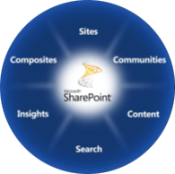
The Business Collaboration Platform
for the Enterprise and the Internet
The Business Collaboration Platform for the Enterprise & the Internet
Deliver the Best Productivity Experience
Cut Costs with a Unified Infrastructure
Rapidly Respond to Business Needs
The capabilities of SharePoint 2010 provide a powerful business
collaboration platform

Slide 125
Project and SharePoint
Better Together
Manage Resources
Improve efficiency and save money by better managing work and allocation of resources
Maximize Portfolio Returns
Make informed investment decisions and effectively communicate results across a portfolio of projects
Keep Teams Productive
Save time and improve project results by centralizing team collaboration on deliverables and tasks
Improve SharePoint ROI
Effectively manage requests to maximize the ROI of your SharePoint environment
www.sharepoint.microsoft.com
www.microsoft.com/project

Slide 126




Resources
Learning
  Connect. Share. Discuss.
  Microsoft Certification & Training Resources
http://northamerica.msteched.com
www.microsoft.com/learning
TechNet
  Resources for IT Professionals
  Resources for Developers
http://microsoft.com/technet
http://microsoft.com/msdn

Slide 127







Required Slide
Complete an evaluation on CommNet and enter to win!

Slide 128


MS Tag
Scan the Tag
to evaluate this
session now on
myTechEd Mobile

Slide 129
http://tiny.cc/danholmepresentations http://bit.ly/danholmearticles http://bit.ly/danholmebooks http://www.docave.com
A Hui Ho
(‘til next time)

Slide 130
dan.holme@avepoint.com
@danholme
Q&A: AvePoint Booth 1707
Book Signing: O’Reilly Booth 1906 4:00pm
Liked? Feedback? PLEASE submit an eval!
MAHALO!
(Thank You)

Slide 131
© 2012 Microsoft Corporation. All rights reserved. Microsoft, Windows, Windows Vista and other product names are or may be registered trademarks and/or trademarks in the U.S. and/or other countries.
The information herein is for informational purposes only and represents the current view of Microsoft Corporation as of the date of this presentation. Because Microsoft must respond to changing market conditions, it should not be interpreted to be a commitment on the
part of Microsoft, and Microsoft cannot guarantee the accuracy of any information provided after the date of this presentation. MICROSOFT MAKES NO WARRANTIES, EXPRESS, IMPLIED OR STATUTORY, AS TO THE INFORMATION IN THIS PRESENTATION.

