Slide 1
Building Integrated Microsoft Office 365, SharePoint Online, and Office Solutions Using BCS and LOB Data
OSP302
Donovan Follette
donovanf@microsoft.com
Sr. Technical Evangelist
Microsoft Corporation

Slide 2
Session Objectives and Takeaways
Session Objective:
  Propose why Business Connectivity Services (BCS) is such a valuable addition to Office 365 SharePoint Online
Key Takeaway
  You’ll be inspired to use Business Connectivity Services to “light up” your productivity solutions
Let’s take this journey of discovery together.

Slide 3







Business Connectivity Services (BCS)
Extend the reach of Enterprise Data
Bring data from external systems into SharePoint and Office, interact with it, reuse it, and empower end users to gain insight into the underlying data in a reusable way.
Centrally manage reusable connections
Easily create custom solutions

Slide 4


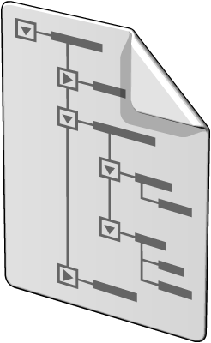



Business Connectivity Services Architecture
Office Client
SharePoint Online Site
VSTO
Package
External List
Office Add-In/ Custom Code
Search, Workflow, Web Parts
BCS
(Client Runtime)
BCS
(Server Runtime)
BCS
Sync
External
Content Type
BCS Runtime
SSS
Cache
BCS
Other (LOB)
SQL

Slide 5
BCS in Office 365 SharePoint Online
How does it differ from SharePoint on-premises?
BCS was not present at GA
Only supports SOAP-based web services
  No SQL connections
  No .NET connections
Only supports username/password authentication
  “Group” permissions only

Slide 6

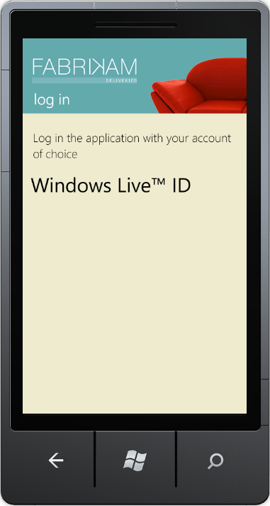
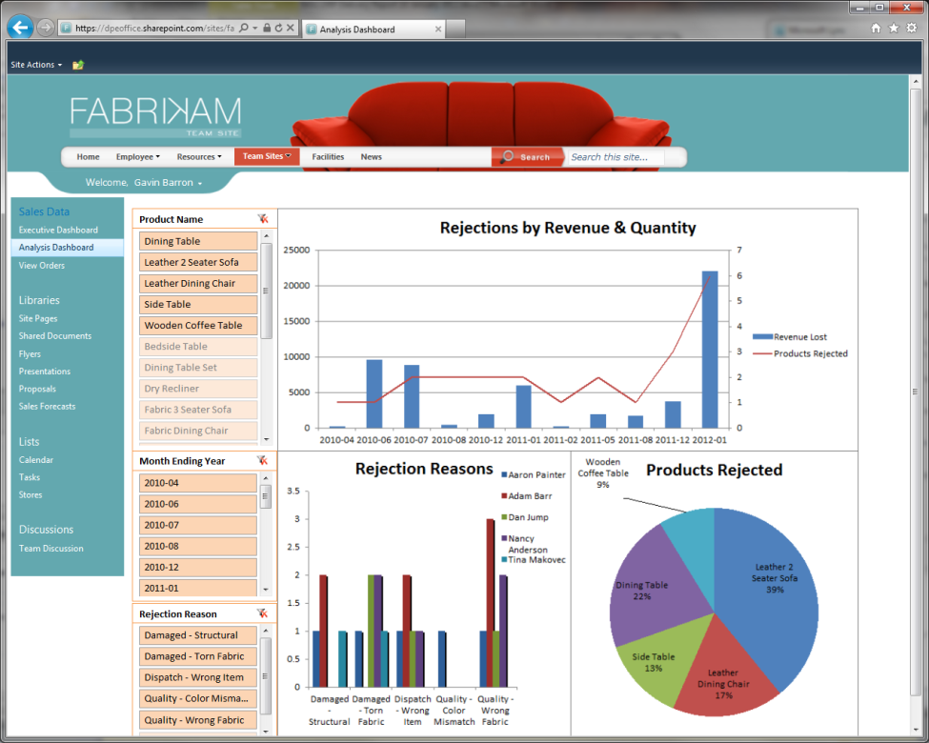


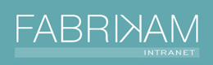





Fabrikam: end-2-end Business Scenario
Office
Clients
Excel
Web Access WP
Windows
Phone
External
List
Blob
Storage
External
Content
Type
Excel
Services
SharePoint
Online (Now with BCS)
WCF
Web Service
Order
Data

Slide 7
The Cloud Services: O365 and Windows Azure
“Work against any SOAP web service external
to SharePoint using a WCF connector”
1. LOB Ordering System
2. BLOB Storage for Pictures
3. WCF Service R/W Data
4. Wire-up ECT
5. Create External Lists
6. Ready for solutions
External
List
Blob
Storage
External
Content
Type
SharePoint
Online (Now with BCS)
WCF
Web Service
Order
Data

Slide 8
Building on the Foundation:
SharePoint Online BCS, Cloud-based Services and LoB Data
demo
Wiring up SharePoint Online BCS

Slide 9
How It Works
Wiring up SPO BCS with Windows Azure WCF Service
Build WCF Service
  Methods to expose data access
  Deploy to Windows Azure via portal
Create a BDC Model in SharePoint Online
  Use SharePoint Designer to wire up WCF Service
  Set permissions on ECT
  Create External List

Slide 10
Fabrikam: No-code and BCS Business Scenario
Office
Clients
Excel
Web Access WP
Windows
Phone
1. No-code (External Data List)
2. No-code (EWA Web Part)
3. No-code (Windows Phone)
1
2
3
External
List
Blob
Storage
External
Content
Type
Excel
Services
SharePoint
Online (Now with BCS)
WCF
Web Service
Order
Data

Slide 11
Lighting up No-code Productivity User Experiences
demo

Slide 12
How it works
demo
No-code drill-down

Slide 13
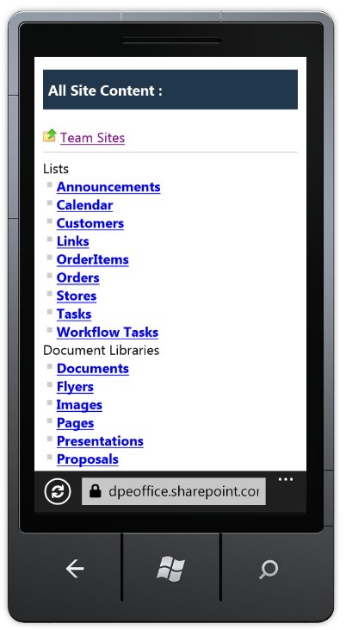
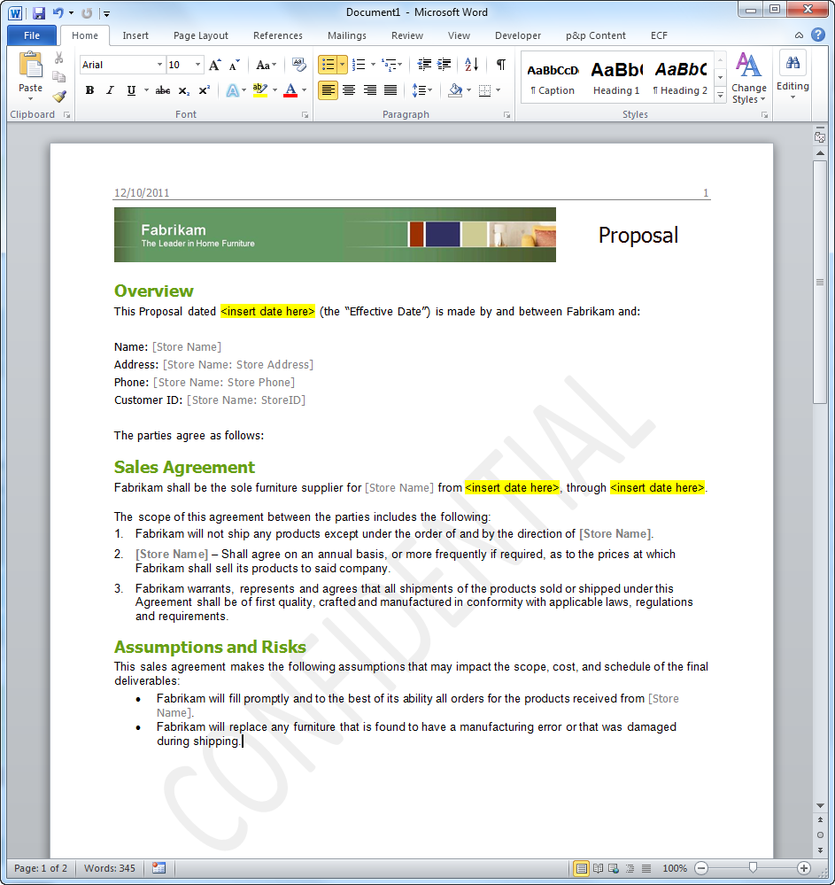
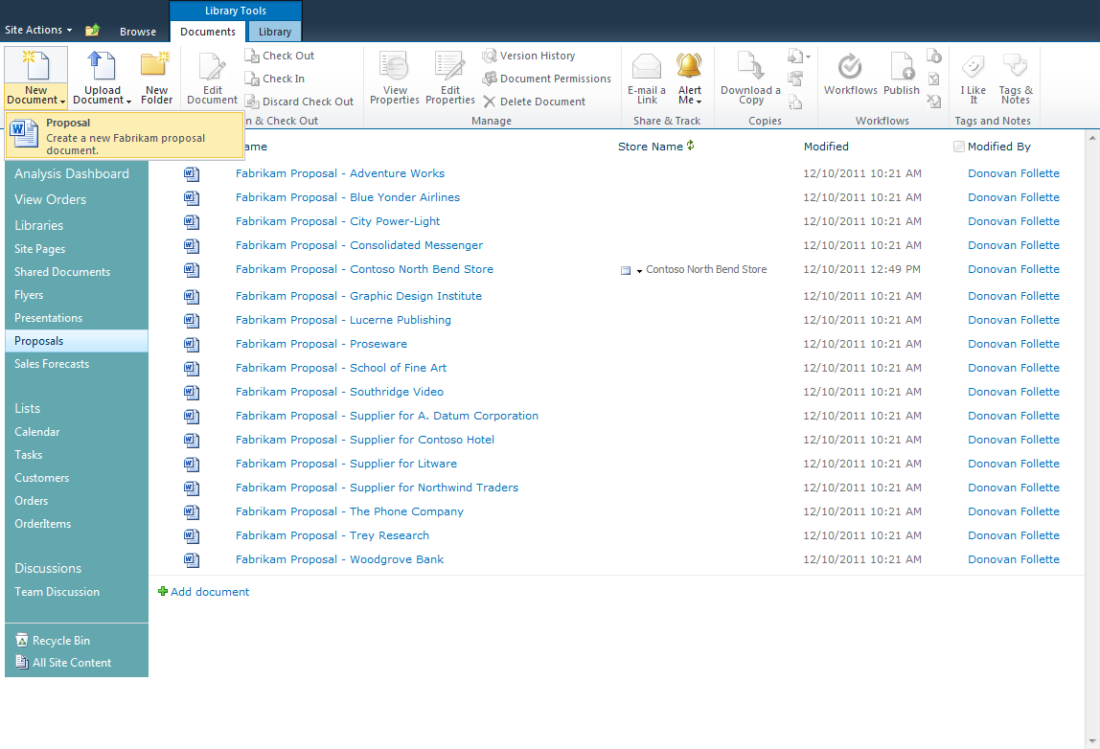
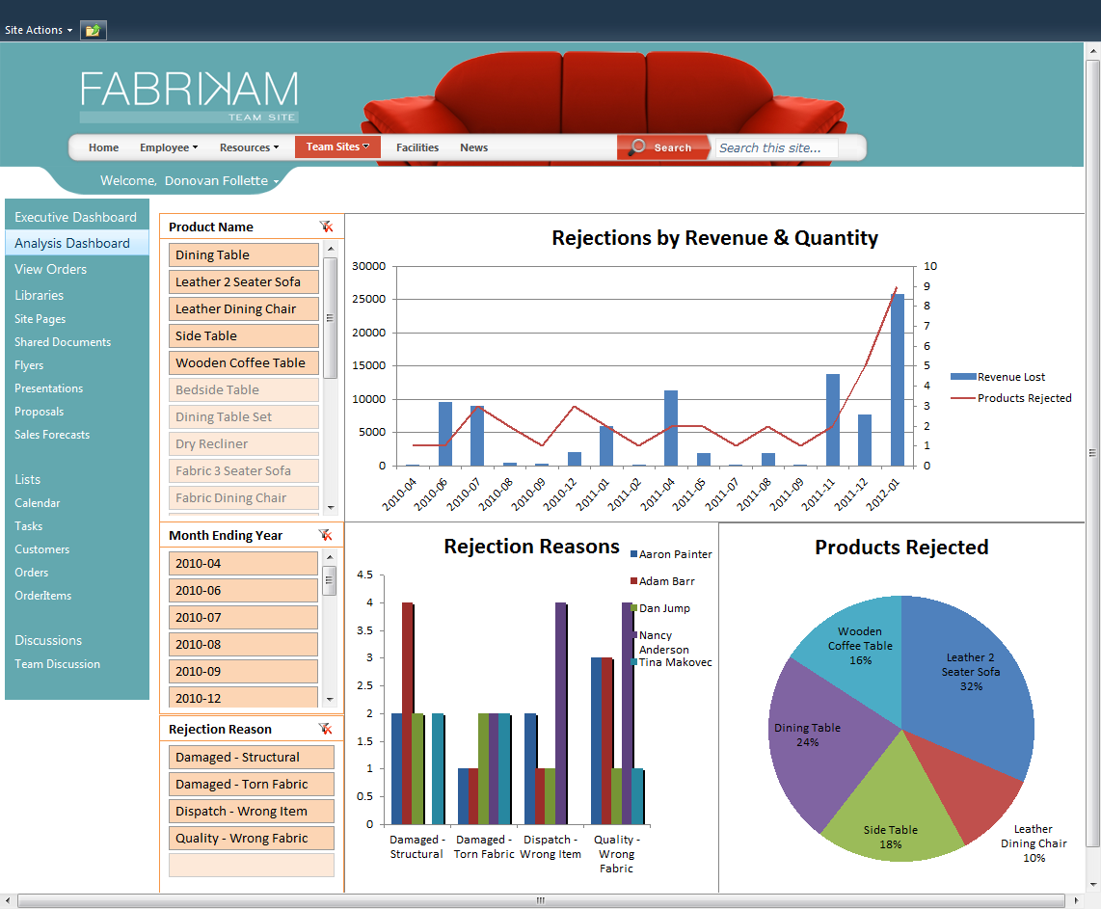
How It Works
No-code drill-down
SharePoint Online
  Add BCS-enabled External Columns to a document library
  Replace default document in doc library
Word 2010
  Edit new default document in Word
  Add Quick Part Document Properties to document
  Save document as default document type for library
Excel Web Access Web Parts
  Upload Excel spreadsheet
  Add a new SharePoint Online site page
  Add EWA Web Part(s) to the page
Windows Phone
  Login to SharePoint Online tenancy
  Browse to the External List

Slide 14

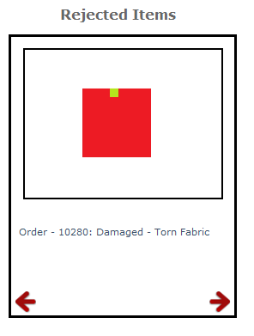
Fabrikam: Code-based and BCS Business Scenario
Office
Clients
Excel
Web Access WP
Windows
Phone
4. Code (Doc-Level Add-in)
5. Code (JS Object Model)
6. Code (Custom Phone App)
4
6
JSOM
CSOM, REST
5
4
External
List
Blob
Storage
External
Content
Type
Excel
Services
SharePoint
Online (Now with BCS)
WCF
Web Service
Order
Data

Slide 15




Office 365 Identity Architecture
Identity Options
Microsoft Online IDs
Microsoft Online IDs + DirSync
Federated IDs + DirSync
Microsoft Online Services
Identity Platform
Contoso Customer (on-premises)
Trust
Federation
Gateway
Exchange
Online
Active Directory Federation Server 2.0
Authentication platform
IdP
SharePoint®
Online
IdP
MS Online Directory Sync
Provisioning
platform
AD
Directory
Store
Lync™
Online
Admin Portal

Slide 16
Lighting up Code-based Productivity User Experiences
demo

Slide 17
How it works
demo
Code-based drill-down

Slide 18
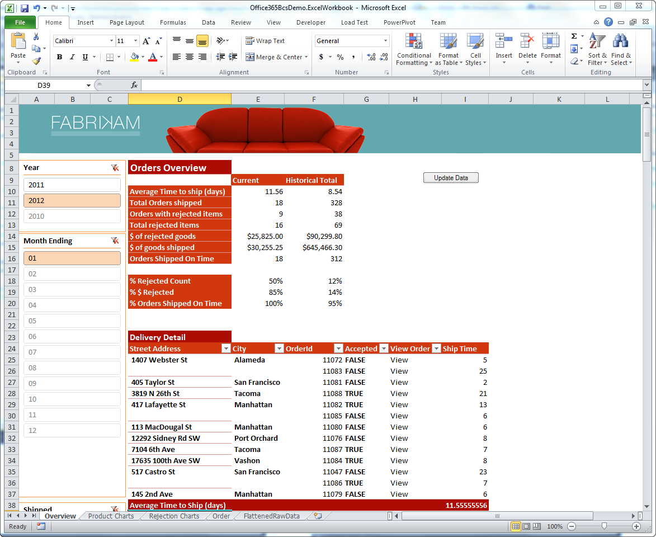
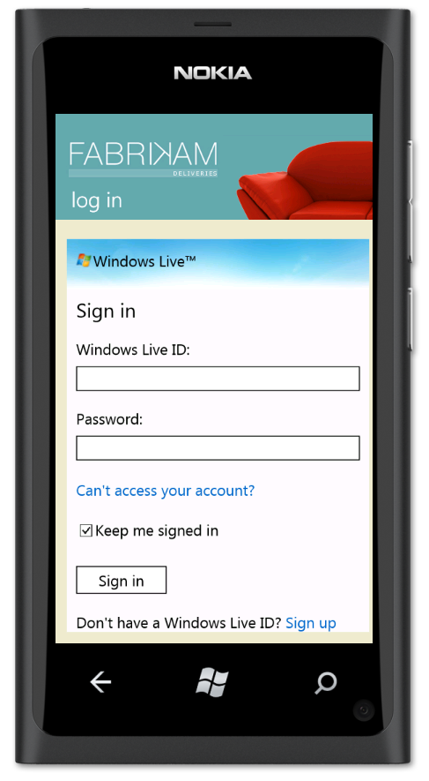
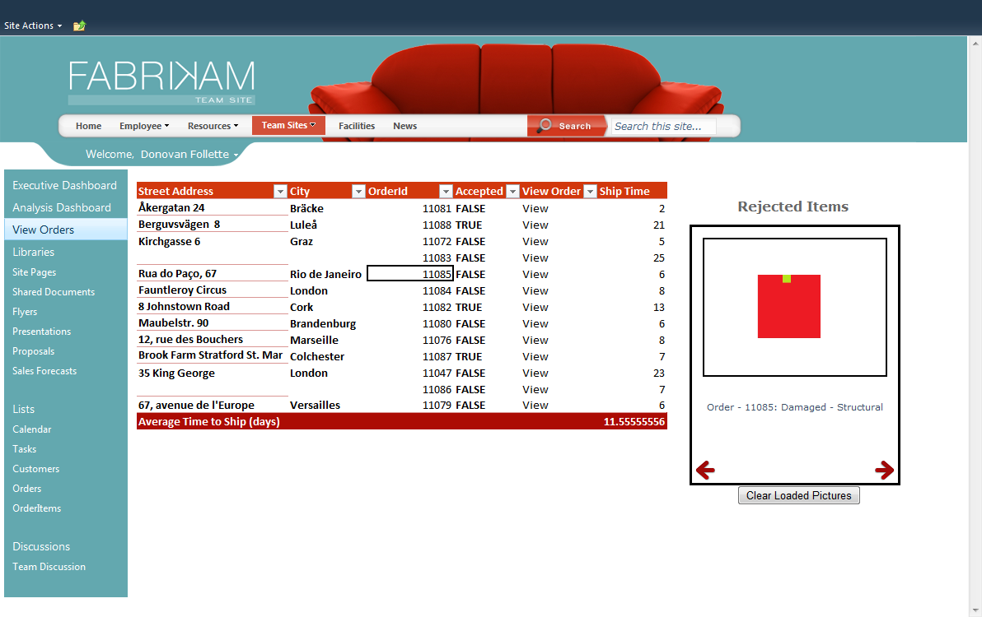
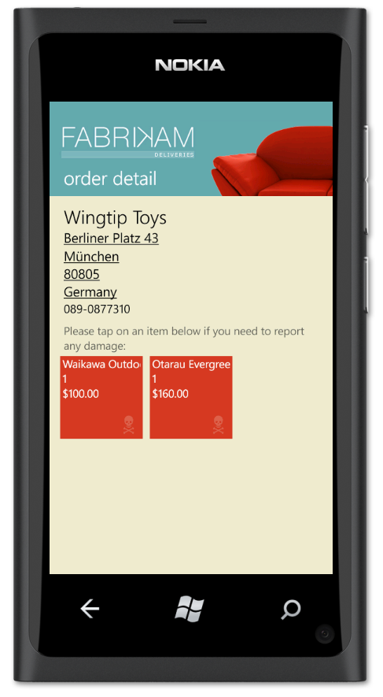
How It Works
Code-based drill-down
Excel 2010 Add-in
  SharePoint client object model (CSOM) for .NET
  Remote claims-based authN for SharePoint Online
  msdn.microsoft.com/en-us/library/hh147177.aspx
Excel Services and EWA Web Part
  JavaScript Object Model (JSOM)
  CSOM for JavaScript
  REST calls for Blob storage
Windows Phone
  Authentication via Windows Azure Access Control Service
  WCF Service called directly from phone

Slide 19
E-2-E Productivity Solution via BCS in SharePoint Online!
Office
Clients
Excel
Web Access WP
Windows
Phone
1. No-code (External Data List)
2. Code (Doc-Level Add-in)
3. No-code (EWA Web Part)
4. Code (JS Object Model)
5. No-code (Windows Phone)
6. Code (Custom Phone App)
1
2
3
5
6
JSOM
CSOM, REST
4
4
External
List
Blob
Storage
External
Content
Type
Excel
Services
SharePoint
Online (Now with BCS)
WCF
Web Service
Order
Data

Slide 20
Other Potential BCS LOB Connectivity Patterns
Any public facing WCF/ASMX service
  Open or username/password protected
A WCF service that wraps any OData service
A WCF service that wraps any REST-based service
A WCF service that exposes data from any database
An on-premises WCF service
  Use a Windows Azure WCF Service as a proxy service
    Access on-premises service via Windows Azure Service Bus

Slide 21
In Review: Session Objective and Takeaway
Session Objective:
  Through demos I proposed why…
    BCS is valuable to the Power User
    BCS is valuable to the Developer
    BCS is valuable to the end-user, where information is turned into action
Key Takeaway
  If you agree with the added value of BCS to SharePoint Online
Join the journey of discovery and build
BCS-enabled productivity solutions.

Slide 22
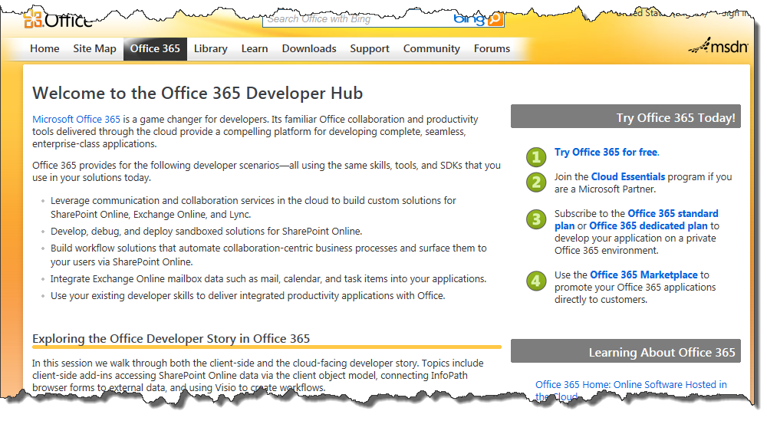
Resources
Office 365 Developer Hub http://msdn.microsoft.com/en-us/office/hh506337
blogs.msdn.com/donovanf
donovanf@microsoft.com
Watch my blog for a
Hands-on Lab that
will be coming available
that helps step you through
setting up BCS.

Slide 23
Related Content
Code | Title | Schedule
OSP221 | Microsoft Office 365 for Enterprises | 6/11/2012 3:00 PM
OSP305 | The Modern Compatibility Process to Accelerate Microsoft Office Deployment | 6/11/2012 4:45 PM
OSP321 | Active Directory Integration with Microsoft Office 365 | 6/12/2012 10:15 AM
OSP224 | Microsoft Office 365 Management and Deployment | 6/12/2012 1:30 PM
OSP223 | Microsoft Office 365 for Education | 6/12/2012 3:15 PM
OSP303 | Supporting Microsoft Office in an Enterprise Environment | 6/12/2012 3:15 PM
OSP202 | Microsoft Excel: A Web Development Tool? | 6/12/2012 5:00 PM
OSP306 | Microsoft Office Deployment for the Elite | 6/13/2012 10:15 AM
OSP325 | To the Cloud, from the Trenches: Best Practices for Migrating to Microsoft Office 365 | 6/13/2012 1:30 PM
OSP302 | Building Integrated Microsoft Office 365, SharePoint Online, and Office Solutions Using BCS and LOB Data | 6/13/2012 3:15 PM
OSP323 | Microsoft Office 365 Security, Privacy, and Trust | 6/13/2012 5:00 PM
OSP324 | Microsoft Office 365 Service Reliability and Disaster Recovery | 6/14/2012 8:30 AM
OSP304 | Optimized Desktop Deployment Jeopardy Live Game Show | 6/14/2012 1:00 PM
OSP222 | Empowering Small Businesses: Microsoft Office 365 P-Suite | 6/14/2012 4:30 PM

Slide 24

Related Resources
Office 365 TechCenter: technet.microsoft.com/Office365
Office Client TechCenter: technet.microsoft.com/office
Office, Office 365 and SharePoint Demo Area Includes:
  Office 365 IT Pro Command Center
  Office 365 Data Center Exhibit

Slide 25




Resources
Learning
  Connect. Share. Discuss.
  Microsoft Certification & Training Resources
http://northamerica.msteched.com
www.microsoft.com/learning
TechNet
  Resources for IT Professionals
  Resources for Developers
http://microsoft.com/technet
http://microsoft.com/msdn

Slide 26







Complete an evaluation on CommNet and enter to win!

Slide 27


MS Tag
Scan the Tag
to evaluate this
session now on
myTechEd Mobile

Slide 28
© 2012 Microsoft Corporation. All rights reserved. Microsoft, Windows, Windows Vista and other product names are or may be registered trademarks and/or trademarks in the U.S. and/or other countries.
The information herein is for informational purposes only and represents the current view of Microsoft Corporation as of the date of this presentation. Because Microsoft must respond to changing market conditions, it should not be interpreted to be a commitment on the
part of Microsoft, and Microsoft cannot guarantee the accuracy of any information provided after the date of this presentation. MICROSOFT MAKES NO WARRANTIES, EXPRESS, IMPLIED OR STATUTORY, AS TO THE INFORMATION IN THIS PRESENTATION.

