Slide 1
Microsoft Trustworthy Computing Cloud Security, Privacy, and Reliability in a Nutshell
SIA202

Slide 2
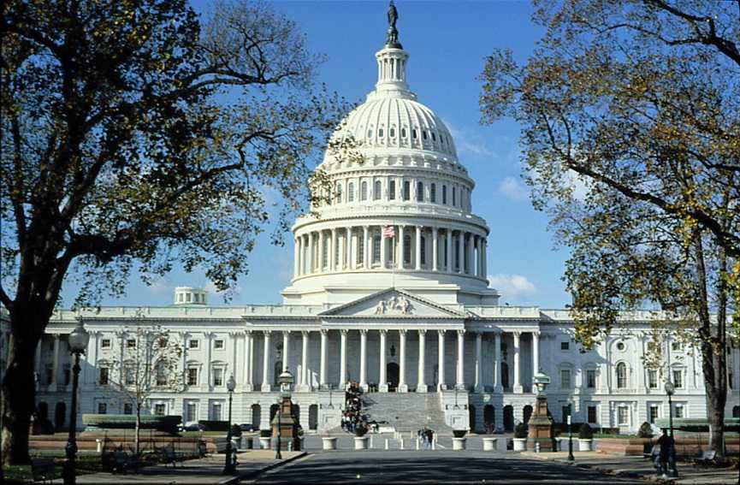

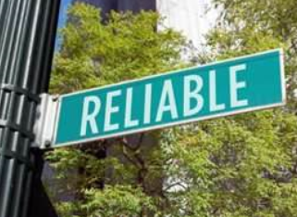
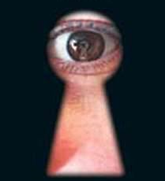

Welcome
What is the biggest cloud adoption hurdle?
Select the appropriate level that you fits your current level
Getting started
Almost there
Making Progress
Completed
IT Process and Compliance
Getting started
Almost there
Making Progress
Completed
Identity and Security Services

Slide 3
Welcome
What is the biggest cloud adoption hurdle?
Select the appropriate level that you fits your current level
Getting started
Almost there
Making Progress
Completed
IT Process and Compliance
Getting started
Almost there
Making Progress
Completed
Identity and Security Services

Slide 4


COMPUTING AND SOCIETAL TRENDS
  CONSUMERIZATION OF IT
  TARGETED ATTACKS
  IDENTITY AND PRIVACY
  CLOUD COMPUTING
  AVALIBILITY OF SERVICES
Notes:
NDA - Microsoft Confidential
Microsoft Security Strategy Briefing

Slide 5




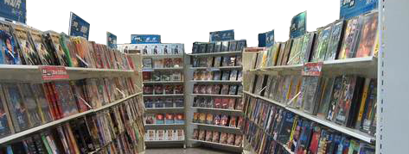
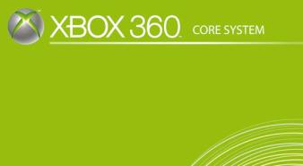

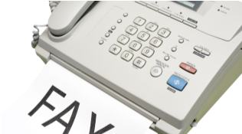
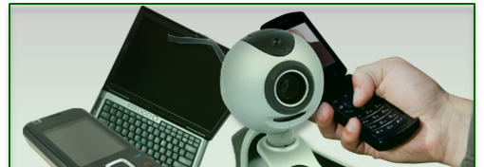
BIG SHIFTS: OPPORTUNITY & RISK
THEN
NOW

Slide 6


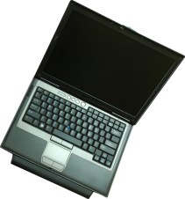



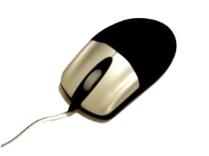




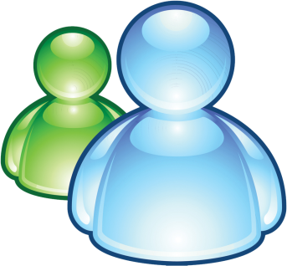




LEARNING FROM THE PAST

Slide 7

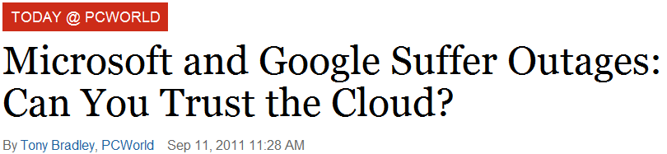




IN THE NEWS…
Sony Finds More Cases of Hacking of Its Servers
By NICK BILTON , May 2, 2011
Sony said Monday that it had discovered that more credit card information and customer profiles had been compromised during an attack on its servers last week.
Microsoft and Google Suffer Outages: Can You Trust the Cloud?
By Tony Bradley, PCWorld Sep 11, 2011
The cloud is falling! The cloud is falling! No, seriously. It keeps falling. If it's not Google Docs or Gmail, it's Microsoft's Office 365, Hotmail, and SkyDrive.
The issues encountered over the past week or so--and the sporadic-but-too-frequent-to-ignore outages before that--raise serious questions about just how dependable cloud-based services really are.
Wmware causes second outage while recovering from first
By Jon Brodkin, May 2, 2011
Network World – WMware’s attempt to recover from an outage in its brand-new cloud computing service inadvertently caused a second outage the next day, the company said..
Microsoft's Office 365 Hit By Outages: Reports
Microsoft’s Office 365 is reportedly hit by outages of undetermined size.
Microsoft hopes Office 365 will help sell customers on its "all-in" cloud strategy.
Microsoft’s Office 365 seems to be experiencing some outages.
“We apologize for the inconvenience that the [Office 365] outage has caused today. We’re [sic] are working on resolving the issue,” read an Aug. 17 tweet
Hack attack spills web security firm's confidential data
By Dan Goodin in San Francisco Posted in Security, 11th April 2011
Try this for irony: The website of web application security provider Barracuda Networks has sustained an attack that appears to have exposed sensitive data concerning the company's partners and employee login credentials, according to an anonymous post. Barracuda representatives didn't respond to emails seeking confirmation of the post, which claims the data was exposed as the result of a SQL injection attack.
RSA warns SecurID customers after company is hacked
By Robert McMillan, March 17, 2011
EMC's RSA Security division says the security of the company's two-factor SecurID tokens could be at risk following a sophisticated cyber-attack on the company.
Nasdaq Confirms Breach in Network
BY DEVLIN BARRETT, JENNY STRASBURG AND JACOB BUNGE
FEBRUARY 7, 2011
The company that owns the Nasdaq Stock Market confirmed over the weekend that its computer network had been broken into, specifically a service that lets leaders of companies, including board members, securely share confidential documents.

Slide 8
IN THE NEWS…
Sony Finds More Cases of Hacking of Its Servers
By NICK BILTON , May 2, 2011
Sony said Monday that it had discovered that more credit card information and customer profiles had been compromised during an attack on its servers last week.
Microsoft and Google Suffer Outages: Can You Trust the Cloud?
By Tony Bradley, PCWorld Sep 11, 2011
The cloud is falling! The cloud is falling! No, seriously. It keeps falling. If it's not Google Docs or Gmail, it's Microsoft's Office 365, Hotmail, and SkyDrive.
The issues encountered over the past week or so--and the sporadic-but-too-frequent-to-ignore outages before that--raise serious questions about just how dependable cloud-based services really are.
Microsoft's Office 365 Hit By Outages: Reports
Microsoft’s Office 365 is reportedly hit by outages of undetermined size.
Microsoft hopes Office 365 will help sell customers on its "all-in" cloud strategy.
Microsoft’s Office 365 seems to be experiencing some outages.
“We apologize for the inconvenience that the [Office 365] outage has caused today. We’re [sic] are working on resolving the issue,” read an Aug. 17 tweet
Hack attack spills web security firm's confidential data
By Dan Goodin in San Francisco Posted in Security, 11th April 2011
Try this for irony: The website of web application security provider Barracuda Networks has sustained an attack that appears to have exposed sensitive data concerning the company's partners and employee login credentials, according to an anonymous post. Barracuda representatives didn't respond to emails seeking confirmation of the post, which claims the data was exposed as the result of a SQL injection attack.
Wmware causes second outage while recovering from first
By Jon Brodkin, May 2, 2011
Network World – WMware’s attempt to recover from an outage in its brand-new cloud computing service inadvertently caused a second outage the next day, the company said..
RSA warns SecurID customers after company is hacked
By Robert McMillan, March 17, 2011
EMC's RSA Security division says the security of the company's two-factor SecurID tokens could be at risk following a sophisticated cyber-attack on the company.
Nasdaq Confirms Breach in Network
BY DEVLIN BARRETT, JENNY STRASBURG AND JACOB BUNGE
FEBRUARY 7, 2011
The company that owns the Nasdaq Stock Market confirmed over the weekend that its computer network had been broken into, specifically a service that lets leaders of companies, including board members, securely share confidential documents.

Slide 9
IN THE NEWS…
Microsoft and Google Suffer Outages: Can You Trust the Cloud?
By Tony Bradley, PCWorld Sep 11, 2011
The cloud is falling! The cloud is falling! No, seriously. It keeps falling. If it's not Google Docs or Gmail, it's Microsoft's Office 365, Hotmail, and SkyDrive.
The issues encountered over the past week or so--and the sporadic-but-too-frequent-to-ignore outages before that--raise serious questions about just how dependable cloud-based services really are.
Wmware causes second outage while recovering from first
By Jon Brodkin, May 2, 2011
Network World – WMware’s attempt to recover from an outage in its brand-new cloud computing service inadvertently caused a second outage the next day, the company said..
Sony Finds More Cases of Hacking of Its Servers
By NICK BILTON , May 2, 2011
Sony said Monday that it had discovered that more credit card information and customer profiles had been compromised during an attack on its servers last week.
Microsoft's Office 365 Hit By Outages: Reports
Microsoft’s Office 365 is reportedly hit by outages of undetermined size.
Microsoft hopes Office 365 will help sell customers on its "all-in" cloud strategy.
Microsoft’s Office 365 seems to be experiencing some outages.
“We apologize for the inconvenience that the [Office 365] outage has caused today. We’re [sic] are working on resolving the issue,” read an Aug. 17 tweet
Hack attack spills web security firm's confidential data
By Dan Goodin in San Francisco Posted in Security, 11th April 2011
Try this for irony: The website of web application security provider Barracuda Networks has sustained an attack that appears to have exposed sensitive data concerning the company's partners and employee login credentials, according to an anonymous post. Barracuda representatives didn't respond to emails seeking confirmation of the post, which claims the data was exposed as the result of a SQL injection attack.
RSA warns SecurID customers after company is hacked
By Robert McMillan, March 17, 2011
EMC's RSA Security division says the security of the company's two-factor SecurID tokens could be at risk following a sophisticated cyber-attack on the company.
Nasdaq Confirms Breach in Network
BY DEVLIN BARRETT, JENNY STRASBURG AND JACOB BUNGE
FEBRUARY 7, 2011
The company that owns the Nasdaq Stock Market confirmed over the weekend that its computer network had been broken into, specifically a service that lets leaders of companies, including board members, securely share confidential documents.

Slide 10
IN THE NEWS…
Sony Finds More Cases of Hacking of Its Servers
By NICK BILTON , May 2, 2011
Sony said Monday that it had discovered that more credit card information and customer profiles had been compromised during an attack on its servers last week.
Microsoft and Google Suffer Outages: Can You Trust the Cloud?
By Tony Bradley, PCWorld Sep 11, 2011
The cloud is falling! The cloud is falling! No, seriously. It keeps falling. If it's not Google Docs or Gmail, it's Microsoft's Office 365, Hotmail, and SkyDrive.
The issues encountered over the past week or so--and the sporadic-but-too-frequent-to-ignore outages before that--raise serious questions about just how dependable cloud-based services really are.
Wmware causes second outage while recovering from first
By Jon Brodkin, May 2, 2011
Network World – WMware’s attempt to recover from an outage in its brand-new cloud computing service inadvertently caused a second outage the next day, the company said..
Microsoft's Office 365 Hit By Outages: Reports
Microsoft’s Office 365 is reportedly hit by outages of undetermined size.
Microsoft hopes Office 365 will help sell customers on its "all-in" cloud strategy.
Microsoft’s Office 365 seems to be experiencing some outages.
“We apologize for the inconvenience that the [Office 365] outage has caused today. We’re [sic] are working on resolving the issue,” read an Aug. 17 tweet
RSA warns SecurID customers after company is hacked
By Robert McMillan, March 17, 2011
EMC's RSA Security division says the security of the company's two-factor SecurID tokens could be at risk following a sophisticated cyber-attack on the company.
Nasdaq Confirms Breach in Network
BY DEVLIN BARRETT, JENNY STRASBURG AND JACOB BUNGE
FEBRUARY 7, 2011
The company that owns the Nasdaq Stock Market confirmed over the weekend that its computer network had been broken into, specifically a service that lets leaders of companies, including board members, securely share confidential documents.
Hack attack spills web security firm's confidential data
By Dan Goodin in San Francisco Posted in Security, 11th April 2011
Try this for irony: The website of web application security provider Barracuda Networks has sustained an attack that appears to have exposed sensitive data concerning the company's partners and employee login credentials, according to an anonymous post. Barracuda representatives didn't respond to emails seeking confirmation of the post, which claims the data was exposed as the result of a SQL injection attack.

Slide 11
SAFE CLOUD SERVICES

Slide 12

MANAGING RISK AT ALL LAYERS
IDENTITY
AND ACCESS MANAGEMENT
HOST
SECURITY
PHYSICAL
NETWORK
APPLICATION
DATA

Slide 13
RESPONSIBILITIES
You are ultimately responsible for ensuring you meet your compliance obligations
Your provider is your partner
Control will scale based on service orientation
IaaS
PaaS
SaaS
RESPONSIBILITY:
Data Classification and Accountability
Host Level Controls
CLOUD CUSTOMER
Application Level Controls
Identity and Access Management
Network Controls
CLOUD PROVIDER
Physical Security

Slide 14
PHYSICAL CONTROLS

Slide 15
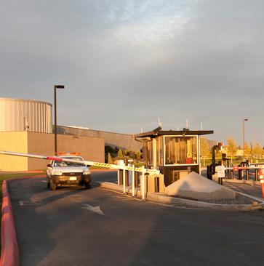

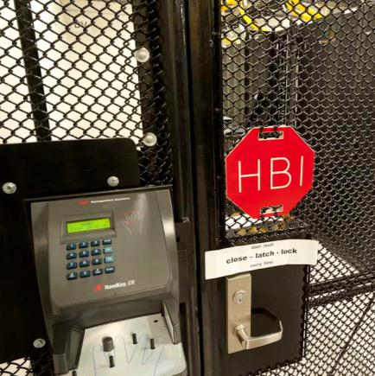
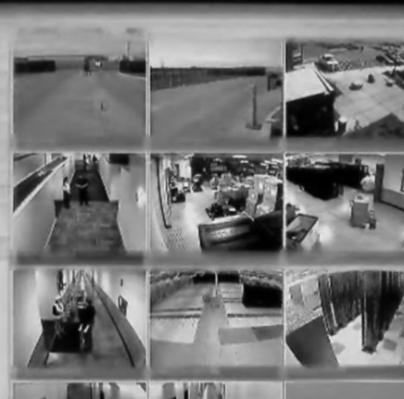
PHYSICAL SECURITY–
Some of the measures we employ:
PERIMETER SECURITY
FIRE SUPPRESSION
MULTI-FACTOR AUTHENTICATION
EXTENSIVE MONITORING

Slide 16



DISTRIBUTED SERVICES
NORTH AMERICA REGION
EUROPE REGION
ASIA PACIFIC REGION
Dublin, IE
London, GB
Stockholm, SE
Chicago, IL
Amsterdam, NL
Seoul, KR
Seattle, WA
Newark, NJ
Ashburn, VA
Vienna, AT
Tokyo, JP
Bay Area, CA
Los Angeles, CA
Hong Kong, HK
Miami, FL
Paris, FR
Zurich, CH
Taipei, TWN
San Antonio, TX
Singapore, SG
São Paulo, BR
Sydney, AU
.

Slide 17
NETWORK CONTROLS

Slide 18






TYPES OF FAILURE
Expected
Fault
tolerance
software
hardware
Human error
Unexpected
Natural disaster
DATA DISRUPTION
Criminal activity
Rapid
recovery
Notes:
NDA - Microsoft Confidential
Microsoft Security Strategy Briefing

Slide 19


DESIGN TO
WITHSTAND
FAILURE

Slide 20




DESIGN TO
WITHSTAND
FAILURE
  Edge Routers
  Aggregation Routers
  Aggregation Switches
  Hosts/VMs
  Storage

Slide 21
DESIGN TO
WITHSTAND
FAILURE
  Edge Routers
  Aggregation Routers
  Aggregation Switches
  Hosts/VMs
  Storage

Slide 22

DESIGN TO
WITHSTAND
FAILURE
  Edge Routers
  Aggregation Routers
  Aggregation Switches
  Hosts/VMs
  Storage

Slide 23
IDENTITY

Slide 24







INDUSTRY TRENDS DRIVING IDENTITY
CLOUD
DEVICES
Externalization of IT
Applications are on-premises and in the cloud
  Multiple vendors and multiple operators
Dispersed enterprise data needs to be protected
  Across a mix of infrastructure, platforms and services
Consumerization of IT
All users need access
  Employee, partner, or customer
From any device
  At work, at home, or mobile

Slide 25
IDENTITY ACCESS MANAGEMENT
Access across Networks
Well-managed Identity
Secure Remote Access
Enable interoperable access across networks
Provide well-managed, common identity infrastructure
Secure remote access to
business resources
Integrated Identity service

Slide 26
PROTECTING THE HOST

Slide 27
Industry-wide vulnerability disclosures
Industry-wide vulnerability severity
Industry-wide vulnerabilities by access complexity
Industry-wide OS, browser, application vulnerabilities
Industry-wide vulnerability disclosures

Slide 28
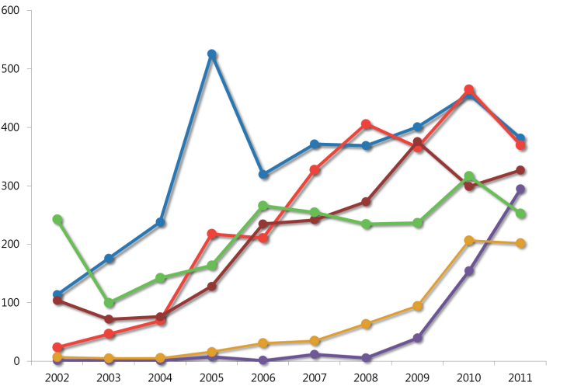
Vulnerabilities by Vendor
Enterprise
Linux
Apple
Oracle
Google
Microsoft
Adobe

Slide 29
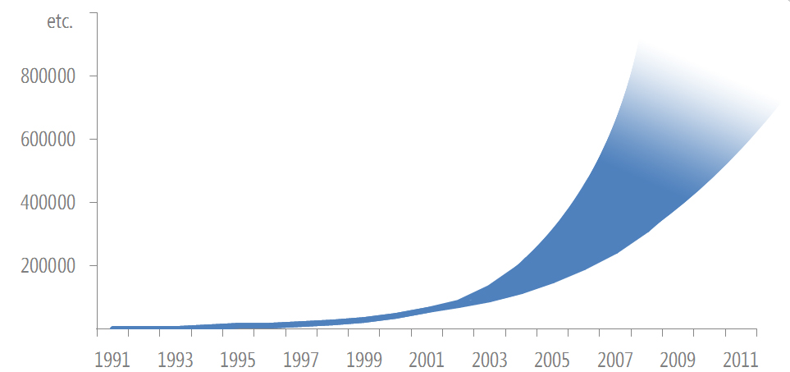
Approximate growth of malware since 1991
At the end of 2001, approximately 60,000 forms of malware or threats were known to exist. This number was a significant increase from 1996 (about 10,000) and 1991 (about 1,000).

Slide 30
Malware categories peeking since 2006
Adware detections increased significantly in 1H11, including the adware families Win32/OpenCandy and JS/Pornpop.
The Miscellaneous Potentially Unwanted Software category, which was the most commonly detected category in 2006, declined in prevalence in 2007 and 2008 Win32/Keygen
Win32/FakeSpyPro, the most commonly detected rogue security software family in 2010.
Win32/Alureon, Win32/Hiloti, which interferes with an affected user's browsing habits and downloads and executes arbitrary files.

Slide 31
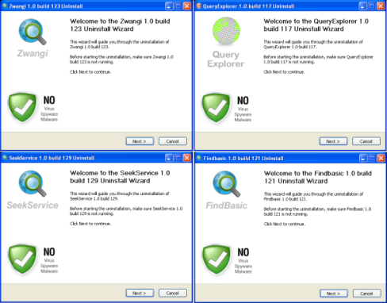


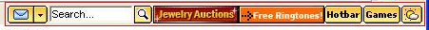

Prevalent adware
Pornpop
Zwangi
ClickPotato
Hotbar
Autorun abuse

Slide 32
Malware that have peaked and declined since 2006
Win32/Rbot was an early botnet family that gained notoriety in 2004 and 2005
Win32/Zlob a trojan found on almost one of every four computers that was infected with malware in 1H08
Win32/Conficker is a worm family discovered in November 2008 that initially spread by exploiting a vulnerability addressed by security update MS08-067, which was released the previous month.
JS/Pornpop is adware that consists of specially crafted JavaScript-enabled objects that attempt to display pop-under advertisements.
Win32/Autorun is a generic detection for worms that attempt to spread between mounted computer volumes by misusing the AutoRun feature in Windows.

Slide 33
Most common global threats today
Consumer: % of all non-domain computers cleaned
Business: % of all domain-joined computers cleaned

Slide 34
Conficker detections by Microsoft antimalware products
Win32/Conficker detections
1.7 million detections in 4Q11

Slide 35
Blocked Conficker infection attempts enterprise vs. consumer
Microsoft Forefront Endpoint Protection
Operating System | Credential- based attack | Exploit | Autorun abuse attempt
Windows 2003 | 91% | 9% | —
Windows XP | 88% | 12% | —
Windows Vista | 100% | — | —
Windows 7 | 100% | — | —
Microsoft Security Essentials
Operating System | Credential- based attack | Exploit | Autorun abuse attempt
Windows 2003 | 77% | 22% | 1%
Windows XP | 46% | 51% | 3%
Windows Vista | 77% | — | 23%
Windows 7 | 85% | — | 15%

Slide 36
Conficker passwords
00000000 0000000 00000 0000 000 00 0987654321 0 11111111 1111111 111111 11111 1111 111 11 123123 12321 123321 1234567890 123456789 12345678 1234567 123456 12345 1234 1234abcd 1234qwer 123 123abc | 123asd 123qwe 12 1 1q2w3e 21 22222222 2222222 222222 22222 2222 222 22 2 321 33333333 3333333 333333 33333 3333 333 33 3 4321 44444444 4444444 444444 44444 4444 | 444 44 4 54321 55555555 5555555 555555 55555 5555 555 55 5 654321 66666666 6666666 666666 66666 6666 666 66 6 7654321 77777777 7777777 777777 77777 7777 777 77 | 7 87654321 88888888 8888888 888888 88888 8888 888 88 8 987654321 99999999 9999999 999999 99999 9999 999 99 9 a1b2c3 aaa aaaa aaaaa abc123 academia access account admin123 admin12 | admin1 Admin adminadmin administrator anything asddsa asdfgh asdsa asdzxc backup boss123 business campus changeme cluster codename codeword coffee computer controller cookie customer database default desktop domain example exchange explorer | file files foo foobar foofoo forever freedom games home123 home ihavenopass Internet intranet job killer letitbe letmein Login lotus love123 manager market money monitor mypass mypassword mypc123 nimda nobody | nopass nopassword nothing office oracle owner pass123 pass12 pass1 pass passwd password123 password12 password1 Password private public pw123 q1w2e3 qazwsx qazwsxedc qqq qqqq qqqqq Qwe123 qweasd qweasdzxc Qweewq qwerty | qwewq root123 root rootroot sample secret secure security server shadow share sql student super superuser supervisor system temp123 temp temporary temptemp test123 test testtest unknown web windows Work123 work | xxx xxxx xxxxx zxccxz zxcvb zxcvbn zxcxz zzz zzzz zzzzz

Slide 37
Trends for rogue security software
Unique computers cleaned

Slide 38
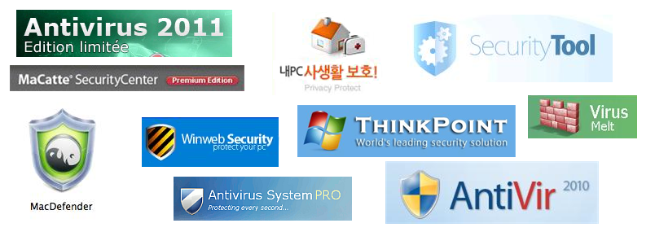
Rogue Security Software Programs

Slide 39
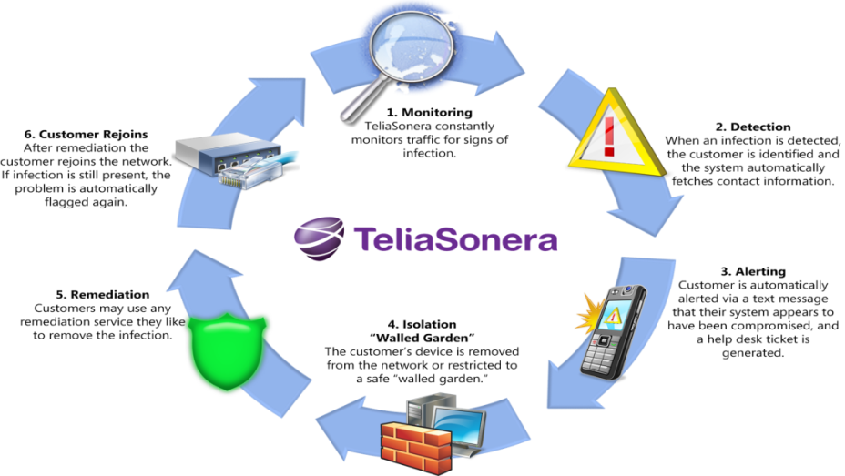
Cleanest network in cleanest location

Slide 40
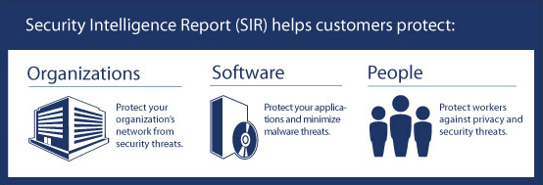
Keep all software on
your systems updated
Third party, as well as Microsoft
Use caution when clicking
on links to Web pages
Use caution with attachments
and file transfers
Use Microsoft Update,
not Windows update
Updates all Microsoft software
Avoid downloading
pirated software
Run anti-virus software
from a trusted vendor
Keep it updated
Protect yourself from
social engineering attacks

Slide 41
PROTECTING APPLICATIONS

Slide 42
MICROSOFT SECURITY DEVELOPMENT LIFECYCLE
WORKING TO PROTECT OUR USERS…
REDUCE VULNERABILITIES, LIMIT EXPLOIT SEVERITY
Education
Process
Accountability
Administer and track security training
Guide product teams to meet SDL requirements
Establish release
criteria and sign- off as part of FSR
Incident
Response (MSRC)
SECURITY FUNDAMENTALS
Training
Requirements
Design
Implementation
Verification
Release
Response
TECHNOLOGY INNOVATIONS
Core Security
Training
Establish Security
Requirements
Create Quality
Gates/Bug Bars
Security & Privacy
Risk Assessment
Establish Design
Requirements
Analyze Attack
Surface
Threat
Modeling
Use Approved Tools
Deprecate Unsafe
Functions
Static Analysis
Dynamic Analysis
Fuzz Testing
Attack Surface Review
Incident
Response Plan
Final Security Review
Release Archive
Execute Incident
Response Plan
INDUSTRY LEADERSHIP
Ongoing Process Improvements – 12 month cycle
Notes:
NDA - Microsoft Confidential
Microsoft Security Strategy Briefing

Slide 43
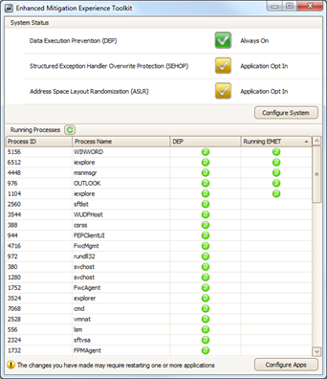


Exploit effectiveness with the enhanced mitigation experience toolkit
Successful exploits
To assess the effectiveness of EMET in addressing a number of commonly exploited vulnerabilities, Microsoft researchers collected a sample of 184 application exploits
All exploits targeted vulnerabilities in popular applications running on one or more versions of Windows in an out-of-the-box configuration

Slide 44
PROTECTING THE DATA

Slide 45




TRUSTWORTHY COMPUTING
SECURITY
PRIVACY
RELIABILITY
BUSINESS PRACTICES
    Secures against attacks
    Protects confidentiality, integrity, and availability of data and systems
    Helps manage risk
    Protects from unwanted communication
    User choice and control
    Products, online services adhere to fair information principles
    Dependable, available
    Predictable, consistent, responsive service
    Maintainable
    Resilient, easily restored
    Proven, ready
    Commitment to
    customer-centric interoperability
    Recognized industry leader, world-class partner
    Open, Transparent
Notes:
NDA - Microsoft Confidential
Microsoft Security Strategy Briefing

Slide 46

RISK MANAGEMENT PROCESS
IDENTIFY threat & vulnerabilities
CALCULATE risks
REPORT risks across Microsoft cloud environment
ADDRESS risks based on impact assessment & business case
TEST remediation effectiveness & residual risks
MANAGE risks on an ongoing basis

Slide 47
PROTECTING DATA IN THE CLOUD
PLAN IT
SAY IT
DO IT
PROVE IT
“I want to understand my compliance requirements.”
“I want to manage my IT environment in a compliant manner.”
“I design my IT environment in a compliant manner.”
“I want to report on the results of my compliance efforts.”
AUTHORITY DOCUMENTS
& RISKS
CONTROL OBJECTIVES
CONTROL ACTIVITIES
TESTS
Discover regulatory requirements
Create Policy
Design Service
Align audit requirements

Slide 48

CONSIDERATIONS FOR CHOICE IN CLOUD SERVICES PROVIDER
Consult guidance from organizations such as the Cloud Security Alliance
Require that the provider has attained
third-party certifications and audits, e.g., ISO/IEC 27001:2005
Know the value of your data and processes and the security and compliance obligations you need to meet
Consider the ability of vendors to accommodate changing security and compliance requirements
Ensure a clear understanding of security and compliance roles and responsibilities for delivered services
Ensure data and services can be brought back in house if necessary
Require transparency in security policies and operations

Slide 49
Example of use of Cloud Control Matrix
Control ID In CCM | Description (CCM Version R1.1. Final) | Microsoft Response
DG-01 Data Governance - Ownership / Stewardship | All data shall be designated with stewardship with assigned responsibilities defined, documented and communicated. | Microsoft Online Services has implemented a formal policy that requires assets (the definition of asset includes data and hardware) used to provide Microsoft Online Services to be accounted for and have a designated asset owner. Asset owners are responsible for maintaining up-to-date information regarding their assets. “Allocation of information security responsibilities and ownership of assets” is covered under the ISO 27001 standards, specifically addressed in Annex A, domains 6.1.3 and 7.1.2. For more information review of the publicly available ISO standards we are certified against is suggested.
DG-02 Data Governance - Classification | Data, and objects containing data, shall be assigned a classification based on data type, jurisdiction of origin, jurisdiction domiciled, context, legal constraints, contractual constraints, value, sensitivity, criticality to the organization and third party obligation for retention and prevention of unauthorized disclosure or misuse. | Microsoft Online Services standards provide guidance for classifying assets of several applicable security classification categories, and then implements a standard set of Security and privacy attributes. “Information classification” is covered under the ISO 27001 standards, specifically addressed in Annex A, domain 7.2. For more information review of the publicly available ISO standards we are certified against is suggested.

Slide 50
RESOURCES
SECURITY RESPONSE CENTER
SECURITY INTELLIGENCE REPORT
SECURITY DEVELOPMENT LIFECYCLE
SECURITY TECH CENTER
MICROSOFT SECURITY UPDATE GUIDE
www.microsoft.com
/security/msrc
www.microsoft.com
/security/sir
www.microsoft.com
/sdl
technet.microsoft.com
/security
www.microsoft.com
/securityupdateguide
SECURITY DEVELOPMENT CENTER
TRUSTWORTHY COMPUTING
END TO END TRUST
MALWARE PROTECTION CENTER
SECURITY BLOG
msdn.microsoft.com
/security
www.microsoft.com
/twc
www.microsoft.com
/endtoendtrust
www.microsoft.com
/security/portal
www.microsoft.com
/about/twc/en/us/blogs.aspx
Notes:
NDA - Microsoft Confidential
Microsoft Security Strategy Briefing

Slide 51


Track Resources
www.microsoft.com/twc
www.microsoft.com/security
www.microsoft.com/privacy
www.microsoft.com/reliability

Slide 52



Resources
Learning
  Connect. Share. Discuss.
  Microsoft Certification & Training Resources
http://northamerica.msteched.com
www.microsoft.com/learning
TechNet
  Resources for IT Professionals
  Resources for Developers
http://microsoft.com/technet
http://microsoft.com/msdn

Slide 53






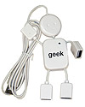
Required Slide
Complete an evaluation on CommNet and enter to win!

Slide 54





Please Complete an Evaluation
Your feedback is important!
Be eligible
to win great daily prizes and the grand prize of a $5,000 Travel Voucher!
Multiple
ways to Evaluate Sessions
Scan the Tag
to evaluate this
session now
on myTechEd Mobile

Slide 55
© 2012 Microsoft Corporation. All rights reserved. Microsoft, Windows, Windows Vista and other product names are or may be registered trademarks and/or trademarks in the U.S. and/or other countries.
The information herein is for informational purposes only and represents the current view of Microsoft Corporation as of the date of this presentation. Because Microsoft must respond to changing market conditions, it should not be interpreted to be a commitment on the part of Microsoft, and Microsoft cannot guarantee the accuracy of any information provided after the date of this presentation. MICROSOFT MAKES NO WARRANTIES, EXPRESS, IMPLIED OR STATUTORY, AS TO THE INFORMATION IN THIS PRESENTATION.

Slide 56
MICROSOFT IN THE CLOUD

Slide 57














MICROSOFT END-TO-END CLIENT PROTECTION
PROTECT AND
MANAGE THREATS
PROTECT SENSITIVE DATA
SECURE ACCESS
TO RESOURCES
Universal Extensible Firmware Interface (UEFI)
Trusted Platform Model (TPM)
    Maintain software with a patch management solution
    Deliver software that is secure by design
    Operate a malware resistant platform and applications
    Secure data that is at rest with encryption
    Protect data that is in motion with encryption
    Protect data that is in use with access controls
    Manage the full identity lifecycle
    Validate user identity with strong authentication
    Secured and always connected remote access
    Protect resources as environment changes
Scenarios
    Secured Boot
    Measured Boot
    Protected View
    IE Smart Screen
    Windows Standard User Accounts
    User Account Control, and AppLocker
    Modern Applications
    Security Development Lifecycle (SDL)
    Windows 7 BitLocker
    MDOP -BitLocker Administration and Monitoring
    Office Information Rights Management (IRM)
    Office Encrypted File System
    Active Directory Rights Management Services
    Active Directory
    Direct Access
    Network Access Protection
    Dynamic Access Control
Features
Products
Notes:
NDA - Microsoft Confidential
Microsoft Security Strategy Briefing

Slide 58


























COMMERCIAL CLOUD SERVICES
DEEP INVESTMENTS IN INFRASTRUCTURE
COMMITMENT TO SERVICES EXCELLENCE
>$2B invested in cloud infrastructure
Financially-backed uptime guarantees
Geo-replicated customer data
SAS 70 and ISO 27001:2005 compliant infrastructure
Public and private cloud flexibility
Commitment to environmental sustainability
Rapid innovation model
  PRODUCTIVITY
  COMMUNICATIONS
  COLLABORATION
  BUSINESS APPS
  MANAGEMENT
  STORAGE
  PLATFORM
Online
On-Premise

Slide 59
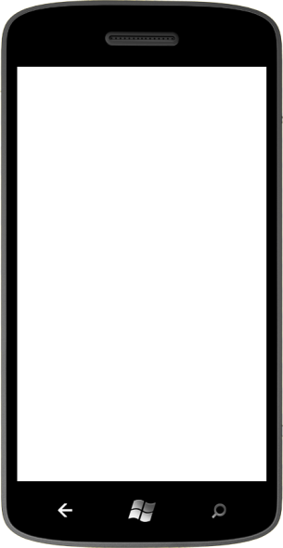

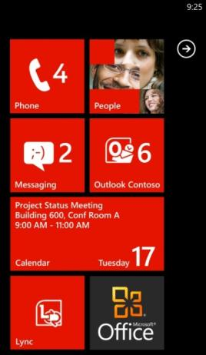






WINDOWS PHONE
FUNDAMENTALLY SECURE TO HELP PROTECT YOUR BUSINESS INFORMATION
HARDENED
Isolates apps
Prevents data theft
Certifies apps
MANAGED
EAS policies
Remote Wipe IRM
TRUSTED APPS
Target distribution
Encrypts data
Cloud ready
Notes:
NDA - Microsoft Confidential
Microsoft Security Strategy Briefing

Slide 60



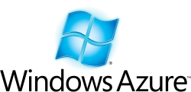











HUGE GLOBAL SCALE 24X7
1.4 Billion Live IDs
59 markets and 36 languages
350M Active Accounts
Over 5.5B WW Queries Each Month
Over 500M Unique Users Each Month
14B Ads
Per Month
300M+ Users 76 markets and 48 languages
5.0 Billion messages a day
59 markets and 36 languages
25M Users
2-4 billion emails per day
400+ Cloud Services
PC
TV/HOME
MOBILE

Slide 61


WHY SHOULD I TRUST THE MICROSOFT CLOUD?
PROVEN TRACK RECORD
  History of meeting obligations associated with the delivery of over 400 cloud services
SCALE
  Spreading cost of robust security and compliance across large number of customers provides a trusted cloud at lower cost
SECURITY AT OUR FOUNDATION
  Years of experience through our
  Trustworthy Computing initiative

Slide 62
MICROSOFT IT CISO AGENDA
MSIT (CISO)
RISK MANAGEMENT
BUSINESS ENABLEMENT
Intellectual Property Protection
Increased Data Leakage and Portability
Insider Threats
Risk Management Vs. Risk Elimination
Business
Continuity
Support for Rapidly Changing Business
Need for Improved Business Intelligence
Building Robust Continuity Plans
Risk Management Vs. Risk Elimination
Deliver First & Best (Products & Services)
41K WinPhone 7 Devices
700K+ SharePoint sites
100+ countries
190K end users
1000+ applications
8 productions data centers
10K+ production servers
12K+ virtual machines
1.3 million devices
TECHNICAL EXCELLENCE
OPERATIONAL EXCELLENCE
“Cloud” Computing
Data Loss Prevention
SIEM Platforms & Programs
IAM Governance & Process
Emerging Technologies
Better Integration with Board/ERM
Vendor & 3rd Party Management
Asset & Configuration Management
Executive Reporting & Metrics
Awareness & Training
102K+ Windows 7 clients
102K+ Windows 7
109K+ Office 2010 clients
49% users on OCS/Lync
SAP single instance on
SQL Server 2008 Rx CTP
Microsoft.com, 1.7B hits/day
7M spam filtered per day
85M IMs per month
34K virtual collaboration
sessions per month
Source: “Trends in Information Protection for 2008” Presentation for SC Magazine WebCast, January 9, 2008

