Slide 1
Cloudy Weather:
How Secure Is the Cloud?
SIA204
David Aiken
Windows Azure
Microsoft Corporation

Slide 2
Agenda
T ‹}h_¢±ìpÌŠ=a•óDw XµÒÃ‹&´ç½a<ô‚;YËˆ™ÿÌZÑ†2±ØøEÍÏrT–.ñ¼ˆý™¿‹X÷!ð±,eH4dPy;–›
¢±ìpÌŠ=a•óDw T ‹}h_ XµÒÃ‹&´ç½a<ô‚;YËˆ™ÿÌZÑ†2±ØøEÍÏrT–.ñ¼ˆý™¿‹X÷!ð±,eH4dPy;–›
‹&´ç½ T ‹}h_¢±ìpÌŠ=a•óDw XµÒÃ a<ô‚;YËˆ™ÿÌZÑ†2±ØøEÍÏrT–.ñ¼ˆý™¿‹X÷!ð±,eH4dPy;–›
CLASSIFIED

Slide 3
Questions
Does Windows Azure provide the rock-solid security required for the most sensitive data and applications?
How do you ensure privacy of sensitive information?
How do you secure access to applications?
What if you have strict compliance requirements?

Slide 4
confidentiality
integrity
availability
C
I
A
risk management
compliance

Slide 5


moving to the cloud
Customer Accountability
Multi-tenancy
Different Responsibilities
Trust

Slide 6

Multiple Sources
LAW
INDUSTRY
STANDARDS
INTERNAL
ISO

Slide 7
ISO 27001
EU PII
FISMA
PCI DSS
HIPAA
SSAE 16
SOX
SAS 70
GLBA
CFR Title 21 Part 11

Slide 8
Windows Azure Compliance (core services)
NOW
  ISO/IEC 27001:2005
  SSAE 16 (SOC 1 Type 2)
  EU-US Safe Harbour
  EU Model Clauses
NEXT
  HIPAA BAA
LATER
    FISMA / FedRAMP…

Slide 9
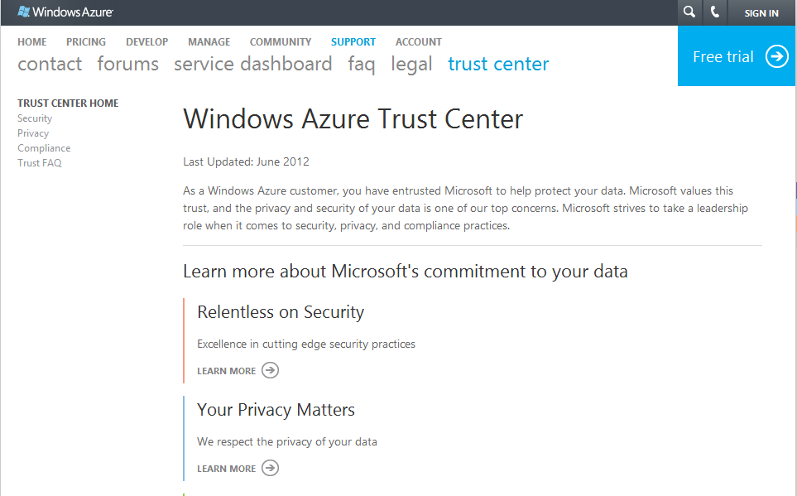
Windows Azure Trust Center
http://www.windowsazure.com/en-us/support/trust-center/
Privacy
Transparent
Compliance
Relentless

Slide 10
Office 365 Compliance
NOW
  ISO/IEC 27001:2005
  EU-US Safe Harbour
  EU Model Clauses
  HIPAA BAA
  DPA

Slide 11
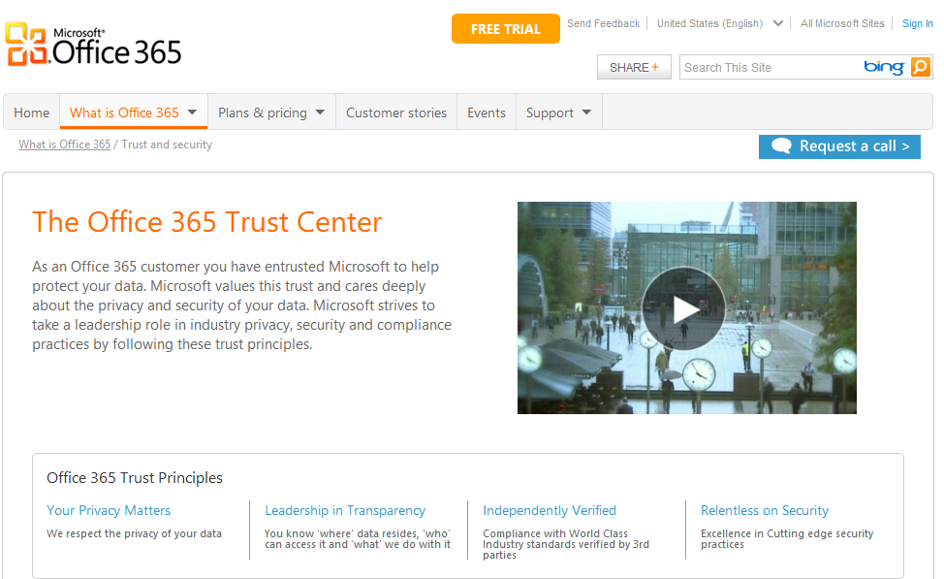
Office 365 Trust Center
http://www.microsoft.com/en-us/office365/trust-center.aspx
Privacy
Transparent
Compliance
Relentless

Slide 12
Defense In Depth
application
data
user
physical
network
host

Slide 13
Defense In Depth
physical
Carrier Class Datacenters
24 x 7 Monitoring
Biometric Access Controls

Slide 14
Defense In Depth
network
Automatic Configuration
VPN Separation
Firewall & Packet Filters

Slide 15
Defense In Depth
host
Hyper-V Isolation
Secure Communications
Reduced OS footprint*

Slide 16
Defense In Depth
application
Trust Level
Automatic Configuration
AV Protection

Slide 17
Defense In Depth
data
SQL Server controls
Storage keys
Trust Services

Slide 18
don’t put keys and data in the same place

Slide 19





Trust Services – define policy
Publisher
Subscriber
_{pub}
_{sub}
Name
SSN
Name
SSN
Name
SSN
Smith, John
123-45-6789
Trust
Services
SDK
SQL Azure
Smith, John
123-45-6789
Trust
Services
SDK
Smith, John
123-45-6789
Data Policy | Authz List | Cert | Key
SSN | pub, sub | Pubsub
 |  | Pubpub
_{admin}
Administrator
Trust Server

Slide 20
Encrypt data
Publisher
Subscriber
_{pub}
_{sub}
Name
SSN
Name
SSN
Name
SSN
Smith, John
123-45-6789
Trust
Services
SDK
SQL Azure
Smith, John
123-45-6789
Trust
Services
SDK
Smith, John
123-45-6789
KGuid
KGuid
K
SSN
E
Data Policy | Authz List | Cert | Key
SSN | pub, sub | Pubsub
 |  | Pubpub
Pubsub
WK
Trust Server

Slide 21
Decrypt data
Privsub
K
Publisher
Subscriber
_{pub}
_{sub}
E
KGuid
Name
SSN
Name
SSN
Name
SSN
Smith, John
123-45-6789
Trust
Services
SDK
SQL Azure
Smith, John
123-45-6789
Trust
Services
SDK
Smith, John
123-45-6789
SSN
Data Policy | Authz List | Cert | Key
SSN | pub, sub | Pubsub
 |  | Pubpub
KGuid
WK
Trust Server

Slide 22
Defense In Depth
user
Access Control
Federation
User Education

Slide 23
Defense In Depth
application
data
user
physical
network
host

Slide 24
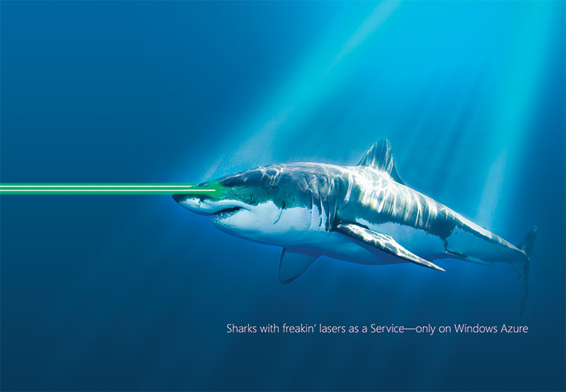


Slide 25
Securing Services

Slide 26
Questions
Does Windows Azure provide the rock-solid security required for the most sensitive data and applications?
How do you ensure privacy of sensitive information?
How do you secure access to applications?
What if you have strict compliance requirements?

Slide 27
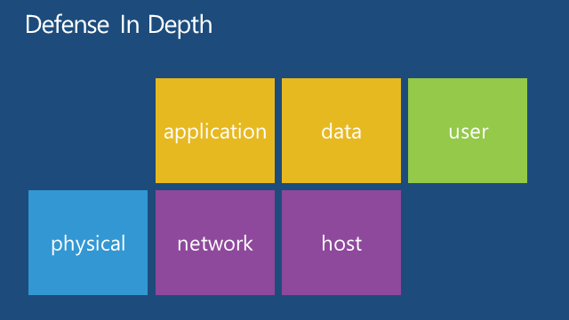
Does Windows Azure provide the rock-solid security required for the most sensitive data and applications?
You Decide

Slide 28
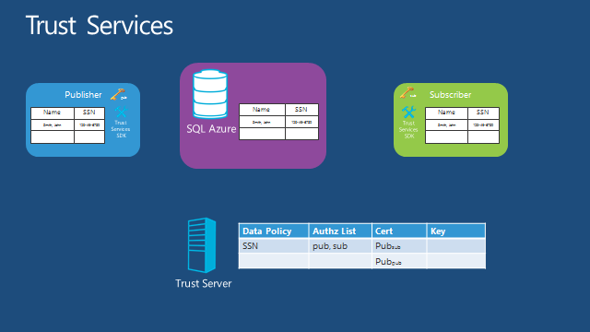
How do you ensure privacy of sensitive information?
Encryption
Key Management
Trust Services

Slide 29
How do you secure access to applications?
Identity
  Integrate with enterprise identity
  Enable single sign-on within your apps
  Enterprise Graph REST API

Slide 30
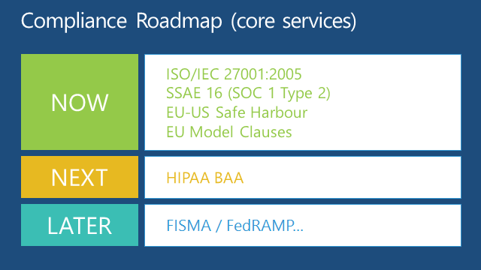
What if you have strict compliance requirements?
Industry standards
Risk
Not everything fits

Slide 31
Summary
Windows Azure gives a Rock Solid Foundation
Responsibilities have changed
Managing Risk
Review the Windows Azure Trust Center
  https://www.windowsazure.com/en-us/support/trust-center/

Slide 32



Related Content
Windows Azure Trust Center
Find Me Later At The Windows Azure Booth

Slide 33


SIA, WSV, and VIR Track Resources
#TE(sessioncode)
Talk to our Experts at the TLC
Hands-On Labs
DOWNLOAD Windows Server 2012 Release Candidate
microsoft.com/windowsserver
DOWNLOAD Windows Azure
Windowsazure.com/
teched

Slide 34



Resources
Learning
  Connect. Share. Discuss.
  Microsoft Certification & Training Resources
http://northamerica.msteched.com
www.microsoft.com/learning
TechNet
  Resources for IT Professionals
  Resources for Developers
http://microsoft.com/technet
http://microsoft.com/msdn

Slide 35





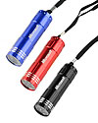

Required Slide
Complete an evaluation on CommNet and enter to win!

Slide 36


MS Tag
Scan the Tag
to evaluate this
session now on
myTechEd Mobile

Slide 37
© 2012 Microsoft Corporation. All rights reserved. Microsoft, Windows, Windows Vista and other product names are or may be registered trademarks and/or trademarks in the U.S. and/or other countries.
The information herein is for informational purposes only and represents the current view of Microsoft Corporation as of the date of this presentation. Because Microsoft must respond to changing market conditions, it should not be interpreted to be a commitment on the
part of Microsoft, and Microsoft cannot guarantee the accuracy of any information provided after the date of this presentation. MICROSOFT MAKES NO WARRANTIES, EXPRESS, IMPLIED OR STATUTORY, AS TO THE INFORMATION IN THIS PRESENTATION.

