Slide 1

10 Deadly Sins of Administrators about Windows Security
SIA300
Paula Januszkiewicz
Penetration Tester, MVP: Enterprise Security, MCT
iDesign - CQURE: paula@idesign.net

Slide 2
Agenda
Introduction
Summary
1
2
3
Top 10 Sins

Slide 3
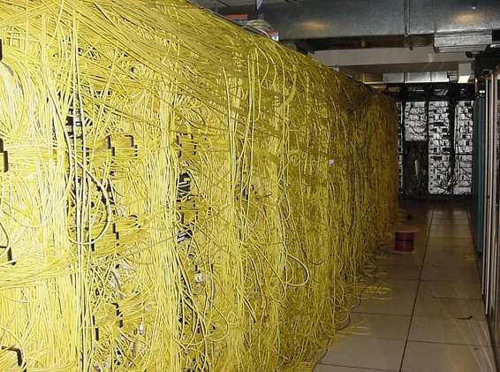

Slide 4
Agenda
Introduction
Summary
1
2
3
Top 10 Sins

Slide 5
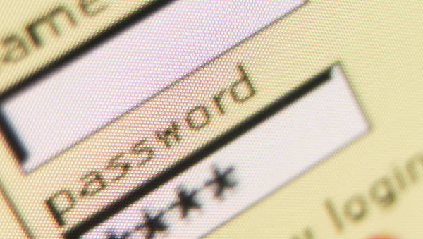
Sin 10:
Misunderstanding
(s)

Slide 6

Sin 10: Misunderstanding Passwords
Will you share your passwords with others?
  We do this every day!
  How do services store passwords?
Passwords are often similar to your other passwords
  At least one of them can be easily accessed by the administrator of the service
Be prepared for password loss and service recovery

Slide 7
Passwords Never Sleep
demo

Slide 8

Sin 9: Ignoring Offline Access
I will get your
pendrive anyway…

Slide 9
Sin 9: Ignoring Offline Access
Offline access allows someone to bypass a system’s security mechanisms
  Useful in critical situations
Almost every object that contains information can be read offline
  It is a minimal privilege for the person with good intentions
  It is a maximum privilege for… everybody else
Simplified offline access is acceptable if you do not value your information

Slide 10
Sophisticated Offline Access
demo

Slide 11

Sin 8: Incorrect Access Control

Slide 12
Sin 8: Incorrect Access Control
Services
When used as a part of software that was not installed in %systemroot% or %programfiles%
Installed in a folder with inappropriate ACLs
Permissions
Should be audited
Should be set up as a part of NTFS, not as a part of shares
BackupRead / BackupWrite
Copy operation that is more important than ACLs
Used by backup software

Slide 13
(Lack of) Permissions in the Operating System
demo

Slide 14
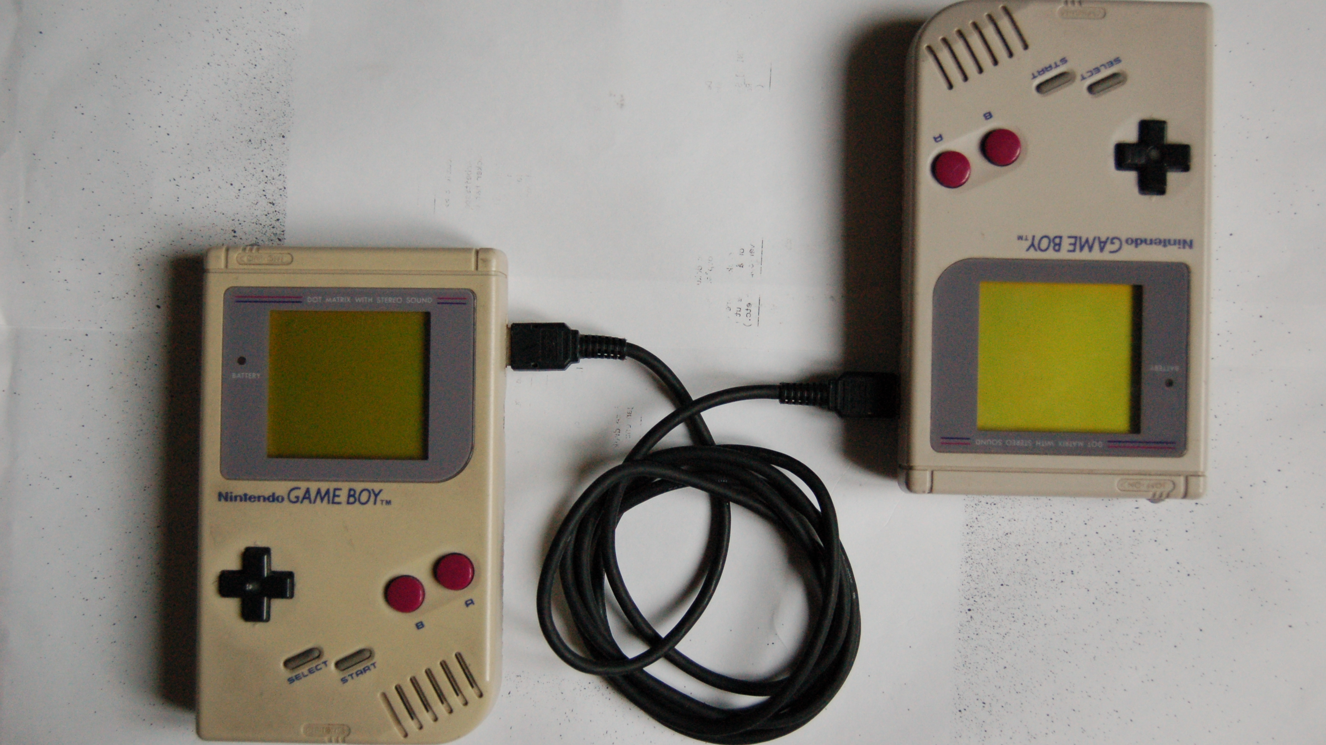
Sin 7: Using Old Technology

Slide 15
Sin 7: Using Old Technology
Hacker’s role here is very valuable
It is hard to be up to date with technology
  But some of the antiques like NT4.0 should be thrown on the scrap heap!
  Perform periodic revisions
Even old technology requires updates
  Sometimes it is not possible (f.e. LNK vulnerability in W2K)

Slide 16
Old Technology a Little Bit Too… Old
demo

Slide 17
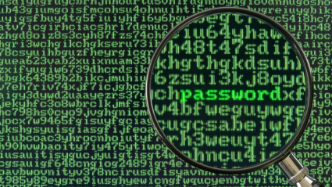
Sin 6: Encryption… What is encryption?

Slide 18
Sin 6: Encryption… What is Encryption?
Data Encryption
  Protects from offline access – stolen laptops, tapes
Transmission Encryption
  Protects from outsiders testing the network sockets
  HTTPS – Man-In-The-Middle
Encryption is problematic for users
  Let’s use the lower layer encryption (BitLocker, IPSec)
New Security Motto: Encrypt when you can!

Slide 19
Easy and Useful Encryption
demo

Slide 20
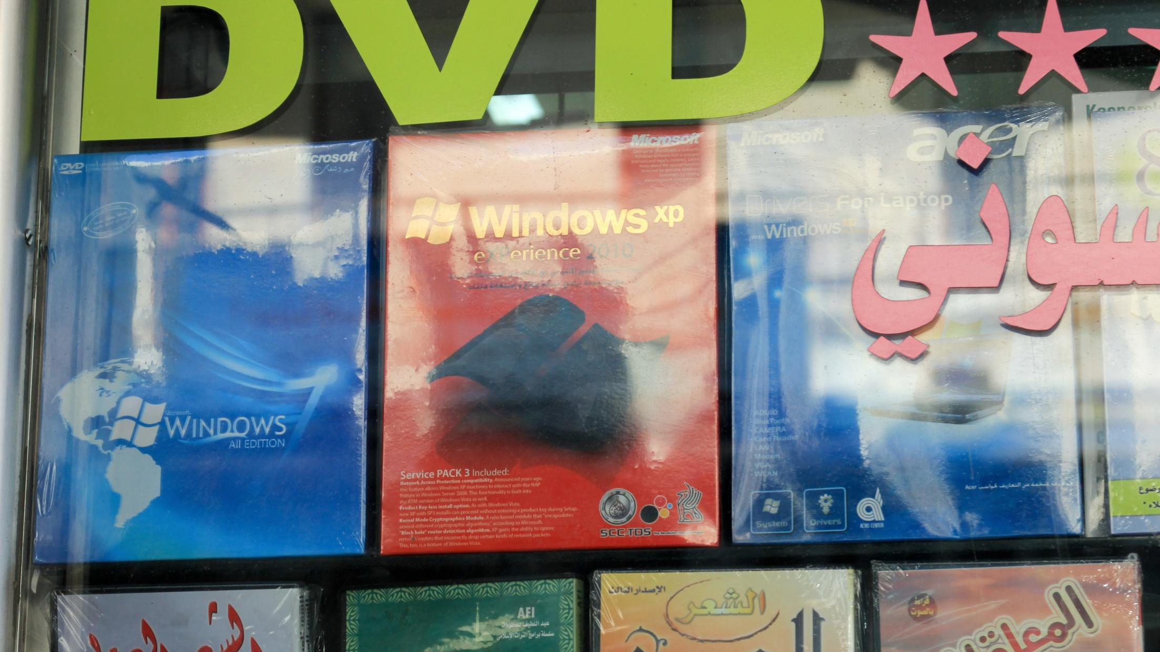
Sin 5: Installing Pirated Software

Slide 21
Sin 5: Installing Pirated Software
& My Small Research
Installation of software is performed on the administrative account
  Malformed installation files are not necessary recognized by antivirus software
  UAC is not the protection method as everybody is used to giving Installer high privileges
Keep your toolbox up to date and keep the checksums in a different place

Slide 22

Do you check for the file’s signatures before installation?
No…
20 of 20 IT admins said:

Slide 23

Do you perform periodic security checks of your folder with installation files?
No?
18 of 20 IT admins said:

Slide 24
Malware Around the Corner
demo

Slide 25
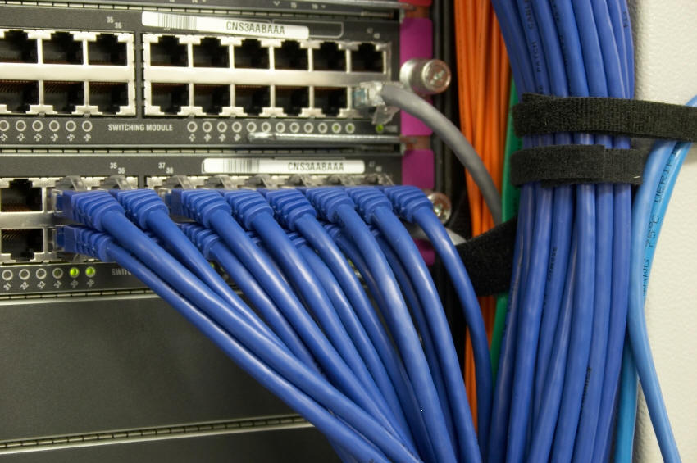
Sin 4: Lack of Network Monitoring

Slide 26
Sin 4: Lack of Network Monitoring
Violation of the one well known rule:
  Do not allow traffic that you do not know
Most of the protocols have space for data
  Why not put the sensitive information there and send it out?
Malicious traffic can be easily connected to the process
  It can happen once a month
  You need context based tools: Network Monitor, Network Miner etc.

Slide 27
Monitoring Network Traffic
demo

Slide 28

Sin 3: What You See Is NOT What You Get

Slide 29
Sin 3: What You See Is NOT What You Get
Explorer.exe is owned by user
Lack of the NTFS permissions does not mean that somebody cannot access the file
Troubleshooting after the injection is difficult
  Rootkits influence the operating system behavior
Conclusion: Always have at least two methods of troubleshooting the same issue

Slide 30
Blinded Operating System
demo

Slide 31
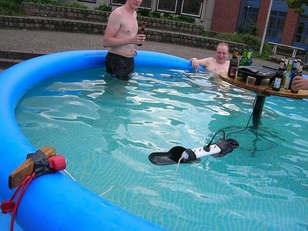
Sin 2: Too Much Trust In People

Slide 32
Sin 2: Too Much Trust in People
The cheapest and most effective attacks are often nontechnical
People tend to take shortcuts
  It is hard to control their intentions
  They should not be a part of a security chain
Monitor them… and show that you’re doing it
Perform periodical audits of your infrastructure

Slide 33
User Becomes Evil
demo

Slide 34

Sin 1: Lack of Documentation

Slide 35
Sin 1: Lack of Documentation & Training
  Is this really the admin’s sin?
  The negative side of this sin is that you need to trust people
  Most companies are not prepared for the IT Staff going on a… vacation
  Set up the rules before creating the solutions

Slide 36
Agenda
Introduction
Summary
1
2
3
Top 10 Sins

Slide 37
10 Deadly Sins
  Sin 10: Misunderstanding Passwords
  Sin 5: Installing Pirated Software
  Sin 9: Ignoring Offline Access
  Sin 4: Lack of Network Monitoring
  Sin 8: Incorrect Access Control
  Sin 3: What You See is NOT What You Get
  Sin 7: Using Old Technology
  Sin 2: Too Much Trust in People
  Sin 6: Encryption… What is encryption?
  Sin 1: Lack of Documentation & Training

Slide 38

Be Proactive!
  Split and rotate tasks between admins
  Use the legal code
  Eliminate at least one of the sins in your organization
  Periodically attend trainings and organize them
  Audit your environment
Source: Heard.TypePad.com

Slide 39


Track Resources
www.microsoft.com/twc
www.microsoft.com/security
www.microsoft.com/privacy
www.microsoft.com/reliability

Slide 40



Resources
Learning
  Connect. Share. Discuss.
  Microsoft Certification & Training Resources
http://northamerica.msteched.com
www.microsoft.com/learning
TechNet
  Resources for IT Professionals
  Resources for Developers
http://microsoft.com/technet
http://microsoft.com/msdn

Slide 41






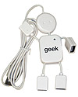
Required Slide
Complete an evaluation on CommNet and enter to win!

Slide 42


MS Tag
Scan the Tag
to evaluate this
session now on
myTechEd Mobile

Slide 43
© 2012 Microsoft Corporation. All rights reserved. Microsoft, Windows, Windows Vista and other product names are or may be registered trademarks and/or trademarks in the U.S. and/or other countries.
The information herein is for informational purposes only and represents the current view of Microsoft Corporation as of the date of this presentation. Because Microsoft must respond to changing market conditions, it should not be interpreted to be a commitment on the
part of Microsoft, and Microsoft cannot guarantee the accuracy of any information provided after the date of this presentation. MICROSOFT MAKES NO WARRANTIES, EXPRESS, IMPLIED OR STATUTORY, AS TO THE INFORMATION IN THIS PRESENTATION.

