Slide 1
Managing and Extending Active Directory Federation Services
SIA318
Brian Puhl
Technology Architect
Microsoft Corporation

Slide 2
Session Objectives
Understand the ADFS authentication process
Identify extensibility and customization areas of ADFS
Leverage the existing ADFS pages to support mobile and strong authentication
Enable rich capabilities to meet your application and business needs

Slide 3


Federated Authentication Flow
Identity Provider
Application Provider
Federation Service
Federation Service
Active
Directory
Application

Slide 4
Federated Authentication Flow
User browses to application
  a. Anonymous landing page or automatic redirect?
Identity Provider
Application Provider
Federation Service
Federation Service
Active
Directory
Application

Slide 5
Federated Authentication Flow
User browses to application
  a. Anonymous landing page or automatic redirect?
Application redirects to federation service
  Home Realm Discovery
Identity Provider
Application Provider
Federation Service
Federation Service
Active
Directory
Application

Slide 6
Federated Authentication Flow
User browses to application
  a. Anonymous landing page or automatic redirect?
Application redirects to federation service
  Home Realm Discovery
Redirects to IdP Federation Service
  Sign-in against AD
Identity Provider
Application Provider
Federation Service
Federation Service
Active
Directory
Application

Slide 7
Federated Authentication Flow
User browses to application
  a. Anonymous landing page or automatic redirect?
Application redirects to federation service
  Home Realm Discovery
Redirects to IdP Federation Service
  Sign-in against AD
Redirects back to Federation services
  Claims provider trust rules
  Relying party rules
Identity Provider
Application Provider
Federation Service
Federation Service
Active
Directory
Application

Slide 8
Federated Authentication Flow
User browses to application
  a. Anonymous landing page or automatic redirect?
Application redirects to federation service
  Home Realm Discovery
Redirects to IdP Federation Service
  Sign-in against AD
Redirects back to Federation services
  Claims provider trust rules
  Relying party rules
Redirects to application
Identity Provider
Application Provider
Federation Service
Federation Service
Active
Directory
Application

Slide 9
Single Instance Federation Flow
User browses to application
  a. Anonymous landing page or automatic redirect?
Federation Service
Application
Active
Directory

Slide 10
Single Instance Federation Flow
User browses to application
  a. Anonymous landing page or automatic redirect?
Application redirects to federation service
  Home Realm Discovery
Federation Service
Application
Active
Directory

Slide 11
Single Instance Federation Flow
User browses to application
  a. Anonymous landing page or automatic redirect?
Application redirects to federation service
  Home Realm Discovery
Redirects to IdP Federation Service
  Sign-in against AD
Federation Service
Application
Active
Directory

Slide 12
Single Instance Federation Flow
User browses to application
  a. Anonymous landing page or automatic redirect?
Application redirects to federation service
  Home Realm Discovery
Redirects to IdP Federation Service
  Sign-in against AD
Redirects back to Federation services
  Claims provider trust rules
  Relying party rules
Federation Service
Application
Active
Directory

Slide 13
Single Instance Federation Flow
User browses to application
  a. Anonymous landing page or automatic redirect?
Application redirects to federation service
  Home Realm Discovery
Redirects to IdP Federation Service
  Sign-in against AD
Redirects back to Federation services
  Claims provider trust rules
  Relying party rules
Redirects to application
Federation Service
Application
Active
Directory

Slide 14
Extensibility Points
Application landing page
Home Realm Discovery
Sign In Page
Relying Party Rulesets

Slide 15


Scenarios for this Discussion
Strong Authentication
Mobile Support
Improved User Experience
  Web.config
  Custom ASP.Net
Home Realm Discovery
  Principles of HRD
  Using WHR parameter
Sign In Page
  Strong authentication and mobile support
Application Experience
Home Realm Discovery
Putting it Together

Slide 16
Scenarios for this Discussion
Strong Authentication
Mobile Support
Improved User Experience
  Web.config
  Custom ASP.Net
Home Realm Discovery
  Principles of HRD
  Using WHR parameter
Sign In Page
  Strong authentication and mobile support
Application Experience
Home Realm Discovery
Putting it Together

Slide 17
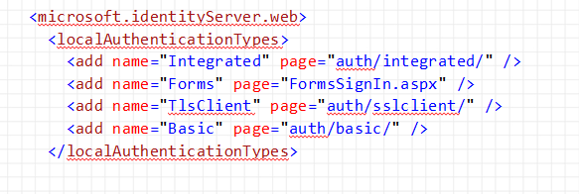
Important Web.Config Settings
The topmost entry in this list is the default authentication type
  Integrated on the internal network
  Forms on the ADFS Proxy servers facing the internet

Slide 18
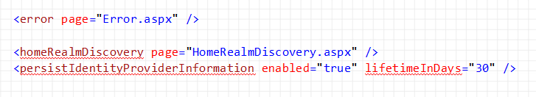
Important Web.Config Settings
The ADFS service can only point to single pages for HomeRealmDiscovery and Error events
Default HRD cookies are enabled, and live for 30 days

Slide 19
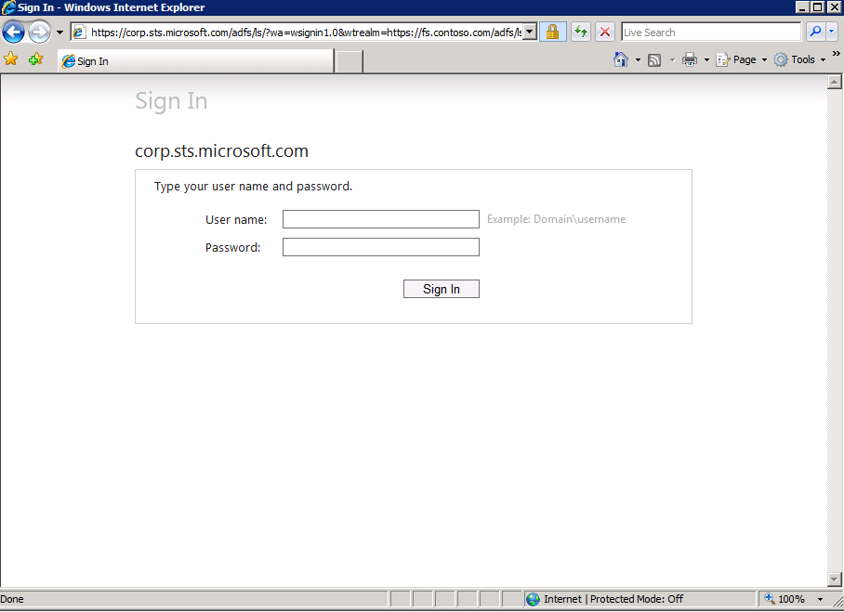
Web.Config Customizations
C:\inetpub\adfs\ls\web.config
Settings apply to all pages
Default ADFS Sign In Page

Slide 20
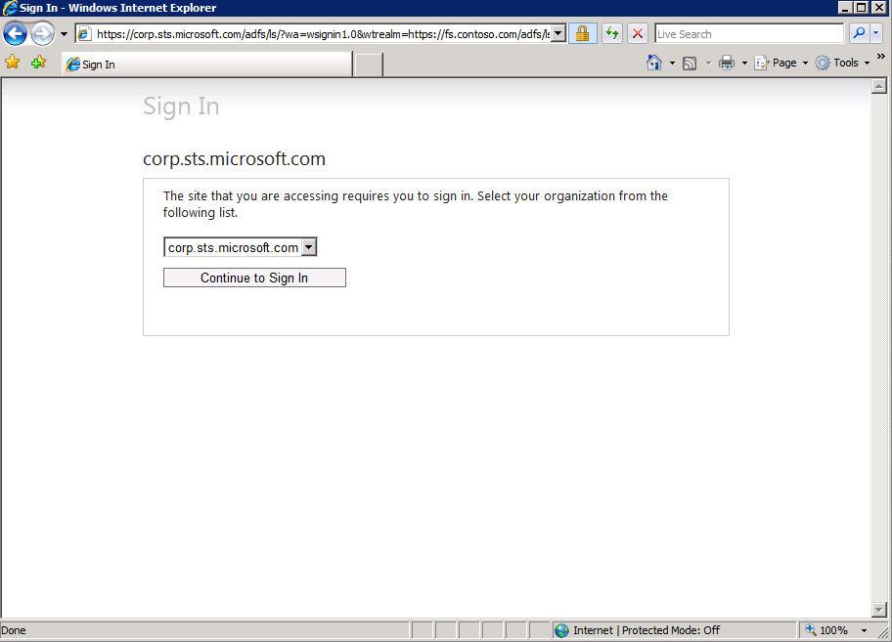
Web.Config Customizations
C:\inetpub\adfs\ls\web.config
Settings apply to all pages
Default Home Realm Discovery Page

Slide 21
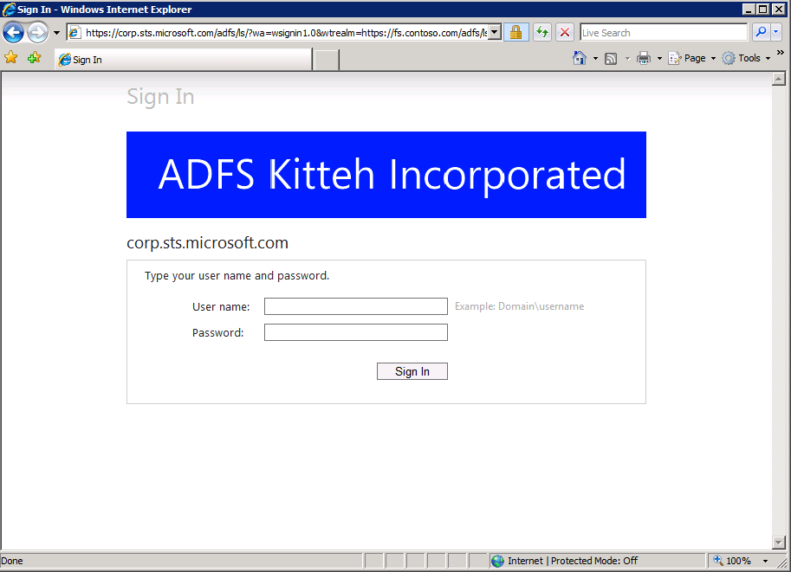


Web.Config Customizations
C:\inetpub\adfs\ls\web.config
Settings apply to all pages
Default ADFS Sign In Page with custom logo

Slide 22
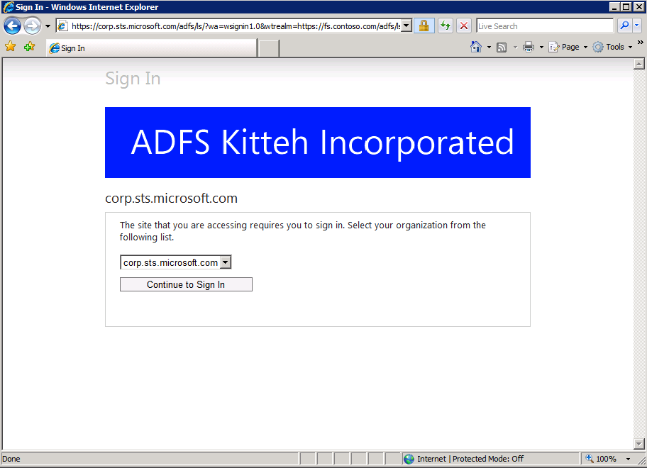
Web.Config Customizations
C:\inetpub\adfs\ls\web.config
Settings apply to all pages
Default Home Realm Discovery Page with custom logo

Slide 23
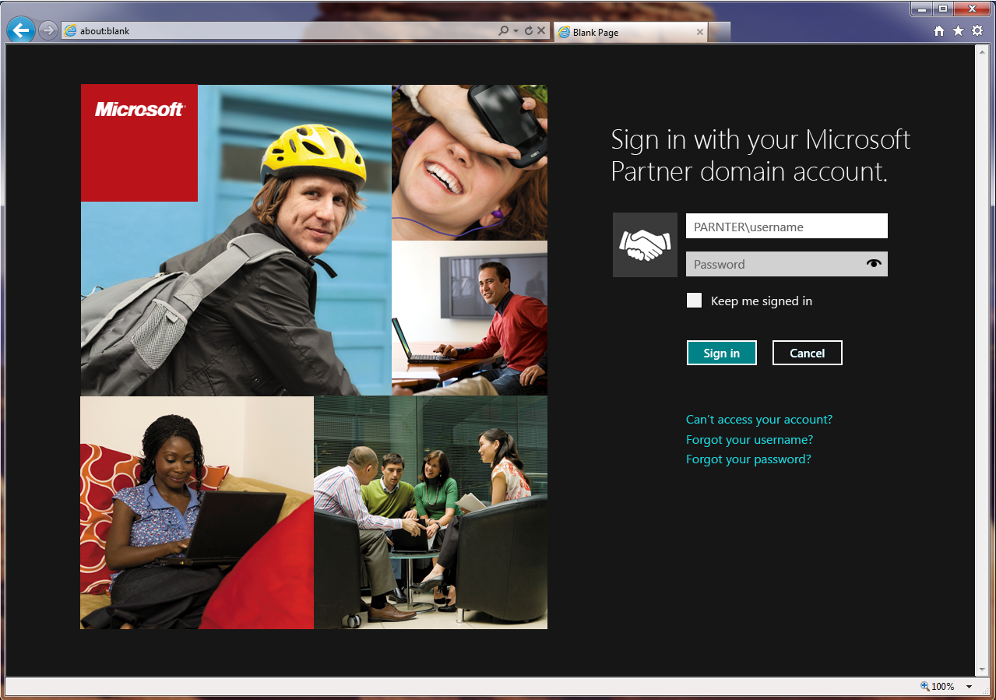
Customizing the ASP.Net Pages
FormSignIn.aspx

Slide 24
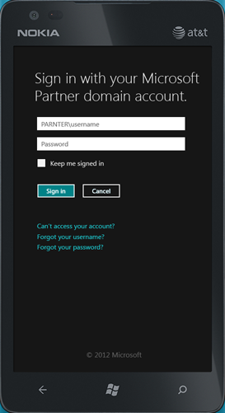
Customizing the ASP.Net Pages
Including mobile detection based on the user agent string and changing the CSS of the page

Slide 25
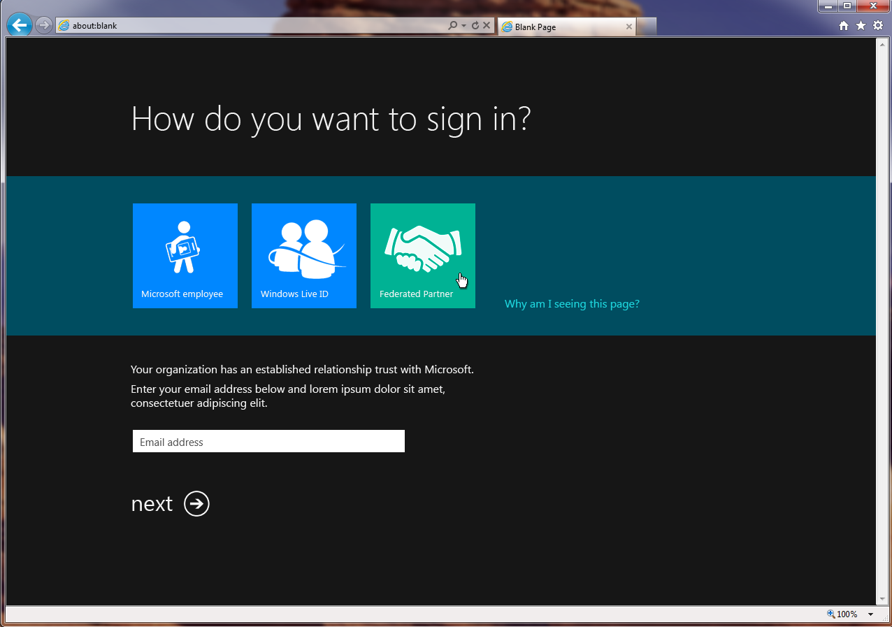
Customizing the ASP.Net Pages
HomeRealmDiscovery.aspx

Slide 26
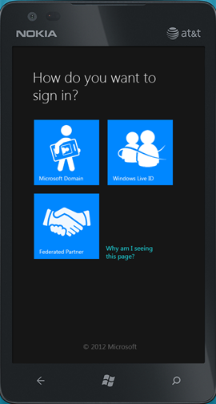
Customizing the ASP.Net Pages
HomeRealmDiscovery.aspx with mobile detection and CSS

Slide 27
The Home Realm Discovery Problems
Application teams want to leverage common infrastructure, so long as they can customize it to fit their exact needs
Requirements from the business owners
  Only show HRD options that a specific application wants
    For example, “only Live ID users can access this application”
  Reduce page loads and click throughs
    Do not render the HRD page unless required
  Provide a predictable user experience
    Always show the same flows, pages, etc…
  Do not let the user know they have left the application
    Look at feel must match the application experience

Slide 28
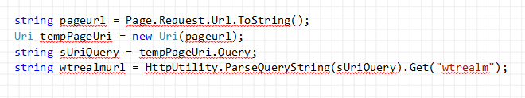
Solution 1: Co-branded HRD
ASP.Net Page: HRD.aspx
When service loads HRD.aspx page, check wtrealm and lookup HRD experience to display

Slide 29
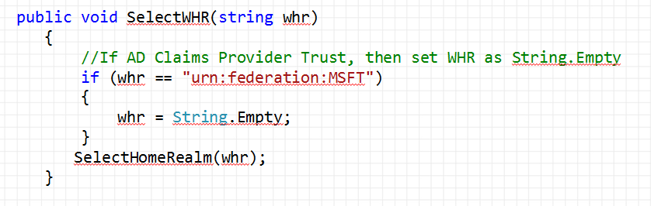
Solution 1: Co-branded HRD
ASP.Net Page: HRD.aspx
For each application which requires, convert their desired page from .aspx to .ascx and load into a full screen panel in the .aspx page
Note the .aspx page needs a selectWHR method calling SelectHomeRealm()
ASP.Net User Control (.ascx)

Slide 30
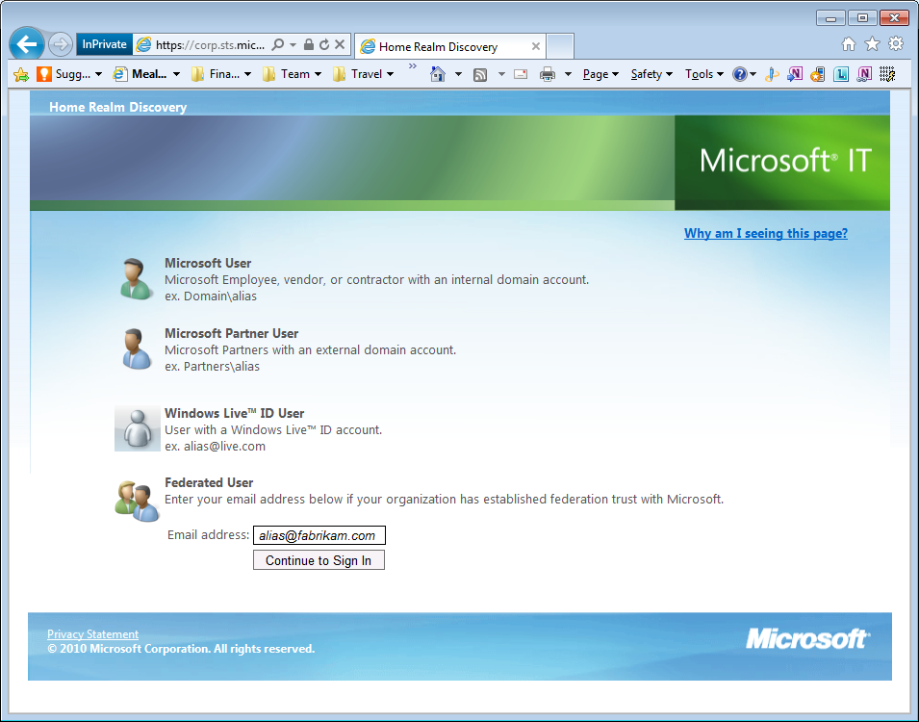
Examples of Co-branded HRD
All of these are loaded as homerealmdiscovery.aspx

Slide 31
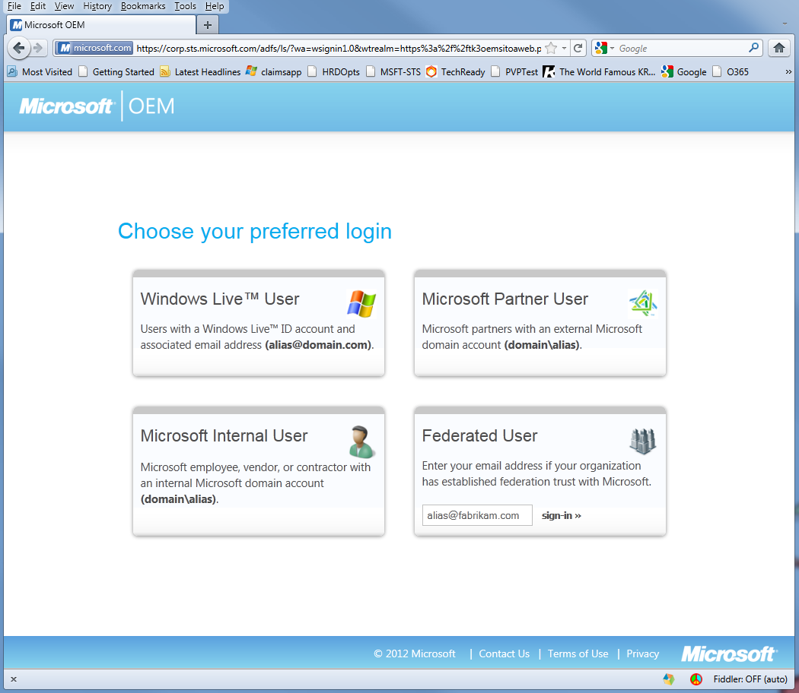
Examples of Co-branded HRD
All of these are loaded as homerealmdiscovery.aspx

Slide 32
Examples of Co-branded HRD
All of these are loaded as homerealmdiscovery.aspx

Slide 33
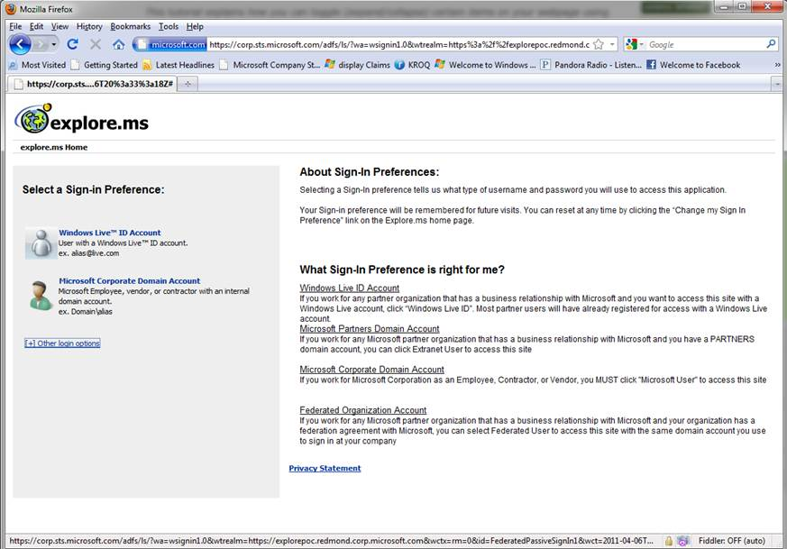
Examples of Co-branded HRD
All of these are loaded as homerealmdiscovery.aspx

Slide 34
Examples of Co-branded HRD
All of these are loaded as homerealmdiscovery.aspx
Note that this team did not want all 4 HRD options to be displayed?
That’s a problem…

Slide 35
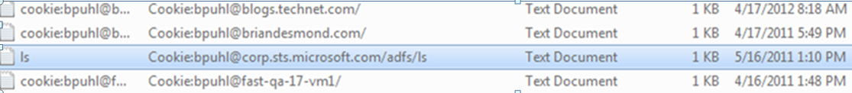
The Next HRD Problem: Cookies

Slide 36
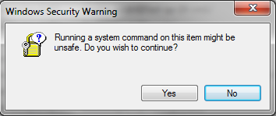
The HRD Cookies

Slide 37
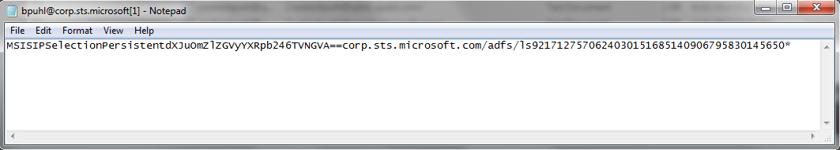
The HRD Cookies

Slide 38
The HRD Cookies
dXJuOmZlZGVyYXRpb246TVNGVA==
Base64 encoded value: urn:federation:MSFT
This is the federation service identifier for the claims provider trust partner that the HRD cookie maps to

Slide 39
Solution 2: WHR and the Application Approach
Summarizing the requirements: Applications want to own the end-to-end experience completely
So let them do it!
May release of ADFS Rollup 2 includes fixes to the cookie behavior and WHR values
The new ADFS approach to HRD:
  We will host our default version, if you want to customize – here are the WHR parameters you need

Slide 40
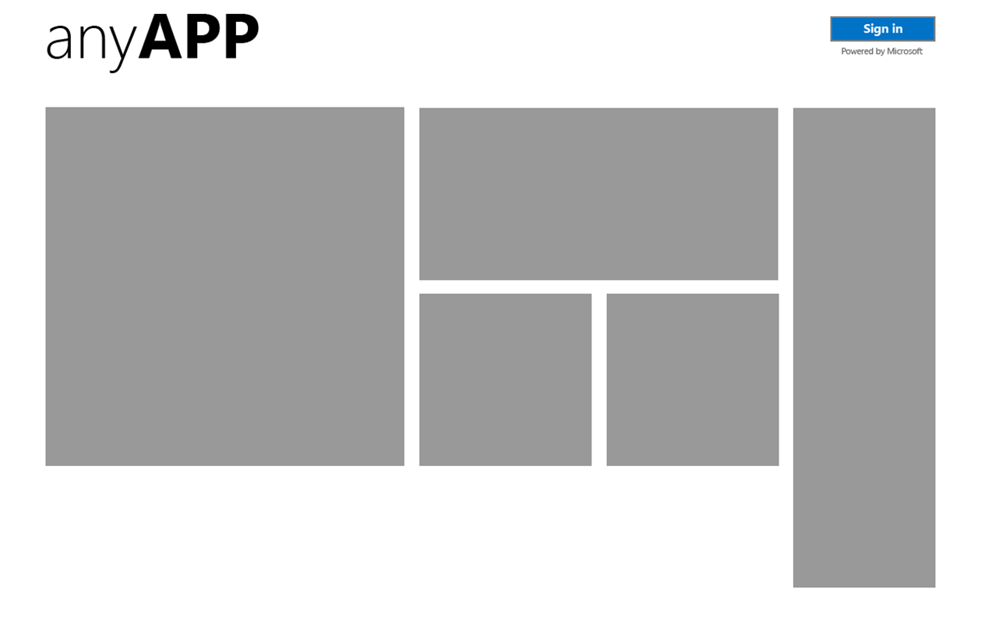
Solution 2: WHR and the Application Approach

Slide 41
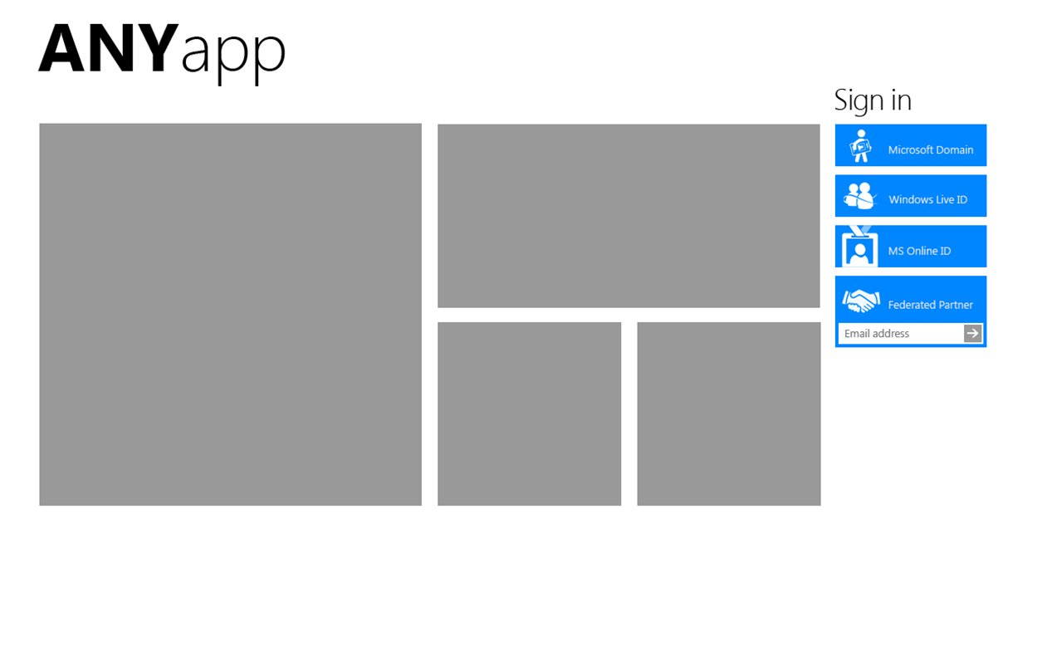
Solution 2: WHR and the Application Approach

Slide 42
WHR, WTRealm – Then Wauth???
WTREALM – The identifier of the relying party
  Use as the configuration key for application specific behaviors
WHR – The identifier of the claims provider
  Use as the configuration key for user type specific behavior
Doesn’t it make sense to use WAUTH the same way?
Yes….and no…
WAUTH parameter let’s an application specify
basic, integrated, forms, or client cert authentication

Slide 43
Using WAUTH to enable Mobile Devices
Mobile applications, or supporting platforms which are internal to your network but cannot do Windows Integrated Authentication
  Configure the web.config file of the application as follows to require forms based authentication

Slide 44
Enabling 2FA for ADFS using Smartcards
Solution Approach
  Map security group SID to OID in smartcard template
    This is the Authentication Assurance feature in Active Directory
  Include option for smartcard logon on default sign-in page
  Add Relying Party Authorization Rules to look for the SID
    Combine with Client Access Policy rules from ADFS October 2011 rollup 1
  Customize the error.aspx page to allow step-up authentication
    Limitation – requires that smartcard is the only RP authorization policy which can result in a Deny Rule

Slide 45
Why Not Just Have Apps Use WAUTH for 2FA?

Slide 46

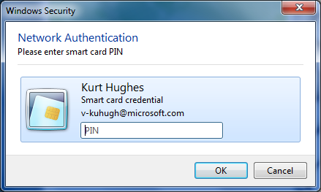
Why Not Just Have Apps Use WAUTH for 2FA?
The default IE user experience does not render anything in the browser behind the credential pop-up

Slide 47
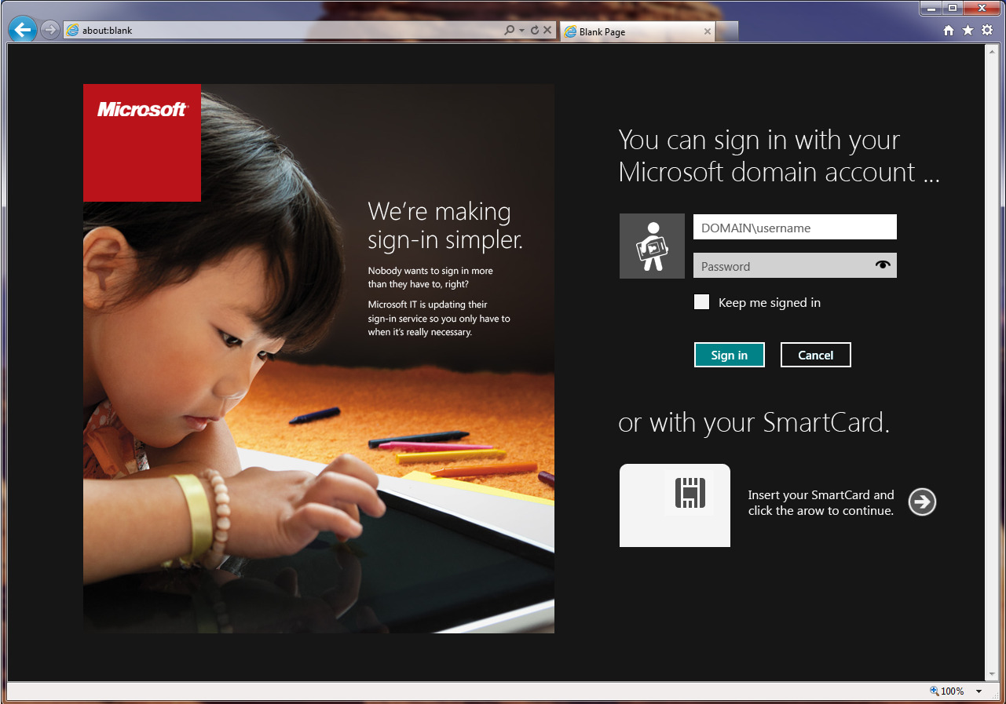
Smartcard and Step-up Authentication
Forms Sign-in page extended with smartcard login option

Slide 48
Smartcard and Step-up Authentication
If user was already signed in using password or is internal and was integrated auth with password only, then RP authorization rule throws error.aspx with access denied message

Slide 49
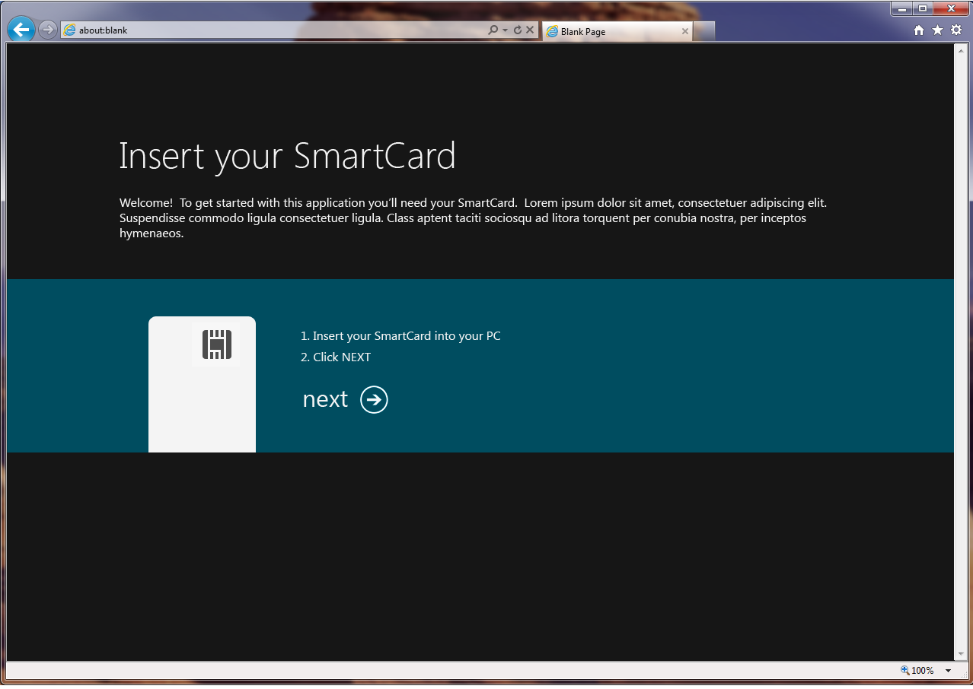
Smartcard and Step-up Authentication
The error.aspx page has
2 distinct code paths forked on “Access Denied” string
If wtrealm has a 2FA policy, and error is access denied, then present with step-up authentication
The behavior here is
that the user is actually signed-out, and the “next” button requests sign-in with client cert wauth parameter

Slide 50
Smartcard and Step-up Authentication
The error.aspx page has
2 distinct codepaths in the single page
If wtrealm has a 2FA policy, and error is
access denied, then present with step-up authentication
The behavior here is that the user is actually signed-out, and the “next” button requests sign-in with client cert wauth parameter

Slide 51
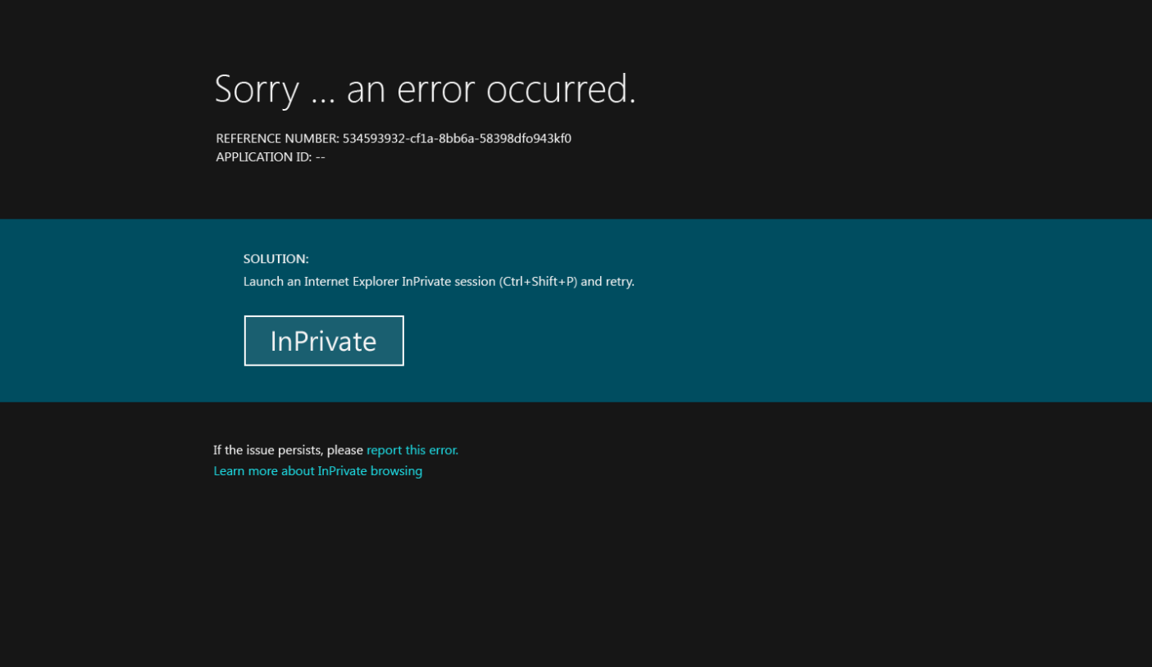
Smartcard and Step-up Authentication
The error.aspx page has
2 distinct codepaths in the single page
If the wtrealm does
not require 2FA, or the error is not access denied, then this is a general error

Slide 52
Summary
Leverage CSS and ASP.NET to deliver rich mobile experiences
Use the error.aspx page, with ADFS authorization rules and PKI to deliver strong authentication
Home Realm Discovery is best left to the applications, but remember WTREALM and co-branding techniques
It IS ABSOLUTELY POSSIBLE to meet the needs of finicky business and application teams and get the security of common authentication infrastructure with ADFS 2.0
Strong Authentication
Mobile Support
Home Realm Discovery
Putting it Together

Slide 53


SIA, WSV, and VIR Track Resources
#TE(sessioncode)
Talk to our Experts at the TLC
Hands-On Labs
DOWNLOAD Windows Server 2012 Release Candidate
microsoft.com/windowsserver
DOWNLOAD Windows Azure
Windowsazure.com/
teched

Slide 54




Resources
Learning
  Connect. Share. Discuss.
  Microsoft Certification & Training Resources
http://northamerica.msteched.com
www.microsoft.com/learning
TechNet
  Resources for IT Professionals
  Resources for Developers
http://microsoft.com/technet
http://microsoft.com/msdn

Slide 55







Required Slide
Complete an evaluation on CommNet and enter to win!

Slide 56





Please Complete an Evaluation
Your feedback is important!
Be eligible
to win great daily prizes and the grand prize of a $5,000 Travel Voucher!
Multiple
ways to Evaluate Sessions
Scan the Tag
to evaluate this
session now
on myTechEd Mobile

Slide 57
© 2012 Microsoft Corporation. All rights reserved. Microsoft, Windows, Windows Vista and other product names are or may be registered trademarks and/or trademarks in the U.S. and/or other countries.
The information herein is for informational purposes only and represents the current view of Microsoft Corporation as of the date of this presentation. Because Microsoft must respond to changing market conditions, it should not be interpreted to be a commitment on the
part of Microsoft, and Microsoft cannot guarantee the accuracy of any information provided after the date of this presentation. MICROSOFT MAKES NO WARRANTIES, EXPRESS, IMPLIED OR STATUTORY, AS TO THE INFORMATION IN THIS PRESENTATION.

