Slide 1
An Overview of Hyper-V Networking
VIR303
See-Mong Tan
Microsoft Corporation

Slide 2
Session Objectives and Takeaways
Session Objective(s):
  Understand the key needs in cloud networks
  Understand the networking habits of highly successful clouds
  Understand the value of Hyper-V Networking in building clouds
Key Takeaways
  Hyper-V Networking is engineered for the networking habits of highly successful clouds
  Hyper-V Network Virtualization revolutionizes the multi-tenant cloud network
  Hyper-V Extensible Switch opens the platform to a rich set of networking partners

Slide 3




Windows Server 2012
Cloud Optimize Your IT
Beyond
Virtualization
Windows Server 2012 offers a dynamic, multi-tenant infrastructure that goes beyond virtualization to provide maximum flexibility for delivering and connecting to cloud services.
The Power of Many Servers, the Simplicity of One
Windows Server 2012 offers excellent economics by integrating a highly available and easy to manage multi-server platform with breakthrough efficiency and ubiquitous automation.
Every App,
Any Cloud
Windows Server 2012 is a broad, scalable and elastic server platform that gives you the flexibility to build and deploy applications and websites on-premises, in the cloud and in a hybrid environment, using a consistent set of tools and frameworks.
Modern Workstyle, Enabled
Windows Server 2012 empowers IT to provide users with flexible access to data and applications from virtually anywhere on any device with a rich user experience, while simplifying management and helping maintain security, control and compliance.

Slide 4

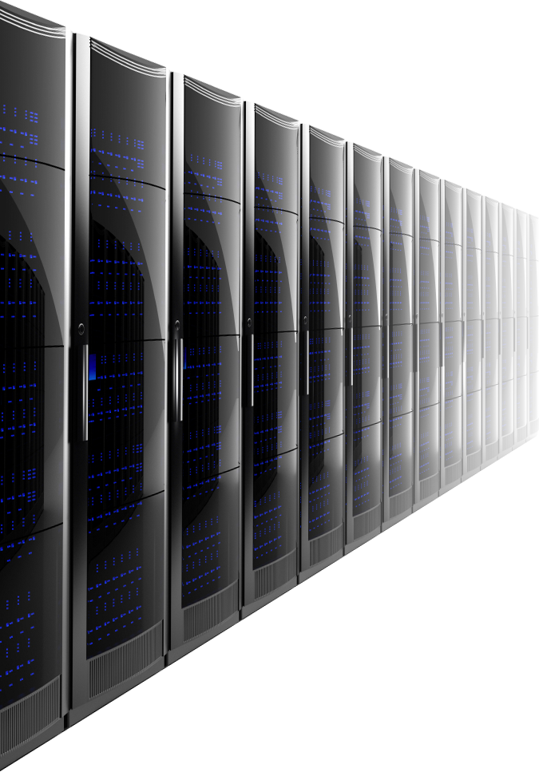


Evolution of Clouds
Cloud
Public
Private
Hybrid
Traditional
Datacenters with Dedicated Servers
Server Virtualization in Datacenters
Servers
Infrastructure Optimization
Cost
Flexibility

Slide 5
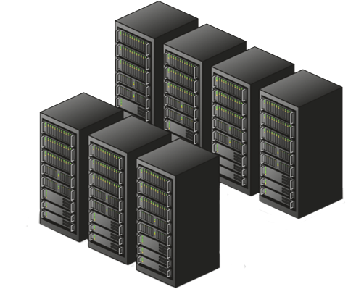



Multi-tenant Clouds
Data Center
Tenant 1: Multiple VM Workloads
Tenant 2: Multiple VM Workloads
Windows Server 2012 is optimized to host multi-tenant workloads in private, public and hybrid clouds.

Slide 6
Reliability
Data Center
Tenant 1: Multiple VM Workloads
Tenant 2: Multiple VM Workloads
Even when hardware fails…
… customers want continuous availability.

Slide 7

Security
Data Center
Tenant 1: Multiple VM Workloads
Tenant 2: Multiple VM Workloads
In a multi-tenant environment…
… customers want security and isolation

Slide 8
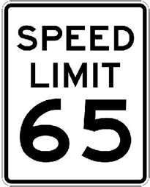
Predictability
Data Center
Tenant 1: Multiple VM Workloads
Tenant 2: Multiple VM Workloads
Even when multiple VMs are competing for bandwidth…
… customers want predictability

Slide 9



Scalability
Data Center
Tenant 1: Multiple VM Workloads
Tenant 2: Multiple VM Workloads
Cloud admins want scalability
…and customers want performance

Slide 10

Extensibility
Data Center
Tenant 1: Multiple VM Workloads
Tenant 2: Multiple VM Workloads
Customers want specialized functionality with lots of choice…
… for firewalls, monitoring and physical fabric integration

Slide 11
WS2012 is designed for the cloud
Manageability
Reliability
Extensibility
Scalability
Security
Predictability
Connectivity

Slide 12
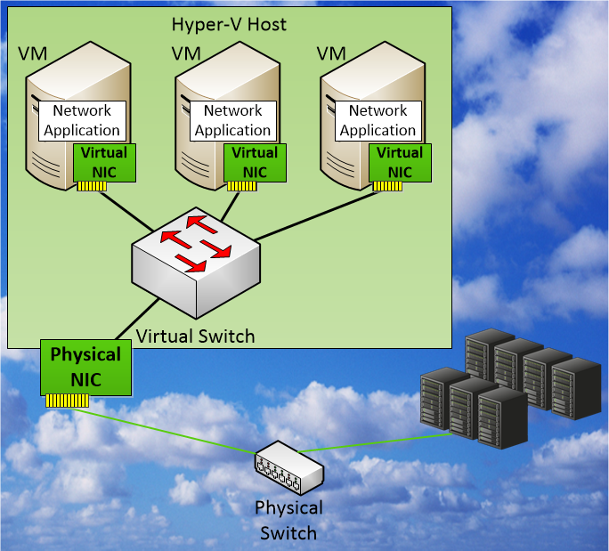
Hyper-V Switch
Network traffic between Virtual Machines,
the external network, and
the Host OS is handled by
the Hyper-V Virtual Switch

Slide 13
Manageability
Reliability
Extensibility
Scalability
Security
Predictability
Connectivity

Slide 14
Windows Server 2012 NIC teaming provides reliability against hardware failures

Slide 15
NIC Teaming
Hyper-V Extensible Switch
LBFO Admin GUI
LBFO Provider
Frame distribution/aggregation
Failure detection
Control protocol implementation
WMI
LBFO Configuration DLL
IOCTL
Virtual miniport 1
Port 1
Port 2
Port 3
IM Mux
Protocol edge
User mode
Kernel mode
Vendor agnostic
Multiple modes: switch dependent and switch independent
Hashing modes: port and 4-tuple
Active active and active standby
NIC 1
NIC 2
NIC 3
Network switch

Slide 16
A Common Hyper-V Config with Teaming
Management OS
VM 1
VM n
Live Migration
Hyper-V virtual switch
Storage
Management
LBFO Teamed NIC
10 GbE Phy NIC
10 GbE Phy NIC
Target Use
75% of servers use NIC teaming today with 3rd party solutions.

Slide 17
Manageability
Reliability
Extensibility
Scalability
Security
Predictability
Connectivity

Slide 18
Windows Server 2012 provides security features required to host multi-tenant workloads in a hybrid cloud

Slide 19

Port ACL
Allow/Deny/Counter
MAC, IPv4, or IPv6 addresses
Wildcards allowed in IP addresses
ACLs are the basic building blocks of virtual switch security functions
Counters are also implemented as ACLs
  Counts packets to address/range
  Read via WMI/PowerShell (not perfmon)

Slide 20
IPsec Task Offload v2 (IPsecTOv2) for VMs
IPsec is the cornerstone of security in Windows networking
Compliance (SOX, HIPPA, etc.)
IPsec is a CPU intensive workload
IPsecTOv2 now extended to VMs
  Managed by the Hyper-V switch
Target Use
Enterprise customer worried about e2e security, possibly migrating to the cloud.

Slide 21

Hyper-V Network Virtualization
Blue VM
Red VM
Blue network
Red network
Virtualization
Physical
server
Physical
network
Server virtualization
  Run multiple virtual servers
  on a physical server
  Each VM has illusion it is running as a physical server
Hyper-V Network Virtualization
  Run multiple virtual networks on a physical network
  Each virtual network has illusion it is running as a physical network

Slide 22
Cross Subnet Live Migration with Hyper-V Network Virtualization
demo

Slide 23
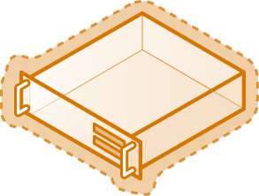
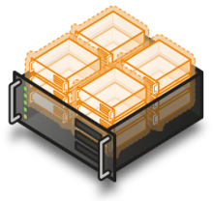

How NV works: NVGRE encap
GRE Wrapper
SRC: PA1 IP
DST: PA2 IP
Virtual Subnet: Red
SRC: CA1 IP
DST: CA2 IP
001010101100101001010101010101001010101010101101010111010101010101010101010101010100110001111101010101010
SRC: CA1 IP
DST: CA2 IP
CA1
CA2
SRC: CA1 IP
DST: CA2 IP
PA1
CA1=PA1
CA2=PA2
PA2
001010101100101001010101010101001010101010101101010111010101010101010101010101010100110001111101010101010
001010101100101001010101010101001010101010101101010111010101010101010101010101010100110001111101010101010
Site A
Site B

Slide 24
Why Network Virtualization
Target Use
Enterprise customers seeking to build private clouds. Hosters seeking flexibility in their public clouds.
Value Proposition
For the tenant: Bring your own IP. For the hoster/admin: Unparalleled flexibility Place VMs anywhere. Live migrate across subnets. Deploy today on existing networks.

Slide 25
Other Features
PVLAN
  Great for web hosters that just want VMs to talk on an uplink only
DHCP Guard
  Prevents unauthorized VMs from acting as DHCP servers

Slide 26
Manageability
Reliability
Extensibility
Scalability
Security
Predictability
Connectivity

Slide 27
Windows Server 2012 QoS provides predictable performance in a multi-tenant environment

Slide 28
Hyper-V QoS
Management OS
VM 1
VM n
Live Migration
Hyper-V virtual switch
Storage
Management
LBFO Team NIC
Phy NIC
Phy NIC
Maximum and Minimum
Target Use
Ensuring workloads have fair sharing, e.g. equal weights between VMs

Slide 29
QOS Maximum Bandwidth
demo

Slide 30
Default Flow per Virtual Switch
Customers may group a number of VMs that each don’t have minimum bandwidth. They will be bucketized into a default flow, which has minimum weight allocation. This is to prevent starvation.
VM1
VM2
Gold Tenant
?
?
10
Hyper-V Extensible Switch
1 Gbps

Slide 31
Maximum Bandwidth for Tenants
One common customer pain point is WAN links are expensive
Cap VM throughput to the Internet to avoid bill shock
Unified Remote Access Gateway
<100Mb
∞
Hyper-V Extensible Switch
Internet
Intranet

Slide 32
Data Center Bridging on Windows Server 2012
Windows Server 2012
QoS
Application
Application
Application
Application
PowerShell
WMI
Winsock
File I/O API
Traffic Classification
Windows Network Stack
Windows Storage Stack
Up to 8 classes
kRDMA
DCB
LAN Miniport

Slide 33
Manageability
Reliability
Extensibility
Scalability
Security
Predictability
Connectivity

Slide 34
Windows Server 2012 performance features enable efficient hybrid cloud operations

Slide 35
Single root I/O Virtualization
For virtual networking the Holy Grail is near-native-I/O
SR-IOV is direct device assignment to VMs
SR-IOV reduces CPU, reduces latency, and increases network throughput
Requirements:
  Chipset:
    Interrupt and DMA remapping: VT-d2 or IOMMU
      Access Control Services (ACS) on PCIe root ports
      Alternative Routing-ID Interpretation (ARI)
  CPU: Hardware virtualization, EPT or NPT
  BIOS

Slide 36
SR-IOV
Host
Host
Root Partition
Virtual Machine
Root Partition
Virtual Machine
Hyper-V Switch
Virtual NIC
Hyper-V Switch
Virtual Function
Routing
VLAN Filtering
Data Copy
VMBUS
Routing
VLAN Filtering
Data Copy
Physical NIC
SR-IOV Physical NIC
Network I/O path without SRIOV
Network I/O path with SRIOV
SR-IOV bypasses the virtual switch
Setting port policies will revoke VM’s IOV
Target Use
IT admins with high demand workloads

Slide 37
SRIOV and LBFO
Host
Virtual Machine
TCP/IP
NIC Team
Virtual Function
Virtual Function
SR-IOV Physical NIC
SR-IOV Physical NIC
SRIOV virtual functions can be teamed in Win 8 VMs

Slide 38
Live Migration with SR-IOV
video
Performance + Flexibility

Slide 39
Dynamic Virtual Machine Queue
Root Partition
Root Partition
Root Partition
Root Partition
CPU
0
CPU
1
CPU
3
CPU
0
CPU
1
CPU
3
CPU
0
CPU
1
CPU
3
CPU
2
CPU
2
CPU
0
CPU
1
CPU
2
CPU
3
CPU
2
Physical NIC
Physical NIC
Physical NIC
Physical NIC
No VMQ
Static VMQ
Windows Server 8 Dynamic VMQ
D-VMQ is adaptive network processing across CPU to provide optimal power and performance for changing workloads
Target Customer
Always advise customers to turn VMQ on.

Slide 40
Datacenter TCP (DCTCP)
Windows Server 2012 addresses congestion in the network by reacting to degree of congestion, not presence of congestion
Goal: Low latency, high burst tolerance, and high throughput, with shallow buffered switches
Requires ECN (RFC 3168) capable switches

Slide 41
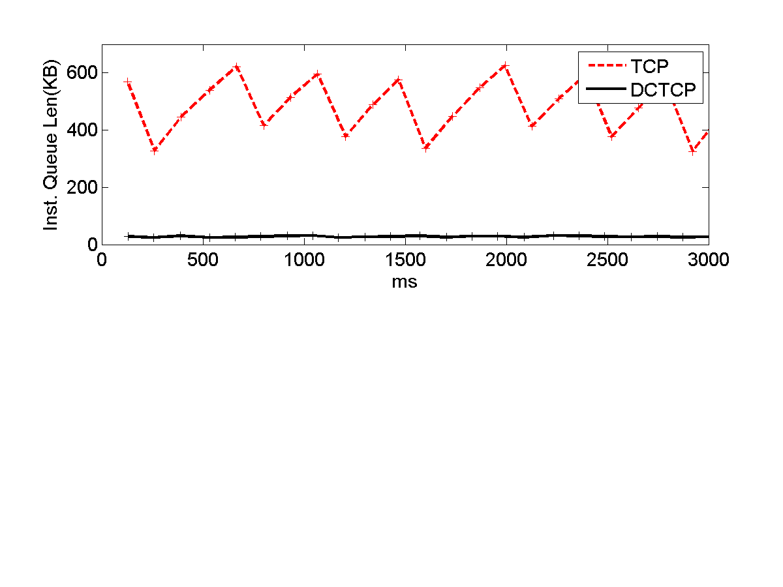
DCTCP Needs Less Buffer Memory than TCP
1 Gbps flow controlled by TCP
  Requires 400 to 600 KB of memory
  TCP sawtooth visible
1 Gbps flow controlled by DCTCP
  Requires 30KB of memory
  Smooth

Slide 42
Datacenter TCP (DCTCP)
When do you need this? | Customers that have large amounts of data flowing east/west within their data center.
How available is the hardware? | ECN (RFC 3168) capable switches include Blade Networks: G8264 (64x10g box), G8052 (48x1g + 4x10g box) Cisco: Quicksilver (N3064), Quickcopper (N3048)
How do I manage it? | Always on, self-activating based on RTT of TCP packets. No management needed. Get-NetTcpConnection will indicate whether DCTCP (Datacenter Connectivity) is being used.
What features are compatible with DCTCP in Windows Server 2012? | All features in Windows Server 2012 are compatible with DCTCP.

Slide 43
Manageability
Reliability
Extensibility
Scalability
Security
Predictability
Connectivity

Slide 44
Windows Server 2012 allows partners to extend Hyper-V Switch

Slide 45
Hyper-V Extensible Switch
Virtual Machine
Virtual Machine
Root Partition
VM NIC
Host NIC
VM NIC
Hyper-V Switch
Extension Protocol
Capture Extensions
Certified
Extensions
WFP Extensions
Filtering Extensions
Forwarding Extension
Extension Miniport
Physical NIC

Slide 46



Partners and Their Extensions
sFlow traffic (capture)
Virtual Firewall v3.0 (filtering)
Nexus 1000V (forwarding)
UCS (forwarding w/SR-IOV)
OpenFlow (forwarding)

Slide 47
Key Tenets for Hyper-V Extensible Switch
Key Tenets | Benefit
Extensible, not replaceable | Added features don’t remove other features
Pluggable switch | Extensions process all network traffic, including VM-to-VM
1st class citizen of system | Live Migration and offloads just work; Extensions work together
Open & public API model | Large ecosystem of extensions
Logo certification and rich OS framework | High quality extensions
Unified Tracing thru virtual switch | Shorter down times
Target Use
Customers who want to integrate Hyper-V deployments with networking management, e.g. enterprises with Cisco Nexus switches can integrate with Nexus 1000v. Customers who want to deploy virtual firewall appliances .

Slide 48
Manageability
Reliability
Extensibility
Scalability
Security
Predictability
Connectivity

Slide 49






Connectivity to hybrid cloud
Current state
Unified
Private cloud
Internet
DirectAccess & VPN: Connecting remote clients to the hybrid cloud for
- Managed
- Unmanaged
Remote access: Connectivity using dedicated infrastructure
Public cloud
Site to Site connectivity using dedicated infrastructure
Cross premise connectivity: Connecting private and public clouds
Unified remote access
Remote access
E2E Security w/IPsec
Site-Site connection

Slide 50
Manageability
Reliability
Extensibility
Scalability
Security
Predictability
Connectivity

Slide 51
The management capabilities in Windows Server 2012 allows cloud admins to manage large scale hybrid clouds

Slide 52
Hyper-V Metering
Built-in metering capabilities allows cloud admins to build chargeback models based on network usage

Slide 53
Hyper-V Metering and Live Migration
Virtual Machine
Configuration
Usage Data
Host 1
Host 2
Extensible Switch
Extensible Switch
Extension Protocol
Extension Protocol
Extension
Extension
Extension Miniport
Extension Miniport
Metering configuration and usage data is preserved across live migration
Target Use
Cloud admins that chargeback or showback customers based on usage

Slide 54
What is IP Address Management?
DHCP and DNS are core to providing network connectivity in enterprises and data centers
Essential operational activities related to address management are built around these
IPAM refers to tools for performing these tasks, with DDI referring to the integrated solution
IP Address Planning
DHCP/ DNS
Trouble-shooting & Audit
Static & Dynamic IP Address Allocation
/
IPAM
IP Address Usage tracking

Slide 55
WS 2012 IPAM – Functionality Overview
Automatic discovery of DC, DHCP and DNS servers, and dynamic IP addresses in use
Network discovery
.
Address space management
(ASM)
Organize, assign, monitor and manage static and dynamic IPv4/v6 addresses
Windows Server 8 - IPAM
.
Multi-server management
(MSM)
Centralized configuration and update of MS DHCP/DNS servers
Visibility & audit
Track and audit changes and provide real-time view of status

Slide 56
Other Features
PowerShell
Unified Tracing
Port Mirroring

Slide 57
WS2012 is designed for the cloud
Manageability
Reliability
Extensibility
Scalability
Security
Predictability
Connectivity

Slide 58



Related Content
VIR307 – Hyper-V Extensible Switch
VIR305 – Hyper-V Network Virtualization for Scalable Multi-Tenancy in Windows
MGT315 - Network Management in Microsoft System Center 2012 SP1
WSV314 – Windows Server 2012 NIC Teaming and Multichannel Solutions
WSV302 – Windows Server 2012 DirectAccess: How to quickly and easily deploy
Visit networking partners in the TechEd Partner Pavilion booths

Slide 59
Backup

Slide 60
PowerPoint Guidelines
Font, size, and color for text have been formatted for you in the Slide Master
This template uses Segoe UI a standard font included in Office 2007, Office 2010, Windows Vista and Windows 7
Use the color palette shown below
Sample Fill
Sample Fill
Sample Fill
Sample Fill
Sample Fill
Sample Fill
Sample Fill
Sample Fill

Slide 61

PowerPoint Template
Subtitle color
Example of a slide with a subhead
  Set subheads in “Sentence case”
  Generally set subhead to 36pt or smaller so it will fit on a single line
  The subhead color is defined for this template but must be selected; In PowerPoint 2007/2010, it is the fourth font color from the left
Hyperlink color: www.microsoft.com

Slide 62
Icons
notebook,
learning
mouse
learn, ideas
file, paper
share, concepts
share,
speech bubble
play, fun,
entertainment
share,
speech bubble
thought bubble
coffee,
work, office
computer monitor
luggage, travel
badge, registration
global, location
the cloud
search, learning
airplane, travel
this way,
look here
decorative arrow
this way, arrow
Birds of a feather
finance, calculator
this way, arrow
hands-on labs
twitter
this way, connect

Slide 63
Icons Reversed
notebook,
learning
mouse
learn, ideas
file, paper
share, concepts
share,
speech bubble
play, fun,
entertainment
share,
speech bubble
thought bubble
coffee,
work, office
computer monitor
luggage, travel
badge, registration
global, location
the cloud
search, learning
airplane, travel
this way,
look here
decorative arrow
this way, arrow
Birds of a feather
finance, calculator
this way, arrow
hands-on labs
twitter
this way, connect

Slide 64
Chart Example

Slide 65

Slide for Showing Developer’s Software Code
Use this layout to show software code
  The font is Consolas, a monospace font
  The slide doesn’t use bullets but levels can be indented using the “Increase List Level” icon on the Home menu

Slide 66
Demo Title
demo
Name
Title
Group

Slide 67
Video Title
video

Slide 68
Partner Title
partner
Name
Title
Company

Slide 69
Customer Title
customer
Name
Title
Company

Slide 70
Announcement Title
announcing

Slide 71
Title
title

Slide 72
Related Content
Required Slide
*delete this box when your slide is finalized
Speakers, please list the Breakout Sessions, Labs, Demo Stations and Certification Exams that relate to your session. Also indicate when they can find you staffing in the TLC.
Breakout Sessions (session codes and titles)
Hands-on Labs (session codes and titles)
Product Demo Stations (demo station title and location)
Related Certification Exam
Find Me Later At…

Slide 73
Track Resources
Required Slide
*delete this box when your slide is finalized
Track PMs will supply the content for this slide, which will be inserted during the final scrub.
Resource 1
Resource 2
Resource 3
Resource 4

Slide 74



Resources
Learning
  Connect. Share. Discuss.
  Microsoft Certification & Training Resources
http://northamerica.msteched.com
www.microsoft.com/learning
TechNet
  Resources for IT Professionals
  Resources for Developers
http://microsoft.com/technet
http://microsoft.com/msdn

Slide 75




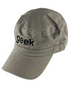
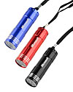

Required Slide
Complete an evaluation on CommNet and enter to win!

Slide 76


MS Tag
Required Slide
*delete this box when your slide is finalized
Your MS Tag will be inserted here during the final scrub.
Scan the Tag
to evaluate this
session now on
myTechEd Mobile

Slide 77
© 2012 Microsoft Corporation. All rights reserved. Microsoft, Windows, Windows Vista and other product names are or may be registered trademarks and/or trademarks in the U.S. and/or other countries.
The information herein is for informational purposes only and represents the current view of Microsoft Corporation as of the date of this presentation. Because Microsoft must respond to changing market conditions, it should not be interpreted to be a commitment on the
part of Microsoft, and Microsoft cannot guarantee the accuracy of any information provided after the date of this presentation. MICROSOFT MAKES NO WARRANTIES, EXPRESS, IMPLIED OR STATUTORY, AS TO THE INFORMATION IN THIS PRESENTATION.

