Slide 1
Hyper-V over SMB:
Remote File Storage Support in Windows Server 2012 Hyper-V
VIR306
Jose Barreto
Principal Program Manager
Microsoft Corporation

Slide 2
agenda
Hyper-V over SMB – Overview
Hyper-V over SMB – Setup
Configuration Options
Sample Configurations

Slide 3
Hyper-V over SMB - Overview
title

Slide 4


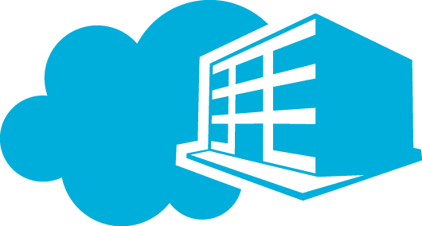

Windows Server 2012
Cloud Optimize Your IT
Beyond
Virtualization
Windows Server 2012 offers a dynamic, multi-tenant infrastructure that goes beyond virtualization to provide maximum flexibility for delivering and connecting to cloud services.
The Power of Many Servers, the Simplicity of One
Windows Server 2012 offers excellent economics by integrating a highly available and easy to manage multi-server platform with breakthrough efficiency and ubiquitous automation.
Every App,
Any Cloud
Windows Server 212 is a broad, scalable and elastic server platform that gives you the flexibility to build and deploy applications and websites on-premises, in the cloud and in a hybrid environment, using a consistent set of tools and frameworks.
Modern Workstyle, Enabled
Windows Server 2012 empowers IT to provide users with flexible access to data and applications from virtually anywhere on any device with a rich user experience, while simplifying management and helping maintain security, control and compliance.

Slide 5
Hyper-V over SMB
File Storage for Virtualization
Hyper-V Cluster
Hyper-V
Hyper-V
Hyper-V
What is it?
Store Hyper-V files in shares over the SMB 3.0 protocol
(include VM configuration, VHD files, snapshots)
Works with both standalone and clustered servers
(file storage used as cluster shared storage)
Highlights
Increases flexibility
Eases provisioning, management and migration
Leverages converged network
Reduces CapEx and OpEx
Supporting Features
SMB Transparent Failover - Continuous availability
SMB Scale-Out – Active/Active file server clusters
SMB Direct (SMB over RDMA) - Low latency, low CPU use
SMB Multichannel – Network throughput and failover
SMB Encryption - Security
VSS for SMB File Shares - Backup and restore
SMB PowerShell - Manageability
Hyper-V
Hyper-V
Hyper-V
Hyper-V
Hyper-V
Hyper-V
SQL
Server
SQL
Server
SQL
Server
IIS
IIS
IIS
VDI
Desktop
VDI
Desktop
VDI
Desktop
File Server Cluster
File Server
File Server
Shared
Storage

Slide 6
SMB Transparent Failover
Failover transparent to server application
  Zero downtime – small IO delay during failover
Supports planned and unplanned failovers
  HW/SW Maintenance
  HW/SW Failures
  Load Rebalancing
Resilient for both file and directory operations
Requires:
  Windows Failover Clusters
  Both server running application and file server cluster must be Windows Server “8”
  Shares enabled for ‘continuous availability’
1
Normal operation
2
Failover share - connections and handles lost,
temporary stall of IO
3
Connections and handles auto-recovered
Application IO continues with no errors
Hyper-V
1
3
\\fs1\share
\\fs1\share
2
File Server Cluster
File Server
Node A
File Server
Node B

Slide 7
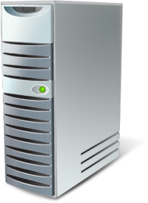
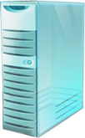


SMB Scale-Out
Hyper-V Cluster
(Up to 64 nodes)
Targeted for server app storage
  Example: Hyper-V and SQL Server
  Increase available bandwidth by adding cluster nodes
Key capabilities:
  Active/Active file shares
  Fault tolerance with zero downtime
  Fast failure recovery
  CHKDSK with zero downtime
  Support for app consistent snapshots
  Support for RDMA enabled networks
  Optimization for server apps
  Simple management
Data Center Network
(Ethernet, InfiniBand or combination)
Single Logical File Server (\\FS\Share)
Single File System Namespace
Cluster Shared Volumes
File Server Cluster
(Up to 8 nodes)

Slide 8
SMB Direct (SMB over RDMA)
Advantages
  Scalable, fast and efficient storage access
  High throughput with low latency
  Minimal CPU utilization for I/O processing
  Load balancing, automatic failover and bandwidth aggregation via SMB Multichannel
Scenarios
  High performance remote file access for application servers like Hyper-V, SQL Server, IIS and HPC
  Used by File Server and Clustered Shared Volumes (CSV) for storage communications within a cluster
Required hardware
  RDMA-capable network interface (R-NIC)
  Three types: iWARP, RoCE and Infiniband
SMB Client
SMB Server
Application
User
Kernel
SMB Client
SMB Server
Network w/
RDMA support
Network w/
RDMA support
NTFS
SCSI
R-NIC
R-NIC
Disk

Slide 9
SMB Multichannel
Sample Configurations
Full Throughput
Bandwidth aggregation with multiple NICs
Multiple CPUs cores engaged when NIC offers Receive Side Scaling (RSS)
Automatic Failover
SMB Multichannel implements end-to-end failure detection
Leverages NIC teaming (LBFO) if present, but does not require it
Automatic Configuration
SMB detects and uses multiple paths
Single 10GbE
RSS-capable NIC
Multiple 1GbE NICs
Multiple 10GbE
in LBFO team
Multiple RDMA NICs
SMB Client
SMB Client
SMB Client
SMB Client
LBFO
NIC
10GbE
NIC
1GbE
NIC
1GbE
NIC
10GbE
NIC
10GbE
NIC
10GbE/IB
NIC
10GbE/IB
Switch
10GbE
Switch
1GbE
Switch
1GbE
Switch
10GbE
Switch
10GbE
Switch
10GbE/IB
Switch
10GbE/IB
SMB Server
SMB Server
SMB Server
SMB Server
NIC
10GbE
NIC
1GbE
NIC
1GbE
NIC
10GbE
NIC
10GbE
NIC
10GbE/IB
NIC
10GbE/IB
LBFO
Vertical lines are logical channels, not cables

Slide 10

SMB Encryption
End-to-end encryption of SMB data in flight
  Protects data from eavesdropping/snooping attacks on untrusted networks
Zero new deployment costs
  No need for IPSec, specialized hardware, or WAN accelerators
Configured per share or for the entire server
Can be turned on for a variety of scenarios where data traverses untrusted networks
  Application workload over unsecured networks
  Branch Offices over WAN networks
Client
Server
SMB Encryption

Slide 11

VSS for SMB File Shares
Backup Server
Application consistent shadow copies for server application data stored on Windows Server “8” file shares
Backup and restore scenarios
Full integration with VSS infrastructure
G
Read from
Shadow Copy
Share
Backup
A
File Share Shadow Copy Agent
Backup Agent
E
Request Shadow Copy
B
Coordinate Shadow Copy
D
Volume Shadow Copy Service
Volume Shadow Copy Service
Relay Shadow Copy request
Create Shadow Copy
F
Create Shadow Copy
C
VSS Providers
File Share Shadow Copy Provider
\\fs\foo
Data volume
\\fs\foo@t1
Shadow Copy
Application Server
File Server

Slide 12
Hyper-V over SMB – Setup
title

Slide 13
Permissions for Hyper-V over SMB
Full permissions on NTFS folder and SMB share for
  Hyper-V Administrator
  Computer Account of Hyper-V hosts
  If Hyper-V is clustered, the Hyper-V Cluster Account (CNO)
Create Folder
  MD F:\VMS
Create Share
  New-SmbShare -Name VMS -Path F:\VMS
  -FullAccess Dom\HAdmin, Dom\HV1$, Dom\HV2$, Dom\HVC$
Apply Share permissions to NTFS Folder permissions
  (Get-SmbShare –Name VMS).PresetPathAcl | Set-Acl

Slide 14
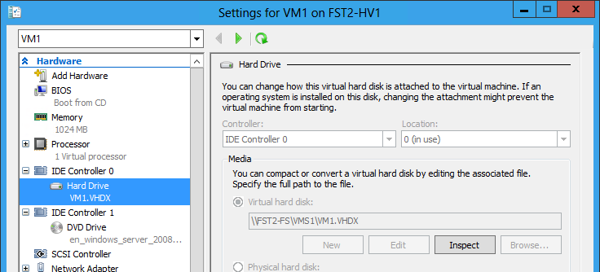
How to use it: simply type a UNC path
New-VHD -Path \\FS1\VMS\VM1.VHDX -Dynamic -SizeBytes 100GB
New-VM -Name VM1 -Path \\FS1\VMS -VHDPath \\FS1\VMS\VM1.VHDX -Memory 4GB

Slide 15
Important notes on Hyper-V over SMB
Hyper-V supports SMB version 3.0 only
  The Hyper-V Best Practices Analyzer (BPA) will check the version of SMB
  Third-party SMB 3.0 implementations coming from storage partners like EMC and NetApp
Continuously Available shares are recommended
Active Directory is required
  Computer accounts, which are required for configuring proper permissions, only exist in a domain
Loopback configurations are not supported
  File Server and Hyper-V must be separate servers
  If using Failover Clusters, File Server and Hyper-V must be on separate clusters
System Center Virtual Machine Manager 2012 SP1 will bring support for Hyper-V over SMB
  CTP is available for download
Remote Management
  Use PowerShell
  Use Server Manager (for file shares)
  Use Remote Desktop (RDP)
  Use VMM 2012 SP1
  If using Hyper-V Manager remotely, Constrained Delegation is required

Slide 16
Hyper-V over SMB Setup
demo
Jose Barreto
Principal Program Manager
Windows Server

Slide 17
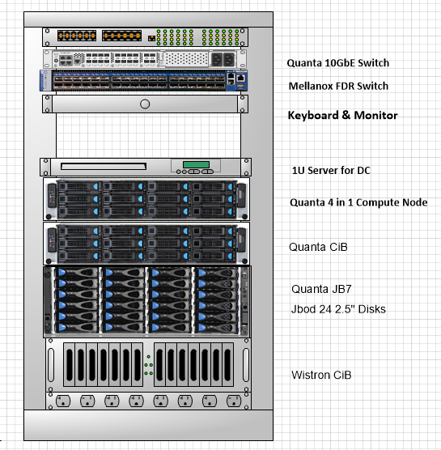
The TechEd Cluster in a Box Demo Stack
Cluster in a Box prototypes
  Quanta
  Wistron
LSI HA-DAS MegaRAID® and SAS controllers
Quanta application servers, JBOD expansion, and 10GbE switch
Mellanox IB FDR NICs and switch
OCZ SAS SSDs
Infrastructure
  Domain Controller server
  Power distribution unit
  1GbE switch
  Keyboard & monitor
MegaRAID® is a registered trademark of LSI Corporation

Slide 18
Configuration Options
title

Slide 19
Hyper-V over SMB
Hyper-V Server
File Server
Child Partition
Parent Partition
Application
User
Kernel
NTFS
SCSI/IDE
VHD Stack
SMB Client
SMB Server
Storage
VSC
Storage
VSP
Network
(RDMA option)
Network
(RDMA option)
NTFS
SCSI
VM Bus
Disk
NIC
NIC

Slide 20
Hyper-V over SMB - File Server Configurations
Single-node File Server
  Lowest cost for shared storage
  Shares not continuously available
Hyper-V Parent 1
Hyper-V Parent N
Config
Child 1
Config
Child N
VHD
Disk
VHD
Disk
File Server
Share1
Share2
Disk
Disk
A

Slide 21

Hyper-V over SMB - File Server Configurations
Single-node File Server
  Lowest cost for shared storage
  Shares not continuously available
Dual-node File Server
  Low cost for continuously available shared storage
  Limited scalability
  (up to a few hundred disks)
Hyper-V Parent 1
Hyper-V Parent N
Hyper-V Parent 1
Hyper-V Parent N
Config
Child 1
Config
Child N
Config
Child 1
Config
Child N
VHD
Disk
VHD
Disk
VHD
Disk
VHD
Disk
File Server
File Server 1
File Server 2
Share1
Share2
Share1
Share2
Share1
Share2
Disk
Disk
Shared SAS Storage
Disk
Disk
Disk
Disk
A
B
Active ON

Slide 22
Hyper-V over SMB - File Server Configurations
Single-node File Server
  Lowest cost for shared storage
  Shares not continuously available
Dual-node File Server
  Low cost for continuously available shared storage
  Limited scalability
  (up to a few hundred disks)
Multi-node File Server
  Highest scalability
  (up to thousands of disks)
  Higher cost, but still lower than connecting all Hyper-V hosts with FC
Hyper-V Parent 1
Hyper-V Parent N
Hyper-V Parent 1
Hyper-V Parent N
Hyper-V Parent 1
Hyper-V Parent N
Config
Child 1
Config
Child N
Config
Child 1
Config
Child N
Config
Child 1
Config
Child N
VHD
Disk
VHD
Disk
VHD
Disk
VHD
Disk
VHD
Disk
VHD
Disk
File Server
File Server 1
File Server 2
FS 1
FS 2
FS 3
FS 4
Share1
Share2
Share1
Share2
Share1
Share2
Share1
Share2
Share3
Share4
Disk
Disk
Shared SAS Storage
Fibre Channel Storage Array
Disk
Disk
Disk
Disk
Disk
Disk
Disk
Disk
Disk
Disk
Disk
A
B
Active ON
C
Active ON

Slide 23
Hyper-V over SMB - Network Configurations
1GbE Networks
Clients
1GbE
1GbE
Hyper-V 1
Hyper-V 2
1GbE
1GbE
File Server 1
File Server 2
A

Slide 24
Hyper-V over SMB - Network Configurations
1GbE Networks
Mixed 1GbE/10GbE
Clients
Clients
1GbE
1GbE
1GbE
1GbE
Hyper-V 1
Hyper-V 2
Hyper-V 1
Hyper-V 2
1GbE
1GbE
10GbE / IB
10GbE / IB
File Server 1
File Server 2
File Server 1
File Server 2
A
B

Slide 25
Hyper-V over SMB - Network Configurations
1GbE Networks
Mixed 1GbE/10GbE
10GbE or InfiniBand
Clients
Clients
Clients
1GbE
1GbE
1GbE
1GbE
10GbE / IB
10GbE / IB
Hyper-V 1
Hyper-V 2
Hyper-V 1
Hyper-V 2
Hyper-V 1
Hyper-V 2
1GbE
1GbE
10GbE / IB
10GbE / IB
10GbE / IB
10GbE / IB
File Server 1
File Server 2
File Server 1
File Server 2
File Server 1
File Server 2
A
B
C

Slide 26
Hyper-V over SMB - Network Configurations
1GbE Networks
Mixed 1GbE/10GbE
10GbE or InfiniBand Networks
Clients
Clients
Clients
1GbE
1GbE
1GbE
1GbE
10GbE / IB
10GbE / IB
Clients
Hyper-V 1
Hyper-V 2
Hyper-V 1
Hyper-V 2
Hyper-V 1
Hyper-V 2
10GbE / IB
10GbE / IB
10GbE / IB
10GbE / IB
10GbE / IB
10GbE / IB
Hyper-V 1
Hyper-V 2
1GbE
1GbE
File Server 1
File Server 2
File Server 1
File Server 2
File Server 1
File Server 2
File Server 1
File Server 2
A
B
C
D

Slide 27
Sample Configurations
title

Slide 28
All Standalone
Hyper-V Host
Hyper-V Host
Hyper-V
Standalone, shares used for VHD storage
File Server
Standalone, Local Storage
Configuration highlights
Flexibility (Migration, shared storage)
Simplicity (File Shares, permissions)
Low acquisition and operations cost
Configuration lowlights
Storage not fault tolerant
File server not continuously available
Hyper-V VMs not highly available
Hardware setup and OS install by IT Pro
Share
Share
VHD
VHDX
File Server

Slide 29
All Standalone + Storage Spaces
Hyper-V Host
Hyper-V Host
Hyper-V
Standalone, shares used for VHD storage
File Server
Standalone, Storage Spaces
Configuration highlights
Flexibility (Migration, shared storage)
Simplicity (File Shares, permissions)
Low acquisition and operations cost
Storage is Fault Tolerant
Configuration lowlights
File server not continuously available
Hyper-V VMs not highly available
Hardware setup and OS install by IT Pro
Share
Share
VHD
VHDX
File Server
Storage Spaces
Space
Space

Slide 30
Standalone File Server, Clustered Hyper-V
Failover Cluster
Hyper-V Host
Hyper-V Host
Hyper-V
Clustered, shares used for VHD storage
File Server
Standalone, Storage Spaces
Configuration highlights
Flexibility (Migration, shared storage)
Simplicity (File Shares, permissions)
Low acquisition and operations cost
Storage is Fault Tolerant
Hyper-V VMs are highly available
Configuration lowlights
File server not continuously available
Hardware setup and OS install by IT Pro
Share
Share
VHD
VHDX
File Server
Storage Spaces
Space
Space

Slide 31
Clustered File Server, Standalone Hyper-V
Hyper-V Host
Hyper-V Host
Hyper-V
Standalone, shares used for VHD storage
File Server
Clustered, Storage Spaces
Configuration highlights
Flexibility (Migration, shared storage)
Simplicity (File Shares, permissions)
Low acquisition and operations cost
Storage is Fault Tolerant
File Server is Continuously Available
Configuration lowlights
Hyper-V VMs not highly available
Hardware setup and OS install by IT Pro
Share
Share
VHD
VHDX
Failover Cluster
File Server
File Server
Clustered Storage Spaces
Active ON
Space
Space
Shared JBOD SAS

Slide 32
All Clustered
Failover Cluster
Hyper-V Host
Hyper-V Host
Hyper-V
Clustered, shares used for VHD storage
File Server
Clustered, Storage Spaces
Configuration highlights
Flexibility (Migration, shared storage)
Simplicity (File Shares, permissions)
Low acquisition and operations cost
Storage is Fault Tolerant
Hyper-V VMs are highly available
File Server is Continuously Available
Configuration lowlights
Hardware setup and OS install by IT Pro
Share
Share
VHD
VHDX
Failover Cluster
File Server
File Server
Clustered Storage Spaces
Active ON
Space
Space
Shared JBOD SAS

Slide 33
Cluster-in-a-box
Failover Cluster
Hyper-V Host
Hyper-V Host
Hyper-V
Clustered, shares used for VHD storage
File Server
Cluster-in-a-box
Configuration highlights
Flexibility (Migration, shared storage)
Simplicity (File Shares, permissions)
Low acquisition and operations cost
Storage is Fault Tolerant
File Server is continuously Available
Hardware and OS pre-configured by the OEM
Share
Share
VHD
VHDX
Cluster-in-a-box
File Server
File Server
Clustered Storage Spaces
Active ON
Space
Space
Shared JBOD SAS

Slide 34
Summary
title

Slide 35
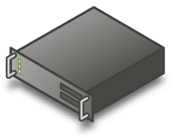
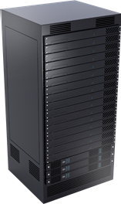

File Server Cluster for Hyper-V
1 GbE
10 GbE
40 GbE
InfiniBand
Networking
2+ Interfaces
+ Optional RDMA
RDMA
Server
2+ servers
2+ node “Cluster-in-a-Box”
2+ discrete servers
Storage Spaces
FC / iSCSI / SAS
fabric
Storage
Reliable Shared Storage
Clustered
RAID
Shared JBOD SAS
External Storage Arrays

Slide 36



Related Content
Breakout Sessions
  WSV303 Windows Server 2012 High-Performance, Highly-Available Storage Using SMB
WSV310 Windows Server 2012: Cluster-in-a-Box, RDMA, and More
  WSV314 Windows Server 2012 NIC Teaming and Multichannel Solutions
  WSV322 Update Management in Windows Server 2012: Revealing Cluster- Aware Updating
  WSV330 How to increase SQL availability and performance using Window Server 2012 SMB
  WSV334 Windows Server 2012 File and Storage Services Management
  WSV410 Continuously Available File Server – Under the Hood
Product Demo Stations (Technical Learning Center, Windows Server)
Find Me Later At http://blogs.technet.com/josebda or http://smb3.info

Slide 37



Resources
Learning
  Connect. Share. Discuss.
  Microsoft Certification & Training Resources
http://northamerica.msteched.com
www.microsoft.com/learning
TechNet
  Resources for IT Professionals
  Resources for Developers
http://microsoft.com/technet
http://microsoft.com/msdn

Slide 38


SIA, WSV, and VIR Track Resources
#TE(sessioncode)
Talk to our Experts at the TLC
Hands-On Labs
DOWNLOAD Windows Server 2012 Release Candidate
microsoft.com/windowsserver
DOWNLOAD Windows Azure
Windowsazure.com/
teched

Slide 39





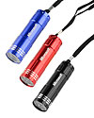

Complete an evaluation on CommNet and enter to win!

Slide 40


MS Tag
Scan the Tag
to evaluate this
session now on
myTechEd Mobile

Slide 41
© 2012 Microsoft Corporation. All rights reserved. Microsoft, Windows, Windows Vista and other product names are or may be registered trademarks and/or trademarks in the U.S. and/or other countries.
The information herein is for informational purposes only and represents the current view of Microsoft Corporation as of the date of this presentation. Because Microsoft must respond to changing market conditions, it should not be interpreted to be a commitment on the
part of Microsoft, and Microsoft cannot guarantee the accuracy of any information provided after the date of this presentation. MICROSOFT MAKES NO WARRANTIES, EXPRESS, IMPLIED OR STATUTORY, AS TO THE INFORMATION IN THIS PRESENTATION.

