Slide 1
Get Hands-on with the New Hyper-V Extensible Switch in Windows Server 2012
VIR307
Bob Combs
Hyper-V Networking
Microsoft Corporation

Slide 2
Agenda
What networking in the cloud means
So what’s new in the Hyper-V virtual switch
What is a Hyper-V Extensible Switch
Give me details!
I’m from Missouri, “show me”
OK, so how do I manage extensions

Slide 3




Windows Server 2012
Cloud Optimize Your IT
Beyond
Virtualization
Windows Server 2012 offers a dynamic, multi-tenant infrastructure that goes beyond virtualization to provide maximum flexibility for delivering and connecting to cloud services.
The Power of Many Servers, the Simplicity of One
Windows Server 2012 offers excellent economics by integrating a highly available and easy to manage multi-server platform with breakthrough efficiency and ubiquitous automation.
Every App,
Any Cloud
Windows Server 2012 is a broad, scalable and elastic server platform that gives you the flexibility to build and deploy applications and websites on-premises, in the cloud and in a hybrid environment, using a consistent set of tools and frameworks.
Modern Workstyle, Enabled
Windows Server 2012 empowers IT to provide users with flexible access to data and applications from virtually anywhere on any device with a rich user experience, while simplifying management and helping maintain security, control and compliance.

Slide 4

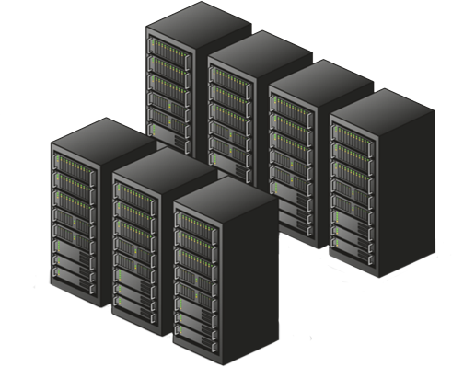
Cloud Demands
Integrated security and protection
Ability to add traffic tools
Unification of management tools
Blur the distinction between physical and virtual networks

Slide 5
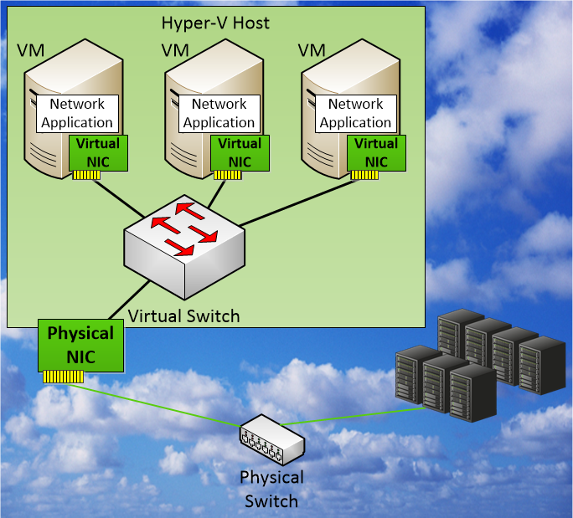
Hyper-V Switch
Network traffic between Virtual Machines,
the external network, and
the Host OS is handled by
the Hyper-V Virtual Switch

Slide 6
Windows Server 2012 Switch Policies
Traffic Isolation/Flow
Port ACL
PVLAN
Trunk Mode
Traffic shaping
QoS
Security
DHCP Guard
IPsec Task Offload
Performance
Dynamic VMQ
SR-IOV
Diagnostics
Port Mirroring
Events Tracing (ETW)
Unified Tracing
Adding more functionality …

Slide 7
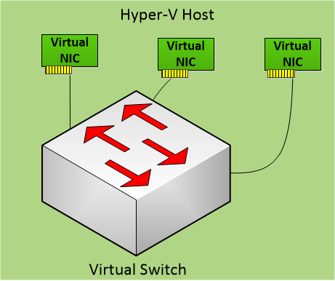
Hyper-V Extensible Switch
Extension
Extension
Extension

Slide 8
Key Tenets for Hyper-V Extensible Switch
Key Tenets | Benefit
Extensible, not replaceable | Added features don’t remove other features
Pluggable switch | Extensions process all network traffic, including VM-to-VM
1st class citizen of system | Live Migration and offloads just work; Extensions work together
Open & public API model | Large ecosystem of extensions
Logo certification and rich OS framework | High quality extensions
Unified Tracing through virtual switch | Shorter down times

Slide 9
Hyper-V Extensible Switch
Extensions are Filters or Windows Filtering Platform Providers
Extension state/configuration is unique to each instance of an Extensible Switch on a machine
Extension
Extension
Extension

Slide 10

SCVMM Management of Switch Extensions
VM₁
VM₂
VM₃
SCVMM
Virtualization
3rd Party components
Root Partition
Capture Extension
VMM Agent
VMM
Service
Filtering Extension
Forwarding Extension
Vendor
SCVMM
Plugin
Physical NIC
Vendor network mgmt console
SCVMM management of extensions
Custom vendor management in SCVMM
Policy database

Slide 11
Capture Extensions
Capture extensions can inspect traffic and generate new traffic for report purposes, but cannot modify traffic
Can have multiple Capture extensions
Capture Extension
Extension
Extension

Slide 12


sFlow traffic monitoring
demo
Stuart Johnston
Chief Security Architect
Inmon

Slide 13
Filtering Extensions
Filtering Extensions can inspect, drop, modify, and insert packets
Extension
Filtering Extension
Extension

Slide 14
Windows Filtering Platform Extensions
Windows Filter Platform (WFP) Extensions can
inspect, drop, modify, and insert packets
Firewall software written for Windows use WFP for traffic filtering
BFE Service
Firewall
Filtering Engine
Callout
Extension
WFP Filter Ext.
Extension

Slide 15

Virtual Firewall v3.0
demo
Konstantin Malkov
Software CTO
5Nine

Slide 16
Forwarding Extensions
Forwarding extensions direct traffic, defining the destination(s) of each packet
Forwarding extensions can capture and filter traffic
Extension
Extension
Forwarding Extension

Slide 17

OpenFlow for Hyper-V
demo
Su-Hun Yun
Senior Manager, OpenFlow Business Development
NEC

Slide 18
UCS for Hyper-V
demo
Chakri Avala
Product Manager, Cisco UCS
Cisco

Slide 19
Nexus 1000V Switch
demo
Appaji Malla
Sr. Product Marketing Manager
Cisco

Slide 20
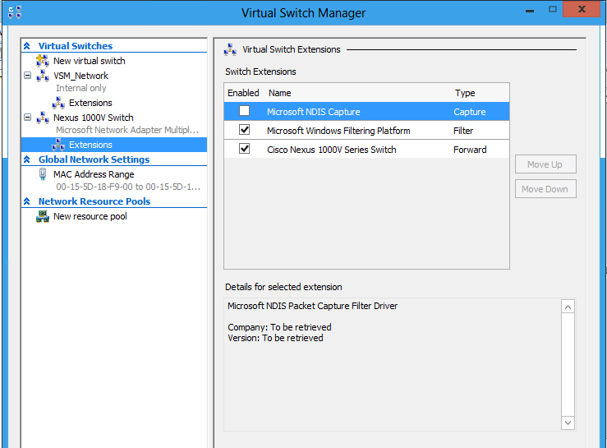
Uniformly Managing Network Resources
Network management packages can extend control across physical and virtual switches for a uniform management experience
Virtual Switch Manager provides UI for extension management

Slide 21
Hyper-V Extensible Switch PowerShell cmdlets
Get-vmSwitch
Get-vmSwitchExtension –vmSwitchName <switchName>
Enable-vmSwitchExtension –vmSwitchName <switchName> -Name <extensionName>
Disable-vmSwitchExtension –vmSwitchName <switchName> -Name <extensionName>

Slide 22
VM based Traffic Tools Can Be Supported Multiple Ways
Traffic Tools can be in VM, extension, host service
Monitoring Port copies traffic to VM
Traffic trunked to VM before distributing to other VMs
Capture extension echo traffic to service
Extension pipe/tunnel traffic to a destination

Slide 23
Extensible Switch ETW Tracing Example
netsh trace start scenario=InternetClient provider=Microsoft-Windows-Hyper-V-VmSwitch
## <generate traffic>
netsh trace stop
## The resulting ETL file can be opened using event viewer or Netmon

Slide 24
Extensible Switch Unified Tracing Example
netsh trace start scenario=InternetClient provider=Microsoft-Windows-Hyper-V-VmSwitch capture=yes capturetype=vmswitch
## Repro issue
netsh trace stop
## Review the generated ETL file and the system event log.

Slide 25
Summarizing Extensible Switch Benefits
Plugin framework for extensions using known API
  Don’t need to write entire switch
  Quicker development
  Native features available with extensions
Services supported for extensions
  NIC offloads supported (checksum, IPsec, LSO, RSC, RSS, SR-IOV)
  Live Migration works for free
Integrated management via PowerShell/WMI
Higher quality plug-ins
  Windows framework
  Windows Certification (HCK)

Slide 26
Useful Links
Hyper-V Extensible Switch on MSDN:
  http://msdn.microsoft.com/en-us/library/hh598161(v=VS.85).aspx
Forwarding sample of extension:
  http://code.msdn.microsoft.com/Hyper-V-Extensible-Virtual-e4b31fbb
Tutorials on programming extensions:
  http://channel9.msdn.com/posts/Hyper-V-Extensible-Switch-Part-I--Introduction
  http://channel9.msdn.com/posts/Hyper-V-Extensible-Switch-Part-II--Understanding-the-Control-Path
  http://channel9.msdn.com/posts/Hyper-V-Extensible-Switch-Part-III--The-Ins-and-Outs-of-the-Datapath-for-Capture-and-Filter-Extensions

Slide 27
Useful Links
Hosted cloud whitepaper http://msdn.microsoft.com/en-us/library/windows/hardware/hh506335
Blogs: http://blogs.microsoft.com/b8
Channel 9 videos
  Cisco
  InMon
  NEC
TechNet video
  http://technet.microsoft.com/en-us/edge/windows-server-8-extensible-switch-in-hyper-v-interview-with-bob-combs

Slide 28



Related Content
VIR303 – An Overview of Hyper-V Networking in Windows Server 2012
VIR305 – Hyper-V Network Virtualization for Scalable Multi-Tenancy in Windows
Visit Hyper-V Switch Extension partners in the TechExpo
MGT315 - Network Management in Microsoft System Center 2012 SP1
WSV314 – Windows Server 2012 NIC Teaming and Multichannel Solutions
MGT314 - What's New in System Center 2012 SP1 - Virtual Machine Manager

Slide 29


SIA, WSV, and VIR Track Resources
#TE(sessioncode)
Talk to our Experts at the TLC
Hands-On Labs
DOWNLOAD Windows Server 2012 Release Candidate
microsoft.com/windowsserver
DOWNLOAD Windows Azure
Windowsazure.com/
teched

Slide 30



Resources
Learning
  Connect. Share. Discuss.
  Microsoft Certification & Training Resources
http://northamerica.msteched.com
www.microsoft.com/learning
TechNet
  Resources for IT Professionals
  Resources for Developers
http://microsoft.com/technet
http://microsoft.com/msdn

Slide 31







Required Slide
Complete an evaluation on CommNet and enter to win!

Slide 32





Please Complete an Evaluation
Your feedback is important!
Be eligible
to win great daily prizes and the grand prize of a $5,000 Travel Voucher!
Multiple
ways to Evaluate Sessions
Scan the Tag
to evaluate this
session now
on myTechEd Mobile

Slide 33
© 2012 Microsoft Corporation. All rights reserved. Microsoft, Windows, Windows Vista and other product names are or may be registered trademarks and/or trademarks in the U.S. and/or other countries.
The information herein is for informational purposes only and represents the current view of Microsoft Corporation as of the date of this presentation. Because Microsoft must respond to changing market conditions, it should not be interpreted to be a commitment on the
part of Microsoft, and Microsoft cannot guarantee the accuracy of any information provided after the date of this presentation. MICROSOFT MAKES NO WARRANTIES, EXPRESS, IMPLIED OR STATUTORY, AS TO THE INFORMATION IN THIS PRESENTATION.

