Slide 1
RemoteFX and RDP Rocking RDS in Windows Server 2012
VIR313
Gaurav Daga
Lead Program Manager
Microsoft Corporation
Rob Williams
Principal Program Manager
Microsoft Corporation

Slide 2
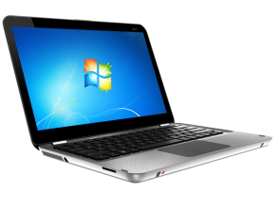


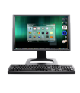

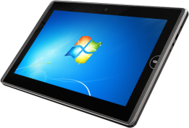
Rich Experience Everywhere
  RemoteFX delivers a consistently rich user experience to users over LAN or WAN (irrespective of deployment model)
RemoteFX
Corporate LAN
Hardware and Software GPUs
Rich multimedia
USB Redirection
Multi Touch
WAN acceleration
Internet or WAN
Single Sign On

Slide 3
RemoteApp and Desktops

Slide 4
IT-provisioned RemoteApp and Desktop Experience
Easy to get Remote Desktop app from the Windows Store
End users just need to know their e-mail ID to subscribe
Automatic discovery and Start screen integration
Full single-sign on
RemoteApp programs integrate seamlessly with local desktop
Best way to serve out desktop apps to your Windows RT slate users
Reconnect feature makes it easy to move between devices

Slide 5
Multi-Touch and Graphics

Slide 6
Multi-Touch and Rich Graphics Experience
Touch friendly app UI
Full multi-touch and gesture remoting
Features like Touch Pointer make slate experience delightful
Aero always on, rich Metro-style UX
Adaptive graphics remoting based on content type
Text kept crisp always

Slide 7
RemoteFX Architecture Overview
Windows Metro style UI and Applications (HTML, XAML, Native, etc..)
Apps and Desktop
RemoteFX Adaptive Graphics
RemoteFX for WAN
RemoteFX Intelligent Caching
RemoteFX Media Streaming
RemoteFX Progressive Rendering
RemoteFX
Optimized Text Codecs
RemoteFX
Calista Codec
RemoteFX Protocol Encoding
RemoteFX for WAN Transports

Slide 8
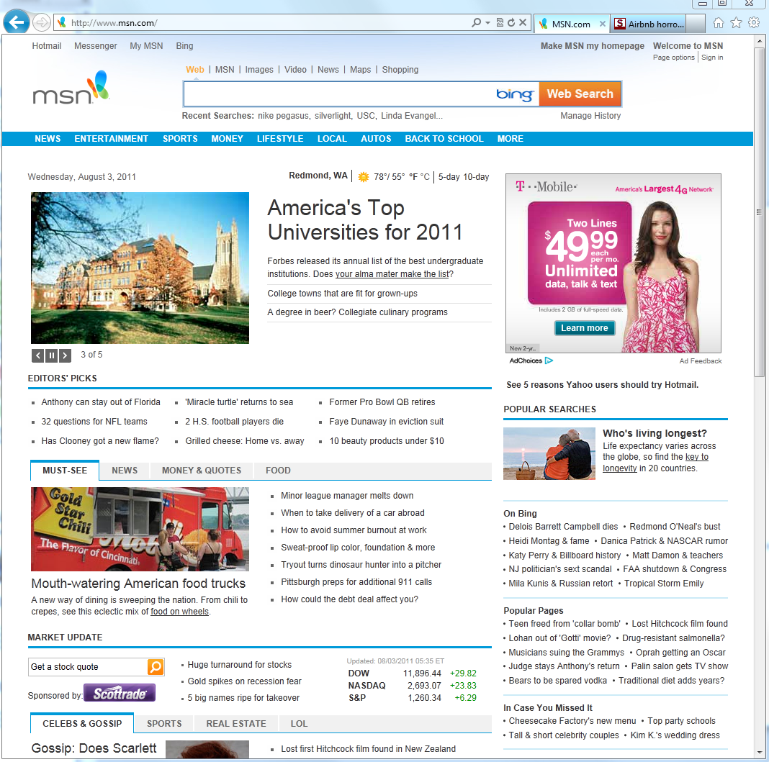
RemoteFX Adaptive Graphics
Text Content
Image Content
Video/Animations

Slide 9



RemoteFX Progressive Rendering

Slide 10

RemoteFX Progressive Rendering
Text remains clear while images are progressively refined

Slide 11
WAN Experience

Slide 12
Factors affecting remoting on WAN
Latency
Packet Loss
Limited bandwidth
End to end delay/ping (e.g. 100 ms RTT)
Burst or Random
E.g. < 2 Mbps vs. 100 Mbps for LAN

Slide 13
RemoteFX for WAN
Combines RemoteFX Adaptive Graphics with intelligent WAN aware transports
  Automatic choice of TCP or secure UDP transport
  Dynamically auto detects and tunes graphics to network
  Integrated with Remote Desktop Gateway
Goal: Deliver a great user experience beyond corporate networks
  Branch Offices
  Wireless devices
  Work from home
  Roaming users with 3g/4g
Balance bandwidth and scale to give best UX

Slide 14
RemoteFX Media Streaming
Windows Media redirection support
Server-side video detection for all other media types
  Flash, Silverlight, QuickTime, HTML5, etc.
Audio and video use new dynamic bit-rate codecs
Up to 90% drop in bandwidth consumption
Quality audio, good FPS video with A/V sync even on WAN
Better VoIP support

Slide 15
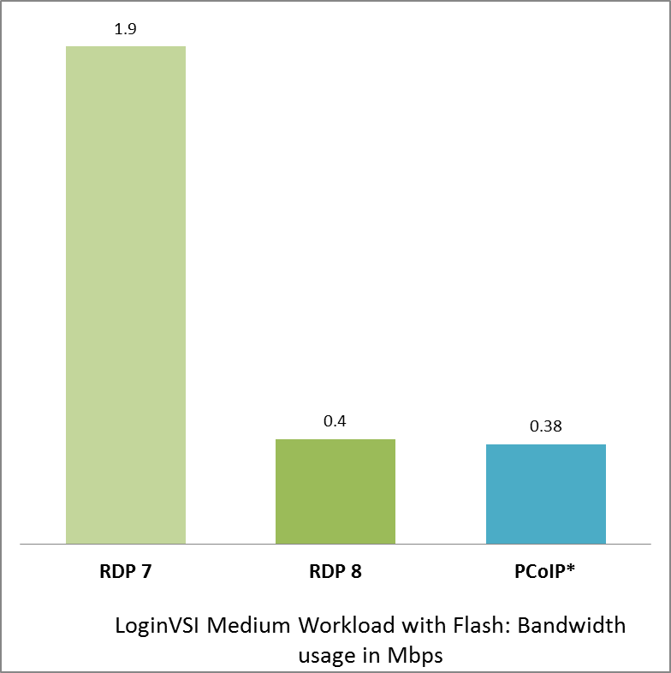
RemoteFX Bandwidth Usage
Guest VM
  RDP 7: Windows 7 Service Pack 1 (no VGPU)
  RDP 8: Windows 8 Release Preview (no VGPU)
  PCoIP: Windows 7 (no mention of Service Pack)
User Experience
  RDP 7: Aero Off, ClearType Text Off
  RDP 8: Aero On, Metro-style UX, ClearType Text On
  PCoIP: Aero Unknown (no mention), ClearType Text On
Customizations
  RDP 7: Default
  RDP 8: Default
  PCoIP: FPS / Quality limited to reduce bandwidth usage
*PCoIP numbers from
http://www.vmware.com/files/pdf/techpaper/PCoIPvHDXsinglesession03-05-12.pdf

Slide 16
Uniform experience with deployment choice
RemoteFX For WAN
RemoteFX Adaptive Graphics
RemoteFX Media Streaming
Customer Value:
Fast and fluid remoting of the full desktop and apps across a wide range of networks
RemoteFX Multi Touch
RemoteFX USB Redirection
Metro-style Remote Desktop App
Choice of Software or Physical GPU, VGPU for VMs
Available for Sessions, VMs and Physical Machines
Broad Range of Clients Supported
Choice of deployment options

Slide 17
Choice of GPU on server
CPU-Emulated DirectX 11 software GPU provides 3D capabilities to sessions and VMs at high scale
  Optimized for knowledge worker workloads, such as Office, Web Browsing
  Highest scale for Session Host and VDI
RemoteFX VGPU provides a virtualized hardware-accelerated DirectX 11 GPU for VDI, optimized for
  Best performance for 3D graphics-intensive applications
  Best experience with full animations and transitions
  Best application compatibility, running as a console session in VM

Slide 18
VGPU Experience

Slide 19
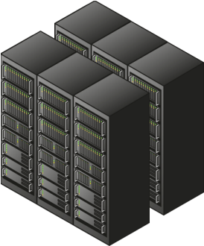
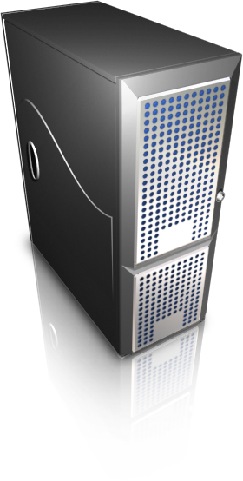
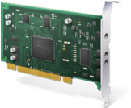



RemoteFX Rich Ecosystem
Servers
GPUs
RemoreFX Clients
Semiconductors
RemoteFX Client Software

Slide 20

RemoteFX Thin Client Logo
Performance
Compatibility
Robustness
Versatility

Slide 21
Non-Windows RDP Client

Slide 22
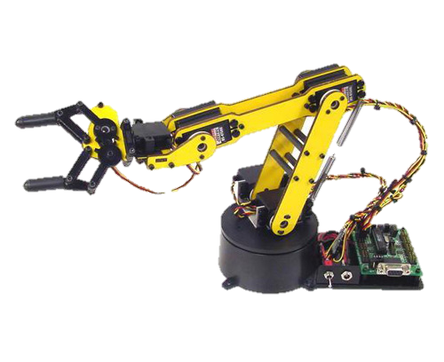


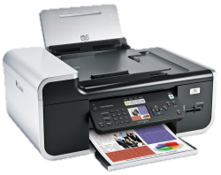
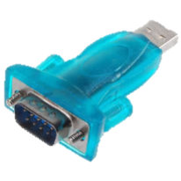
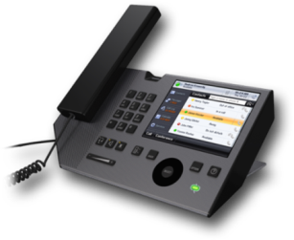
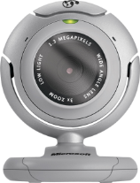
RemoteFX USB Device Redirection
Use with all scenarios
  Physical, virtual, or session desktop
  No GPU needed
Devices are isolated to the user’s session!
Use a wide variety of USB peripherals including isochronous
Isochronous
RemoteFX USB
Device Redirection

Slide 23
USB Peripheral Support

Slide 24

Related Content
Breakout Sessions
VIR317 - Lessons from the Field: 22 VDI and RDS Mistakes You'll Want to Avoid
  Monday, June 11, 1:15-2:30 pm, S220A
VIR314 - Windows Server 2012 VDI/RDS Infrastructure and Management
  Monday, June 12, 3:00-4:15 pm, N320E
WSV202 – Overview of Windows MultiPoint Server
  Monday, June 11, 4:45-6:00 pm, S210E
WCL303 – Microsoft Desktop Virtualization: The Right Technology for Your Scenario
  Tuesday, June 12. 10:15-11:30 am, S320C
WSV311 – Extending Applications to Everywhere! Your Guide to Securing RDS RemoteApps for the Internet
  Tuesday, June 12 at 5:00 PM - 6:15 PM, S320C
WCL283 – Windows 8: Virtual Desktop Infrastructure
  Thursday, June 14 at 8:30-9:45 am, S320E
Product Demo Stations
Remote Desktop Services and Virtual Desktop Infrastructure (VIR 2)
Windows MultiPoint Server (WSV 3)
Windows Server Partner Pavilion (5 RemoteFX Partners)

Slide 25


SIA, WSV, and VIR Track Resources
#TE(sessioncode)
Talk to our Experts at the TLC
Hands-On Labs
DOWNLOAD Windows Server 2012 Release Candidate
microsoft.com/windowsserver
DOWNLOAD Windows Azure
Windowsazure.com/
teched

Slide 26



Resources
Learning
  Connect. Share. Discuss.
  Microsoft Certification & Training Resources
http://northamerica.msteched.com
www.microsoft.com/learning
TechNet
  Resources for IT Professionals
  Resources for Developers
http://microsoft.com/technet
http://microsoft.com/msdn

Slide 27







Required Slide
Complete an evaluation on CommNet and enter to win!

Slide 28


MS Tag
Scan the Tag
to evaluate this
session now on
myTechEd Mobile

Slide 29
© 2012 Microsoft Corporation. All rights reserved. Microsoft, Windows, Windows Vista and other product names are or may be registered trademarks and/or trademarks in the U.S. and/or other countries.
The information herein is for informational purposes only and represents the current view of Microsoft Corporation as of the date of this presentation. Because Microsoft must respond to changing market conditions, it should not be interpreted to be a commitment on the
part of Microsoft, and Microsoft cannot guarantee the accuracy of any information provided after the date of this presentation. MICROSOFT MAKES NO WARRANTIES, EXPRESS, IMPLIED OR STATUTORY, AS TO THE INFORMATION IN THIS PRESENTATION.

