Slide 1
Hyper-V High-Availability & Mobility: Designing the Infrastructure for Your Private Cloud
VIR401
Symon Perriman
Technical Evangelist
Microsoft Corporation
@SymonPerriman

Slide 2


Failover Clustering in Windows Server 2012
Infrastructure for the Private Cloud
Advanced Management
Hyper-V
Virtualization Platform
Infrastructure Integration

Slide 3
Hyper-V High-Availability
Agenda
Planning for Hyper-V High-Availability
Hyper-V Optimization with Failover Clustering
Windows Server 2012 Failover Clustering
System Center Virtual Machine Manager 2008 R2
System Center 2012 Virtual Machine Manager

Slide 4
Planning for Hyper-V
High-Availability

Slide 5







Host Clustering & Guest Clustering
Host Clustering
Guest Clustering
Cluster service runs inside (physical) host and manages VMs
VMs move between cluster nodes
Cluster service runs inside a VM
Apps and services inside the VM are
managed by the cluster
Apps move between clustered VMs
Cluster
Cluster
SAN
iSCSI

Slide 6
What Host Clustering Delivers
Avoids a single point of failure when consolidating
Survive Host Crashes
    VMs restarted on another node
Restart VM Crashes
    VM OS restarted on same node
Recover VM Hangs
    VM OS restarted on same node
Zero Downtime Maintenance & Patching
    Live migrate VMs to other hosts
Mobility & Load Distribution
    Live migrate VMs to different servers to load balance
Cluster
SAN

Slide 7
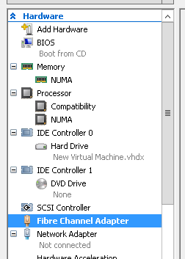
What Guest Clustering Delivers
Application Health Monitoring
    App or service within VM crashes or hangs and
    moves to another VM
Application Mobility
    Apps or services moves to another VM for
    maintenance or patching of guest OS
Cluster
iSCSI

Slide 8
Combining Host & Guest Clustering
Best of both worlds for flexibility and protection
    VM high-availability & mobility between physical nodes
    Application & service high-availability & mobility between VMs
Cluster-on-a-cluster does increase complexity
Guest Cluster
CLUSTER
CLUSTER
iSCSI
SAN
SAN

Slide 9
Mixing Physical and Virtual
Mixing physical & virtual nodes is supported
    Must still pass “Validate”
Requires iSCSI storage
Scenarios
    Spare node is a VM in a Private Cloud
    Shared host running multiple spare nodes as VMs
    Test environment with limited hardware
iSCSI

Slide 10
Workloads in a Guest Cluster
SQL
  Host and guest clustering supported for SQL 2005+
  Supports guest live and quick migration
  Support policy: http://support.microsoft.com/?id=956893
File Server
  Fully Supported
  Live migration is a great solution for moving the file server to a different physical system without breaking client TCP/IP connections
Exchange
  Exchange 2007 SP1 HA solutions are supported for guest clustering
  Support Policy: http://technet.microsoft.com/en-us/library/cc794548.aspx
Other Server Products: http://support.microsoft.com/kb/957006

Slide 11
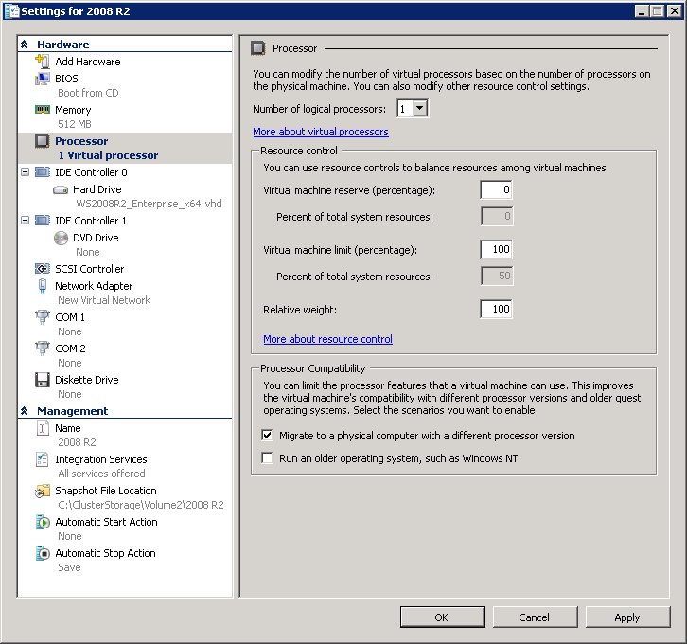
Hardware Planning
Ensure processor compatibility for Live Migration
Processors should be from the same manufacturer in all nodes
  Cannot mix Intel and AMD in the same cluster
Virtual Machine Migration Test Wizard can be used to verify compatibility
  http://archive.msdn.microsoft.com/VMMTestWizard
‘Processor Compatibility Mode’ can also be used
if you have processors not compatible with each
other for live migrating (all Intel or all AMD)

Slide 12
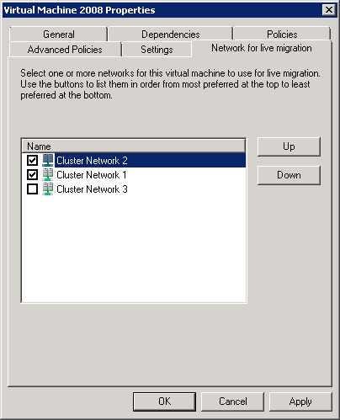
Network Planning
Best Solution
  Internal / Cluster / CSV / ‘Heartbeat’
  Public network for clustered Apps, Services & VMs
  Hyper-V: VM Guest Management
  Hyper-V: Live Migration
  Storage: iSCSI or FCoE
  Data Protection Manager: Backup
Minimum is 2 networks
  Internal & Live Migration
  Public & VM Guest Management
10 GbE recommended

Slide 13

Licensing Planning
No guest OS licenses
4 guest OS licenses
Unlimited guest licenses
Hyper-V Server
Windows Server Enterprise
Windows Server Datacenter
Host OS is Free
Licensed per Server
Licensed per Processor
All include Hyper-V, 16 node Failover Clustering, CSV and live migration

Slide 14
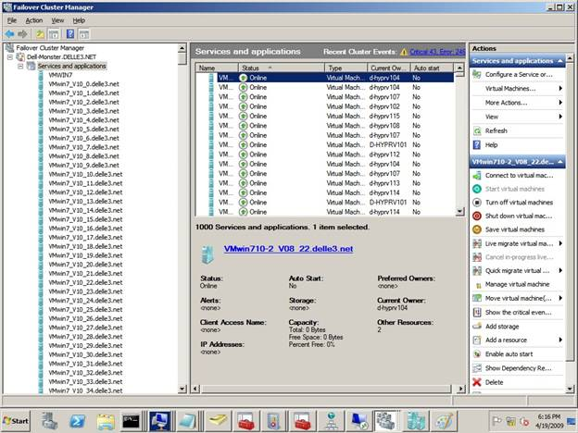
Planning Virtual Machine Density
1,000 VMs per cluster (4 – 16 nodes)
Deploy them all across any number of nodes
Reserve resources for 1 node failure
384 VM per node limit
512 VP per node limit
  12:1 virtual processors per logical
Up to 16 nodes in a cluster
Use Dynamic Memory (SP1 feature)
for greater density

Slide 15
Hyper-V Optimization with Failover Clustering

Slide 16







Quick Migration
Client accessing VM
Quick Migrate
Save state of VM
Offline VM & cluster resources
Move VM & cluster resources
SAN
Online Cluster Resources
Start VM
Client reconnects
VHD

Slide 17
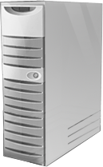

Cluster Shared Volumes
Hyper-V
Only in 2008 R2
Data over any network
Coordinator Node
SAN
Every node can access storage
1 LUN : Many VMs
VHD
VHD
VHD

Slide 18

Live Migration
Entire VM memory copied
Memory content is copied to new server
Live Migrate
SAN
May be additional incremental data copies until data on both nodes is essentially identical
VHD

Slide 19
Live Migration
Client directed to new host
Session state is maintained
No reconnections necessary
Clients stay connected
SAN
ARP redirects clients to new node
Old VM deleted after success
VHD

Slide 20
Protect the Memory of the Host
Root Memory Reserve
Windows Server 2008 R2 RTM
  Host memory reserve uses cluster property, RootMemoryReserved
  Prevent crashes if too much memory is committed during VM startup
  Sets the Hyper-V registry setting, RootMemoryReserve across all nodes
  Cluster default: 512 MB, max: 4 GB
Windows Server 2008 R2 SP1
  First, use Dynamic Memory
  Host memory reserve uses Hyper-V property, MemoryReserve
  Based on automatic “memory pressure” algorithm
  The cluster nodes all use this new value

Slide 21
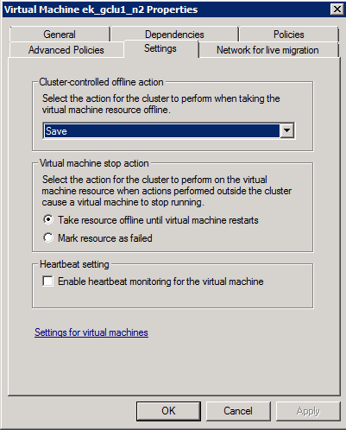
Enable VM Health Monitoring
Enable VM heartbeat setting
    Requires Integration Components (ICs) installed in VM
Health check for VM OS from host
    User-Mode Hangs
    System Crashes
CLUSTER
SAN

Slide 22
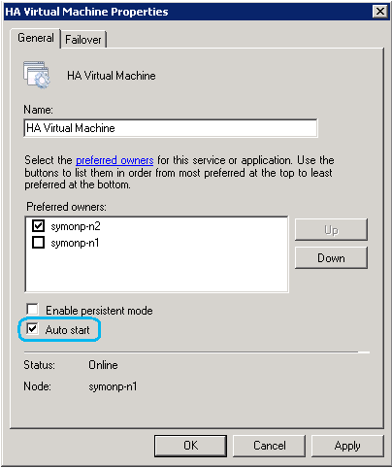
Disable Starting Low Priority VMs
‘Auto Start’ setting configures if a VM should be automatically started on failover
  Group property
  Disabling mark groups as lower priority
  Enabled by default
Disabled VMs needs manual
restart to recover after a crash

Slide 23
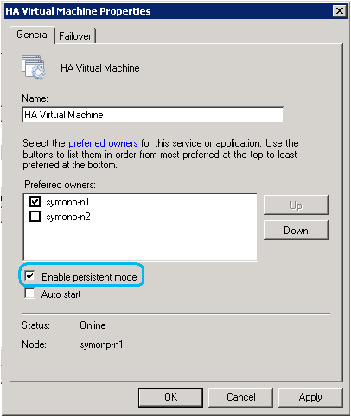
Start VMs on Preferred Hosts
‘Persistent Mode’ will attempt to place VMs back on the last node they were hosted on during start
  Only takes affect when complete cluster is started up
  Prevents overloading the first nodes that startup with large numbers of VMs
Better VM distribution after cold start
Enabled by default for VM groups

Slide 24
Keep VMs off the Same Host
AntiAffinityClassNames
  Groups with same AACN try to avoid moving to same node
Enables VM distribution across host nodes
Better utilization of host OS resources
Failover behavior on large clusters: KB 299631
Scenarios
  Separate similar VMs
    Guest cluster nodes
    DCs or infrastructure servers
  Separate tenets

Slide 25
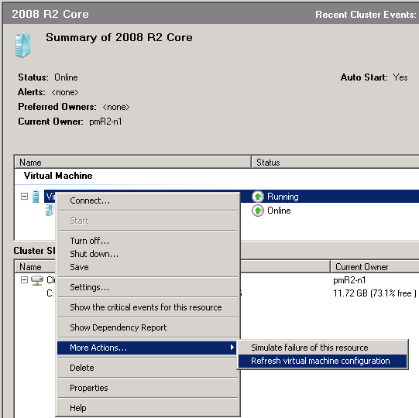
Refreshing the VM Configuration
Replicate VM configuration changes
  Hyper-V Manager is not cluster aware, changes will be lost
Storage
  Ensures VM on correct CSV disk with updated paths
Network
  Checks live migration compatibility
Several other checks performed

Slide 26
Windows Server 2012
Failover Clustering

Slide 27
Increased Scalability
Highly scalable infrastructure for the private cloud
Increased scale out and scale up
4x scale
  64-nodes
  4,000 VMs per cluster
  1,024 VMs per node
...
Scale up
. . .
Scale out
Robust management tools

Slide 28
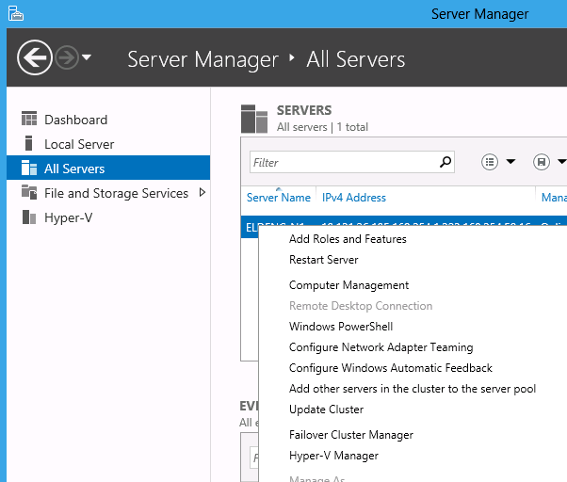
Multi-Machine Management with Server Manager
Cluster integration with new Server Manager
Remote multi-server management
Server Groups manage sets of machines
  Cluster Nodes
  Single-click action to add all cluster nodes
Launch cluster administrative tools
  Right-click node to launch Failover Cluster Manager
Remote Role and Feature installation

Slide 29
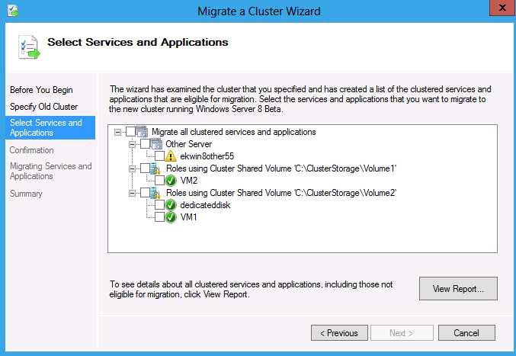
Upgrading Clusters to Windows Server 2012
Migrate your virtual machines from Windows Server 2008 R2
Cluster Migration Wizard
Automated Export / Import of VMs
Migrate to CSV disks
Storage mapping
Virtual network mapping
Use the same storage or different storage

Slide 30
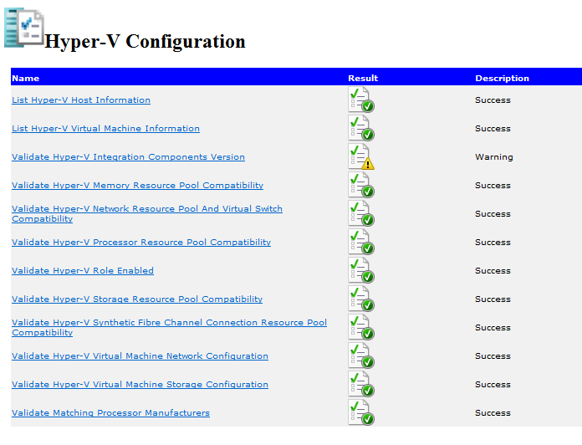
Validation Improvements
Optimized for Hyper-V Hosts
Faster test speed
Validate single LUNs
New Hyper-V Tests
  Integration Components
  Memory Compatibility
  Virtual Switch Compatibility
  Hyper-V Role Enabled
  Network Configuration
  Storage Configuration

Slide 31

Resource Placement in your Cloud
Virtual Machine Priority
Enhanced Failover Placement
Start Order
  Critical Servers
  Infrastructure
Running Priority
  Pre-emption shuts down low priority
Live Migration
Moves to node with most free resources
Requirements evaluated on each VM
Non-Uniform Memory Access (NUMA)
High
Medium
Low

Slide 32

VM Monitoring
Health detection of applications inside a virtual machine
Generic health monitoring for any application
  Monitor services through Service Control Manager
  Generation of specific Event IDs
The host identifies & recovers from services failures in the guest
  Application level recovery
    Service Control Manager (SCM) or event triggered
  Guest level HA recovery
    Failover Clustering gracefully reboots VM
  Host level HA recovery
    Failover Clustering fails over VM to another node

Slide 33
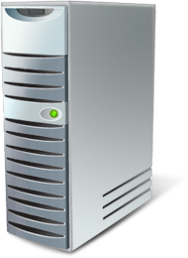

Improved Live Migration
New logic with huge scale
Live Migration Queuing
Concurrent Live Migrations
Traditional Cluster VM Mobility Enhancements
Concurrent Live Migrations:
Multiple simultaneous LMs for a given source or target
Cluster VM Mobility Enhancements:
Honors VM Prioritization: Node Drain, failback, Cluster aware updating…
Live Migration Queuing:
In-box tools queue & manage large numbers of VMs

Slide 34


New Live Migrations
Move a VM anywhere with zero downtime
Storage Live Migration
Network Live Migration
“Shared Nothing” Live Migration
Hyper-V Replica
Network Live Migration:
Moves VMs across the network, supports concurrent LMs
Network
Branch Office
“Shared Nothing” Live Migration:
Moves VMs & VHDs across the network & SAN, supports concurrent LMs
SAN
Hyper-V Replica:
Point-in-time replication of VHDs for disaster recovery
Network
Storage Live Migration:
Moves VHDs from one disk to another, supports concurrent LMs
VHD
VHD

Slide 35


Node Maintenance Mode
Simplify host patching & maintenance
Drain all VMs off a node
Supports all cluster roles
Role-specific features
  Live migration for VMs
  Quick or Live migration based on priority
  Traditional move group for workloads like SQL or File Server
Draining a node
Node is paused preventing new groups from moving to that node
All groups are issued a move
VMs are queued up and live migrated off based on priority
Resuming a node
Resume-ClusterNode –Failback invokes failback policies to return groups to that node when it is brought out of Maintenance Mode

Slide 36

Cluster-Aware Updating
Eliminate repetitive maintenance tasks
Initiate
Cluster-Aware Updating
Admin
Automated cluster updating
Coordinator serially updates all nodes
  Windows Update Agent (WUA)
    Windows Server Update Services (WSUS)
    Windows Update
Workflow
  Scan nodes to identify needed updates
  Identify node with fewest workloads
  Nodes drained
  Call to WUA to patch
  Verify successful
  Repeat steps 2 – 5 on next node
  Repeat on remaining nodes
Update
Coordinator
Windows
Update

Slide 37









Numerous Management Options
Failover Cluster Manager
PowerShell
RSAT
Command Line
(Cluster.exe)
WMI
System Center
Configuration Manager
Data Protection Manager
Operations Manager
Orchestrator
Virtual Machine Manager
Integrated Tool Experience

Slide 38
System Center
Virtual Machine Manager 2008 R2

Slide 39
Managing Hyper-V Clusters
Hyper-V on Windows Server 2008 & 2008 R2 Clusters
Scale Management
Automatic detection of configuration changes

Slide 40
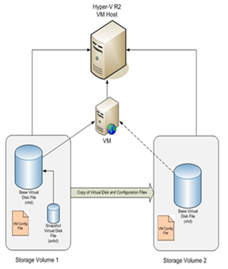
Quick Storage Migration (QSM)
Network migration to new storage or a new cluster
  Supports Cluster Shared Volumes (CSV)
VM stays online for as long as possible
Process
  Snapshot of running VM taken
  Base VHD copies to new location
    VM is still running
  Save State the VM
    clients are now disconnected
  Export VM configuration and snapshot
  Import VM configuration to new host
  Merge snapshot & resume Save State
  Client can reconnect

Slide 41
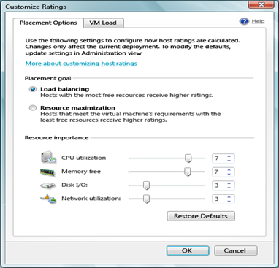
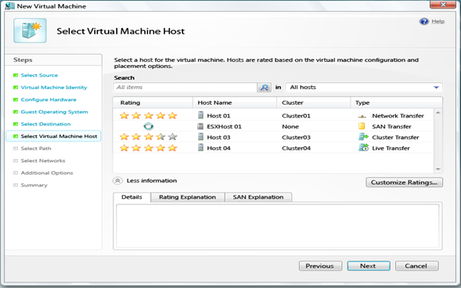
Intelligent Placement
Automates placement logic on hosts
Capacity planning improves resource utilization
Spreads VMs across nodes
‘Star-Rated’ results for easy decision making
Customizable algorithm

Slide 42

Enhanced Cluster Management
Enhanced Live Migrations
  Detects if live migration can be done
  Honors Intelligent Placement
  Live migration queuing
  Live migration retries
Node Maintenance Mode
  Automatically live migrate all VMs to other nodes
    Optional Save State for quick placement
  No VMs can move on to a host in maintenance mode
  Ideal for host maintenance and patching

Slide 43
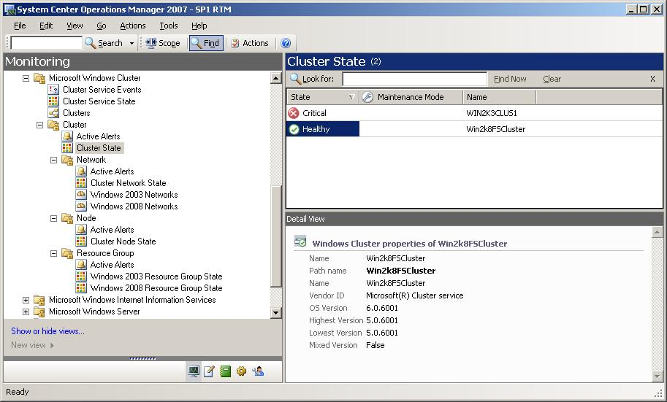
Performance & Resource Optimization
Integration between Operations Manager 2007 R2 & VMM
OpsMgr sends alerts to VMM
Automates capacity load balancing

Slide 44

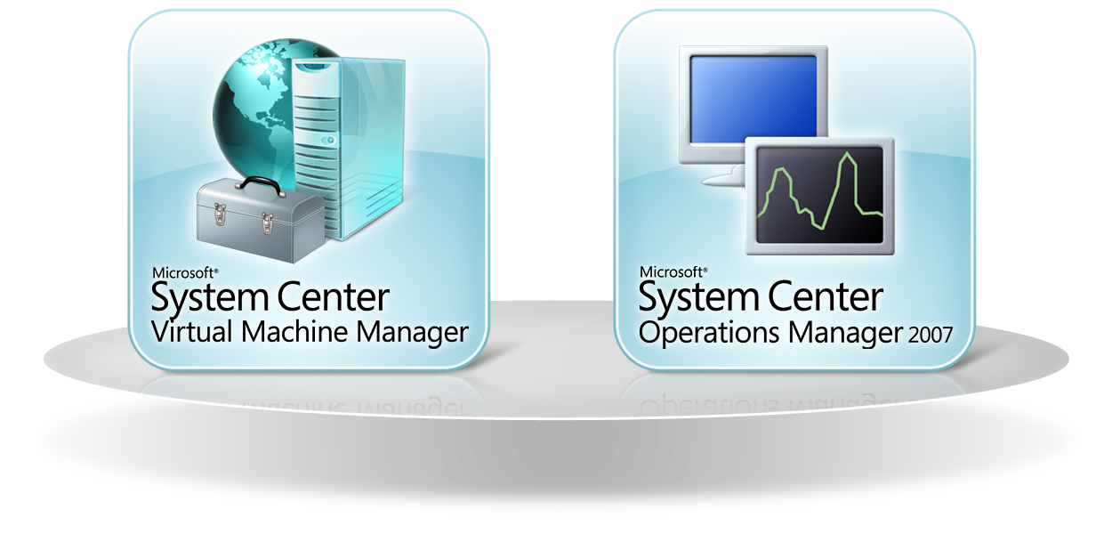

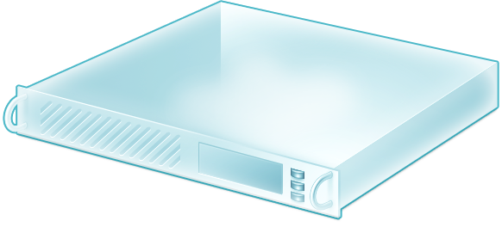


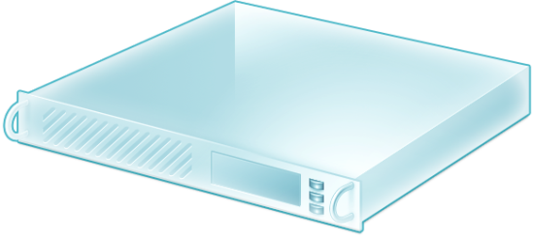
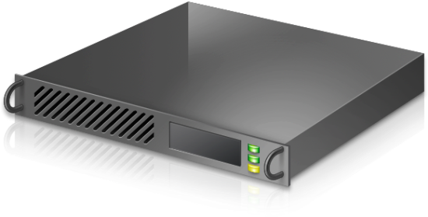


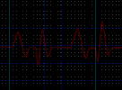
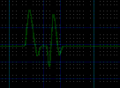
Putting it Together

Slide 45
System Center 2012
Virtual Machine Manager

Slide 46
High Availability Investments
Highly Available VMM Server
  Cluster-aware VMM server
    Can be guarded against OS and VMM failures
  Admin console with reconnect logic
Host Clusters
  Create non-HAVMs on clustered hosts
  Add/remove Hyper-V clusters in untrusted domains
  Hyper-V cluster creation & validation

Slide 47
Heterogeneous Hypervisor Management
SCVMM supports existing environments
  Windows Server 2008+ Hyper-V
  VMware vSphere 4.1+
    Requires vCenter
  Citrix XenServer 6.0+
    No dependency on XenCenter
Live migration, vMotion & XenMotion
Multiple hypervisors in the same “Cloud”
Services automatically deployed to correct hosts

Slide 48
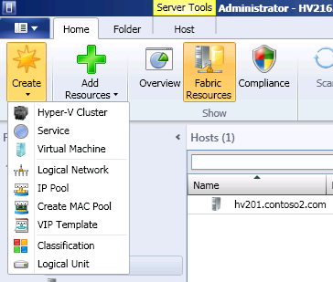





Bare Metal Cluster Provisioning
Configure
Boot & Install
Hyper-V Role
Failover Clustering Feature
Hyper-V Cluster
VMM Server
Bare Metal
Server
Configure
network
Configure storage
Validate the configuration
Storage
Cluster Shared Volumes (CSV)
Network
Notes:
48

Slide 49

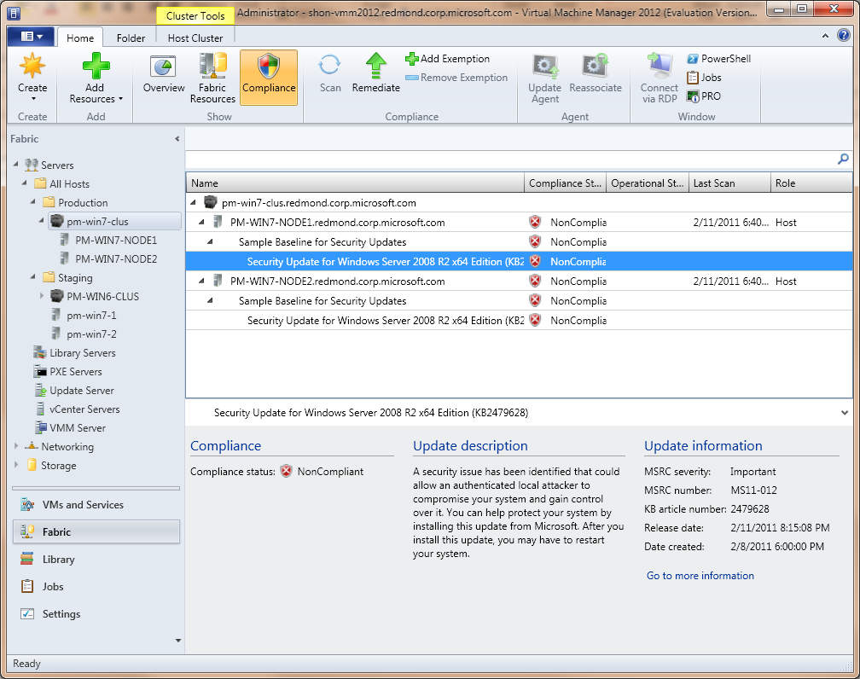
Update Management
Automated cluster updating
PowerShell Support
Most hosts can be patched
  Hosts, Host Groups, Host Clusters, VMM Server Roles (Library Server, PXE Server, Update Server, VMM Server)
  Cannot patch VMs (running or stored) or VHDs in library
Enable Feature
Manage Baselines
Scan Servers
Remediate Servers
Manage Exemptions

Slide 50





Infrastructure Management
Dynamic Optimization (DO)
  Cluster level workload balancing scheme to optimize for VM performance
  Leverages live migration to move workloads
Power Optimization (PO)
  Leverages live migration to pack more VMs per host
  Powers down servers to optimize for power utilization
Enhanced Placement
  Over 100 placement checks/validation
  Support for custom placement rules
  Multi-VM deployment for Services

Slide 51
Failover Clustering in Windows Server 2012
Infrastructure for the Private Cloud
Advanced Management
Hyper-V
Virtualization Platform
Infrastructure Integration

Slide 52


Related Content
DBI334 - Business Continuity Solutions in Microsoft SQL Azure
DBI316 - SQLCAT: SQL Server HA and DR Design Patterns, Architectures, and Best Practices Using Microsoft SQL Server 2012 AlwaysOn
MGT320 - Microsoft System Center Virtual Machine Manager 2012: Zero to Cluster to Cloud
MGT327 - Preparing for "The Big One": Protection and Disaster Recovery Using New Capabilities of Windows Server 2012 and Microsoft System Center 2012 SP1
VIR304 - Building Flexible Hyper-V Environments Windows Server 2012 Hyper-V Live Migration and Live Storage Migration
WSV310 - Windows Server 2012: Cluster-in-a-Box, RDMA, and More
WSV322 - Update Management in Windows Server 2012: Revealing Cluster-Aware Updating and the New Generation of WSUS
WSV324 - Building a Highly Available Failover Cluster Solution with Windows Server 2012 from the Ground UP
WSV410 - Continuously Available File Server: Under the Hood
WSV411 - Guest Clustering and VM Monitoring in Windows Server 2012
WSV430 - Cluster Shared Volumes Reborn in Windows Server 2012: Deep Dive
WSV34-HOL - Configuring a Highly Available Window Server 2012 iSCSI Target
WSV03-TLC - Windows Server 2012 High Availability

Slide 53



Resources
Learning
  Connect. Share. Discuss.
  Microsoft Certification & Training Resources
http://northamerica.msteched.com
www.microsoft.com/learning
TechNet
  Resources for IT Professionals
  Resources for Developers
http://microsoft.com/technet
http://microsoft.com/msdn

Slide 54







Required Slide
Complete an evaluation on CommNet and enter to win!

Slide 55


MS Tag
Scan the Tag
to evaluate this
session now on
myTechEd Mobile

Slide 56
© 2012 Microsoft Corporation. All rights reserved. Microsoft, Windows, Windows Vista and other product names are or may be registered trademarks and/or trademarks in the U.S. and/or other countries.
The information herein is for informational purposes only and represents the current view of Microsoft Corporation as of the date of this presentation. Because Microsoft must respond to changing market conditions, it should not be interpreted to be a commitment on the
part of Microsoft, and Microsoft cannot guarantee the accuracy of any information provided after the date of this presentation. MICROSOFT MAKES NO WARRANTIES, EXPRESS, IMPLIED OR STATUTORY, AS TO THE INFORMATION IN THIS PRESENTATION.

