Slide 1
Troubleshooting Windows 7 Deployments
WCL323
Michael Niehaus
Senior Program Manager
Microsoft Corporation

Slide 2
Windows 7 Deployment
An introduction
There are many ways to deploy Windows 7
  Leveraging common tools and techniques
  Assembled together into a full deployment process
So there are often many moving parts
  Lots of moving parts = lots of points for failure
  You need to be able to troubleshoot all parts
Different solutions have different parts

Slide 3

Windows 7 Deployment
A range of solutions
We will spend some time on each of these
Configuration Manager
2007 SP2 / 2012
Microsoft Deployment Toolkit
Windows Deployment Services
Core Windows AIK/ADK Tools
Build your own
(or 3rd party)
Simple Scenarios
More features
Complete Control

Slide 4
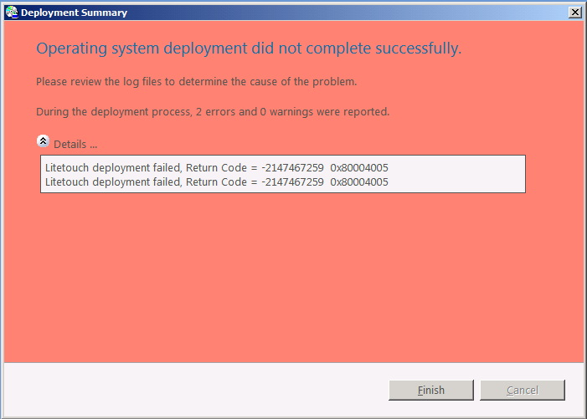
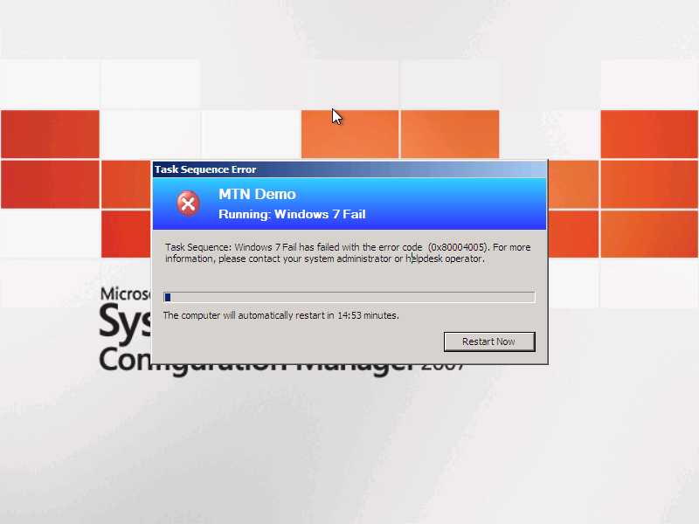
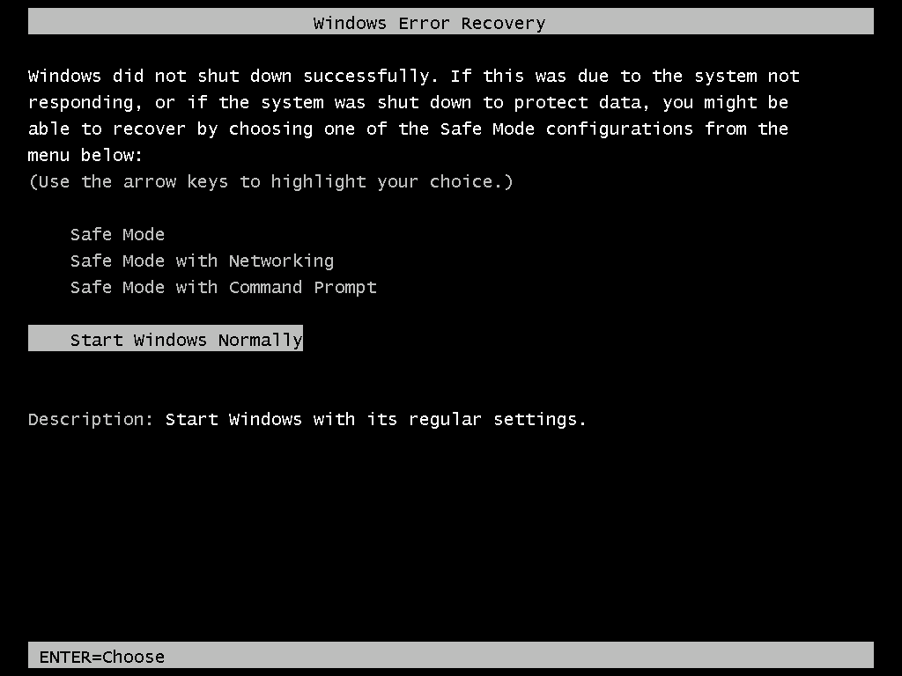
Windows 7 Deployment
Typical errors
Obviously these aren’t always very useful…

Slide 5
Windows 7 Deployment
Getting to the root cause
Logs, logs, and more logs
For best results:
  Understand what a successful deployment looks like
  Don’t be distracted by errors and warnings that aren’t really errors or warnings
  Pay as much attention to what isn’t in the logs as what is
  Know how to get error text from error numbers
  Use TRACE32/CMTrace from the ConfigMgr toolkit
    Use the latest version for Unicode, CM12 version for 64-bit
    Watch out for null characters in log files

Slide 6
Windows 7 Deployment
Getting to the root cause
Where do I look?
  You can never have too many log files, grab them all
  Find the error and work backwards to look for clues
  Error messages are often too high level, so you need to dig deeper
  Identifying the cause from these messages is a critical skill
Each tool creates its own logs (sometimes more than one)
  That’s a lot of logs…
  Know which ones to look at for each scenario

Slide 7
Windows 7 Deployment
Getting to the root cause
Using MDT?
  Configure SLShare (and maybe SLShareDynamicLogging)
  Enable Monitoring

Slide 8
Log Files

Slide 9
Operating System Logs
Windows 7 and Windows Vista
Two key logs created by the SETUP process
  Setupact.log: Contains information about setup actions during the installation process
  Setuperr.log: Contains only the error messages (subset of what is in Setupact.log)
Depending on when the failure occurs, the files can be located in different places:
  C:\$WINDOWS.~BT\Sources\Panther, X:\$WINDOWS.~BT\Sources\Panther (Windows PE)
  C:\WINDOWS\Panther (specialize)
  C:\WINDOWS\Panther\UnattendGC (OOBE)
  C:\WINDOWS\System32\Sysprep\Panther (sysprep)
http://support.microsoft.com/kb/927521

Slide 10
Operating System Logs
Windows 7 and Windows Vista
More useful logs:
  Cbs.log: Shows results of DISM commands to inject drivers, language packs, security updates, etc. during the OS installation process
  Setupapi.dev.log. Resides in %WinDir%\inf; useful when investigating failed driver installations
  Netsetup.log. Resides in %WinDir%\Debug; useful when troubleshooting domain join issues
  WindowsUpdate.log. Resides in %WINDIR%\; useful for detecting issues installing updates from Windows Update, WSUS, or ConfigMgr (SUP)

Slide 11
Operating System Logs
Windows PE
Two main logs:
  Wpeinit.log: Resides in X:\WINDOWS\system32 (so grab it before rebooting); useful when investigating start-up issues or slow initialization times
  Setupapi.dev.log. Resides in %WinDir%\inf; useful when investigating failed driver installations (just like in the full OS)

Slide 12
Operating System Logs
Windows Deployment Services
Logging to a file is disabled by default, so you first need to turn it on
  http://support.microsoft.com/kb/936625
Once enabled, there is one main log:
  WDSServer.log: Resides in C:\WINDOWS\Tracing; useful when confirming if WDS is seeing and processing requests

Slide 13
User State Migration Tools
Useful logs
Logs depend on what is being done:
  USMTEstimate.log. Created when estimating the USMT space requirements (not always created)
  USMTCapture.log or Scanstate.log. Created by the USMT when capturing data
  USMTRestore.log or Loadstate.log. Created by the USMT when restoring data
  USMTCapture.prg or USMTRestore.prg. Created by USMT

Slide 14
Task Sequencer
Useful logs
SMSTS.log. This file is created by the Task Sequencer and describes all Task Sequencer transactions.
  Depending on the deployment scenario, it may move around:
    %TEMP%\SMSTSLog
    %WinDir%\System32\ccm\logs
    %WINDIR%\Syswow64\ccm\logs
    C:\_SmsTaskSequence\Logs
    C:\SMSTSLog
    X:\SMSTSLog

Slide 15
Microsoft Deployment Toolkit
Useful logs
Each script generates its own log file in the log path
The log path will change based on the type of deployment and phase
  X:\MININT\SMSOSD\OSDLOGS
  C:\MININT\SMSOSD\OSDLOGS
  C:\_SmsTaskSequence\SMSOSD\OSDLOGS
  C:\Windows\Temp\Deploymentlogs
BDD.log contains a summarized view of all other MDT log files
  Some pieces might require looking at other files (e.g. ZTIBackup_ImageX.log, USMTCapture.log)

Slide 16
Configuration Manager
Useful logs
Other useful logs beyond the SMSTS.LOG include:
  DriverCatalog.log: Contains information that may be useful when getting errors while importing drivers
  TaskSequenceProvider.log: Useful when getting errors while saving or importing a task sequence
  SMSPXE.LOG: Used when troubleshooting PXE boot issues
  SMSPROV.LOG: May have more error details while saving or importing a task sequence
More at http://technet.microsoft.com/en-us/library/bb932135.aspx

Slide 17
Getting to the Logs
Magic keystrokes:
  With ConfigMgr, check the “Enable command support (testing only)” box to enable F8 while in Windows PE
    No reboot until the command prompt exits.
  With MDT 2010 Lite Touch, F8 always works while in Windows PE
    No reboot until the command prompt exits
  While Windows Setup is running, press Shift-F10 to get a command prompt

Slide 18
Common Issues:
Windows 7

Slide 19
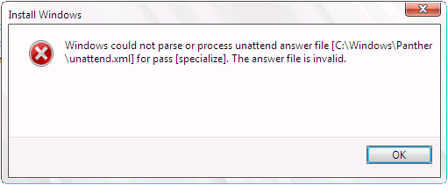
Windows Setup Failures
Bad computer name
From setuperr.log:
  [windeploy.exe] Setup failed,
  returning exit code [0x1f]
From BDD.LOG (Lite Touch):
  Setup failed applying image <path>, rc = 31
Dig into details in setupact.log:
  [setup.exe] SMI data results dump: Source = Name: Microsoft-Windows-Shell-Setup, …, /settings/ComputerName
  [setup.exe] SMI data results dump: Description = Value is invalid
Cause:
  Computer names can be at most 15 characters long (may be a problem using OSDComputerName=%SerialNumber%)
Key learning: Error 31 means “something is wrong with unattend.xml”
How to shoot yourself in the foot

Slide 20
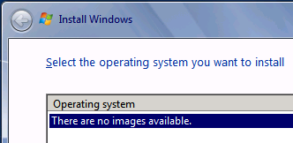
Windows Setup Failures
Mismatched product key
From setuperr.log:
  CallBack_SelectImageOrShowUi:
  There are no matching OS images
Dig into details in setupact.log:
  CallBack_ProductKey_Validate: EditionID for product key is Professional
  CDepImageXMLInfo::GetEditionID:EditionID=Enterprise, Flags=Enterprise : Returning Enterprise
  SelectOSImages: Using EditionID as a constraint and couldn’t find any matching image
Cause:
  Product key specified didn’t match the image
  May also mean no EditionID was captured (Windows 7 with certain patches or old ImageX) or Flags wasn’t specified (Windows Vista)
Key learning:
  “No images” might mean “no matching images”

Slide 21
Windows Setup Failures
Broken domain join
Simplest scenario:
  Create an autounattend.xml with domain join details, prompting for the computer name
  Install Windows from media
Issue:
  Domain join happens with a random computer name, and the later computer rename breaks the domain trust
Cause:
  http://support.microsoft.com/kb/944353, “by design”
Workaround:
  Run a command (e.g. NETDOM) or script later to do the join
  Build an unattend with all the needed information, then install
Key learning:
  That’s why other tools don’t do it this way
IBM, acronym, “broken as design”

Slide 22
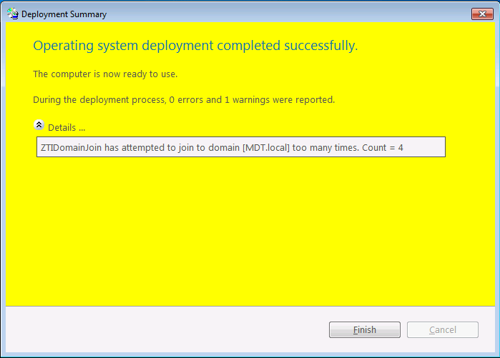
Windows Setup Failure
Domain join issues
Issue:
  OS deployment is successful, but the
  computer is still in a workgroup
  From SETUPACT.LOG:
    [DJOIN.EXE] Unattended Join:
    NetJoinDomain failed error code is [1355]
  From %WINDIR%\Debug\Netsetup.log:
    NetpGetComputerObjectDn: Specified path ‘CN=Computers,DC=domain,DC=com’ is not an OU
Causes:
  Incorrect join settings
Key learning:
  Don’t specify CN=Computers, leave the OU blank instead
  “NET HELPMSG 1355” is “invalid domain” – kind of misleading
  It’s a quiet “failure”, unless using MDT Lite Touch
Insanity is doing the same thing over and over and expecting a different result.

Slide 23
Windows Setup Failure
Domain join issues
Issue:
  Computer joins the domain but doesn’t end up in the specified OU
Causes:
  “By design”, the existing computer object is updated but it won’t be moved to another OU
Key learning:
  It may be necessary to move the computes to another OU manually or using a script
  You can use WMI filters to exclude GPOs if necessary
Issue:
  Join fails if the computer object already exists but works otherwise
Causes:
  Join account needs to update the existing computer object

Slide 24
Windows Setup Failure
Crashes
Issue:
  You see this screen instead of new OS
  Rebooting has the same result
Causes:
  Blue screen crash
    Bad driver (e.g. x64 injected into x86)
    Missing mass storage driver
Key learning:
  To get more information, uncheck “Automatically restart” on system failure or set registry key in the OS image:
    HKLM\System\CurrentControlSet\Control\CrashControl\AutoReboot=0
    http://support.microsoft.com/kb/307973
  STOP 0x7B: Mass storage driver issue
    http://support.microsoft.com/kb/324103
  Status 0xc0000359: Wrong driver platform
    http://support.microsoft.com/kb/2008373
  Dumps may be required
Blue screen pictures

Slide 25
Windows Setup Failures
demo

Slide 26
Common Issues:
Windows PE

Slide 27
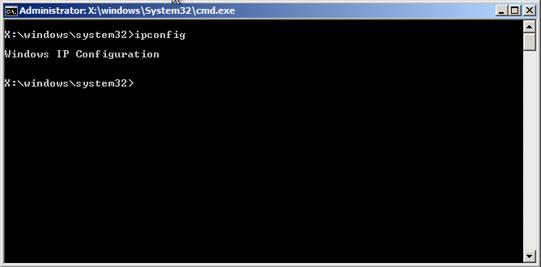
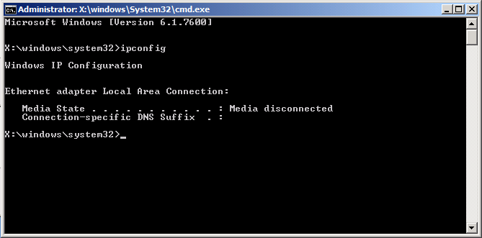
Windows PE Failures
Networking issues
Issue:
  A connection to the
  deployment share <share>
  could not be made.
  Failed to find a valid
  network adapter.
  An error occurred while
  retrieving policy for this
  computer (0x80072EE7)
Causes:
  No DHCP address received (portfast)
  No network driver
  Name resolution issue
Key learning:
  Press F8 to get to a command prompt, IPCONFIG to see networking details, PING/NSLOOKUP to check name resolution

Slide 28
Common Issues: Microsoft Deployment Toolkit

Slide 29
Microsoft Deployment Toolkit
Task sequence doesn’t resume in new OS
Issue:
  A customer performs a Lite Touch deployment and the OS installs correctly. However, the machine doesn’t automatically log in to resume the task sequence.
  When logging in manually, the task sequence still doesn’t continue.
  When looking for the C:\Windows\Panther\UnattendGC\setupact.log, they find it is missing or old.
Causes:
  The image wasn’t sysprepped – either it failed (look for C:\Windows\system32\sysprep\Panther\setupact.log) or it wasn’t executed at all.
Key learning:
  Ask how the customer captured the image. In most cases, this happens when the customer captures the image by hand and misses some steps.
  (Yes, sysprep is required, see http://blogs.technet.com/b/deploymentguys/archive/2009/12/03/sysprep-machine-sids-and-other-myths.aspx)

Slide 30
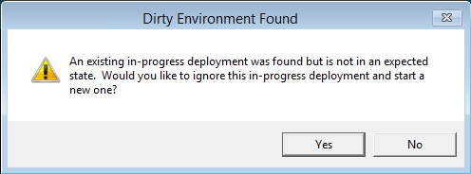
Microsoft Deployment Toolkit
Task sequence failure causes issues for the next task sequence
Issue:
  A task sequence fails or doesn’t complete, leaving behind files that interfere with the next task sequence that runs on the computer
Causes:
  The original failure can happen for a number of reasons:
    Wrong boot order, Windows Setup failure, pressing the power button, missing network or mass storage driver, etc.
    Suspending a task sequence but not resuming it
  Subsequent issues are caused by MININT and/or _SMSTaskSequence folders present from the original failure
Key learning:
  Move to MDT 2012!

Slide 31
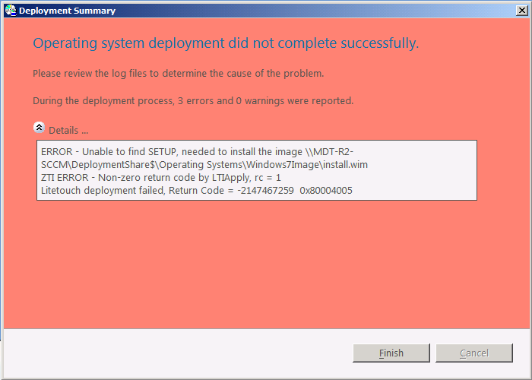
Microsoft Deployment Toolkit
Unable to find SETUP
Issue:
  When deploying Windows 7 via
  MDT Lite Touch, the OS install fails
  with an error:
    ERROR - Unable to find SETUP,
    needed to install the image
Cause:
  MDT Lite Touch always uses SETUP.EXE to install the OS
  If you import an image without SETUP files from the original media, or if you are doing a cross-platform deployment, it will try to find another copy of the deployment share
  If there are no matching copies, it fails
Key learning:
  Make sure at least one image on the deployment share (or media) has source files
  See the MDT troubleshooting guide

Slide 32
Microsoft Deployment Toolkit
Task Sequence Failures
Issue:
  Task sequence failure, return
  code -2147467259 (80004005)
Cause:
  A step in the task sequence failed
  Could be just about anything
    Incorrect command lines
    Batch files run without “cmd.exe /c”
    Batch files using relative file references (issue when run via a UNC)
    MSU files without “wusa.exe /quiet”
    Unexpected return codes
  Find the SMSTS.LOG to see the real reason
Key learning:
  This error does not mean “access denied”
  Use TRACE32 or similar tools to look up errors
  Use tools to capture the errors
Red herring

Slide 33
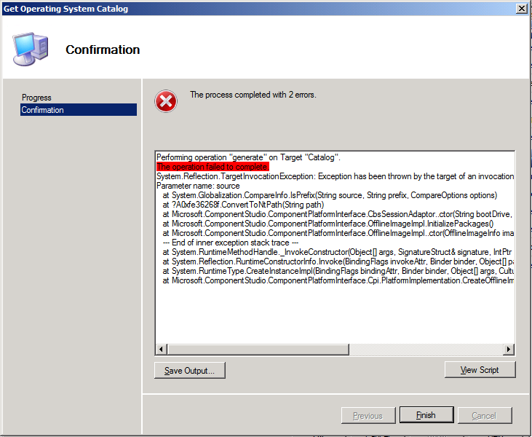
Microsoft Deployment Toolkit
Catalog generation error
Issue:
  When trying to edit an unattend.xml
  associated with a custom WIM image,
  a catalog (CLG) file needs to be
  generated matching what is in the
  image
  Catalog generation fails
Causes:
  Unable to mount the WIM (fails quickly), often a WIMGAPI issue
  Issues with antivirus software (fails slowly) when it tries to mount registry hives from the image
  Unsupported for an x86 WIM on an x64 OS (fails slowly)
    See note at http://technet.microsoft.com/en-us/library/dd744500(WS.10).aspx
Key learning:
  You might need to use an x86 OS to generate a catalog for x86 OSes

Slide 34
Common Issues:
ConfigMgr OS Deployment

Slide 35
ConfigMgr OS Deployment
Task Sequence Failures
Issue:
  Task sequence failure, return
  code -2147467259 (80004005)
Cause:
  A step in the task sequence failed
  Most of the same causes as with
  Lite Touch
  Find the SMSTS.LOG to see the real reason, or check the status messages
  (they contain the last 1024 characters of output)
Key learning:
  This error does not mean “access denied”
  Use TRACE32 or similar tools to look up errors
  Use tools to capture the errors…

Slide 36
ConfigMgr OS Deployment
Windows is running from D:\WINDOWS
Issue:
  Using the original INSTALL.WIM as an OS image package, the OS ends up on the D: drive
Cause:
  When using an OS image package, ConfigMgr forces the OS to use the same drive letter as where it was captured
    Technically this isn’t needed any more for Windows 7…
  Windows 7 is originally installed on D:
    Done in the Windows build lab before sysprepping and capturing
Key learning:
  Install from an OS install package (as SETUP will fix the drive letter)
  Create a custom image using an OS install package (captured from C:) and deploy that instead

Slide 37
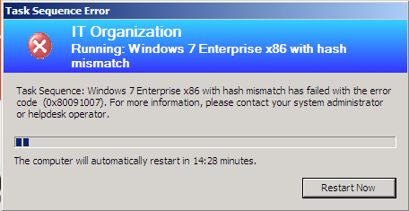
ConfigMgr OS Deployment
Hash mismatch
Issue:
  Task sequence will fail if
  the downloaded content
  hash does not match what
  was previously calculated
Cause:
  Usually unknown, often happens with new packages
Resolution:
  Refresh the DPs for the affected package
Key learning:
  Test your task sequence to make sure it works before targeting large groups of machines

Slide 38
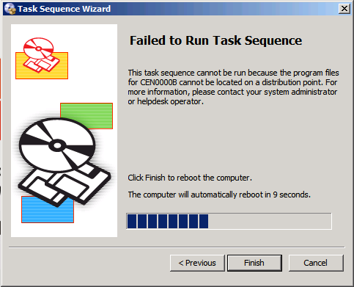
ConfigMgr OS Deployment
Packages not available
Issue:
  Task sequence won’t run
  if all packages are not
  available on DPs
Cause:
  Packages never distributed
  to accessible DPs
  Pending package distributions
  Out-of-date task sequence policies (clients need to poll again)
Resolution:
  Push the required packages, wait for policy update
  Scripted…

Slide 39
ConfigMgr OS Deployment
PXE boot issues
Issues:
  Computers will not PXE boot
Causes:
  Networking issues (BOOTP forwarders, PORTFAST configuration)
    PXE-E53: No boot filename received
  DHCP option configuration
    Same vs. different server, options 60/66/67
  Unknown computer support not enabled
  No task sequence advertisements
    “All Systems” doesn’t include “All Unknown Computers”
    ABORTPXE
  No boot images available for task sequence advertisements
    X86 and x64 are needed in order to extract needed files
  Cached information on server
    Default cache time of 60 minutes (including negative)
    ABORTPXE

Slide 40
ConfigMgr OS Deployment
PXE boot issues
Resolutions and troubleshooting instructions:
  Distribute both boot images (x86, x64)
  Check SMSPXE.LOG and WDSSERVER.LOG
    Ignore dummy “ping” requests, search for computer’s MAC or UUID
    Look at lines after “LookupDevice” and “GetBootAction”
  Set the cache expire time
  http://support.microsoft.com/kb/2019640
  Know the meanings of different PXE error codes
  http://h18013.www1.hp.com/products/servers/management/rdp/knowledgebase/00000138.html
  More troubleshooting notes
  http://blogs.technet.com/smsandmom/archive/2008/09/17/configmgr-2007-troubleshooting-pxe-service-point-issues-and-wds-service-not-starting.aspx
Key learning:
  Troubleshooting requires an understanding of what is going on – pay attention to subtle details

Slide 41
Troubleshooting ConfigMgr PXE Booting
demo

Slide 42
Troubleshooting Techniques

Slide 43
Manually Testing Deployments
How to restart a task sequence
Application installation test Task Sequence
Testing the gather process

Slide 44
Troubleshooting Techniques
demo

Slide 45
Stumped?
Become a fan of MDT
  http://www.facebook.com/MicrosoftDeploymentToolkit
Contact Microsoft Support
  Have all logs ready, they’ll ask for them
Use the “MDT” and ConfigMgr OSD forums on TechNet:
  http://social.technet.microsoft.com/Forums/en-US/mdt
  http://social.technet.microsoft.com/Forums/en-US/configmgrosd
  Post your error messages, or even logs
Use the MDTOSD mailing list, hosted by http://www.myitforum.com

Slide 46



Related Content
Breakout Sessions (session codes and titles)
Hands-on Labs (session codes and titles)
Product Demo Stations (demo station title and location)
Related Certification Exam
Find Me Later At…

Slide 47
DEV Track Resources
Visual Studio Home Page :: http://www.microsoft.com/visualstudio/en-us
Somasegar’s Blog :: http://blogs.msdn.com/b/somasegar/
Jason Zander’s Blog :: http://blogs.msdn.com/b/jasonz/
Facebook :: http://www.facebook.com/visualstudio
Twitter :: http://twitter.com/#!/visualstudio

Slide 48



Resources
Learning
  Connect. Share. Discuss.
  Microsoft Certification & Training Resources
http://northamerica.msteched.com
www.microsoft.com/learning
TechNet
  Resources for IT Professionals
  Resources for Developers
http://microsoft.com/technet
http://microsoft.com/msdn

Slide 49







Complete an evaluation on CommNet and enter to win!

Slide 50


MS Tag
Scan the Tag
to evaluate this
session now on
myTechEd Mobile

Slide 51
© 2012 Microsoft Corporation. All rights reserved. Microsoft, Windows, Windows Vista and other product names are or may be registered trademarks and/or trademarks in the U.S. and/or other countries.
The information herein is for informational purposes only and represents the current view of Microsoft Corporation as of the date of this presentation. Because Microsoft must respond to changing market conditions, it should not be interpreted to be a commitment on the
part of Microsoft, and Microsoft cannot guarantee the accuracy of any information provided after the date of this presentation. MICROSOFT MAKES NO WARRANTIES, EXPRESS, IMPLIED OR STATUTORY, AS TO THE INFORMATION IN THIS PRESENTATION.

