Slide 1
Raiders of the Elevated Token:
Understanding User Account Control and Session Isolation
WCL325
Raymond P.L. Comvalius
Independent IT Infrastructure Architect
NEXTXPERT

Slide 2

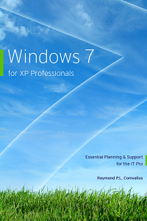
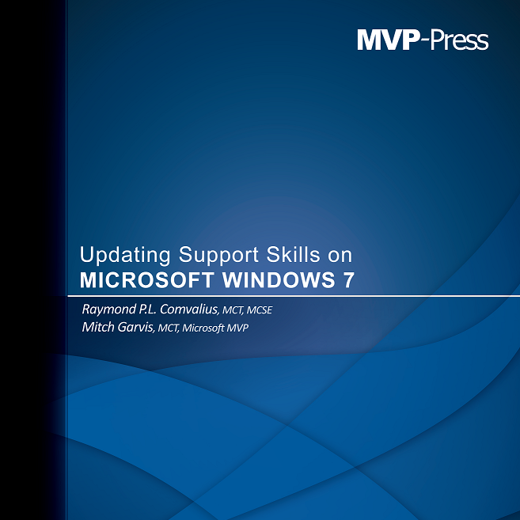

About the speaker
Raymond P. L. Comvalius
  Consultant, trainer and author
  MVP Windows Expert IT Pro since 2011
  raymond.comvalius@nextxpert.com
@nextxpert

Slide 3
Agenda
User Account Control
  What is UAC?
  Configuring User Account Control
  Integrity Levels
  File & Registry Virtualization
  How to Control Elevation
Session 0 Isolation
Service ID

Slide 4
What is User Account Control?
“The UAC solution is to run most applications with standard user rights…., and encourage software developers to create applications that run with standard user rights.
UAC accomplishes this by enabling legacy applications to run with standard user rights, making it convenient for standard users to access administrative rights when they need them.” From: Microsoft Technet
“UAC is not a security boundary”

Slide 5

Windows User Types
The Administrator
  The account named ‘administrator’
An Administrator
  Your name with administrator privileges
Protected Administrator
  AKA: ‘Administrator in Admin Approval Mode’
Standard User
  Your name without administrator privileges

Slide 6
Standardizing the User Token
  Administrators
  Backup Operators
  Power Users
  Network Configuration Operators
  Cryptographic Operators
  Domain Admins
  Schema Admins
  Enterprise Admins
  Group Policy Creator Owners
  Domain Controllers
  Enterprise Read-Only Domain Controllers
  Account Operators
  Print Operators
  Server Operators
  RAS Servers
  Pre-Windows 2000 Compatible Access
User SID
Deny
Group SIDs
Mandatory Label
  Remove all except:
  Bypass traverse checking
  Shutdown the System
  Remove computer from Docking station
  Increase a process working set
  Change the Time zone
Rights/Privileges

Slide 7
Analyzing the User Token
Demo
Demo
With or without administrative privileges

Slide 8
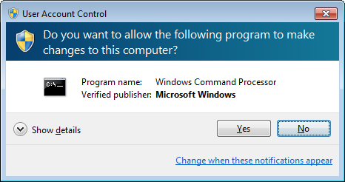
Consent UI
The ‘face’ of UAC
Warns you for a User State change
(aka new token creation)
Secure Desktop
  Screen mode like pressing Ctrl-Alt-Del
  Creates screenshot of the desktop (programs keep running in the background)
  Keeps scripts etc. from pressing keys or clicking the mouse

Slide 9
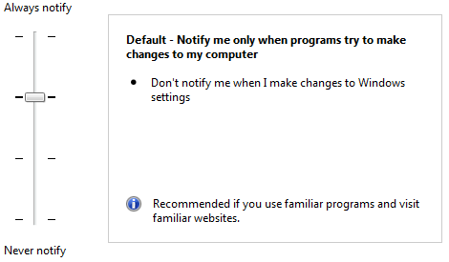
Configuring UAC in the Control Panel
From the Control Panel
  Always notify
  Default
  Do not dim the display
  Never notify
With Group Policy
  More granular controls

Slide 10
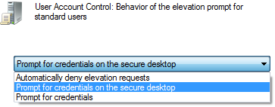
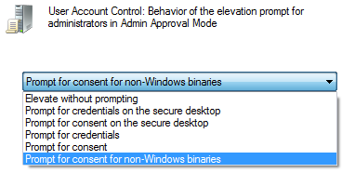
Configuring UAC in Group Policy
Behavior for Standard Users
  Deny Access
  Prompt for Credentials
Admin Approval Mode for the built-in Administrator account
For Administrators in Admin Approval Mode
  Prompt for Consent
  Prompt for Credentials
  Elevate without prompting
    Not same as disable UAC!

Slide 11
Configuring UAC
Demo

Slide 12
UIAccess Applications
Software alternatives for the mouse and keyboard
  For example Remote Assistance
User Interface Accessibility integrity level
Windows always checks signatures on UIAccess Applications
UIAccess applications must be installed in secure locations
Optionally these applications can disable the secure desktop (used with Remote Assistance)

Slide 13
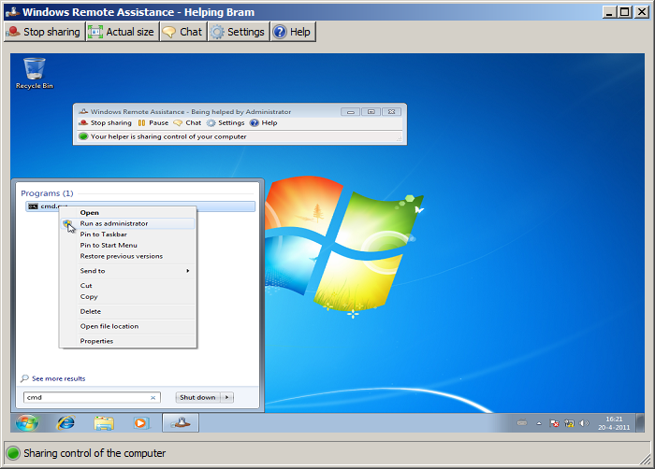
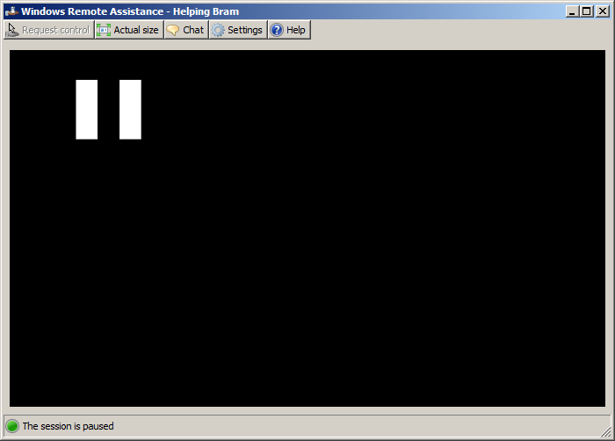
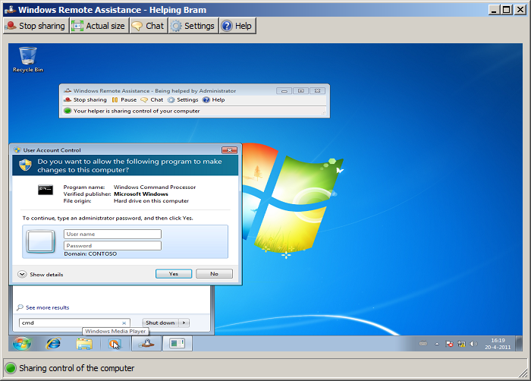
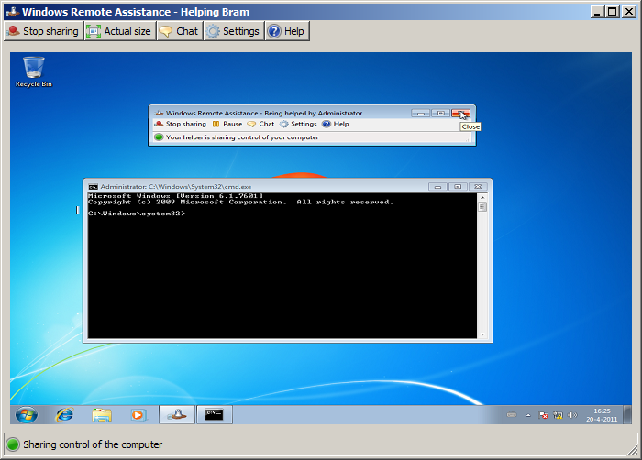
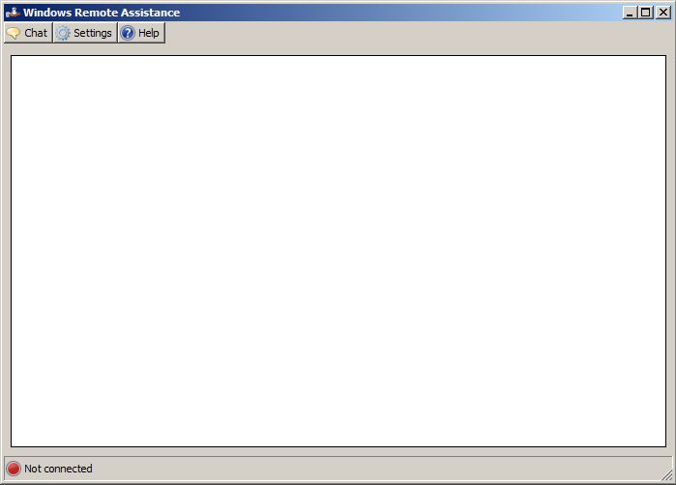
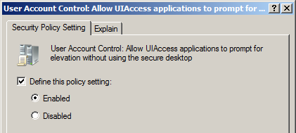
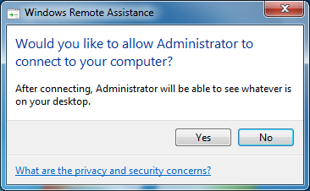
Remote Assistance and the Secure Desktop
for non-administrative users

Slide 14
Integrity Levels
Mandatory Access Control
Levels are part of ACLs and Tokens
Lower level object has limited access to higher level objects
Used to protect the OS and for Internet Explorer Protected Mode
Services
Administrators
Standard Users
IE Protected Mode
Medium
(Default)
System
High
Low

Slide 15
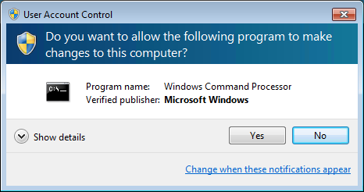
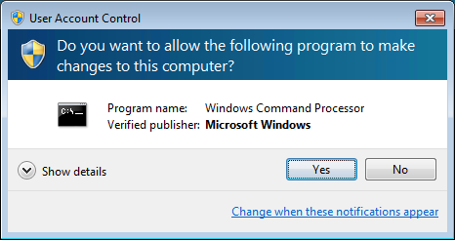
Standardizing the User Token
User SID
Group SIDs
  Integrity Level: High
  (Elevated Token)
Mandatory Label
  Integrity Level: Medium
  (Restricted Token)
Rights/Privileges

Slide 16

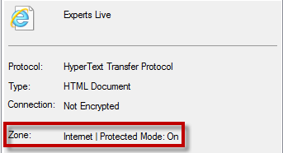

IE Protected Mode
Only with User Account Control enabled
iexplore.exe runs with Low Integrity Level
User Interface Privilege Isolation (UIPI)
Internet Explorer 8
Internet Explorer 9/10

Slide 17



IE Broker mechanism
iexplore.exe (management process)
Protected-mode Broker Object
UI Frame
Favorites Bar
Command Bar
Low Integrity Level
Protected Mode = On
Medium Integrity Level
Protected Mode = Off
iexplore.exe (content process)
iexplore.exe (content process)
Toolbar Extensions
Toolbar Extensions
ActiveX Controls
ActiveX Controls
Trusted Sites
Internet/Intranet
Browser Helper Objects
Browser Helper Objects

Slide 18
Integrity Levels
Demo

Slide 19
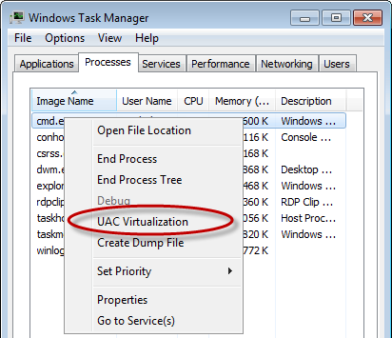
File Virtualization
File Virtualization is a compatibility feature
The following folders and subfolders are virtualized:
  %WinDir%
  \Program Files
  \Program Files (x86)
Virtual Store:
  %UserProfile%\AppData\Local\VirtualStore
Troubleshooting file virtualization
  Event Log: UAC-FileVirtualization
Disabling file virtualization

Slide 20
Registry Virtualization
Virtualizes most locations under HKLM\Software
Keys that are not virtualized:
  HKLM\Software\Microsoft\Windows
  HKLM\Software\Microsoft\Windows NT\
  HKLM\Software\Classes
Per user location: HKCU\Software\Classes\VirtualStore
Flag on a registry key defines if it can be virtualized
  “Reg flags HKLM\Software” shows flags for HKLM\Software
Registry Virtualization is NOT logged in the EventLog

Slide 21
File & Registry Virtualization
Demo

Slide 22
What defines a UAC state change
Executables that are part of the Windows OS
File Names
Manifests
Compatibility Settings
Shims

Slide 23
UAC for the Windows OS
Default no warning when elevating Windows OS programs
Except for:
  cmd.exe
  regedit.exe

Slide 24
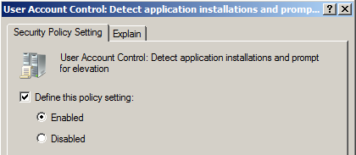
What’s in a name?
Evaluation of the file name determines need for elevation
  Setup
  Instal
  Update
Disable this feature in Group Policy when needed

Slide 25
UAC and Manifests
Configure the need for elevation per file:
  asInvoker
  highestAvailable
  requireAdministrator
External or Internal
Use mt.exe from the SDK to inject manifests
Use sigcheck.exe from SysInternals to view manifests

Slide 26
File Names & Manifests
Demo

Slide 27
UAC and Compatibility Settings
Configure the shortcut
  RequireAdministrator
  RunAsInvoker
Create a Shim
  Needs the Application Compatibility Toolkit
  Compatibility Administrator
  Compatibility Modes
  Compatibility Fixes

Slide 28
Compatibility Settings
Demo

Slide 29
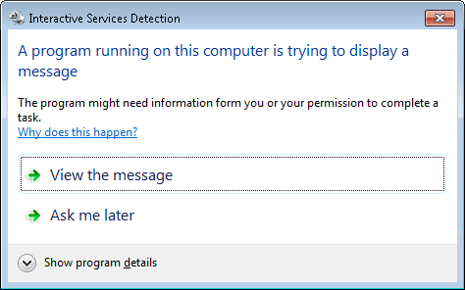
Does this look familiar?

Slide 30
Session 0 Isolation
Services run in session 0
Before Windows Vista, session 0 belonged to the console
Users logon to session 1 and higher
When a service interacts in session 0 you see this message on Windows 7 and earlier

Slide 31
Session 0 Isolation
Demo

Slide 32
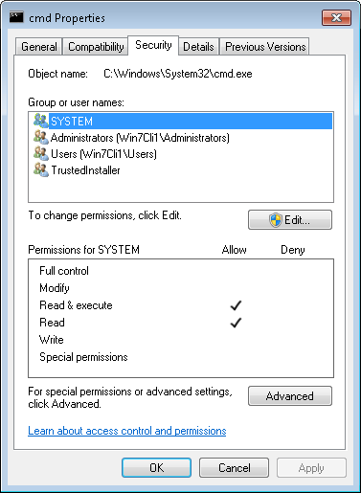
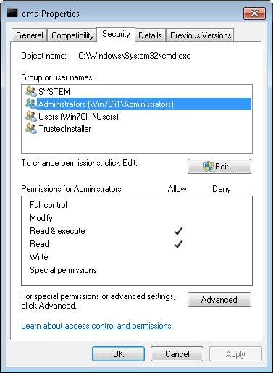
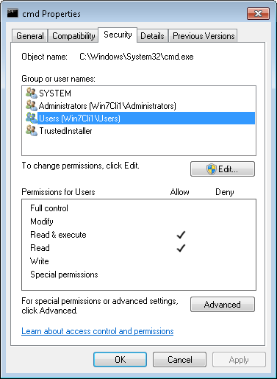
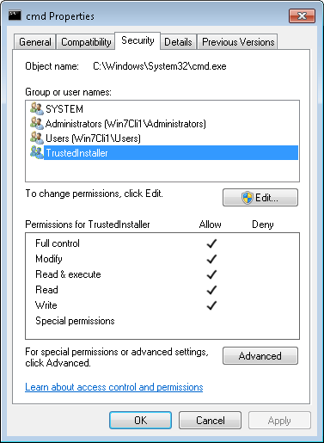
Windows OS File Security

Slide 33

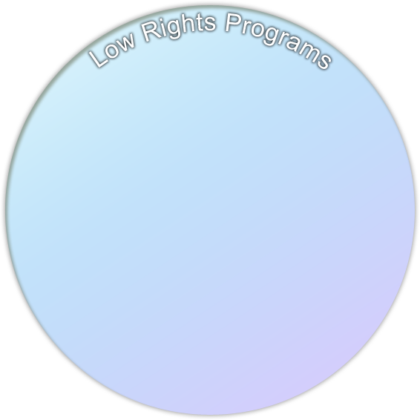

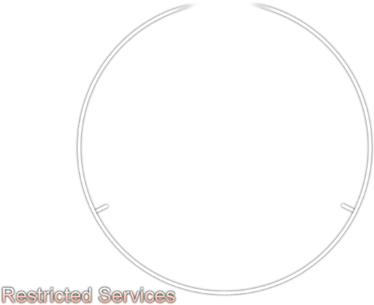





Multiple Layers of Protection
Reduce size of
high risk layers
Increase #
of layers
Segment the
services
Service
…
Service
1
D
Service
…
D
D
Service
2
Service
A
Service
3
Service
B
D
Kernel Drivers
D
User-mode Drivers
D
D
D

Slide 34
Services SID
Services now have SIDs
  S-1-80-<SHA-1 hash of logical service name>
ACLs have been set on these SIDs
Services are taken out of the LocalSystem security context
LocalSystem is no longer “The Master of the Universe”

Slide 35
Who is TrustedInstaller?
“Windows Installer Service” in the Services MMC
“NT Service\TrustedInstaller” in icacls.exe
TrustedInstaller installs:
  Windows Service Packs
  Hotfixes
  Operating System Upgrades
  Patches and installations by Windows Update

Slide 36
Concluding

Slide 37
Yes you can!
User Account Control is no rocket science
UAC makes Internet Explorer a safer browser
Analyze your applications
Get to know the tools
  whoami.exe
  Process Explorer
  icacls.exe
  Application Compatibility Toolkit

Slide 38


Related Content
WCL301: Case of the Unexplained 2012
WCL402: App Compat for Nerds
www.microsoft.com/springboard
www.nextxpert.com
Find Me Later At the Technical Learning Center

Slide 39
Track Resources
Resources for Developers
http://msdn.microsoft.com/en-us/windows/apps
Windows 8 is ready for Business
http://www.microsoft.com/en-us/windows/enterprise/products-and-technologies/windows-8/default.aspx
Microsoft Desktop Optimization Pack:
www.microsoft.com/MDOP
Microsoft Desktop Virtualization:
www.microsoft.com/dv

Slide 40
Track Resources
Track Resources
Springboard Series: www.microsoft.com/springboard
Explore > Plan > Deliver > Operate > Support for
Windows 7 and Windows 8
MDOP
Desktop Virtualization
Windows Intune
Internet Explorer 8, 9 and 10

Slide 41
Download the Windows 8 Release Preview Today
Download
http://windows.microsoft.com/en-US/windows-8/release-preview

Slide 42



Resources
Learning
  Connect. Share. Discuss.
  Microsoft Certification & Training Resources
http://northamerica.msteched.com
www.microsoft.com/learning
TechNet
  Resources for IT Professionals
  Resources for Developers
http://microsoft.com/technet
http://microsoft.com/msdn

Slide 43







Required Slide
Complete an evaluation on CommNet and enter to win!

Slide 44





Please Complete an Evaluation
Your feedback is important!
Be eligible
to win great daily prizes and the grand prize of a $5,000 Travel Voucher!
Multiple
ways to Evaluate Sessions
Scan the Tag
to evaluate this
session now
on myTechEd Mobile

Slide 45
© 2012 Microsoft Corporation. All rights reserved. Microsoft, Windows, Windows Vista and other product names are or may be registered trademarks and/or trademarks in the U.S. and/or other countries.
The information herein is for informational purposes only and represents the current view of Microsoft Corporation as of the date of this presentation. Because Microsoft must respond to changing market conditions, it should not be interpreted to be a commitment on the
part of Microsoft, and Microsoft cannot guarantee the accuracy of any information provided after the date of this presentation. MICROSOFT MAKES NO WARRANTIES, EXPRESS, IMPLIED OR STATUTORY, AS TO THE INFORMATION IN THIS PRESENTATION.

