Slide 1
Windows Intune: Equipping the Enterprise to Manage the Consumerization of IT
WCL386
Craig Morris
Senior Program Manager

Slide 2
Session Objectives and Takeaways
Session Objectives:
  Learn about key features of Windows Intune June 2012 release
Key Takeaways
  How to embrace Consumerization of IT today with Windows Intune
  Best practices for configuring and using Windows Intune in the Enterprise

Slide 3

VISION
Deliver the best Windows experience, embrace consumerization trends with enterprise-class management
ENABLE FLEXIBLE WORKSTYLES
COMPLEMENT TO SCCM
LATEST IN
WINDOWS
RAPID RELEASE CYCLES
Empower users to work from anywhere, anytime with any device using the tools they need.
Deliver simplified, enterprise-class management for IT with less costs and higher productivity
Give users a modern OS experience for greater productivity, security, and mobility benefits.
Provide customers continuous improvements & new features without costly deployments.

Slide 4

Wave 1 April ‘11
Wave 2 Oct ‘11
Wave 3 June ‘12
Release Cadence

Slide 5


A World of Connected Devices
One User =
One Desktop
In 2011 power users owned between 5 and 7 internet connected devices
916M smart connected devices were shipped in 2011
This is forecasted
to double to 1.84B
in 2016
Source: IDC, 2010-2011
Media Tablet Multi-Client Study, February 2011.
Note: IDC only surveyed iPad owners for this study.
Source: IDC, "Nearly 1 Billion Smart Connected Devices
Shipped in 2011 with Shipments Expected to Double by 2016,
According to IDC," Doc #prUS23398412, March 28, 2012.
Organizations say 34%
of their employees are accessing business apps
on personal devices
69% of employees say
they are accessing business apps on personal devices
Source for both: IDC, “2011 Consumerization of IT Study :
Closing the ‘Consumerization Gap’”, July 2011

Slide 6



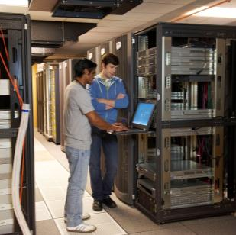
CHALLENGES FACING CLIENT DEVICE MANAGEMENT
Security
  Workers in many locations
  Non-domain joined desktops
  Workers “offline” for extended periods
  Compromised security on remote PCs
  Multiple configurations, versions
  Lack of insight into PCs & inventory
  Infrastructure investments required
Reliability

Slide 7

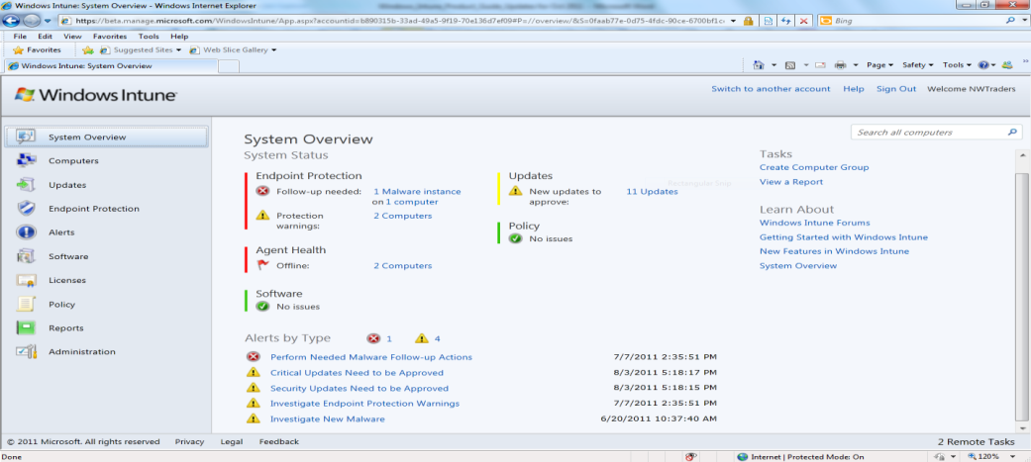


MANAGE, SECURE PCS AND DEVICES ANYWHERE
Simple Web-Based Administration Console and a friendly IW experience
  Help protect PCs from malware
  Manage updates
  Distribute and consume software
  Proactive monitoring and alerts
  Provide remote assistance
  Inventory hardware and software
  Monitor & track licenses
  Increase insight with reporting
  Set security policies
Enabling Flexible Workstyles
  Users can be managed from the office, branch office, or on the road
  IT and partners can work from virtually anywhere

Slide 8
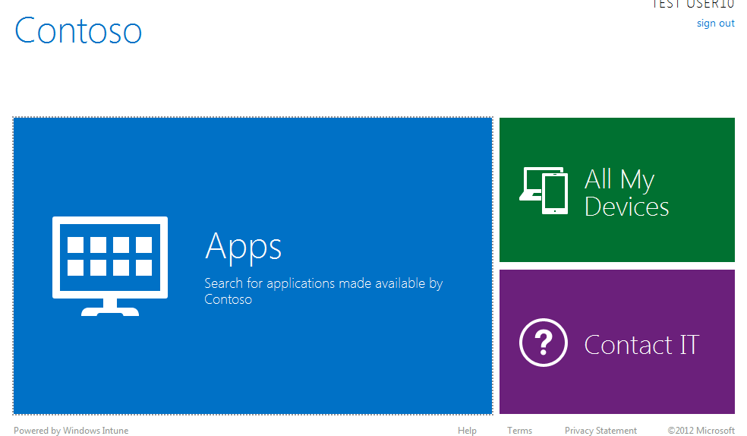


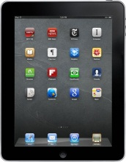


WHAT’S NEW IN THE RELEASE?
User Centric IT Pro experience
Self Service Portal
Modern Device Management
Enable IT pros to think users first
Empower end users to self service their management needs
Manage Corporate and Personally owned mobile (phone & tablets) devices
User Centric Management

Slide 9



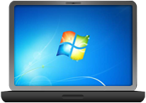

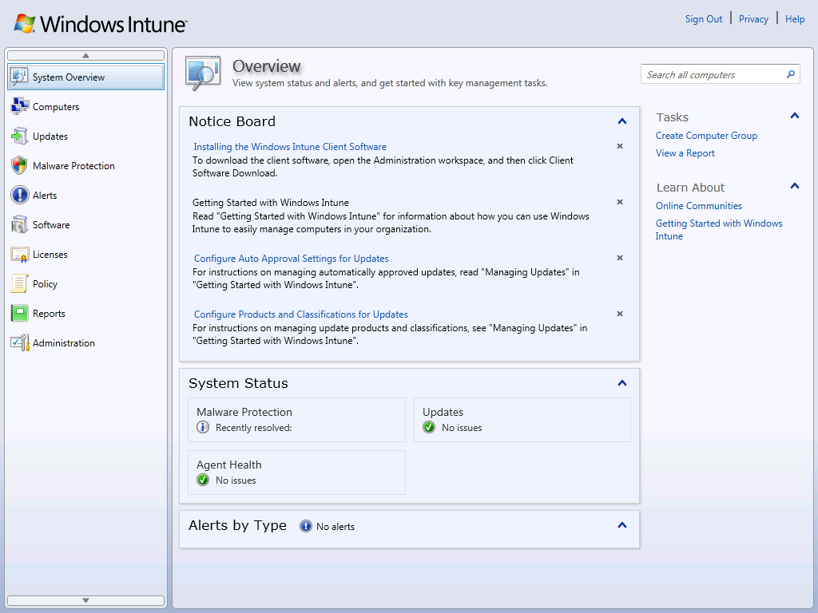


Windows Intune Architecture
  PC agents report to the Windows Intune service
  Mobile devices managed through EAS connectivity
  IT Admins can manage users, devices through web based console
  End user productivity enabled through self-service portal
  Ports 80 and 443 are all that is required for agent communications
  AD integration available to manage users

Slide 10
USER CENTRICITY FOR IT PROS
Allow the administrator to think users first
User identity
  Leverage existing investments in Active Directory/Office 365
  Enterprise class identity and authentication services with
  AD Azure
User Device Affinity
  Establish and maintain user/device relationship
  Identify users with non compliant devices
Dynamic Grouping
  Dynamic updates to user group membership based on
  Security groups and/or Manager
  Define exception rules
  Deploy Software and Policies to user groups
Application Management
  Target uploaded software to user groups
  Monitor compliance from a user perspective

Slide 11
User centricity for IT Pros
DEMO

Slide 12
Integration with AD

Slide 13

  USER CENTRIC MANAGEMENT -LOGICAL ARCHITECTURE
On-Prem | Microsoft Cloud
Users
Azure Active Directory
Directory Synchronization
Sync AD user data into the cloud
Active Directory
Sync user data to Windows Intune
Manage User device affinity
Publish software & policies to users
Users

Slide 14
User Identity OPTIONS
Cloud Identity
User identities and Security Groups (SGs) managed in Windows Azure AD via the account portal.
Cloud Managed Identity
Windows Azure AD
Intune
Synced Identity
User identities and SGs managed in on-prem AD
DirSync delta syncs on-prem to Windows Azure AD
Password created in
Windows Azure AD
Additional identities and SGs could be created/modified in Windows Azure AD
These do not flow back to on-prem AD
On-prem AD
Windows Azure AD
Intune
Federated Identity
User identities and SGs managed in AD
DirSync delta syncs on-prem to Windows Azure AD
Federation allows SSO experience to users
Additional identities and SGs could be created/modified in Windows Azure AD
These do not flow back to on-prem AD
On-prem AD
Windows Azure AD
Intune
ADFS

Slide 15
User management takeaways
Windows Intune leverages Windows Azure Active Directory infrastructure for user management
  This common user identity is shared with Office 365
In the enterprise, on-premise Active Directory can be leveraged to manage user access to Intune
    You can selectively manage AD users in Intune
    Dynamic user groups can be created from AD
    Single sign-on can be set up with ADFS 2.0
User Device Affinity (UDA) can be established through Windows Intune

Slide 16
USER CENTRICITY FOR END USERS
Enable IT self service for end users with Company Portal
Self Enroll Devices
  View all my devices
  Remotely wipe mobile devices
  Manage device affinity
Web based software catalog
  Company Branding
  Easily search and install software
  Users decide what software/apps to
  install from catalog made available to them
  Install software locally/remotely
  Do not need administrator privileges
Contact IT for support

Slide 17
User centricity for End users
DEMO

Slide 18
Modern Device Management

Slide 19
MOBILE CAPABLITIES
Unified experience across all devices
  Automatic discovery of all mobile devices that access Exchange
  Single console to manage computers and mobile devices
  User centric views for device inventory
Protect corporate data on mobile device
  Deploy Active Sync policies to user groups (password, encryption…)
  Define mobile device access rules by device family/model
  Remove mobile devices that access Exchange (with an option to wipe)
User empowerment through self service portal for the provision of mobile apps or to contact IT

Slide 20
MODERN DEVICE MANAGEMENT
Exchange 2010 EAS and Windows Intune
  Device inventory
  User device association
  Mobile security policies
  Remote Wipe
Windows Intune’s own infrastructure
  LOB Application Deployment
  User initiated remote wipe

Slide 21

  MODERN DEVICE MANAGEMENT - LOGICAL ARCHITECTURE
On-Prem | Microsoft Cloud
Azure Active Directory
Sync AD user data into the cloud
Directory Synchronization
Active Directory
Sync user data to Windows Intune
Users
Sync mobile devices for managed users
Microsoft Exchange Server 2010
Windows Intune Exchange Connector
Apply policies or trigger remote tasks
Modern Devices

Slide 22
POLICY AUTHORING
Mobile devices are managed through the user’s mailbox account in Exchange
  Policy applied to a user account is applied to ‘All devices’ of that user in Exchange
  Mobile device access rules can be defined to govern which types of mobile devices can consume corporate data through Exchange
Deploy policy
  Allow admin to select and deploy Microsoft best practice mobile device policy
  Allow admin to customize recommendation if they desire to do so
Author and enact ActiveSync policies on mobile devices
  Set Device Password
  Configure Encryption
  Email security
  Control device features (Camera, Browser)

Slide 23
MODERN DEVICE MANAGEMENT
DEMO

Slide 24
Additional Feature enhancements

Slide 25




BANDWIDTH OPTIMIZATION
Customer Feedback
Help us minimize internet bandwidth usage for updates and software in remote
branch offices
Feature Enhancement
Windows Intune clients now leverage Win7 Peer distribution platform – the technology that powers Branch Cache
No additional infrastructure required
Results
In pre-release seeing ~45% savings in WAN traffic in some cases
1
0
1
1
0
0
0
1
0
0
1
1
1
0
0
1
1
0
1
0
1
0
1
1
0
1
1
0
1
1
0
0
1
0
0
1
0
1
1
0
1
0
1
0
1
1
1
0
0
0
0
1
0
0
1
1
1
0
1
1
1
0
1
0
0
1
0
0
0
1
0
1
1
0
1
1
0
1
1
1
0
0
1
0
0
1
1
0
1
0
1
1
0
0
1
0
0
1
0
1
1
0
1
1
1
0
0
1
0
1
1
0
0
1
0
0
1
0
1
0
1
1
1
0
0
0
1
0
0
1
1
0
1
0
1
0
1
1
0
0
1
0
0
1
0
1
1
0
1
0
1
0
01
11
01
11
1
1
0
11
10
11
10
1

Slide 26
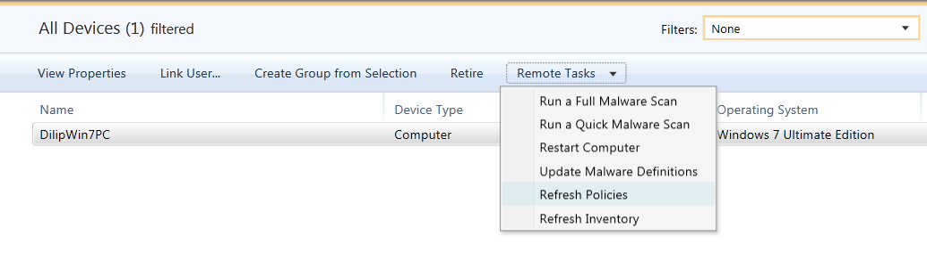
POLICY MANAGEMENT
Customer Feedback
How can I push out security policies immediately without waiting for the default client sync window
Feature Enhancement
New remote task to refresh policies on remote computers
Compliance status updated on task completion
Remote task for inventory update

Slide 27
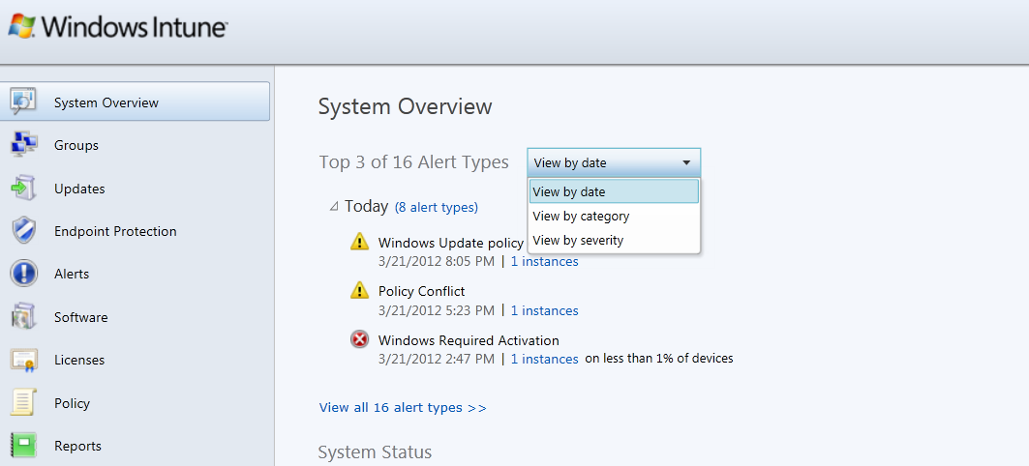
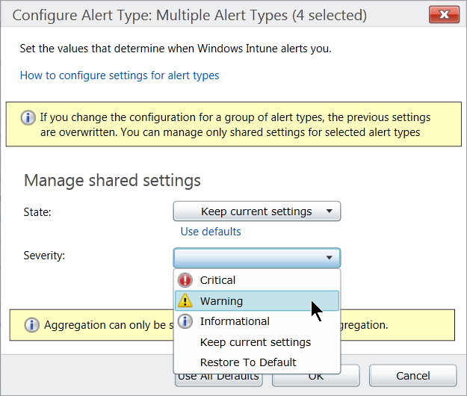
ALERTS
Customer Feedback
How can Windows Intune help us improve Alert responses to critical issues?
Feature Enhancement
New alert filters on System overview dashboard, helps IT focus on most pressing issues
Alert severity can now be customized to meet your needs and reduce noise

Slide 28
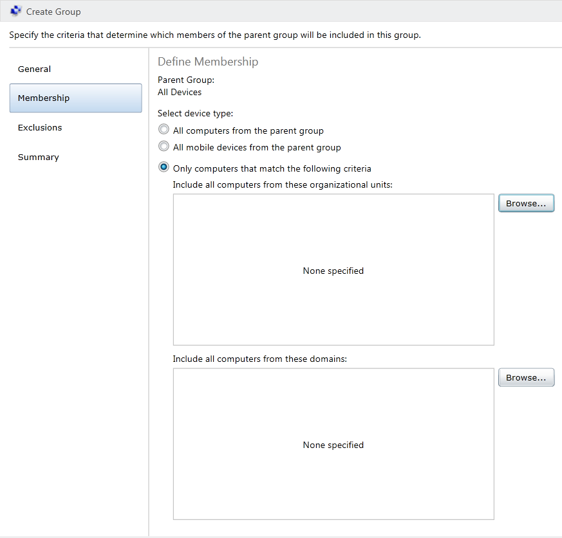
DYNAMIC DEVICE GROUP MEMBERSHIP
Customer Feedback
I would like to assign devices to specific groups similar to my AD hierarchy
Feature Enhancement
New dynamic group membership for Computers that can be based on Domain or OU membership

Slide 29
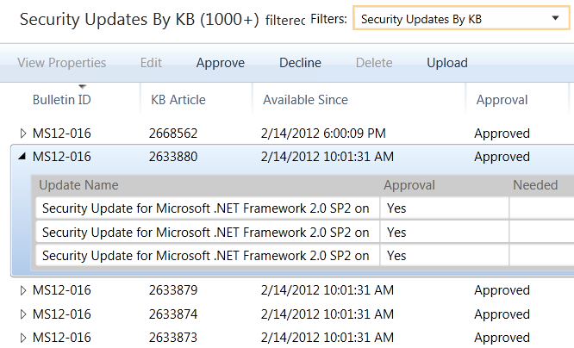
UPDATE MANAGEMENT
Customer Feedback
I need to view compliance with my ‘Patch Tuesday’ KBs
Feature Enhancement
New view provides compliance rollup of updates belonging to each security bulletin

Slide 30
SUMMARY
Windows Intune helps you with consumerization of IT
  Allow Administrators to think user first (and leverage existing AD investment to do so)
  Empower Users to manage their own application selection
  Support flexible workstyles and the devices that drive it
Call to action
  Release of Intune available today!!
    www.windowsintune.com

Slide 31



Track Resources
Resources for Developers
http://msdn.microsoft.com/en-us/windows/apps
Windows 8 is ready for Business
http://www.microsoft.com/en-us/windows/enterprise/products-and-technologies/windows-8/default.aspx
Microsoft Desktop Optimization Pack:
www.microsoft.com/MDOP
Microsoft Desktop Virtualization:
www.microsoft.com/dv

Slide 32
Track Resources
Track Resources
Springboard Series: www.microsoft.com/springboard
Explore > Plan > Deliver > Operate > Support for
Windows 7 and Windows 8
MDOP
Desktop Virtualization
Windows Intune
Internet Explorer 8, 9 and 10

Slide 33
Download the Windows 8 Release Preview Today
Download
http://windows.microsoft.com/en-US/windows-8/release-preview

Slide 34



Resources
Learning
  Connect. Share. Discuss.
  Microsoft Certification & Training Resources
http://northamerica.msteched.com
www.microsoft.com/learning
TechNet
  Resources for IT Professionals
  Resources for Developers
http://microsoft.com/technet
http://microsoft.com/msdn

Slide 35






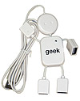
Required Slide
Complete an evaluation on CommNet and enter to win!

Slide 36


MS Tag
Required Slide
*delete this box when your slide is finalized
Your MS Tag will be inserted here during the final scrub.
Scan the Tag
to evaluate this
session now on
myTechEd Mobile

Slide 37
© 2012 Microsoft Corporation. All rights reserved. Microsoft, Windows, Windows Vista and other product names are or may be registered trademarks and/or trademarks in the U.S. and/or other countries.
The information herein is for informational purposes only and represents the current view of Microsoft Corporation as of the date of this presentation. Because Microsoft must respond to changing market conditions, it should not be interpreted to be a commitment on the
part of Microsoft, and Microsoft cannot guarantee the accuracy of any information provided after the date of this presentation. MICROSOFT MAKES NO WARRANTIES, EXPRESS, IMPLIED OR STATUTORY, AS TO THE INFORMATION IN THIS PRESENTATION.

