Slide 1
Client management scenarios in the Windows 8 timeframe
WCL388
Bryan Keller – Lead Program Manager
Craig Morris – Senior Program Manager

Slide 2
Agenda
Trends in client management in the Windows 8 timeframe
Solutions to these trends using Configuration Manager and Windows Intune

Slide 3


A World of Connected Devices
One User =
One Desktop
In 2011 power users owned between 5 and 7 internet connected devices
916M smart connected devices were shipped in 2011
This is forecasted
to double to 1.84B
in 2016
Source: IDC, 2010-2011
Media Tablet Multi-Client Study, February 2011.
Note: IDC only surveyed iPad owners for this study.
Source: IDC, "Nearly 1 Billion Smart Connected Devices
Shipped in 2011 with Shipments Expected to Double by 2016,
According to IDC," Doc #prUS23398412, March 28, 2012.
Organizations say 34%
of their employees are accessing business apps
on personal devices
69% of employees say
they are accessing business apps on personal devices
Source for both: IDC, “2011 Consumerization of IT Study :
Closing the ‘Consumerization Gap’”, July 2011

Slide 4
Client Management Approach
Control
Governance
Think: System Center Configuration Manager 2007
Infinite Tweaking
Think: Exchange ActiveSync, VPN Policies
Simple Primitives
Corporate Devices
IT Owns the Device and Sets the all of the Rules
Homogenous Systems
Hardware, Apps, OSes
Push
Of apps, patches, configurations
Corporate Standards
Devices, Applications, Configurations
Protected Devices
Systems enforce device standards to Protect data (Bitlocker, OS/Patch Level, Applications)
Personal Devices
IT uses system of least control
Heterogeneous Systems
PC, Mobile, Slate, Laptop
Pull
Self Service, App Stores
Constraints
Conditional access to Network, Applications and Data
Protected Data
Variable device trust level, data must be directly protected

Slide 5



Client Management Solutions
Controlled and Governed
IT controlled
People-centric
Windows, EAS, OMADM
Governed
Personally controlled
People-centric
Windows, EAS, OMADM
Controlled
Corporate controlled
Device centric
Windows only

Slide 6



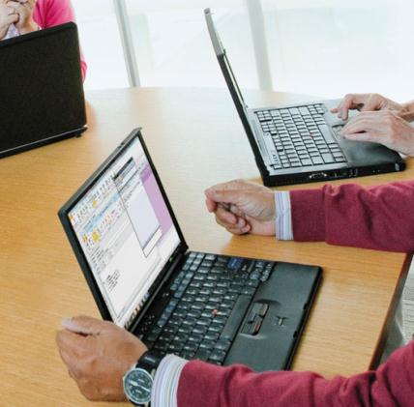

Windows 8 for Enterprise
Devices & Experiences Users Want
Devices & Experiences Users Love
Enterprise-Grade
Solutions
Enterprise-Grade
Solutions
No Compromise Business Tablet
New Possibilities in Mobile Productivity
Enhanced End-to-End Security
Management and Virtualization

Slide 7


Client Management in Windows 8 Timeframe
IT Controlled
Personally Controlled
Windows 8 OS Deployment
Metered Connections
User Data and Settings Management
Anywhere Apps and Data
Meet IT standards by controlling devices and applications
Empower users while ensuring key IT constraints
Windows To Go

Slide 8
Client Management in Windows 8
Support existing management features
Software Updates Management
Software Distribution
Inventory
Asset Intelligence
Settings Management
Remote Control
OS Deployment
And more!
Support new Windows 8 functionality
Windows To Go
Metered Connection support
User Data and Settings Management
BitLocker Enhancements
Windows 8 Apps
Deep Link Apps

Slide 9
Windows 8 OS Deployment
ConfigMgr for Windows 8 supports the same core OS Deployment scenarios as Windows 7
  Same day-to-day administrative workflow
  Requires Windows Assessment and Deployment Kit
Additional functionality:
  Windows To Go support
  Used Space BitLocker
  TPM plus PIN BitLocker

Slide 10
Core OS Deployment Scenarios
Scenario
Key Functionality
New computer
Fresh install of a new operating system on client or server system
New or repurposed hardware
Bootable Media (CD or USB Flash Drive)
PXE boot
Integrate with WDS PXE server
Control deployment action with Configuration Manager deployments
Self-provisioning via F12
Wipe-and-load
Install new version of operating system on existing client or server hardware
Reinstall applications under new operating system
For clients, securely save/restore user state and settings (locally or on a file server)
Side-by-side
Install new version of operating system on new client hardware for an existing user
Reinstall applications on new computer under new operating system
Move user state and settings from old computer to new computer via a file server
Offline with removable media
Do operating system deployment from removable media (CD set, DVD, USB flash drive)
With low bandwidth or no connectivity
Large software packages are on the media
No status reporting
Prestaged Media
Optimized for network bandwidth
Speeds up end to end deployment
Works with existing processes
Initial staging can be completed detached from ConfigMgr environment

Slide 11
Windows To Go
Scenarios:
  Contractors
  Bring Your Own Device
  Travel Light
  Shared PCs
Create:
  Build a WTG image using ConfigMgr
Provision:
  Admin can push deploy WTG to a removable device
  End User can pull provision WTG
Manage:
  Updated and managed same as a physical laptop/desktop
  Admin can determine if device is WTG or not

Slide 12
Deploying Windows To Go with Configuration Manager 2012 SP1
demo
Name
Title
Group

Slide 13
Metered Connection Support
Trends:
  Increased use of devices connecting via paid networks
  Mobile end users
Admin with Windows 8 is able to control traffic:
  Block network impactful client management activities
  Avoid being unpleasantly surprised with their network bill

Slide 14
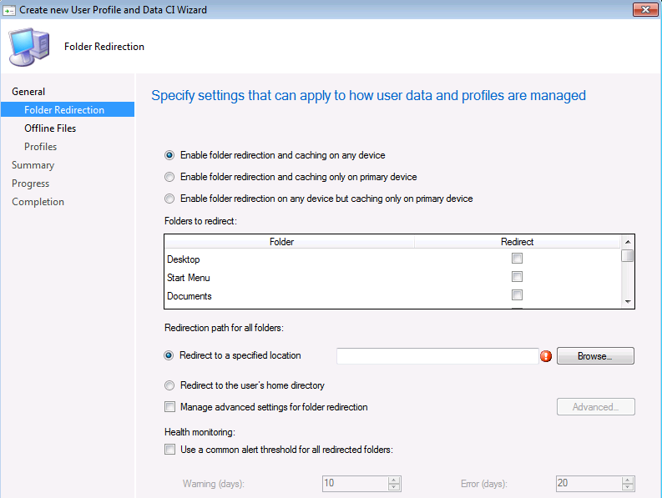
User Data and Settings Management
Consistent end user experience and access to their data on Windows devices
New ConfigMgr feature to manage:
  Client Side Caching
  Roaming User Profiles
  Folder Redirection
ConfigMgr applies policies at user logon

Slide 15






Your Data & Apps on Any Devices
Personalized, consistent, online & offline experience
Apps and data follow users
Centralized management of apps and data (IT)
Local data is protected (IT)
Configuration Manager
App-V 5.0 and U-EV (MDOP), Folder Redirection
User Settings
RDS/VDI
+ Apps
+ Data
User Settings+ Apps + Data
BitLocker Drive Encryption
BitLocker Drive Encryption

Slide 16
Characteristics of Personally Controlled
End users install software vs. pushing software
Constrain access to apps and data based on specific settings vs. controlling the whole device
Support user access from a many different devices vs. access from just corp owned devices

Slide 17
Client Management in Windows 8 Timeframe
IT Controlled
Personally Controlled
Modern Applications
Consumer Windows Devices
Heterogeneous Mobile Devices
Meet IT standards by controlling devices and applications
Empower users while ensuring key IT constraints

Slide 18

User Centric Software Distribution
Your end-users are changing the way they do work
  Ultra mobility
  Lots of devices
  New generation with new expectations
  Personally owned
Lots of apps from a variety of sources
  Legacy apps (MSI, Exe)
  Windows 8 apps
  Mobile apps
  Apps from online stores
What’d we do?
    Built a model for defining applications that takes into account user/device relationships and the rich variety of application types
Traditional Model
User Centric Model
Management Service

Slide 19


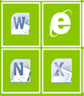

Windows 8 Apps
Benefits:
  Runs across x86 and ARM
  Inherently more secure
  Easier and faster to deploy
Software distribution updated:
  New object
  Same deployment process
  Similar management functionality
End users installation same as today
Windows Store
IT
Self-Service Portal (SSP)
FIREWALL
Side-loading
Side-loading
Windows 8 (x86)
Windows RT device

Slide 20
Deep Link Apps
Software Distribution updated:
  New type of software
  Same process
Administrators do not need to repackage applications
End Users have one location for all Enterprise Applications
Redirects
Windows Store
Self-Service Portal (SSP)

Slide 21
Windows RT Client Management
Primarily Personally Controlled
  Bring Your Own Device
  Also support for specialized use cases (e.g. Airline, Retail)
Focused on self service with constraints
  Software
  Configuration
Different in how they are used and behave
  Always on always connected
  More prevalent use of metered connections (e.g. 3/4G)

Slide 22
User Centricity for End Users
Self Enroll Devices
  View all my devices
  Manage device affinity
Web based software catalog
  Easily search and install software
  Users decide what software/apps to
  install from catalog made available to them
  Install software locally/remotely
  Do not need administrator privileges
Contact IT for support

Slide 23
User Centric Application Deployment with Windows Intune
demo
Name
Title
Group

Slide 24
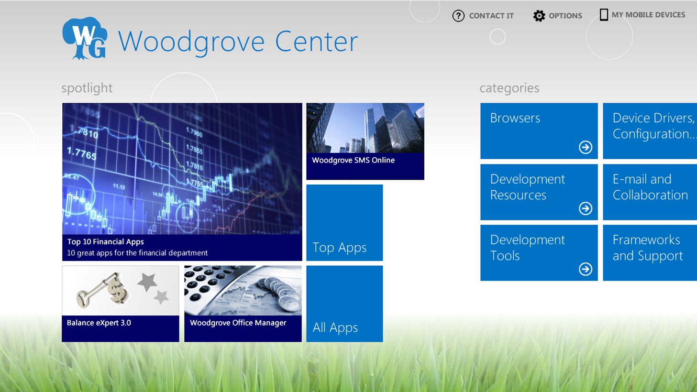
Metro Style SSP Sneak Peek

Slide 25
Heterogeneous Mobile Device Management
Admin still wants to support user access to corporate resources, just in a secure way
Security and Policy management (through EAS)
  Including Windows, iOS and Android devices
  Device inventory
  User device association
  Mobile security policies
  Remote Wipes
Windows Intune further extends this to provide application provisioning support
  Mobile Software Portal

Slide 26
Closing slide
Microsoft Client Management and Windows 8, better together
ConfigMgr and Windows Intune are the solutions for consumerization

Slide 27


Track Resources
Resources for Developers
http://msdn.microsoft.com/en-us/windows/apps
Windows 8 is ready for Business
http://www.microsoft.com/en-us/windows/enterprise/products-and-technologies/windows-8/default.aspx
Microsoft Desktop Optimization Pack:
www.microsoft.com/MDOP
Microsoft Desktop Virtualization:
www.microsoft.com/dv

Slide 28
Track Resources
Track Resources
Springboard Series: www.microsoft.com/springboard
Explore > Plan > Deliver > Operate > Support for
Windows 7 and Windows 8
MDOP
Desktop Virtualization
Windows Intune
Internet Explorer 8, 9 and 10

Slide 29
Download the Windows 8 Release Preview Today
Download
http://windows.microsoft.com/en-US/windows-8/release-preview

Slide 30



Resources
Learning
  Connect. Share. Discuss.
  Microsoft Certification & Training Resources
http://northamerica.msteched.com
www.microsoft.com/learning
TechNet
  Resources for IT Professionals
  Resources for Developers
http://microsoft.com/technet
http://microsoft.com/msdn

Slide 31






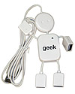
Required Slide
Complete an evaluation on CommNet and enter to win!

Slide 32





Please Complete an Evaluation
Your feedback is important!
Be eligible
to win great daily prizes and the grand prize of a $5,000 Travel Voucher!
Multiple
ways to Evaluate Sessions
Scan the Tag
to evaluate this
session now
on myTechEd Mobile

Slide 33
© 2012 Microsoft Corporation. All rights reserved. Microsoft, Windows, Windows Vista and other product names are or may be registered trademarks and/or trademarks in the U.S. and/or other countries.
The information herein is for informational purposes only and represents the current view of Microsoft Corporation as of the date of this presentation. Because Microsoft must respond to changing market conditions, it should not be interpreted to be a commitment on the
part of Microsoft, and Microsoft cannot guarantee the accuracy of any information provided after the date of this presentation. MICROSOFT MAKES NO WARRANTIES, EXPRESS, IMPLIED OR STATUTORY, AS TO THE INFORMATION IN THIS PRESENTATION.

