Slide 1
Microsoft Private Cloud Fast Track:
The Next Generation of Private Cloud
Reference Architecture
WSV201
Mike Truitt
Sr. Product Planner
Bryon Surace
Sr. Program Manager

Slide 2
Agenda
Microsoft Private Cloud Fast Track – Fast Facts
Business Before Technology
Microsoft Private Cloud Overview
Fast Track Architecture Principles
Principles to Technical Reality
Fast Track Partner Update
MAP Overview/Demo
Business Before Technology
Wrap-up

Slide 3
Microsoft Private Cloud Fast Track:
Fast Facts
Combination of Compute, Networking and Storage with Microsoft Hyper-V & System Center 2012
Validated Microsoft design that includes System Center management
A physical solution ready to integrate and drive business value

Slide 4
Business Before Technology
Driving Value
Integration is key; very few “green-field” environments
Complexity tamed with System Center 2012 managing the datacenter
Solving business problems with compelling technology

Slide 5
Microsoft Private Cloud Fast Track:
Planning to Reality
Product Planning
Content Creation
Solution Validation
Launch & GTM
Sustained Engineering
Microsoft Private Cloud Fast Track
Fast Track History
  V1.0
  V1.1
  V2.0
Planning to Reality
  Microsoft investments
  Partnering is key

Slide 6



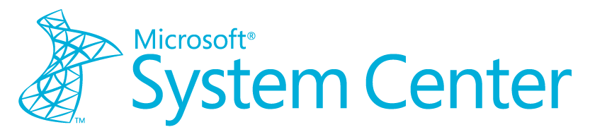
Microsoft Private Cloud Solutions
Microsoft Private Cloud Accelerate
On-premises Private Cloud
Pre-configured
Private Cloud
Hosted Private Cloud
Deployment
Options
Microsoft Cloud
Deployment Guides
Microsoft Private Cloud
Fast Track
Microsoft Cloud Service Providers
Programs
MPN Microsoft Cloud Partners
Microsoft Cloud Services
6

Slide 7








Microsoft Private Cloud Fast Track:
Architectural Principles
Pooled Resources
Elastic
Continuous Availability
Predictable
Usage-Based
Multi-Tenant
Secure
Self-Service
Partner Software Technology
Compute
Network
Storage

Slide 8
Private Cloud Fast Track 2.0
Technical Overview

Slide 9


Conceptual Architecture Components
The Dynamic Datacenter Reference Model
Compute
Network
Storage
Management
Virtualization
Automation
Service Management
Tenant / User Self-Service
Service Deliver Sub-Domain
Provides Service to
Defines
Software Sub-Domain
Provides Service to
Manages
Defines
Platform Sub-Domain
Management
Sub-Domain
Operations Sub-Domain
Provides Service to
Manages
Infrastructure
Sub-Domain

Slide 10
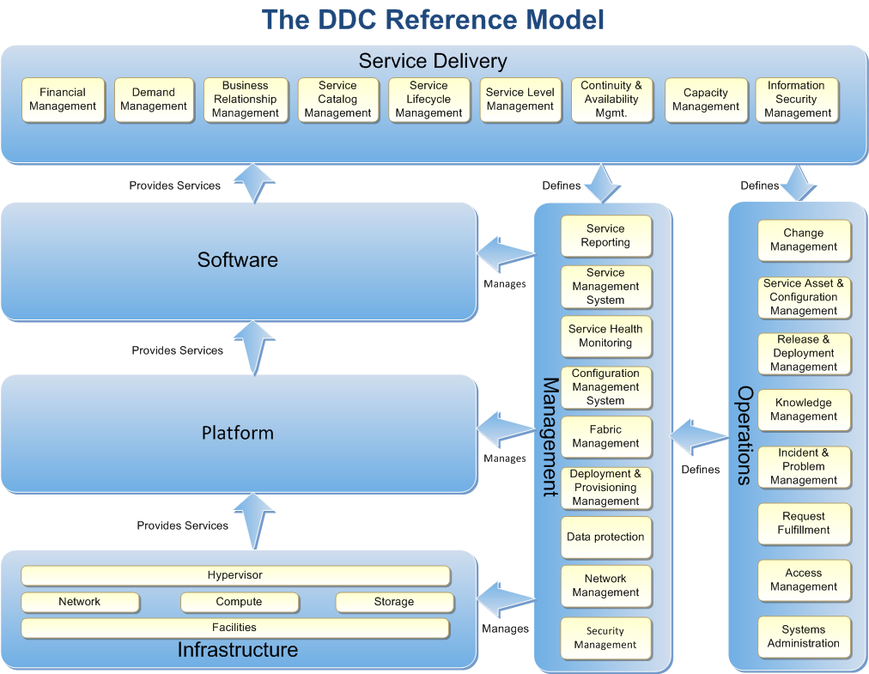

Slide 11
Scenarios Targetted
Scenarios | Enabling Technologies
Fabric Provider | AppCtrl | OM | Orch | SM | VMM
Bare metal deploy |  |  |  |  | X
Integration with Network & Storage |  |  | X |  | X
Host patching |  |  |  |  | X
Host optimization / power optimization |  |  |  |  | X
Monitoring of Fabric |  | X |  |  | X
Capacity reporting |  | X |  |  | X
Service Provider
Service Templates (offerings) |  |  |  |  | X
Service and VM Catalog | X |  |  | X | X
Lifecycle (create, upgrade, retire) | X |  | X | X | X
Application and SLA Monitoring |  | X
SLA and Capacity Reporting |  | X |  | X
Service Consumer
Request quote or capacity (Cloud) |  |  | X | X | X
Request/Deploy VM | X | X | X | X | X
Request/Deploy Service | X | X | X | X | X
Quota enforcement | X |  |  |  | X
Request Approvals |  |  | X | X

Slide 12
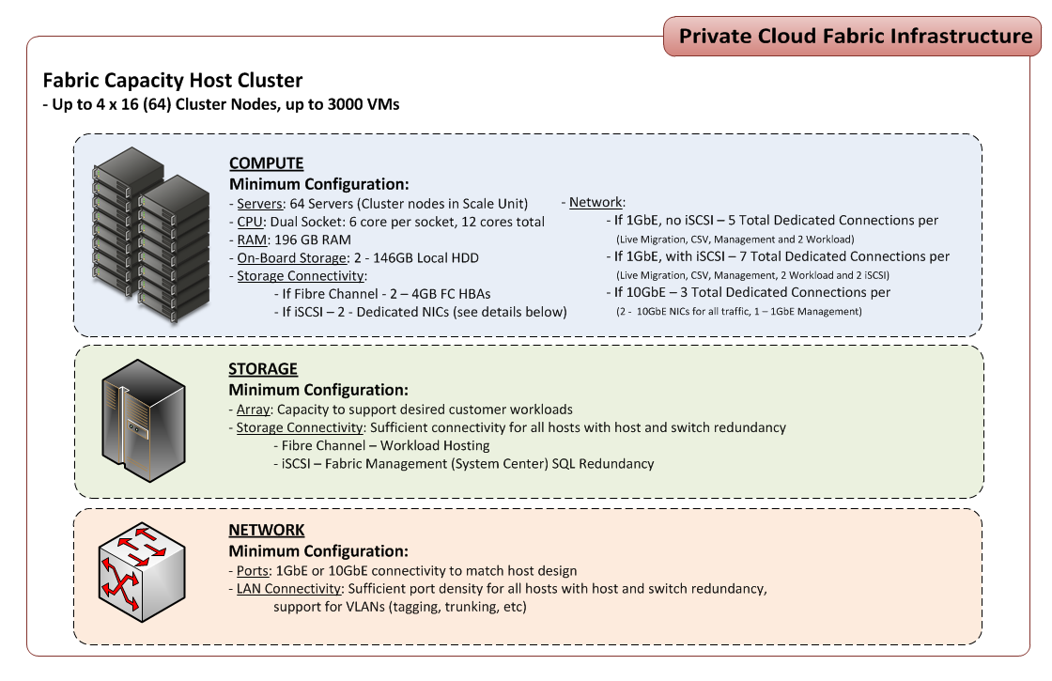

Slide 13
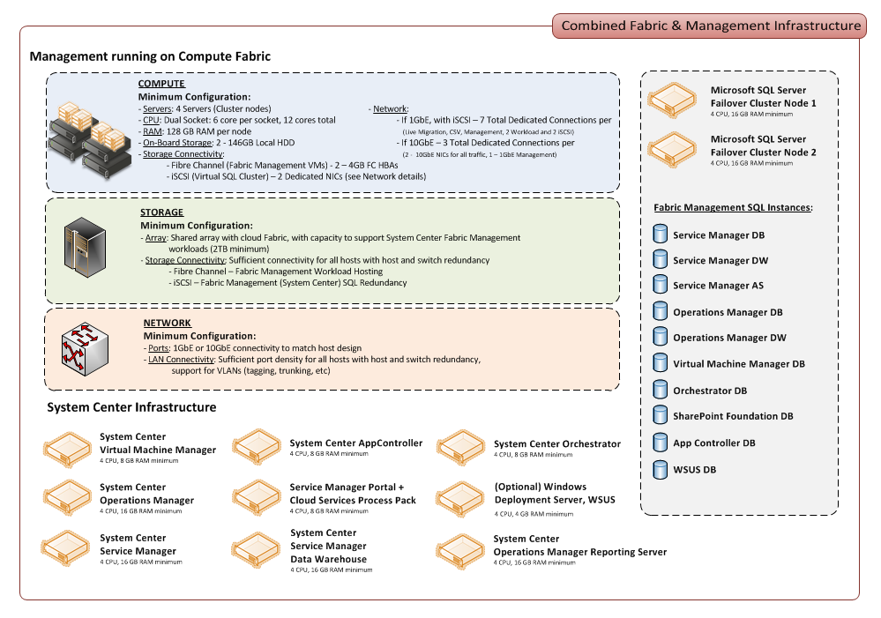

Slide 14
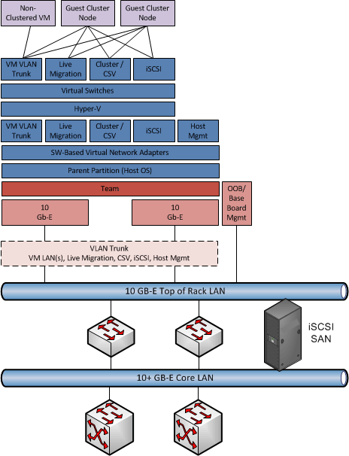
Network
FCOE/CNE
Converged
NIC HW Team

Slide 15
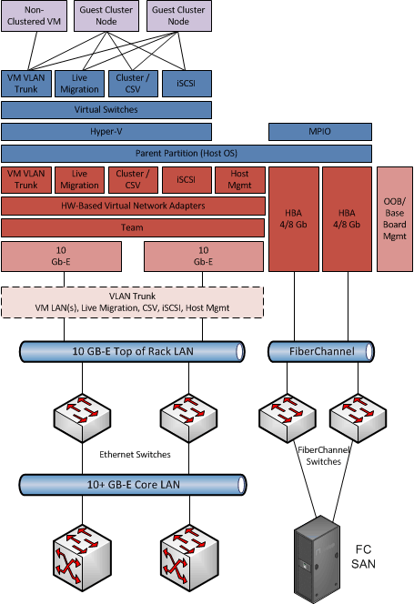
Network
Traditional
Fiber Channel + Ethernet

Slide 16
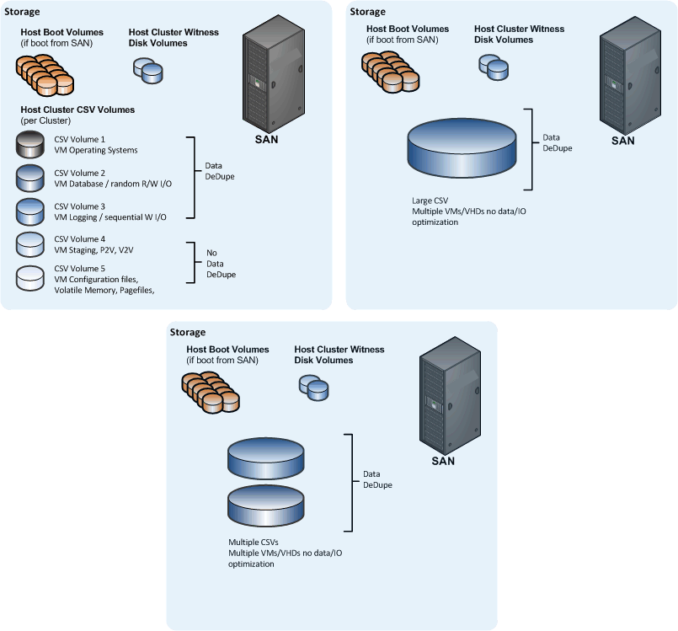
Storage
Host LUNs & CSVs

Slide 17
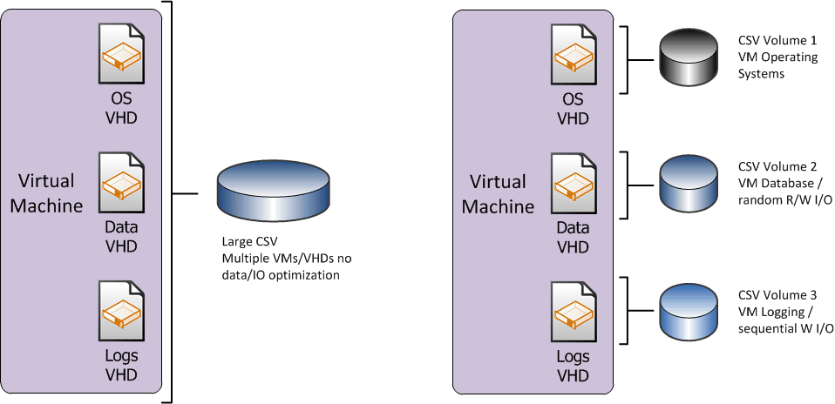
Storage
VM Storage Placement

Slide 18
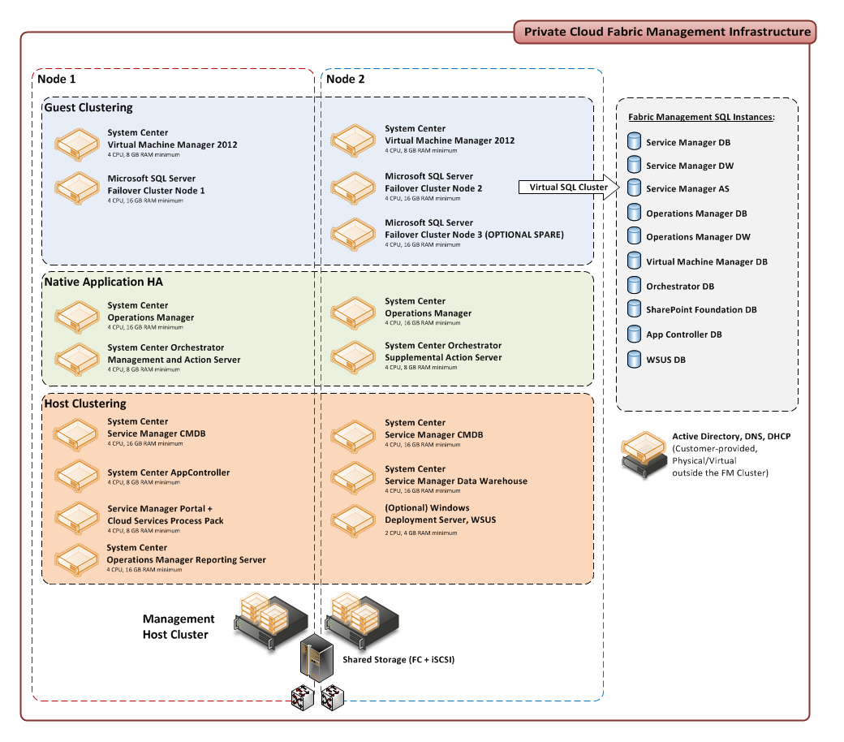

Slide 19






Microsoft Private Cloud Fast Track

Slide 20


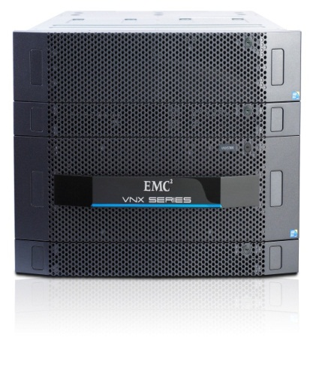
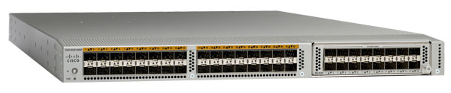
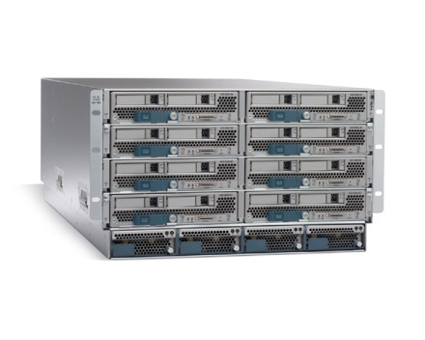
Cisco/EMC Fast Track Solutions
EMC / CISCO solution
  Scalable: 8 – 16 B200/M2 node implementation
  VNX 5300 array – FC & iSCSI
Multi Protocol Support
  Nexus converged SAN/Network
  Boot from SAN
  Converged FC/FCoE
  iSCSI – HA VM storage
Full Microsoft integration
  PowerShell for all components
  SCOM 2012 management packs
  SCO 2012 integration pack
‘Virtualized’ hardware through UCS service profiles
  Minimize cabling with converged network (FC, iSCSI, FCOE)
22 to 75TB RAW storage for Server Applications / VDI solutions
EMC VNX 5300
Cisco
Nexus 5K
UCS – B series

Slide 21

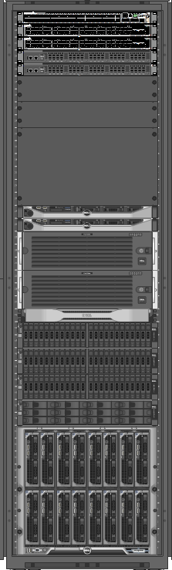
Dell Fast Track Solutions
vStart 1000
Enables IT & business stakeholders to accelerate application & IT service delivery.
Provides agile & predictable application services with Microsoft System Center.
Includes pre-tested solution components:
Includes pre-tested solution components:
  Management
  Server
  Network
  Storage
  Deployment & IT Support Services
Leverages Microsoft Hyper-V virtualization platform
Highly scalable architecture
Dell Open Manage Pro Packs and Action Packs
PowerEdge M620 blades
Force10 S4810
Compellent Series-40
Deployment & IT Support Services

Slide 22
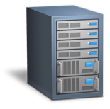

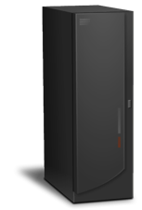
Hitachi Fast Track Solutions
Infrastructure as a Service
  Configurations with 8 or 16 servers
Optimized for System Center 2012
  Provisioning of compute, network and storage
Simple to Order
  HDS Orderable Products
Fast to Deploy
  Pre-configured from the HDS factory
Easy to Customize
  Validated for Microsoft Applications
Hitachi Data
Systems link:
www.hds.com/go/hypervcloud
Hitachi Compute
Network
Hitachi Storage

Slide 23
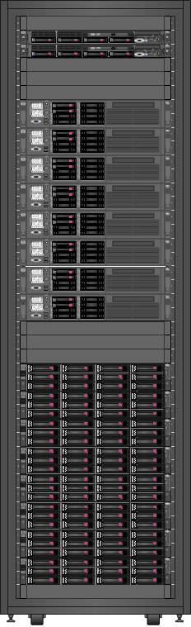
HP VirtualSystem VS1 Fast Track Solution
Rack mount
  Optimized converged infrastructure
  Complete solution and services
  Tightly integrated management with Insight Control for System Center
  Foundation for the cloud
96 cores
1.5 TB memory
P4500 SAN
Min 14.4 TB
Max 57.6 TB
A-Series Switches
Two 1 Gb
Two 10 Gb
ProLiant DL380
2 to 8 servers

Slide 24
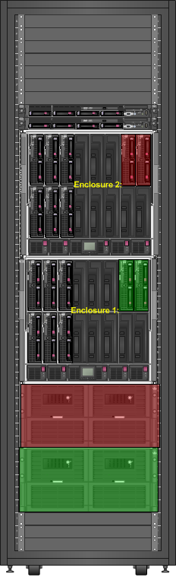
HP VirtualSystem VS2 Fast Track Solution
Blades / Enterprise
  Optimized converged infrastructure
  Complete solution and services
  Tightly integrated management with Insight Control for System Center
  Foundation for the cloud
336 cores
10.8 TB memory
P4800 SAN
Min 42 TB
Max 84 TB
A-Series Switches
Two 1 Gb
Two 10 Gb
ProLiant BL460
6 to 12 blades
Scalable to 28

Slide 25
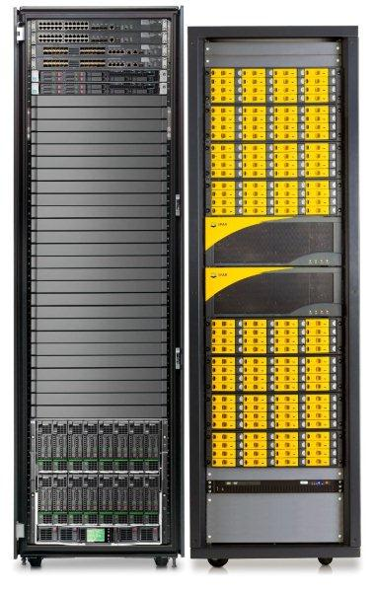
HP VirtualSystem VS3 Fast Track Solution
Highest performance for large enterprise
  ProLiant Gen 8 servers
  HP 3PAR storage
  Insight Control for System Center 2012
512 cores
16.4 TB memory
3PAR F400
Min 38.4 TB
Max 384 TB
A-Series Switches
Two 1 Gb
Two 10 Gb
ProLiant BL460
16 blades
Scalable to 32

Slide 26
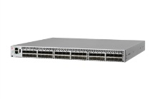
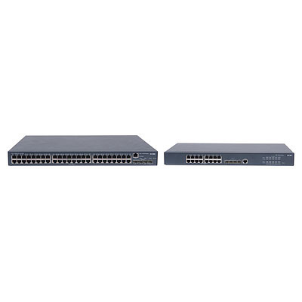
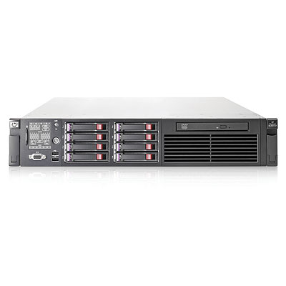
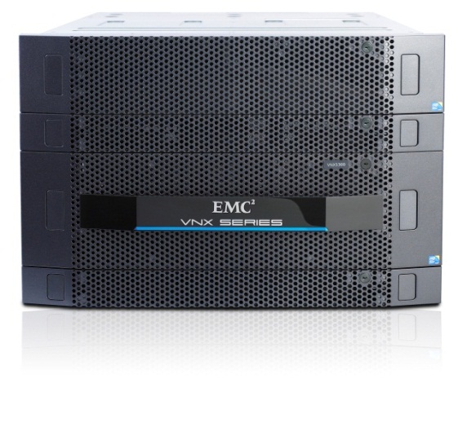
EMC Solution with Brocade and HP Servers
1Gb Infrastructure
Storage
  VNX 5300
SAN Connect
  Dual Brocade 8000
  Brocade 1020 (dual)
Network
  Dual Brocade 8000
  Dual HP 1Gb Ethernet
Server
  Dual DL380 for Management
  DL380 for Compute
Management Nodes
DL380 G7 2 Proc
12 core / 128 GB RAM
VNX 5300
FC / iSCSI 10Gb
75 x 300GB SAS
Compute Nodes
DL380 G7 2 Proc
12 core / 64 GB RAM

Slide 27

FlexPod with Microsoft Private Cloud
FlexPod with Microsoft Private Cloud, an integrated NetApp and Cisco solution for Microsoft Private Cloud
First Fast Track 2.0 Validated Design
  Fully integrated with System Center 2012 and the Cloud Services Process Pack
‘Virtualized’ hardware through service profiles and stateless computing
Highly scalable Hyper-V platform
Virtualization Guarantee. 50% less storage *
Accelerates private cloud deployments at reduced risk
Modular growth for scaling up and scaling out
  All HW Components Shipping NOW
  Reference Implementation Available NOW
Learn more:
  www.netapp.com/microsoftsolutions
  www.cisco.com/go/microsoft
Cisco® UCS B-Series Blade Servers and UCS Manager
Cisco Nexus®
Family Switches
NetApp FAS
Storage Systems
* NetApp 50% Storage Guarantee http://www.netapp.com/us/solutions/infrastructure/virtualization/guarantee.html

Slide 28

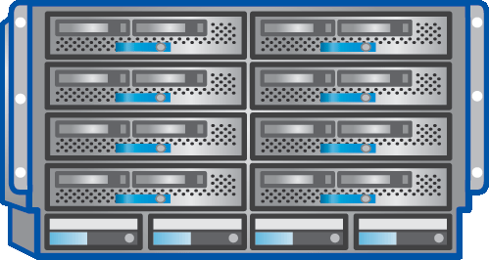
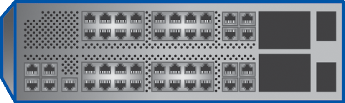

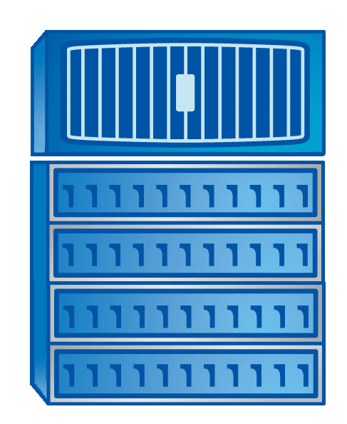
FlexPod with Microsoft Private Cloud
Validated with Citrix XenDesktop
Citrix XenDesktop is the first validated workload on FlexPod with Microsoft Private Cloud
First Fast Track 2.0 Validated Design
  Fully integrated with Microsoft System Center 2012 and Citrix XenDesktop 5.6
  Validated to run 2000 virtual desktops
  Highly scalable VDI solution
  Virtualization Guarantee. Save 50% less storage*
Accelerates VDI deployments at reduced risk
  Provision and manage large VDI environments quickly and efficiently.
  Provision 2,000 VMs 25 times faster than traditional SAN
  All HW Components Shipping NOW
  Cisco Validated Design Available NOW
Learn more:
  Visit NetApp at Booth 221 at MMS or www.netapp.com/microsoftsolutions
  www.cisco.com/go/microsoft
  www.citrix.com/microsoft
Cisco® UCS B-Series Blade Servers and UCS Manager
Cisco Nexus®
Family Switches
NetApp FAS
Storage Systems
* NetApp 50% Storage Guarantee http://www.netapp.com/us/solutions/infrastructure/virtualization/guarantee.html

Slide 29

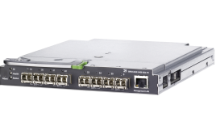
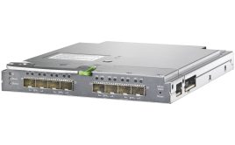
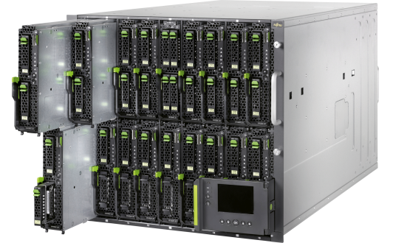


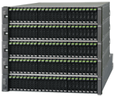

Fujitsu Fast Track Solution
Efficient management of server, network and storage resources with best of breed platform
Self-service portal to help IT deliver services rapidly and easily
hundreds of VMs per system rack, expandable system (racks) on demand
Server
& Network
Storage

Slide 30



NEC Fast Track
Complete High-Efficiency and High-Quality Solution
  Additional option for near-zero-downtime
Scalability up to 30 Virtual Servers
  5 physical servers with 8 CPU cores each
Direct sales by NEC Japan and NEC Corporation of America
NEC M-Series Storage
NEC 10 gigabit Intelligent L3 Switch
NEC Express5800 Servers

Slide 31
Microsoft Private Cloud Fast Track

Slide 32
Microsoft Assessment & Planning Tool
DEMO

Slide 33
Business Before Technology
  Integration is key; very few “green-field” environments
  Microsoft manages the datacenter with System Center
  System Center Orchestrator as differentiators

Slide 34
Microsoft Private Cloud Fast Track:
Fast Facts
Combination of Compute, Networking and Storage with Microsoft Hyper-V & System Center
Validated Microsoft design that includes System Center management
Reference Implementation ready to integrate

Slide 35


SIA, WSV, and VIR Track Resources
#TE(sessioncode)
Talk to our Experts at the TLC
Hands-On Labs
DOWNLOAD Windows Server 2012 Release Candidate
microsoft.com/windowsserver
DOWNLOAD Windows Azure
Windowsazure.com/
teched

Slide 36




Resources
Learning
  Connect. Share. Discuss.
  Microsoft Certification & Training Resources
http://northamerica.msteched.com
www.microsoft.com/learning
TechNet
  Resources for IT Professionals
  Resources for Developers
http://microsoft.com/technet
http://microsoft.com/msdn

Slide 37





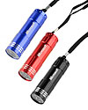

Required Slide
Complete an evaluation on CommNet and enter to win!

Slide 38





Please Complete an Evaluation
Your feedback is important!
Be eligible
to win great daily prizes and the grand prize of a $5,000 Travel Voucher!
Multiple
ways to Evaluate Sessions
Scan the Tag
to evaluate this
session now
on myTechEd Mobile

Slide 39
© 2012 Microsoft Corporation. All rights reserved. Microsoft, Windows, Windows Vista and other product names are or may be registered trademarks and/or trademarks in the U.S. and/or other countries.
The information herein is for informational purposes only and represents the current view of Microsoft Corporation as of the date of this presentation. Because Microsoft must respond to changing market conditions, it should not be interpreted to be a commitment on the
part of Microsoft, and Microsoft cannot guarantee the accuracy of any information provided after the date of this presentation. MICROSOFT MAKES NO WARRANTIES, EXPRESS, IMPLIED OR STATUTORY, AS TO THE INFORMATION IN THIS PRESENTATION.

