Slide 1
Windows Server 2012 Unified Remote Access
WSV302
Sandeep K. Singhal, Ph.D.
General Manager, Windows Networking
Microsoft Corporation

Slide 2
Agenda
Introduction to Unified Remote Access
Remote Access building blocks
What’s new in Windows 8 and Windows Server 2012?
  Integrated client experience
  Simplified deployment and flexible management
  Multi-site deployment, high availability, and performance scaling

Slide 3




Windows Server 2012
Cloud Optimize Your IT
Beyond
Virtualization
Windows Server 2012 offers a dynamic, multi-tenant infrastructure that goes beyond virtualization to provide maximum flexibility for delivering and connecting to cloud services.
The Power of Many Servers, the Simplicity of One
Windows Server 2012 offers excellent economics by integrating a highly available and easy to manage multi-server platform with breakthrough efficiency and ubiquitous automation.
Every App,
Any Cloud
WS8 is a broad, scalable and elastic server platform that gives you the flexibility to build and deploy applications and websites on-premises, in the cloud and in a hybrid environment, using a consistent set of tools and frameworks.
Modern Workstyle, Enabled
Windows Server 2012 empowers IT to provide users with flexible access to data and applications from virtually anywhere on any device with a rich user experience, while simplifying management and helping maintain security, control and compliance.

Slide 4






Work-Life
blur
Always connected
Productive
from
anywhere
Information
in the cloud
Where we work and when we work
is changing
Where our data lives and how we access it
is changing

Slide 5





Remote Access Alternatives for a Changing Workforce
Windows
Non-Windows
VPN
F
I
R
E
W
A
L
L
Windows
Non-Windows
VPN
Managed Windows Clients
DirectAccess
VPN
Unified remote access
server
From any PC
Windows to Go + DirectAccess
RDS / VDI
Remote Desktop
Gateway
Mobile Phones
VPN

Slide 6

Unified Remote Access
Exchange
SharePoint
Apps
Intranet
End User:
Great Experience
IT: Manage Out
VPN
FIREWALL
Improved productivity
"Light up"
remote clients
Win XP / Vista / Non-Windows
DirectAccess
Not user initiated
Decreases patch miss rates
Mobile Broadband
Windows 7
Windows 8
Simplified connectivity
Applies GPOs to remote computers
VPNs connect the user to the network
DirectAccess extends the network to the computer and user

Slide 7
Unified Remote Access
Unified Remote Access management
Off premise provisioning
Great User Experience
Scale and Performance
Works with existing networks
Hybrid Cloud
Reporting and accounting
VPN interoperability with mobile devices
Integrated client experience
High performance in virtual environments
Enhanced authentication
Deployment and Monitoring
Enabling New Scenarios
High availability
Connect through local server
Thousands of users per server

Slide 8
Client Experience
Everywhere ease-of-use improves user satisfaction
User in control
Integrated troubleshooting

Slide 9
Integrated Client Experience
Windows 8 automatically connects users to DirectAccess – in the most efficient way
Integrated DirectAccess user experience
Flexible authentication: Kerberos, PKI, smartcard, virtual smartcard and TPM
Easily see connectivity status

Slide 10
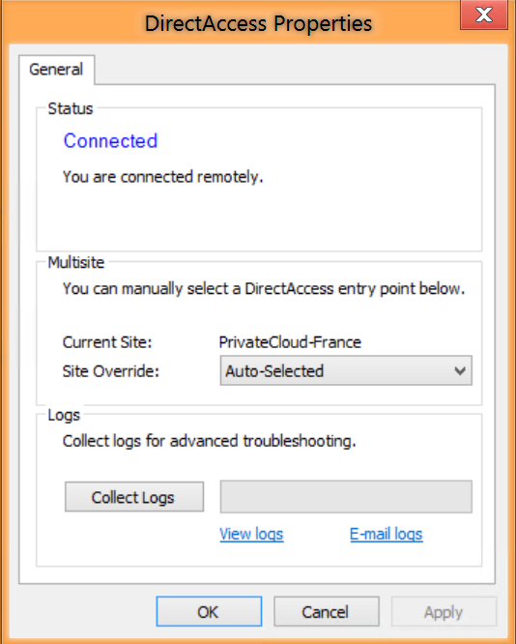
Integrated Troubleshooting with
DirectAccess Properties Page
Accessible through the networks UI
Reiterates connection status
Clearly presents remediation options for actionable problems
Users can manually select a DirectAccess entry point
Enables easy collection and emailing of customized logs to helpdesk

Slide 11
Demo:
Client Experience
Internet
DC1
APP1
EDGE1

Slide 12
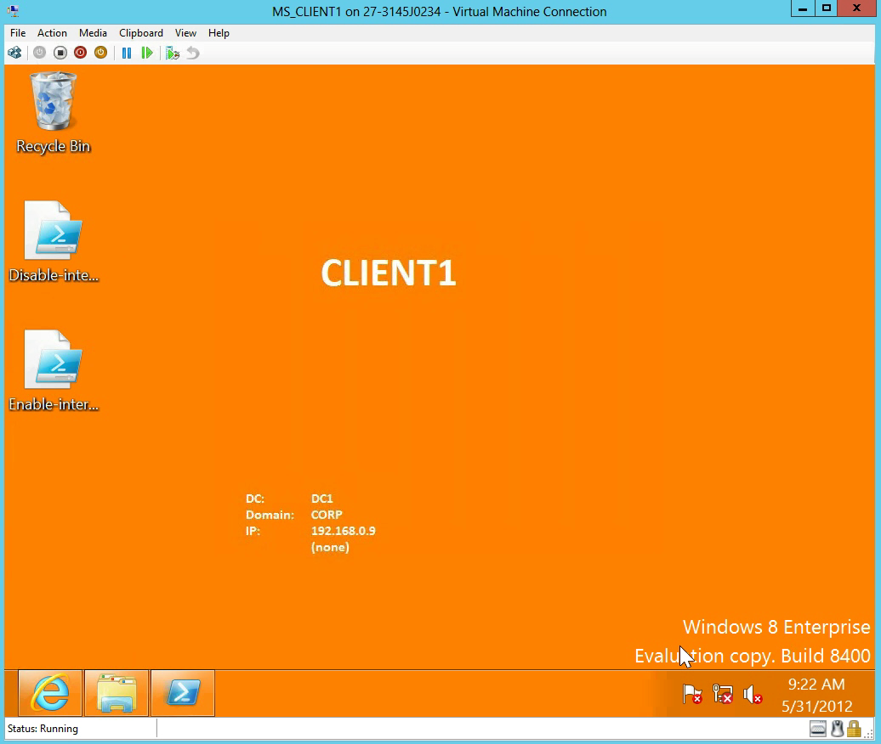

Slide 13
Unified Remote Access:
Off Premise Provisioning with DirectAccess
Enable clients to join the corporate network from offsite locations
Create provisioning package
Transfer
or load on client
Apply provisioning package
Works with Windows To Go

Slide 14
“Very excited about this feature to get currently unmanaged devices at kiosks to become manageable again. Right now we don’t have a solution.” - Expedia
Customer Quote

Slide 15
Multisite Deployment
Client connects automatically to nearest entry point
Integrated configuration management across global sites

Slide 16
Multisite Client Site Selection
Automatic closest entry point selection for Windows 8 clients
  Probe-based mechanism
  Windows 7 clients fixed to single entry point
Support for GSLB based entry point detection
50 ms
20 ms
150 ms

Slide 17
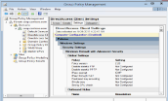
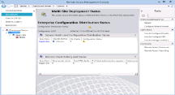
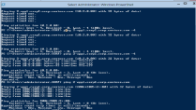
Configuration and Monitoring Flow
Admin UX
PowerShell
DC’s
Server GPOs
Client GPOs
Monitoring
Configurations
Win7
Win7
Win8
Win8
Site A
Site B
DA servers (Win8 )

Slide 18
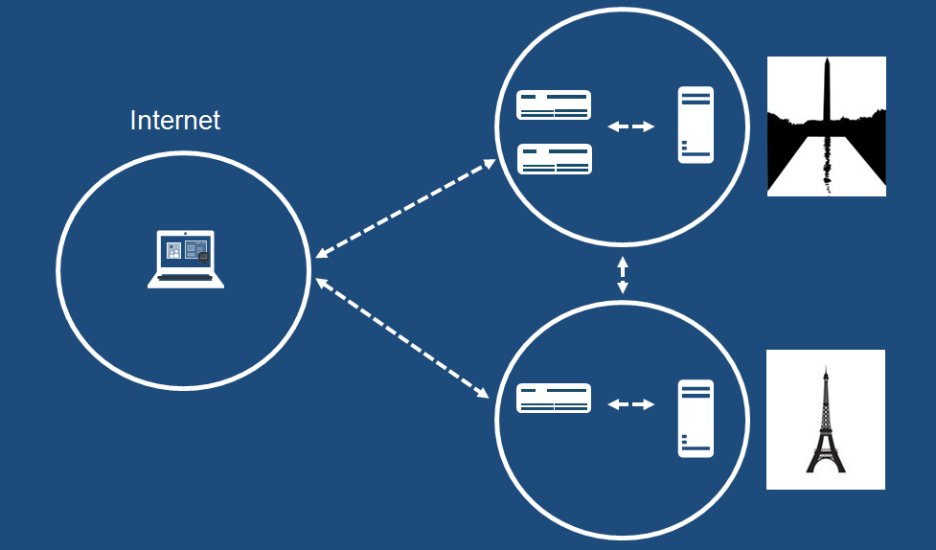
Demo: Multisite and High Availability
Internet
DC1
APP1
EDGE1

Slide 19
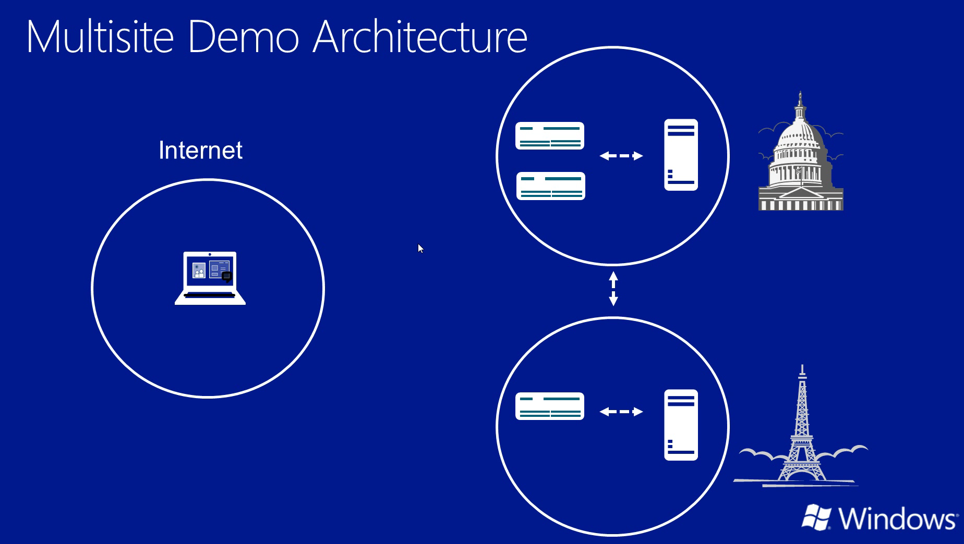

Slide 20


Multisite demo
DC:1000
DC:1001
FR:1000
Internet

Slide 21
“I wanted to compliment you on the new DirectAccess offering. The options for geographically dispersed and high availability deployments are very nice” – Concurrency
Customer Quote

Slide 22
Ease of Deployment
No changes needed to
enterprise infrastructure
Express wizard setup in minutes
Combined DirectAccess and VPN configuration

Slide 23
Demo: Easy Server Setup
Internet
DC1
APP1
EDGE1

Slide 24
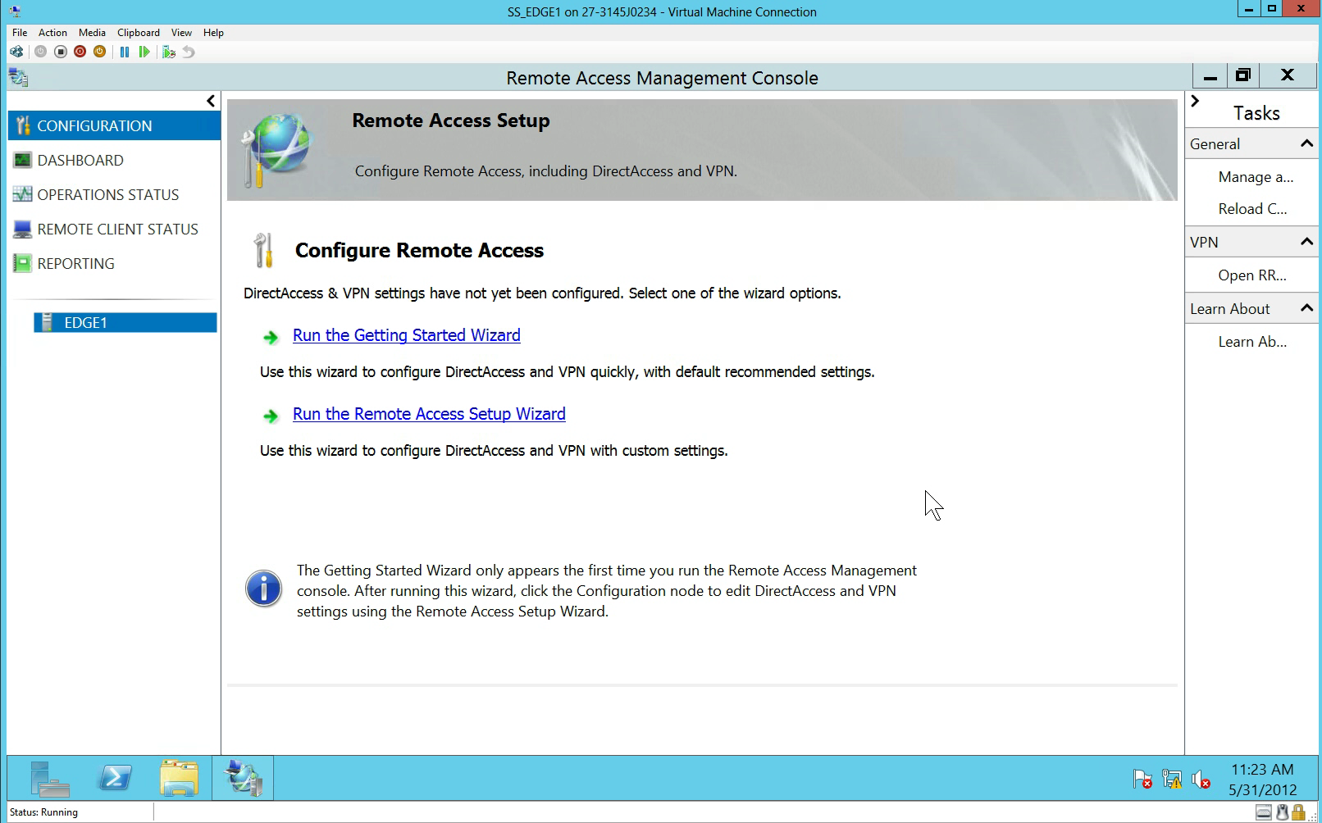

Slide 25
“DirectAccess was brain-dead easy to install!”
– Bear Creek School
Customer Quote
.

Slide 26
DirectAccess Deployment Options
Express Setup wizard Makes new deployments easy
Requires Windows 8 clients
No PKI
  Use inbox Kerberos proxy to acquire Kerberos Ticket
  Wizard creates self signed SSL certs
  No Machine Certificates required, no cert revocation lists
Single IPsec tunnel configuration – No IP management needed
Single factor authentication

Slide 27
DirectAccess Deployment Options
Support Advanced and customized configurations
PKI integration
  Uses Machine Certificates
  Cert revocation lists still optional
Double IPsec tunnel configuration
  New 1st tunnel sync Powershell
Single Factor, Two Factor, and Cert Authentication
  Smartcard, OTP, TPM (vSC)
  NAP
Multisite deployment options
Support Windows 8 and Windows 7 Clients

Slide 28
Connectivity – No IPv6 Required
DirectAccess uses IPv6 to avoid address ambiguity
If native IPv6 is not available
  Clients tunnel IPv6 over the Internet or intranet
  Use built-in DNS64/NAT64 to access IPv4 corporate network or resources
IPv6 Options
DirectAccess does not require IPv6 deployment
Internet
Intranet
Native IPv6
IPv6 Tunneling
IPv4

Slide 29
Ongoing Management
Health monitoring across all remote access servers
Connection monitoring and reporting all remote access servers

Slide 30
DirectAccess Server PowerShell
If it’s in the GUI – its in PowerShell
##View Features
Get-WindowsFeature
##Install Remote Access
Add-windowsfeature RemoteAccess
##Check out cmdlets
Get-Command –Module RemoteAccess

Slide 31
High availability
High scale
Lower costs
Performance and Scale

Slide 32
Performance Comparison
Windows Server 2008 R2 vs. Windows Server 2012:
Twice the capacity!
Example:
  CPU: 4 Cores, 2.1 GHz
  RAM: 4 GB

Slide 33
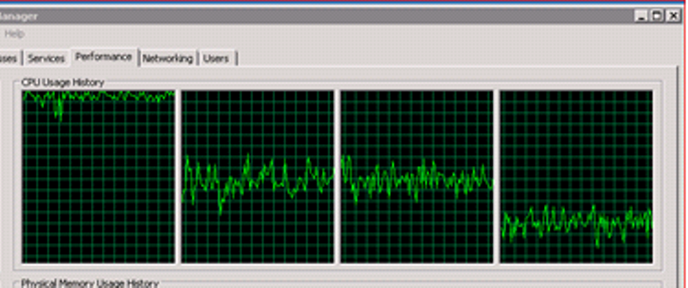
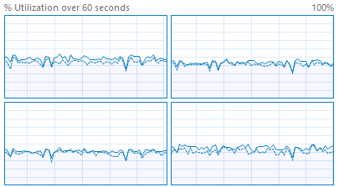

Dramatic Scale Improvements
RSS with UDP for DirectAccess
IP-HTTPS performance at near parity with Teredo
  No double encryption when using IPHTTPS
  Reduced Duplicate Address Detection (DAD) traffic
SR-IOV –Allows full use of server cores when running in a VM
  Server 2008 R2 – NO RSS for UDP
Server 2012 – w/RSS for UDP

Slide 34
End to End Security Scale Improvements
Windows Server 2012 supports IPsec hardware acceleration within a VM
Easily enabled with PS command:
Offload hardware adapters can also be configured as team NICs for failover
PS> Set-NetAdapterIPsecOffload –Name Interface1 –Enabled TRUE

Slide 35
Connectivity to the Hybrid Cloud:
Unified State
Current State
Private cloud
Internet
DirectAccess & VPN: Connecting remote clients to the hybrid cloud for
- Managed
- Unmanaged
Remote access: Connectivity using dedicated infrastructure
Public Cloud / Branch
Cross premise connectivity: Connecting private and public clouds
Site to Site connectivity using dedicated infrastructure
Remote Access
Unified Remote Access
Site to Site
End to End Security W/IPsec (Optional)

Slide 36
Interoperability Matrix
 | Windows Server 2012 | Windows Server 2008 R2
Windows 8 | Fully supported | Supported with the following limitations No DirectAccess and VPN on a single server No access to IPv4 only resources within Corpnet (needs add-on NAT64/DNS64 solution) Requires PKI No multisite deployment
Windows 7 | Supported with the following limitations Requires PKI Windows 7 clients must connect to pre-configured entry point (no automatic site selection) No off premise provisioning or Windows To Go | Supported with the following limitations No DirectAccess and VPN on a single server No access to IPv4 only resources within Corpnet (needs add-on NAT64/DNS64 solution) Requires PKI No multisite deployment No off premise provisioning or Windows To Go

Slide 37
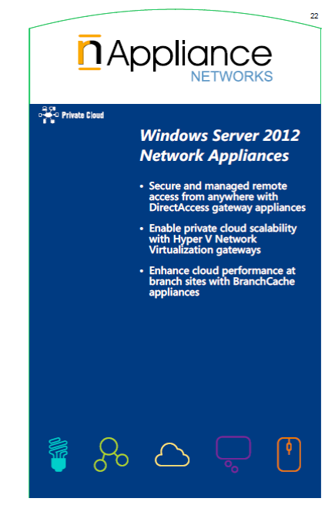




Unified Remote Access Partners

Slide 38
Summary

Slide 39
Enabling the Mobile Workforce:
Unified Remote Access
Unified Remote Access management
Off premise provisioning
Great User Experience
Scale and Performance
Works with existing networks
Hybrid Cloud
Reporting and accounting
VPN interoperability with mobile devices
Integrated client experience
High performance in virtual environments
Enhanced authentication
Deployment and Monitoring
Enabling New Scenarios
High availability
Connect through local server
Thousands of users per server

Slide 40
Summary
Unified Remote Access meets the needs of your evolving mobile workforce
  Managed Windows clients
  Unmanaged Windows clients and non-Windows devices
  Cross-premise cloud connectivity
Major enhancements available for DirectAccess
  Both in Windows 8 and Windows Server 2012
  Easy small-scale deployment up to large-scale global deployment
Start deploying now!

Slide 41


Related Content
FND03: Enable Consumerization of IT
WSV304: Windows Server 2012 Networking Performance and Management
WCL324: IPv6 Bootcamp: Get Up To Speed Quickly
WCL384: Windows 8: Windows To Go Overview
WCL284: Windows 8: An Introduction to Mobile Broadband, DirectAccess, and BranchCache
VIR305: Hyper-V Network Virtualization for Scalable Multi-Tenancy in Windows
DirectAccess and BranchCache booth in Microsoft Technical Learning Center
Technet documentation and step by step guides:
http://technet.microsoft.com/library/hh831416
Windows Server DirectAccess page: http://www.microsoft.com/directaccess
… or contact me at sandeep.singhal@microsoft.com

Slide 42


SIA, WSV, and VIR Track Resources
#TE(sessioncode)
Talk to our Experts at the TLC
Hands-On Labs
DOWNLOAD Windows Server 2012 Release Candidate
microsoft.com/windowsserver
DOWNLOAD Windows Azure
Windowsazure.com/
teched

Slide 43



Resources
Learning
  Connect. Share. Discuss.
  Microsoft Certification & Training Resources
http://northamerica.msteched.com
www.microsoft.com/learning
TechNet
  Resources for IT Professionals
  Resources for Developers
http://microsoft.com/technet
http://microsoft.com/msdn

Slide 44







Required Slide
Complete an evaluation on CommNet and enter to win!

Slide 45


MS Tag
Scan the Tag
to evaluate this
session now on
myTechEd Mobile

Slide 46
© 2012 Microsoft Corporation. All rights reserved. Microsoft, Windows, Windows Vista and other product names are or may be registered trademarks and/or trademarks in the U.S. and/or other countries.
The information herein is for informational purposes only and represents the current view of Microsoft Corporation as of the date of this presentation. Because Microsoft must respond to changing market conditions, it should not be interpreted to be a commitment on the
part of Microsoft, and Microsoft cannot guarantee the accuracy of any information provided after the date of this presentation. MICROSOFT MAKES NO WARRANTIES, EXPRESS, IMPLIED OR STATUTORY, AS TO THE INFORMATION IN THIS PRESENTATION.

Slide 48
Internet

