Slide 1
Build an Enterprise-Level Storage Infrastructure for Small and Midsize Businesses
WSV305
Prabu Rambadran and David Fabritius
Product Marketing Managers
Microsoft Corporation

Slide 2

Business challenges
  Maximize utilization of existing storage investments
  Control storage costs due to expanding data requirements
  Improve storage reliability and provide disaster recovery
  Be ready for next generation hardware

Slide 3
Technology challenges
  Manage planned/unplanned down time
  Deliver continuously available services
  Enable elastic storage capacity
  Provide a cross-platform solution
  Manage storage resources efficiently

Slide 4
Top 10 capabilities to answer challenges
Storage Spaces
File System improvements
Clustered Share Volume v2
Live Storage Migration
Offloaded Data Transfer
SMB for workloads
SMB Direct and SMB Multichannel
NFS support
iSCSI software target
Enhanced manageability

Slide 5
SAN-like capabilities on commodity hardware
title

Slide 6
Scenario
Delivering key SAN features on commodity hardware
  Parity with key values of best-in-class SAN storage
  Lower cost – acquisition, deployment, operation
  Better serviceability and data management model
  Easier to deploy and manage
Supporting Features
  Storage Spaces
  SMB 3.0
  Thin and trim provisioning
  Data deduplication
  SMB Direct

Slide 7




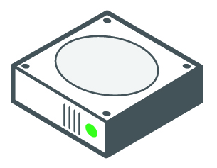
Storage Spaces
Active ON
Virtualizes commodity storage into Storage Spaces and Storage Pools
Integration with other Windows Server 2012 capabilities
Provides storage resilience and availability from commodity storage
SAS and SATA interconnects
Cluster support
Windows Application Servers or File Servers
Physical or virtualized deployments
File Server Administration Console
Hyper-V
SMB Multichannel
Integrated with other
Windows 8 Consumer Preview capabilities
Failover Clustering
NTFS
SMB Direct
Cluster Shared Volumes
NFS
Windows Storage Mgmt.
Windows
Virtualized
Storage
Storage
Spaces
Storage
Spaces
Storage
Spaces
Storage Pool
Storage Pool
Storage Pool
(Shared) SAS or SATA
Physical
Storage

Slide 8
Storage Spaces
demo

Slide 9




SMB Enhancements
  High-availability scale out file server
  SQL Server and Hyper-V data store
  Single file system namespace
  Zero application downtime for both planned maintenance and unplanned failures
  Active/active access
Hyper-V
Cluster
SMB
Single Logical Server \\Foo\Share
Single File System Namespace
File Server Cluster
Cluster Shared
Volumes

Slide 10
SMB3 support for SQL Server and Hyper-V
Hyper-V Cluster
Hyper-V
Hyper-V
Hyper-V
Hyper-V
Hyper-V
Hyper-V
Hyper-V
Hyper-V
Hyper-V
  Hyper-V can now leverage file share storage for virtual storage
  Application-specific capabilities for Hyper-V and SQL Server workload types
  Leverage new high-performance and high-availability SMB features for applications
  Cluster-Aware Updating for applications
SQL
Server
SQL
Server
SQL
Server
IIS
IIS
IIS
VDI
Desktop
VDI
Desktop
VDI
Desktop
File Server Cluster
File Server
File Server
Shared
Storage

Slide 11
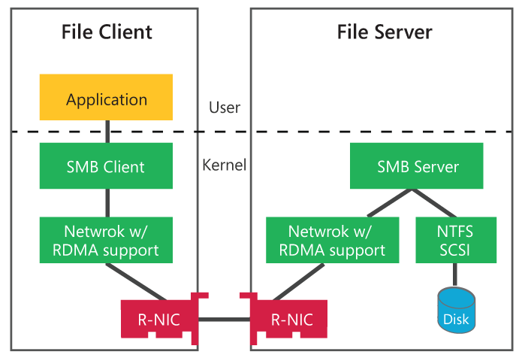
SMB Direct (RDMA)
Active ON
New class of SMB file storage
Minimal CPU utilization for I/O processing
Low-latency with ability to leverage high-speed networks (InfiniBand and iWARP)
Can be used with SMB Multichannel for load balancing and failover

Slide 12
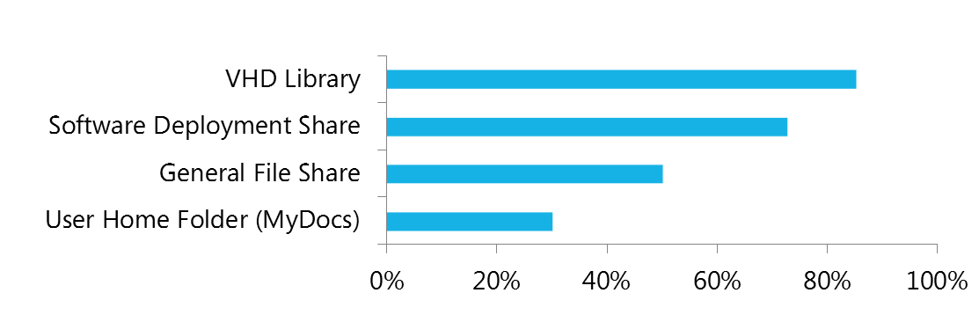
Data Deduplication
Capacity Optimization
      2:1 with File Shares
      20:1 with Virtual Storage
Scale and Performance
      Low CPU & memory impact
      Configured scheduling
Reliability and Integrity
    Redundant metadata
    Checksums and integrity checks
Greater efficiency with BranchCache
Average savings with data deduplication by workload type

Slide 13
Reliable storage solutions built for the cloud
title

Slide 14
Scenario
Reliable storage solutions built for the cloud
  Ability to automatically recover from file corruption
  Reduce downtime
Supporting Features
  NTFS/ReFS Self-healing capability
  Chkdsk improvements
  Online data backup

Slide 15
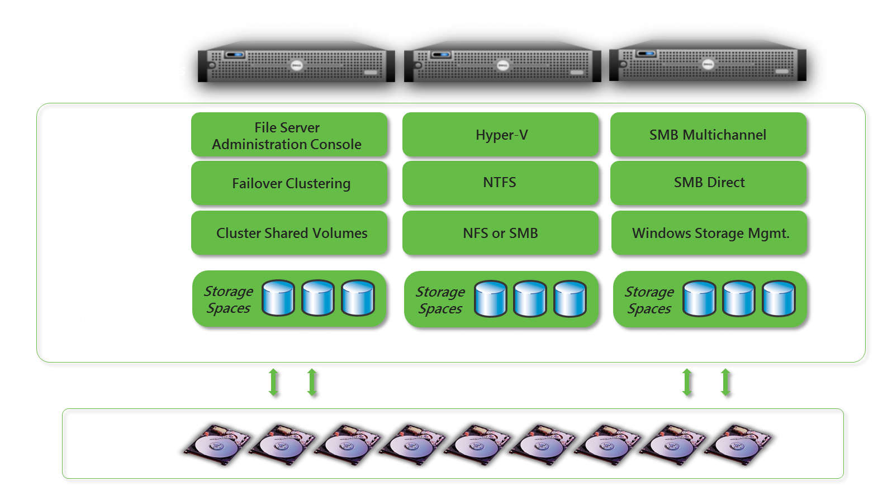
Storage Spaces Resiliency
Software-only storage virtualization of individual disks to manage as pools
Data redundancy with either
n-way mirroring (optionally clustered) or parity mode (unclustered)
Designed for resiliency on industry standard storage hardware (JBOD with SAS or SATA interconnects)
Integrated with Windows Failover Clustering & Cluster Shared Volumes
Thin-provisioning of storage pools in unclustered mode

Slide 16



Resilient File System (ReFS)
Active ON
Data corruption avoided
    Allocate-on-write
    Checksum to detect whether the data on disk has changed since last write
Data integrity protection
    File system metadata is always protected, maximizing online operation
    Optional user data protection configurable per-volume, per-directory, and per-file
Rapid recovery from file system corruption without affecting availability
    If redundant copy available, automatic correction
    If not, salvage done online and only corrupt portion of namespace affected

Slide 17
NTFS Online Scan and Repair (CHKDSK)
Active ON
Disk scanning process separated from repair process
Scanning done with volume online, taken offline only for time to repair – based on number of errors to fix rather than size of volume
Zero offline time when used with CSV

Slide 18







Online backup
Third-party cloud
Reduces costs associated with backup storage and management
Can leverage Windows Azure™ cloud services
Options for third-party cloud services
Ideal for small businesses, branch offices, and departmental business continuity needs
Microsoft Online
Backup Portal
Third-party Online
Backup Portal
Sign up
Billing
Sign up
Billing
Microsoft Online
Backup Service
3rd Party Online
Backup Service
IT Admin
or
VAP
Registration
IT Admin
or
VAP
Backup/Restore
Backup/Restore
Registration
Inbox Engine
Inbox UI
Agents
Microsoft Online Backup
Third-party agents
Windows Server 2012 RC Backup (Extensible)
Windows Server 2012 RC

Slide 19
Continuous storage solutions
title

Slide 20
Scenario
Storage solutions that deliver continuous services
  Services are transparent to underlying hardware failures
  Low-cost, high availability solutions on industry-standard hardware
  Patching applications and OS without interrupting service
  Product built ground-up to support “Active-on” (across storage, networking, and Hyper-V)
Supporting Features
  SMB Transparent failover
  Clustered Share Volume v2
  Cluster aware updating
  SMB Multichannel
  Continuous availability with SMB, iSCSI and NFS

Slide 21
SMB Transparent Failover
Active ON
Failover transparent to server apps
    Zero downtime
    Small IO delay during failover
Supports
    Planned moves
    Load balancing
    OS restart
    Unplanned failures
    Client redirection (Scale-Out only)
Supports both file and directory operations
Requires:
    Windows Server “8” Failover Clusters
    Both server running application and file server cluster must be Windows Server “8”
1
Normal operation
2
Failover share - connections and handles lost,
temporary stall of IO
3
Connections and handles auto-recovered
Application IO continues with no errors
SQL Server
1
3
\\fs1\share
\\fs1\share
2
File Server Cluster
File Server Node A
File Server Node B

Slide 22

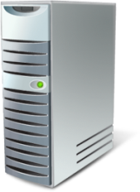








Cluster-Aware Updating
Active ON
Initiates
Check & Update
Admin
Simple orchestration of cluster node updates
Determines updates needed, moves workloads off nodes for updates
    Uses Windows Update Agent
    Identifies node with least load
    Puts node in maintenance mode
    Verifies success, then moves to next node
Maintains service availability and without impacting cluster quorum
Update Cluster
(Orchestrator)
Windows Update
Cluster
Node Drained

Slide 23
SMB MultiChannel
Active ON
Sample Configurations
Uses multiple TCP connections for each SMB session if available
Transparent failover – recovers network failure if another connection is available
Improved throughput
    Bandwidth aggregation with multiple NICs
    Utilizes multiple CPUs for network processing with multiple or RSS-capable NICs
    Can combine with NIC teams
Simple automatic configuration - SMB detects and uses multiple network paths
Multiple 1GbE NICs
Multiple 10GbE/IB
RSS-capable NICs
SMB Client
SMB Client
NIC
1GbE
NIC
1GbE
NIC
10GbE/IB
NIC
10GbE/IB
Switch
1GbE
Switch
1GbE
Switch
10GbE/IB
Switch
10GbE/IB
SMB Server
SMB Server
NIC
1GbE
NIC
1GbE
NIC
10GbE/IB
NIC
10GbE/IB

Slide 24
SMB, Clustering, & Hyper-V
demo

Slide 25
Operational efficiency with simplified manageability
title

Slide 26
Scenario
Delivering operational efficiency with simplified manageability
  Provide a rich set of tools for IT pros anc Developers
  Provide an framework on which consistent, repeatable and reliable automation can be built
  Perform complex activities through simple wizard driven experience
Features
  SMI-S and WMI Management
  Comprehensive storage management
  Powershell

Slide 27
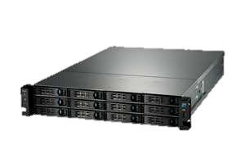
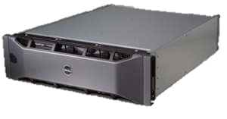
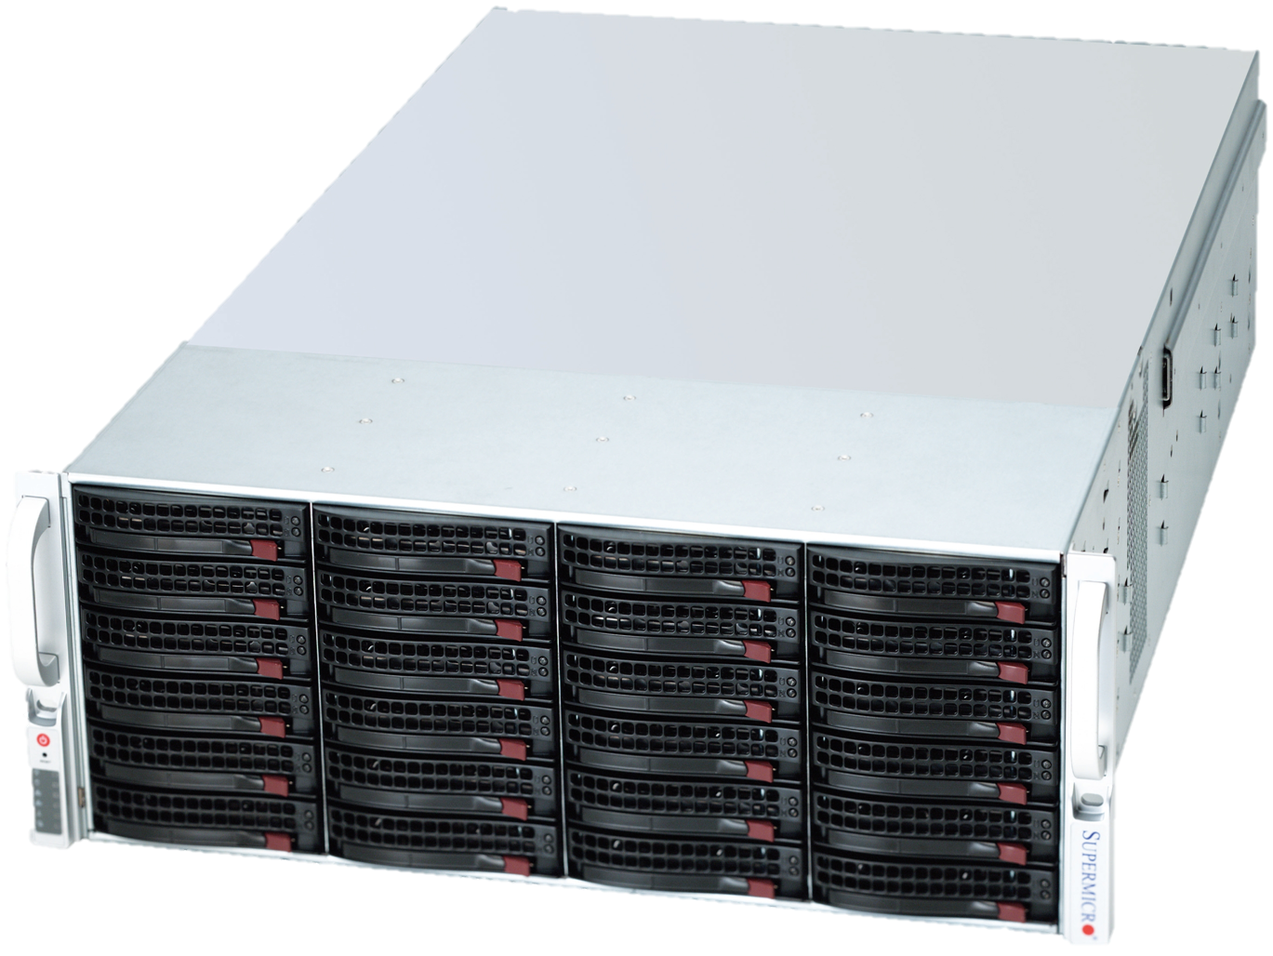
Unified management of storage
File & Storage Services
(Server Manager)
Microsoft Applications
ISV or Storage Vendor Applications
Windows Storage Management API (PowerShell & WMI)
(Physical Disks, Storage Pools, Virtual Disks & Volumes)
Storage Spaces
Storage Spaces
compatible JBOD
SMP compliant array
SMI-S compliant array

Slide 28

Management Options
Automation using PowerShell & WMI
System Center Management Packs available for Beta:
    SMB
    NFS
    iSCSI
    Deduplication
    FSRM / FCI
    DFS-N / DFS-R
BPA – Best Practice Analyzer available for all components
Get-Command –module [ ]
  SMBshare
  NFS
  FileServerResourceManager
  DFSN
  Deduplication
  iSCSITarget
  Storage
  FailOverClusters
http://blogs.technet.com/b/roiyz/archive/2012/03/06/windows-powershell-reference-sheet-for-file-and-storage-services-in-windows-server-8-beta.aspx

Slide 29
Storage Configuration Options
title

Slide 30
All Standalone
Hyper-V Host
Hyper-V Host
Hyper-V
Standalone, shares used for VHD storage
File Server
Standalone, Local Storage
Configuration highlights
Flexibility (Migration, shared storage)
Simplicity (File Shares, permissions)
Low acquisition and operations cost
Configuration lowlights
Storage not fault tolerant
File server not continuously available
Hyper-V VMs not highly available
Hardware setup and OS install by IT Pro
Share
Share
VHD
VHDX
File Server

Slide 31
All Standalone + Storage Spaces
Hyper-V Host
Hyper-V Host
Hyper-V
Standalone, shares used for VHD storage
File Server
Standalone, Storage Spaces
Configuration highlights
Flexibility (Migration, shared storage)
Simplicity (File Shares, permissions)
Low acquisition and operations cost
Storage is Fault Tolerant
Configuration lowlights
File server not continuously available
Hyper-V VMs not highly available
Hardware setup and OS install by IT Pro
Share
Share
VHD
VHDX
File Server
Storage Spaces
Space
Space

Slide 32
Standalone File Server, Clustered Hyper-V
Failover Cluster
Hyper-V Host
Hyper-V Host
Hyper-V
Clustered, shares used for VHD storage
File Server
Standalone, Storage Spaces
Configuration highlights
Flexibility (Migration, shared storage)
Simplicity (File Shares, permissions)
Low acquisition and operations cost
Storage is Fault Tolerant
Hyper-V VMs are highly available
Configuration lowlights
File server not continuously available
Hardware setup and OS install by IT Pro
Share
Share
VHD
VHDX
File Server
Storage Spaces
Space
Space

Slide 33
Clustered File Server, Standalone Hyper-V
Hyper-V Host
Hyper-V Host
Hyper-V
Standalone, shares used for VHD storage
File Server
Clustered, Storage Spaces
Configuration highlights
Flexibility (Migration, shared storage)
Simplicity (File Shares, permissions)
Low acquisition and operations cost
Storage is Fault Tolerant
File Server is Continuously Available
Configuration lowlights
Hyper-V VMs not highly available
Hardware setup and OS install by IT Pro
Share
Share
VHD
VHDX
Failover Cluster
File Server
File Server
Clustered Storage Spaces
Space
Space
Shared JBOD SAS

Slide 34
All Clustered
Failover Cluster
Hyper-V Host
Hyper-V Host
Hyper-V
Clustered, shares used for VHD storage
File Server
Clustered, Storage Spaces
Configuration highlights
Flexibility (Migration, shared storage)
Simplicity (File Shares, permissions)
Low acquisition and operations cost
Storage is Fault Tolerant
Hyper-V VMs are highly available
File Server is Continuously Available
Configuration lowlights
Hardware setup and OS install by IT Pro
Share
Share
VHD
VHDX
Failover Cluster
File Server
File Server
Clustered Storage Spaces
Space
Space
Shared JBOD SAS

Slide 35
Cluster-in-a-box
Failover Cluster
Hyper-V Host
Hyper-V Host
Hyper-V
Clustered, shares used for VHD storage
File Server
Cluster-in-a-box
Configuration highlights
Flexibility (Migration, shared storage)
Simplicity (File Shares, permissions)
Low acquisition and operations cost
Storage is Fault Tolerant
File Server is continuously Available
Hardware and OS pre-configured by the OEM
Share
Share
VHD
VHDX
Cluster-in-a-box
File Server
File Server
Clustered Storage Spaces
Space
Space
Shared JBOD SAS

Slide 36



Related Content
Breakout Sessions (session codes and titles)
Hands-on Labs (session codes and titles)
Product Demo Stations (demo station title and location)
Related Certification Exam
Find Me Later At…

Slide 37


SIA, WSV, and VIR Track Resources
#TE(sessioncode)
Talk to our Experts at the TLC
Hands-On Labs
DOWNLOAD Windows Server 2012 Release Candidate
microsoft.com/windowsserver
DOWNLOAD Windows Azure
Windowsazure.com/
teched

Slide 38



Resources
Learning
  Connect. Share. Discuss.
  Microsoft Certification & Training Resources
http://northamerica.msteched.com
www.microsoft.com/learning
TechNet
  Resources for IT Professionals
  Resources for Developers
http://microsoft.com/technet
http://microsoft.com/msdn

Slide 39







Complete an evaluation on CommNet and enter to win!

Slide 40





Please Complete an Evaluation
Your feedback is important!
Be eligible
to win great daily prizes and the grand prize of a $5,000 Travel Voucher!
Multiple
ways to Evaluate Sessions
Scan the Tag
to evaluate this
session now
on myTechEd Mobile

Slide 41
© 2012 Microsoft Corporation. All rights reserved. Microsoft, Windows, Windows Vista and other product names are or may be registered trademarks and/or trademarks in the U.S. and/or other countries.
The information herein is for informational purposes only and represents the current view of Microsoft Corporation as of the date of this presentation. Because Microsoft must respond to changing market conditions, it should not be interpreted to be a commitment on the
part of Microsoft, and Microsoft cannot guarantee the accuracy of any information provided after the date of this presentation. MICROSOFT MAKES NO WARRANTIES, EXPRESS, IMPLIED OR STATUTORY, AS TO THE INFORMATION IN THIS PRESENTATION.

