Slide 1
Windows Server 2012:
Storage Capabilities for Everyone
WSV327
Bryan Matthew
Program Manager
Microsoft Corporation

Slide 2
The Storage and File Systems (SFS) group builds the platform storage features shipping across all versions of Windows

Slide 3
Storage Platform in Windows Server 2012
Maximizes the value of existing storage infrastructure
Empowers customers to build highly resilient, scalable, available, and performant storage solutions with commodity hardware
Enables deployment of flexible, highly scalable, manageable, and low-cost appliances

Slide 4
Storage Platform Overview
Benefit
Capability
Feature
Maximize Availability
Maximize data availability
Modern NTFS CHKDSK
Next-generation scale, availability, and integrity
Resilient File System (ReFS)
Minimize Cap-Ex
Storage virtualization and resiliency
Storage Spaces
Minimize Op-Ex
Ease of storage administration
Storage Management PowerShell with SMI-S & SMP integration
Maximize Existing Hardware
Efficient capacity utilization
Thin provisioning integration
Dynamic data movement
Offloaded Data Transfers

Slide 5




Enabled Deployment Models
 | Cost-Efficient Storage (New) | Traditional Storage
Block Access
File Access
SAS
FC
iSCSI
App Servers
JBODS
App Servers
.\db
.\db
File
SAS
File
FC
iSCSI
App Servers
CA File Servers
JBODS
App Servers
CA File Servers

Slide 6
Windows Server 2012 is the most cost-efficient platform for continuously available and highly scalable data access

Slide 7
Storage Array Integration
Maximizing Hardware Investments

Slide 8

Maximizing Hardware Investments
Storage Array Integration
Get the most out of advanced capabilities in your storage array investments
Thin Provisioning (TP)
  Optimization minimizes storage footprint
  Threshold notifications enable agility and responsiveness

Slide 9
Thin Provisioning
Identification
  Industry leadership for standards based thinly provisioned virtual disk identification
Optimization
  End-to-end transparency of file system allocation
  Space reclamation occurs both real-time and on a scheduled basis
  Scheduled slab consolidation ensures smallest storage footprint
Works automatically with Storage Spaces and supported storage arrays

Slide 10
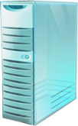
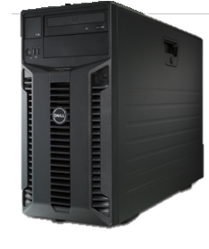
Thin Provisioning
End-to-end
optimization
Virtual Machine
File Deletion
Physical Machine
Hosting Storage Spaces and Virtual Machines
Filters
NTFS
TRIM/UNMAP
Spaces
Storage Space
(Allocation View)
Storage Pool (Allocation View)

Slide 11
Maximizing Hardware Investments
Storage Array Integration
Get the most out of advanced capabilities in your storage array investments
Offloaded Data Transfers (ODX)
  Efficient and secure data movement between Windows systems
  Full stack integration automatically attempts to leverage capability when available

Slide 12
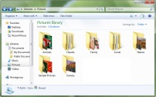
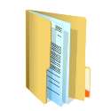


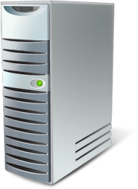


Traditional Data Movement
DATA
Actual Data Transfer
Read
Data
Write Data
Results
Virtual Disk
Virtual Disk
Traditional Storage Array

Slide 13
Offloaded Data Transfers
Token
Offload Read
Token
Offload Write with Token
Results
Virtual Disk
Actual Data Transfer
Virtual Disk
Storage Array
w/ ODX Support

Slide 14
Offloaded Data Transfers
Traditional transfers have avoidable resource consumption when (simply) moving data around
  Consumes CPU cycles and Memory on hosts
  Utilizes both storage and network bandwidth
    Performance always constrained by available network bandwidth
  ODX transparently enables through Drag-and-Drop, Copy, Powershell, Robocopy, etc
    Supports local volumes, file shares, VHDs, from within VMs
Great for Hyper-V VM/VHD Provisioning, Data Mining, Hyper-V Storage Migration

Slide 15



Traditional Data Transfers
SMB Shares
File
Servers
Redmond, WA
~2650 miles
Traditional Storage Array
Actual Data Transfer
Orlando, FL

Slide 16
Offloaded Data Transfers
SMB Shares
File
Servers
Redmond, WA
~2650 miles
Actual Data Movement
Storage Array
w/ ODX Support
Orlando, FL

Slide 17
Offloaded Data Transfers & Thin Provisioning
Demo

Slide 18
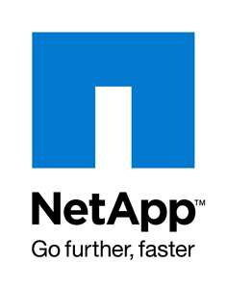
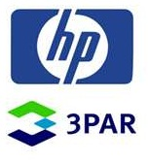


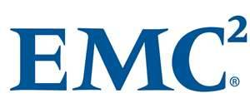
Subset of partners with POR to support
TP and ODX for Windows Server 2012

Slide 19

Windows Server 2012 works better with the advanced capabilities present in many of today’s storage arrays.

Slide 20
Storage Spaces
Storage Virtualization and Resiliency

Slide 21
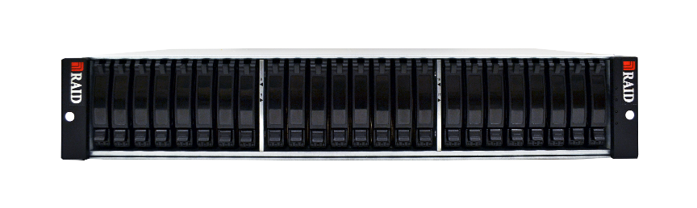
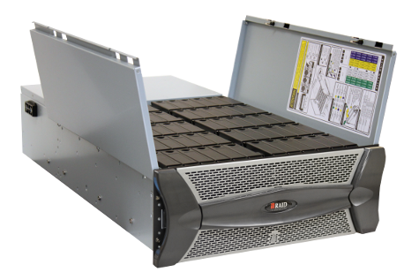
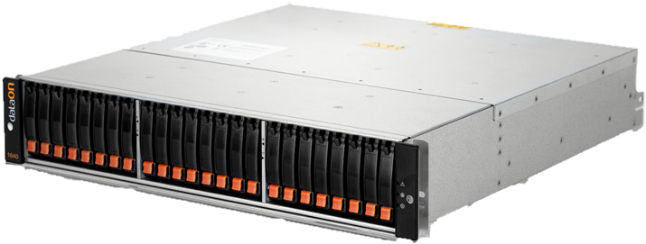
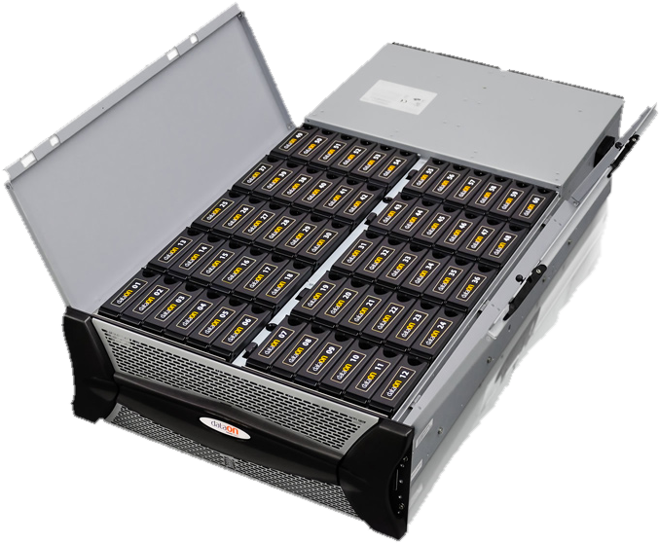
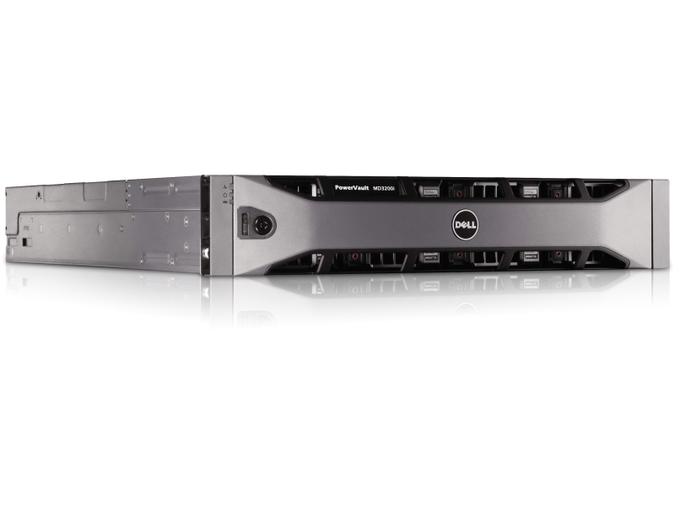
Cost-Efficient Business Critical Storage
Powerful new platform abstractions
  Storage Pools: Units of aggregation, administration, isolation
  Storage Spaces: Resiliency, provisioning
Industry standard commodity storage
  Interconnects: SAS, USB, and SATA
  Enclosures: Shared SAS JBOD arrays

Slide 22
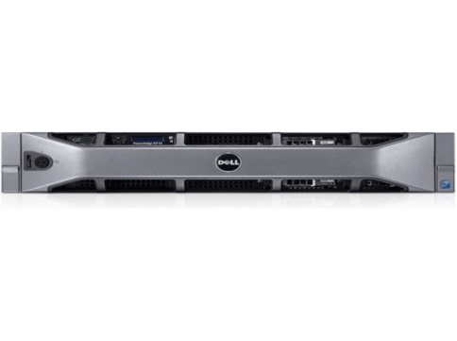
Storage Spaces Model
Physical or
Virtualized Servers
Windows Server 2012 Capabilities
File and Storage Manager
ReFS & NTFS
SMB v3 RDMA
Failover Clustering & CSV v2
Hyper-V
Storage Mgmt. PowerShell
Virtualized Resilient Storage
Mirror Space
Parity Space
Mirror Space
Mirror Space
Mirror Space
Parity Space
Parity Space
Mirror Space
Mirror Space
Mirror Space
Mirror Space
Parity Space
Cost-efficient shared SAS JBOD arrays

Slide 23
Storage Spaces
Overview of Capabilities
Resiliency to Media Failure
  Redundant Storage: Mirrored and Parity Spaces
  Rapid Recovery: Designated Hot-Spares in a Pool
Optimized & Flexible Storage Utilization
  On-Demand Provisioning
  Elastic Capacity Expansion
  Space Reclamation
Application Driven Error Correction
  APIs enabling applications to inspect all copies of the data and self-correct using appropriate copy

Slide 24
Storage Spaces
Overview of Capabilities
Integration with Windows Failover Clustering & CSV
  Availability and Scale-Out
Operational Simplicity
  Managed via. Storage Management APIs, Server Manager, and PowerShell
  Enclosure Awareness
Workload Optimized Performance via. Heterogeneous Media Support
  Supports mixed deployment requirements utilizing both SSD and HDD media types
    Enables tiered provisioning based on workload needs

Slide 25







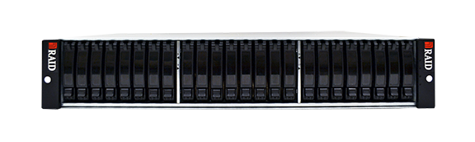
Storage Spaces
Non-clustered standalone deployment
Low number of individual servers, each with directly-attached storage
Acceptable periods of planned downtimes for traditional maintenance
\\home
Standalone Storage Pools with Spaces
Space
Space
Space
Space
Space
Space
Single Server
Direct-Attach
SAS JBODs
Individual Server
Workloads
Individual Server
Workloads

Slide 26


Storage Spaces
“deployment element”
Building block for scalable, HA deployments
  Easily expandable through additional Deployment
  Elements
Can move HA workload off a cluster node for maintenance without disruption
  Live Migration for running VMs
  Simple “Move” Operation for others
Enterprise Workload
Unified Cluster Shared Volume Namespace
\CRM
Clustered Storage Spaces
Space
Space
Space
2-4 servers
Shared SAS storage
Deployment Element

Slide 27




Scalable and Continuous Availability
Logical View
(Highly available, scalable, cost-efficient)
VMs
.\db
.\VHD
.\Home
Enterprise Workload
Enterprise Workload
CA File Server
Unified Cluster Shared Volume Namespace
\Finance
\CRM
\File-Shares
Clustered Storage Spaces
Space
Space
Space
Space
Space
Space
Space
Space
Space
Physical View
(64 servers max)
2-4 servers
Shared SAS storage
Deployment Element
Deployment Element
Deployment Element

Slide 28
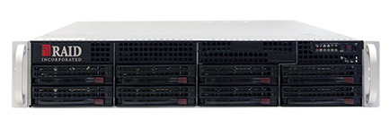
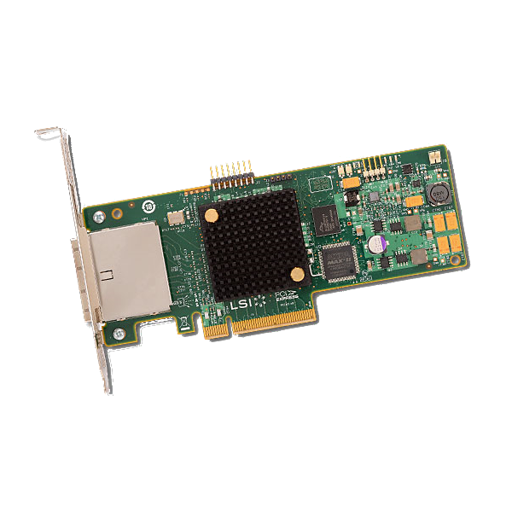

Representative Deployment Element
60-bay
SAS array
60-bay
SAS array
60-bay
SAS array
60-bay
SAS array
3TB Near-line SAS HDDs
720TB
High-Cap
600GB 15K SAS HDDs
144TB
Mid-Perf
400GB SAS HDDs
96TB
High-Perf

Slide 29
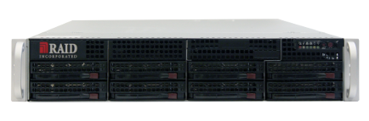
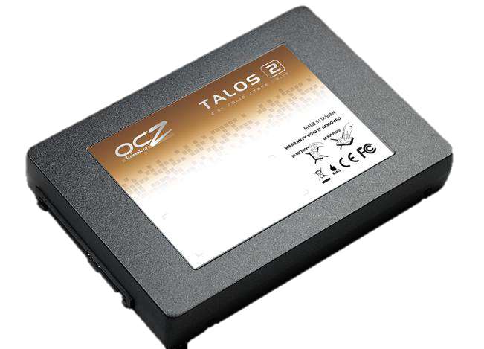
Performance Cluster Deployment Element
3 RAID Inc FusionRomley®2U Dual-Socket EP Cluster Nodes
w/ Dual LSI 9205-8e SAS Adapters
Shared SAS
RAID Inc 2U 24-bay EBOD
w/ OCZ Talos 2 “R” 400GB SAS SSDs
9.6TB SSD Storage

Slide 30
High Performance
Clustered Storage Spaces
Demo

Slide 31
Performance Cluster Deployment Element
3 RAID Inc FusionRomley®2U Dual-Socket EP Cluster Nodes
w/ Dual LSI 9205-8e SAS Adapters
Shared SAS
RAID Inc 2U 24-bay EBOD
w/ OCZ Talos 2 “R” 400GB SAS SSDs
9.6TB SSD Storage
See this hardware at Partner Pavilion booth #23

Slide 32
Storage Spaces delivers a new category of highly capable storage solutions to all Windows customer segments at dramatically
lower price-points and maximized operational simplicity

Slide 33
Modern NTFS Health Model & CHKDSK
Maximized Volume Availability

Slide 34
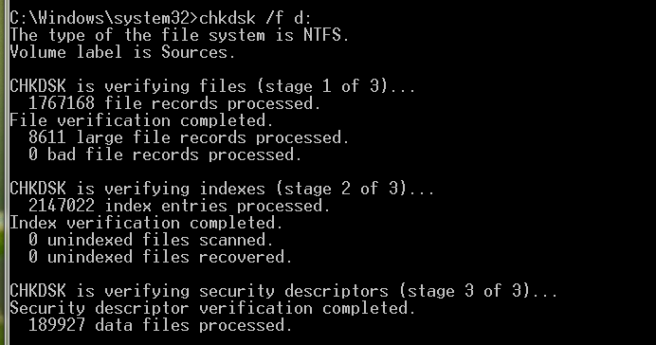
Background
NTFS supports volumes up to 256TB
  Practical volume size is reduced due to potential volume unavailability with long running CHKDSK
Overall CHKDSK execution time has decreased with every Windows release since Windows 2000
Windows 8 and Windows Server 2012
maximizes volume availability

Slide 35
Maximizing Availability & Improving Scalability in Windows Server 2012
Improved detection and handling of corruptions in NTFS
Change in the CHKDSK execution model
  Online analysis and potentially offline repair phases
Integration with Cluster Shared Volumes (CSV)
File system health monitored through Action Center and Server Manager

Slide 36
Modern CHKDSK
Online scan & repair execution workflow
Possible Corruption Detected
NTFS detects a perceived anomaly in file system metadata
Online Self-Healing
NTFS attempts to rapidly self-heal
NTFS will validate whether issue is transient or genuine
Online Verification
Volume remains online
Volume remains online
Online Identification & Logging
If not self-healed, NTFS will identify and log corrective actions for later processing
Precise & Rapid Correction
Volume remains online
User or Admin is notified
With CSV, I/O is transparently paused for rapid correction, then automatically resumed
The user or admin can take the volume offline when convenient, and outstanding logged corruptions are rapidly corrected aka. “spot fixed”

Slide 37
Modern CHKDSK
Time required to fix a single corruption - Going from hours to mere seconds
0.13
0.13
0.13
Windows Server 2012

Slide 38
Confidently deploy
multi-TB volumes with Windows Server 2012

Slide 39
Data Deduplication
Optimized Space Utilization

Slide 40
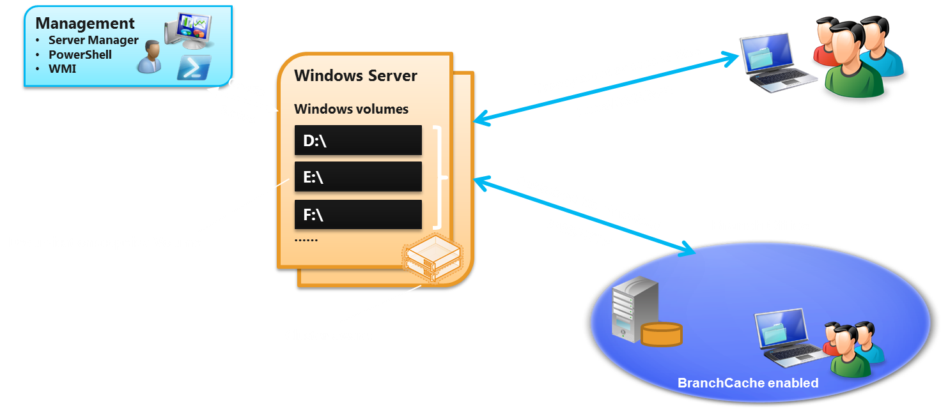
Optimized Space Utilization
Deduplication - Deployment View

Slide 41
Data Deduplication
Finds and removes duplication within data without compromising its fidelity or integrity
Works transparently in the background
Typical savings based on usage:
Use DDPPEval to estimate deduplication savings in your storage environment

Slide 42
Data Deduplication
Demo

Slide 43
With Data Deduplication in Windows Server 2012, customers can maximize space utilization with new or existing storage investments.

Slide 44
Windows Storage Management
Minimized Operational Complexity & Cost

Slide 45
Storage Management
A new approach
Standards-Based Storage Management
  WMI-based class structure
  Integration with SMI-S and SMP arrays
Integration with SCVMM 2012
  Easy management of virtualized deployments
PowerShell commands simplify end-to-end storage management
  Enables remote administration and scripting
Easily manage your
heterogeneous storage

Slide 46

Operational Simplicity
Comprehensive storage management
Microsoft Applications
ISV or Storage Vendor Applications
Single Storage Management Interface
Storage
Spaces
SMP compliant
array
SMI-S compliant
array
Storage Spaces compatible JBOD

Slide 47
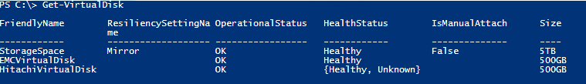
Integrated Storage Management
Virtual Disks are exposed by available providers
In this example, Virtual Disks are shown from:
  Storage Spaces Provider
  EMC Provider
  Hitachi Provider
Storage
Spaces
SMI-S compliant
array
SMP compliant
array
Storage Spaces compatible JBOD

Slide 48
Windows Storage Management

Slide 49
With Windows Server 2012, storage management is an integrated and intuitive experience, which reduces operational complexity.

Slide 50
Integrated Storage Stack with the Resilient File System (ReFS)
Next-Gen Scalability, Availability, and Data Integrity

Slide 51
Introduction
Customer Needs
  Windows customers want a cost-effective platform that maximizes data availability, scales efficiently to very large data sets across diverse workloads, and guarantees data integrity via resiliency to corruption (regardless of software or hardware failures)
The Resilient File System (ReFS)
  ReFS is a new file system targeting these customer needs while providing a foundation for significant future innovations. Windows 8 customers can now deploy the most cost-effective platform for available and scalable data access using cost-efficient storage, by utilizing an integrated storage stack comprising ReFS and Storage Spaces.

Slide 52
ReFS
Overview of benefits
Integrity of Metadata and (optionally) User Data
  Checksums detect changes to on-disk representation of data
  Utilizes data redundancy offered by Storage Spaces to auto-correct corruptions
  Metadata always protected and auto-corrected. Optionally, user data can be protected and similarly auto-corrected
  Scrubber to protect against latent corruptions
Maximized Dataset Availability
  When corruption is detected, file system is made consistent while remaining online

Slide 53
ReFS
Overview of benefits
Scalability
  Efficient and scalable metadata structures
  Scales beyond capabilities of NTFS, efficiently handling PB+ datasets comprising of very large files or directories
Architectural Evolution
  Architecture enables efficient evolution for new storage devices, new access patterns, and capabilities

Slide 54

ReFS Deployments
Deployable on cost-efficient commodity hardware
  Optional integrity guarantee for user data
  Storage spaces provides resiliency against media failure
  Failover Clustering provides high availability for File Server
Considerations
  ReFS available only with Windows Server 2012
  Can only be deployed as data volume
  Does not guarantee the same level of appcompat as NTFS
VHDs
\\Docs
\\Home
\\VHDs
Highly Available File Server
Mark’t Dept.
Home Dirs
VHD Library
ReFS volumes with user data integrity
Space
Space
Space
Clustered Storage Spaces
2-4 servers
Shared SAS storage
Deployment Element

Slide 55
ReFS is a new file system delivering on demanding customer needs while providing a foundation for significant future innovations.
Windows Server 2012 customers can now deploy the most cost-efficient platform for available and scalable data access using commodity storage, by utilizing an integrated storage stack comprising ReFS and Storage Spaces.

Slide 56
Storage Platform Overview
Benefit
Capability
Feature
Maximize Availability
Maximize data availability
Modern NTFS CHKDSK
Next-generation scale, availability, and integrity
Resilient File System (ReFS)
Minimize Cap-Ex
Storage virtualization and resiliency
Storage Spaces
Minimize Op-Ex
Ease of storage administration
Storage Management PowerShell with SMI-S & SMP integration
Maximize Existing Hardware
Efficient capacity utilization
Thin provisioning integration
Dynamic data movement
Offloaded Data Transfers

Slide 57

Related Content
Windows Server 2012 File System Enhancements: Redefining Storage
Wednesday June 13 at 5:00PM – 6:15PM in S320E
Building a Highly Available Failover Cluster Solution with Windows Server 2012 from the Ground UP
Wednesday, June 13 at 10:15AM – 11:30AM in N210
Windows Server 2012 High-Performance, Highly-Available Storage Using SMB
Wednesday, June 13 3:15PM – 4:30PM in N320A
Architecting Private Clouds Using Windows Server 2012
Thursday, June 14 at 4:30PM – 5:45PM in S320A

Slide 58
Related Content
Windows Server 2012 File and Storage Services Management
Wednesday, June 13 at 10:15AM – 11:30AM in N310
Partner Demo Stations
  RAID Incorporated, Partner Pavilion Booth #23
  DataON Storage, Partner Pavilion Booth #34
Find me later at… The Partner Pavilion

Slide 59
Track Resources
Virtualizing Storage for Scale, Resiliency, and Efficiency
http://go.microsoft.com/fwlink/?LinkID=254536
Building the Next Generation File System for Windows: ReFS
http://go.microsoft.com/fwlink/?LinkId=254680
Redesigning Chkdsk and the new NTFS health model
http://go.microsoft.com/fwlink/?LinkId=254679
Storage Spaces FAQ
http://go.microsoft.com/fwlink/?LinkID=254539

Slide 60



Resources
Learning
  Connect. Share. Discuss.
  Microsoft Certification & Training Resources
http://northamerica.msteched.com
www.microsoft.com/learning
TechNet
  Resources for IT Professionals
  Resources for Developers
http://microsoft.com/technet
http://microsoft.com/msdn

Slide 61







Required Slide
Complete an evaluation on CommNet and enter to win!

Slide 62


MS Tag
Required Slide
*delete this box when your slide is finalized
Your MS Tag will be inserted here during the final scrub.
Scan the Tag
to evaluate this
session now on
myTechEd Mobile

Slide 63
© 2012 Microsoft Corporation. All rights reserved. Microsoft, Windows, Windows Vista and other product names are or may be registered trademarks and/or trademarks in the U.S. and/or other countries.
The information herein is for informational purposes only and represents the current view of Microsoft Corporation as of the date of this presentation. Because Microsoft must respond to changing market conditions, it should not be interpreted to be a commitment on the
part of Microsoft, and Microsoft cannot guarantee the accuracy of any information provided after the date of this presentation. MICROSOFT MAKES NO WARRANTIES, EXPRESS, IMPLIED OR STATUTORY, AS TO THE INFORMATION IN THIS PRESENTATION.

