Slide 1
How to Increase SQL Server Availability and Performance using Windows Server 2012 SMB 3.0 Solutions
WSV330
Gunter Zink and Claus Joergensen
Principal Program Manager
Microsoft Corporation

Slide 2
Agenda
Microsoft SQL Server database storage
Microsoft SQL Server databases on SMB file shares
Windows Server 2012 SMB File Server enhancements

Slide 3
SQL Server Database Storage
Current
Direct Attached Storage (DAS)
Storage Area Network (SAN)
Storage system directly attached to SQL Server
Good performance
Creates storage islands
Dedicated network providing access to consolidated block level storage
Increase storage capacity utilization
Dedicated, non-shared virtual disks
SQL Server
SQL Server
SQL Server
SQL Server
SQL Server
SQL Server
Storage Area Network (FC / iSCSI)
Disks
Disks
Disks
Disks

Slide 4
SQL Server Database Storage
New storage option
Shared network providing access to consolidated file level remote storage
High performance
Highly available
Simpler management
  Manage SMB file shares instead of SAN storage (LUNs and zoning)
  Dynamic server/service relocation
  Database storage operations within one organization
Reduce SQL Server solution complexity
SMB File Shares
SQL Server
SQL Server
SQL Server
File Server
Disks
File Access (SMB)
Block Access

Slide 5
Storing Databases on File Servers
Traditional use of file servers
Storing Databases on file servers
  Scenarios
    Document repositories and sharing
    User file storage
  Characteristics
    High volume/IO ratio
    Mostly full file writes
    Not typically IO bound
  Scenarios
    Online Transaction Processing
    Data Warehouse
  Characteristics
    Higher IO/volume ratio
    Mostly write-in-place
    More likely to be IO bound
    May have areas of great activity (hotspots)

Slide 6
Why Would You Do This, Anyway?
Why Not?
Historically, SMB file shares have been perceived as having:
  Unreliable connections
  Poor performance
  Unreliable storage behind the file server
  Lack of integrity guarantees

Slide 7
The world has changed
Ethernet hardware is more reliable
Ethernet speed is competitive with Fibre Channel
New availability options for the SMB file server
  SMB Multichannel – network fault tolerance
  SMB Transparent Failover – server fault tolerance
New performance options for the SMB file server
  SMB Multichannel – bandwidth aggregation
  SMB Direct – support for RDMA enabled network adapters
New storage options for Windows SMB file servers
  Storage Spaces – Storage Virtualization and Resiliency
  Cluster-in-a-box – Clustered RAID controllers

Slide 8
Simpler Database Migration
Storage Area Network
  Take database offline
  File request to remap SAN disk
  Meet with storage admin
  Unmap SAN disk from original server
  Map SAN disk to new server
  SAN disk discovered and mounted on new server
  Database is attached to new server
  Database is brought online
SMB File Shares
  Verify correct permissions on the share(s)
  Detach database (takes it offline)
  Attach database on new server using UNC path (brings it online)

Slide 9
Changes to Microsoft SQL Server
SQL Server 2008 R2
  Formalized support for storing user databases on SMB file shares (removed traceflag requirement)
  Integrated SMB scenarios into automated test infrastructure and labs
SQL Server 2012
  Added support for SQL Server clusters using SMB file shares
    Adds flexibility to cluster configurations
    Removes the drive-letter restriction for cluster groups
  Added support for System DB on SMB file shares
    Root of the installation can now be on the share
Windows fix for improved performance (253493)
    Significantly improves performance for OLTP workloads on Windows Server 2008 R2

Slide 10
Windows Server 2012
File server features at a glance
Availability
Performance and Scalability
SMB Transparent Failover
  Server fault tolerance with zero application downtime
SMB Multichannel
  Network fault tolerance with zero app downtime
SMB Multichannel
  Bandwidth aggregation
SMB Direct (SMB over RDMA)
  Support for Remote Direct Memory Access (RDMA) enabled network adapters
  High bandwidth, low latency and CPU usage
SMB Scale Out
  Active/Active file shares
  Increased bandwidth
SMB Performance for Server Apps
  Optimizations for server app IO profiles
  Performance analysis & tuning

Slide 11
Historical - Windows Server 2008 R2
Failovers are not transparent
Targeted for traditional file server use scenarios
Server applications expect storage to be continuously available
In Windows Server 2008 R2
  Connection and file handles are lost on share failover, leading to
  Application disruption
  Administrator intervention required to recover
1
Normal operation
2
Failover share and connections and handles lost
3
Administrator intervention needed to recover
SQL Server
1
3
\\fs1\share
\\fs1\share
2
File Server Cluster
Node A
Node B

Slide 12
Windows Server 2012
SMB Transparent Failover
Failover transparent to server application
  Zero downtime
  Small IO delay during failover
Supports planned and unplanned failovers
  Hardware/software maintenance
  Hardware/software failures
  OS restart
  Load balancing
Resilient for both file and directory operations
Requires:
  Windows Server 2012 Failover Cluster
  SMB Client with SMB 3.0
  File shares configured with Continuously Availability property
1
Normal operation
2
Failure occurs - connections and handles lost,
temporary stall of IO (seconds)
3
Connections and handles auto-recovered
Application IO continues with no errors
SQL Server
1
3
\\fs1\share
\\fs1\share
2
File Server Cluster
Node A
Node B

Slide 13
SMB Multichannel
Multiple connections per SMB session
Sample Configurations
Automatic Failover
SMB Multichannel implements end-to-end failure detection
Leverages NIC teaming if present, but does not require it
Full Throughput
Bandwidth aggregation with multiple network interface cards (NIC)
Multiple CPUs cores engaged when using Receive Side Scaling (RSS)
Automatic Configuration
SMB detects and uses multiple network paths
Single 10GbE
RSS-capable NIC
Multiple 1GbE NICs
Multiple 10GbE
in a NIC team
Multiple RDMA NICs
SMB Client
SMB Client
SMB Client
SMB Client
RSS
NIC Teaming
NIC
10GbE
NIC
1GbE
NIC
1GbE
NIC
10GbE
NIC
10GbE
NIC
10GbE/IB
NIC
10GbE/IB
Switch
10GbE
Switch
1GbE
Switch
1GbE
Switch
10GbE
Switch
10GbE
Switch
10GbE/IB
Switch
10GbE/IB
SMB Server
SMB Server
SMB Server
SMB Server
NIC
10GbE
NIC
1GbE
NIC
1GbE
NIC
10GbE
NIC
10GbE
NIC
10GbE/IB
NIC
10GbE/IB
RSS
NIC Teaming
Vertical lines are logical channels, not cables

Slide 14
SMB Multichannel
Performance
Preliminary results using four 10GbE NICs simultaneously
Linear bandwidth scaling
  1 NIC – 1150 MB/sec
  2 NICs – 2330 MB/sec
  3 NICs – 3320 MB/sec
  4 NICs – 4300 MB/sec
Leverages NIC support for RSS (Receive Side Scaling)
Bandwidth for small IOs is bottlenecked on CPU
** Preliminary Results **
Windows Server “8” Developer Preview
Data goes all the way to persistent storage.
White paper provides full details.
See http://go.microsoft.com/fwlink/p/?LinkId=227841

Slide 15
SMB Direct (SMB over RDMA)
Benefits
  Minimal CPU utilization
  Low latency
  Ability to leverage high speed network interfaces
Required hardware
  RDMA-capable network interface (R-NIC)
  Support for iWARP, InfiniBand and RoCE
  32 or 56 Gbps with InfiniBand
Integrates with SMB Multichannel
File Client
File Server
Application
User
Kernel
SMB Client
SMB Server
Network w/
RDMA support
Network w/
RDMA support
NTFS
SCSI
R-NIC
R-NIC
Disk
 | $/NIC port | $/switch port | $ total/port | MBs/port | $/MB
1GbE NIC | on-board | $25 | $25 | 110 | $0.23
10GbE NIC | $300 | $674 | $974 | 1100 | $0.89
56Gb/s InfiniBand | $790 | $243 | $1,033 | 5600 | $0.18
8G Fibre Channel | $950 | $933 | $1,883 | 750 | $2.51
*) Based on Hewlett Packard list prices on 5/15-2012

Slide 16
Measuring SMB Direct Performance
Local
SMB 3.0 + RDMA (InfiniBand FDR)
2x computers, each with
  Sandy Bridge EP
  Dual socket 2.7 GHz
  8 physical cores
  32 GB memory
  2x InfiniBand FDR
4x storage elements, each
  LSI 9280-8E
  2x 6G SAS (SFF-8088)
  8x OCZTalos2
  RAID1
  1 volume
  1 share
SMB
Client
IO Micro Benchmark
IB FDR
Single
Server
SMB
Server
IO Micro Benchmark
IB FDR
Storage
Storage
Fusion IO
Fusion IO
Fusion IO
Fusion IO
Fusion IO
Fusion IO

Slide 17
SMB Direct Performance
Preliminary results based on Windows Server 2012 RC
Workload: 128KB IOs, 4 threads, 64 outstanding
Configuration | BW MB/sec | IOPS IOs/sec | %CPU Privileged
RDMA (InfiniBand FDR, 54Gbps) | 10,900 | 83,400 | 8
Local | 11,200 | 85,500 | 5
Workload: 8KB IOs, 16 threads, 48 outstanding
Configuration | BW MB/sec | IOPS IOs/sec | %CPU Privileged
RDMA (InfiniBand FDR, 54Gbps) | 4,550 | 555,000 | 55
Local | 4,870 | 595,000 | 29

Slide 18
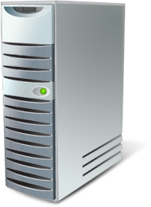
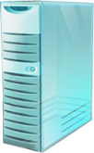


SMB Scale-Out File Server
New clustered file server
Targeted for server app storage
Key capabilities:
  Scale-out file shares (active-active)
  CHKDSK with zero downtime
  Clustered Shared Volumes cache
  Simpler management
Requires:
  Windows Server 2012 Failover Cluster with Clustered Shared Volumes
  SMB Client with SMB 3.0
  File shares configured with Continuously Availability property
Application Servers
Data Center Network
(Ethernet, InfiniBand or combination)
Clustered File Server
Single Logical File Server (\\fs\share)
Single File System Namespace
Cluster Shared Volumes

Slide 19
SMB Performance
Fundamental gains for server applications
Windows Server 2012 at 98%
of local storage transactional performance
  Identical servers and storage
  1Gbps Ethernet v. 4Gbps FC
  22 x 10KRPM HDD
Network transport optimizations
  TCP/IP – SMB multi-channel & NIC Teaming, TCP offloads, DC-TCP
  RDMA – Lowest network CPU overhead (cycles/byte)

Slide 20
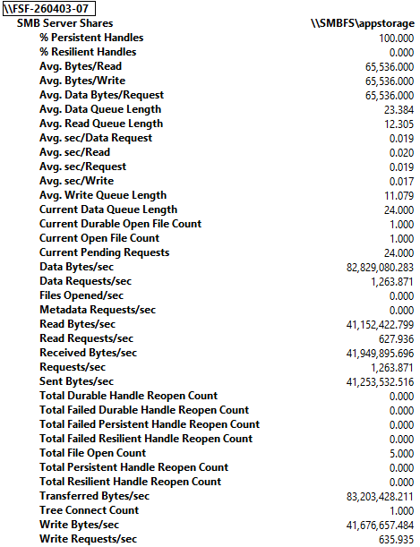
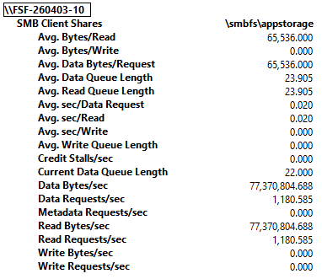
SMB Performance
Performance tuning and debug
SMB Server View
Enabling SQL DBAs to use existing skills to tune performance
SMB Client counters track per-share load
  IO size/latency/queue length etc.
  Separately tune/target log file vs. data file performance
SMB Server counters track per-client load
  Rebalance of load
  Diagnose rogue clients
SMB Client View

Slide 21




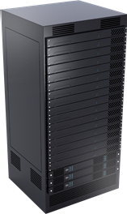

Platform Choices: File Server for Server Applications
1 GbE
10 GbE
InfiniBand
Networking
2+ Interfaces
+ Optionally RDMA
RDMA
Server
2+ servers
2+ node “Cluster in a Box”
2+ single node servers
Storage Spaces
Clustered
RAID
FC / iSCSI / SAS
fabric
Storage
Reliable Shared Storage
Shared JBOD SAS
External Storage Array

Slide 22
SQL Server databases on SMB file shares
demo
Gunter Zink
Principal Program Manager
SQL Server

Slide 23
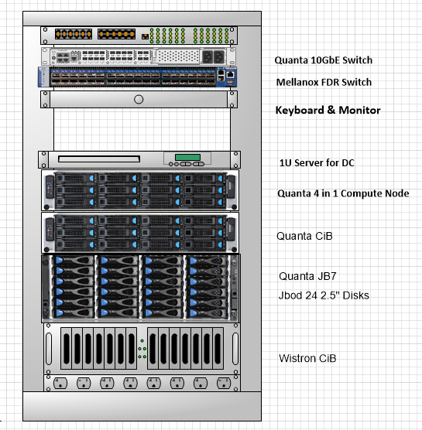
The TechEd Cluster in a Box Demo Stack
Cluster in a Box prototypes
  Quanta
  Wistron
LSI HA-DAS MegaRAID® and SAS controllers
Quanta application servers, JBOD expansion, and 10GbE switch
Mellanox IB FDR NICs and switch
OCZ SAS SSDs
Infrastructure
  Domain Controller server
  Power distribution unit
  1GbE switch
  Keyboard & monitor
MegaRAID® is a registered trademark of LSI Corporation

Slide 24
In Review
SQL databases on SMB file shares
  Shared network providing access to consolidated file level remote storage
  Highly available storage
  High performance
  Reduce SQL Server solution complexity
  Reduce acquisition costs
    Leverage commodity components
    Leverage existing network investments
  Reduce operational costs
    Simpler management
    Leverage existing people investment

Slide 25


Related Content
Breakout Sessions
VIR306 Hyper-V over SMB2: Remote File Storage Support in Windows Server 2012 Hyper-V
  WSV303 Windows Server 2012 High-Performance, Highly-Available Storage Using SMB
  WSV310 Windows Server 2012: Cluster-in-a-Box, RDMA, and More
  WSV314 Windows Server 2012 NIC Teaming and Multichannel Solutions
  WSV322 Update Management in Windows Server 2012: Revealing Cluster- Aware Updating
  WSV334 Windows Server 2012 File and Storage Services Management
  WSV410 Continuously Available File Server: Under the Hood

Slide 26


SIA, WSV, and VIR Track Resources
#TE(sessioncode)
Talk to our Experts at the TLC
Hands-On Labs
DOWNLOAD Windows Server 2012 Release Candidate
microsoft.com/windowsserver
DOWNLOAD Windows Azure
Windowsazure.com/
teched

Slide 27



Resources
Learning
  Connect. Share. Discuss.
  Microsoft Certification & Training Resources
http://northamerica.msteched.com
www.microsoft.com/learning
TechNet
  Resources for IT Professionals
  Resources for Developers
http://microsoft.com/technet
http://microsoft.com/msdn

Slide 28


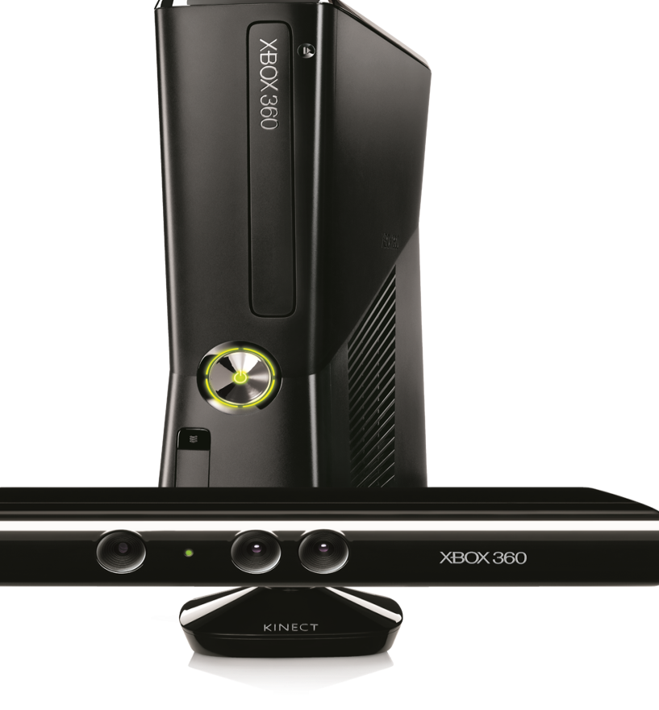




Complete an evaluation on CommNet and enter to win!

Slide 29





Please Complete an Evaluation
Your feedback is important!
Be eligible
to win great daily prizes and the grand prize of a $5,000 Travel Voucher!
Multiple
ways to Evaluate Sessions
Scan the Tag
to evaluate this
session now
on myTechEd Mobile

Slide 30
© 2012 Microsoft Corporation. All rights reserved. Microsoft, Windows, Windows Vista and other product names are or may be registered trademarks and/or trademarks in the U.S. and/or other countries.
The information herein is for informational purposes only and represents the current view of Microsoft Corporation as of the date of this presentation. Because Microsoft must respond to changing market conditions, it should not be interpreted to be a commitment on the
part of Microsoft, and Microsoft cannot guarantee the accuracy of any information provided after the date of this presentation. MICROSOFT MAKES NO WARRANTIES, EXPRESS, IMPLIED OR STATUTORY, AS TO THE INFORMATION IN THIS PRESENTATION.

