Slide 1
What’s New with IIS 8:
Open Web Platform for Cloud
WSV331
Won Yoo
Principal Program Manager Lead (IIS)
Microsoft Corporation

Slide 2
Session Objectives and Takeaways
Session Objective(s):
  Provide an overview of web farm deployments.
  Highlight key IIS 8 cloud investments on Windows Server 2012.
Key Takeaways
  Windows and OOB investment complement overall value to customers.
  IIS 8 is the most secure, highly scalable, and easy to manage open web platform for the cloud.

Slide 3
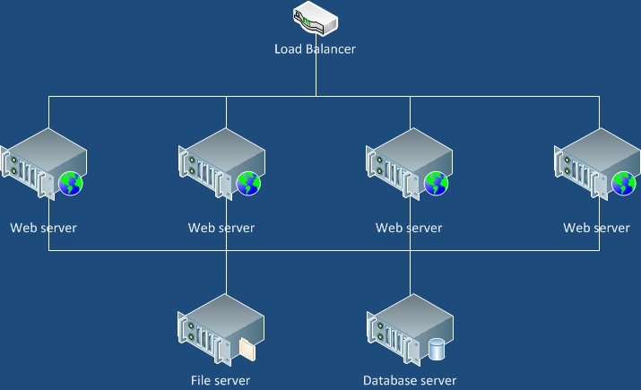
Common Web Farm Deployment
www.contoso.com
www.contoso.com
www.contoso.com

Slide 4
Pros and Cons
Pros
  Simple solution.
  Good for scaling-out a dedicated/homogeneous environment.
Cons
  Not appropriate for shared/cloud deployment with many customers.
  Difficult to scale-up to achieve high site-density.

Slide 5

Web Farm Deployment with ARR
Application Request Routing (ARR)
www.contoso.com
www.contoso.com
www.iis.net
www.asp.net

Slide 6
Pros and Cons
Pros
  Good for managing many customers, such as shared/cloud deployment.
  Server resources are consumed only on affinitized servers.
  Addresses both scale-up and scale-out needs.
Cons
  Requires dynamic awareness of customer’s configuration and content.

Slide 7
Application Request Routing
Hostname Affinity
demo

Slide 8
IIS 8 Improvements
Must be able to:
  Dynamically retrieve customer’s configuration and content.
  Start a site quickly.
  Achieve high site-density.
  Easy to manage.

Slide 9
IIS 8 Improvement
Configuration Scalability
With a typical hosting configuration (3,500 sites)
WS08 R2:
Windows Server 2012:
1/2
memory usage vs R2!
Config mem usage: 760MB
Config mem usage: 340MB
166x
faster
WS08 R2
WS2012

Slide 10
Configuration Scalability
demo

Slide 11
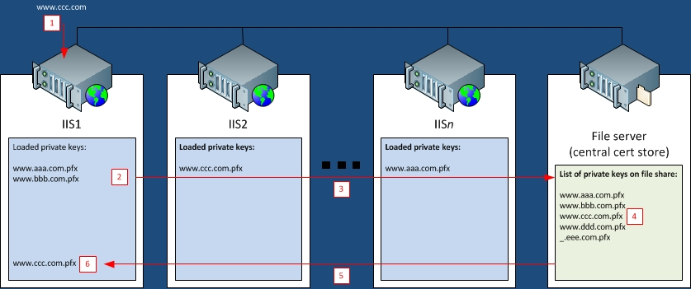
IIS 8 Improvement
Centralized SSL Certificate Support

Slide 12
Centralized SSL Certificate Support
demo

Slide 13
Resource Sand-boxing
Network bandwidth.
Storage space.
Memory consumption.
CPU consumption.

Slide 14
Resource Sand-boxing
demo

Slide 15
Elastic Scalability
Per customer elastic scalability.
Web farm elastic scalability.

Slide 16
Elastic Scalability
demo

Slide 17
Session Summary
Discuss web hosting platform components and topology.
Highlight key IIS 8 investments for cloud.
  Performance
  Site-density
  Sand-boxing
  Elastic scalability

Slide 18
Questions?
Q & A

Slide 19


SIA, WSV, and VIR Track Resources
#TE(sessioncode)
Talk to our Experts at the TLC
Hands-On Labs
DOWNLOAD Windows Server 2012 Release Candidate
microsoft.com/windowsserver
DOWNLOAD Windows Azure
Windowsazure.com/
teched

Slide 20



Related Content
WSV331 - What's New with IIS 8: Open Web Platform for Cloud
WSV332 - What's New with IIS 8: Performance, Scalability, and Security
DEV349 - Internet Information Services (IIS) Express for Web Developers
Find Me Later At… the IIS Booth!

Slide 21
IIS.NET: Home for the IIS Community!
In-depth technical articles and samples
Connect with other IIS experts through blogs
http://learn.iis.net
http://blogs.iis.net
Free advice and assistance in forums
Download center with IIS solutions
http://forums.iis.net
http://www.iis.net/download

Slide 22



Resources
Learning
  Connect. Share. Discuss.
  Microsoft Certification & Training Resources
http://northamerica.msteched.com
www.microsoft.com/learning
TechNet
  Resources for IT Professionals
  Resources for Developers
http://microsoft.com/technet
http://microsoft.com/msdn

Slide 23







Required Slide
Complete an evaluation on CommNet and enter to win!

Slide 24
© 2012 Microsoft Corporation. All rights reserved. Microsoft, Windows, Windows Vista and other product names are or may be registered trademarks and/or trademarks in the U.S. and/or other countries.
The information herein is for informational purposes only and represents the current view of Microsoft Corporation as of the date of this presentation. Because Microsoft must respond to changing market conditions, it should not be interpreted to be a commitment on the
part of Microsoft, and Microsoft cannot guarantee the accuracy of any information provided after the date of this presentation. MICROSOFT MAKES NO WARRANTIES, EXPRESS, IMPLIED OR STATUTORY, AS TO THE INFORMATION IN THIS PRESENTATION.

