Slide 1
Networking for Hybrid Cloud: BranchCache and Cross-Premises Connectivity
WSV333
Bala Rajagopalan
Group Program Manager
Microsoft Corporation
Rob Kuehfus
Program Manager
Microsoft Corporation

Slide 2
Problem

Slide 3
Access and Optimization
URA
10101011010100110101001010101010101011100101010101
11011011010100110101001010101010101011100101010101
URA
Hosted Cache
Branch Office
10101010110101001101010010101010101
10101010110101001101010010101010101
010101010111101010001001010101010111001010
01010101011110101000100100101010101010111
Headquarters
URA
Cloud

Slide 4
Agenda
Cross-Premises Connectivity
Enabling communication between offices and with the cloud
Acceleration with BranchCache
Getting the most out of your WAN links with a cache in the office

Slide 5
Enabling communication between offices and the cloud
Cross-Premises Connectivity
Bala Rajagopalan

Slide 6



Scenarios
Contoso Branch Office (10.1.0.0/16)
Contoso Corp. HQ (10.0.0.0/16)
10.1.2.0/24
10.1.3.0/24
10.1.2.0/24
10.1.3.0/24
S2S
LAN
DirectAccess
Hosters network in cloud

Slide 7
Cross-Premises Connectivity – Requirements
Customer perspective
  Easy to deploy, configure and use
  Security
  Makes network migration easy
(Additional) Hoster perspective
  AAA
  Availability and scale
  Interoperability
  Customer (tenant) isolation

Slide 8
Connectivity to the hybrid cloud:
Unified State
Current State
Private Cloud/
HQ
Internet
DirectAccess & VPN: Connecting remote clients to the hybrid cloud for
- Managed
- Unmanaged
Remote access: Connectivity using dedicated infrastructure
URA
Hoster/
Branch
Cross premise connectivity: Connecting private and public clouds
Site to Site connectivity using dedicated infrastructure
URA
Remote Access
Unified Remote Access
Site to Site
End to End Security W/IPsec (Optional)

Slide 9
URA Highlights
Interoperability via IKEv2 and IPSec
  Support for EAP, PSK, and m/c cert
Easy deployment and configuration via PowerShell and UI
Dynamic distribution of routes (RIPv2)
IPv6-ready (Direct or Tunneled over IPv4)
Auto-detection of remote endpoint reachability
Load-balancing and alternate path routing
Encryption off-load capability
VM-based deployment
On-demand connection establishment

Slide 10
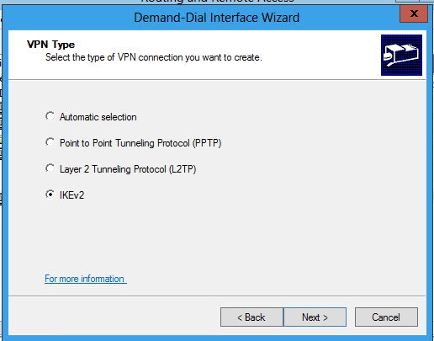
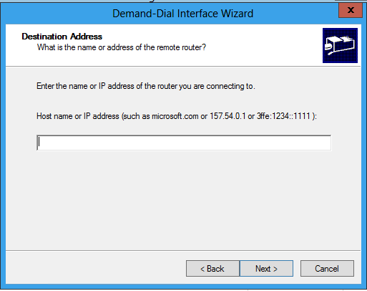
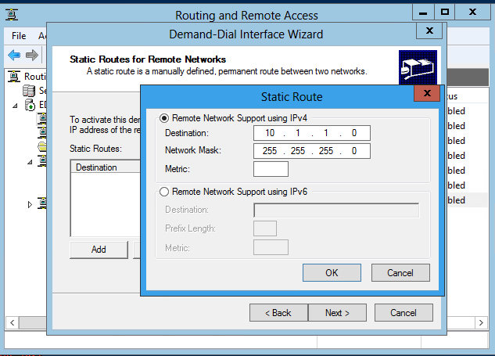
Easy to Deploy & Configure
PowerShell
Easy configuration wizard
PS> Add-VpnS2SInterface interfacename destinationip -protocol IKEv2 - Authenticationmethod PSK –SharedSecret “abc” –IPv4Subnet 10.1.1.0/24:10

Slide 11

Benefits
IT Pro
Hoster
Quickly extend / migrate enterprise networks to cloud, and readily avail infrastructure services
Minimal changes to network infrastructure
Single server to manage all remote access needs
Service customers with overlapping address spaces
Provide high uptime and scalability to customers
Protect investment -IPv6 Ready
Provide Remote Access service to customers

Slide 12


Cross-Premises Demo Scenario
DC1
2-App1
App1
Corp-Edge
Cloud-Edge
Client1
S2S
LAN

Slide 13
Setting up Cross-Prem Connectivity
Demo
Rob Kuehfus
Program Manager
Wireless and Networking Services

Slide 14
More on Cross-Premises Connectivity …
WSV301: Building Hosted Public and Private Clouds Using Windows Server 2012
  Cross-premises replication and disaster recovery using Hyper-V Replica, Hyper-v Network Virtualization and Remote Access

Slide 15
Optimizing Cross-Premises Communication
Branch Cache
Rob Kuehfus

Slide 16
BranchCache
1
0
1
1
0
0
1
0
0
1
0
1
1
0
1
0
0
1
1
0
0
1
0
0
1
0
1
1
0
1
0
1
0
1
1
0
0
1
0
0
1
0
1
1
0
1
0
1
0
1
1
0
1
1
0
1
1
0
1
1
0
1
1
0
0
0
1
0
0
1
1
1
0
0
1
1
0
1
0
1
0
1
1
0
1
1
0
1
1
0
0
1
0
0
1
0
1
1
0
1
0
1
0
1
1
0
1
1
0
1
1
1
0
1
0
1
1
0
1
0
0
1
0
0
1
1
0
1
0
1
0
1
1
0
0
1
0
0
1
0
1
1
0
1
0
1
1
0
1
0
1
0
1
1
0
1
1
1
0
0
1
0
0
1
1
0
1
1
0
1
0
1
0
1
1
1
0
1
0
0
1
0
1
1
0
1
0
1
0
1
1
0
0
1
0
0
1
0
1
1
0
1
0
1
0
1
1
0
0
0
1
0
0
1
1
1
0
0
1
1
0
1
0
1
0
1
1
0
0
1
0
0
1
0
1
1
0
1
0
1
0
1
1
1
0
0
0
0
1
0
0
1
1
1
0
1
1
1
0
1
0
0
1
0
0
0
1
0
1
1
0
1
1
0
1
1
0
0
1
0
0
1
0
1
1
0
1
0
1
0
1
1
1
0
0
0
0
1
0
0
1
1
1
0
1
1
1
0
0
1
0
0
1
1
0
1
0
1
1
0
0
1
0
0
1
0
1
1
0
1
1
1
0
0
1
0
1
1
0
0
1
0
0
1
0
1
0
1
1
1
0
0
0
1
0
0
1
1
0
1
0
1
0
1
1
0
0
1
0
0
1
0
1
1
0
1
0
1
0
11
10
11
10
1
1
0
01
11
01
11
1
1
0
11
10
10
11
11
10
1
1
0
11
10
11
10
1
1
0
11
10
10
11
11
10
1
1
0
11
10
10
11
11
10
1

Slide 17


BranchCache Hosted Cache
Get
Data
Data
ID
ID
ID
Get
ID
Get
Get
Search
Search
ID
Data
Offer
ID
Request
Data
ID
Put

Slide 18

BranchCache Distributed Cache
ID
Get
Data
Data
ID
Get
Get
Data
Get

Slide 19
What’s new in Windows 8
Performance
Management
Scale
Greater performance gains and bandwidth savings with state-of-the-art content chunking
Deeply integrated with the Windows File Server

Slide 20

Smaller Chunks Improve Performance
Identifiers
Block Hashes
ID1
ID2
ID3
ID4
ID5
ID6
ID7
ID8
ID9
Blocks
Max 128K
Fingerprint
Used to choose boundaries
Content

Slide 21
Performance
Management
Scale
No need for branch-by-branch configuration.
New tools for configuring BranchCache and preloading cache data

Slide 22
Deploy BranchCache with One GPO
Clients use Service Connection Points (SCPs) to discover and connect to hosted cache servers.
Hosted cache servers can automatically create SCPs.
No site-by-site configuration needed.
SCP
SCP

Slide 23
Data is Always Encrypted
BranchCache cache is encrypted by default.
Certificate no longer required on hosted cache server
Actually a performance improvement!

Slide 24
Preload Data for Speedy First Access
Warm
Hosted Cache
Data can be exported from “warm” hosted cache servers
IIS
Hosted Cache
File Server
Data Packages
Data Packages can be imported on hosted cache servers and clients
New tools let you prehash data on both file and web servers, and create data packages.

Slide 25
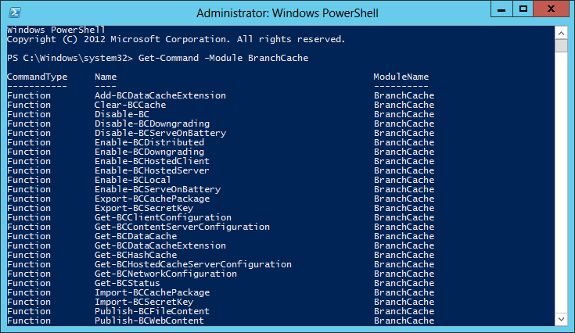
Manage Remotely with WMI and PowerShell

Slide 26
Performance
Management
Scale
Use BranchCache in offices of any size.
Optimize your network at headquarters for employees connecting to the cloud

Slide 27
Cache More Data and Serve More Clients
Hosted cache server can store much more data, increasing bandwidth savings.
More efficient architecture based on the Extensible Storage Engine enables a single hosted cache to serve more clients.
Multi-TB cache can be spread across disks.
ESE

Slide 28

High Availability and Unlimited Scale
Clients can be configured to use multiple hosted cache servers in one branch.
Existing logic enables retrieval from multiple servers. Uploads done only once.
Improves scale and availability without the complexity of clustering.

Slide 29
BranchCache Deployment and Acceleration
Demo
Rob Kuehfus
Program Manager
Wireless and Networking Services

Slide 30
BranchCache Platform and Ecosystem
BranchCache

Slide 31
The Windows BranchCache Framework
3rd Party Applications
Office
CopyFile
Explorer
WMP
IE
SCCM
WSUS
3rd Party Protocols
SMB 2
HTTP
BITS
Intune
BranchCache™ Platform

Slide 32





Visit BranchCache Partners at TechEd

Slide 33
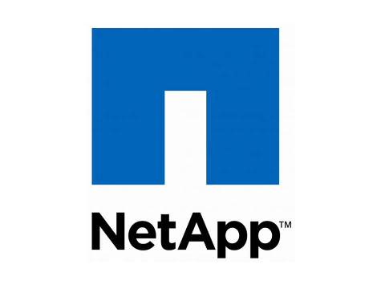
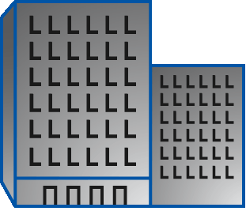

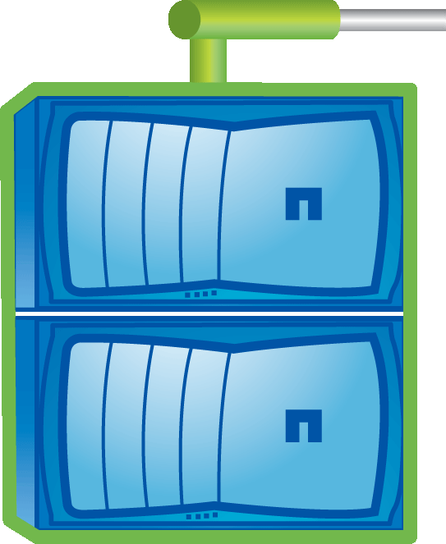
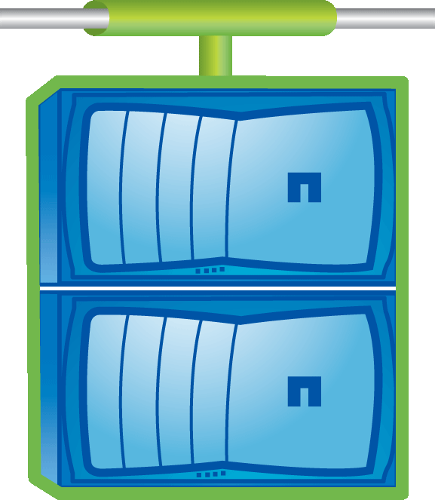
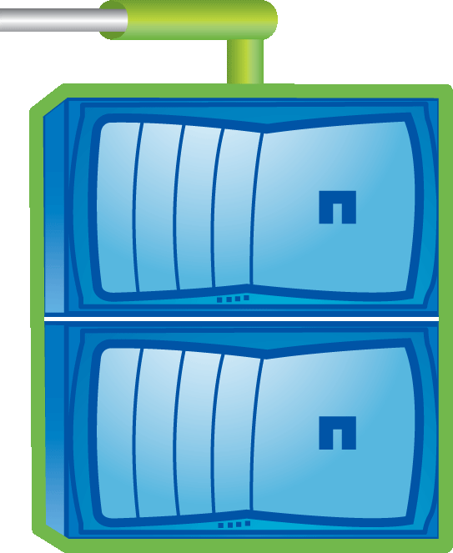

BranchCache on NetApp
Enhancing your Windows file experience
NetApp offers best-in-class solutions for Windows File Services
  Leading Storage Vendor, 10,000’s of joint customers, latest SMB versions
BranchCache — NetApp as a Content Server
  Increase productivity for Windows users in remote offices
  Saves bandwidth and administration costs
  Provides significant performance improvements over the WAN
Support for BranchCache V2 with Windows 8/Server 2012
  Enhances ease-of-use, brings substantial performance improvements
NetApp is a Platinum Sponsor here at TechEd – visit their booth!
NetApp in the Data Center
Users at Branch Office
(Distributed or Hosted Modes)

Slide 34
customer
“Our remote office users with less than favorable bandwidth connectivity have really benefited from BranchCache. Took our IT guys moments to enable, and have provided huge improvements in time savings and employee productivity, silly for us to not have enabled it sooner!”
Rand Morimoto
President
Convergent Computing

Slide 35
Related Content
WSV301: Building Hosted Public and Private Clouds Using
Windows Server 2012

Slide 36


SIA, WSV, and VIR Track Resources
#TE(sessioncode)
Talk to our Experts at the TLC
Hands-On Labs
DOWNLOAD Windows Server 2012 Release Candidate
microsoft.com/windowsserver
DOWNLOAD Windows Azure
Windowsazure.com/
teched

Slide 37




Resources
Learning
  Connect. Share. Discuss.
  Microsoft Certification & Training Resources
http://northamerica.msteched.com
www.microsoft.com/learning
TechNet
  Resources for IT Professionals
  Resources for Developers
http://microsoft.com/technet
http://microsoft.com/msdn

Slide 38







Complete an evaluation on CommNet and enter to win!

Slide 39





Please Complete an Evaluation
Your feedback is important!
Be eligible
to win great daily prizes and the grand prize of a $5,000 Travel Voucher!
Multiple
ways to Evaluate Sessions
Scan the Tag
to evaluate this
session now
on myTechEd Mobile

Slide 40
© 2012 Microsoft Corporation. All rights reserved. Microsoft, Windows, Windows Vista and other product names are or may be registered trademarks and/or trademarks in the U.S. and/or other countries.
The information herein is for informational purposes only and represents the current view of Microsoft Corporation as of the date of this presentation. Because Microsoft must respond to changing market conditions, it should not be interpreted to be a commitment on the
part of Microsoft, and Microsoft cannot guarantee the accuracy of any information provided after the date of this presentation. MICROSOFT MAKES NO WARRANTIES, EXPRESS, IMPLIED OR STATUTORY, AS TO THE INFORMATION IN THIS PRESENTATION.

Slide 41
Backup
© 2012 Microsoft Corporation. All rights reserved. Microsoft, Windows, Windows Vista and other product names are or may be registered trademarks and/or trademarks in the U.S. and/or other countries.
The information herein is for informational purposes only and represents the current view of Microsoft Corporation as of the date of this presentation. Because Microsoft must respond to changing market conditions, it should not be interpreted to be a commitment on the
part of Microsoft, and Microsoft cannot guarantee the accuracy of any information provided after the date of this presentation. MICROSOFT MAKES NO WARRANTIES, EXPRESS, IMPLIED OR STATUTORY, AS TO THE INFORMATION IN THIS PRESENTATION.

Slide 42








Deployment
Branch Office
Branch Office
IIS
File Server
Group Policy
Management
BitLocker
Certificate
Main Office
Branch Office
GPO
GPO

Slide 43

Security
BranchCache accelerates e2e encrypted traffic (TLS/HTTPS, IPsec)
Cached data encrypted on disk and in transit between clients
Prevents unauthorized access to cached data

Slide 44
BranchCache Security Model
Server transmits content information structure to the client only if the client has access. Transfer happens over the accelerated protocol.
Server authenticates the client and performs authorization checks.
Client downloads encrypted blocks from a peer or the hosted cache and decrypts them with the encryption key.
Client uses content information structure to calculate:
-segment id (public)
-encryption key (private)
Client multicasts the segment id to find a peer with the data.
Cached data is stored in encrypted.

Slide 45







Hosted Cache vs Distributed Cache
Enterprise
Distributed Cache
Data cached amongst clients
Hosted Cache
Data cached at hosted cache server
Recommended for branches without any infrastructure
Easy to deploy: Enabled on clients through Group Policy
Cache availability decreases with laptops that go offline
Recommended for larger branches
Cache stored centrally: can use existing server in the branch
Cache availability is high
Enables branch-wide caching

