Slide 1
Advanced Automation Using Windows PowerShell 3.0
WSV414
Hemant Mahawar
Program Manager
Microsoft Corporation
Travis Jones
Program Manager
Microsoft Corporation

Slide 2
Session Overview
Technical Level: 400
Intended Audience: IT administrators & scripters
Learning Objectives:
  Learn about the improvements in Windows PowerShell 3.0
  Understand how to use advanced automation techniques
  See how PowerShell features work in common scenarios

Slide 3
Windows Server Management Philosophy
In the past, Windows Server was a great operating system
for a single server
and its devices
Windows Server 2012 is a great operating system
for many servers
and the devices that connect them
whether they are physical or virtual
on premises or off premises

Slide 4
Managing a Cloud-Optimized OS
Robust
Remote
Agile
PowerShell
Scale
Standards
Automate

Slide 5

Windows PowerShell 3.0 Themes
Simple & Easy
Comprehensive Coverage
Robust & Scalable
Rich Platform
Standards-based
PS 3.0 -gt PS 2.0

Slide 6

Windows PowerShell 3.0 Features
DEMO: PowerShell Workflow
DEMO
DEMO: PS Web Access
Windows PowerShell Workflow
.NET Framework 4 support
Add-Member improvements
Computer cmdlets
CSV handling improvements
Get-ChildItem attributes
Get-Command improvements
Get-Content -Tail
Disconnected sessions
Better history support
Security cmdlet fixes
Select-Object optimizations
Select-String improvements
Tee-Object -Append
Idle timeout & server buffering control
Invoke-Command in disconnected sessions
Disconnected jobs
STA mode by default
Run with PowerShell context menu
Updated console font & branding
Console host start perf improvements
ETW logging and tracing
Scheduled jobs
New Group Policy settings
Output redirection for all streams
Dynamic types & formats
Word wrap
Default properties on custom objects
Updatable help system
Method overload discovery
HelpUri attribute support
HelpFile property on FunctionInfo
Custom parameter value defaults
Simplified Where and ForEach
Remoting local variables via $using
Array syntax for scalars
New parser built on DLR
Generic method invocation
Typecasting deserialized objects
Improved method overload selection
New objects from hash tables
Ordered hash tables
Typecasting for parameter values
Pipeline paging APIs
Nested pipeline APIs
$PSScriptRoot and $PSCommandPath
Improved module discovery & import
New module manifest keys
Public abstract syntax tree
Runspace pool cleanup API
Public tab completion
Windows RT API support
Obsolete cmdlet attribute
Verb & noun on FunctionInfo
Web & REST cmdlets
JSON cmdlets
CIM cmdlet authoring from WMI v2
CIM .NET APIs
Core CIM cmdlets
Runtime script compilation
Engine reliability improvements
Better Get-ChildItem network perf
Cmdlet definition files
Certificate provider improvements
Credentials for FileSystem provider
Alternate NTFS data stream support
Move-Item across drives
Remote module discovery & import
Remote session autodisconnect & retry
Transport options for remote sessions
Module logging
RunAs and SharedHost support
Job integration with Task Scheduler
Alternate credential support for jobs
Module autoloading
Command discovery improvements
Special character handling
LiteralPath support for core cmdlets
Improved tab completion
Session configuration files
Intellisense
Windows Management Framework 3.0
WinPE support
Windows RT support
DEMO
Windows PowerShell Web Access
XAML-based workflows
Script-based workflows
Control Panel cmdlets
Unblock-File cmdlet
Workflow help
Cmdlet to activity conversion
Workflow persistence
Improved WMI object formatting
Heterogeneous object formatting
Workflow logging
Workflow extensibility
Common workflow parameters
Workflow execution environment
Windows PowerShell Web Services
Snippets
ISE Add-ons
IntelliSense support
Show-Command
Get-Help -ShowWindow
Restart Manager support
Script autosave support
Out-GridView -PassThru
XML syntax highlighting
Block select
Collapsible regions
Contextual F1 support
Script Explorer
DEMO: Parameter Defaults
DEMO
DEMO: Disconnected Sessions
DEMO
DEMO: Ordered Hash tables
DEMO
DEMO: PS Web Services
DEMO
DEMO
DEMO: RunAs Support
DEMO: Modules
DEMO
DEMO: Scheduled Jobs
DEMO
DEMO
DEMO: Session Config Files

Slide 7
Windows PowerShell 3.0 Themes
Simple & Easy
Comprehensive Coverage
Robust & Scalable
Rich Platform
Standards-based
PS 3.0 -gt PS 2.0

Slide 8
Simple & Easy
New Users
  Windows PowerShell ISE:
    IntelliSense, Tab completion,& Snippets
  Command Discovery:
    Get-Command discovery cache
    Automatic module importing
    Show-Command
  Help System Improvements:
    Updatable help
    Contextual F1
    Get-Help ˗ShowWindow
  Syntax & Language:
    Simplified Where & ForEach
    $PSItem alias for $_
    Array syntax for singletons
Existing Users
  ETS:
    Ordered hash tables
    New objects from hash tables
  Cmdlets:
    Custom parameter value defaults
    Select-String improvements
  Types & Formats
    Dynamic types & formats
    Typecasting deserialized objects
  ISE:
    Command + output in single pane
    Out-GridView -PassThru
    Restart Manager support

Slide 9
Simple & Easy Delegated Administration
Session Configuration Files
  Easy remote endpoint creation
  Uses .psd1 PowerShell data files
  Declarative name-value pairs
  No scripting required
RunAs
  New settings within WSMan plug-in
  RunAsUser & RunAsPassword
  Allows running remote sessions with different creds

Slide 10
Simplified Delegated Administration
Demo
Simple & Easy
Travis Jones
Program Manager
Windows PowerShell

Slide 11
Windows PowerShell 3.0 Themes
Simple & Easy
Comprehensive Coverage
Robust & Scalable
Rich Platform
Standards-based
PS 3.0 -gt PS 2.0

Slide 12
Management CEC
CEC: Common Engineering Criteria
What: All Microsoft server products are required to comply with a set of engineering requirements as part of the CEC
Goal: Reduce the overall total cost of ownership through improved integration, manageability, security, reliability, and other critical infrastructure
Requirement: All management surfaces must be exposed via PowerShell cmdlets or providers
Result: COVERAGE

Slide 13
Coverage Comparison
Windows Server 2008 R2 shipped with 456 cmdlets
How many cmdlets shipped in Windows Server 2012 RC?
  2032
  2192
  2321
  2418
Windows Server 2008 R2 shipped with 10 modules
How many modules shipped in Windows Server 2012 RC?
  56
  67
  79
  85

Slide 14
New Cmdlets in Windows PowerShell 3.0
Thousands more in Windows Server 2012
Jobs
  Add-JobTrigger
  Disable-JobTrigger
  Enable-JobTrigger
  Get-JobTrigger
  New-JobTrigger
  Remove-JobTrigger
  Set-JobTrigger
  Disable-ScheduledJob
  Enable-ScheduledJob
  Get-ScheduledJob
  Register-ScheduledJob
  Set-ScheduledJob
  Unregister-ScheduledJob
  Get-ScheduledJobOption
  New-ScheduledJobOption
  Set-ScheduledJobOption
  ISE
  Get-IseSnippet
  Import-IseSnippet
  New-IseSnippet
CIM
  Get-CimAssociatedInstance
  Get-CimClass
  Get-CimInstance
  Get-CimSession
  Invoke-CimMethod
  New-CimInstance
  New-CimSession
  New-CimSessionOption
  Register-CimIndicationEvent
  Remove-CimInstance
  Remove-CimSession
  Set-CimInstance
  Remoting
  Connect-PSSession
  Disconnect-PSSession
  Receive-PSSession
  New-PSSessionConfigurationFile
  Test-PSSessionConfigurationFile
  New-PSTransportOption
  Workflow
  New-PSWorkflowExecutionOption
  New-PSWorkflowSession
  Invoke-AsWorkflow
  Resume-Job
  Suspend-Job
  Web
  ConvertFrom-Json
  ConvertTo-Json
  Invoke-RestMethod
  Invoke-WebRequest
  Other
  New-WinEvent
  Unblock-File
  Show-Command
  Rename-Computer
  Save-Help
  Update-Help
  Get-TypeData
  Remove-TypeData
  Get-ControlPanelItem
  Show-ControlPanelItem

Slide 15
Available Everywhere
Windows 8, Windows RT, & Windows Server 2012 Full Server
  PowerShell Remoting enabled by default on server SKUs
Server Core
  With or without Server Graphical Shell or Graphical Management Tools
  CIM modules remotable without PowerShell or .NET Framework installed
Windows Preinstallation Environment (WinPE) 4.0
Windows Management Framework 3.0
  Windows Server 2008 / Windows 7 / Windows Server 2008 R2 (+Server Core)

Slide 16
Windows PowerShell 3.0 Themes
Simple & Easy
Comprehensive Coverage
Robust & Scalable
Rich Platform
Standards-based
PS 3.0 -gt PS 2.0

Slide 17
Windows PowerShell Workflow
What: Multi-machine orchestration engine built on Windows Workflow Foundation and .NET 4.0
Why: Reliably execute long-running management tasks across multiple machines or IT processes
How:
  Robust: Suspend & resume workflows, survives machine reboots
  Performance: Connection pooling, workflow throttling, and shared hosting
  Scalable: Execute multiple tasks in parallel, common parameters for multi-machine
  Reliable: Automatic connection and action retry with configurable intervals
  Familiar: Author workflows as PowerShell scripts or using XAML, management through *-Job cmdlets

Slide 18
PowerShell Workflow
Demo
Robust & Scalable
Hemant Mahawar
Program Manager
Windows PowerShell

Slide 19
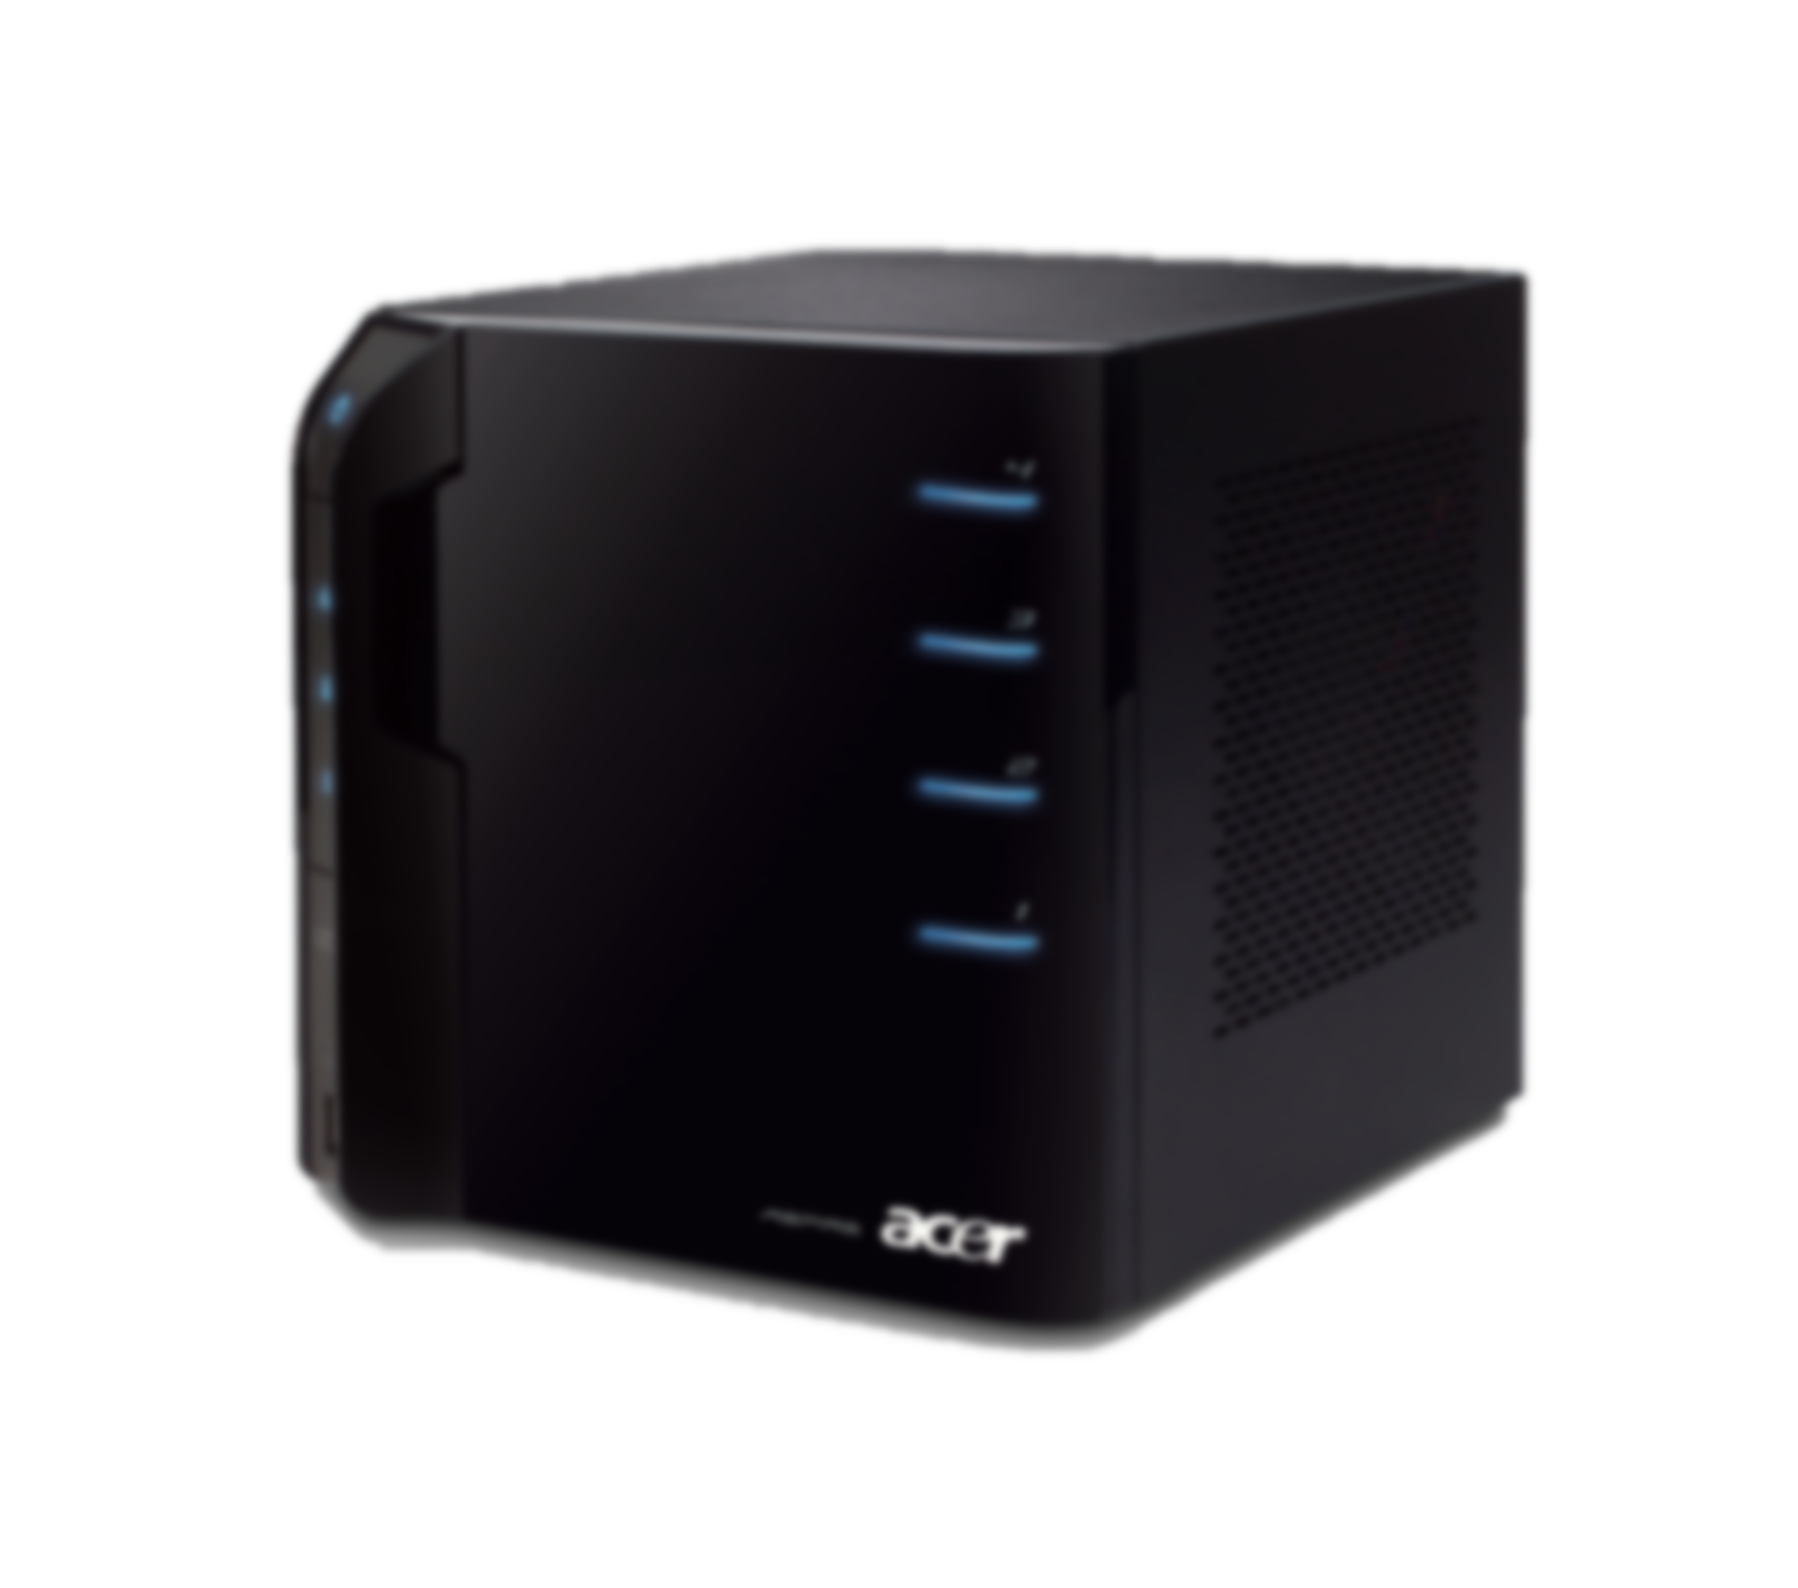
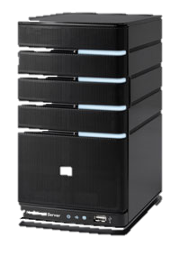

Demo Setup
Client
Where the IT Pro does their work
Connects to the workflow server
Managed Nodes
Target of the IT Pro workflow
Management Server
Stores and manages PowerShell Workflow
Remotely connects from various clients
Runs PowerShell Workflow targeting multiple managed nodes

Slide 20


Scheduled Jobs
Job Scheduling allows you to schedule the execution of a PowerShell background job
Support for a rich set of triggers
  Run commands according to schedule or in response to an event
PSScheduledJob module with 16 cmdlets
  *-JobTrigger to create scheduled triggers
  *-ScheduledJob to register, unregister, and change scheduled job definitions
  *-ScheduledJobOption to configure advanced settings
  *-Job to retrieve results

Slide 21
Scheduled Jobs
Demo
Robust & Scalable
Travis Jones
Program Manager
Windows PowerShell

Slide 22
Robust Session Connectivity
Remote sessions remain in a "Connected" state during transient network glitches or failures for up to 4 minutes
After 4 minutes, remote sessions automatically transition to a new "Disconnected" state
Persistent commands and jobs can continue to run even if the session is disconnected
Client can reconnect to a disconnected session after network connectivity with the server has been restored
Cmdlets for managing disconnected sessions

Slide 23
Disconnected Sessions
Demo
Robust & Scalable
Travis Jones
Program Manager
Windows PowerShell

Slide 24
Windows PowerShell 3.0 Themes
Simple & Easy
Comprehensive Coverage
Robust & Scalable
Rich Platform
Standards-based
PS 3.0 -gt PS 2.0

Slide 25



Windows PowerShell Web Access
Provides access to Windows PowerShell from anywhere
Increases the value of your investment in PowerShell
Write cmdlets, get web-based management for free
Built for phones, tablets, and mobile devices as well as PCs
Cross-platform support
  IE
  Firefox
  Safari
  Chrome
  Opera

Slide 26
PowerShell Web Access
Demo
Rich Platform
Travis Jones
Program Manager
Windows PowerShell

Slide 27
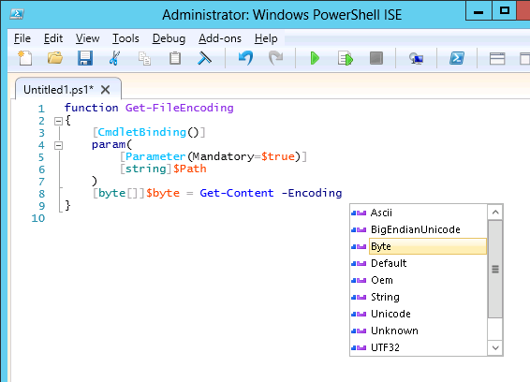
Windows PowerShell ISE
Integrated Scripting Environment
IntelliSense
  AST & Command Completion
Show-Command pane
  Get-Command
Regions
  AST
F1 Help window
  Get-Help
Rich copy
  AST
IntelliSense

Slide 28
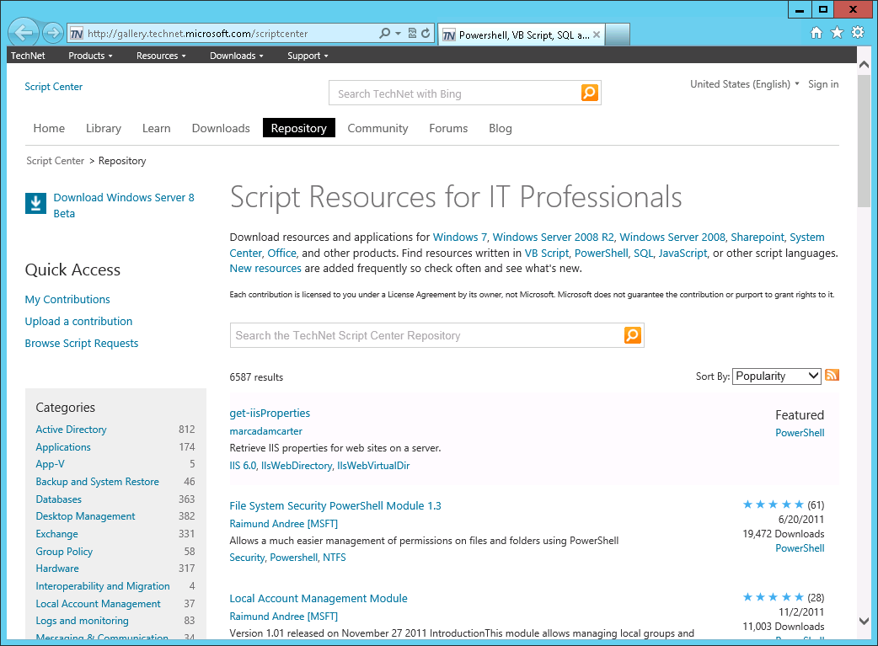
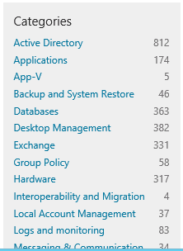
Rich Platform Enables Script Sharing
TechNet Script Center
Script Repository
Script Explorer
ISE Add-ons Website
PowerShell Modules
PoshCode.org
PowerShellCommunity.org
PowerShell.com
PowerShellGroup.org
Windows PowerShell ISVs

Slide 29
Windows PowerShell 3.0 Themes
Simple & Easy
Comprehensive Coverage
Robust & Scalable
Rich Platform
Standards-based
PS 3.0 -gt PS 2.0

Slide 30
Standard-Based Management
Provides management interoperability with standard interface and protocol
DMTF standards
  CIM (Common Information Model) => interface semantics
    WMI v2: Access to CIM over WS-Man
    PowerShell cmdlets automatically generated from WMI v2 providers by authoring simple XML (*.cdxml) file
  WS-Man (Web Services for Management) => protocol
    WinRM: Microsoft implementation of the WSMan protocol
    Microsoft extensions to WSMan enable PowerShell remoting

Slide 31
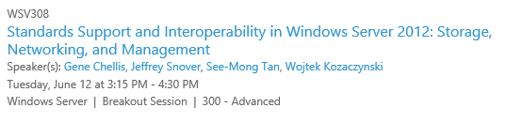
Learn More

Slide 32
Standard-Based Management
OData (Open Data Protocol)
  RESTful web protocol based on HTTP for querying and updating data
Management OData IIS Extension
  Provides an ability to manage Windows Servers from various type of devices : Windows, Non Windows
  Allows to plugin Windows Server management via PowerShell into a simplified management application experience:
  Processes OData requests and converts them into PowerShell invocations to perform the management function
  Optional feature on Windows Server 8 for hosting PowerShell cmdlets as OData endpoints.
  Hosted in IIS; resource schema and authorization module supplied by the customer

Slide 33
Management OData IIS Extension
Demo
Standards-based
Hemant Mahawar
Program Manager
Windows PowerShell

Slide 34
Demo Setup
Client
Where the IT Pro does their work
Connects to the workflow server
OData IIS Ext.
Managed Nodes
Target of the IT Pro workflow
Management Server
Stores and manages PowerShell Workflow
Remotely connects from various clients
Runs PowerShell Workflow targeting multiple managed nodes

Slide 35
Windows PowerShell 3.0 Themes
Simple & Easy
Comprehensive Coverage
Robust & Scalable
Rich Platform
Standards-based
PS 3.0 -gt PS 2.0

Slide 36
The Journey
  PowerShell 1.0
    Introduced a great scripting language for local machine management
    Great APIs for developers to write cmdlets and providers
    Microsoft Exchange made a big bet on PowerShell
    Shipped with Windows Server 2008
  PowerShell 2.0
    Shipped with Windows 7 and Windows Server 2008 R2
    Remoting introduced: 1:1, Fan-out, Fan-in, Implicit remoting
    Introduced ISE: Syntax coloring, Graphical debugging, Intl. support
    Introduced Modules: Self containing packaging mechanism
    IT Pros can create PowerShell cmdlets using PowerShell script
    Huge feature set:
      Background Jobs, Restricted Sessions, Transactions, Out-GridView, Eventing

Slide 37
Top Votes on Connect
Bugs Suggestions
Bug with Default Formatter
*-item cmdlets ignore items containing "[]"
Square Bracket "Range" globbing is a BUG not a FEATURE
Can’t redirect all the output pipelines
Get-ACL (and some other cmdlets) need support for the LiteralPath parameter
Get-Command doesn't show function if 2 modules are loaded that have same function name
Get-Command doesn't display information about duplicate commands
Foreach should not execute the loop body for a scalar value of $null
Default properties on custom objects
Select-Object optimization
Set-AuthenticodeSignature fails on scripts created from ISE
Multiple ambiguous overloads
Move-Item cmdlet can’t move items between different PSDrives
Same command with different output fails if run in sequence
Capture Warning, Verbose, Debug and Host Output via alternate streams
Add enumeration parameter to Get-ChildItem cmdlet to specify Container/Non-container/Both
dir -ad and other Get-ChildItem improvements
Make it easier to create custom objects
Ordered hashes as an option
Modules: Unable to determine script module filename at load time (there should be a $psmoduleinfo)
Get-Command and Get-Help should display the ModuleName
MVP: Get-Module output should sort by name by default
PSV2: Lazy pipeline - ability for cmdlets to say "NO MORE"
Add auto-variable $PSScriptRoot
Script Logging needs to be improved
Import-Csv should have -Encoding parameter
add an -Append Switch to Export-CSV
Tee-Object Needs -Append parameter
Add "sst" alias for Select-String cmdlet

Slide 38
PS 3.0 -gt PS 2.0
Demo
PS 3.0 -gt PS 2.0
Hemant Mahawar and Travis Jones
Program Manager
Windows PowerShell

Slide 39

Get-Involved

Slide 40
Call to Action
Windows PowerShell 3.0 provides a comprehensive, resilient, and simple way to automate the management of servers in your network
Pick up the RC bits today
  Windows 8 Release Preview and Windows Server 2012 RC
  Windows Management Framework 3.0 RC
    http://www.microsoft.com/downloads search for “Windows Management Framework 3.0”
Give us feedback | Have fun!!

Slide 41
Questions ?

Slide 42
Community Resources
Team blog: http://blogs.msdn.com/PowerShell
PowerShell Community: http://www.powershellcommunity.org
Channel 9: http://channel9.msdn.com/tags/PowerShell
Wiki: http://channel9.msdn.com/wiki/default.aspx/Channel9.WindowsPowerShellWiki
Script Center: http://www.microsoft.com/technet/scriptcenter/hubs/msh.mspx
CodePlex: http://codeplex.com/Project/ProjectDirectory.aspx?TagName=powershell
Books
  Windows PowerShell in Action, Second Edition, by Bruce Payette
  http://www.manning.com/payette2/
  Windows PowerShell Cookbook, Second Edition, by Lee Holmes http://shop.oreilly.com/product/9780596801519.do
  Professional Windows PowerShell Programming http://www.wrox.com/WileyCDA/WroxTitle/productCd-0470173939.html
  Many others…

Slide 43


Related Content
Breakout Sessions
WSV306: Inside Windows Server 2012 Multi-server Management Capabilities
WSV321: Windows PowerShell Crash Course
WSV301: Building Hosted Public and Private Clouds Using Windows Server 2012
WSV308: Standards Support and Interoperability in Windows Server 2012: Storage, Networking, and Management
WSV335: Using the Windows Server 2012 Server Manager for Remote and Multi-Server Management
Hands-on Labs
WSV11-HOL: What's New in Windows PowerShell 3.0
WSV12-HOL: Introduction to Windows PowerShell Fundamentals 3.0
WSV25-HOL: Multi-Server Management with Windows Server 2012 Server Manager and PowerShell 3.0
Product Demo Stations / Find us Later at…
  Windows Server 2012 Server Manager & PowerShell

Slide 44


SIA, WSV, and VIR Track Resources
#TE(sessioncode)
Talk to our Experts at the TLC
Hands-On Labs
DOWNLOAD Windows Server 2012 Release Candidate
microsoft.com/windowsserver
DOWNLOAD Windows Azure
Windowsazure.com/
teched

Slide 45



Resources
Learning
  Connect. Share. Discuss.
  Microsoft Certification & Training Resources
http://northamerica.msteched.com
www.microsoft.com/learning
TechNet
  Resources for IT Professionals
  Resources for Developers
http://microsoft.com/technet
http://microsoft.com/msdn

Slide 46







Required Slide
Complete an evaluation on CommNet and enter to win!

Slide 47





Please Complete an Evaluation
Your feedback is important!
Be eligible
to win great daily prizes and the grand prize of a $5,000 Travel Voucher!
Multiple
ways to Evaluate Sessions
Scan the Tag
to evaluate this
session now
on myTechEd Mobile

Slide 48
© 2012 Microsoft Corporation. All rights reserved. Microsoft, Windows, Windows Vista and other product names are or may be registered trademarks and/or trademarks in the U.S. and/or other countries.
The information herein is for informational purposes only and represents the current view of Microsoft Corporation as of the date of this presentation. Because Microsoft must respond to changing market conditions, it should not be interpreted to be a commitment on the
part of Microsoft, and Microsoft cannot guarantee the accuracy of any information provided after the date of this presentation. MICROSOFT MAKES NO WARRANTIES, EXPRESS, IMPLIED OR STATUTORY, AS TO THE INFORMATION IN THIS PRESENTATION.

