Slide 1
Group Policy Reporting and Analysis with Windows PowerShell
WSV415
Jeremy Moskowitz
Chief Propeller-Head
GPAnswers.com /
PolicyPak Software
Jeffery Hicks
Prof. PowerShell
JDH Information Technology Solutions

Slide 2


Why are you here?
You are the Group Policy Go-To "Guy"
You know a little PowerShell
You want to blend the two. Solve problems proactively
Jeremy, Group Policy MVP: Mr. Problem Explainer
Jeff, PowerShell MVP: Mr. Solutions guy

Slide 3
Action Items
PowerShell and Group Policy Requirements (Myths and Facts)
Group Policy Reporting
Group Policy Analysis (ie: Find “oops-ed” GPOs)
  Find Extra Registry Settings
  Find GPO with ADM Files
  Find Unlinked GPOs

Slide 4
A word about demos
Want the demos & samples?
Sign up: tinyurl.com/teps1
Problems with the signup? Just email us
(URL will show up again later, but write it down now)

Slide 5
PowerShell and Group Policy Requirements
Myth Busted:
  Any Active Directory is A-OK
Requirements:
  Windows 7 or later on management machine (preferred)
  RSAT for Windows 7
  PowerShell v2.0 or later
Optional:
  Microsoft Active Directory Provider recommended

Slide 6
Group Policy Module Basics
Import-module GroupPolicy
Get a GPO PowerShell Object
Build a report based on the object
Build HTML/XML GPO Reports
Parse and search the XML for analysis
Select-XML and Xpath searches are helpful

Slide 7
Problem #1:
Boss wants there to be a “paper record” of what’s currently in Group Policy

Slide 8
The GPO PowerShell Object
PS C:\> Import-Module GroupPolicy
PS C:\> Get-GPO JeremyGPO
DisplayName : JeremyGPO
DomainName : GLOBOMANTICS.local
Owner : GLOBOMANTICS\Domain Admins
Id : cd73c562-5bfe-40e2-b81e-28da10da425c
GpoStatus : ComputerSettingsDisabled
Description :
CreationTime : 12/28/2011 2:52:37 PM
ModificationTime : 5/21/2012 11:08:26 AM
UserVersion : AD Version: 4, SysVol Version: 4
ComputerVersion : AD Version: 1, SysVol Version: 1
WmiFilter :

Slide 9
Solution: Create GPO Reports
Get-GPOReport (HTML and XML)
GPOs Modified and Created
Automated HTML GPO Reports
GPOs by Container

Slide 10
GPO Report Sample
get-gpo -all | Where {$_.ModificationTime -gt (Get-Date).AddDays(-30)}
... | Sort ModificationTime -Descending | Where {$_.ModificationTime -ge (Get-Date).AddDays(-30)} | Select Displayname,ModificationTime,Description
... | Export-CSV R:\GPOModReport.csv

Slide 11
GPO Reports with PowerShell

Slide 12
Problem #2:
Boss says “There are too many GPOs, some don’t appear to be used”

Slide 13
Solution: Find Empty GPOs
Identify Group Policy Objects with no settings
Look for XML ExtensionData

Slide 14
Empty GPOs <> ExtensionData
PS C:\> Import-Module GroupPolicy
PS C:\> [xml]$r = Get-GPOReport -Name MyGPO
-ReportType XML
PS C:\> if ((-Not $r.gpo.user.extensiondata) -AND (-not $r.gpo.computer.extensiondata)) {
"GPO is empty"
}

Slide 15
Find Empty GPOs

Slide 16
Problems #3A, 3B, and 3C:
(Three problems solved for the price of one line of code)
Boss says “When was the last time anyone touched
[Group Policy Object X]?”
“Are there any GPOs with ‘half’ the policy disabled?”
“Are there any GPOs with ‘all’ the policy disabled?”

Slide 17
Filter GPOs by GPOStatus
PS C:\> get-gpo -all | Sort GPOStatus | format-table -GroupBy GPOStatus Displayname,*Time
PS C:\> get-gpo -all | where {$_.GPOStatus -match "disabled"} | Select GPOStatus,Displayname
PS C:\> get-gpo -all | where {$_.GPOStatus -match "AllSettingsDisabled"}

Slide 18
Filter GPOs by Node Status

Slide 19
Problem 4:
Why have GPOs which “have stuff” but aren’t being utilized anywhere?

Slide 20
Find Unlinked GPOs
Import-Module ActiveDirectory
Get-ADOrganizationalUnit -filter * | select-object
-ExpandProperty DistinguishedName | get-adobject
-prop gplink | where {$_.gplink} | Select-object
-expand gplink | foreach-object {
foreach ($item in ($_.Split("]["))) {
$links+=$regex.match($item).Value
}
}
Get-GPO -All | Where {$links -notcontains $_.id}

Slide 21
Find Unlinked GPOs

Slide 22
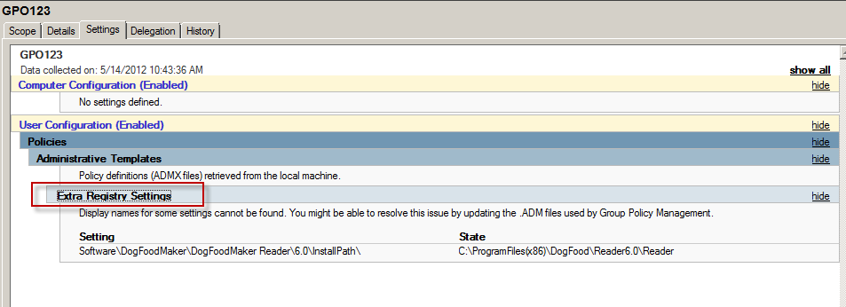
Problem #5: GPOs with “Extra Registry Settings”

Slide 23
Find Extra Registry Settings
#Use Xpath with the XML report data
PS C:\> [xml]$report = Get-GPOReport -Name MyGPO
-ReportType XML
PS C:\> $ns = @{q3 = "http://www.microsoft.com/GroupPolicy/Settings/Registry"}
PS C:\> $nodes = Select-Xml -Xml $report -Namespace $ns -XPath "//q3:RegistrySetting" | select -expand Node | Where {$_.AdmSetting -eq 'false'}

Slide 24
Find Extra Registry Settings

Slide 25
Your Turn
Get-Question | Out-Answer

Slide 26
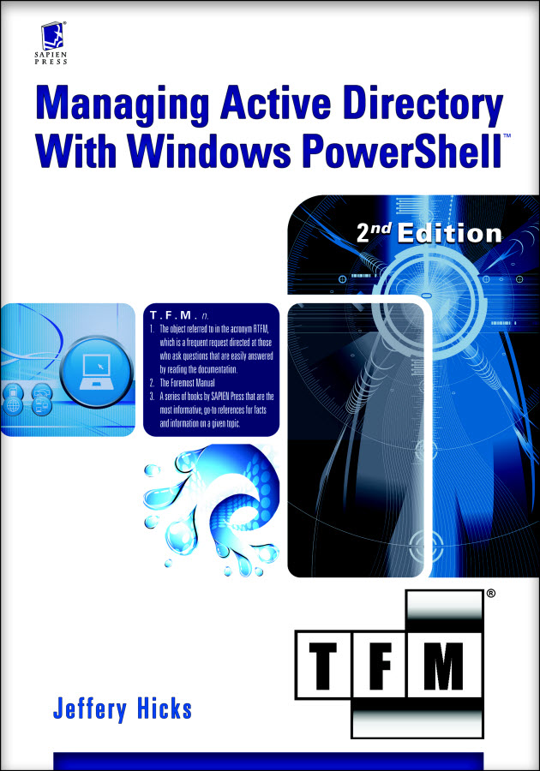
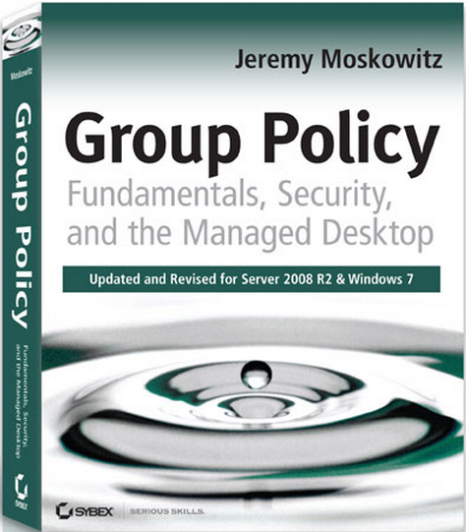
Our Resources
Managing Active Directory with Windows PowerShell: TFM 2nd Ed. (SAPIEN Press 2010)
Group Policy Fundamentals, Security & the Managed Desktop
  www.GPanswers.com/book

Slide 27

Connect with us!
Jeff Hicks
  http://jdhitsolutions.com/blog
  @JeffHicks
  Jeremy Moskowitz
  http://gpanswers.com
  http://www.policypak.com
  @jeremymoskowitz
Get Examples
Get Help
Get Smarter
FREE PS+Group Policy chaper:
tinyurl.com/teps1

Slide 28


SIA, WSV, and VIR Track Resources
#TE(sessioncode)
Talk to our Experts at the TLC
Hands-On Labs
DOWNLOAD Windows Server 2012 Release Candidate
microsoft.com/windowsserver
DOWNLOAD Windows Azure
Windowsazure.com/
teched

Slide 29




Resources
Learning
  Connect. Share. Discuss.
  Microsoft Certification & Training Resources
http://northamerica.msteched.com
www.microsoft.com/learning
TechNet
  Resources for IT Professionals
  Resources for Developers
http://microsoft.com/technet
http://microsoft.com/msdn

Slide 30







Required Slide
Complete an evaluation on CommNet and enter to win!

Slide 31


MS Tag
Scan the Tag
to evaluate this
session now on
myTechEd Mobile

Slide 32
© 2012 Microsoft Corporation. All rights reserved. Microsoft, Windows, Windows Vista and other product names are or may be registered trademarks and/or trademarks in the U.S. and/or other countries.
The information herein is for informational purposes only and represents the current view of Microsoft Corporation as of the date of this presentation. Because Microsoft must respond to changing market conditions, it should not be interpreted to be a commitment on the
part of Microsoft, and Microsoft cannot guarantee the accuracy of any information provided after the date of this presentation. MICROSOFT MAKES NO WARRANTIES, EXPRESS, IMPLIED OR STATUTORY, AS TO THE INFORMATION IN THIS PRESENTATION.

