Slide 1
Cluster Shared Volumes Reborn in Windows Server 2012: Deep Dive
WSV430
Amitabh Tamhane Vineeth Karinta
Program Manager 2 Senior Engineer
Microsoft Corporation NetApp

Slide 2
Agenda
Cluster Shared Volumes (CSV) in Windows Server 2012
Overview
What’s changed in Windows Server 2012
New architecture
Performance enhancements
Improved Backup & Restore of volumes

Slide 3
What is Cluster Shared Volumes (CSV)
Clustered file system in Windows Server 2012
  Layer of abstraction above NTFS
All cluster nodes can read/write to the CSV volume
LUN ownership by node abstracted from application
Applications failover without
drive ownership changes
  No dismounting and remounting of volumes
  Faster failover times (less downtime)

Slide 4

CSV reduces Management Complexity
Flexibility
  No LUN per Application
Manageability
  Fewer LUNs reduce SAN complexity
Scalability
  No drive letter limitation
Capacity
  Better SAN space utilization

Slide 5
CSV in Windows Server 2008 R2
Focused v1 release first introduced
Only Hyper-V workload supported
  Targeted at enabling Hyper-V
Implemented as a file system mini-filter
  Intercepts and routes I/O

Slide 6
CSV Motivations for Windows Server 2012
Expand CSV to support more workloads
  File Server in addition to Hyper-V
Improve Backup / Restore
Improved performance
  Block Level I/O redirection
  Direct I/O for more scenarios
CSV on top of Storage Spaces
Leverage SMB 3.0 & new File System features

Slide 7
New CSV Architecture in Windows Server 2012
What it delivers
Improved interoperability with file system mini-filter drivers
  Anti-virus software
  Backup software
Infrastructure for Application Consistent distributed backups
Integrate with new File System features
  Support for Offloaded Data Transfer (ODX)
  Spot-fixing integrated to do online correction
Significant performance improvements
Supports BitLocker encrypted volumes
Memory mapped files now supported
No longer Active Directory dependencies for improved performance and resiliency

Slide 8
CSV Architecture
Under the hood

Slide 9


Cluster Shared Volumes (CSV)
I/O synchronization overview
Metadata
Simultaneous read/write access
All cluster nodes
Server side metadata sync
Avoids I/O interruptions
Read/Write
Shared Storage
Shared LUN
VHD
VHD
VHD

Slide 10
When do Metadata Updates Occur
Scenarios where metadata updates occur:
  VM creation/deletion
  VM power on/off
  VM mobility (live migration or storage live migration)
  Snapshot creation
  Extending a dynamic VHD
  Renaming a VHD
Key Takeaways
Metadata updates are small operations that happen infrequently for VMs
Parallel metadata updates that are non-disruptive for applications

Slide 11



CSVFS Architecture - Proxy File System
Share
VM
Share
VM
CSVFS
Coordinator Node
Client / SMB
Server / SMB
CSV Proxy File System
CSV Proxy File System
CSV File System Filter
NTFS
CSV VolumeMgr
CSV VolumeMgr
Volume Manager
Disk
Disk
Node 1
Node 2
Direct I/O
SAN

Slide 12
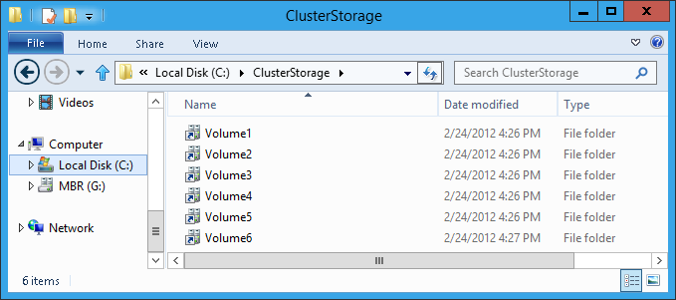
Single Namespace
Consistent view across the cluster
Single consistent file name space across cluster nodes
Volumes exposed under “ClusterStorage” root directory
  VolumeX directory name can be renamed

Slide 13
CSV Namespace
Mount Points
Used custom reparse points in Windows Server 2008 R2
Windows Server 2012 uses standard Mount Points
Delivers better interoperability with:
  Performance Counters
  System Center Operations Manager
  Monitoring free space on CSV volumes
  Backup software

Slide 14
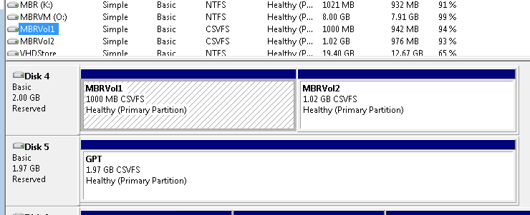
CSV Proxy File System
CSV enabled volumes now appear as “CSVFS”
  NTFS file system under the covers
  Volumes are still formatted with NTFS file system
Enables applications to be CSV aware
  Ensures compatibility

Slide 15
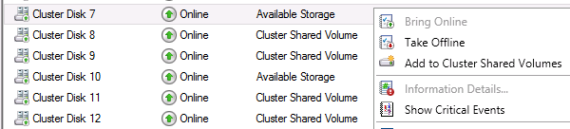
Simplified CSV Setup
Integrated into Failover Cluster Manager Storage view
  “Cluster Shared Volumes” container removed
CSV integrated into Failover Cluster core feature
  No longer needs to be explicitly enabled
Simple right-click to add to CSV

Slide 16
Setting up Clustered Shared Volumes
demo
Amitabh Tamhane
Program Manager 2
Clustering and High Availability

Slide 17
How CSV Enables Even Higher Availability
Resiliency

Slide 18
Fault Tolerant Application Handles
CSV Resiliency
CSV provides I/O fault tolerance
  Transparently handles node, network, and HBA failures
CSV virtualizes file handles to applications
  Volume Paused - I/O queued
  Reopens “true” files handles and remaps the “virtual” handles
  Volume Resumed – I/O completed
Failover is transparent to application!

Slide 19



I/O Connectivity Fault Tolerance
I/O Redirected via network
VM running on Node 2 is unaffected
Coordination Node
SAN Connectivity Failure
VHD
VM live migration with zero downtime

Slide 20



Node Fault Tolerance
New Coordination
Node
Node Failure
VM running on Node 2 is unaffected
Coordination Node
Brief queuing of I/O while volume ownership is changed
Volume relocates to a healthy node
VHD

Slide 21
Network Fault Tolerance
Metadata Updates Rerouted to redundant network
VM running on Node 2 is unaffected
Coordination Node
Network Path Connectivity Failure
VHD

Slide 22

Continuously Available Scale out File Server
Flexible storage choices for the private cloud
Cluster platform for a continuously available scale out file server
  Cluster-wide client access point
  Consistent cluster-wide file server configuration
  CSV cluster-wide file system
Zero client downtime failover – both planned and unplanned downtime
Accessing VHDs over SMB
Hyper-V Cluster
Single Logical Server (\\Foo\Share)
Single File System Namespace
Cluster Shared Volumes
File Server Cluster

Slide 23
Maximized File System Availability
CHKDSK / SPOTFIX Integration
<3 sec of downtime
Disk scanning separated from disk repair
Online volume scanning
  Volume offline only to repair
  Based on number of errors to fix rather than size of volume
Zero offline time with CSV
From Hours to Seconds …

Slide 24
Improved CSV Performance
Performance

Slide 25
CSV Block Cache
Distributed write-through cache
Consistent across cluster
Unbuffered I/O (excluded from Windows Cache Manager)
Windows Cache Manager integration
Same as traditional NTFS
Buffered I/O
Huge value for Pooled VDI VM scenario
Read-write differencing VHDs
Read-only parent VHD

Slide 26
Configuring CSV Block Cache
Configuring Size of Cache
  SharedVolumeBlockCacheSizeInMB – Cluster common property
    0 = Disabled
    Non-zero = Amount of RAM in MB to be used for cache on all nodes in cluster
    512 MB recommended value
Enabling CSV Caching
  Per CSV Volume
  CsvEnableBlockCache - Physical Disk resource private property
    0 = Disabled (default)
    1 = Enabled for that LUN
      Requires recycling the resource to take effect

Slide 27
Redirected I/O Less Often
CSV Optimizations
Direct I/O for more scenarios
  Delivers faster I/O performance and lower network overhead
  Better VM creation and copy performance
New algorithm for determining what types of I/O is redirected
  Uses oplocks as a distributed locking mechanism to determine if I/O can go via direct path
Direct I/O
Redirected I/O
Block level I/O performance parity
Remote file system (SMB) performance parity

Slide 28

High Performance Block Level I/O Redirection
Share
VM
Share
VM
CSVFS
Coordinator Node
Avoids traversing File System stack twice
Client / SMB
Server / SMB
CSV Proxy File System
CSV Proxy File System
CSV File System Filter
NTFS
Delivers 2x
performance
CSV VolumeMgr
CSV VolumeMgr
Volume Manager
Disk
Disk
Node 1
Node 2
Storage Connection Broken
or not present
SAN

Slide 29
High Speed CSV I/O Redirection
SMB 3.0 integration
CSV traffic streamed across multiple networks with SMB multi-channel
  Improved I/O performance in redirected mode
CSV will also leverage SMB Direct (SMB 3.0 over RDMA)
VM with I/O being redirected
Coordinator Node
10.10.10.X
20.20.20.X
CSV Streaming I/O Across Multiple Networks
VHD

Slide 30
SMB Performance Improvements
Inherit gains for CSV redirection performance
Improved Performance of refactored SMB client (98%)
Network transport optimizations
  TCP/IP – SMB multi-channel & NIC Teaming, TCP offloads, DC-TCP
  RDMA – Lowest network CPU overhead (cycles/byte)

Slide 31

Performance Improvements – Recap
CSV Redirected mode
Many Pieces Come Together for Radical Improvement
I/O redirection needed less often
CSV Block Level Redirection
SMB 3.0
Multi-Channel
SMB 3.0 Direct (RDMA)
CSV Block Cache

Slide 32
Deployment Considerations

Slide 33

Planning VM Density Per CSV Volume
Deployment considerations
How many VMs per CSV volume?
  No CSV volume restrictions
  VMFS limitations do not apply to CSV
  CSV volume Metadata updates orchestrated server side and parallelized
How many IOPS can your storage array handle?

Slide 34
Networking Planning
Network path leveraged when…
  Metadata updates to files
    Very infrequent for VM workload
  No storage connectivity
    Failure recovery
    Asymmetric storage configurations
Multi-path networks
  Delivers performance
  Avoids CSV traffic flowing over the public network
Disable iSCSI networks for cluster use (auto disabled)

Slide 35
CSV Backup and Restore
Backup

Slide 36
CSV Backup Key Wins
Distributed Snapshots
Distributed app consistent snapshot creation across cluster
Parallel Backups
On same or different
  CSV volumes
  Cluster nodes
Improved Interoperability
Backup applications
Requestors not required to be ‘CSV aware’
Non-disruptive backups
CSV volume ownership does not change during backup
Improved I/O performance
Direct I/O mode for software snapshots

Slide 37
CSV Backup using NetApp SnapManager
NetApp
Vineeth Karinta
Senior Engineer
NetApp

Slide 38
NetApp and Windows Server 2012 CSV
NetApp
  Developer of storage and data management solutions
  US$6.23bn in Revenue in FY2012
SnapManager® for Hyper-V (SMHV)
  Policy-based Backup and Restore of Hyper-V VMs
  Protects VMs running on multiple Hyper-V clusters and/or nodes
    Single pane of glass for multi-host Hyper-V backups
  VMs grouped into “Datasets” for ease of backup administration
    Data-protection policies applied to datasets
Visit us in the TechExpo in booth 1505

Slide 39
CSV Backups in Windows Server 2012
Distributed application consistent backups of VMs in the cluster using the New ‘VSS CSV Writer’ and ‘VSS CSV Provider’
CSV value for Hyper-V backups
  Multiple VMs running in the local/partner cluster nodes on the same ‘CSV volume’ is now consistent with in a single snapshot
  Initializes VSS backup once on the
  ‘backup node’
  VSS providers is only called on ‘backup node’
  Faster backups, Fewer snapshots

Slide 40
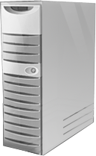

Backup Architecture
SMHV MMC Snap In
PowerShell CLI
  Backup Node
  Non Requestor Nodes
SMHV Service (VSS Requester)
VSS Requester (no participation)
VSS Service
VSS Service
Hyper-V writer
CSV writer
Hyper-V writer
CSV writer
CSV Providers
CSV Providers
Data ONTAP Hardware provider
Hardware provider (no participation)
VM1
VM3
  “Host1”
  Demosvr-01
  “Host2”
  Demosvr-02
VM2
VM4
CSV
iSCSI, FCP, FCoE
VHD
VHD
VHD
Single Windows Volume
Data ONTAP®

Slide 41
CSV Backup using
NetApp SnapManager for Hyper-V
Backup Demo
Vineeth Karinta
Senior Engineer
NetApp

Slide 42

Summary
Key Takeaways
Cluster Shared Volumes is significantly enhanced in Windows Server 2012
Supports more workloads
High performance
  CSV Block Cache
CSV is core infrastructure to enable your private cloud
INFRASTRUCTURE
as a SERVICE

Slide 43
Question & Answers

Slide 44


Related Content
WSV315 Windows Server 2012 File System Enhancements: Redefining File Storage
VIR401 Hyper-V High Availability and Mobility: Designing the Infrastructure for Your Private Cloud
WSV324 Building a Highly Available Failover Cluster Solution with Windows Server 2012 from the Ground UP
WSV411 Guest Clustering and VM Monitoring in Windows Server 2012
VIR301 Windows Server 2012 Hyper-V Storage
VIR304 Building Flexible Hyper-V Environments Windows Server 2012 Hyper-V Live Migration and Live Storage Migration
VIR306 Hyper-V over SMB: Remote File Storage Support in Windows Server 2012 Hyper-V
Find Us Later at the “Availability” Booth
http://blogs.msdn.com/b/clustering/

Slide 45


SIA, WSV, and VIR Track Resources
#TE(sessioncode)
Talk to our Experts at the TLC
Hands-On Labs
DOWNLOAD Windows Server 2012 Release Candidate
microsoft.com/windowsserver
DOWNLOAD Windows Azure
Windowsazure.com/
teched

Slide 46



Resources
Learning
  Connect. Share. Discuss.
  Microsoft Certification & Training Resources
http://northamerica.msteched.com
www.microsoft.com/learning
TechNet
  Resources for IT Professionals
  Resources for Developers
http://microsoft.com/technet
http://microsoft.com/msdn

Slide 47







Complete an evaluation on CommNet and enter to win!

Slide 48


MS Tag
Scan the Tag
to evaluate this
session now on
myTechEd Mobile

Slide 49
© 2012 Microsoft Corporation. All rights reserved. Microsoft, Windows, Windows Vista and other product names are or may be registered trademarks and/or trademarks in the U.S. and/or other countries.
The information herein is for informational purposes only and represents the current view of Microsoft Corporation as of the date of this presentation. Because Microsoft must respond to changing market conditions, it should not be interpreted to be a commitment on the
part of Microsoft, and Microsoft cannot guarantee the accuracy of any information provided after the date of this presentation. MICROSOFT MAKES NO WARRANTIES, EXPRESS, IMPLIED OR STATUTORY, AS TO THE INFORMATION IN THIS PRESENTATION.

