Slide 1
Please visit m.ausalgo.com on your device and sign in

Slide 2

Please visit m.ausalgo.com on your device and sign in

Slide 3
Processing the future
War stories from the trading floor
SESSION CODE: ARC-MID206
Martin Granell
Quant Analyst
martin@ausalgo.com
Chris Hewitt
Quant Analyst
chris@ausalgo.com

Slide 4
Agenda
Foundations
Patterns
Virtual Time
Guidance

Slide 5
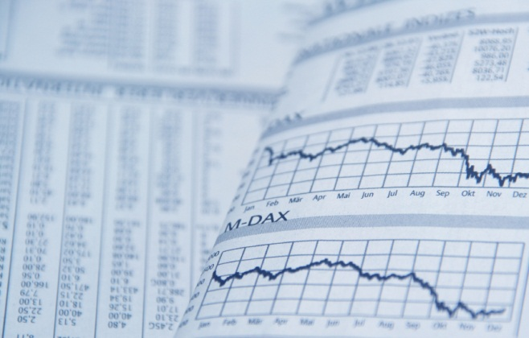
The Project
Market Information
?
Orders and Status
Foundations Patterns Virtual Time Guidance

Slide 6
Non-Functional Requirements
Correct
Custom
Robust
Fast
Foundations Patterns Virtual Time Guidance

Slide 7
Who has
Control?
Market Data Processor
Decision Maker
Risk
Manager
Trade Gateway
Foundations Patterns Virtual Time Guidance

Slide 8
Enumerables
GetEnumerator
MoveNext + Current(a)
GetEnumerator
MoveNext + Current(b)
MoveNext + Current(a)
MoveNext + Current(b)
Dispose
MoveNext + Current(c)
Consumer 1
MoveNext
Dispose
Enumerable
Consumer 2
Foundations Patterns Virtual Time Guidance

Slide 9
Observables
Subscribe
OnNext(a)
Subscribe
OnNext(b)
OnNext(b)
Dispose
OnNext(c)
Observer 1
OnCompleted
Observable
Observer 2
Foundations Patterns Virtual Time Guidance

Slide 10
Loose Coupling
Market Data Processor
Decision Maker
Risk
Manager
Trade Gateway
Foundations Patterns Virtual Time Guidance

Slide 11


Monitoring
Data flowing between modules *
?
Commands
Changing state of modules *
* Observables over WCF
Foundations Patterns Virtual Time Guidance

Slide 12
Demo
Please visit m.ausalgo.com on your device
and sign in
Foundations Patterns Virtual Time Guidance

Slide 13

Azure Trader Demo
Worker Role
Web
Role(s)
Foundations Patterns Virtual Time Guidance

Slide 14
Why should you care?
Declarative
WWF
Stream Insight
Asynchronous
Rx
await
F#
MPI
Native
C++
VB / C#
F#
Synchronous
LINQ
SQL
Declarative
Stateful
Functional
Foundations Patterns Virtual Time Guidance

Slide 15

Reactive Extensions
  Rx is a library for composing asynchronous and event-based programs using observable sequences.
  Rx = Observables + LINQ + Schedulers
Theory
Foundations Patterns Virtual Time Guidance

Slide 16
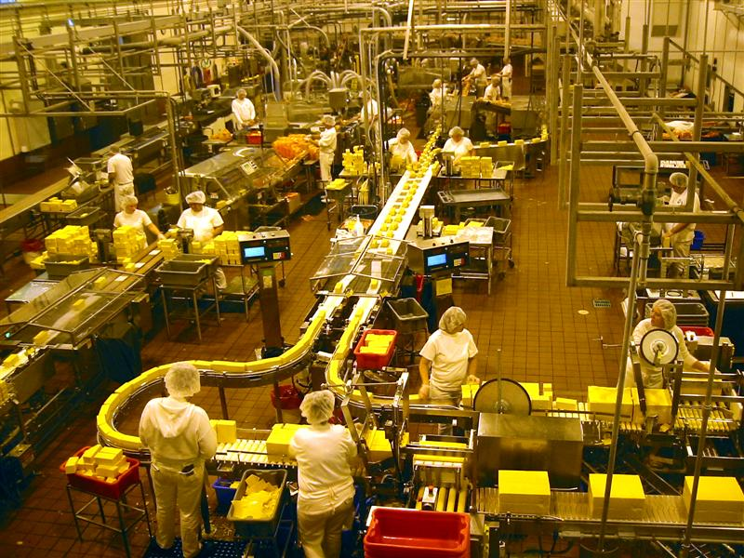
Composing Observables

Slide 17
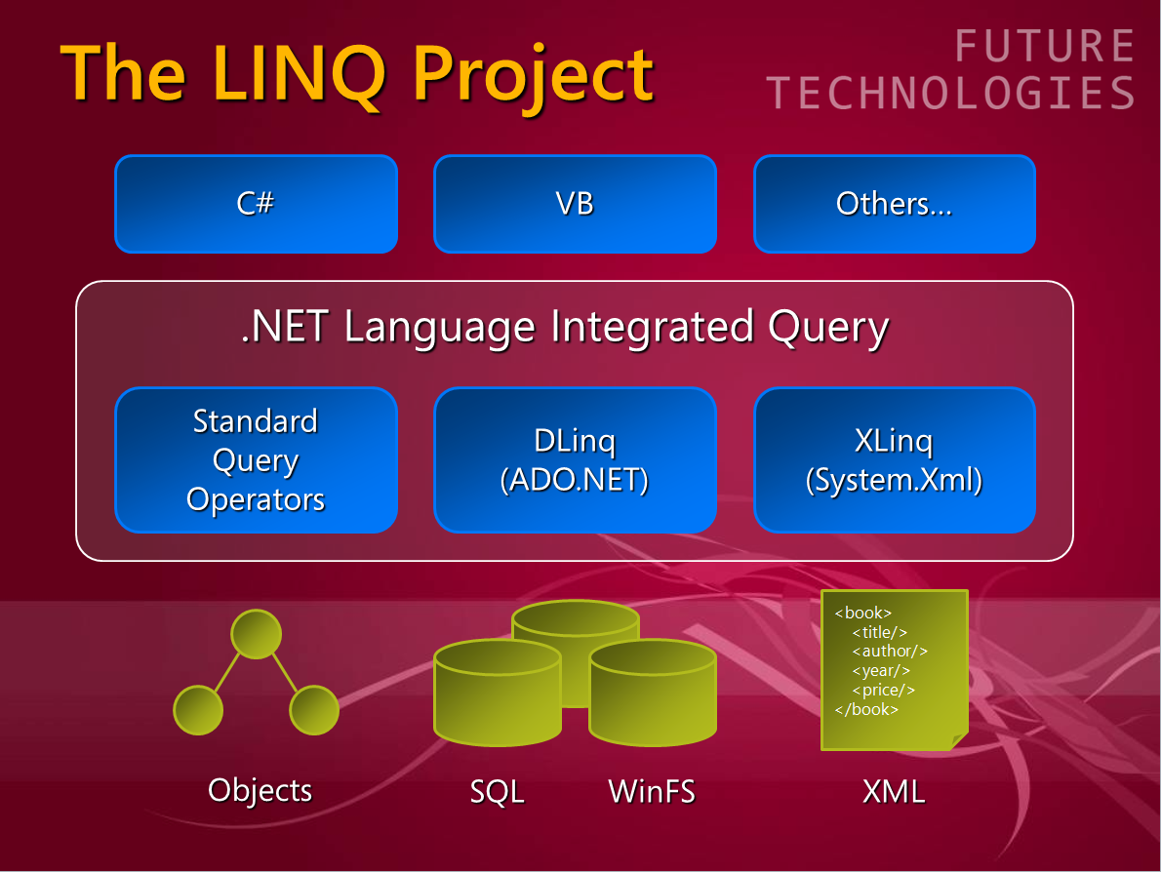
A Historical Perspective
5 years ago
Foundations Patterns Virtual Time Guidance

Slide 18
Quiz
from x in a
from y in b
select x + y
Theory
Foundations Patterns Virtual Time Guidance

Slide 19
Projection
a.Select(x => x + 1)
1
2
3
2
3
4
Theory
Foundations Patterns Virtual Time Guidance

Slide 20
Combining Operators (OR)
a.CombineLatest(b, (x, y) => x * y)
$1
$2
$1
1
2
3
$2
$4
$2
$3
Theory
Foundations Patterns Virtual Time Guidance

Slide 21
Combining Operators (AND)
a.Zip(b, (x, y) => x + y)
f
g
h
x
y
z
fx
gy
hz
Theory
Foundations Patterns Virtual Time Guidance

Slide 22
Time Operators
a.Delay(timespan)
1
2
3
1
2
3
Foundations Patterns Virtual Time Guidance

Slide 23
Combining + Time Operations
a.Delay(3s).StartWith(0)
.CombineLatest(a,
(prev, now) => now – prev)
1
2
3
0
1
2
3
1
2
1
0
1
0
Theory
Foundations Patterns Virtual Time Guidance

Slide 24
Windows
from w in a.Window(period)
from total in w.Sum()
select total;
1
1
1
2
0
1
0
Foundations Patterns Virtual Time Guidance

Slide 25
Sushi Gatherer
sushi.Where(KidsWillEat)
.Scan(SumUpCost)
.TakeWhile(CanPay)
.Select(TakeOffPlate)
.Buffer(KidCount, MaxDelayTime)
.Do(DeliverSushi)
Foundations Patterns Virtual Time Guidance

Slide 26
Temporal Design Patterns
Splitting
Combining
Time varying
Windowing
Foundations Patterns Virtual Time Guidance

Slide 27
Time as an Aspect
Configuration
Logging
Data Access
Decision Maker
Control Flow
Time
Foundations Patterns Virtual Time Guidance

Slide 28
Testing
Time <= Test
Mock Events
Test
Decision Maker
Time
Output Decisions
Foundations Patterns Virtual Time Guidance

Slide 29
Simulation
Time <= Data
Historical Events
Historical
Data
?
?
?
?
Simulation
Results
Simulated Orders
100s of concurrent simulations
Foundations Patterns Virtual Time Guidance

Slide 30
Production
Time <= Market
Real Market Events
?
Orders and Status
Foundations Patterns Virtual Time Guidance

Slide 31
Schedulers
Abstract Time
Abstract Processing location
a.Delay(period, scheduler)
Time
Processor
Foundations Patterns Virtual Time Guidance

Slide 32
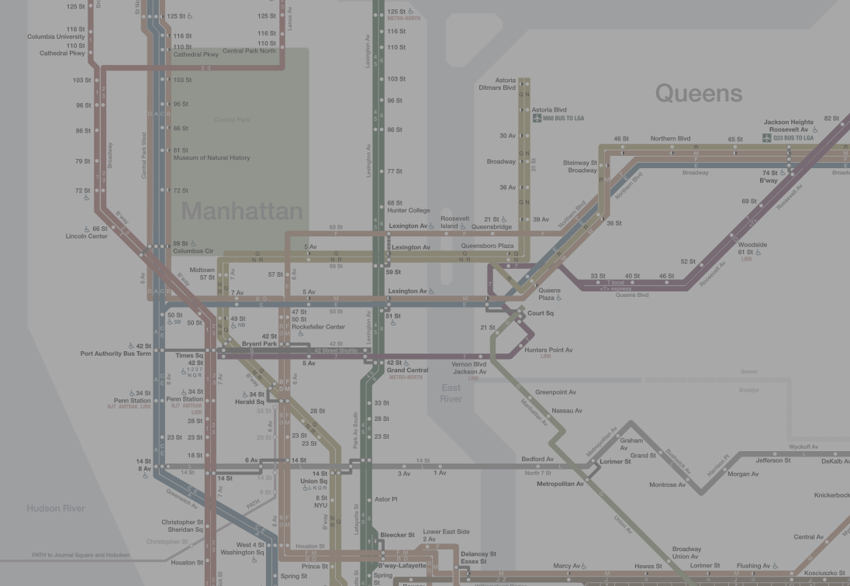
Our Experience
Testable
Explicit
Immature
Flexible
Foundations Patterns Virtual Time Guidance

Slide 33
Guidance --
Automatic Parallelism
Automatic State Persistence
Procedural Asynchronous
Guidance
Foundations Patterns Virtual Time Guidance

Slide 34
Guidance ++
Declarative Asynchronous
Multiple events or sources
Time dependent behaviour
Query off-loading
Guidance
Foundations Patterns Virtual Time Guidance

Slide 35
Questions & Answers

Slide 36
Next Steps
Install with NuGet
  Rx_Experimental
Watch videos on Rx Lauch Page
  http://msdn.microsoft.com/en-us/data/gg577609
Play with RxSandbox
  http://mnajder.blogspot.com/2011/05/rx-projects-update.html

Slide 37
Resources
Forum
http://social.msdn.microsoft.com/Forums/en-au/rx/threads
Resource List - http://tinyurl.com/45ybngy
Channel 9 videos - http://channel9.msdn.com/Tags/rx
Rx power toys - http://rxpowertoys.codeplex.com/
Rxx - http://rxx.codeplex.com/
Demos - http://techedau11arc206.codeplex.com/

Slide 38

Enrol in Microsoft Virtual Academy Today
Why Enroll, other than it being free?
The MVA helps improve your IT skill set and advance your career with a free, easy to access training portal that allows you to learn at your own pace, focusing on Microsoft technologies.
What Do I get for enrolment?
Free training to make you become the Cloud-Hero in my Organization
Help mastering your Training Path and get the recognition
Connect with other IT Pros and discuss The Cloud
Where do I Enrol?
www.microsoftvirtualacademy.com
Then tell us what you think. TellTheDean@microsoft.com

Slide 39




Resources
www.msteched.com/Australia
  Sessions On-Demand & Community
www.microsoft.com/australia/learning
Microsoft Certification & Training Resources
http:// technet.microsoft.com/en-au
  Resources for IT Professionals
http://msdn.microsoft.com/en-au
  Resources for Developers

Slide 40

© 2010 Microsoft Corporation. All rights reserved. Microsoft, Windows, Windows Vista and other product names are or may be registered trademarks and/or trademarks in the U.S. and/or other countries.
The information herein is for informational purposes only and represents the current view of Microsoft Corporation as of the date of this presentation. Because Microsoft must respond to changing market conditions, it should not be interpreted to be a commitment on the part of Microsoft, and Microsoft cannot guarantee the accuracy of any information provided after the date of this presentation. MICROSOFT MAKES NO WARRANTIES, EXPRESS, IMPLIED OR STATUTORY, AS TO THE INFORMATION IN THIS PRESENTATION.

